Slide 1
Services for RE3&4 Upscope
Ian Crotty on behalf of Anton, Aleksandar and Salvatore
2 June 2016

Slide 2
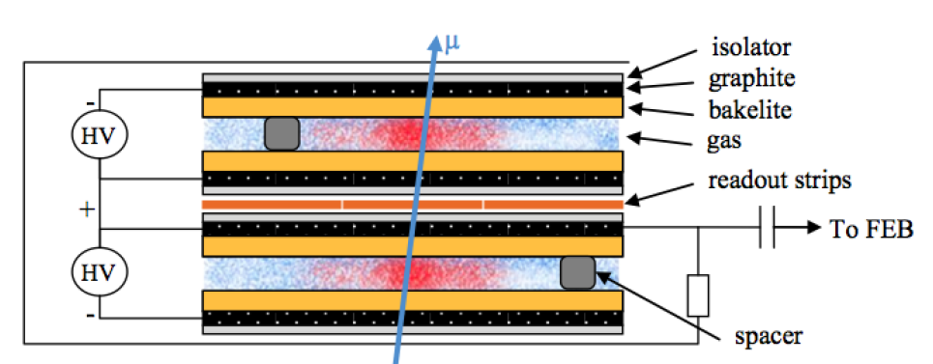
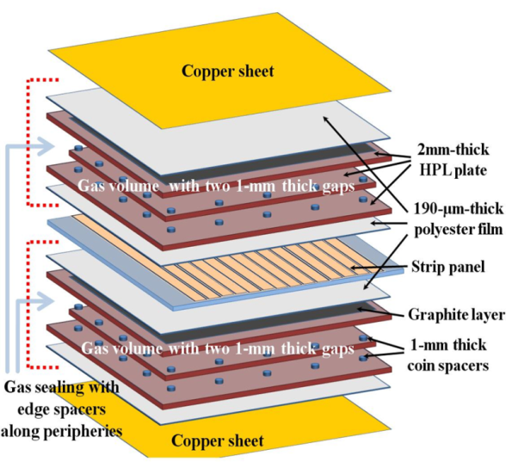
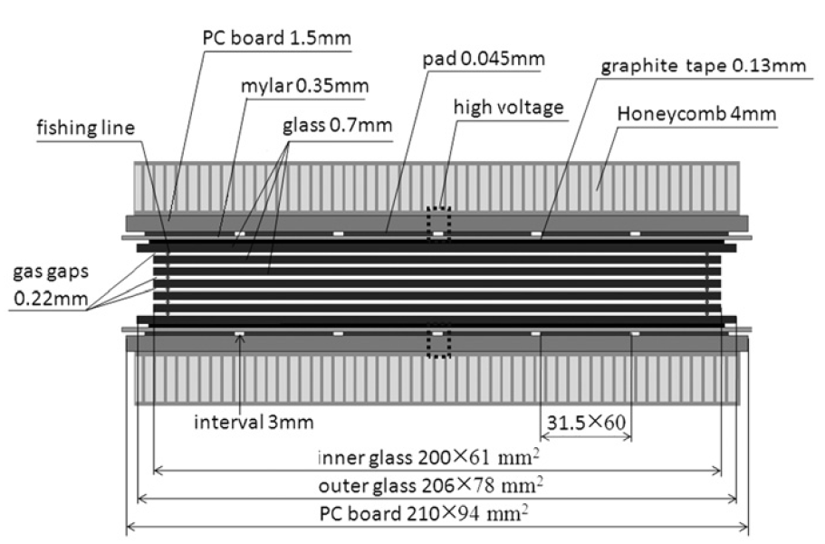
Original or New Technology
Standard double-gap RPC
What impact on services.

Slide 3
Content
HV
LV
Signal
Gas
Cooling
UXC Rack space
USC Rack space
Installation

Slide 4
Electric power
USC Rack Space. HV will need HV distribution space , can be crammed into Mainframe rack ? Request rack space
Plan to upgrade the MAO
Adding LV modules in New rack space . Still need rack space 6U in each tower.
If remapping then will fit into present Crates, with reduced granularity.
Large 80% power increase with no space increase , therefore density increase > temp increase. Increased flow
Signal extraction under RE3/2 RE4 ?
Signal from 1440 dia 10 to 8 fibre optics Non standard FEB option is clealy beter for signal cabling installation

Slide 5
HV Power System for RE3/1 & RE4/1 (I)
Assume 20° chambers
18 chambers per Endcap disk or 36 per station
RE3/1 – 36 chambers
RE4/1 – 36 chambers
Unique powering independent on detector technology
1 HV channel per chamber = 72 HV channels & 72 HV cables
18 HV cables per disk, 36 HV cables per end
18 HV cables in mCC per side & end
RE3/1 & RE4/1 slots already available on X1 RE HV PP
72 HV channels in 4 crates ➔ 18 channels (3 HV boards) per crate
Upgrade present HV system from 4 to 6 crates in EASY chain
More service power will be required (A3485S)
This powering schema is valid for Double and Multigap design.
Double gap design:
1 HV connection, top and bottom layer powered separately.
Standard double-gap RPC

Slide 6
HV needs
Umbilical cables USC > UXC
PP on YE1
Rack space in USC

Slide 7
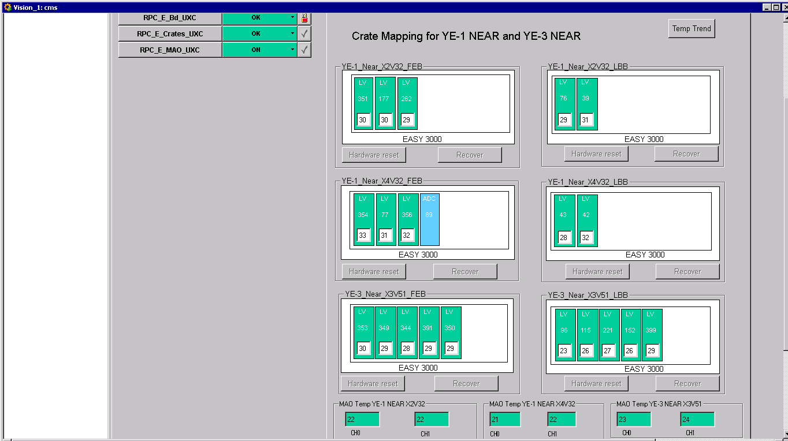
LV Power System Optimisation for RE3/1 & RE4/1
For each end && side we would need 2 A3016 LV boards to power the RE3/1 and RE4/1 chambers.
If we redesign the entire RPC LV system such that:
We redistribute the LV power cables of 2 A3009 boards into neighbouring 3 A3009 boards
then
We will free slots for 2 A3016 boards for powering RE3/1 and RE4/1
Need 6U Rack space in each tower of YE3
OR
Re-mapping of LV cabling to give Crate space must be tested first
At present 1 LV A3009 channel powers 6 FEBs which is ~30% of max channel power.
Assuming we double them after the power redistribution, it will still continue to work in optimal power regime ~60% of max power.
The real question is how to group the chambers into LV board channels to keep some logical and physical power distribution in phi… to be thought
In this scenario – no additional crates, branches and rack space is required!

Slide 8
Significant cable section, cost and Rack space (24U)with original FEB/LBB system

Slide 9
Signal Readout for RE3/1 & RE4/1 (II)
New/Developing RPC FE electronics
1 GBT optical link per chamber to transmit data to one data concentrator card per station ~1 W
Data Concentrator Card: One card, common for one disk of 18 chambers, includes 18 + 2 spares = 20 GBT links and 1 FPGA to be located on the detector periphery.
DCC in UXC or USC?
UXC: shorter paths from detector to DCC
USC: from DCC to USC would go 2 fibers instead of 18, but is length long for optical power losses?
DCC output: 2 optical fibers: 1 trigger and 1 data link per disk.
Rack space: No much space in racks is needed. The “Link system” is presented only by 2 DCC per end.
DCC, low power 40W/station
New FE is being investigated with greatly reduced space requirements in the Crates, service section on yoke. 20 FO instead of 1440 dia10mm cables.
Optical link goes to towers OR all the way to USC. To be studied.

Slide 10
RPC Upgrade RE(3,4)/1 gas supply needs (preliminary)
The estimate is based on evaluation of different scenarios and assumptions.
The gas supply from surface to USC gas room is covered by the existing gas lines even if different gas mixture is used.
Taking into account the volume of the chambers and refresh rate of HL-LHC (1 volume change/hour, ~9l/h) the number of the gas channels can be fixed (6 gas channels per RE).
From USC gas room to the RE(3,4)/1 chambers there are three scenarios but in all three cases installation of new gas racks in UXC is not required:
Use the same gas mixture: Requires minimal efforts from gas group and ZEC team. The spare 12 gas channels of rack 85 (RE+3/Top) and of rack 67 (RE-3/Top) can be used to supply RE(3,4)/1. Also this possibility is implemented in the GCS software.
Use the same but not humidified (dry) gas mixture: Requires medium efforts from the gas group and ZEC team. Modifications of the existing gas system are needed in SGX and USC gas room. The supply to the new chambers can be included in the close loop of the existing system. The manifolds (rack 81, RE+3/Bot and rack 63, RE-3/Bot) can be used to supply the dry gas to the chambers while the chambers from RE±3 will be connected to the free manifold of rack 85 and rack 67. Again no change in the GCS software.
Use different gas mixture: Requires an enormous amount of efforts from gas group and ZEC team. Installation of new mixer in SGX and new gas distributor in the USC gas room. Installation of new pipes from USC to the gas racks are needed. The gas racks (racks 85, 67) have to be extracted and modified. There is no possibility for close loop unless a new gas system is build. Also there should be performed some changes to the GCS software.

Slide 11
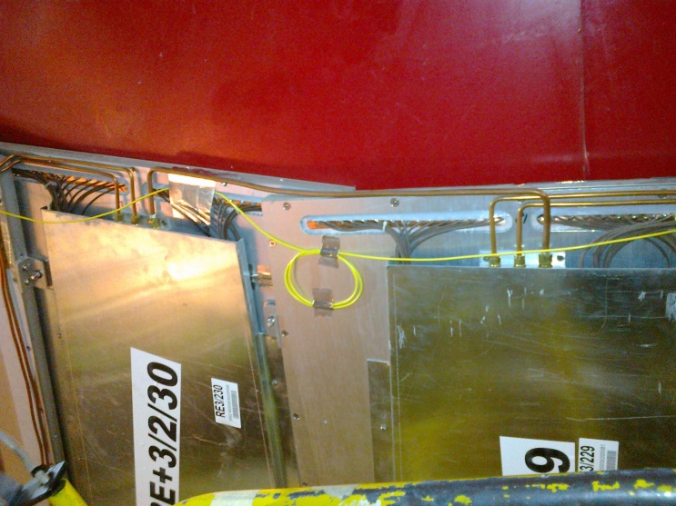
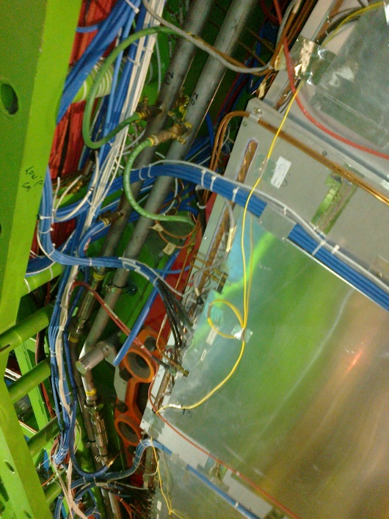
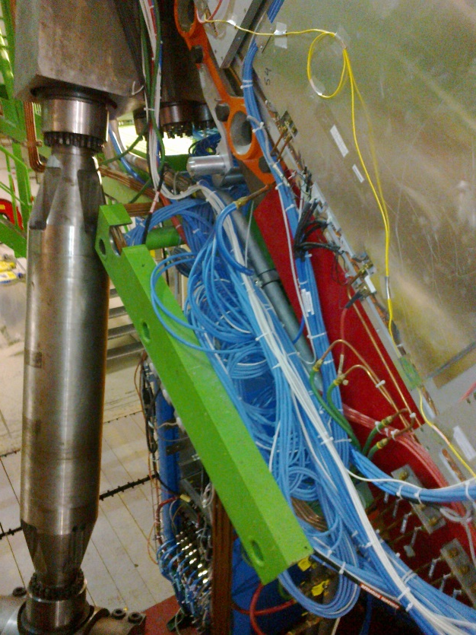
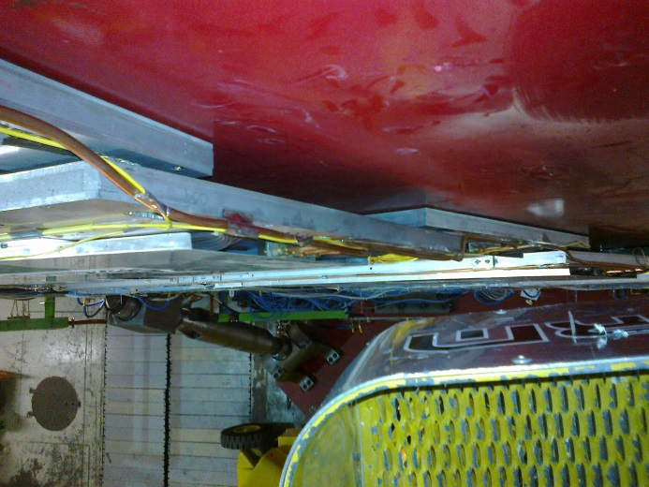
RE3/1 service passage
Space on the periphery is very limited
Service passage to the periphery is either on top of or under the RE3/2 & RE3/3

Slide 12
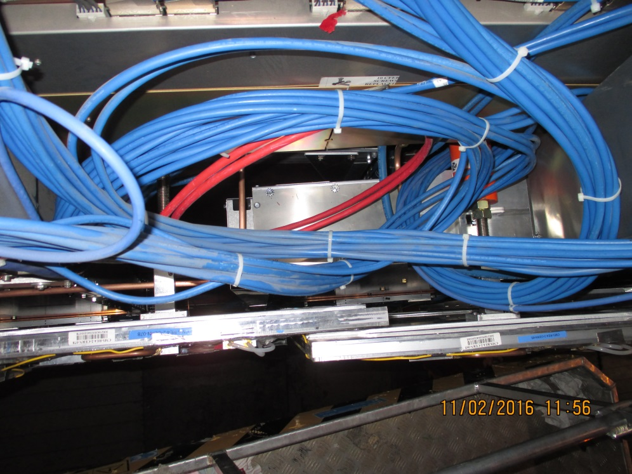
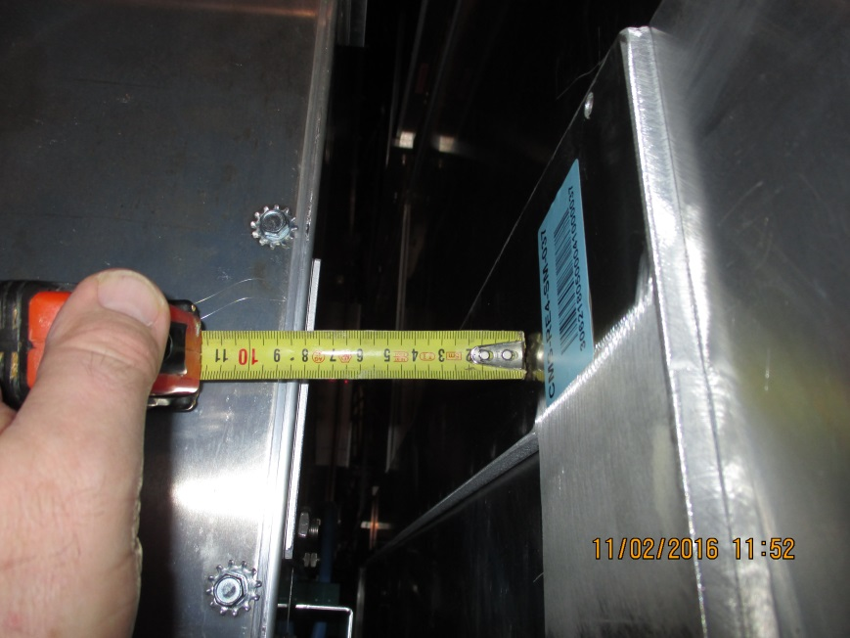
RE4/1 Service Passage
There are large passages under the CSCs that may or may not be useful. If not then services must transit over the RE4 SMs. This is not a good solution either as they are very flexible.

Slide 13
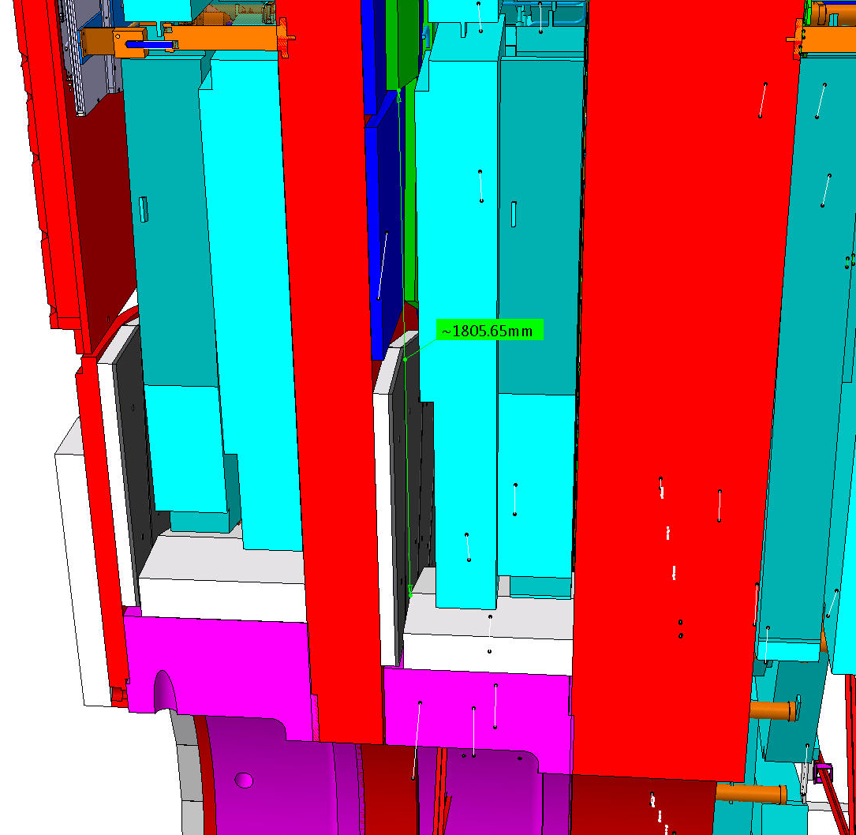
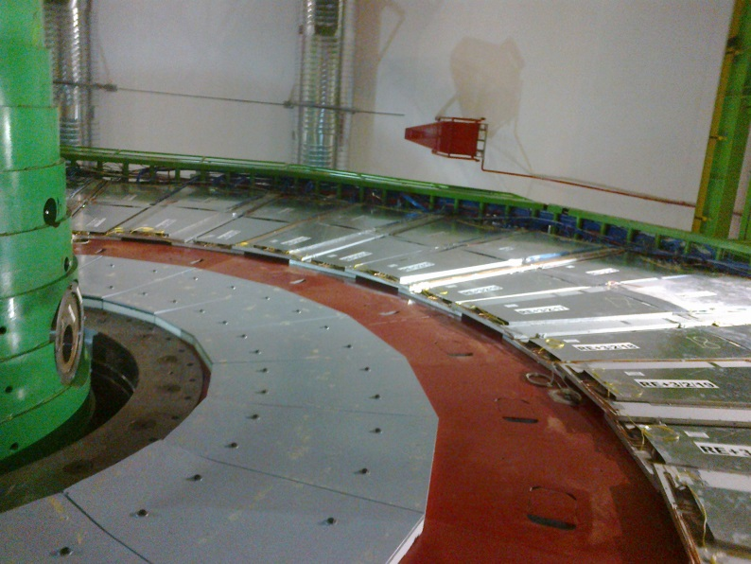
RE3/1
Basic parameters
R Outer = 3302
R Inner = 1526
Delta = 1776
This area has to be studied and an envelope produced and agreed with Integration

Slide 14
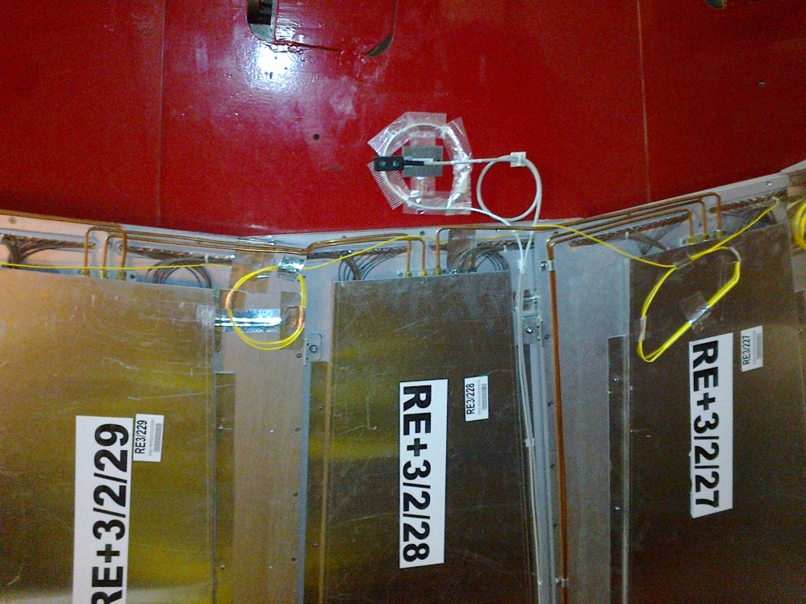
RE3/1 as built. Mounted on the Yoke. Shielding takes up significant space in “Z”
Services to extend to RE3/1 ?
Space to cover

Slide 15
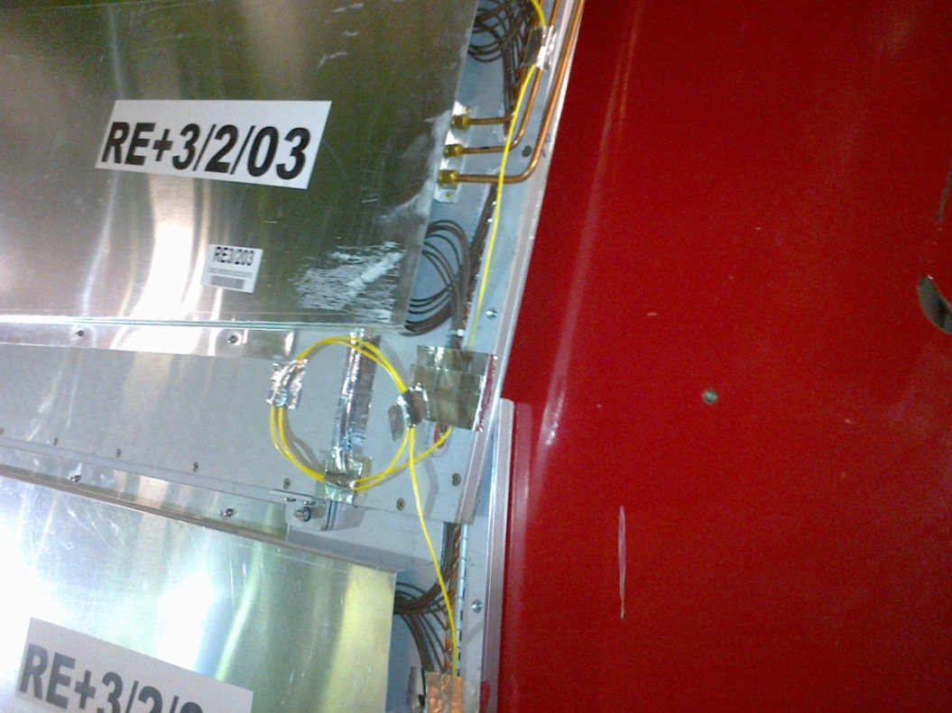
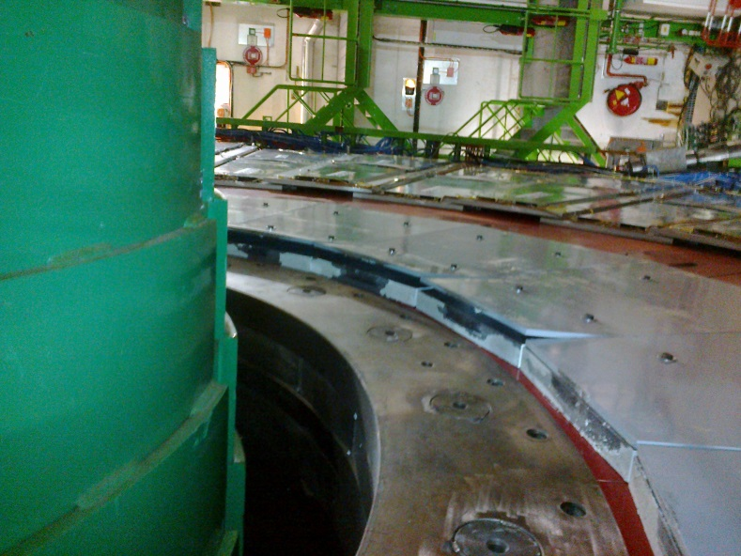
RE3/1 Mounting
Bolt heads (and washers ?) to be made flush with shield (Pb) to gain >10mm
Chambers will be exposed to this type of error !
M12 Mounting holes drilled for “short” RE3/1

Slide 16
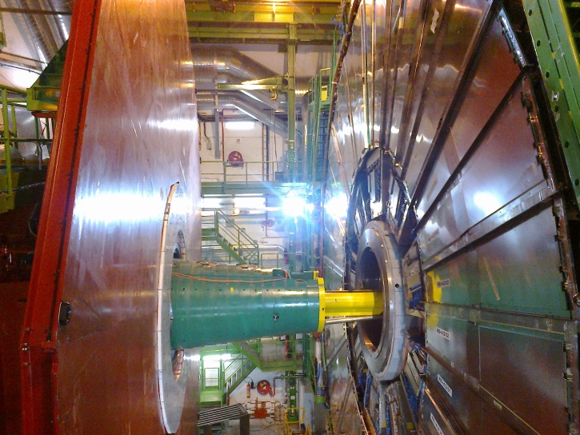
RE4/1 Mounting
Chambers to be mounted between the shielding, CSCs and RE4 SMs

Slide 17
RE4/1 extended Pino & Pigi (2015)
RE4 SM

Slide 18
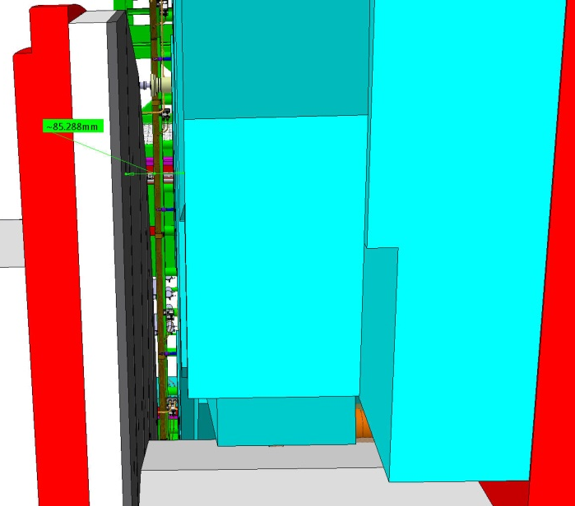
These dimensions will be verified with Integration office .
Resultant RE4/1 envelope
85mm Gap.
A model should be made and tested in situ.

Slide 19
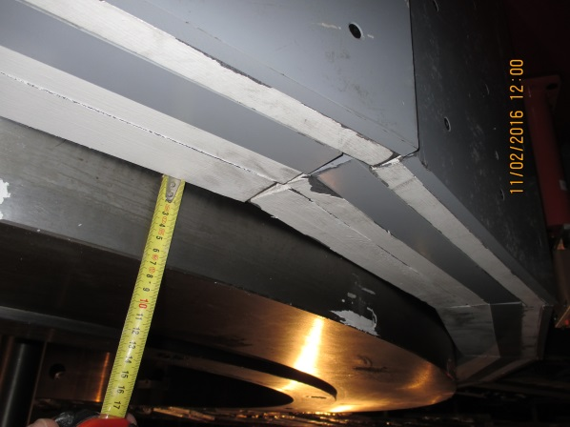
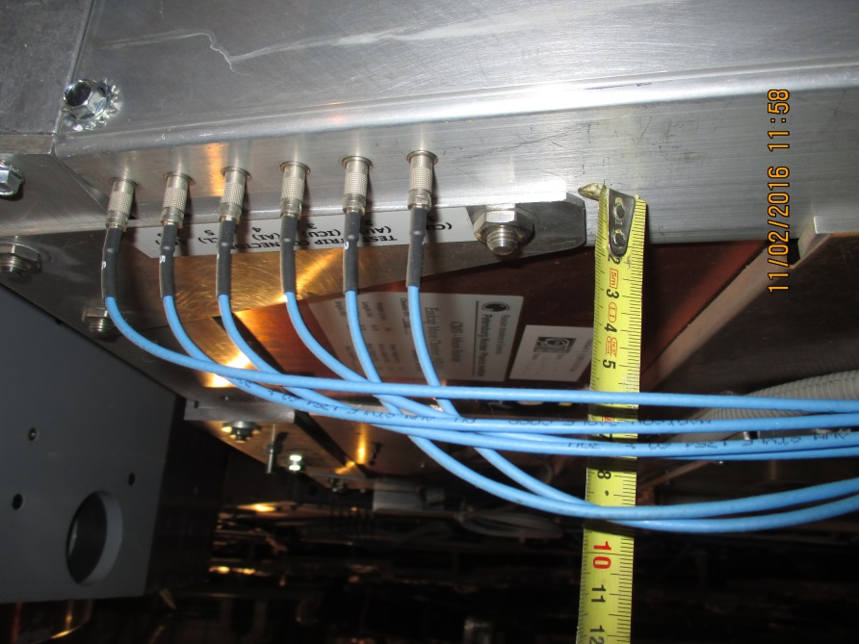
RE4/1 Mounting

Slide 20
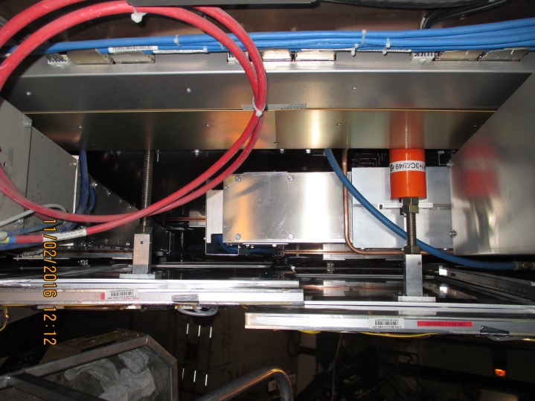
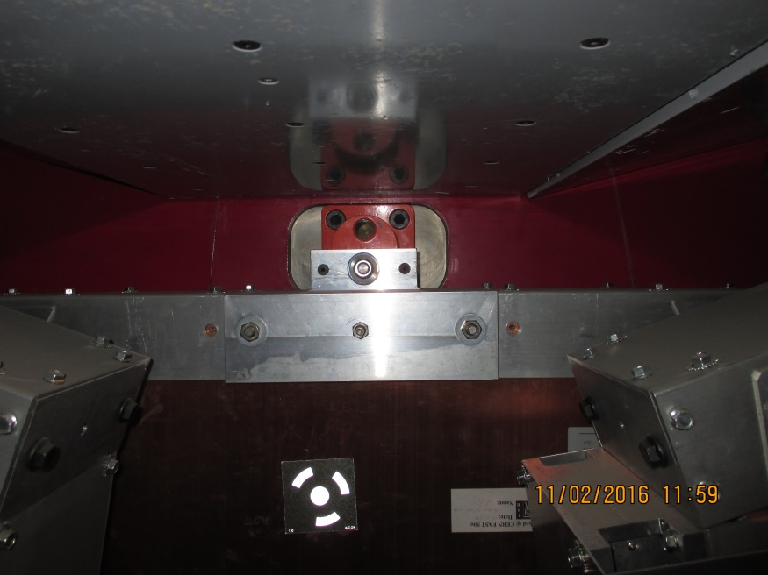
RE4/1 mounting
Inner radius CSC mounting with Spare M24
Outer radius Mounting (M24) supporting the RE4 SMs. An astute solution is required here.

Slide 21
Conclusion
HV
LV
Signal
Gas
Rack cabling not studied.
Signficicant increase in electrical load on YE3

Slide 22
Additional Slides

Slide 24
LV Power System Requirements: Summary

