Slide 1
Cooling RE3/1 and RE4/1

Slide 2
It should include information on
- how we connect RE3/1 cooling to existing RE3/2 circuits
- how we connect RE4/1 cooling. Here explain both possibilities "a-la 3/1"
and your proposal with T-junction at mini-manifold valves and try to draw
some pros and cons for both (as we did last Wednesday when we discussed it
with Isabel in my office).
- list of material for procurement
- dates, urgencies, deadlines for procurement. The most important at this
stage is to know which is the latest date we have to start the procurement
in all pieces such that they are here in time (01.March.2019 latest). Let's
put a safety margin and say Dec.2018.
- planning of cooling intervetions: I will provide you one file with an
extractions of iRPC service installation from the Muon LS2 project. In fact,
RE3/1 will happen in YETS after chamber installation.
- answer the question: do we need any drawings or engeneering help from
Integration Office? If yes, for what and for when!!! This is very important.
- conclude on the readiness of the cooling upgrade, what is still misssing
to proceed faster and now.
As all points are already thought out and discussed with our neighbours I will act as post box between IO and anton

Slide 3
Power to dissipate
The power estimates vary from 16 – 23Watts.
This is basically the same as the values of the present FEBs namely 10W per 10degrees for one chamber.

Slide 4
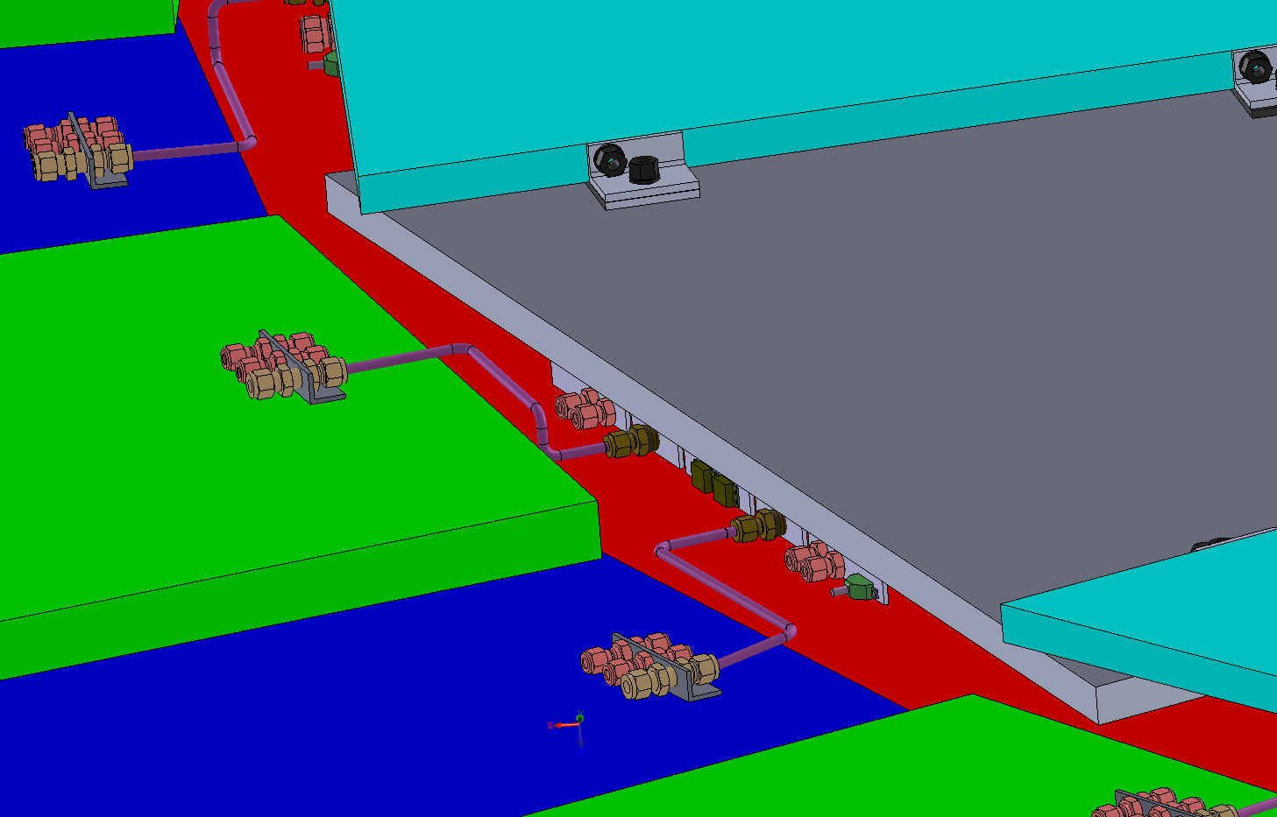
RE3/1 cooling link to RE3/2
x2 RE3/2 circuits feed x1 RE3/1 chamber
No modification to the manifolds, mini or main.
As used on the first 3 stations
The rigid copper piping could be replaced by flexible hose links to reduce the strain on the unions.

Slide 5
RE4 SM Cooling
Original documentation from our USA colleagues
Flexibles feed cooling water to both the RPCs and the CSC racks
Notice that all fittings are inch sizes

Slide 6
There are numerous solutions to RE4/1 cooling
Rigid copper pipes from the RE4 SMs to the RE4/1s. Need to remove the SS ferrules. Many unions are over tightened.
Flexible hoses to make the same link, a good solution if we can fit to the Sagana fittings in the limited space over the chamber. Need to remove the SS ferrules. Many unions are over tightened.
Flexible hoses from the mini-manifolds to the chambers. No need to remove the SS ferrules but still a good idea. The over tightened unions are not disturbed.

Slide 7
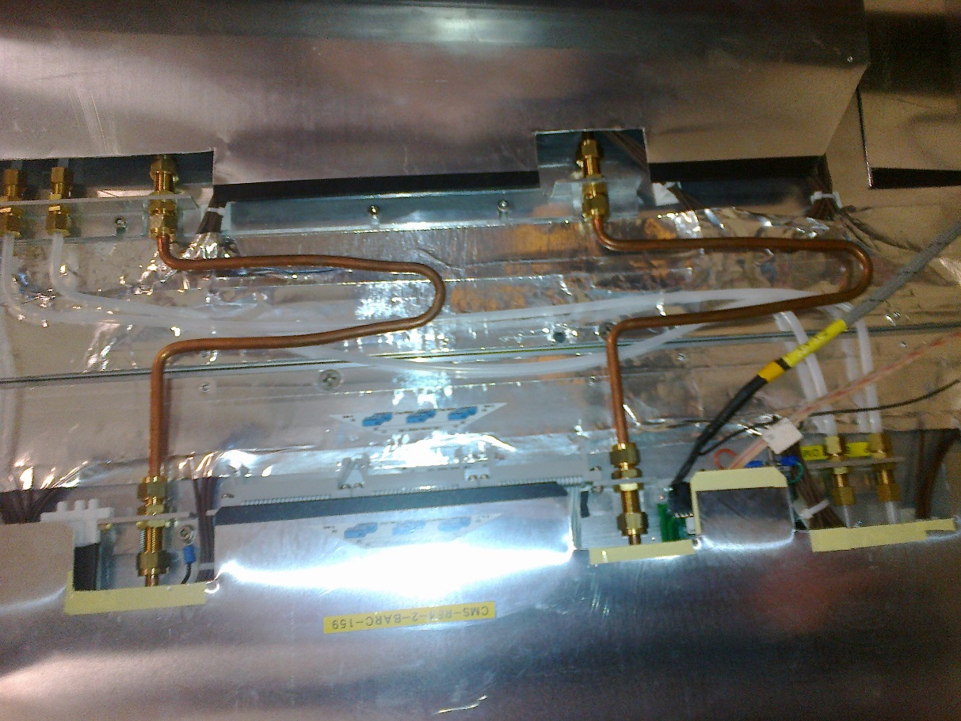
An example of rigid piping to link the chambers . This works if the chambers are rigidly mounted to the yoke as they are in RE1, RE2 and RE3.
However the very large dimensions (3.7 x 1.3m) of the RE4 SMs mounted on long extensions and plenty of “play” at only 3 points gives a very flexible and non defined plane to work in. This can be seen by the “ venetian blind” effect of the chambers in the 3 o’clock and 9 o’clock positions.
The mounting of the RE4/1s will be a similar structure that will also use long extensions but somewhat smaller dimensions in “R” and so will be stiffer.
Alternatively use flexible hoses that fit in the limited “depth” in Z over the chamber without modifying the patch panels on the chamber
Direct rigid link

Slide 8
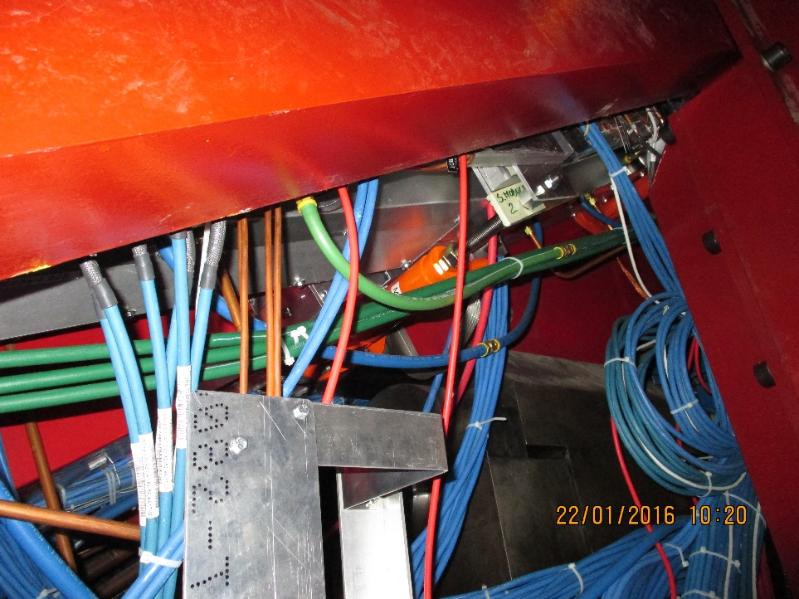
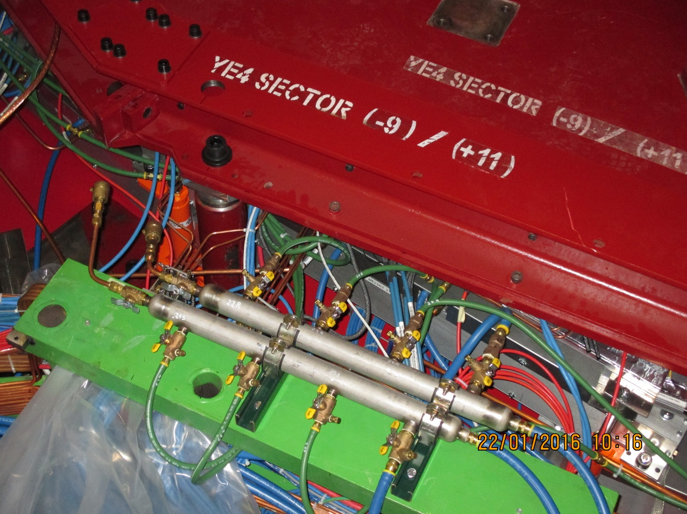
Flexible version with long hoses to the present RE4 SMs, repeat for RE4/1
Green flexible hoses to the chambers
Adding “Ts” to the Manifold will reduce the spread of hoses and permit good granularity
Mini-Manifold

Slide 9
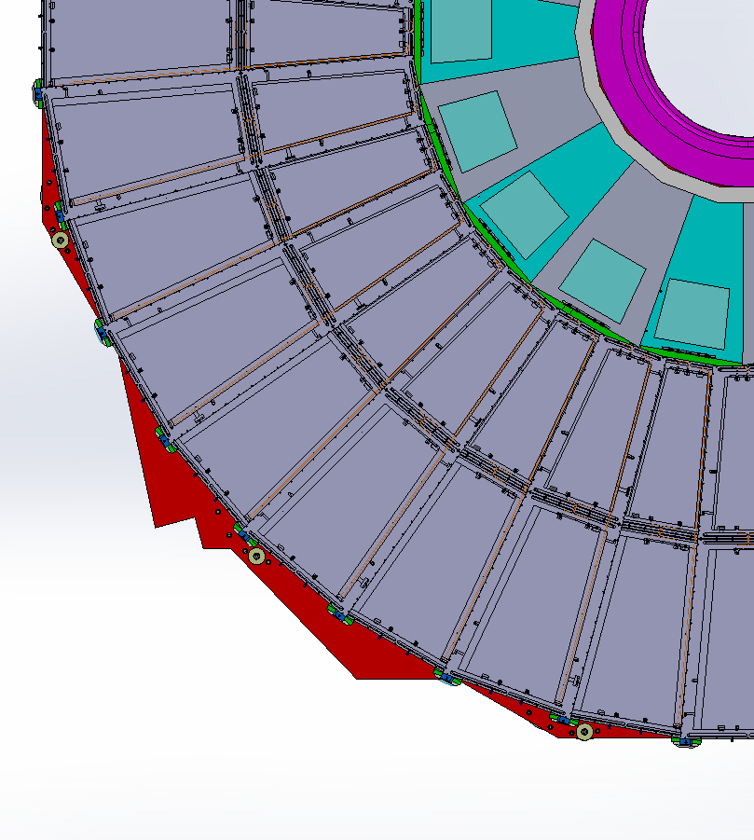
RE4/1 Cooling manifolds
RE4/1
Return
Manifold
Diagram of 1 channel per 2 chambers. Flexible hose from the “T” mounted on the mini manifold.
The two RE4/1s will also be linked by flexibles.
Supply

Slide 10
RE4/1 cooling
Why not repeat the method used in RE3/1, it is very cheap and quick.
The initial proposal is to add “Ts” to the mini-manifold and then run with flexible hoses all the way to the chambers as is done for the RE4 SMs.
The argument to not disturb the chambers that have “sensitive SS unions” is not valid if they can all be replaced. Nominally only the inner radius ones will have to be disturbed. However if a good solution is found to eradicate all the SS ferrules then clearly it should be done on all the cooling circuits of both RE4/2 and RE4/3 chambers.
If the choice is to go for the RE3/1 version then a detailed trial will have to be made in 904 with the mock-up.
The Cooling to RE4/1 is recommended to be done differently from the RE3/1 using long flexibles from the Mini Manifolds.
Of course since Mexico has good links with the USA then sourcing the correct inch size components is perhaps made easier.

Slide 11
LS2 Schedule
In case of the mini-manifold version these times are available. If the other versions are used then we must wait for the chambers to be installed.
The Cooling of RE3/1 is done once the chambers are mounted in position on the yoke .

Slide 12
Conclusions
Georgia has started the on chamber part, need final FEB design
Conclude on which version for RE4/1
Design of the system for integration to CMS and component selection, number of circuits etc. Can Georgia do this ?
Order material
ZEC to install and Commission

