Slide 1
Installed OF USC to UXC minus and plus Z
Ian, Ivan and Andres
1 Sept 2020

Slide 2
Installed OF chamber to UXC from USC. Four cables each with 144 fibres.
YE1 PP connection
OTDR commission of link for data and control functions. No termination, nor access, other than protection is required.
Connectivity test to verify mapping from USC to chambers in UXC. Requires access to the chamber ends !

Slide 3
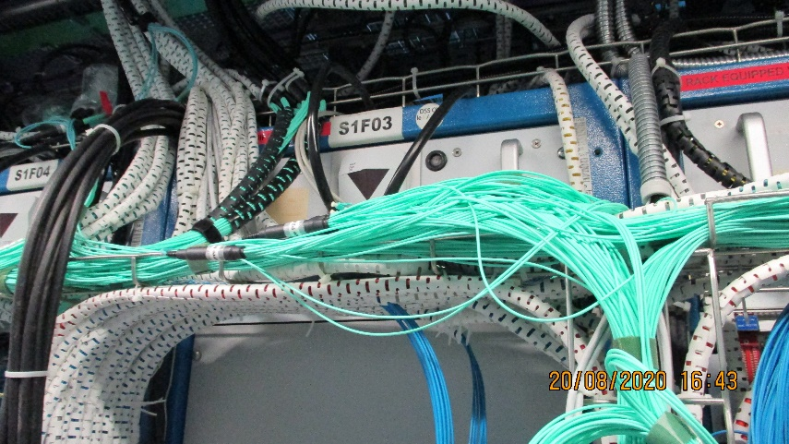
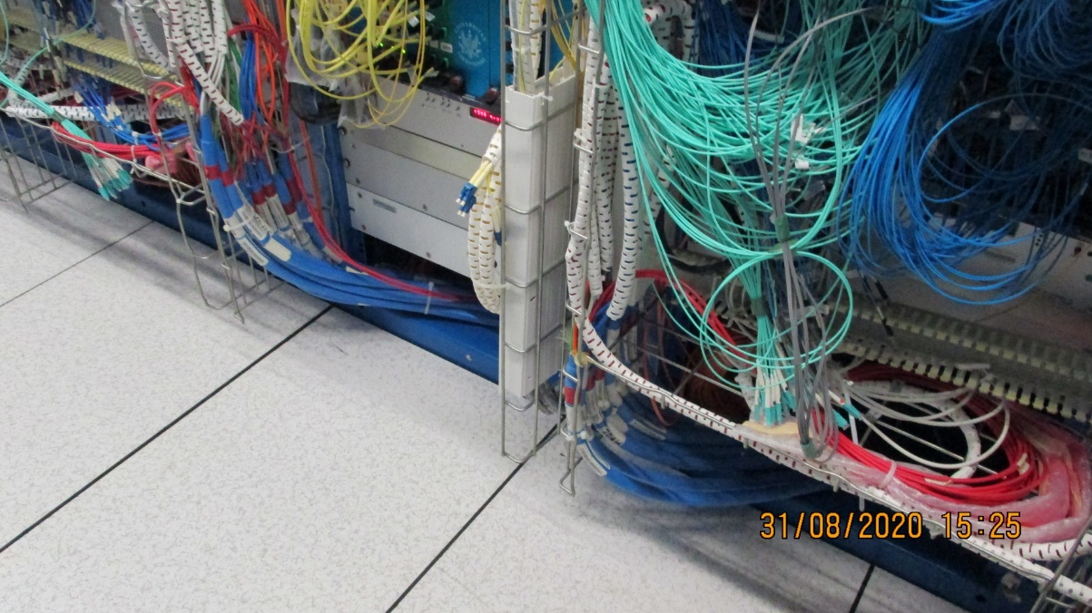
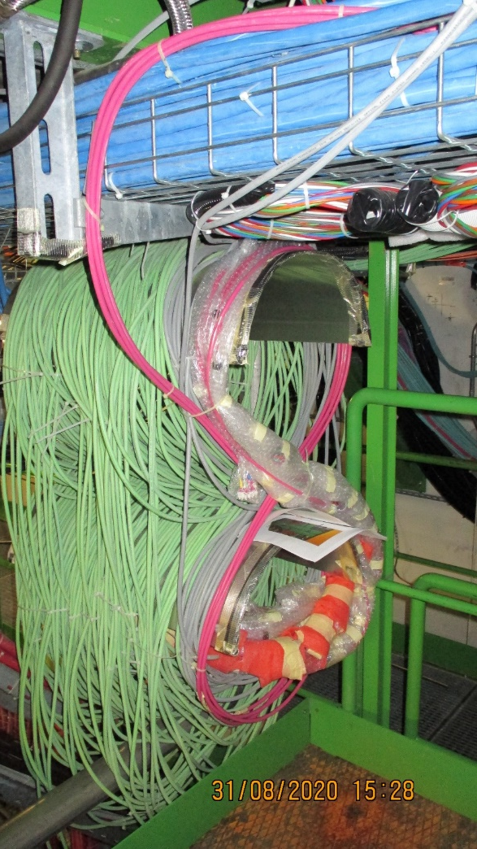
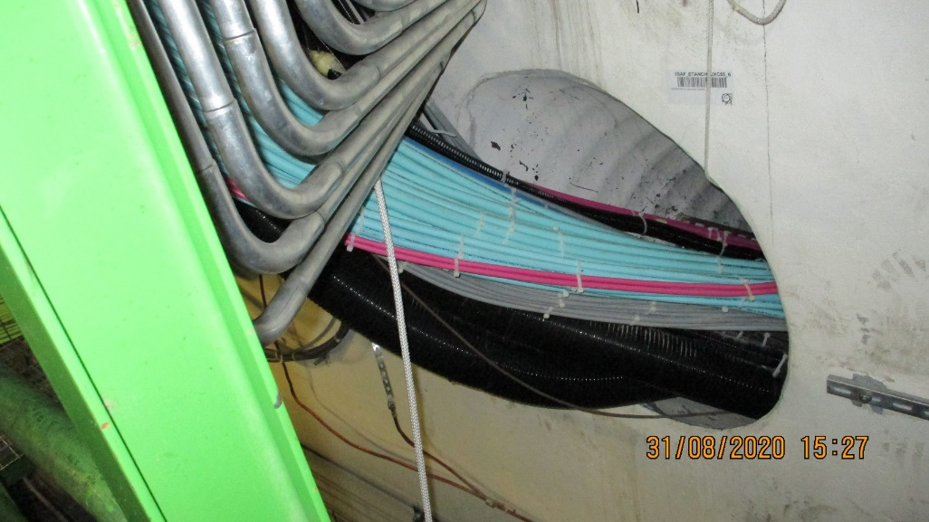
OF will be stored under the Trigger crates, specifically S1F03
Minus Z
Minus Z Trigger tunnel, USC to UXC
Storage of excess length under the S1F03 using original Ecal storage

Slide 4
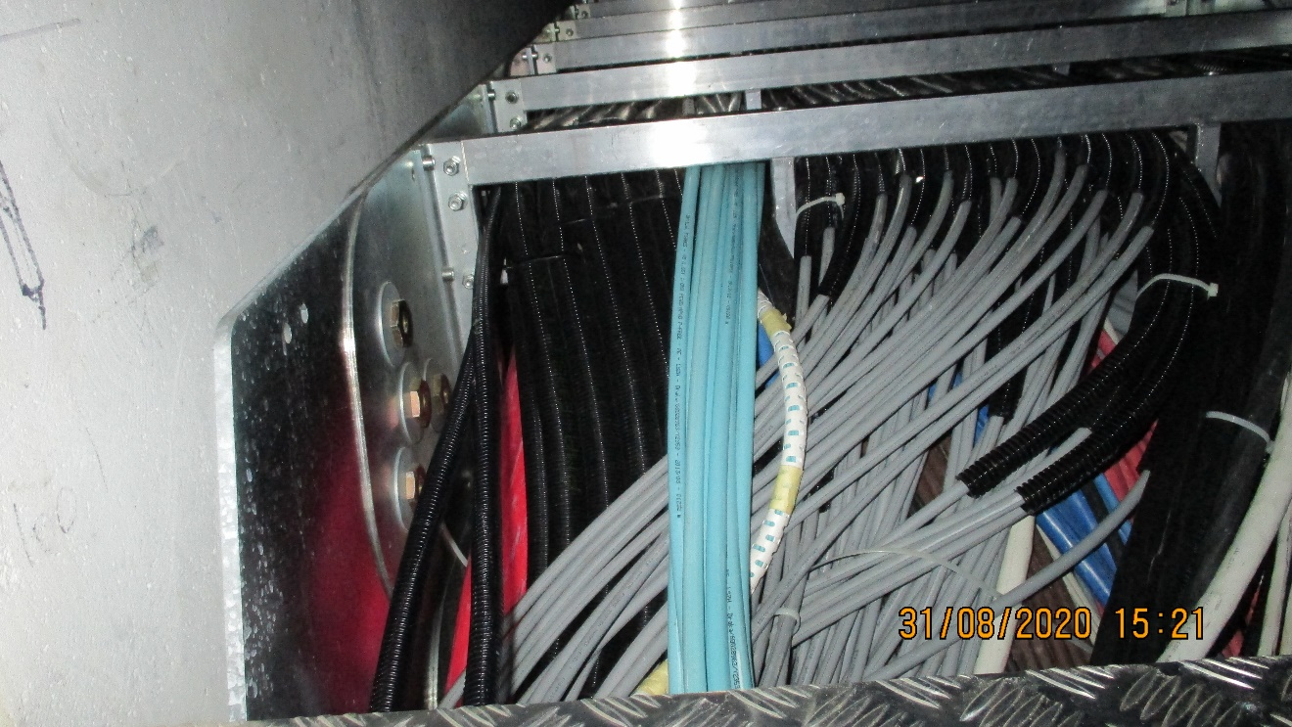
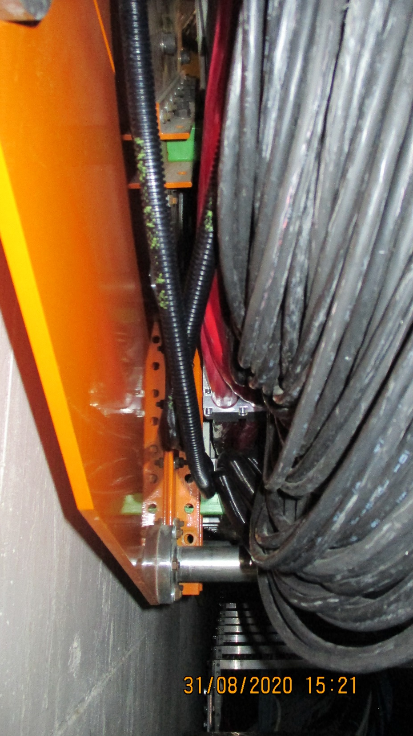
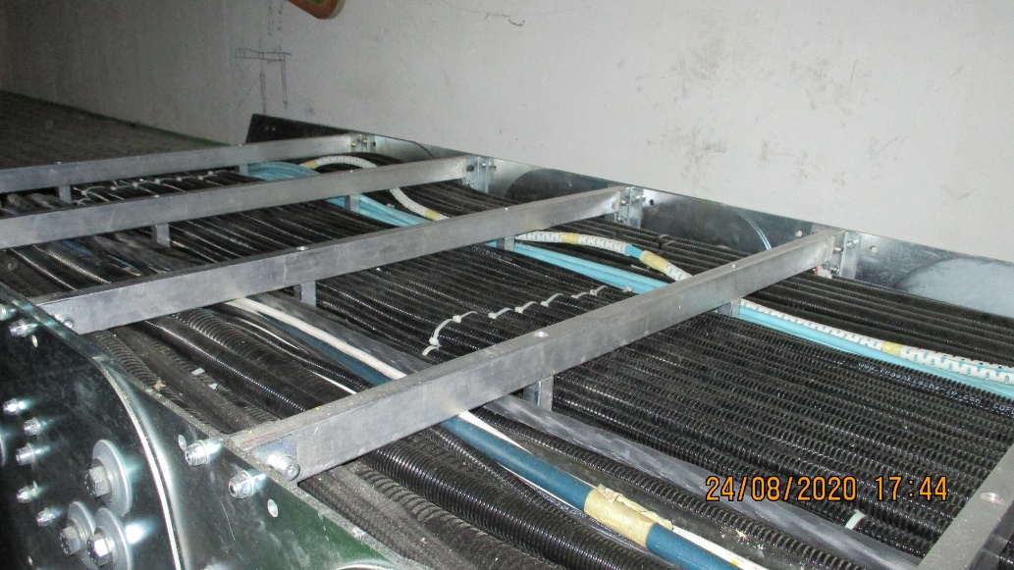
Serious protection of OF is necessary in the Main cable chain. Newly installed Hcal are suffering.
Small space left in Main cable chain

Slide 5
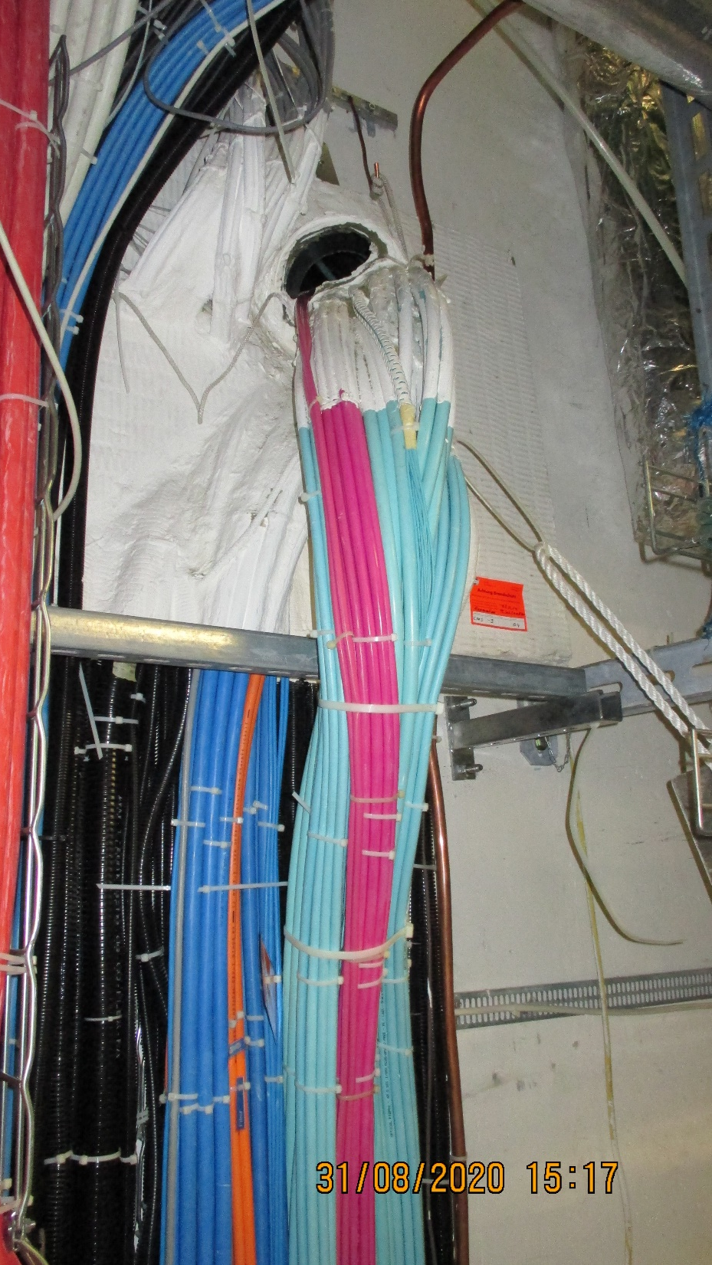
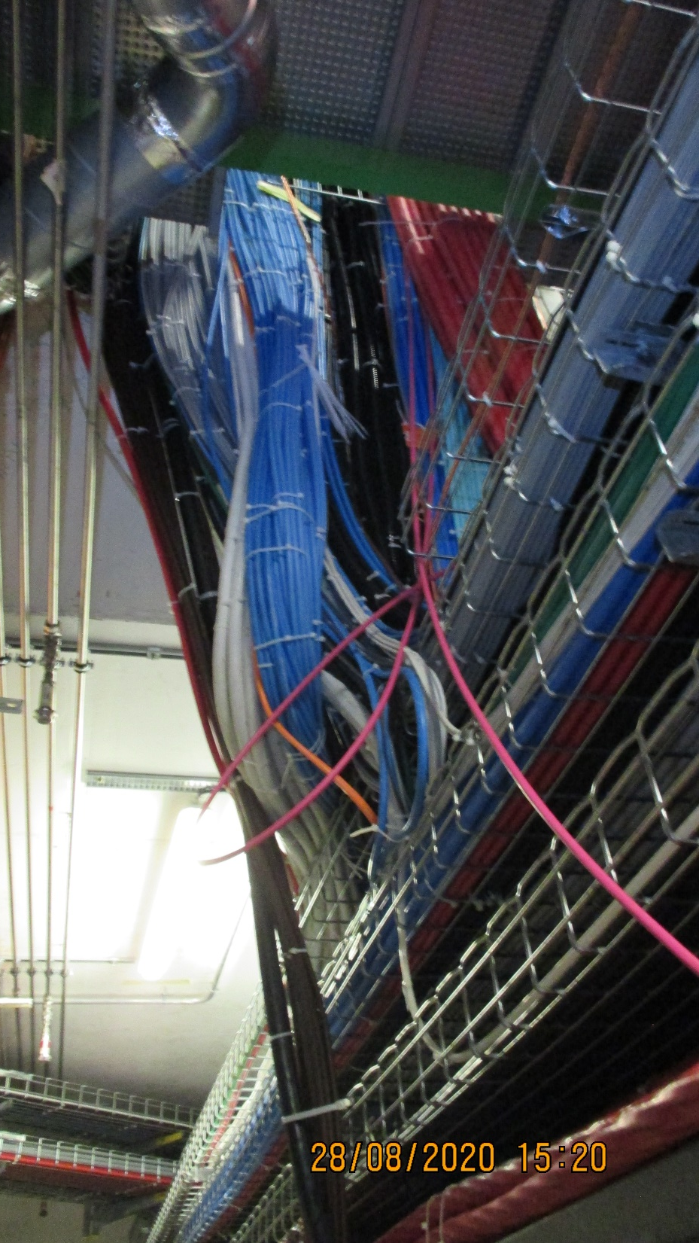
Access from Trigger tunnel in UXC to X0 under the experiment
The descent into the X0 to go off to the Main cable chains (-Z)

Slide 6
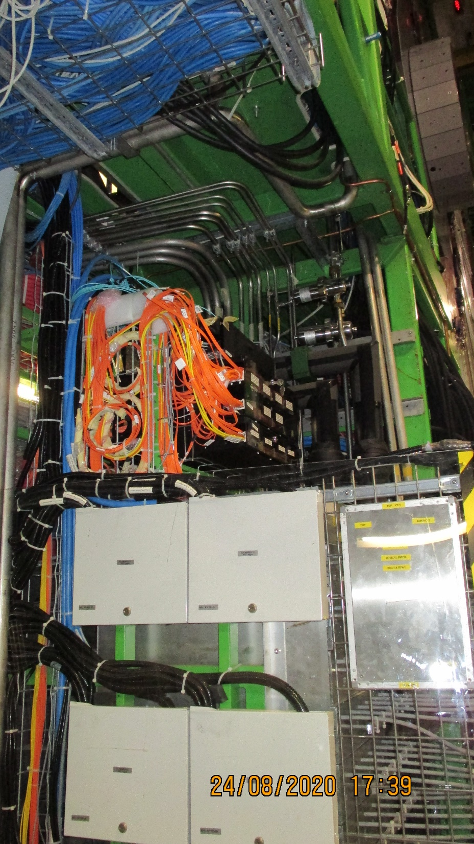
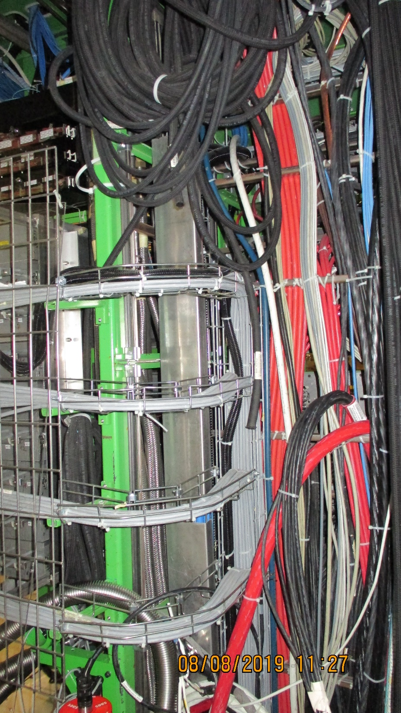
Alternative routes were studied with colleagues, including the original path shown in red.
Final destination in UXC

Slide 7
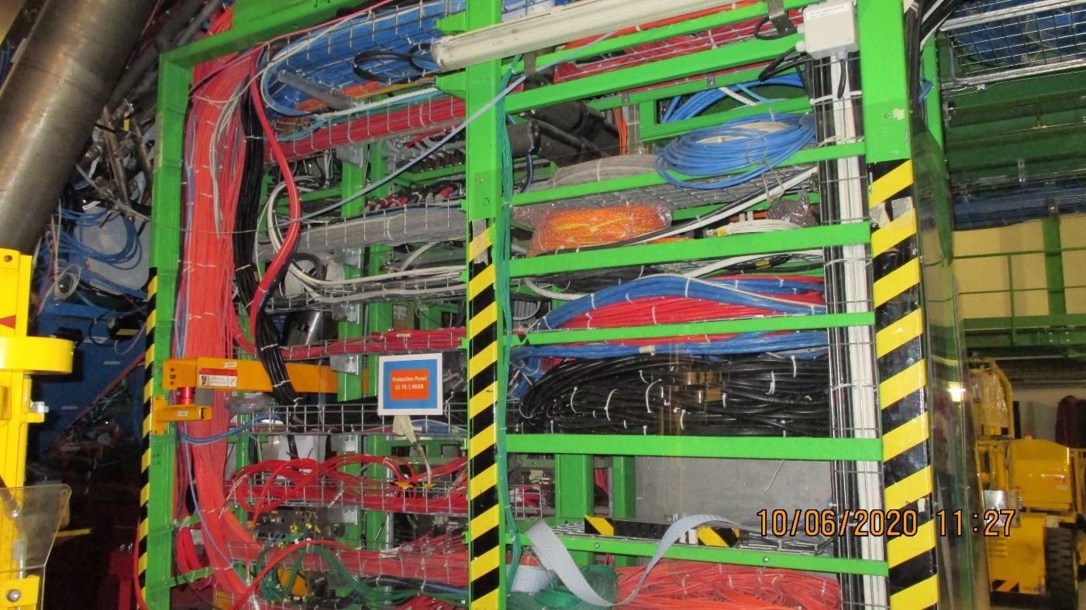
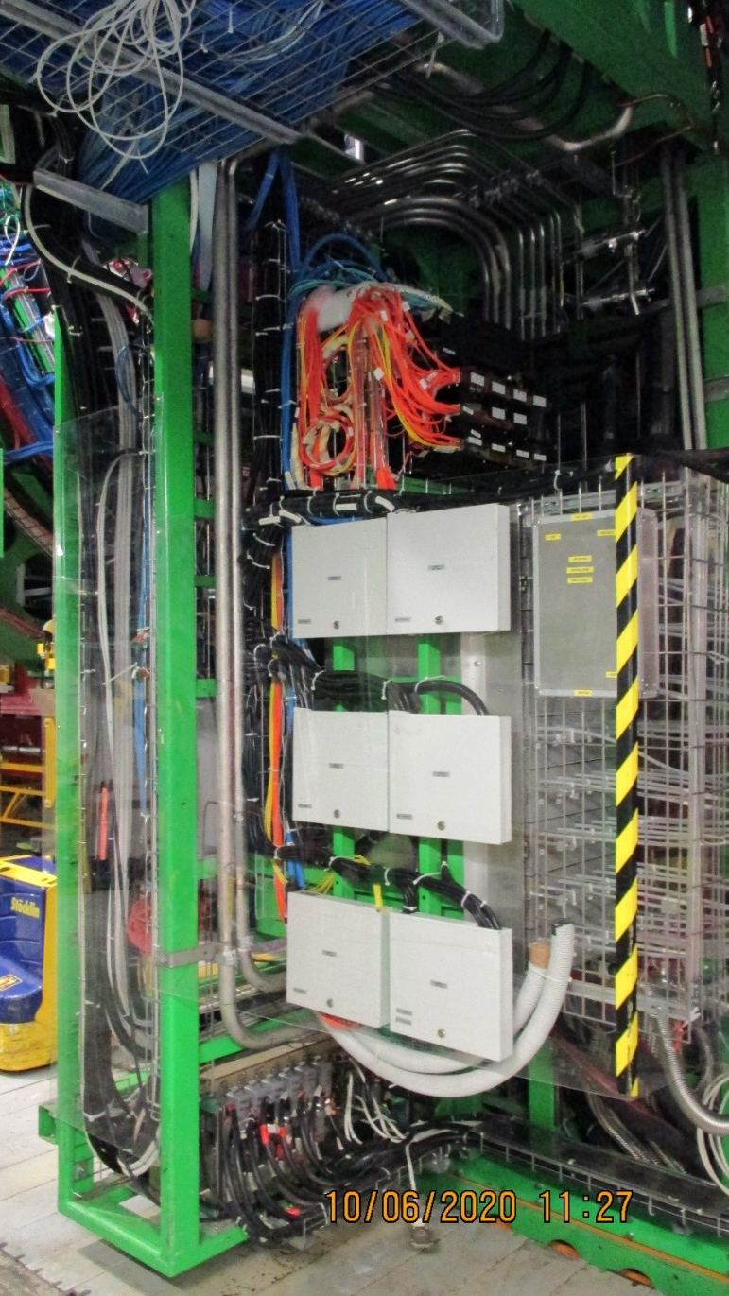
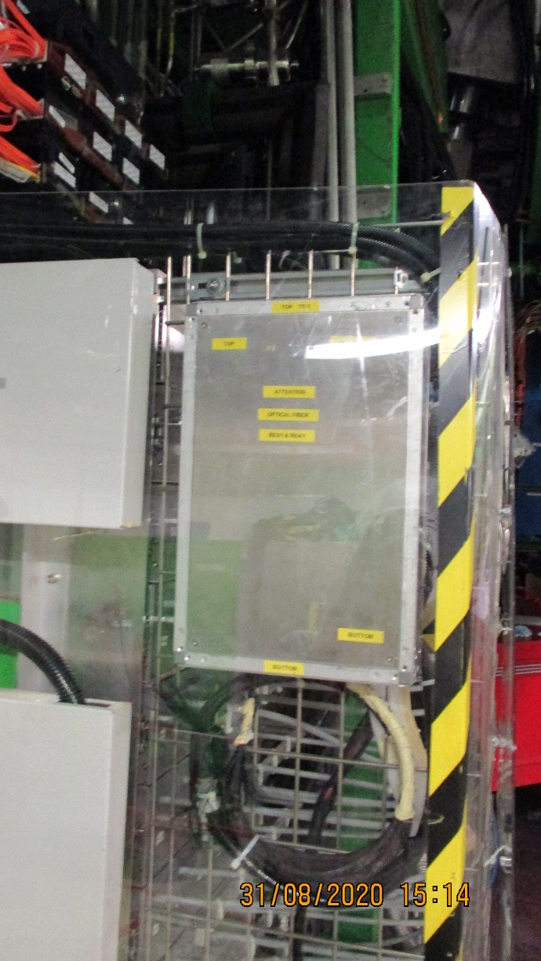
Chamber OF on top and the USC at the bottom
Final routing around the front of the YE-1 patch panel following the chamber OF.

Slide 8
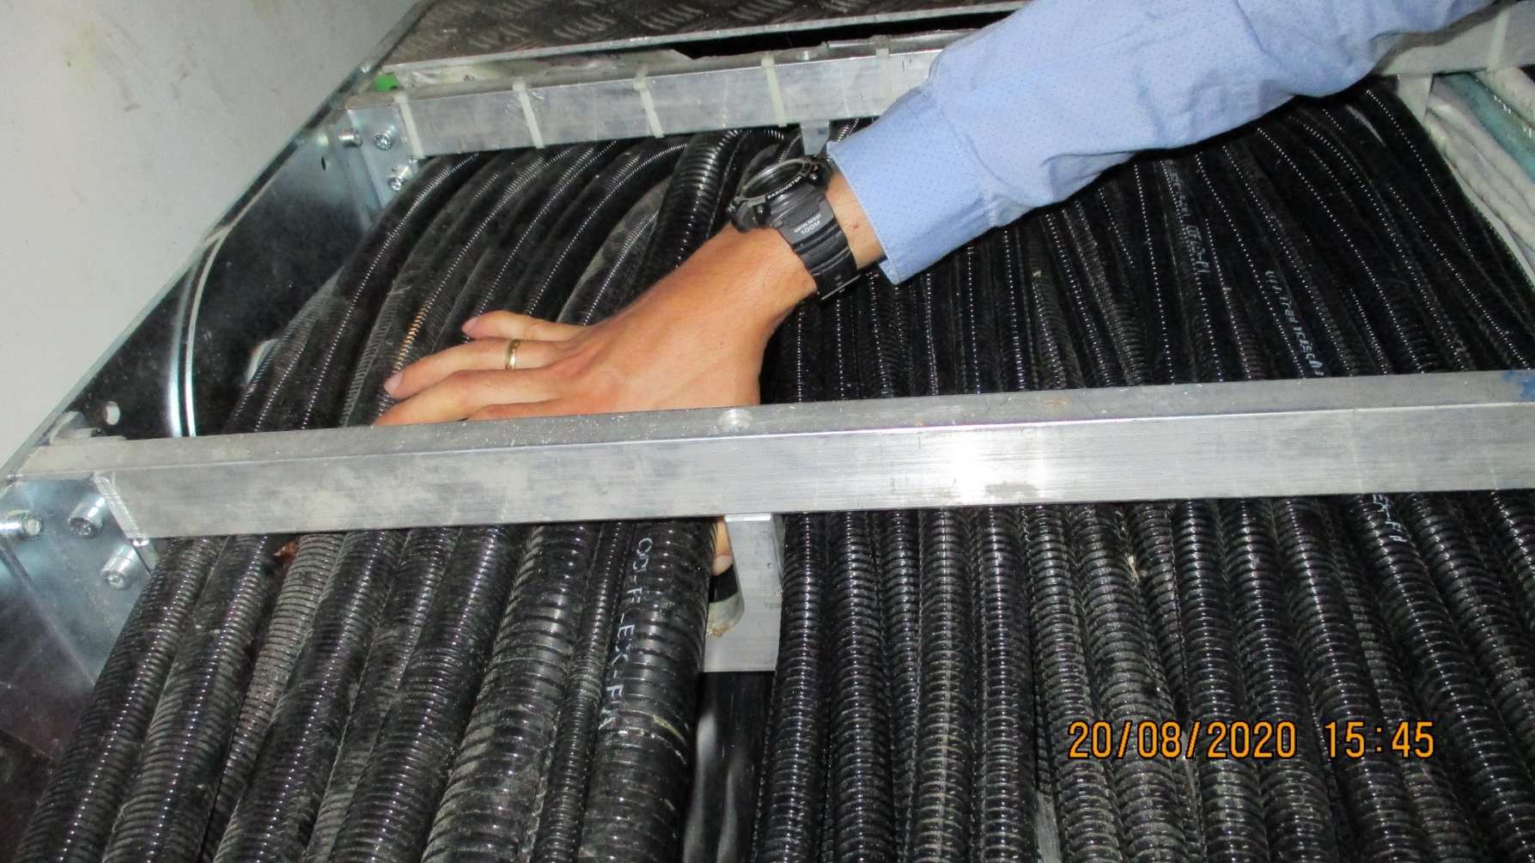
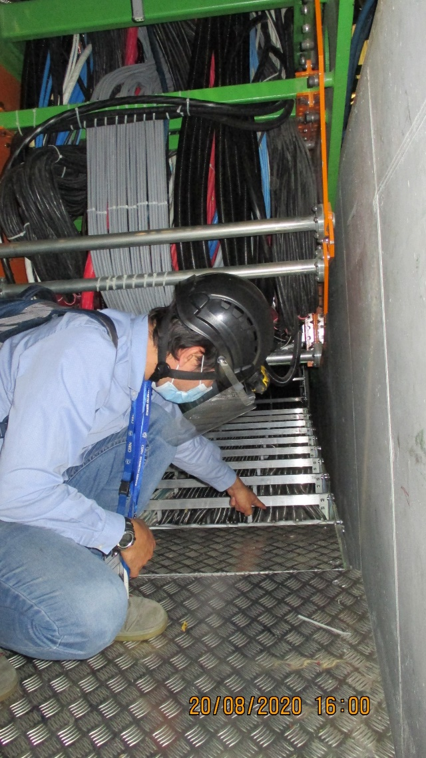
Plus Z
This is the Main Cable Chain (+Z Near) that is absolutely full in the accessible channels
Accessing X0 we located some few spare cm2 in the fibre area.

Slide 9
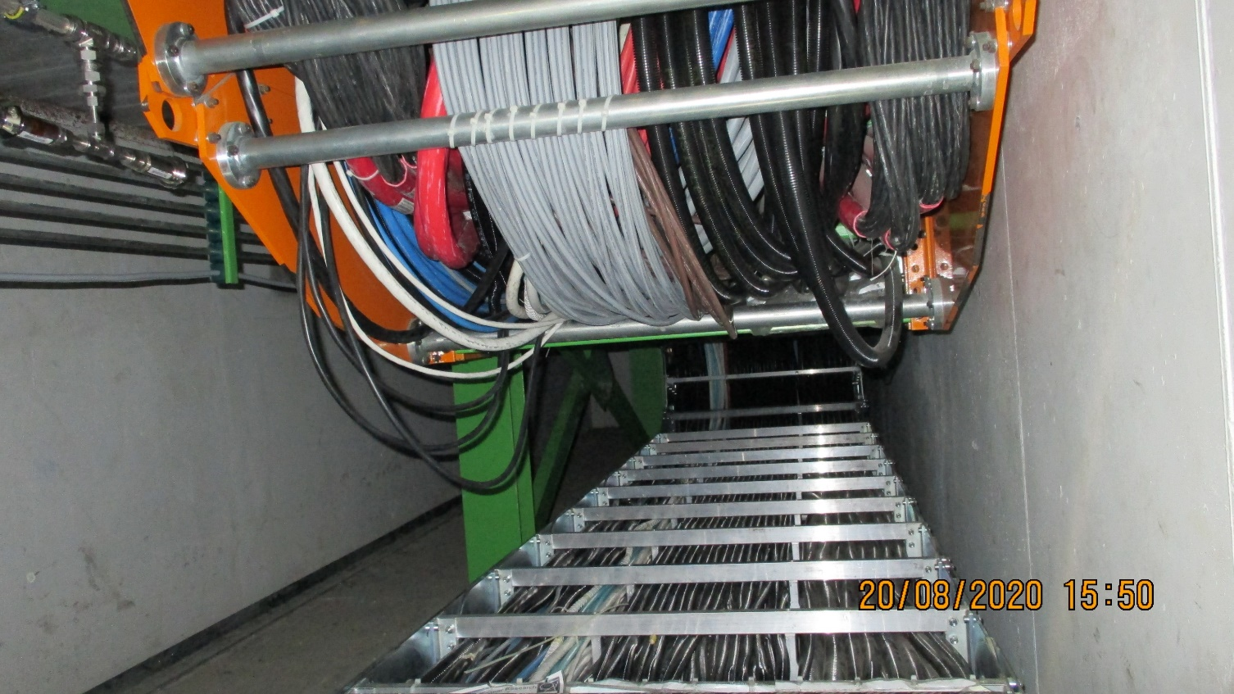
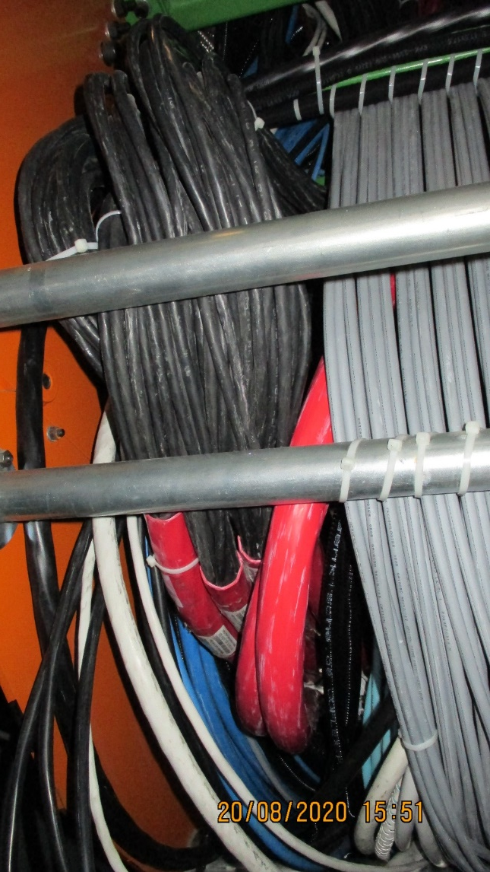
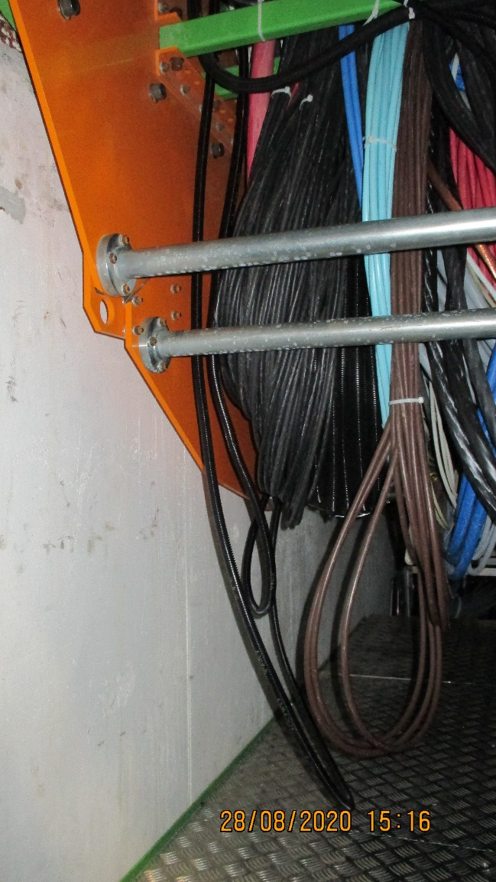
There is a phenomena of the cables shuffling up and/or down the cable chain and as they are constrained, originally at one end only, they can become compressed and leave the chain as can be seen in numerous cases. Tension may not be a problem if the above condition has been respected through out.

Slide 10
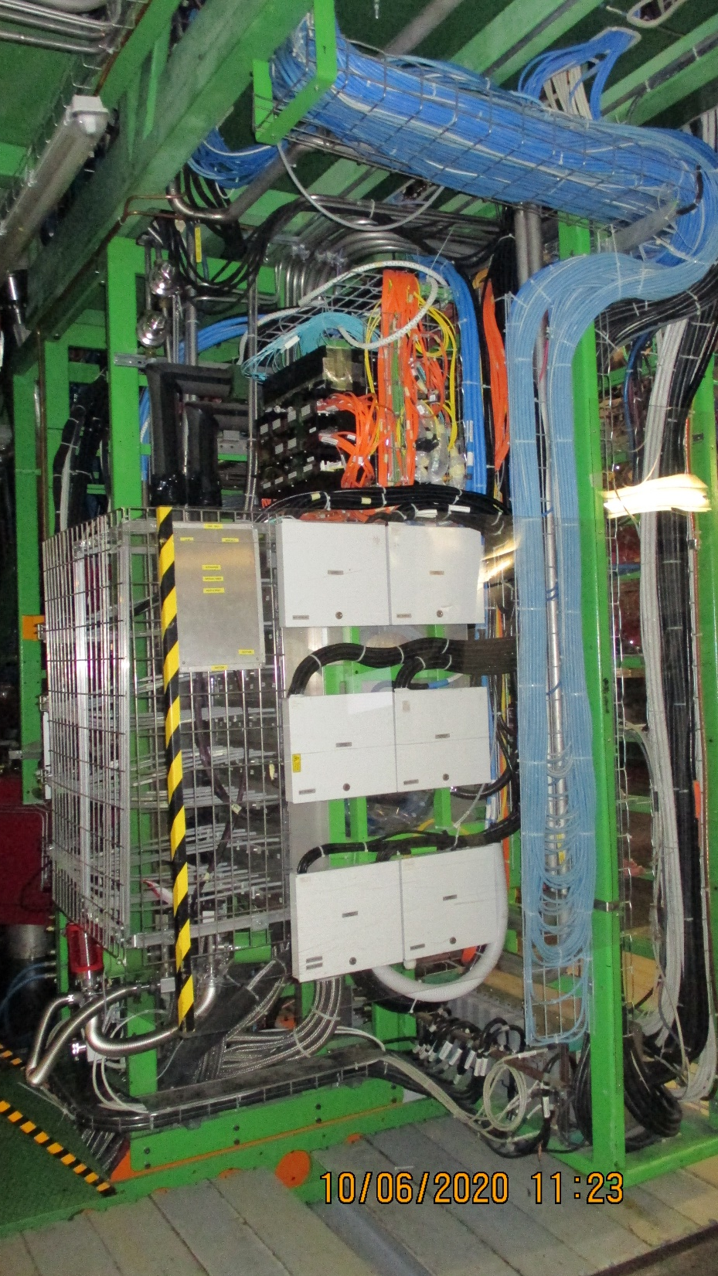
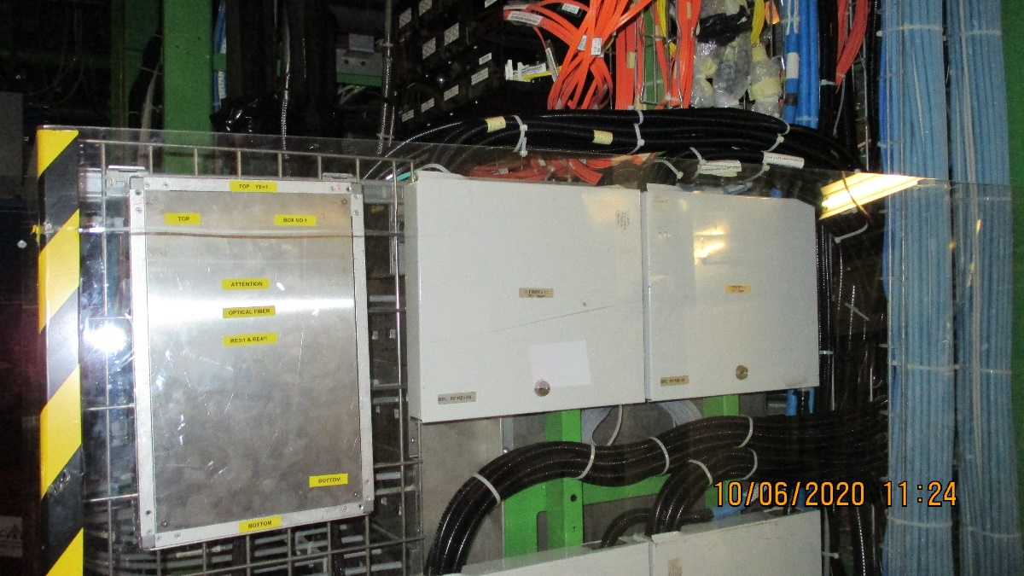
Routing out of the Main Cable chain and around the YE1PP
Original routing taken on the +Z end

Slide 11
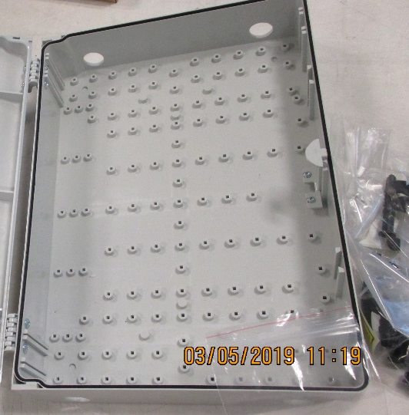
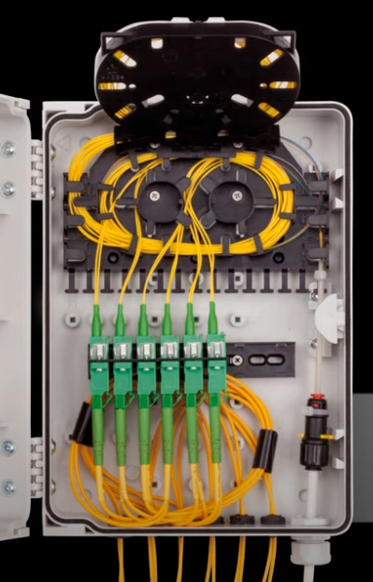
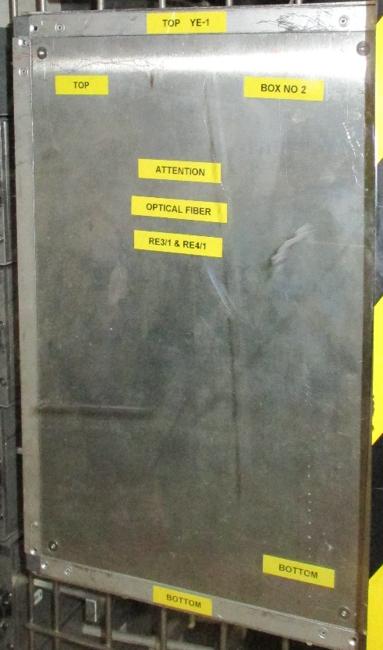
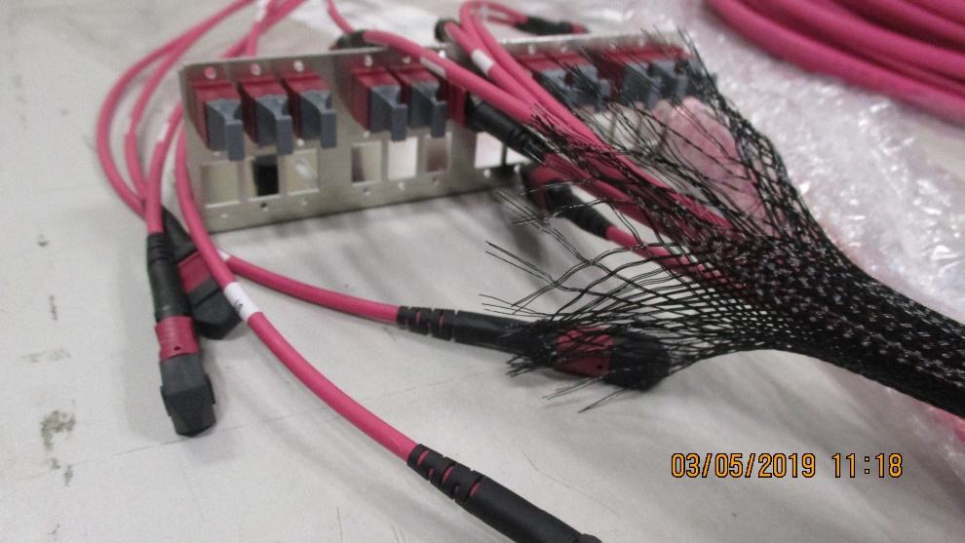
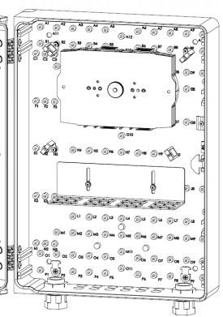
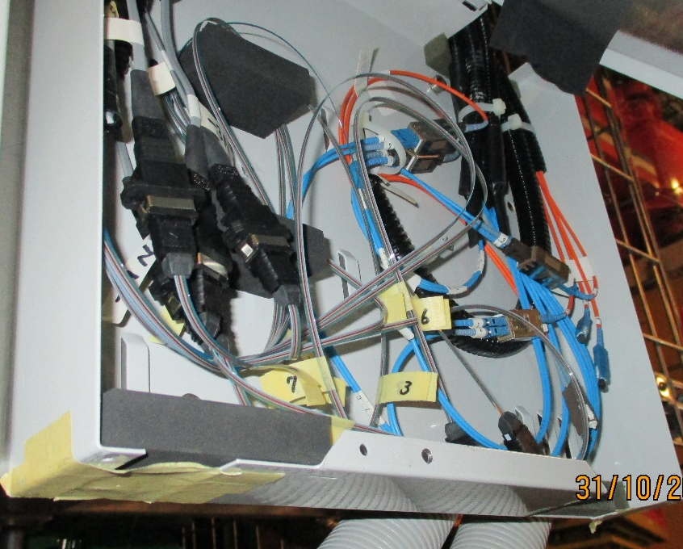
The YE1 PP
We have to go from this, on the left to something like the image on the right
We have made a great effort to obtain the dedicated boxes for making the OF connections and so to avoid damage, tight radii and non professional quality we should find those with the appropriate skills, such as the Russian team.

Slide 12
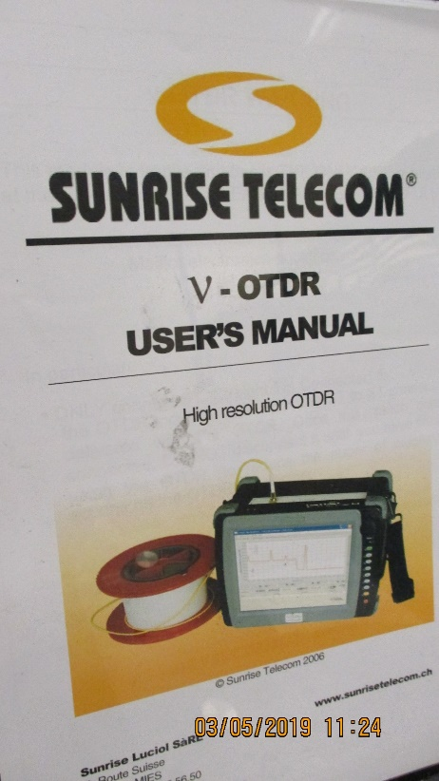
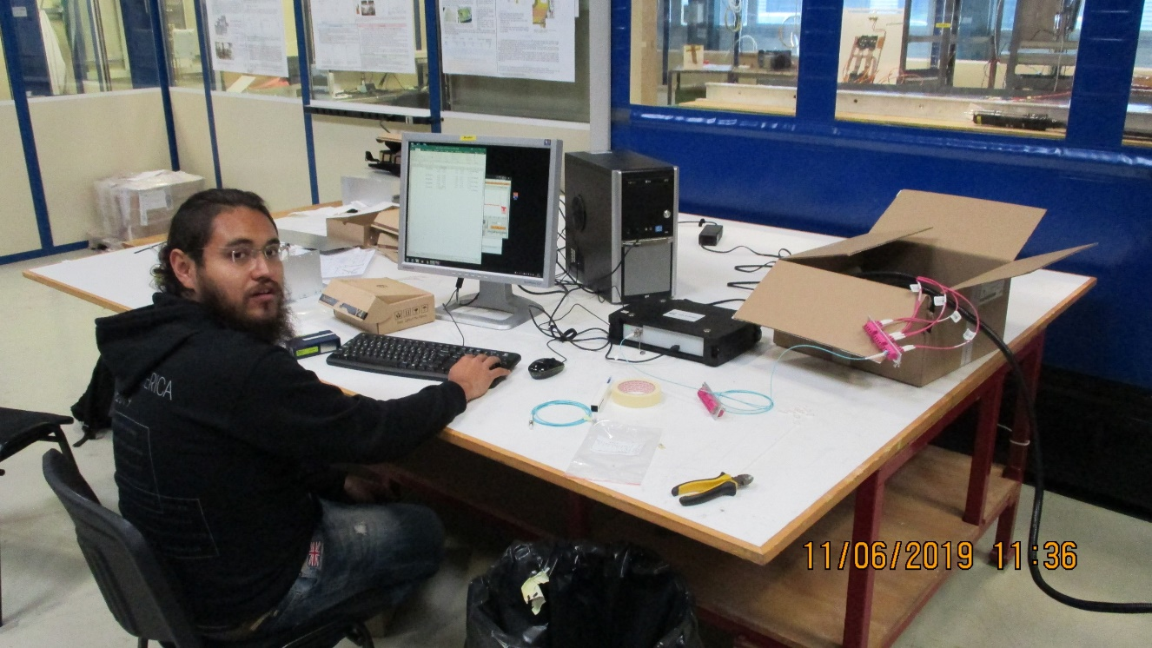
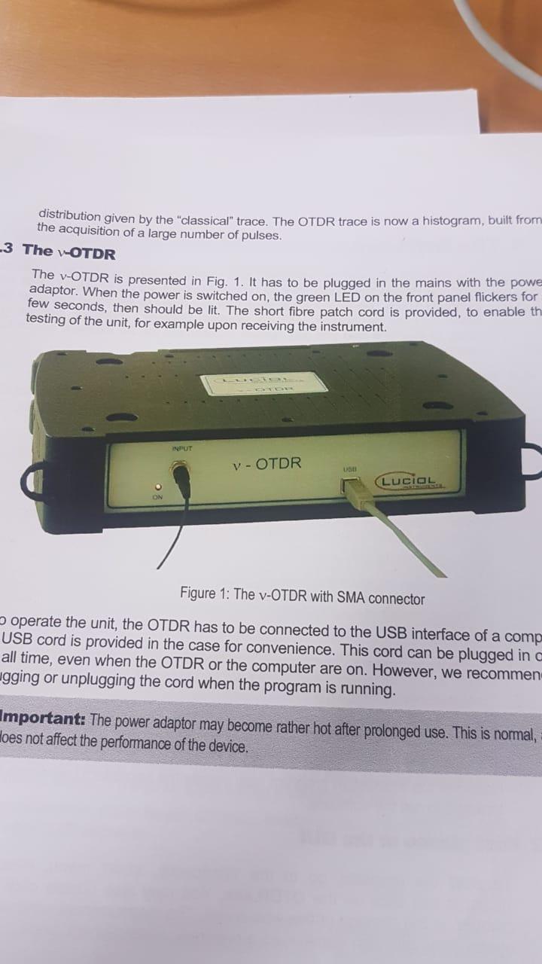
Commissioning of the OF system USC to RE3/1 and RE4/1 chambers.
Data should be cross checked with that from 904 to look for attenuation and interruption
Document explain what was done in 904
http://project-cms-rpc-endcap.web.cern.ch/rpc/UpscopeHighEta/RPCDevelopements/RE31and41/Services/OpticalFibres/QA/Method/OpticalFiberTest.pptx

Slide 13
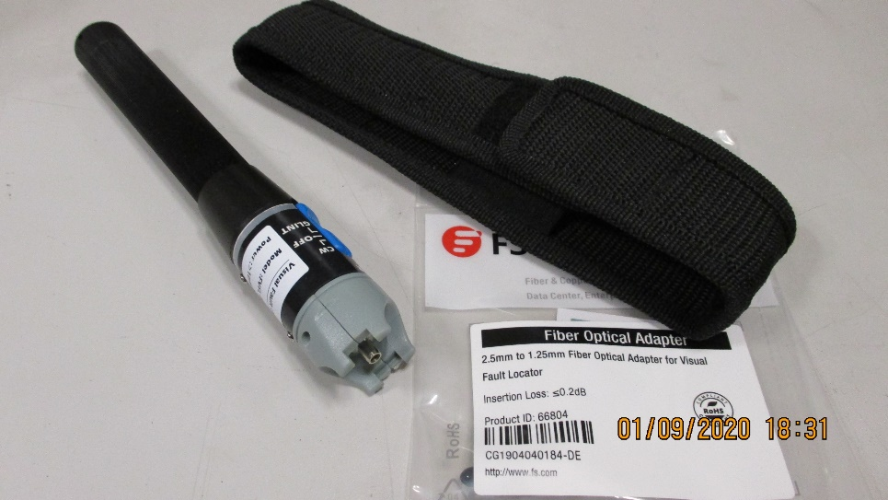
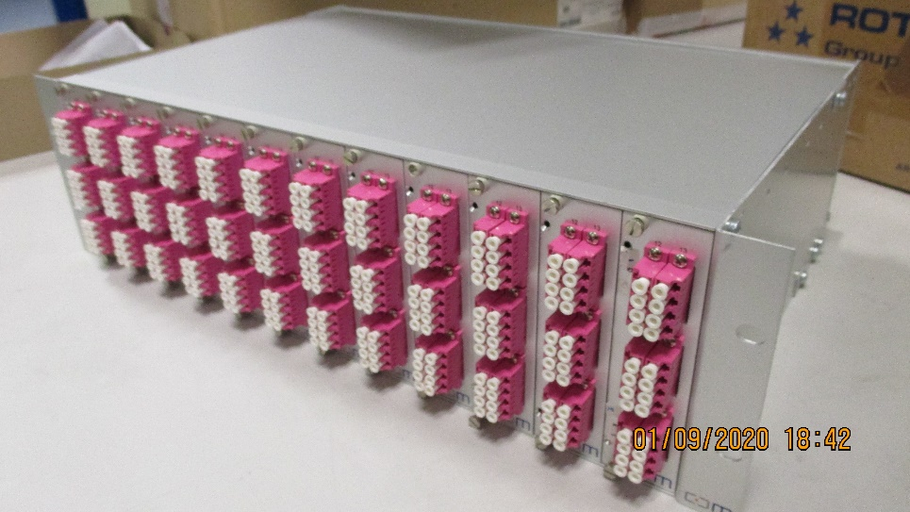
How to verify the mapping from USC to the Chambers ?
The signal cabling for the previous RE chambers was fraught with errors.
The identification of the OF in the USC that goes to one of the RE3/1 or RE4/1 chambers can be done by using the laser tool shown here. This is applied to either the USC end or the chamber end. Access being required to the other end.
The real question is how to set up the USC end, at the moment all the LC connectors are under the S1 racks protected in there massive sleeve, 1.5m long.
They could be individually labelled, chamber ID, and repacked for final connection to the fan out (re-arranger) box shown. Requested by Zhen-An.
The fibres could be brought out into the rack area with or with out mounting in the fan out box shown. They will finally go to this box one day. Can the box be mounted today in the S1F03 ?
Final aim;
The OF should be set up in the USC so that whenever access is available to one station the 18 points are verified and the as built mapping established.

Slide 14
Micos range
https://www.youtube.com/watch?time_continue=1&v=BTJ_yh3610s&feature=emb_title
https://www.youtube.com/watch?time_continue=11&v=PLWhW1Mkzeg

