Slide 1

Installation of MTP fiber cable inside YE1 Patch panel
Andrés Leonardo Cabrera Mora
2 September 2020
1

Slide 2
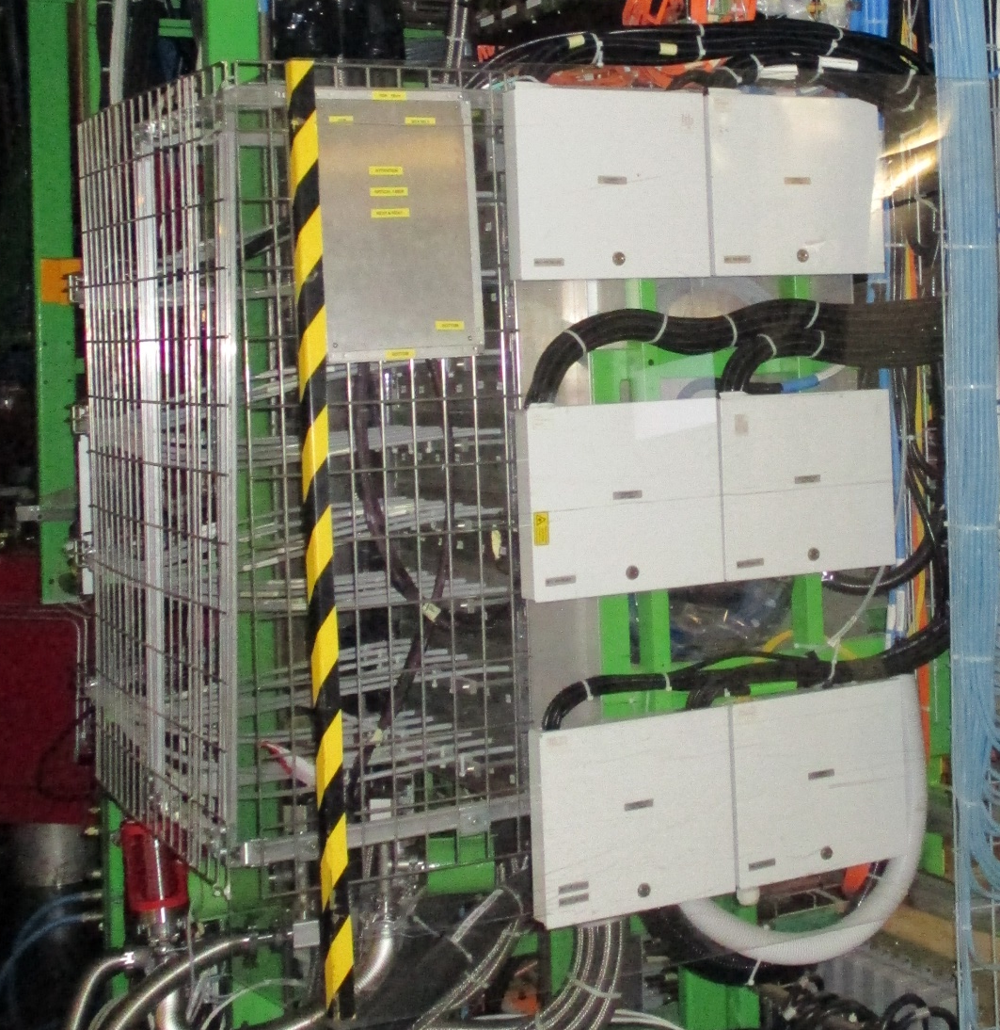
Sketch of the complete fiber optic installation
UXC
2 September 2020
2

Slide 3
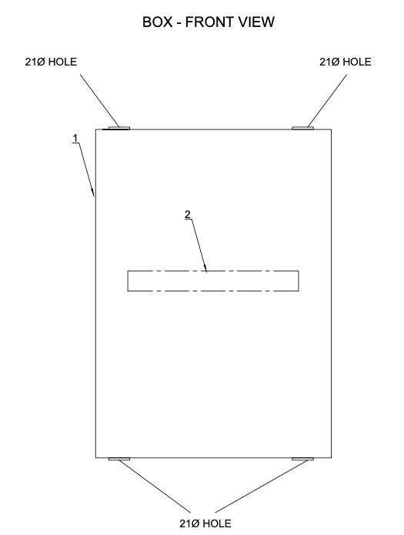
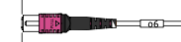
YE+1 Patch pannel
YE+1 Patch pannel
RPC Optical Fiber Box
Optical fiber cable coming from YE3
(2 MTP cables)
Cable 2
Glande
Glande is installed on the hole
Optical fiber cable coming from USC
(2 MTP cables)
Cable 3
2 September 2020
3

Slide 4
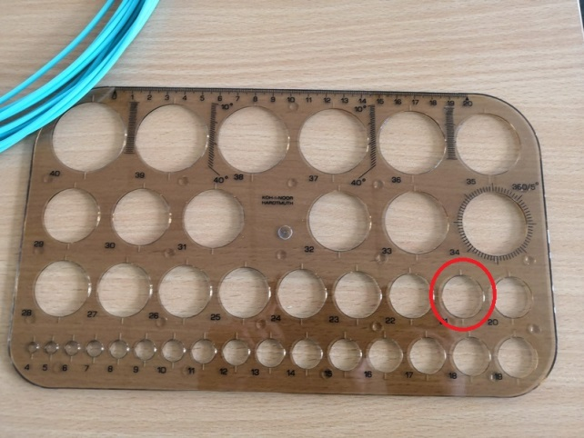
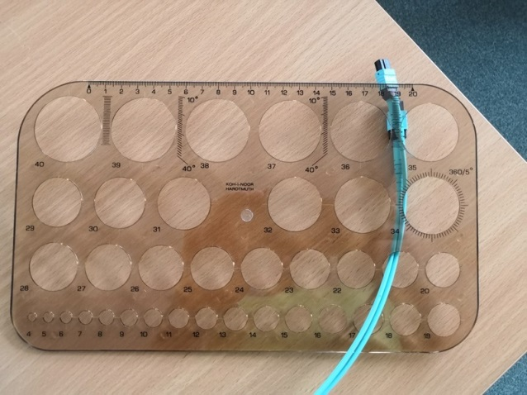
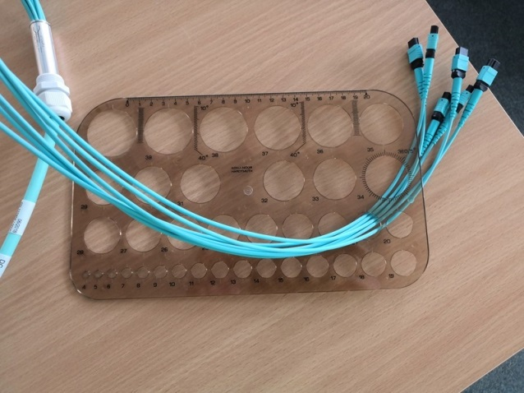
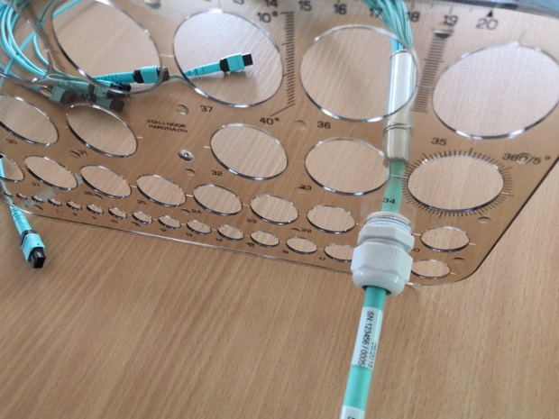
Fixing the gland with the nut in the hole of the box
Step 1
Step 2
Step 1
Step 3
Step 4
2 September 2020
4

Slide 5
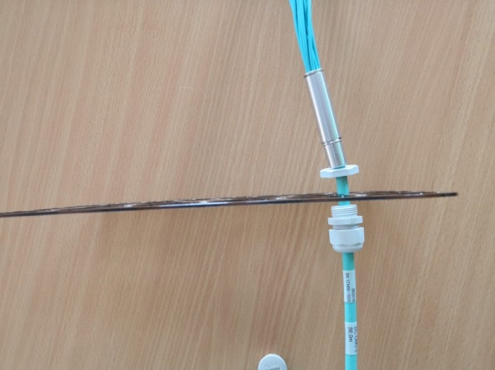
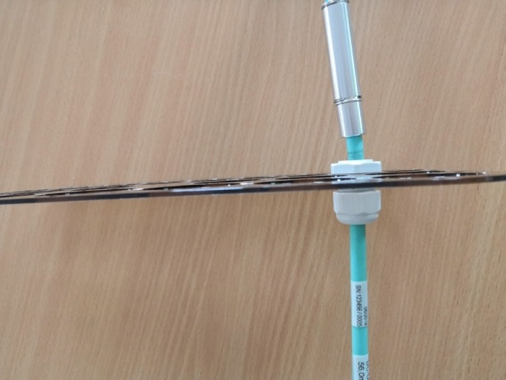
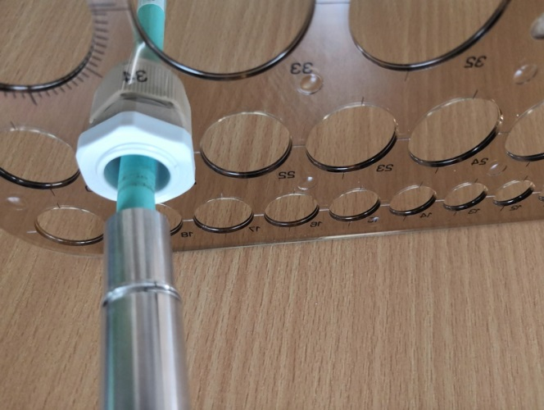
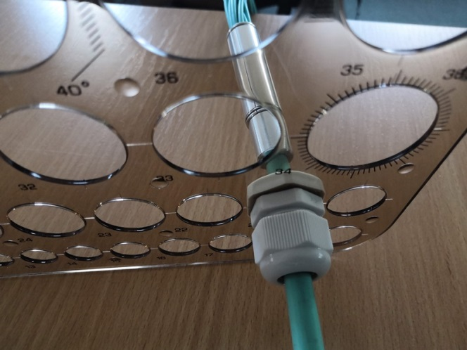
Fixing the gland with the nut in the hole of the box
Step 5
Step 6
Step 7
Step 8
2 September 2020
5

