Slide 1
Optical fibre Power loss
Ian
25 April 2019

Slide 2
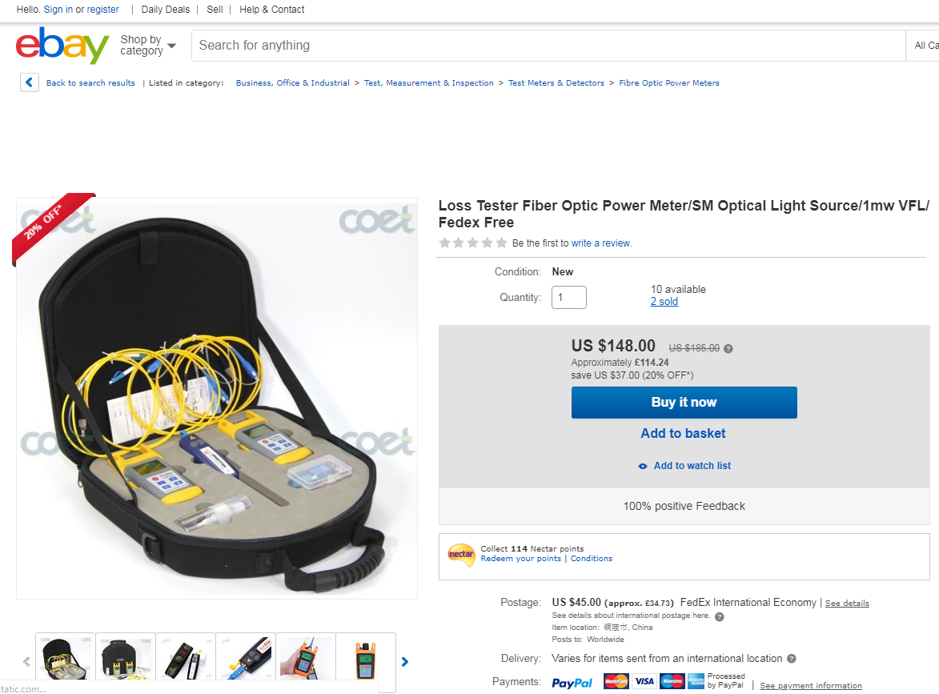
https://www.ebay.co.uk/itm/Loss-Tester-Fiber-Optic-Power-Meter-SM-Optical-Light-Source-1mw-VFL-Fedex-Free/223244666409?hash=item33fa6b4629:g:2wwAAOSw-wJaCTO-&frcectupt=true

Slide 3
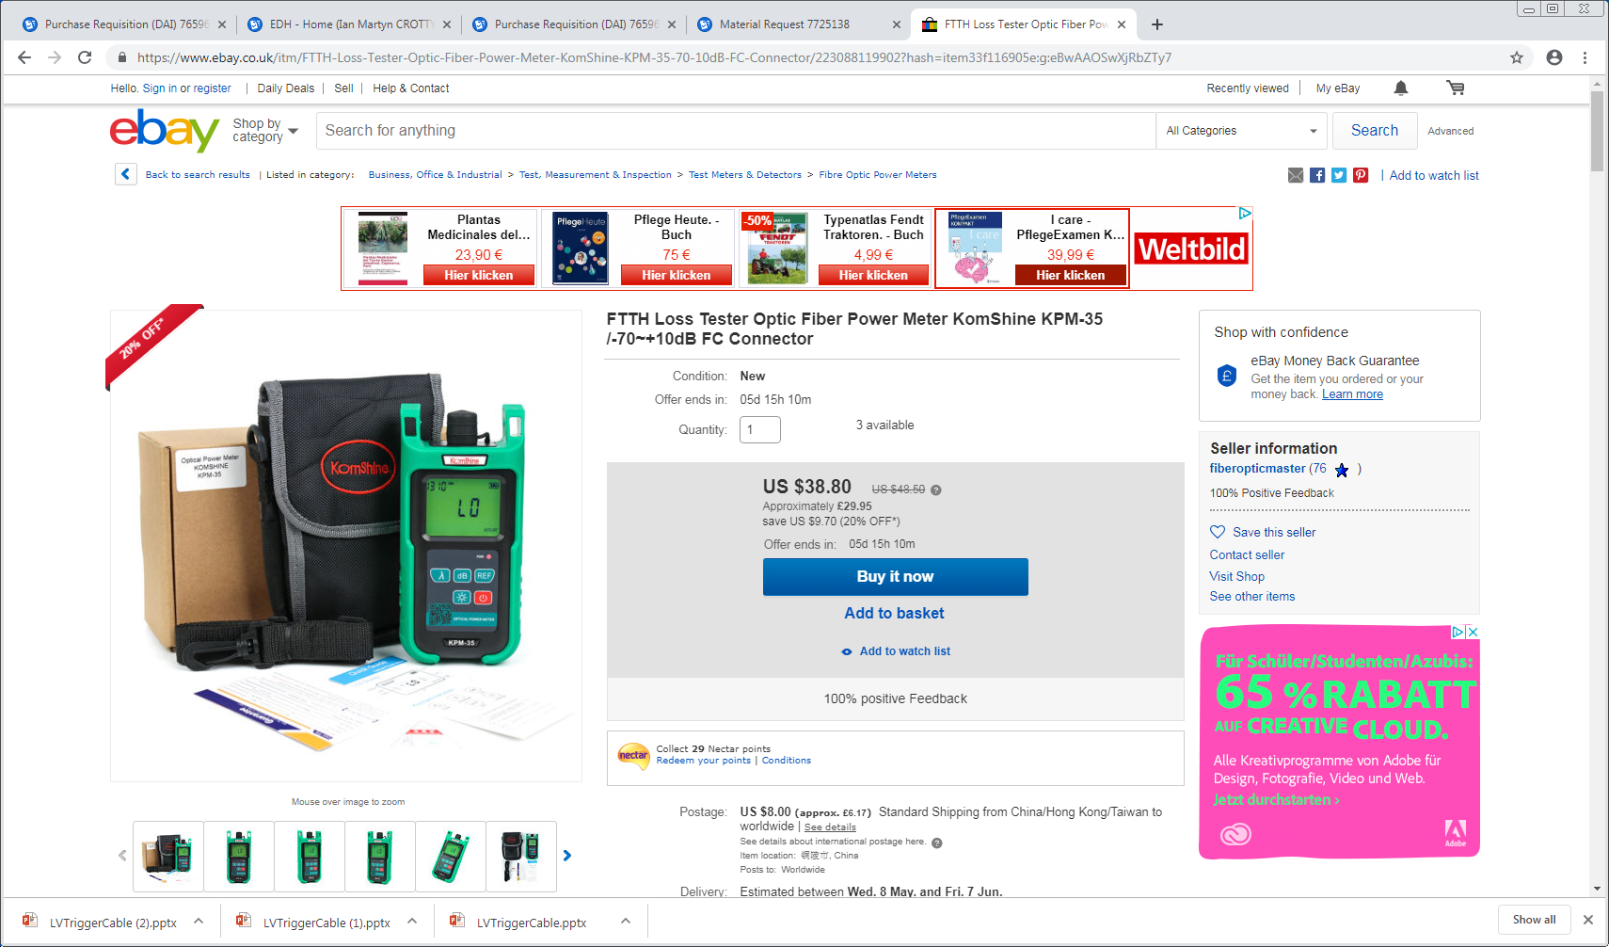
https://www.ebay.co.uk/itm/FTTH-Loss-Tester-Optic-Fiber-Power-Meter-KomShine-KPM-35-70-10dB-FC-Connector/223088119902?hash=item33f116905e:g:eBwAAOSwXjRbZTy7

Slide 5
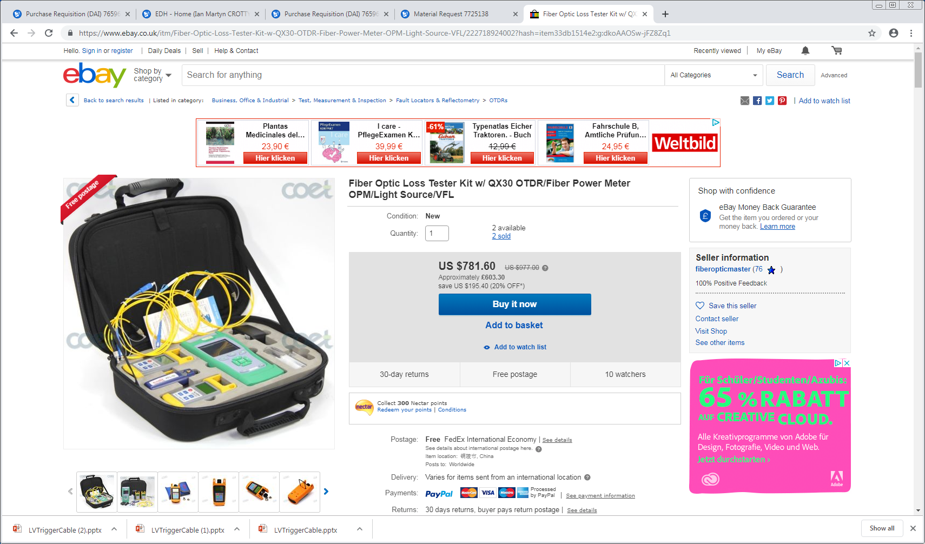
https://www.ebay.co.uk/itm/Fiber-Optic-Loss-Tester-Kit-w-QX30-OTDR-Fiber-Power-Meter-OPM-Light-Source-VFL/222718924002?hash=item33db1514e2:g:dkoAAOSw-jFZ8Zq1

