Slide 1
Fibres for the iRPC, and New Link board
Ian
Gleaned from Behzad, Zhenan and Lyon Colleaguers

Slide 2
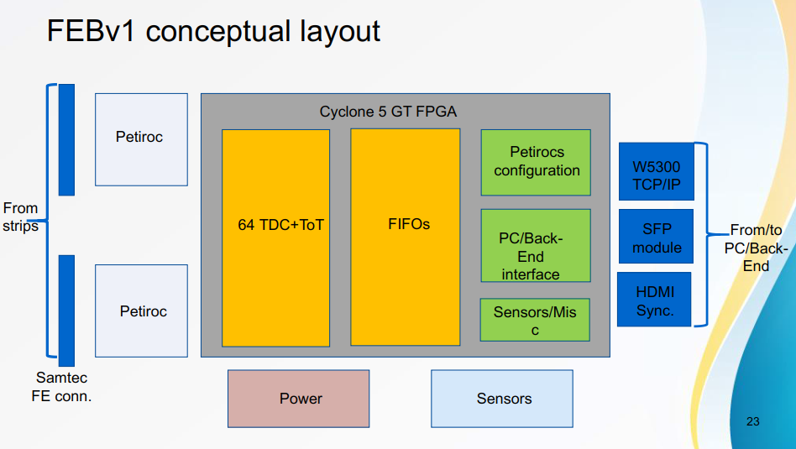

Slide 3
2 fibres from each FEB. There are 2 per chamber plus 1 spare = 5 (or 6) fibres per chamber

Slide 4
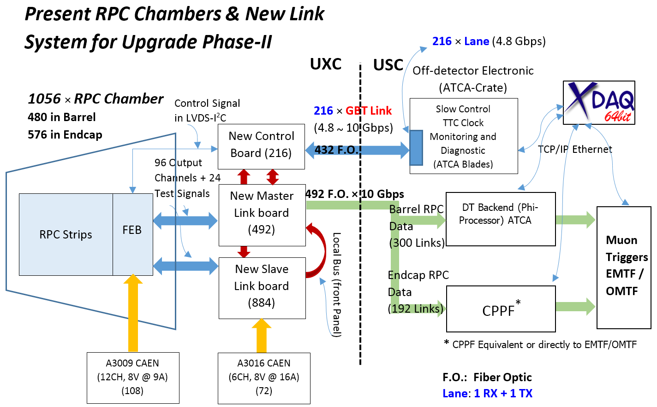
Architecture of RPC data flow via New Link Board system
The functionalities of present Slow controller (Slide 13) will be handled with new RPC Off-detector electronic
The New Off-detector Electronic is under responsibility of China Institute of high energy physics (IHEP)
Before the delivery of the new Off-detector electronic we will test the new Link board and control board with our evaluation board (KC705) which will discuss more on slide 8

Slide 5
New LB and IRPC Optical fibre needs
chambers stations FO/station
RB data 480 5 96
RB Cont’l 216/13 5 20
RE data 576 8 72
RE Cont’l 216/13 8 20
iRPC 72 4 4x18=72

Slide 6
CMS RPC Stations
Present conditions
RE4
RE3
RE2
RE1
RB2
RB1
RB0
RB1
RB2
RE1
RE2
RE3
RE4
+Z
-Z
Data
Cont’l
34/1
XXX
Xx
xx
XXX
xx
XXX
xx
XXX
xx
XXX
xx
XXXxx
XXXxx
XXXxx
XXXxx
xx

Slide 7
CMS RPC Stations
Future conditions
10 Gbps FO through out
RE4
RE3
RE2
RE1
RB2
RB1
RB0
RB1
RB2
RE1
RE2
RE3
RE4
+Z
-Z
Data
Cont’l
34/1
144
20
144
144
20
96
20
96
20
96
20
96
20
96
20
14420
14420
144
Control fibres are an estimate 216/13 stations

Slide 9
Draka CERN
They must be kept the picture, a quote being made

Slide 10
Bezhad contact

