Slide 1
YE3
YE1
UXC
USC
Mini Cable Chain
Panel iRPC
Trunk Cable 1
Trunk Cable 2
Patch Panel
USC
iRPC
Patch
Panel
USC Rack
Main Cable Chain
iRPC: 4 fibers per chamber
Number of Chambers:
18 RE+3/1 -> 72 fibers
18 RE+4/1 -> 72 fibers
18 RE-3/1 -> 72 fibers
18 RE-4/1 -> 72 fibers
Proposal:
4 Trunk cable 1 (96 fibers: 72 used + 24 spares)
4 Trunk cable 2 (96 fibers: 72 used + 24 spares)
*1 cable per 18 chambers

Slide 2
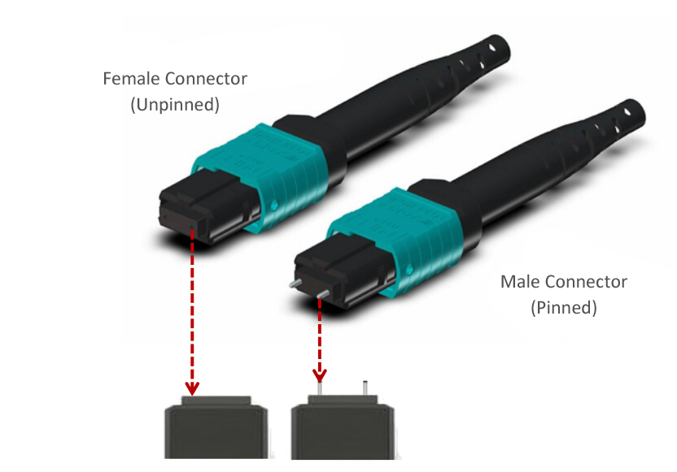
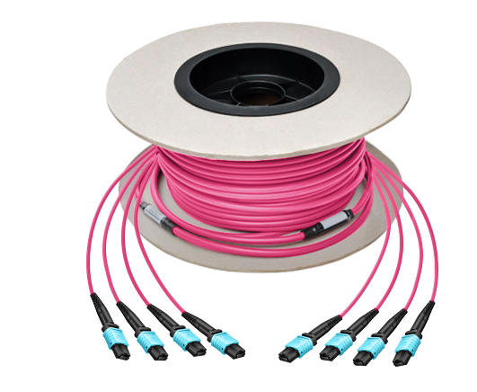
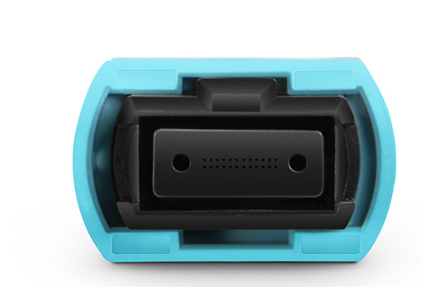
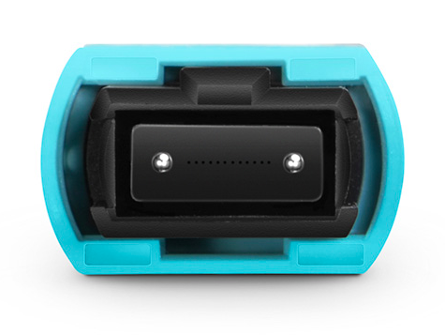
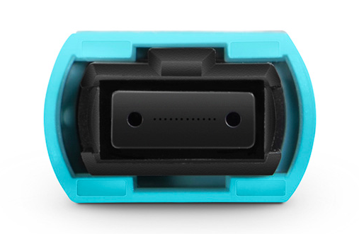
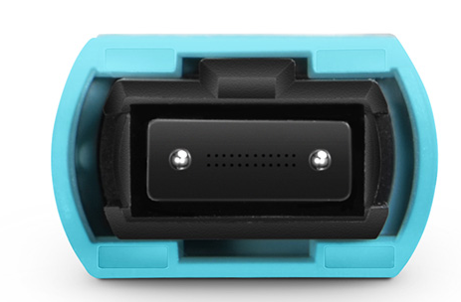
Trunk cable option
MTP/MPO connector
24 fibers per connector
12 fibers per connector
Male
Female
Male
Female

Slide 3
Specification Trunk Cable 1 (96 fibers)
Length A: 1 m. ?
Length C: 1 m.?
Length B: 30 m.?
Patch
Panel
Panel iRPC
8 MPT/MPO Connectors Female
6 used + 2 spares
(12 fiber per connector)
4 MPT/MPO Connectors Female
3 used + 1 spare
(24 fiber per connector)
Specification Trunk Cable 2 (96 fibers)
Length A: 1 m. ?
Length : 1 m. ?
Length B: 80 m.?
Patch Panel
USC
Patch
Panel
4 MPT/MPO Connectors Male
3 used + 1 spare
(24 fiber per connector)
4 MPT/MPO Connectors Male
3 used + 1 spare
(24 fiber per connector)

Slide 4
General Cable Requirements
96 fibers per cable
Multimode OM3
Jacket: Low Smoke Zero Halogen (LSZH)
Compliance with CERN IS23:
https://edms.cern.ch/document/335745/LAST_RELEASED/

