Slide 1
Fibre Optic Cable supports
Ian Crotty
8 April 2019

Slide 2
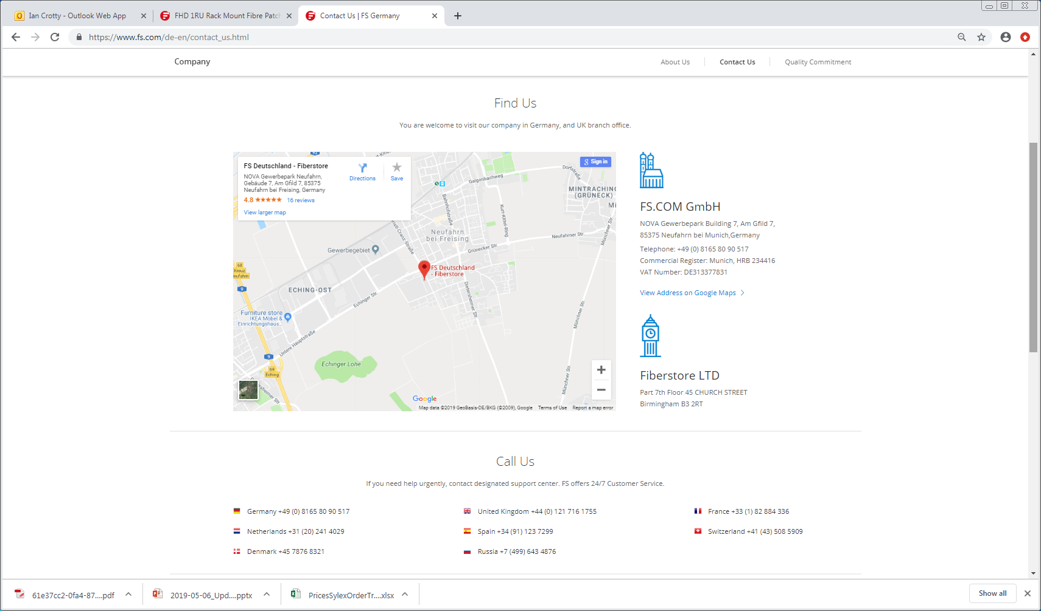

Slide 3
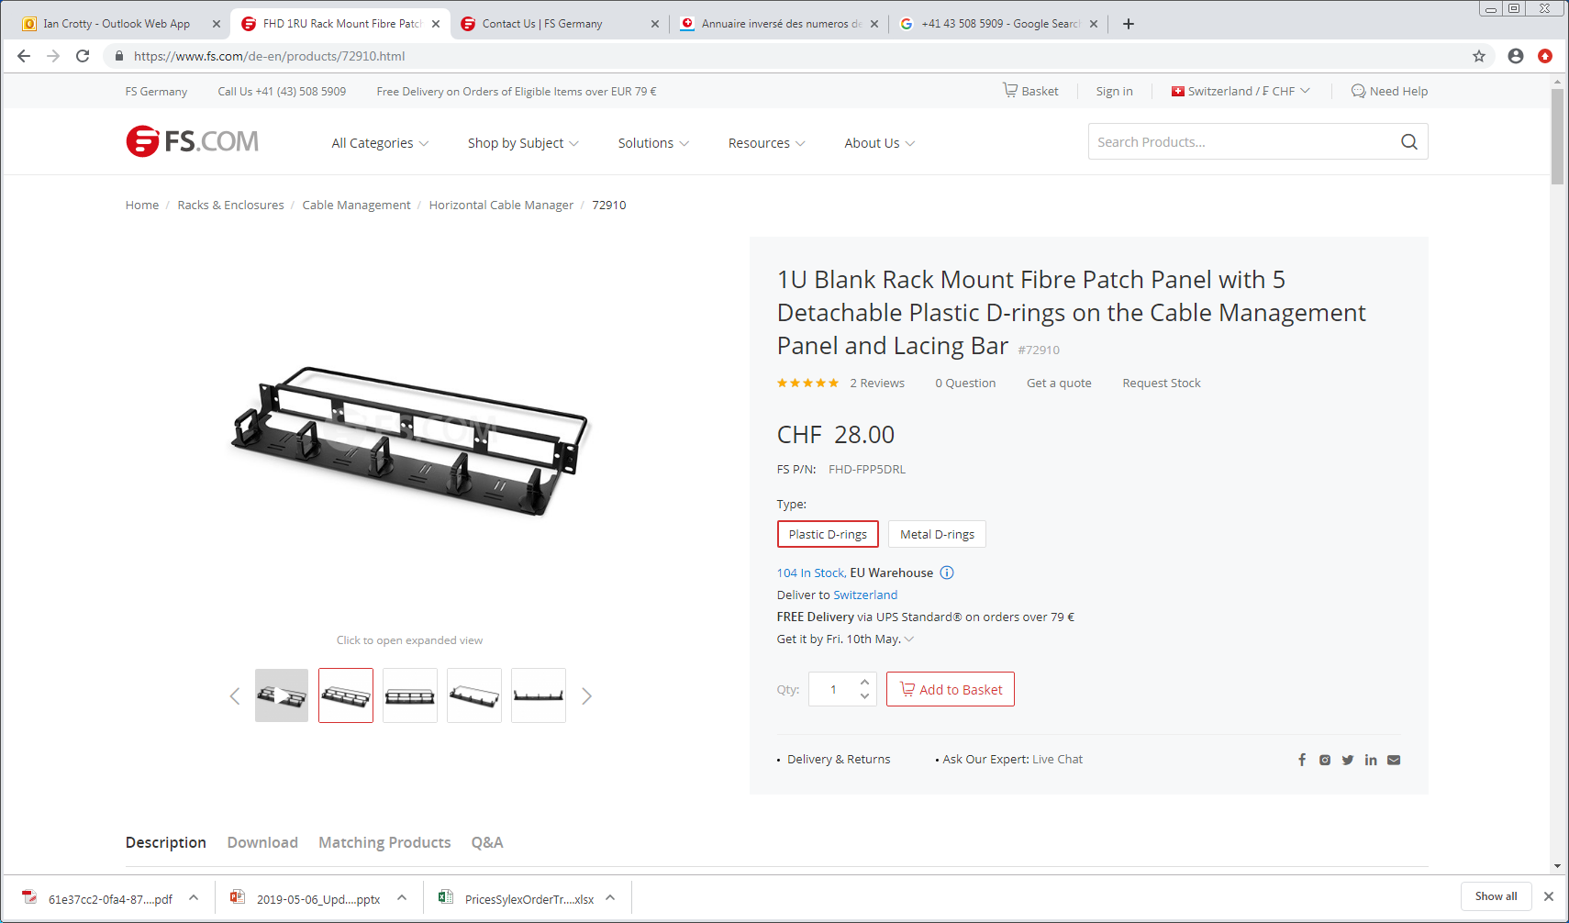

Slide 4
