Slide 1
LV cable production V4
Ian
12 Feb 2018

Slide 2
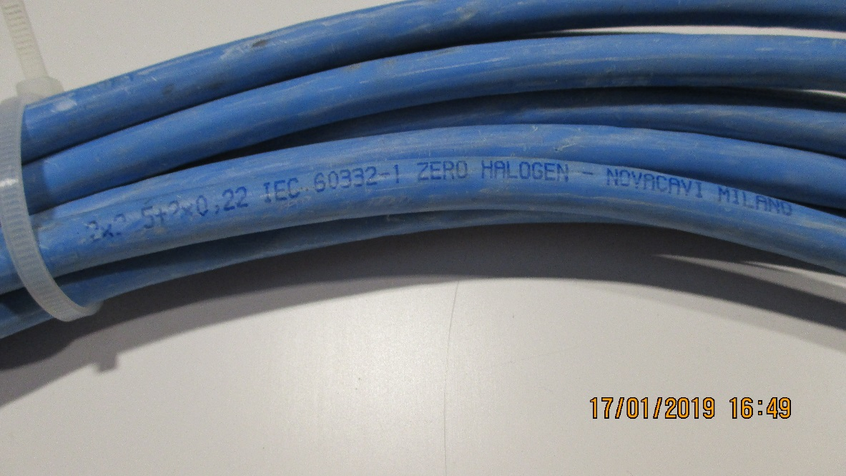
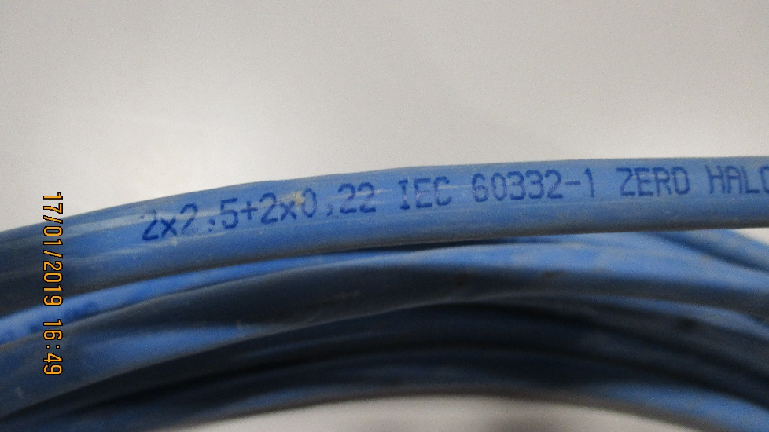
Use the LV Link board cable, used for the initial installation
2 x 2.5mm² (13AWG) + 2 x 0.22mm2 (24AWG )
Sheath diameter = 8.3mm approx. (8.22mm)
Perhaps we have 3.5km available
P5 was not able to measure this !

Slide 3
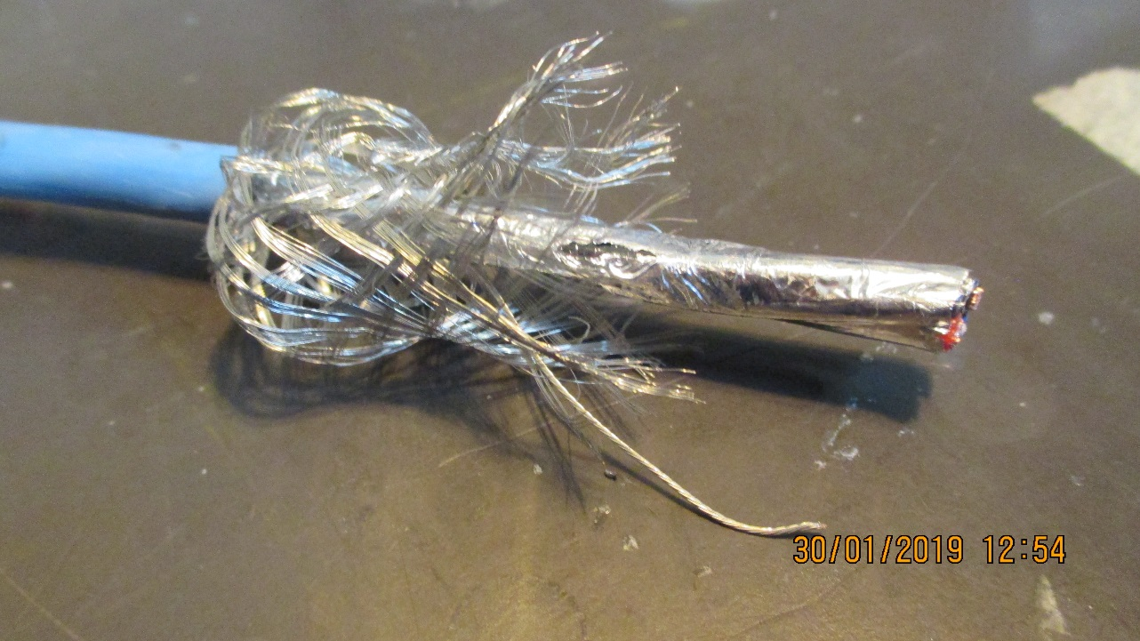
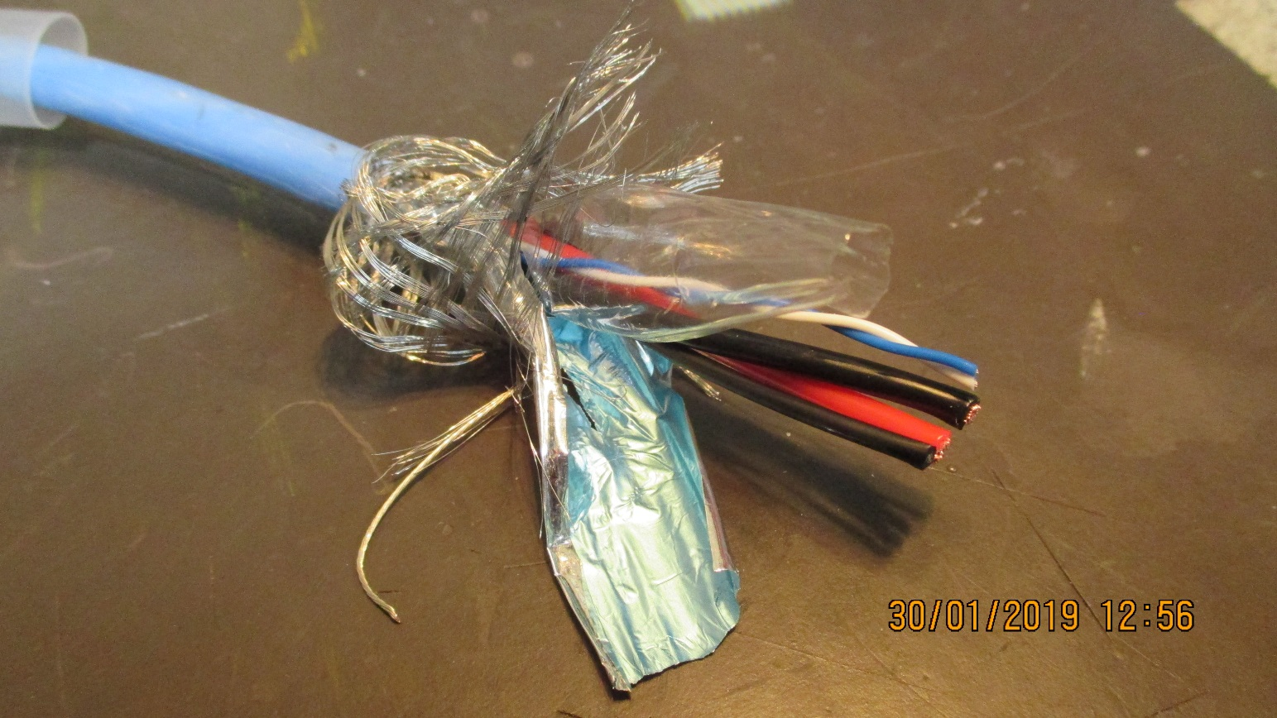

Slide 4
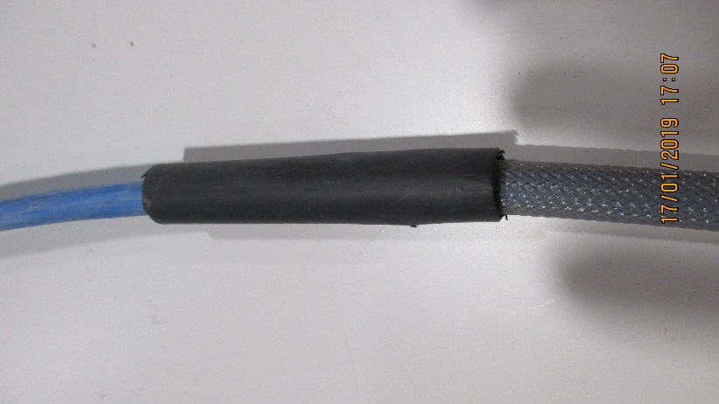
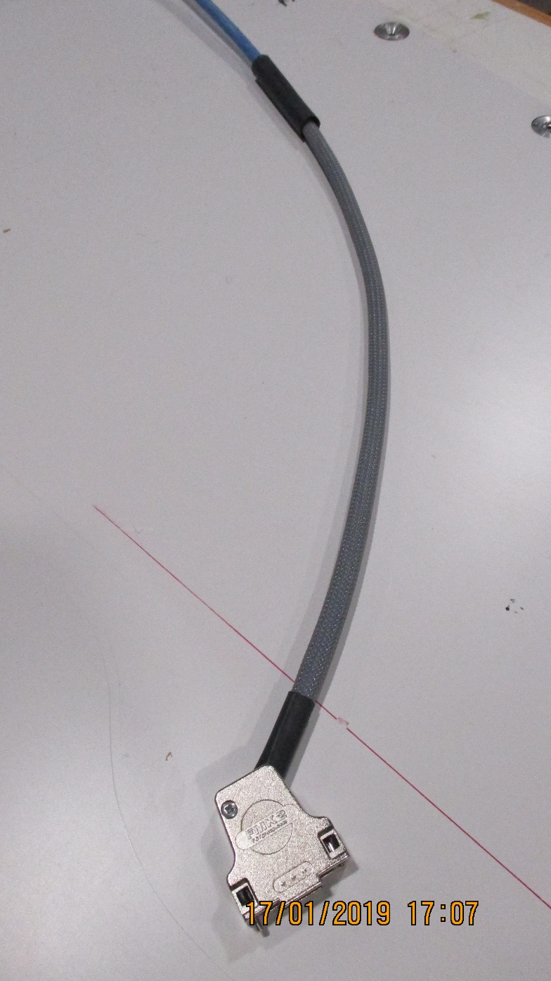
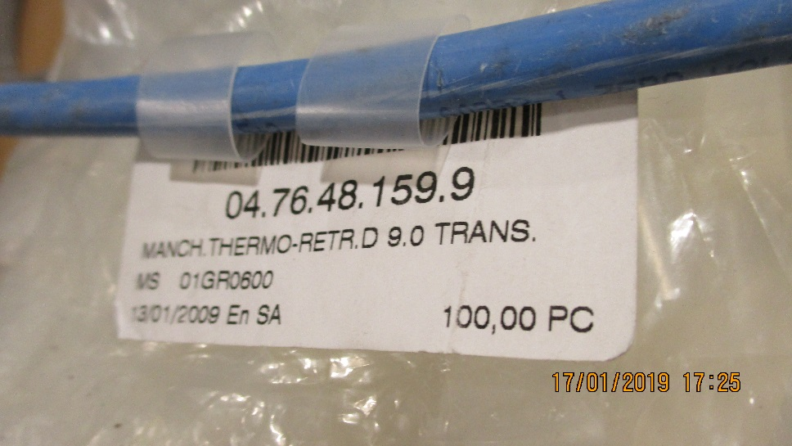
Connecteur cote Chambre
For dia 9,6 mm cable with 45deg entry FMK21
1000mm
± 20mm
Thermo retractable , protection transparent etiquettes. 2 x 100mm

Slide 5
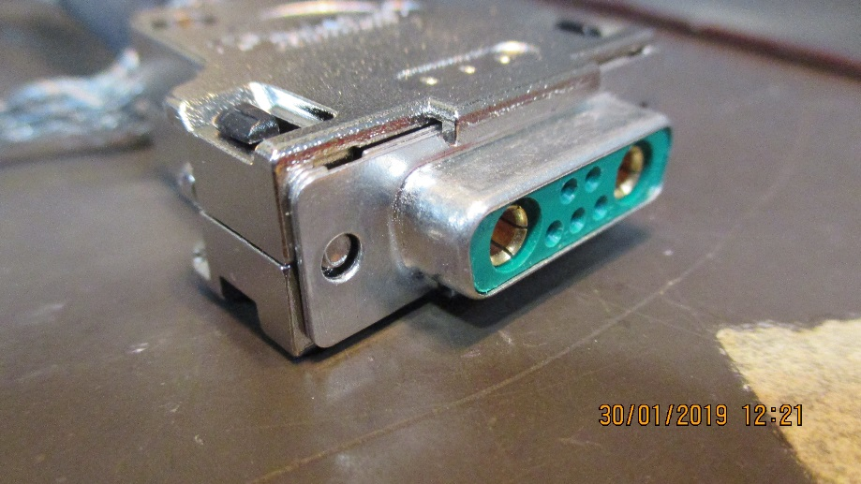
Connector pinout
Sortie Cable a droite
A2
A1
2
1
A1 Rouge 2.5mm2 +ve
A2 Noir 2.5mm2 -ve
Blanc AWG 25 +ve
2 Bleu AWG 25 -ve

Slide 6
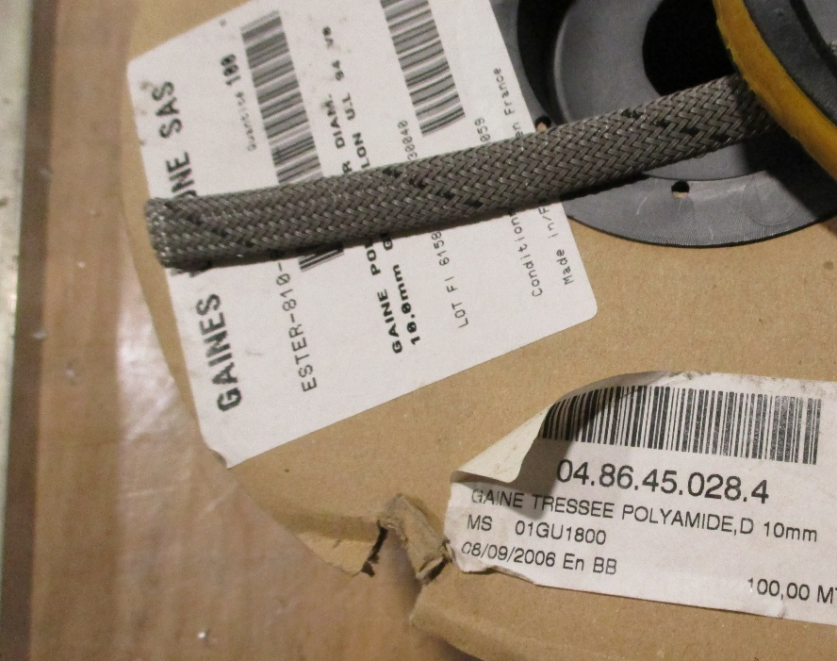
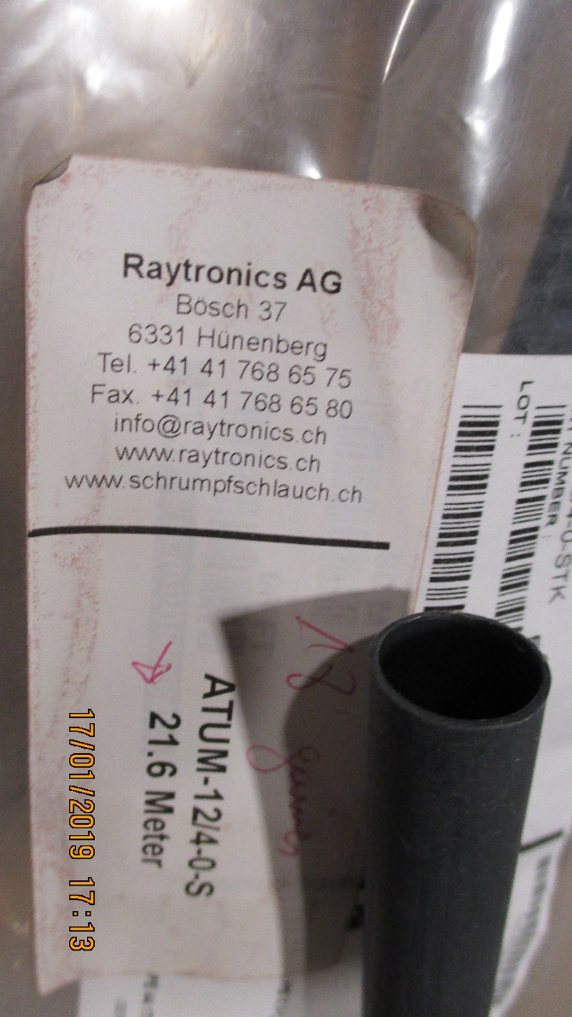
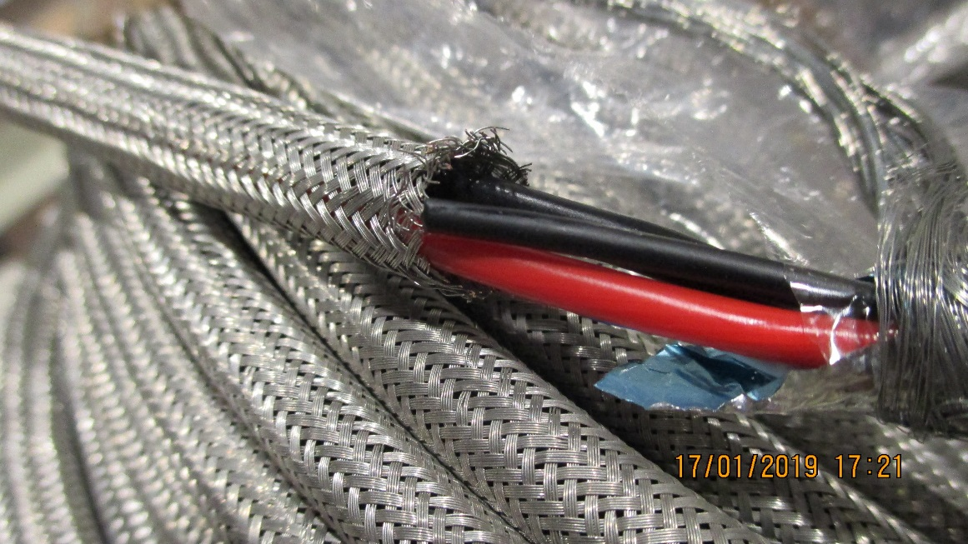
Tresse poly et Cuivre
Tresse Cu04.01.33.050.5
Nominal dia. 6mm
Sheath dia. 4 -7mm
160 wires of 15/100
Thermo retractable , Raychem 12/4-0-STK

Slide 7
Connecteur cote Alimentation

Slide 8
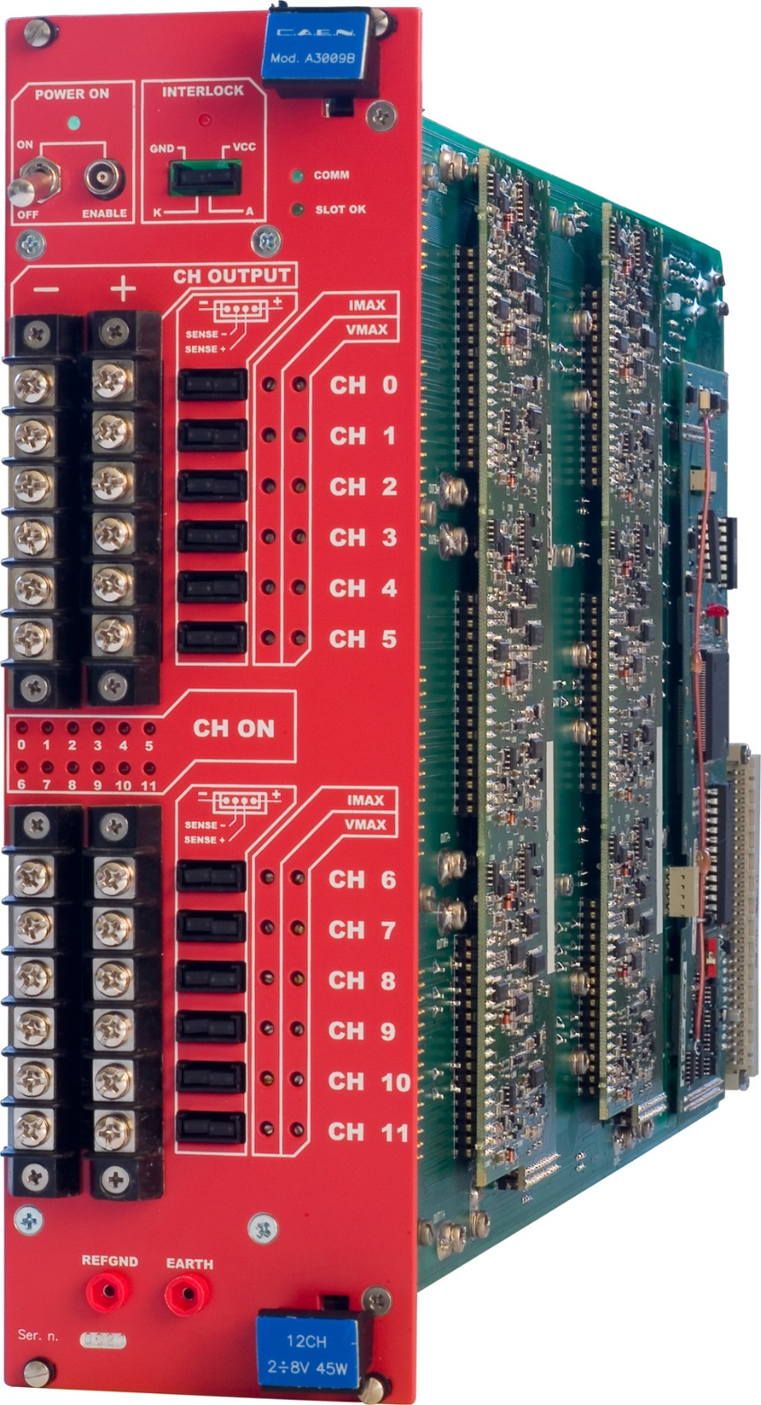
Thread dia.
3.38mm
6-32 UNC inch thread
8.3mm
https://www.caen.it/products/a3009b/
https://www.boltdepot.com/fastener-information/machine-screws/machine-screw-diameter.aspx

Slide 9
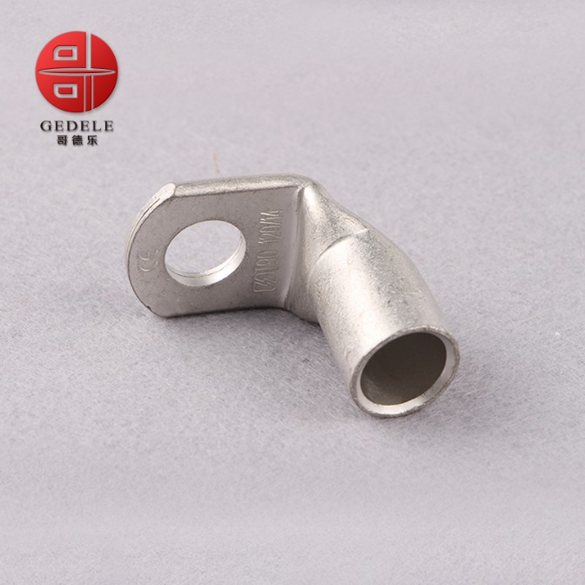
Lug dia 6mm
Section 2.5mm²
Ring terminal,
T90-25mm 90 Degree Angle Battery End Termi
https://www.cabac.com.au/brands/cabac/lugs-links-and-terminals/lugs-and-links/copper-crimp-lugs/cu-crimp-15-95mm2/10100505?s=

Slide 10
Lusin input week 2
https://www.klauke.com/en/electrical/electrical-connection-systems/
Gustav Klauke GmbH Auf dem Knapp 46 42855 Remscheid Deutschland Tel.: +49 (0)2191 / 907-0 Fax: +49 (0)2191 / 907-141 E-Mail: Klauke-Info@Emerson.com

Slide 11
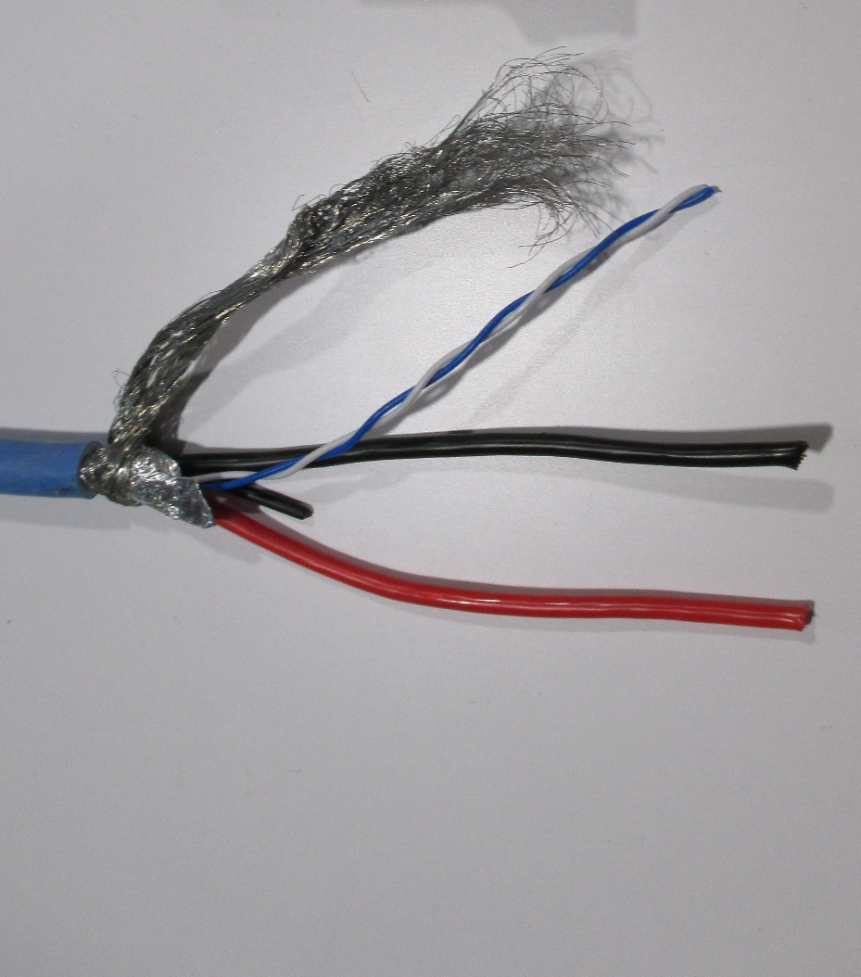
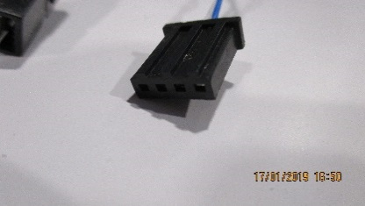
Connecteur cote Alimentation
Blindage a l’interieur de la Poly Tresse
Lug dia 3.5mm
Lug width 8.0mm
Section 2.5mm²

Slide 12
Longeur des cables

Slide 14
References

Slide 15
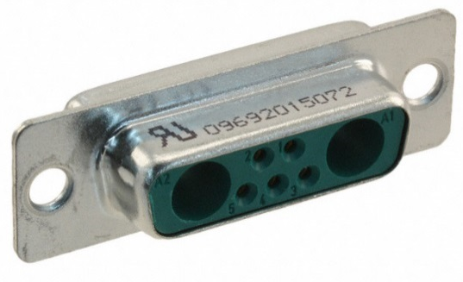
Chamber end with sense wire
D-sub.
Harting 0969201X072
Code commande RS 141-0381
Référence fabricant 09692015072
https://b2b.harting.com/ebusiness/en/DSUB-FE-7W2-SHELL-WITH-SOLDER-CUP-CONT/09692015072
Also another supplier
http://common.leocom.kr/pdfcat/pdfcat2009/c126_sec3_Con(D-sub).pdf

Slide 16
Pins
Farnell
Power
2433225 female
2433223 male
Sense
http://www.farnell.com/datasheets/1836824.pdf?_ga=2.199927789.278703743.1546866397-246438842.1465995239
http://www.farnell.com/datasheets/1836823.pdf?_ga=2.199927789.278703743.1546866397-246438842.1465995239

Slide 17
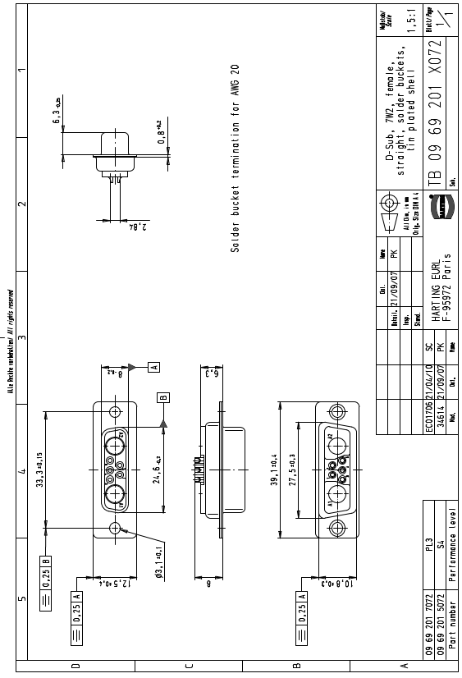
What is female the pins or the body ….???

Slide 18
Drawing
https://docs-emea.rs-online.com/webdocs/167c/0900766b8167c5a2.pdf
447-7353
Hood is therefore for a 15pin size connector
09.21.23.013.7 Straight outlet cover high section 8,5 mm FMK21G 2
OR
For dia 12,5 mm cable FMK2G SCEM 09.21.23.013.9
For dia 9,6 mm cable with 45deg entry FMK21 09.21.23.022.0 4.1chf

Slide 19
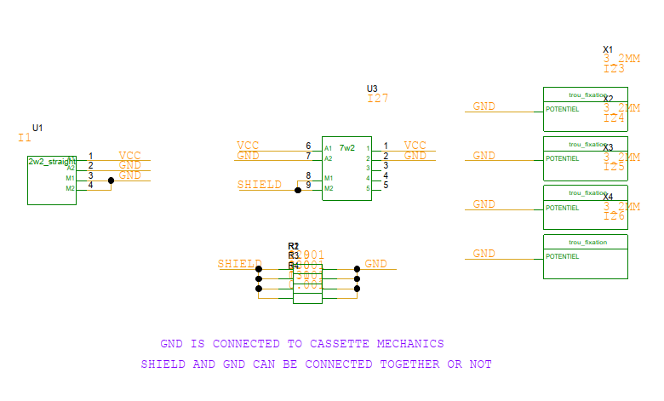
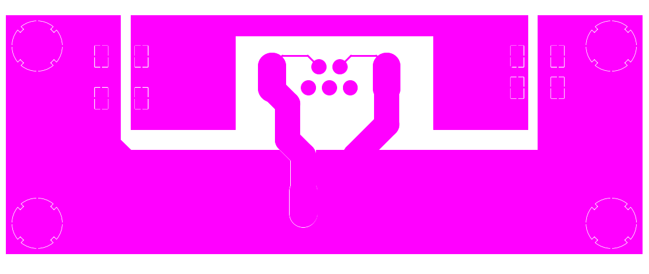
From Christoph 5 Feb 2019
10Euro for >75 pieces
Insulated PP made from PCB

Slide 20
PS end
Lugs and Sense wire connectors
Sense wire connectors 232-9959 (RS)
Pins 233-0038 (RS) or Farnell 182206-2

Slide 21
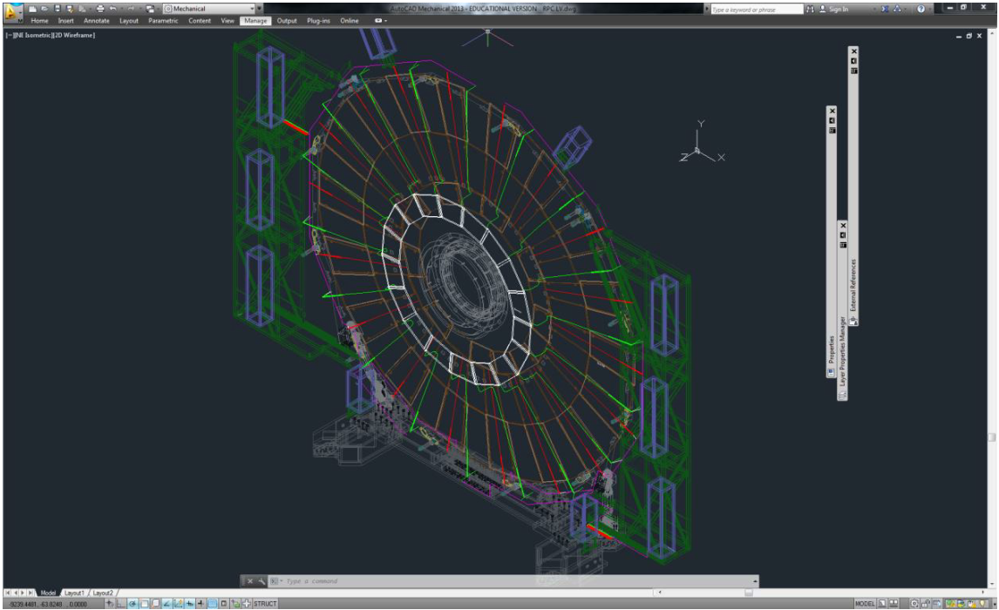

Slide 23
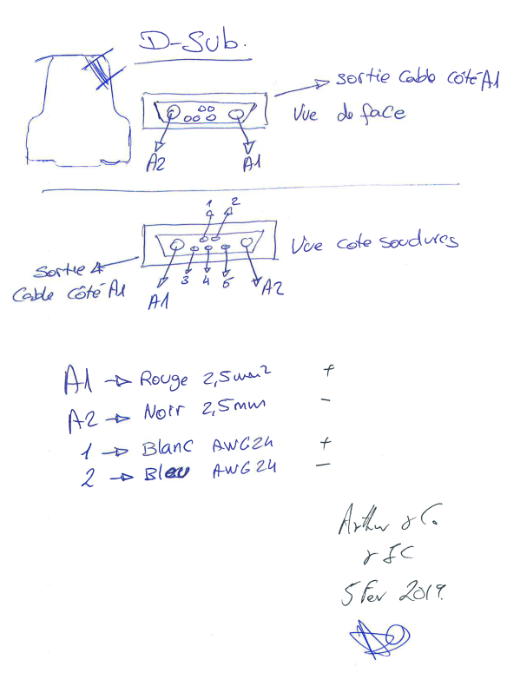
Pin-out decided at Cavitech according the accepted norms.

Slide 24
references
AWG to mm2 https://www.multicable.com/resources/reference-data/cross-reference-awg-to-mm2/

Slide 25
https://www.boltdepot.com/fastener-information/machine-screws/machine-screw-diameter.aspx

Slide 26
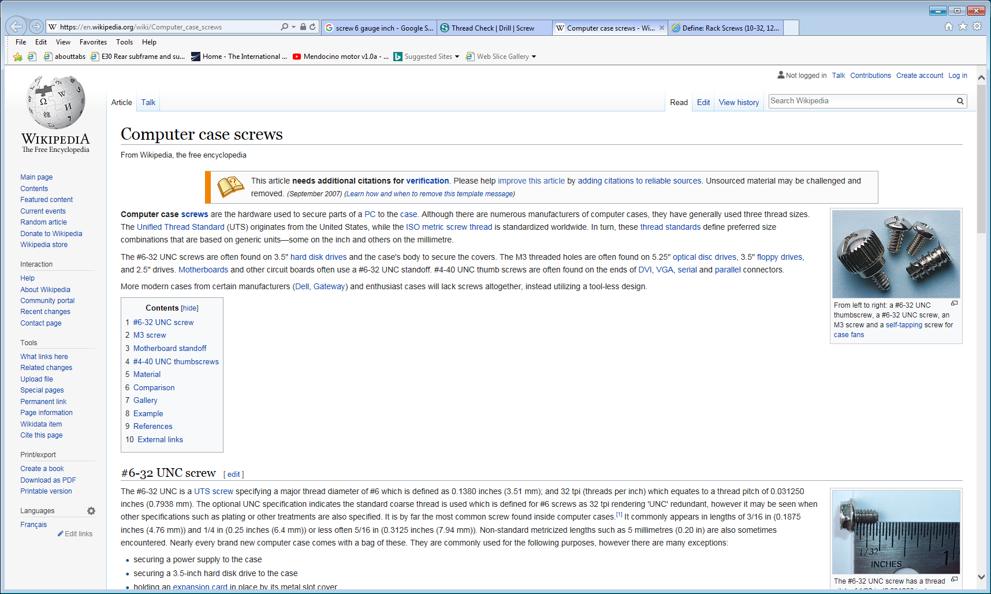
https://en.wikipedia.org/wiki/Computer_case_screws

Slide 27
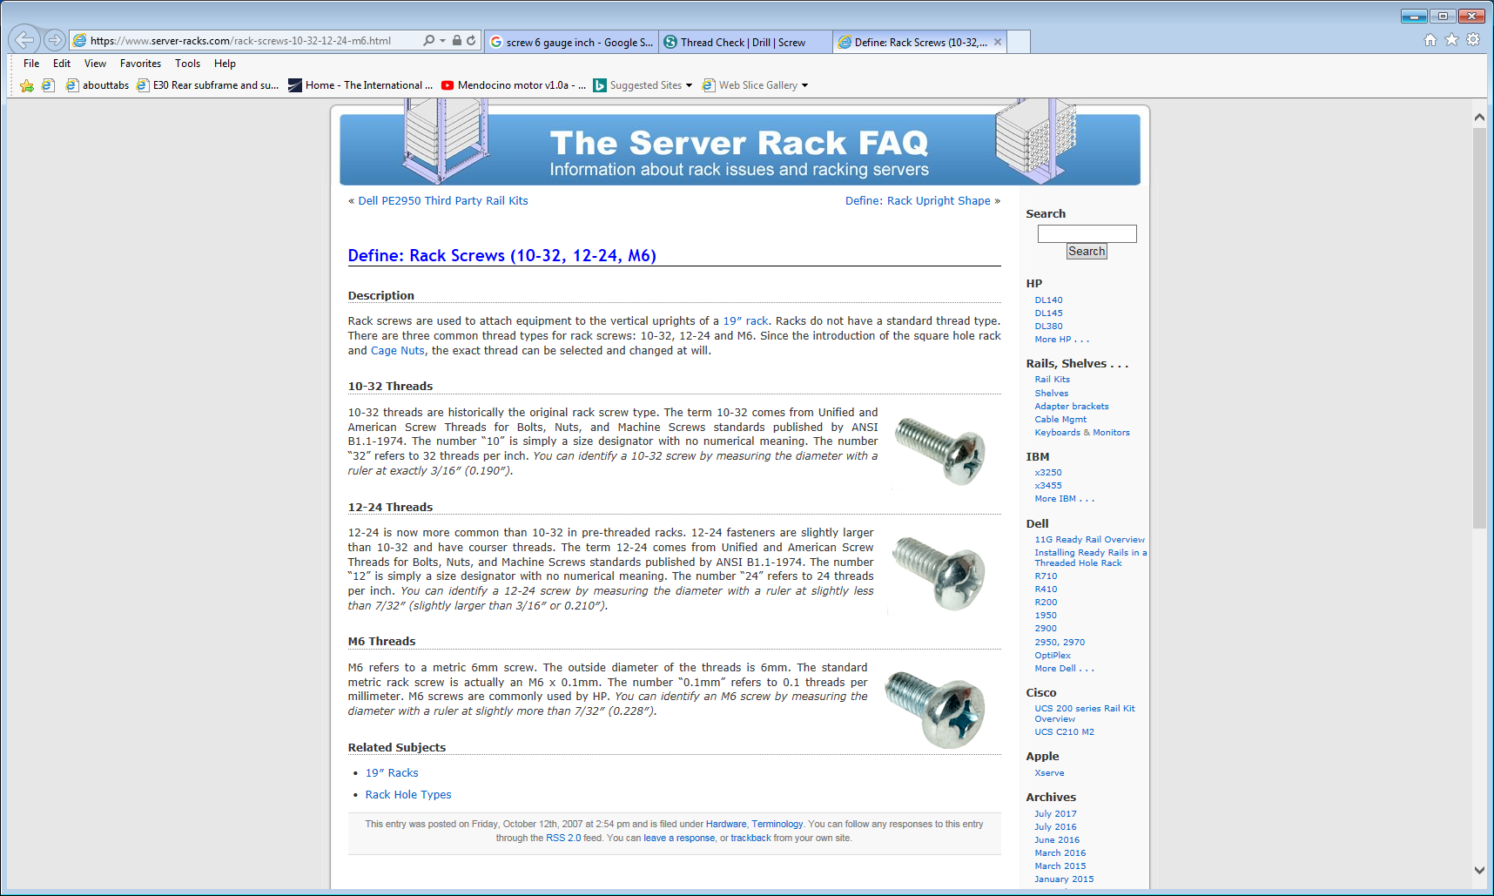
https://www.server-racks.com/rack-screws-10-32-12-24-m6.html

