Slide 1
LV cable production
Ian
17 Dec 2018

Slide 2
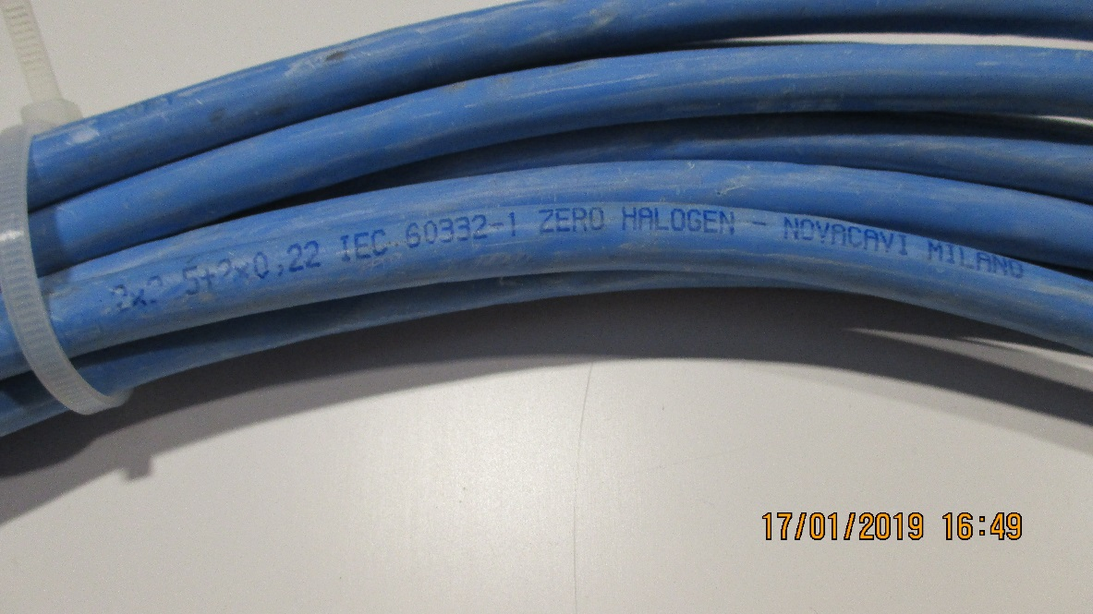
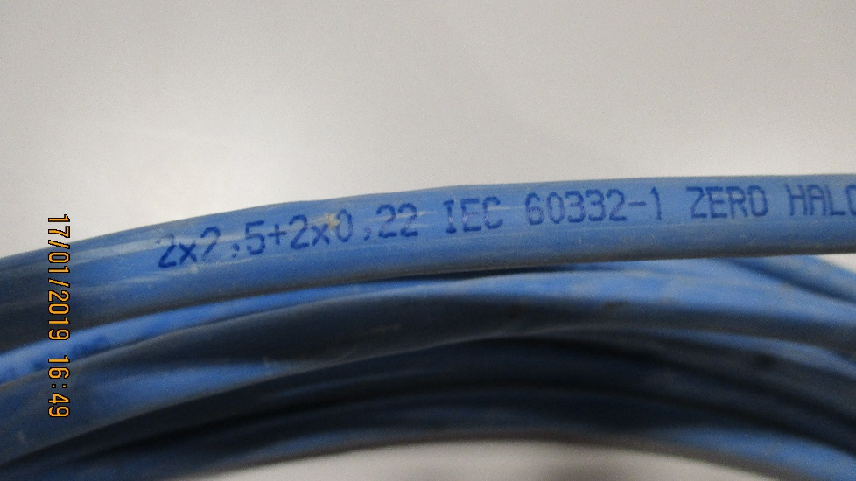
Use the LV Link board cable, used for the initial installation
2 x 2.5mm² (13AWG) + 2 x 0.22mm2 (24AWG )
Sheath diameter = 8.3mm approx. (8.22mm)
Perhaps we have 3.5km available
P5 was not able to measure this !

Slide 3
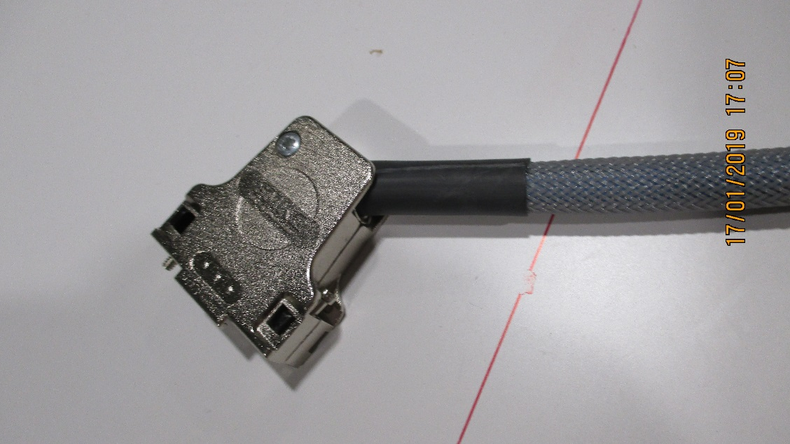
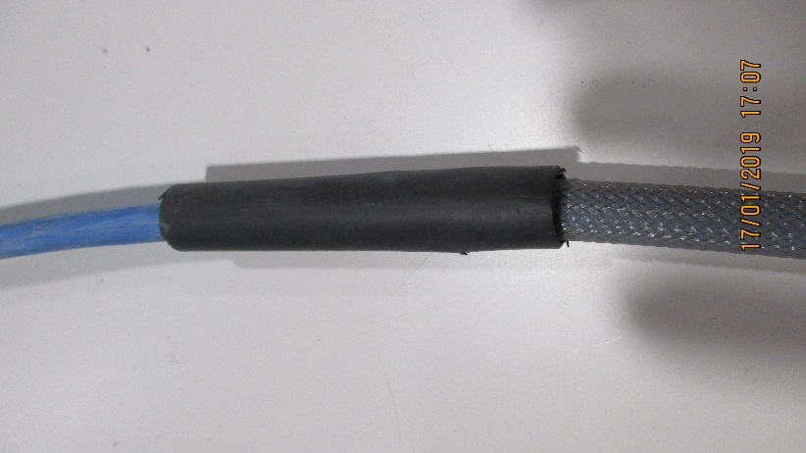
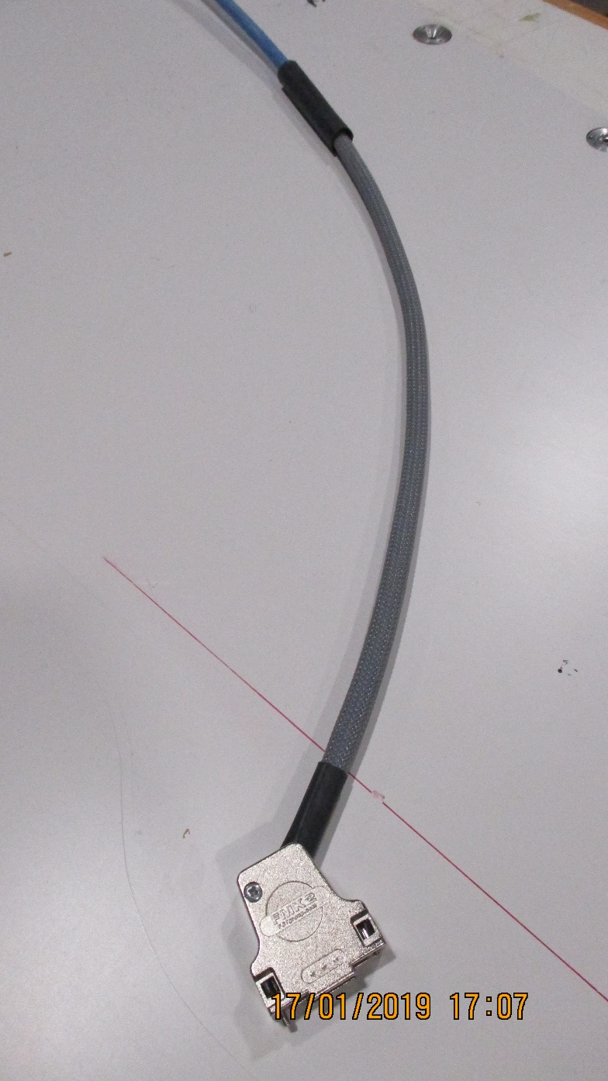
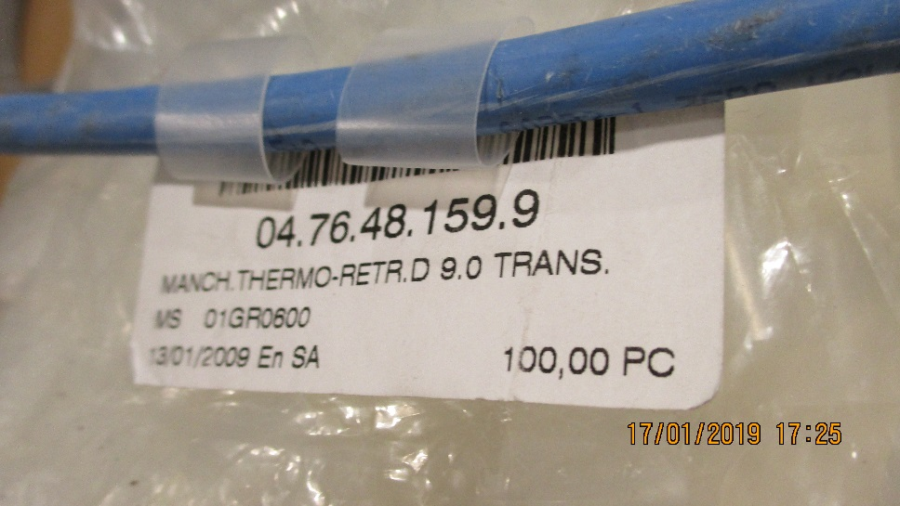
Connecteur cote Chambre
Thermo retractable , protection Etiquettes

Slide 4
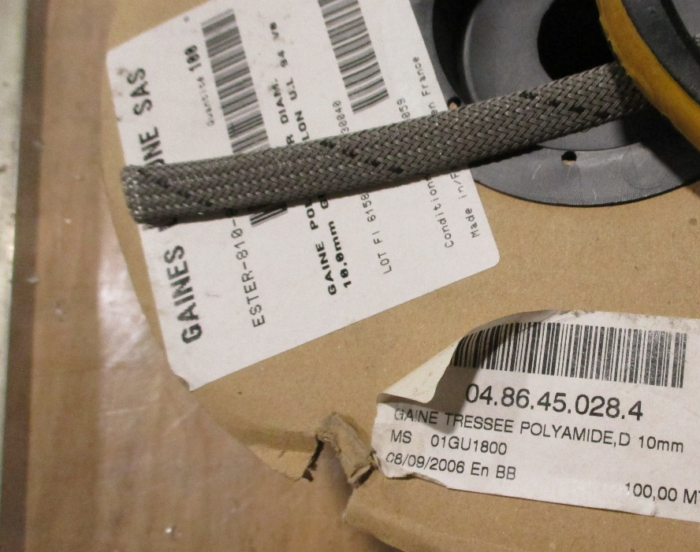
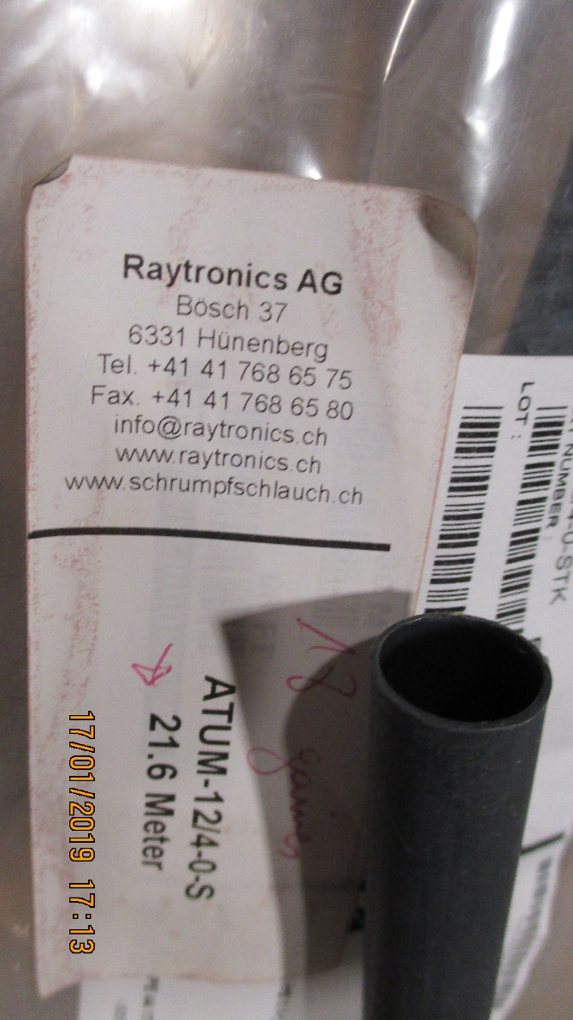
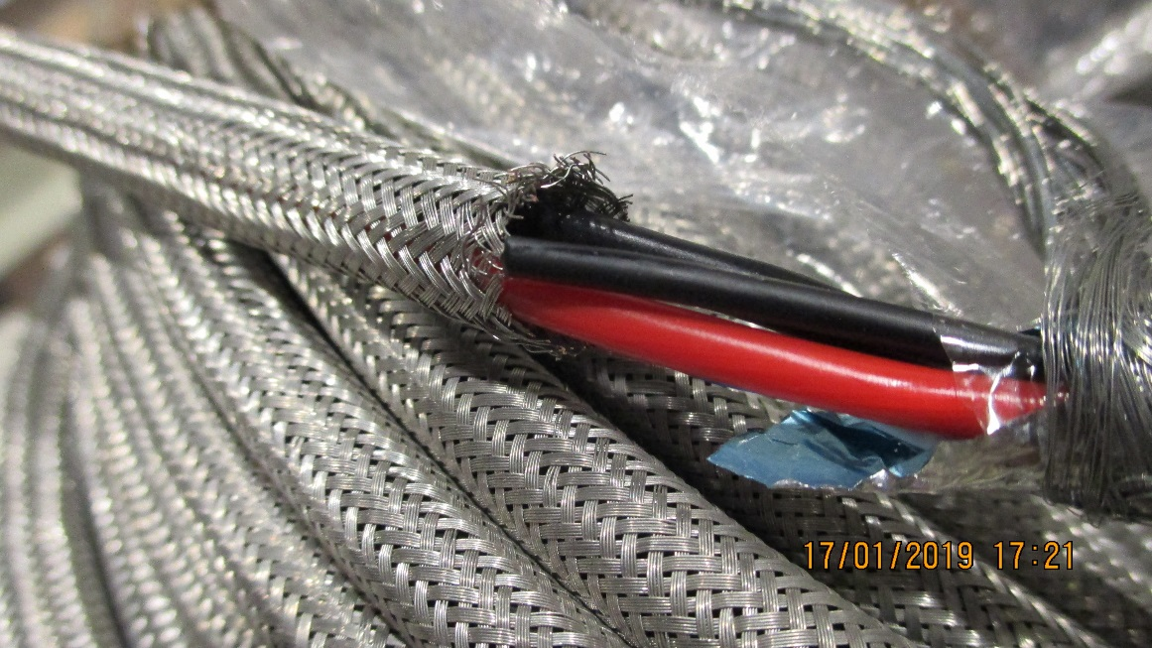
Tresse poly et Cuivre
Tresse Cu04.01.33.050.5
Nominal dia. 6mm
Sheath dia. 4 -7mm
160 wires of 15/100
Thermo retractable , Raychem 12/4-0-STK

Slide 5
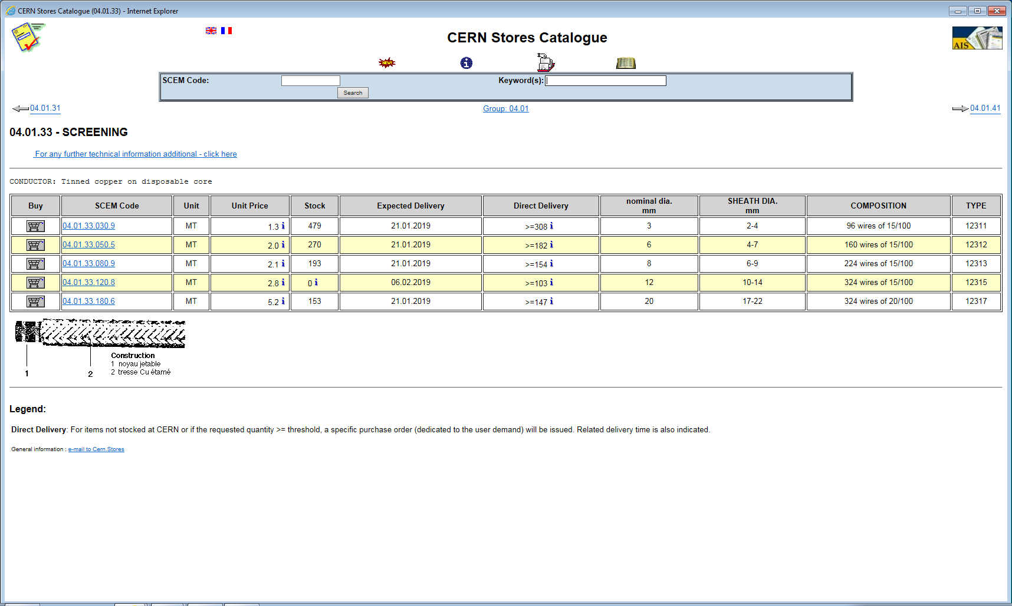
RE4 request by JF Pernot
4985695 - Material Request

Slide 6
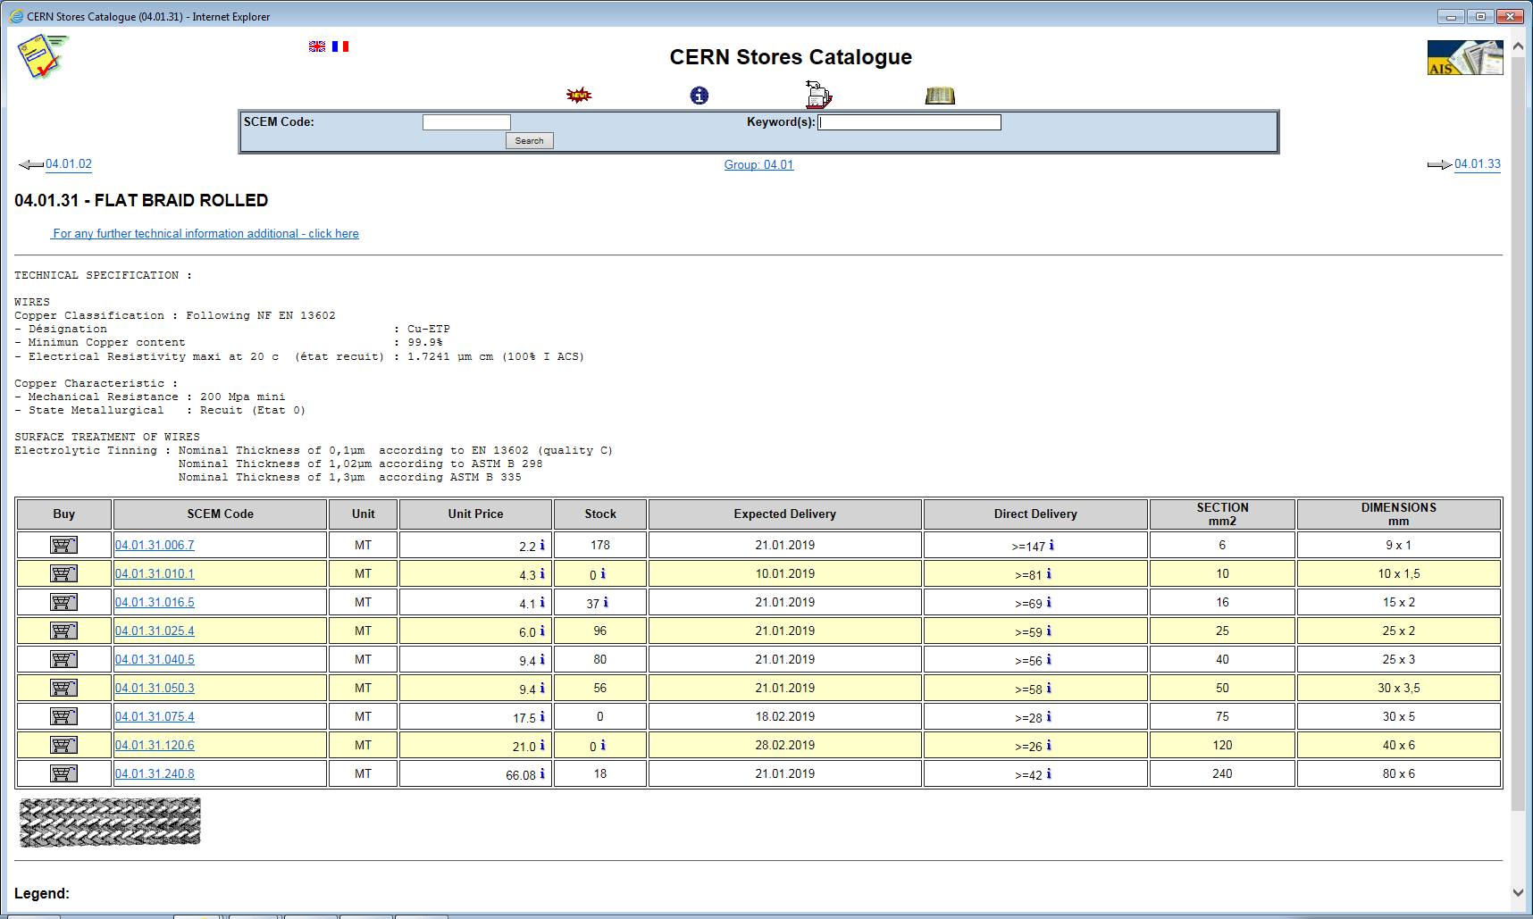

Slide 7
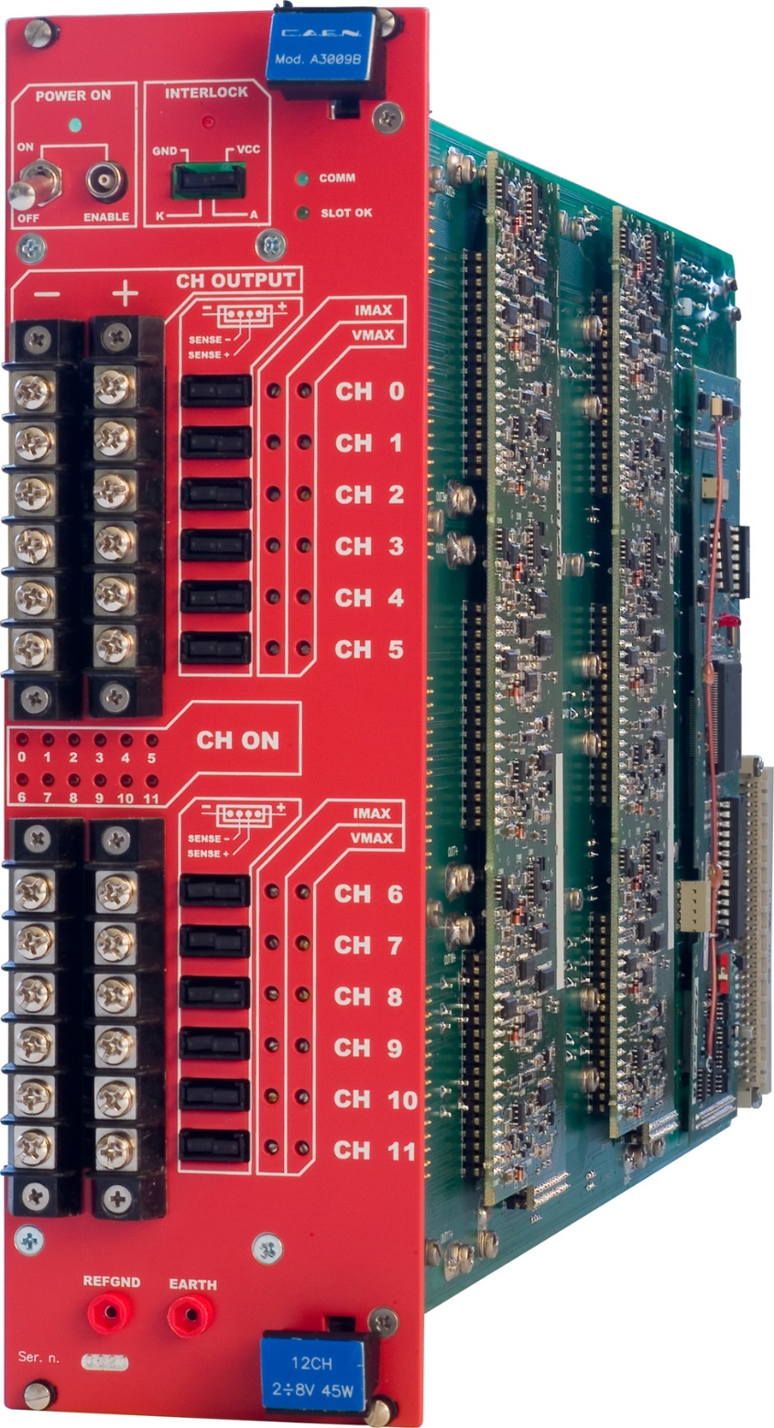
Thread dia.
3.38mm
6-32 UNC inch thread
8.3mm
https://www.caen.it/products/a3009b/
https://www.boltdepot.com/fastener-information/machine-screws/machine-screw-diameter.aspx

Slide 8
The #6-32 UNC is a UTS screw specifying a major thread diameter of #6 which is defined as 0.1380 inches (3.51 mm); and 32 tpi (threads per inch) which equates to a thread pitch of 0.031250 inches (0.7938 mm). ... It is by far the most common screw found inside computer cases.
https://en.wikipedia.org/wiki/Computer_case_screws

Slide 9
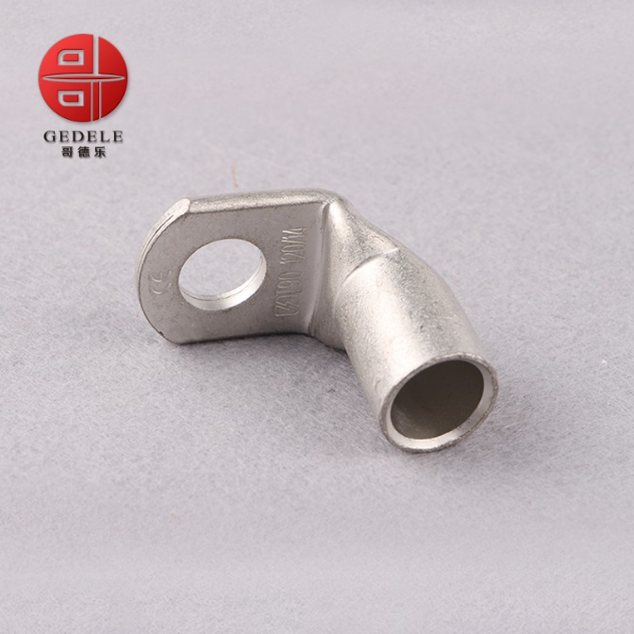
Lug dia 6mm
Section 2.5mm²
Ring terminal,
T90-25mm 90 Degree Angle Battery End Termi
https://www.cabac.com.au/brands/cabac/lugs-links-and-terminals/lugs-and-links/copper-crimp-lugs/cu-crimp-15-95mm2/10100505?s=

Slide 10
CERN stores
04.76.22.346.2

Slide 11
www.cembre.co.uk/family/Print/3696
catalogue
https://www.bpx.co.uk/dbdocument/99116/crimp%20terminal.pdf

Slide 12
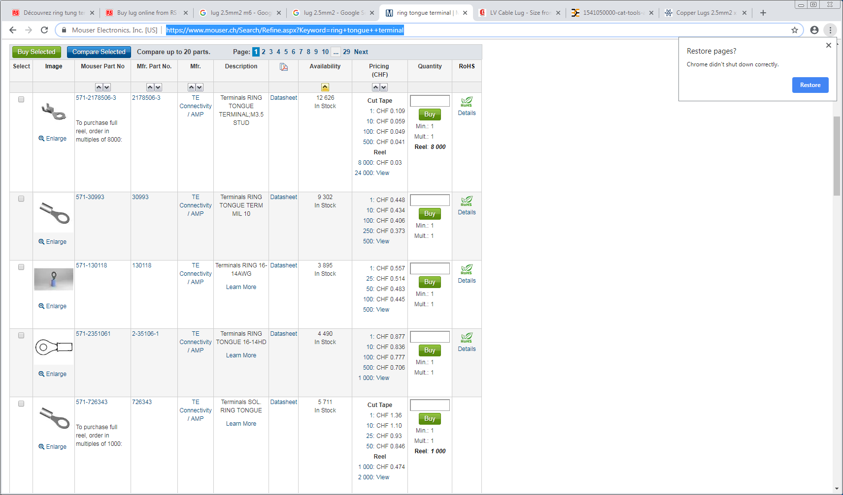
https://www.mouser.ch/Search/Refine.aspx?Keyword=ring+tongue++terminal

Slide 13
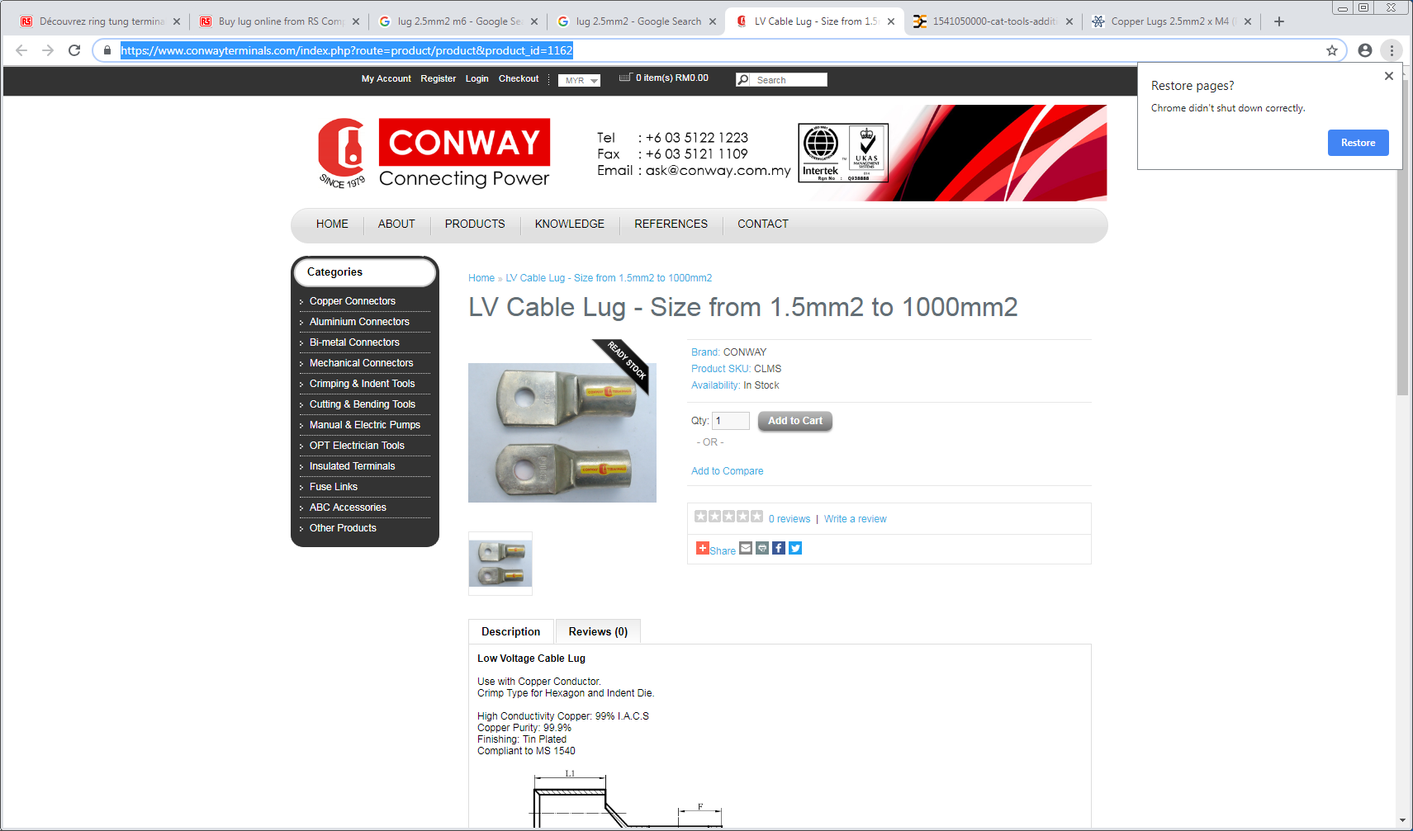
https://www.conwayterminals.com/index.php?route=product/product&product_id=1162

Slide 14
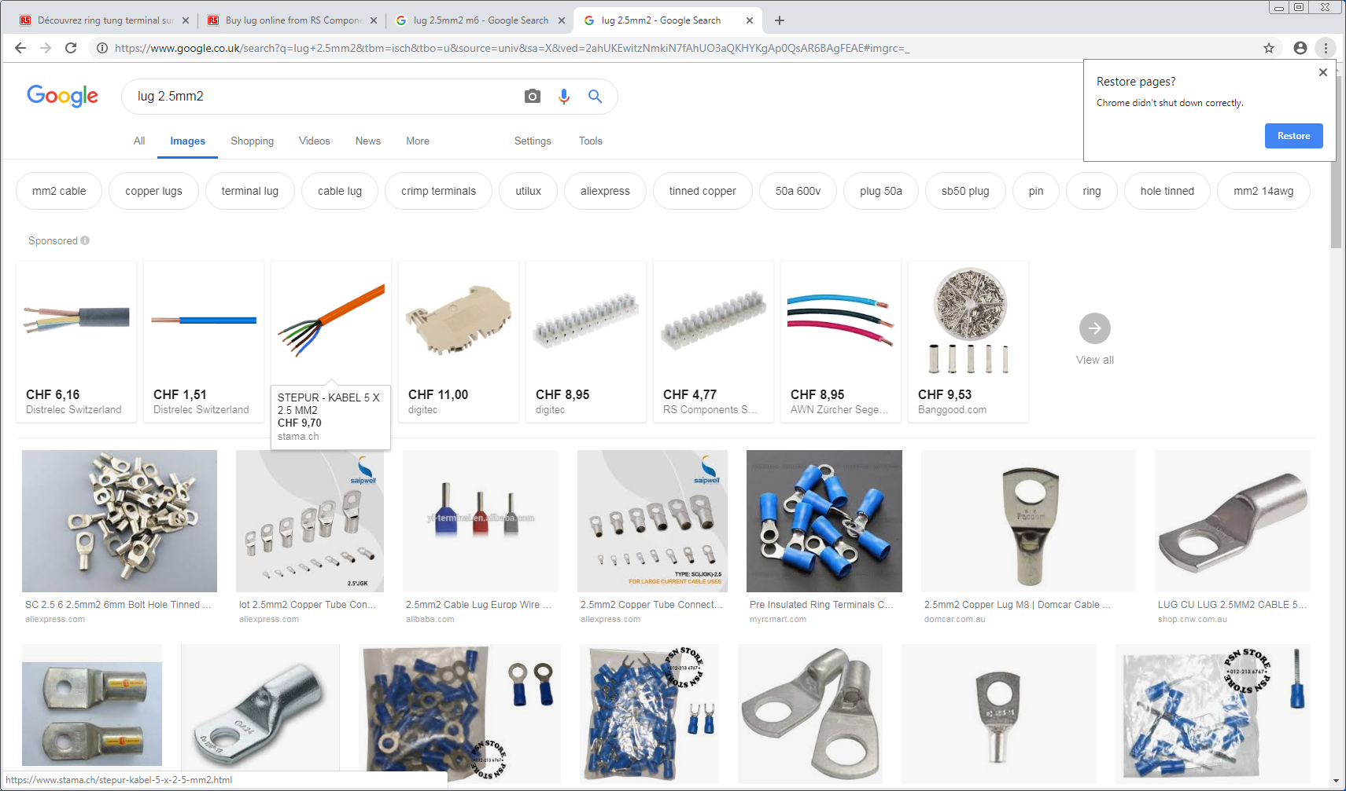
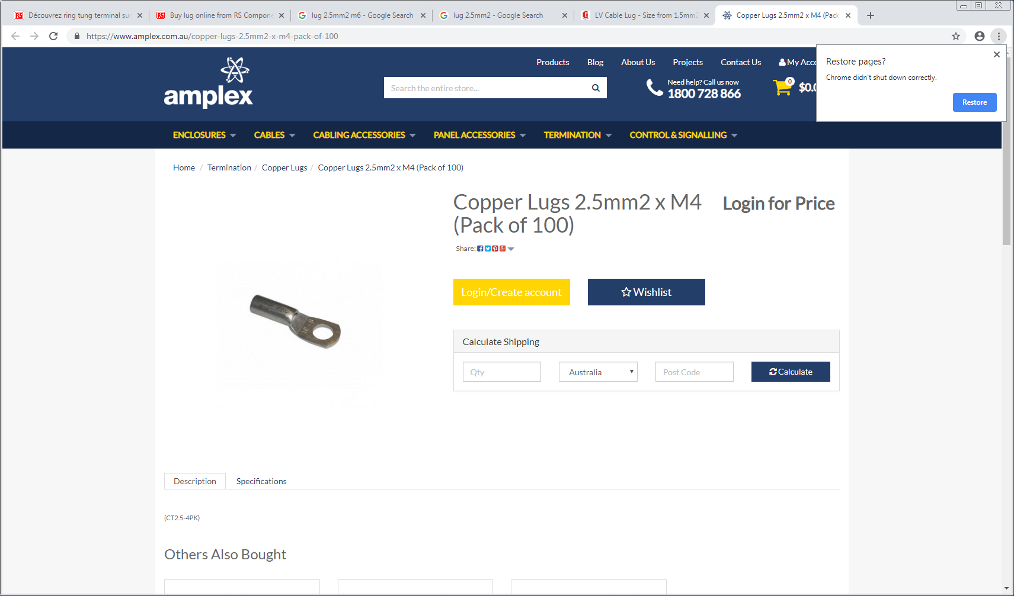
http://www.weidmueller.cz/files/download/download-sekce/product-catalogues/tools/1541050000-cat-tools-addition-en.pdf

Slide 15
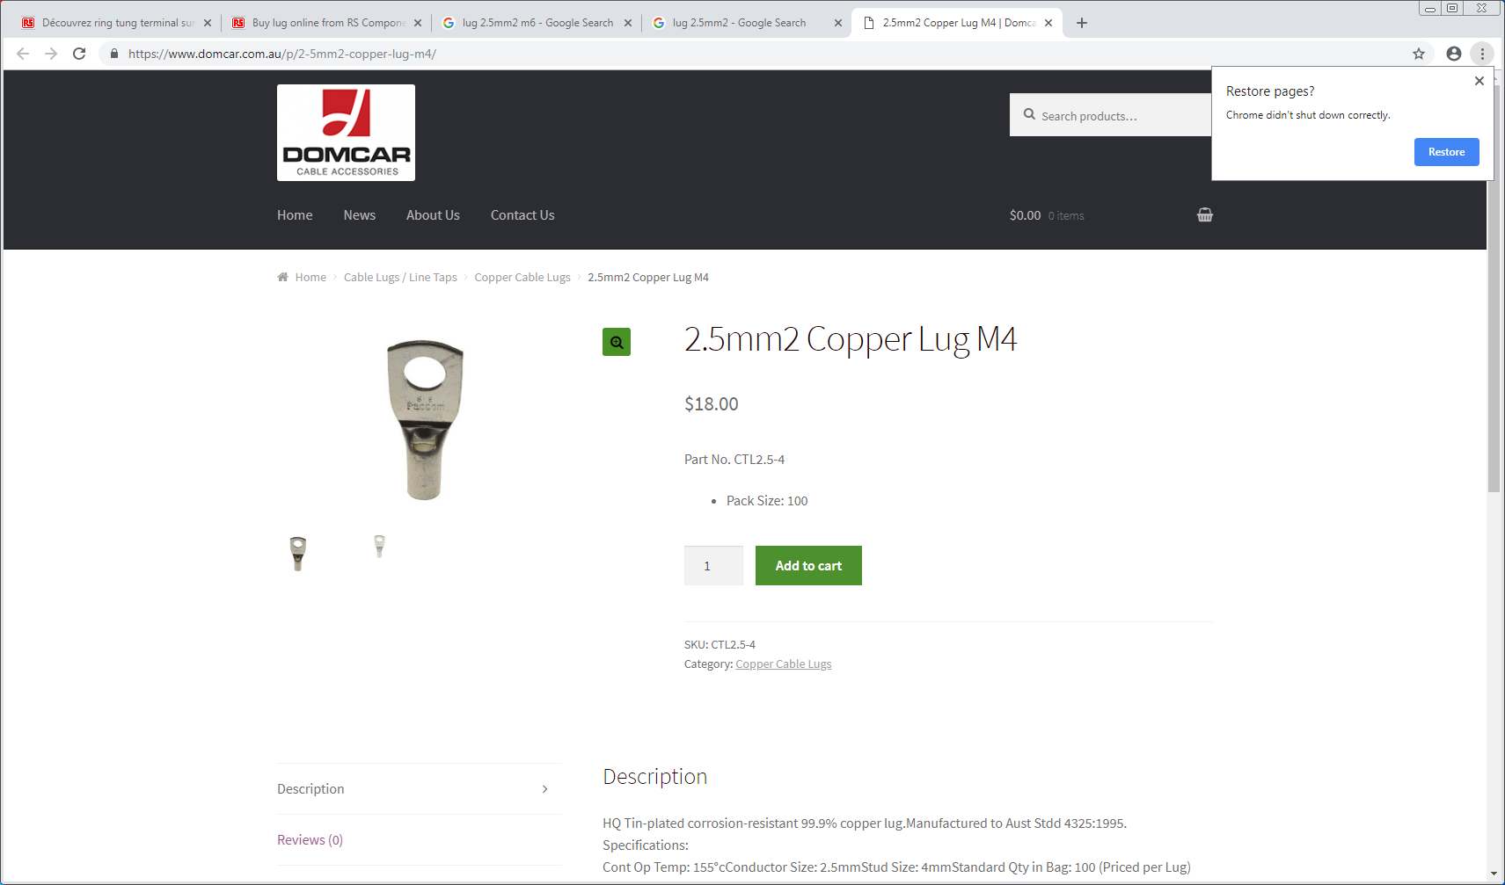
https://www.domcar.com.au/p/2-5mm2-copper-lug-m4/

Slide 16
http://ftp.weitkowitz.de/downloads/print/weitkowitz_maincatalog_english_web.pdf

Slide 17
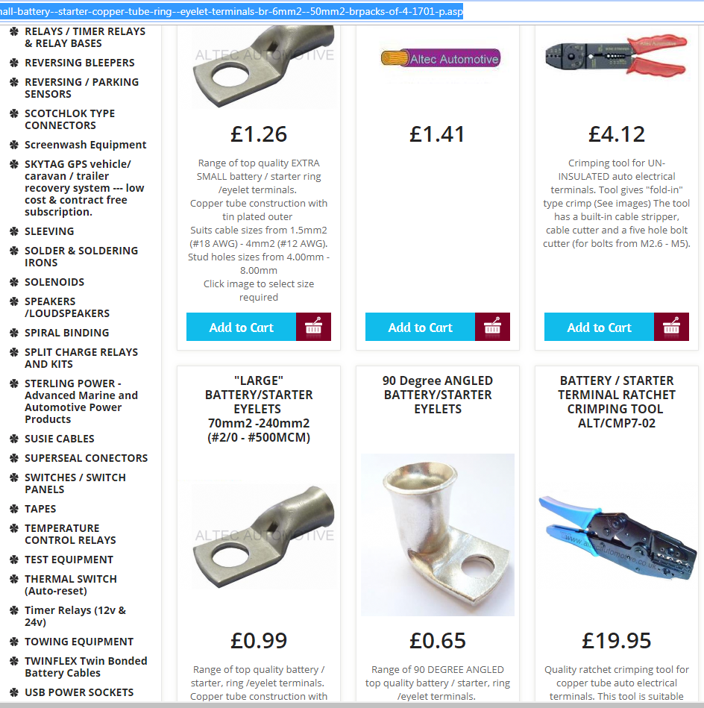
https://www.altecautomotive.co.uk/small-battery--starter-copper-tube-ring--eyelet-terminals-br-6mm2--50mm2-brpacks-of-4-1701-p.asp

Slide 18
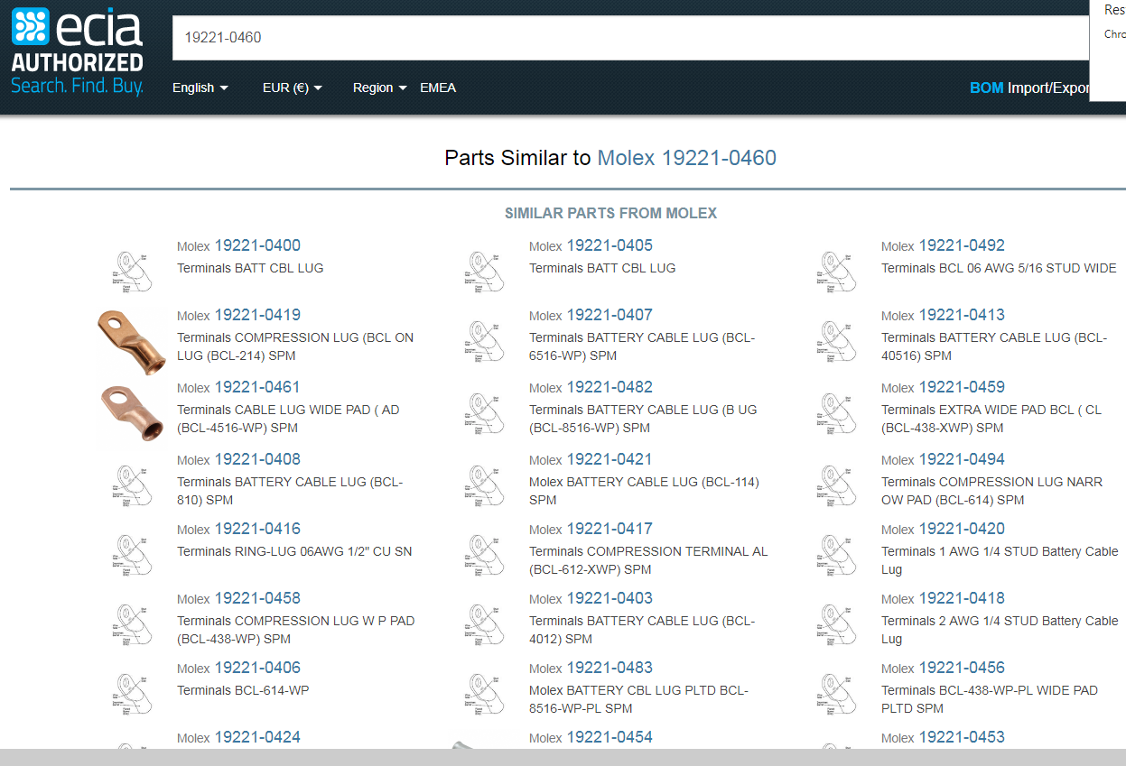
https://www.eciaauthorized.com/en/similar-parts/molex/0192210460

Slide 19
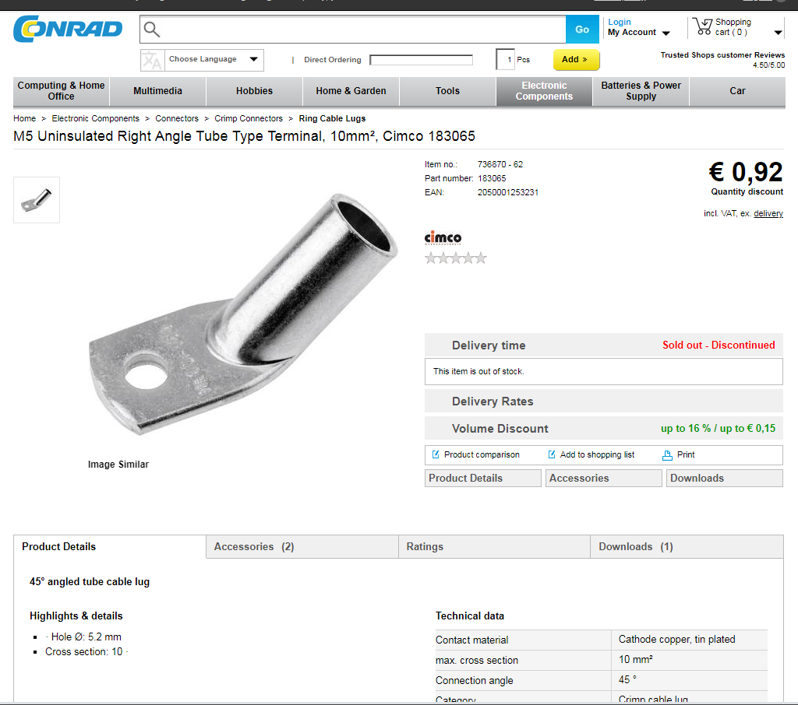
https://www.conrad.com/ce/en/product/736870/M5-Uninsulated-Right-Angle-Tube-Type-Terminal-10mm-Cimco-183065

Slide 20
https://www.hubbell.com/burndy/en/search?q=stud%3Arelevance&style=grid&pageSize=90&page=8

Slide 21
Lusin input week 2
https://www.klauke.com/en/electrical/electrical-connection-systems/
Gustav Klauke GmbH Auf dem Knapp 46 42855 Remscheid Deutschland Tel.: +49 (0)2191 / 907-0 Fax: +49 (0)2191 / 907-141 E-Mail: Klauke-Info@Emerson.com

Slide 22
Resume Lug PS end

Slide 23
Sense Wire PS end

Slide 24
PS end
Lugs and Sense wire connectors
Sense wire connectors 232-9959 (RS)
Pins 233-0038 (RS) or Farnell 182206-2

Slide 25
Resume Lug and sense connectors for the PS end

Slide 26
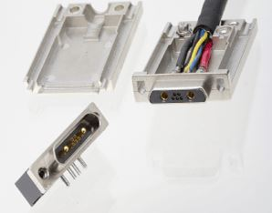
Chamber end connector D-Sub with sense

Slide 27
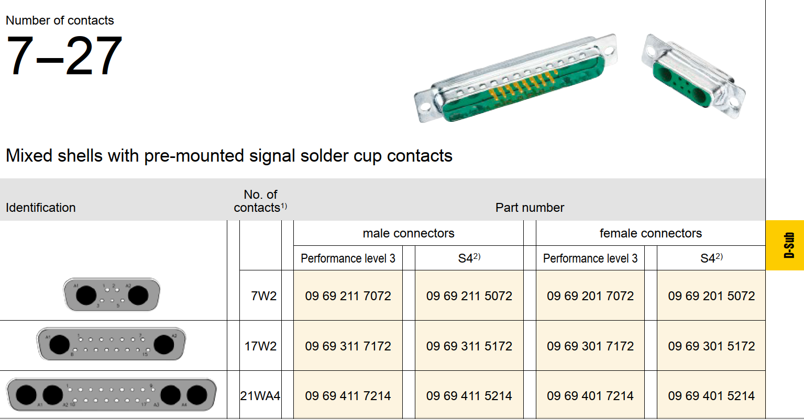
Panel Mount
Nota , what does the “with solder cup cont” mean
https://b2b.harting.com/ebusiness/en/DSUB-FE-7W2-SHELL-WITH-SOLDER-CUP-CONT/09692015072
https://b2b.harting.com/files/livebooks/en/PRD0200000100047/downloads/395.pdf

Slide 28
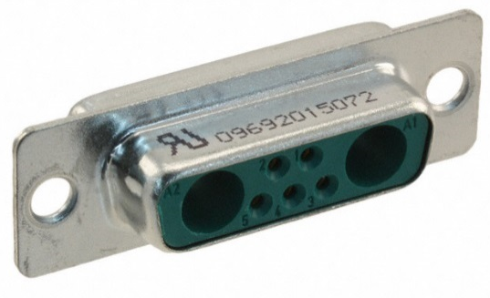
Chamber end with sense wire
D-sub.
Harting 0969201X072
Code commande RS 141-0381
Référence fabricant 09692015072
https://b2b.harting.com/ebusiness/en/DSUB-FE-7W2-SHELL-WITH-SOLDER-CUP-CONT/09692015072
Also another supplier
http://common.leocom.kr/pdfcat/pdfcat2009/c126_sec3_Con(D-sub).pdf

Slide 29
Pins
Farnell
Power
2433225 female
2433223 male
Sense
http://www.farnell.com/datasheets/1836824.pdf?_ga=2.199927789.278703743.1546866397-246438842.1465995239
http://www.farnell.com/datasheets/1836823.pdf?_ga=2.199927789.278703743.1546866397-246438842.1465995239

Slide 30
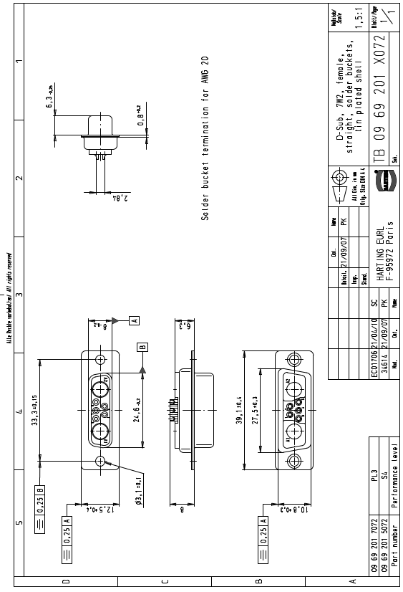
What is female the pins or the body ….???

Slide 31
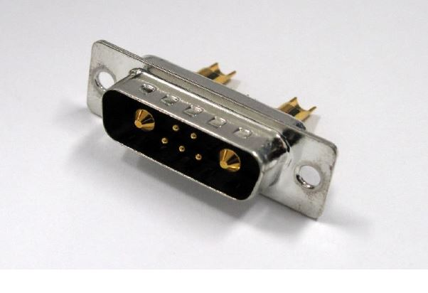
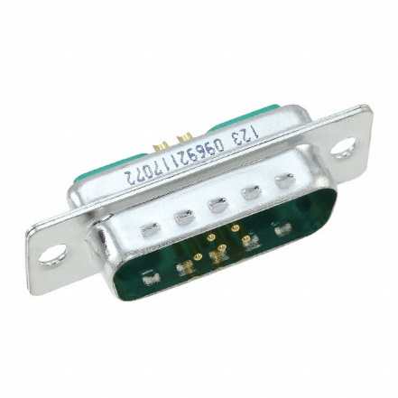
RS Stock No. 923-5189
Mfr. Part No. 09692117072
Brand Harting
Harting online Catalogue
https://docs-emea.rs-online.com/webdocs/14d3/0900766b814d30d8.pdf

Slide 32
Drawing
https://docs-emea.rs-online.com/webdocs/167c/0900766b8167c5a2.pdf
447-7353
Hood is therefore for a 15pin size connector
09.21.23.013.7 Straight outlet cover high section 8,5 mm FMK21G 2
OR
For dia 12,5 mm cable FMK2G SCEM 09.21.23.013.9
For dia 9,6 mm cable with 45deg entry FMK21 09.21.23.022.0 4.1chf

Slide 33
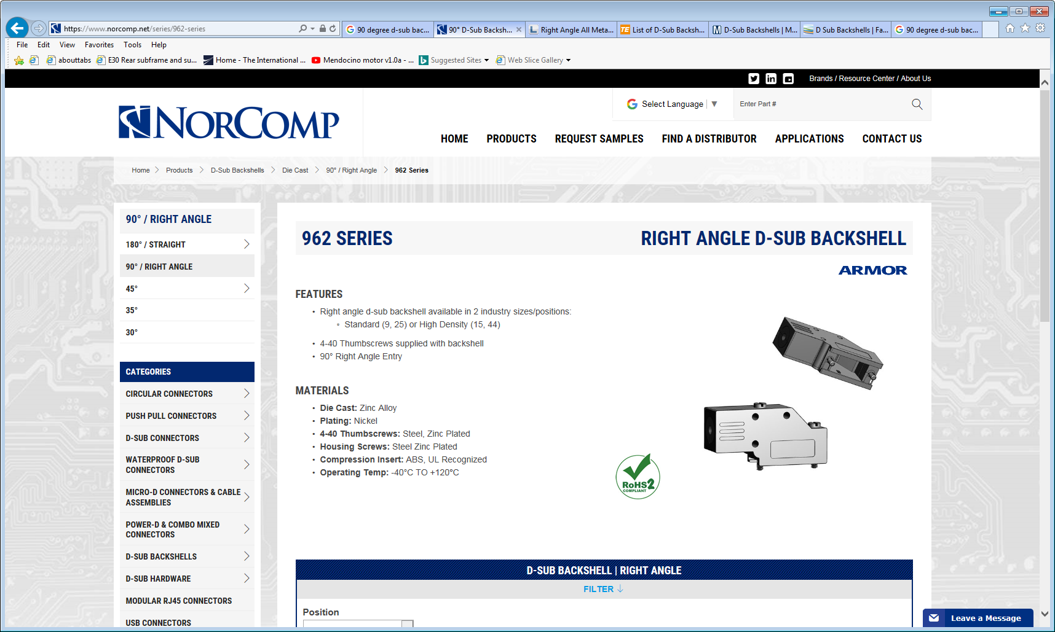
https://www.norcomp.net/series/962-series

Slide 34
http://www.l-com.com/d-sub-right-angle-assembled-d-sub-hood-kit-db9-hd15-metal

Slide 35
https://uk.farnell.com/mh-connectors/mhdcmr09-ulp/hood-ultra-low-9way/dp/4861784

Slide 36
https://www.mouser.ch/ProductDetail/NorComp/981-009-130R121?qs=sGAEpiMZZMu5A18b%252bIx2GqJEXxljCpJzENh9gueg4Rk%3d

Slide 37
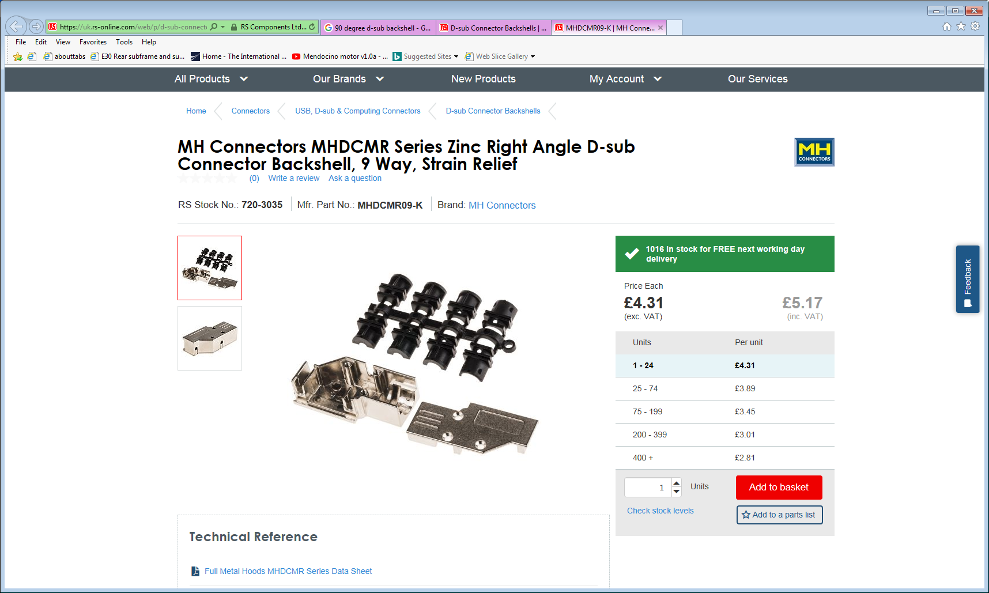
https://uk.rs-online.com/web/p/d-sub-connector-backshells/7203035/

Slide 38
Resume of connectors D-Sub
RS Farnel Quantity
Base Cable end 923-5189 144 + 26 = 170
Female pins 2433225 144 + 26 = 170
Male pins 2433223 144 + 26 = 170
Hood 447-7353 144 + 26 = 170

Slide 39
Polarity and 45deg body

Slide 41
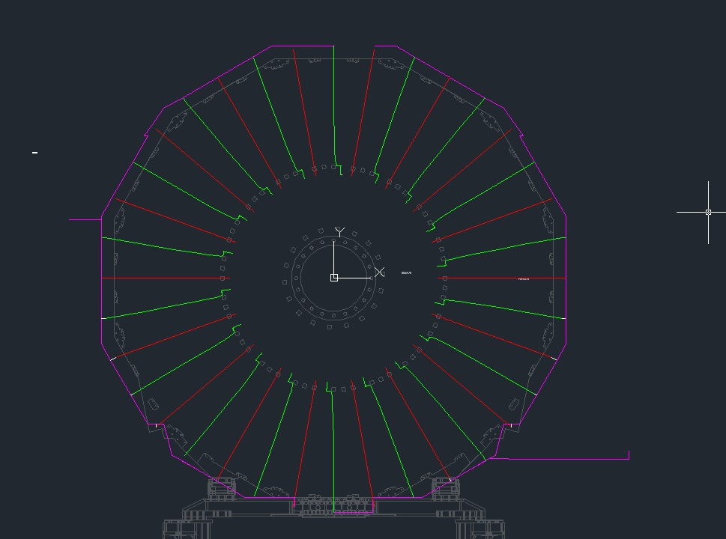
Lengths by S. Bally from the IO

Slide 42
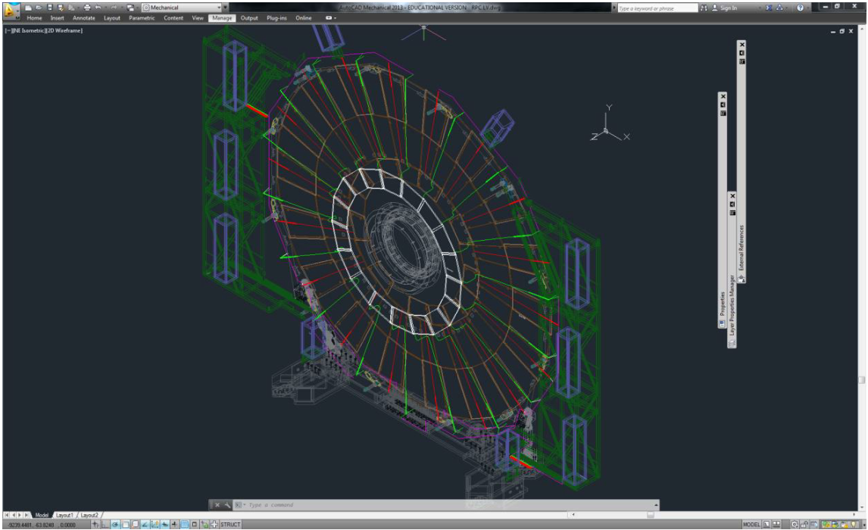

Slide 44
references
AWG to mm2 https://www.multicable.com/resources/reference-data/cross-reference-awg-to-mm2/

Slide 45
https://www.boltdepot.com/fastener-information/machine-screws/machine-screw-diameter.aspx

Slide 46
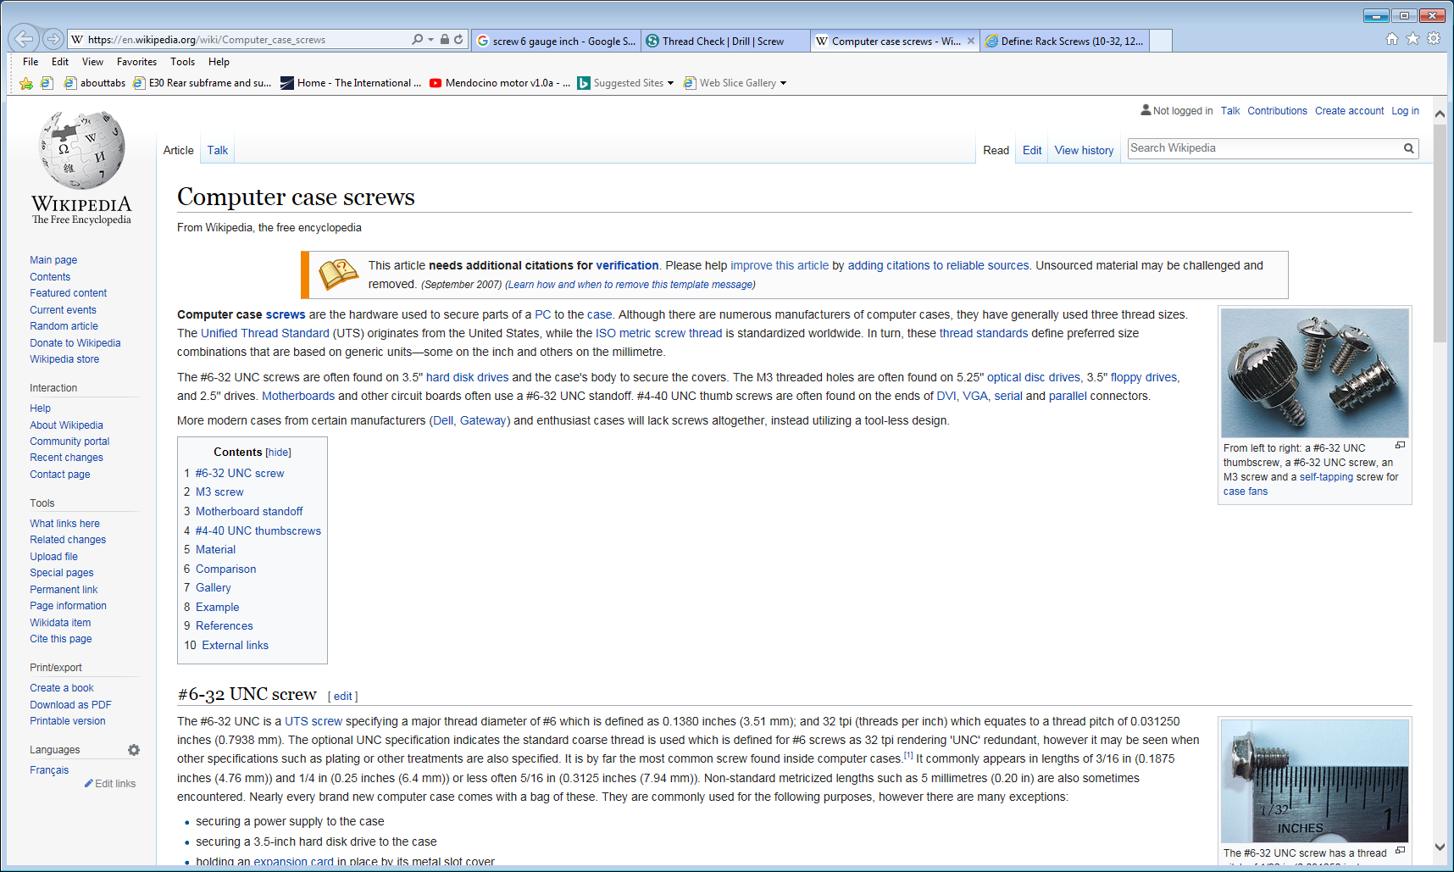
https://en.wikipedia.org/wiki/Computer_case_screws

Slide 47
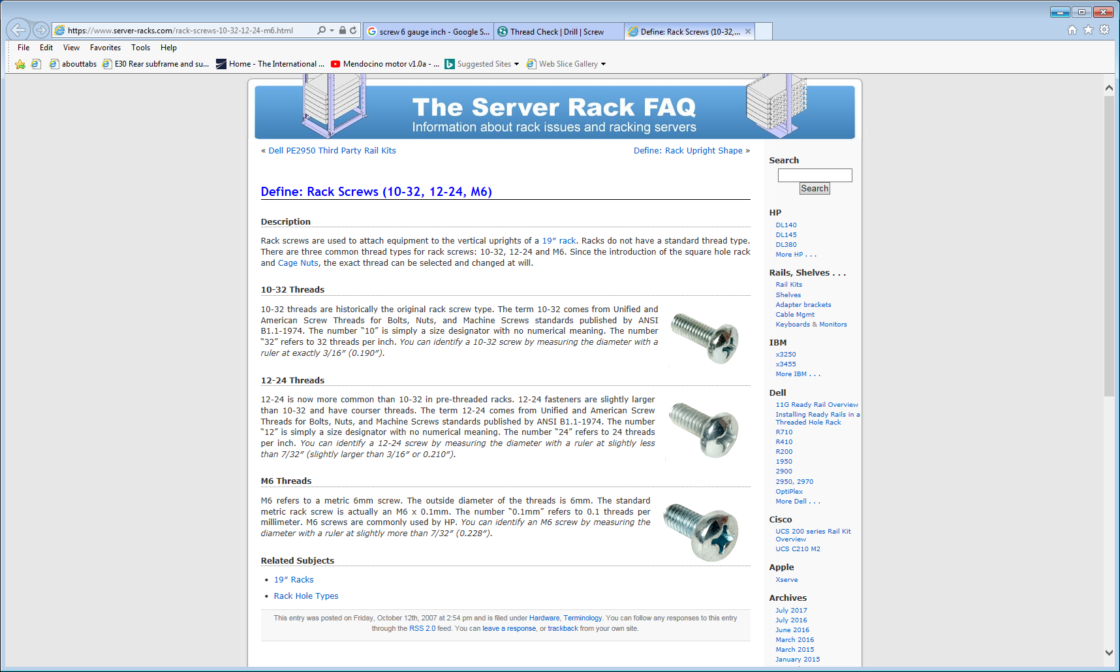
https://www.server-racks.com/rack-screws-10-32-12-24-m6.html

