Slide 1
RPC power estimation for on board Chamber up scope ( High eta)

Slide 2
RE 4/1 Design so far
Pigi & Pino
April 2015

Slide 3
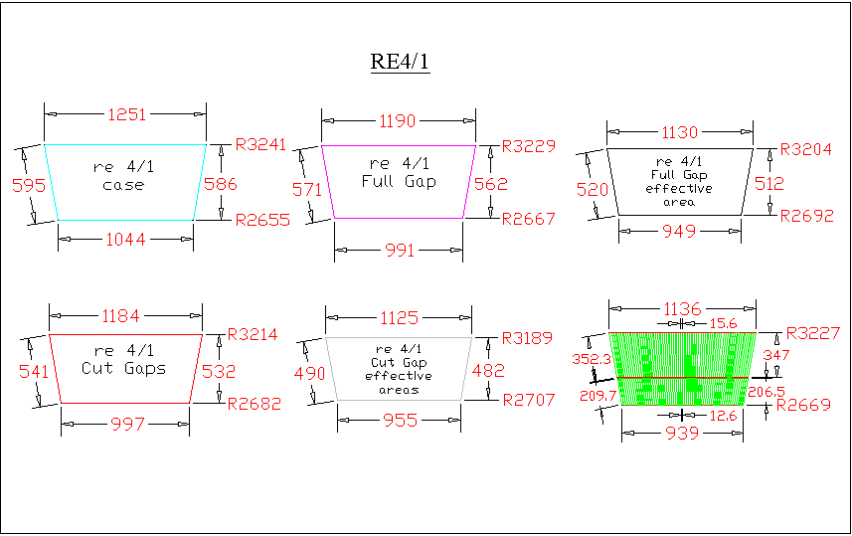

Slide 4
Eta division
64 strips/ 20deg
5 eta divisions > strip length of ~ 260mm
Original design strip length for RE4/1 was 206 & 347mm
4 eta divisions gives strip length ~ 325mm
Original design strip length for RE3/1 was 426 & 347mm
3 eta divisions gives strip length ~ 430mm
20 deg

Slide 5
Standard RPC RE electronics
Power to digital = 7.5V x 1.43A = 10.5Watts
Power to Analogue = 7.0V x 0.73A = 5.11Watts
Total Power/chamber = 15.61/2 = 7.8W (inc x2 Dist. Boards)
FEB power = 2.6W (32 strips)
Power / channel = 0.084W
 | Upscope for RE4/1 for 20 deg chambers
 | 1 Eta division with 64 strips and 2 FEBs ( assume that Dist board power is included)
 |  | Power = | 5.28 | [watts]
# Eta divisions |  | Power | Power 1 endcap |  | Present RPC power on YE3
 |  |  |  |  | 36 x 4 = 144 chambers
 |  | [W] | [W] |  | Total (x1) YE3 RPC Chamber Power |  |  |  | 1140 | [Watts]
 |  |  |  |  | % increase
2 |  | 10.56 | 190 |  | 17
3 |  | 15.84 | 285 |  | 25
4 |  | 21.11 | 380 |  | 33
5 |  | 26.39 | 475 |  | 42
6 |  | 31.67 | 570 |  | 50

Slide 6
YE3 (x1 endcap)Power CSC & RPC
Power includes chambers and Rack units.
CSC chambers ME4 6500W
CSC & RPC racks 1.7 + 5kW (?)
RPC chambers RE3&4/2&3 1140W
RPC upgrade RE3&4/1 < 1kW
Up scope increase rack ? kW
The RE chamber upscope will increase the heat load by < 7%
Manifold was designed for 15kW capacity, as a function of temp increases accepted 10 years ago !

Slide 7
Conclusions
Numbers to be checked. Rack power increase.
Consult with CMS Cooling and Intergration.
Choice of FE to define heat load.
Design of cooling circuit on chamber and access to present manifold.
Tests to be made on chamber
Procure and build

