Slide 1
Power and Cooling RE
Ian Crotty 27 may 2016
Thanks to Sergei, Petr and Anton

Slide 2
Contents
RPC requirements
Present loads on YE3 (ME4, RE3 & 4)
Future Up-scope loads

Slide 3
Requirements
18- 22 deg C ( at 24 deg C RPCs are switched off.
Stable conditions
No leaks
Minimium operating pressure to achieve flow.

Slide 4
How to achieve these conditions
Conductivity checks.
Annual Inspection and Tests.
Repairs ahead of time.
Correct assembly technics.
QA during upscope.
Early detection of leaks.
Ageing study of brass components.
More instrumentation eg; coolant temp on Manifold.

Slide 5
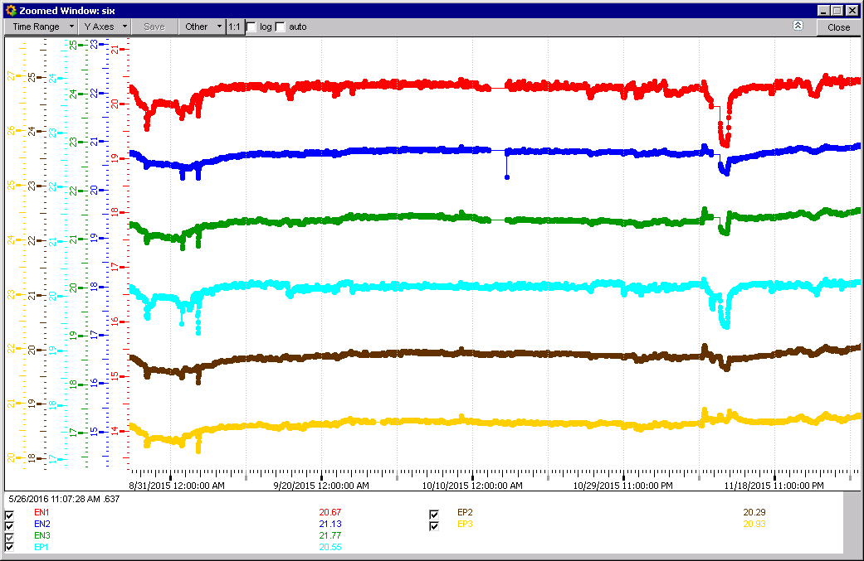
2015 FOS Sensors stable apart interventions etc

Slide 6
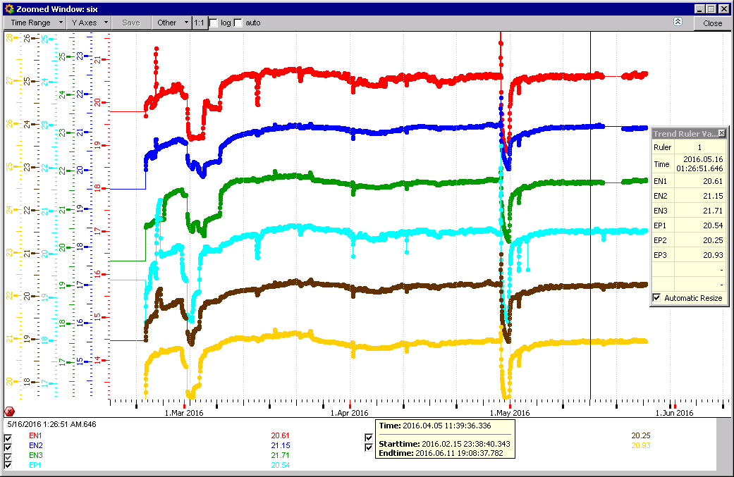
2016 FOS sensors
Start-up condition take time to stabilise

Slide 7
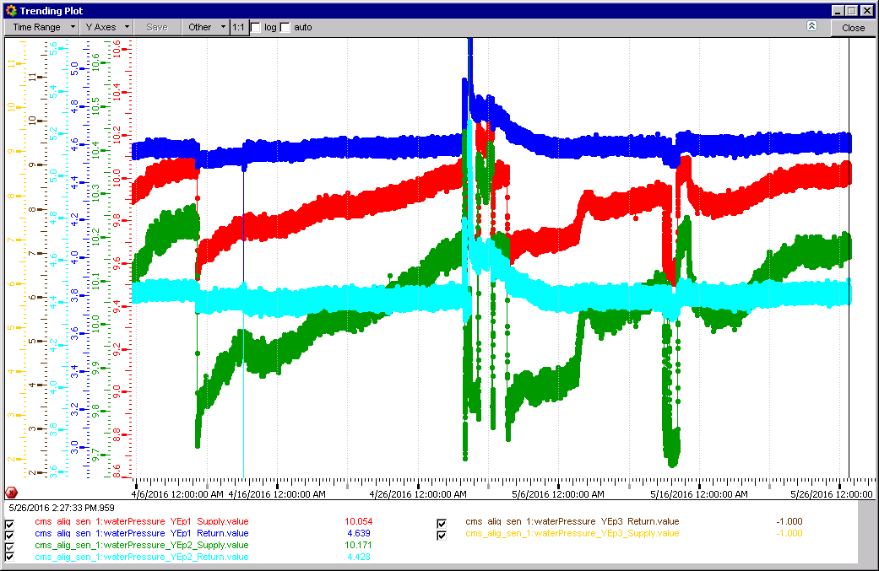
Pressure in Manifold
YE-3 pressures
Delta P = 5.6bar

Slide 8
Power in and Dissipation
Power dissipated from Chambers/Loads
Power dissipated in Rack
Power to Racks
Power to Load
Power_{tot} = Rack_{dissip} + Load_{dissip}

Slide 9
Present Configuration

Slide 10
Present configuration
One cooling circuit for Racks and Chambers on one YE3
Total Power on YE3 11748[W]
CSC Power 8890[W]
RPC Power 3264[W]

Slide 11
Configuration after Up-Scope

Slide 12
Upgrade Power Provisional values
FEB & LBB 6kW
Alternatives, assuming similar PS efficiency 0.56
PETIROC (embed) 5.1kW
PETIROC (FPGA) 8.3kW
Values (estimates) given include an estimate of the rack components.

Slide 13
Provisional Conclusions
Temperatures has been stable over the years.
These are very provisional values
The full power system has to be studied for the alternatives.
RE3&4 is approx 27% of total Power on YE3.

