Slide 1
Power and Cooling RPC
Ian Crotty 27 may 2016
Thanks to Sergei, Petr and Anton

Slide 2
Contents
RPC requirements
Present loads on YE3 (ME4, RE3 & 4)
We have had leaks, latest end 2015

Slide 3
Requirements
18- 22 deg C ( at 24 deg C RPCs are switched off.
Stable conditions
No leaks
Minimium operating pressure to achieve flow.

Slide 4
How to achieve these conditions
Conductivity checks.
Annual Inspection and Tests.
Repairs ahead of time.
Correct assembly technics.
QA during upscope.
Early detection of leaks.
Ageing study of brass components.
More instrumentation eg; coolant temp on Manifold.

Slide 5
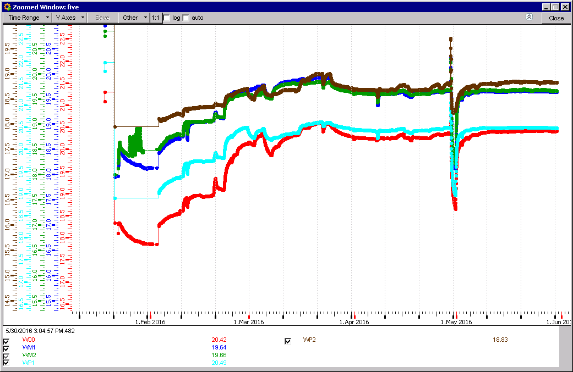
RB temperatures
Response is quick as the mass has reached operating temperature.
High inertia due to Yoke mass after shut down.

Slide 6
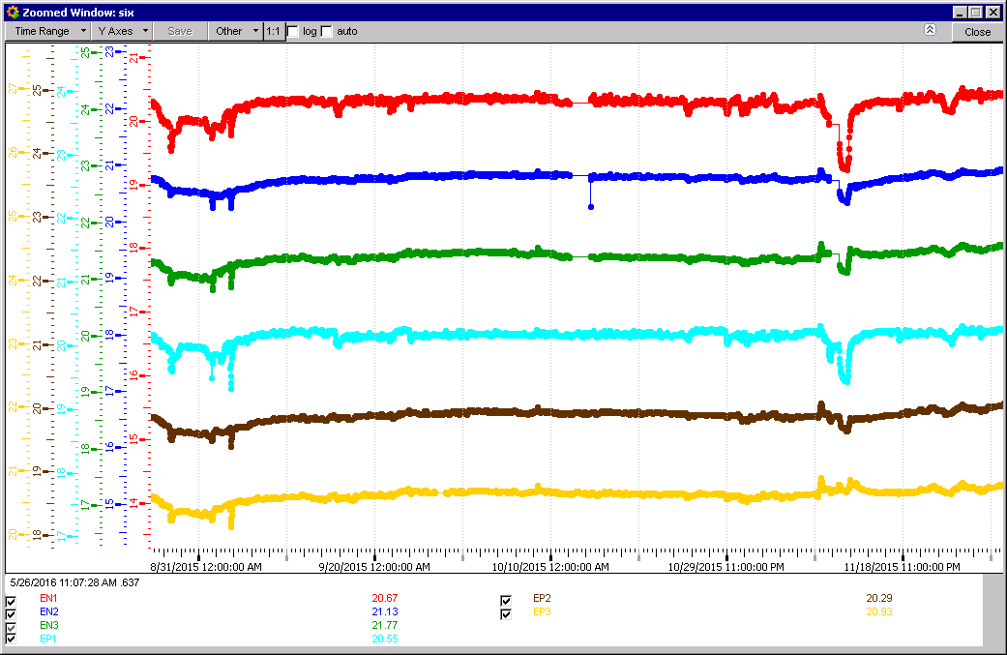
2015 FOS Sensors stable apart interventions etc

Slide 7
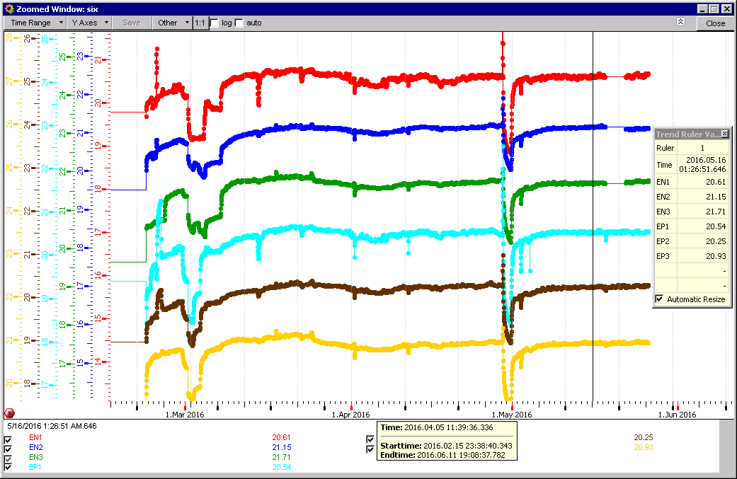
2016 FOS sensors
Start-up condition take time to stabilise

Slide 8
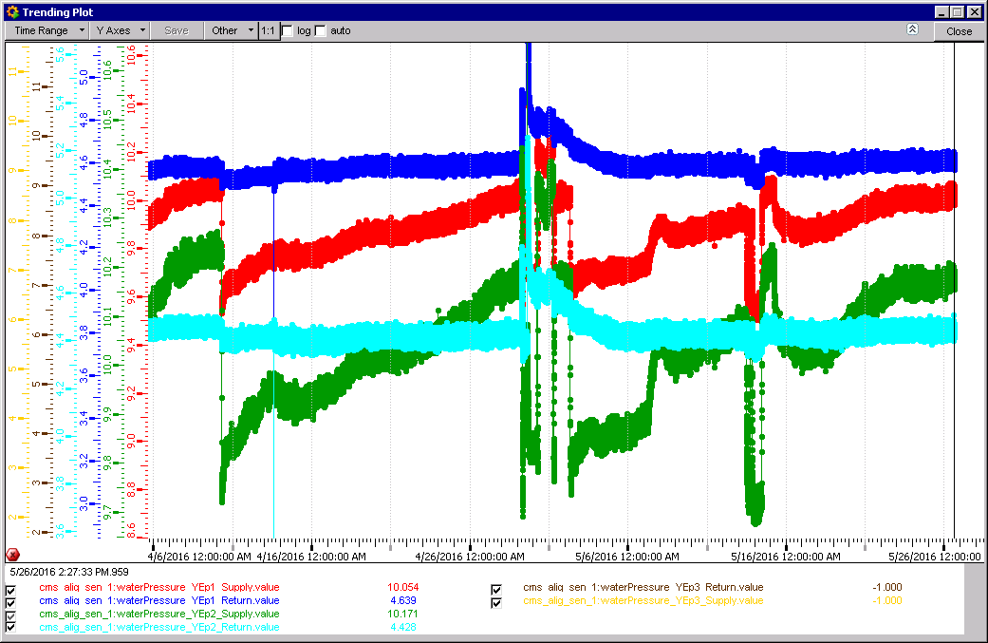
Pressure in Manifold
YE-3 pressures
Delta P = 5.6bar

Slide 9
Power in and Dissipation
Power dissipated from Chambers/Loads
Power dissipated in Rack
Power to Racks
Power to Load
Power_{tot} = Rack_{dissip} + Load_{dissip}

Slide 10
Present Configuration RE3 & RE4 on ONE Endcap

Slide 11
Present configuration
One cooling circuit for Racks and Chambers on one YE3
Total Power on YE3 11748[W]
CSC Power 8890[W]
RPC Power 3264[W]
CMS absorbs ~ 1MW

Slide 12
Leaks end 2015 and actions
1 Leak on RE+4/3/22
2 Leaks on RE+4/2/06
1 leak on RE-4/X/27
Tests in 904 QC4
The “Tightness” of all unions on RE+4 (“tightness” = swag level)
Unions to be produced by ZEC.
Unions produced by Sagana tooling.
Tightness versus leak rate.

Slide 13
Leak Rates RE+4 after repairs on 22 and 6
Sector 15-20 passes @ 18Bar
Sector 9-14 has factor 2 higher than “APD”.
However the ALR does not give the Volume
The leak rate appears higher at 12 than at 18 Bar.
ZEC attended to the leak !
“Acceptable Pressure Drop” (APD) equivalent 5E-2 [mBar.l/s]
There appears no correlation with SS ferrules
SS Ferruled chambers

Slide 15
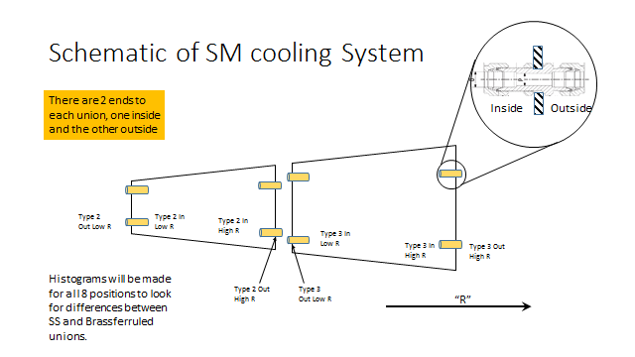

Slide 16
Specified “tightness” or swag
Before Tightening 4.83mm
After Tightening 3.62mm
Instructions in French
The question is the point at which the 1 ¼ turns is started. The shim tool necessitates tools to achieve the “Serrage a la main” !
Pitch is 20tpi (1.27mm). 1 ¼ turns = 1.59mm. But the Difference in Shim is 4.83-3.62 = 1.21mm which is 0.95 turns.

Slide 18
Looking at the level of swaging for each of the 8 positions across the radius.
1 ¼ turns = 3.4 ± 0.1[mm]
Brass Ferrules
SS Ferrules
Mean
StDev
3.23 | 3.29
0.31 | 0.35
Tighter

Slide 19
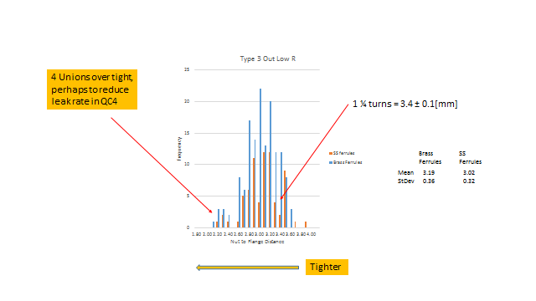

Slide 20
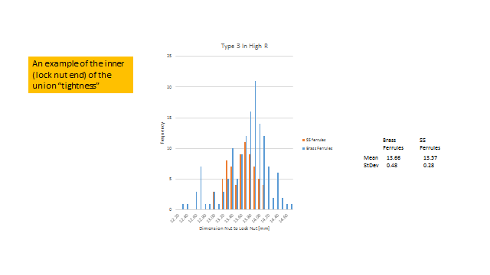

Slide 21
Conclusions for the leaks 2015
Do we change all the SS ferrules ? Little concrete evidence.

Slide 22
Conclusions
Temperatures has been stable over the years.
Leaks should be dealt with quickly,(detection)
Repairs by ZEC. What of the future….
Introduce routine checks and fix weaknesses before they give problems.

