Slide 1
LV routing study in extremis for RE4/1 LV cables
By Ivan
7 Aug 2019
This doc is available here;
http://project-cms-rpc-endcap.web.cern.ch/project-cms-rpc-endcap/rpc/UpscopeHighEta/RPCDevelopements/RE31and41/Services/LV/Installation/Ivan/

Slide 2
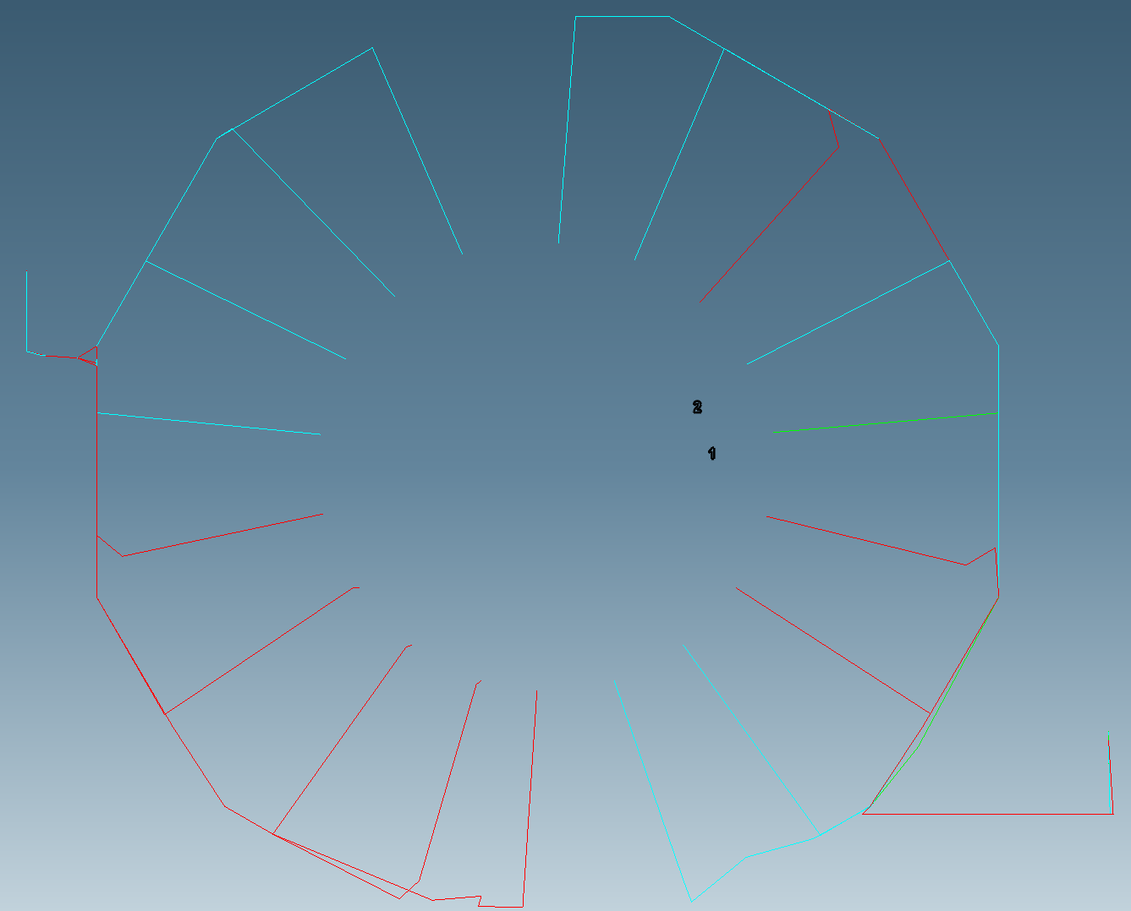

Slide 3
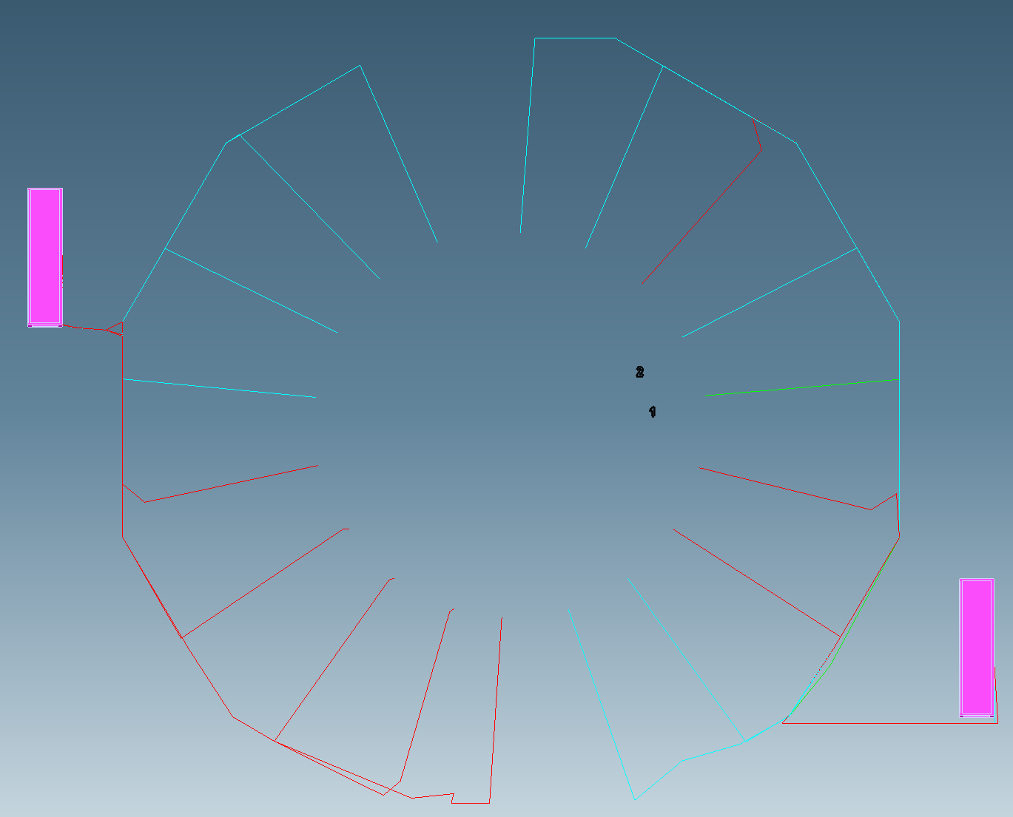

Slide 4
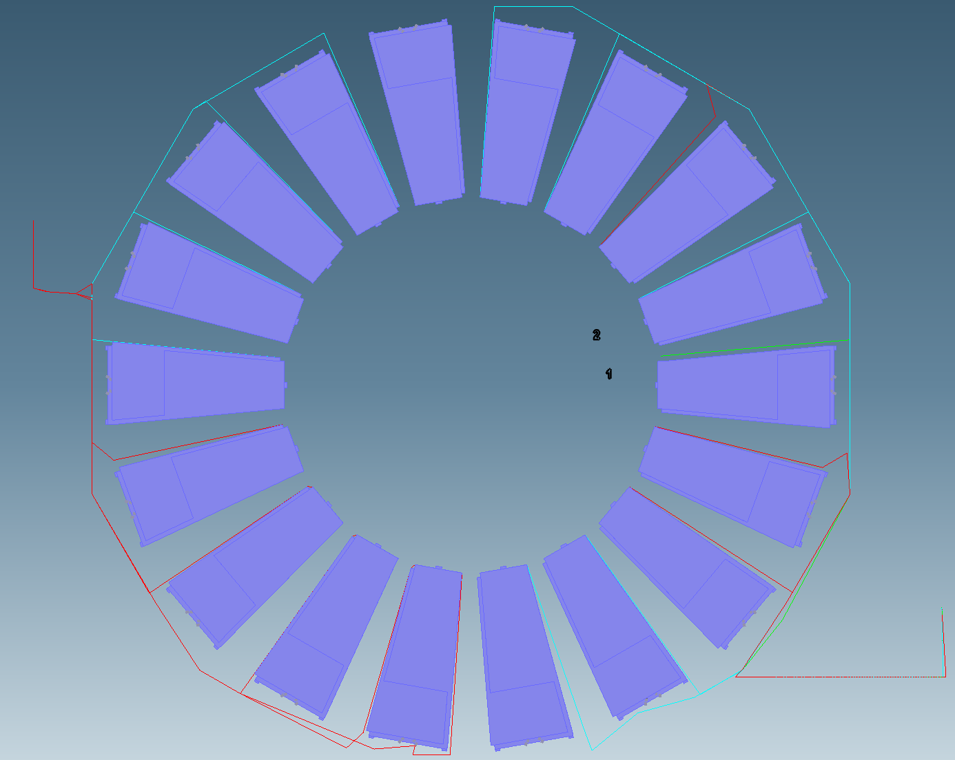

Slide 5
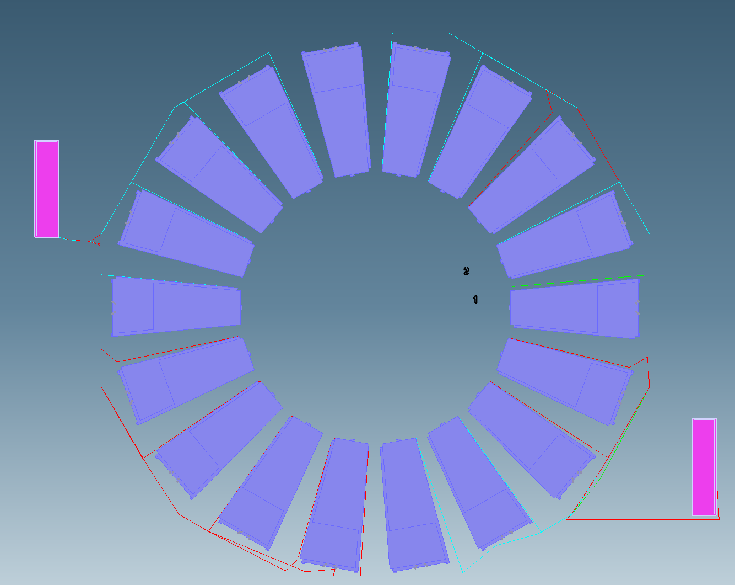

Slide 6
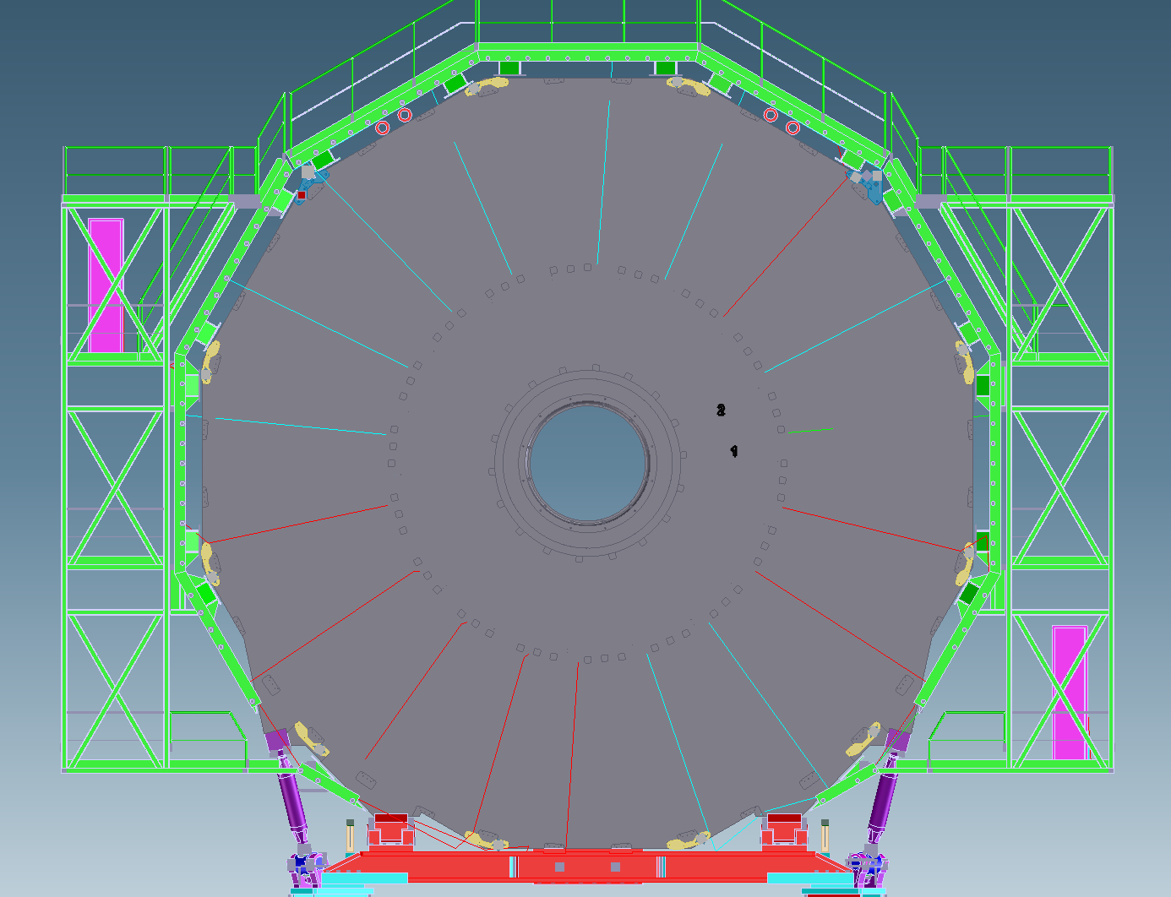

Slide 7
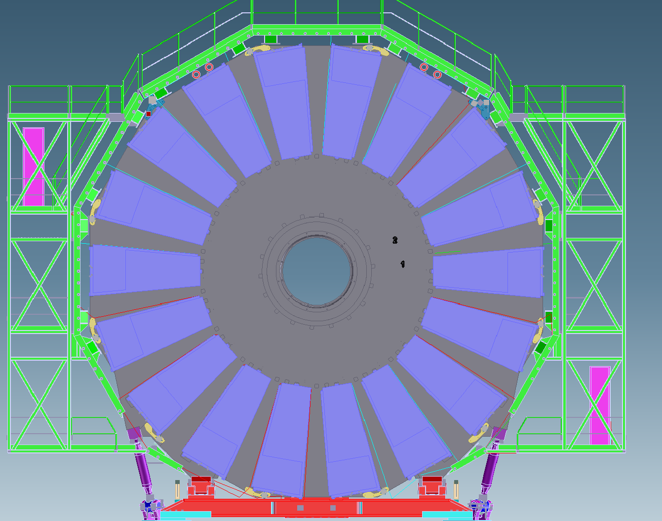

Slide 8
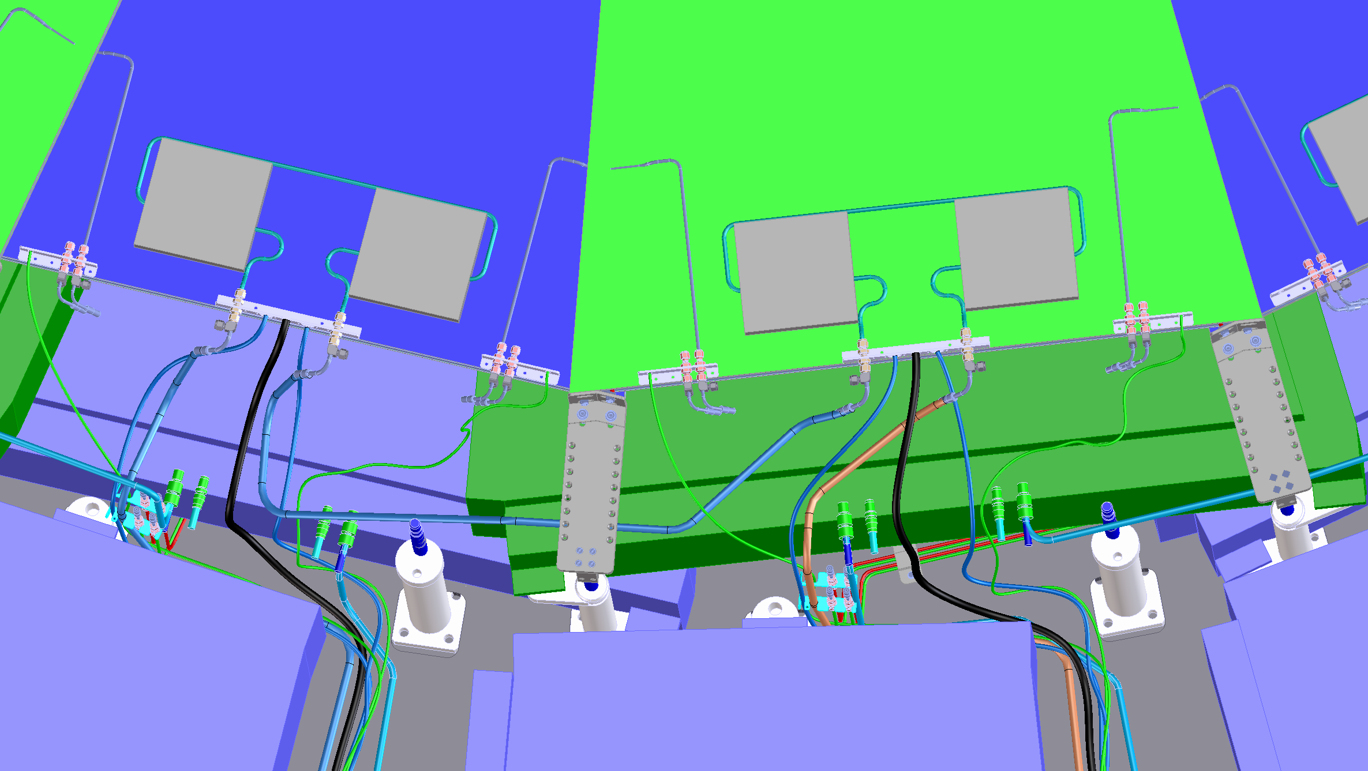

Slide 9
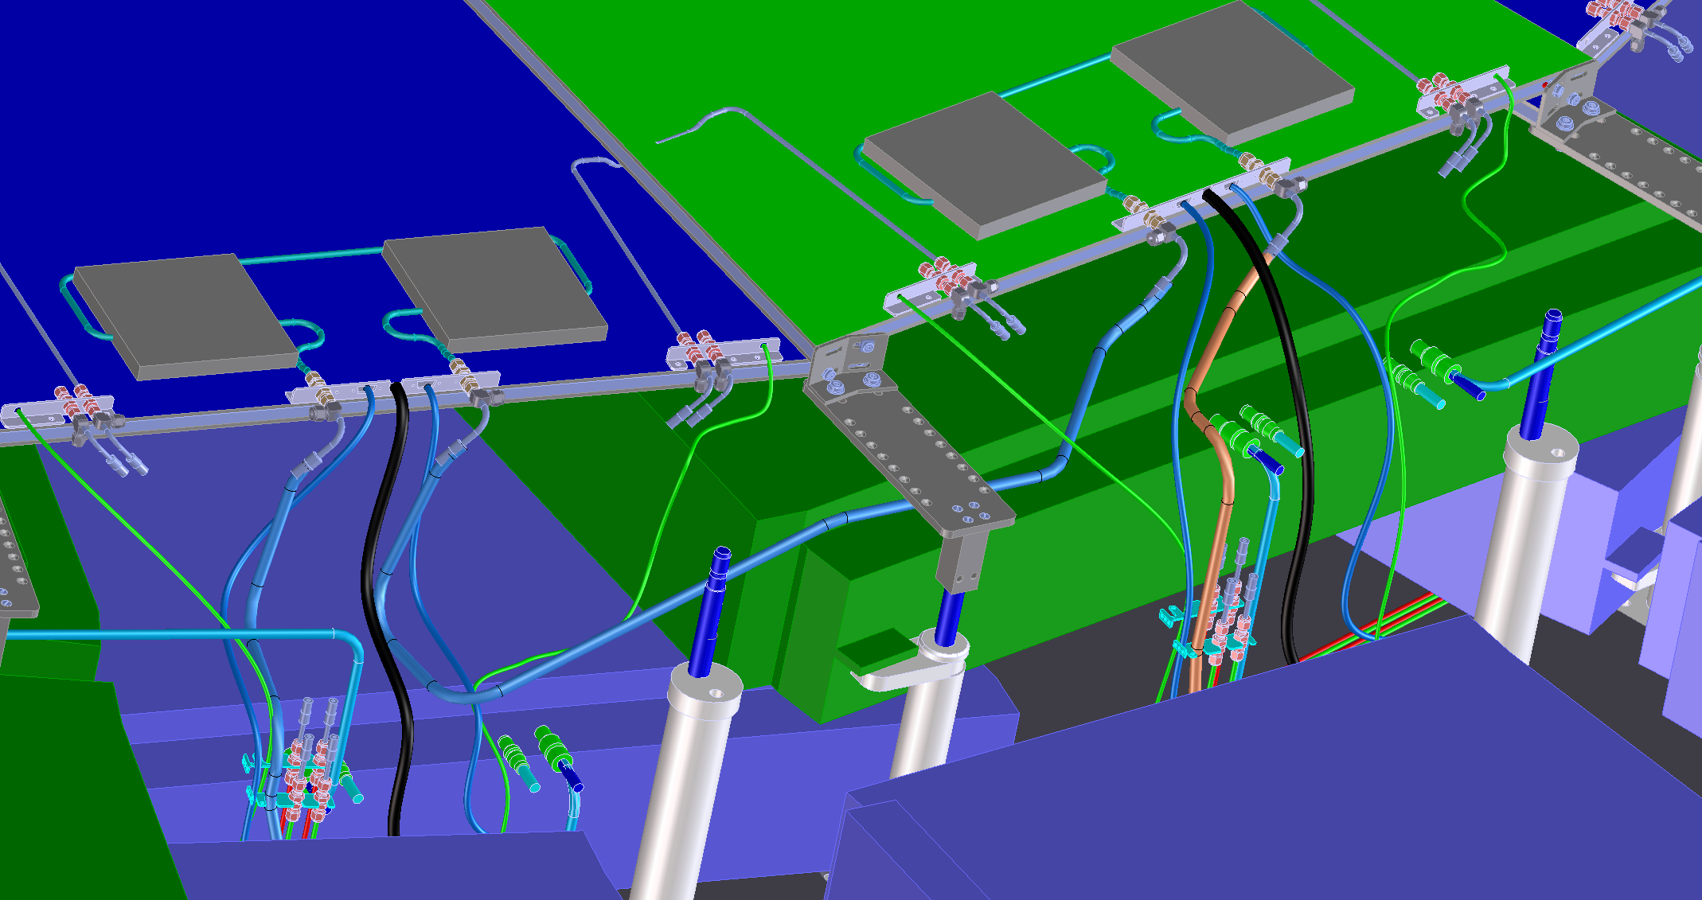

Slide 10
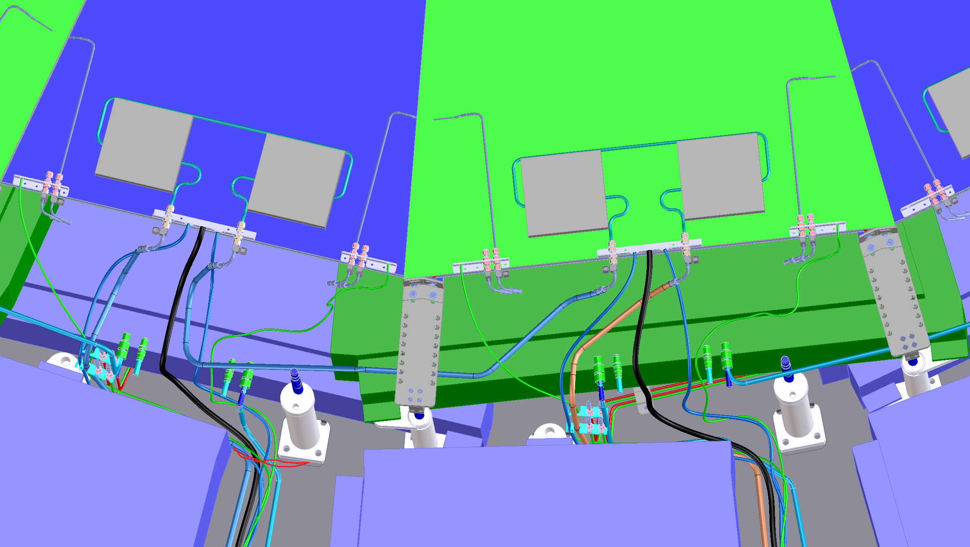

Slide 11
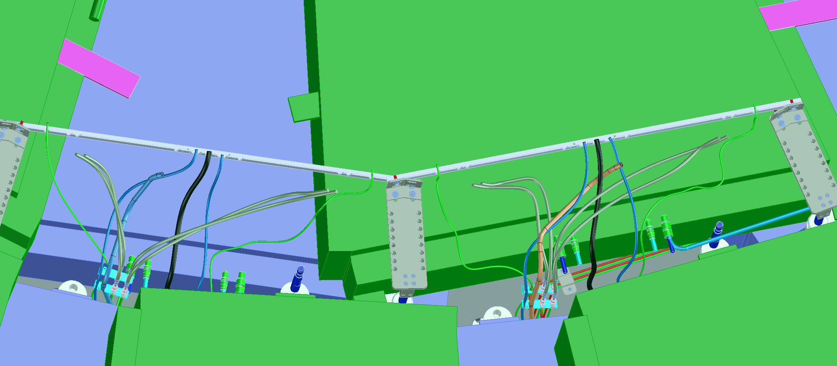

Slide 12
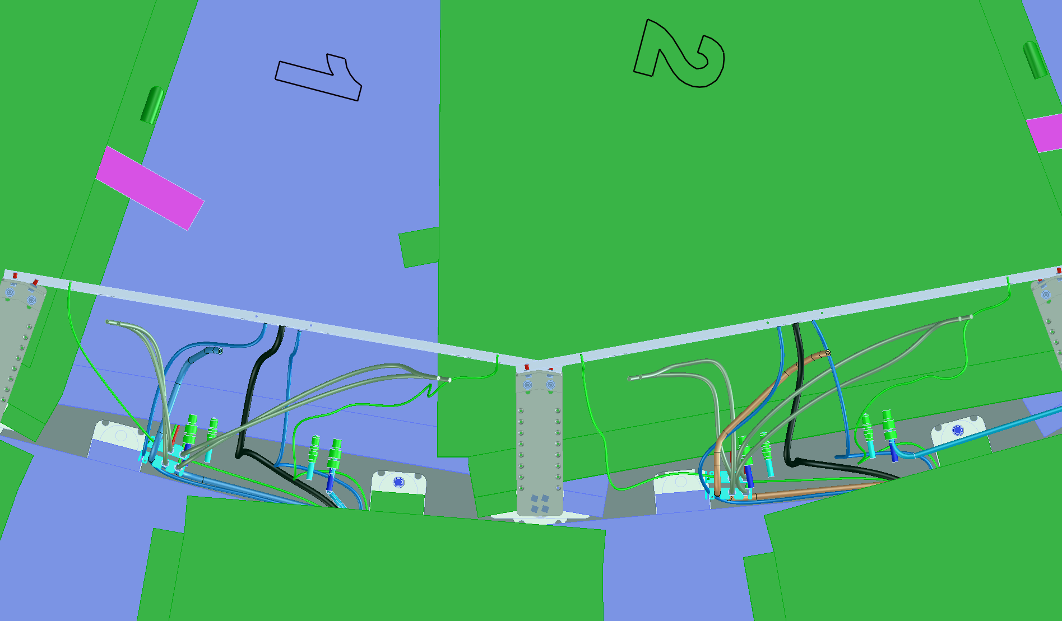

Slide 13
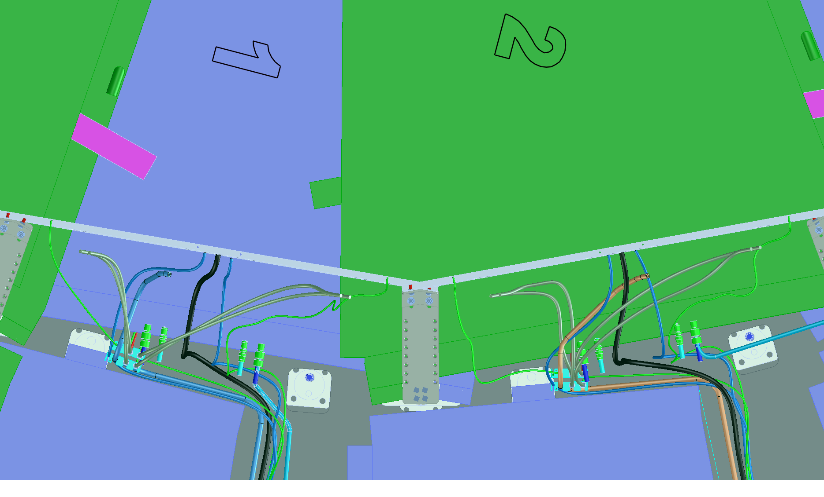

Slide 14
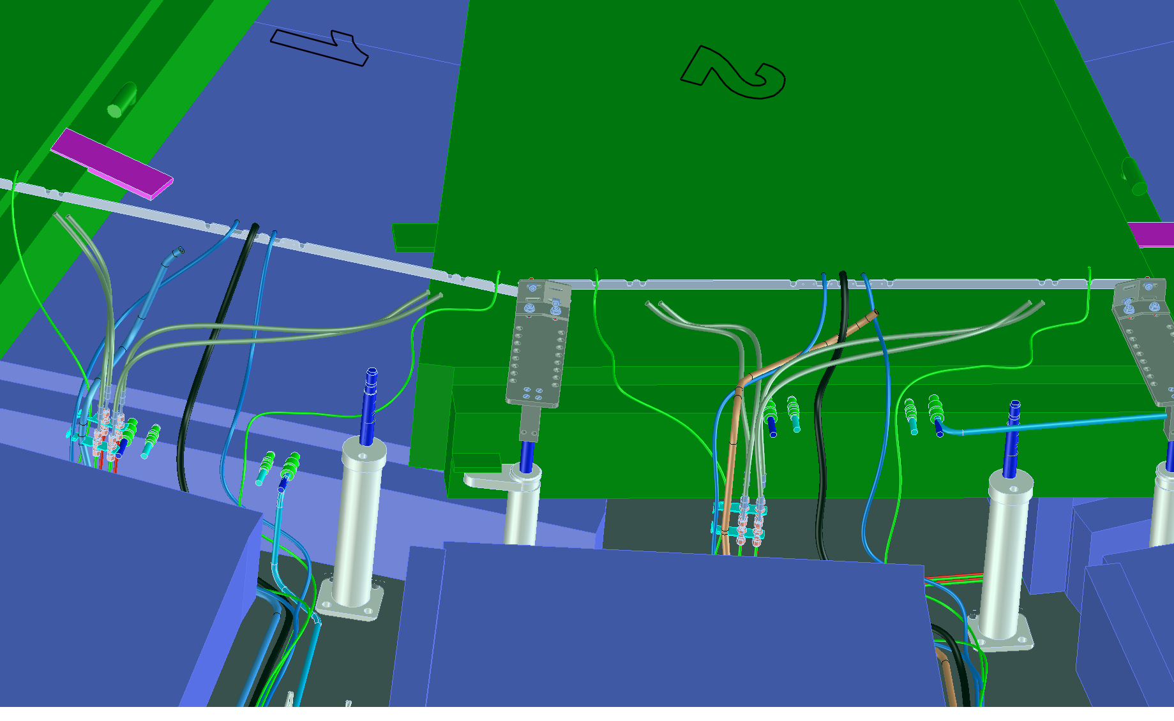

Slide 15
