Slide 1
LV Trigger Cable
Polish
Ian
April 2019

Slide 2
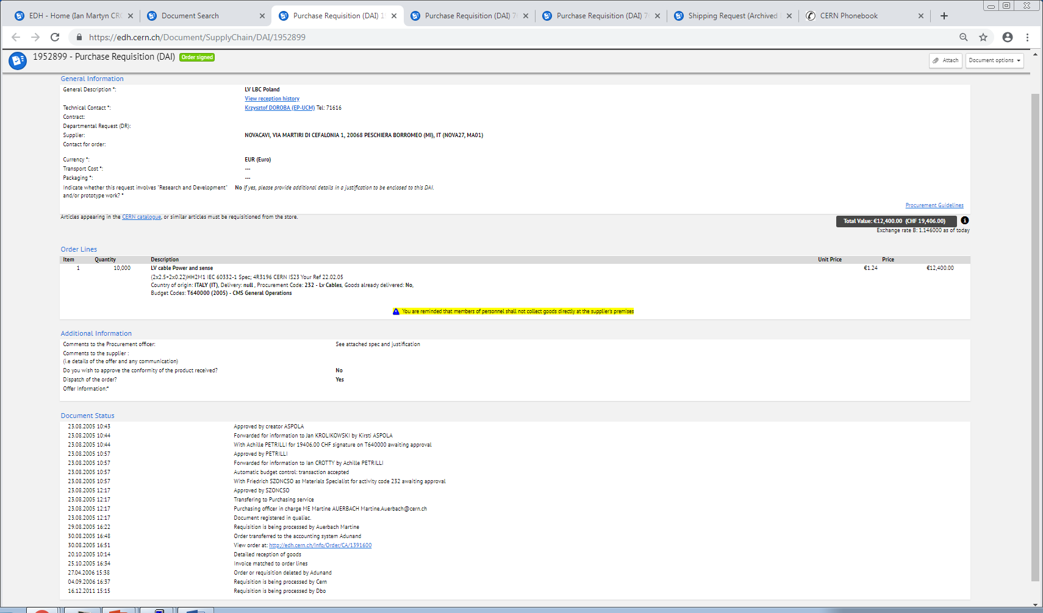
EDH order 30(or 29) Aug 2005
No. 1952899
CA 1391600 (Ns. Rif. 477_05-10)
(2x2.5+2x0.22)HH2M1-100V IEC 60332-1 Spec; 4R3196 CERN IS23 Your Ref 22.02.05
Cable type 4R3196
Matricola Bobina 081_80740
Price per metre for 10km was 1.24Euro/m

Slide 5
