Slide 1
HV Test

Slide 2
SAMAR MI D30
http://www.samar-instruments.it/lists/en/INSTRUMENTS.pdf
http://www.samar-instruments.it/lists/STRUMENTAZIONE.pdf

Slide 3
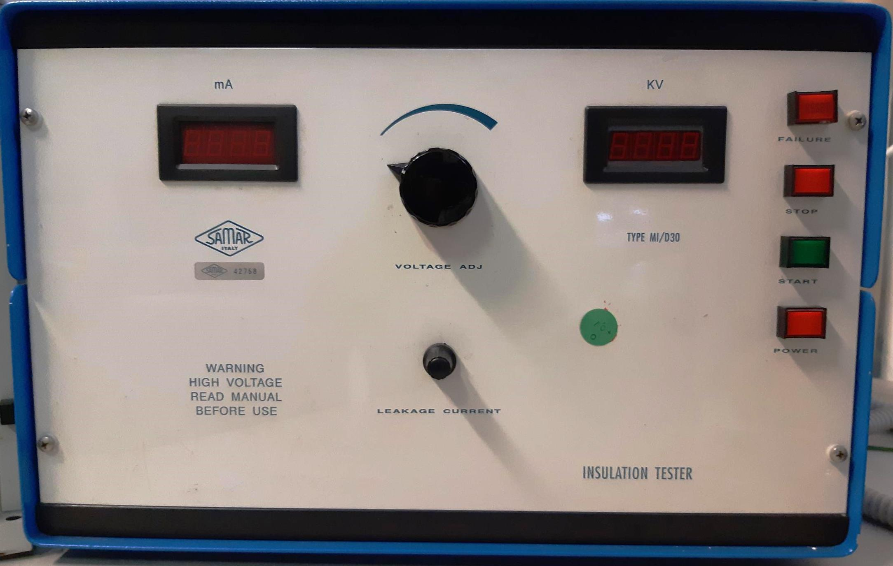

Slide 5
