Slide 1
Rectangular and circular Flexible conduit
Ian
12 Feb 2019

Slide 2
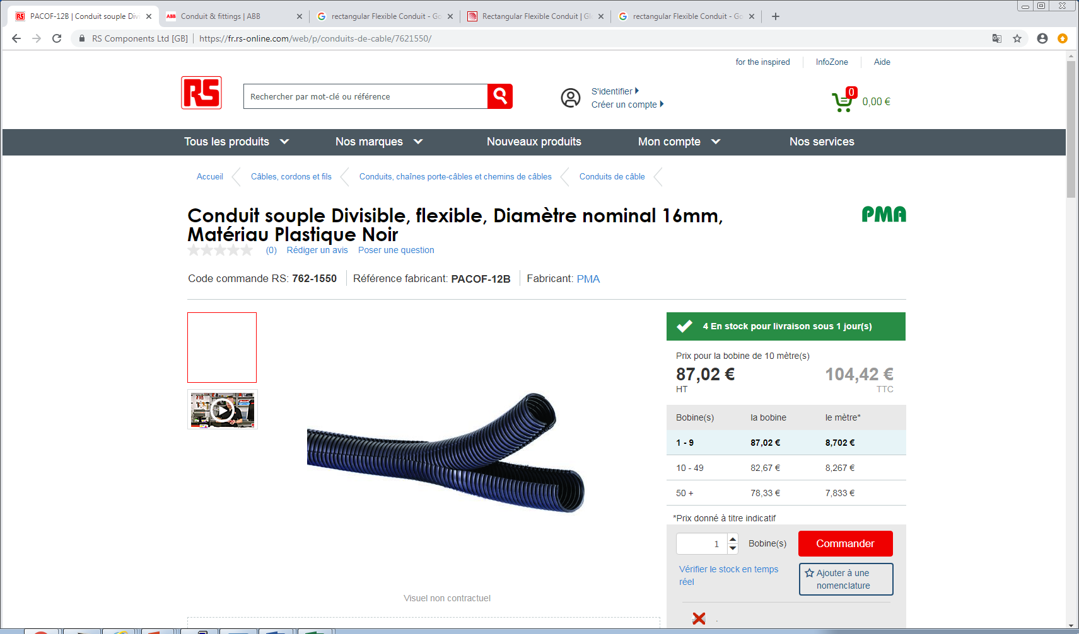
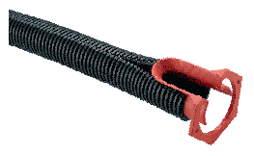
What we all know

Slide 3
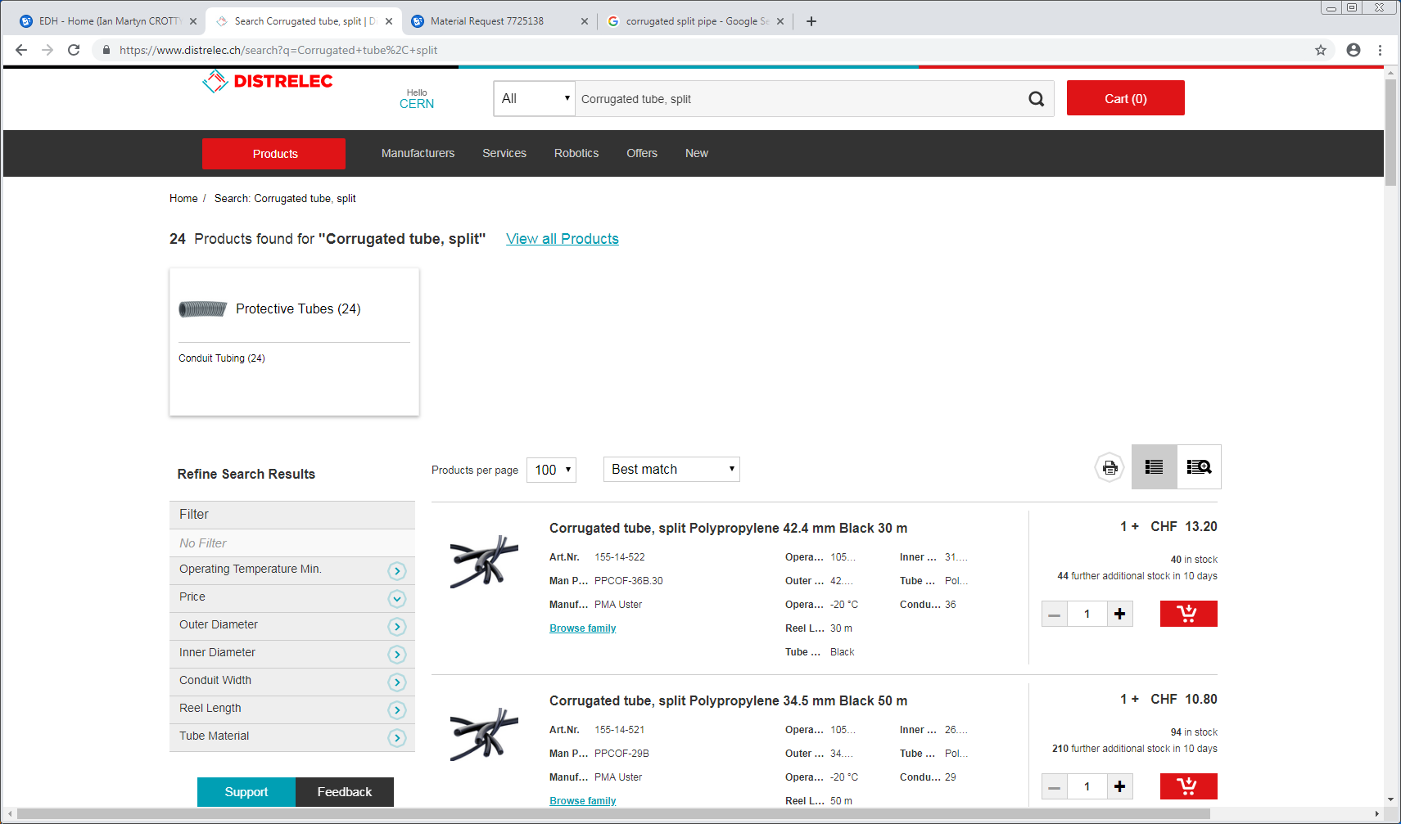

Slide 4
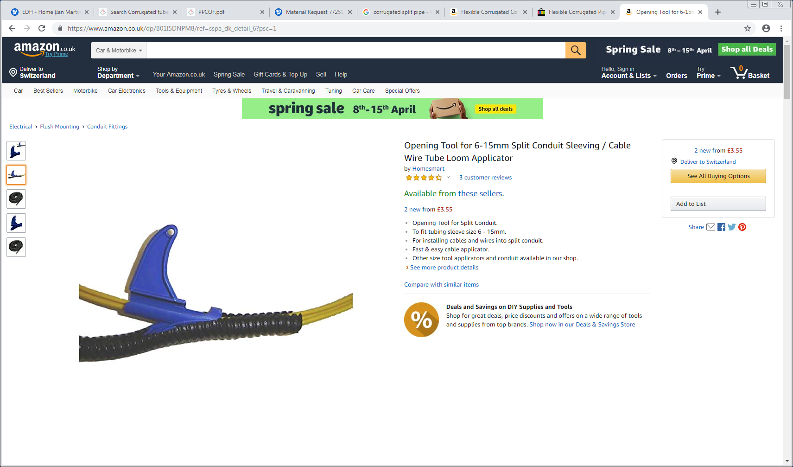
https://www.amazon.co.uk/dp/B01I5DNPM8/ref=sspa_dk_detail_6?psc=1

Slide 5
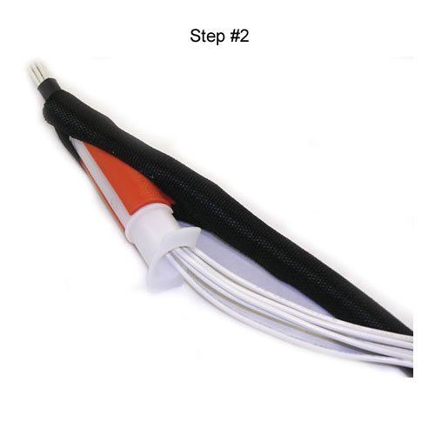
https://www.amazon.co.uk/Wire-Loom-Cable-Insertion-Tool/dp/B01D7DRB9Y/ref=pd_sbs_263_14?_encoding=UTF8&pd_rd_i=B01D7DRB9Y&pd_rd_r=74b86088-5a04-11e9-b207-0b3f002341e8&pd_rd_w=a09sJ&pd_rd_wg=Gd1pe&pf_rd_p=18edf98b-139a-41ee-bb40-d725dd59d1d3&pf_rd_r=BKWDX11QTD1XMZTHS5JW&psc=1&refRID=BKWDX11QTD1XMZTHS5JW

Slide 6
https://www.youtube.com/watch?v=XBbaQ6HbTrQ

Slide 7
Examples used in P5 underground
PMA Easiflem-NW 23B (?) YE + 1 PP
PMA Easi Flex 50-105degC (?) USC
Co-Plex – PA www.greenische.de (?) USC
Conclusion
Not checkedwith P5
PMA Coflex PACO – 12B divisible (made from PA) with internal dia. 12mm p.18 & p.53 in catalogue . It contains no halogens and is non flame propagating p.09
Tool p.69 does it do both types, ie twin layers

Slide 8
PMAFLEX
http://www.pma.ch/pma_com/downloads/datasheet/11020.pdf

Slide 9
CS EASYFLEX
https://docs-emea.rs-online.com/webdocs/1366/0900766b813669ed.pdf

Slide 10
https://www.schlemmer.com/global/en/solutions/products/cable-management#corrugated-smooth-and-protection-tubes

Slide 11
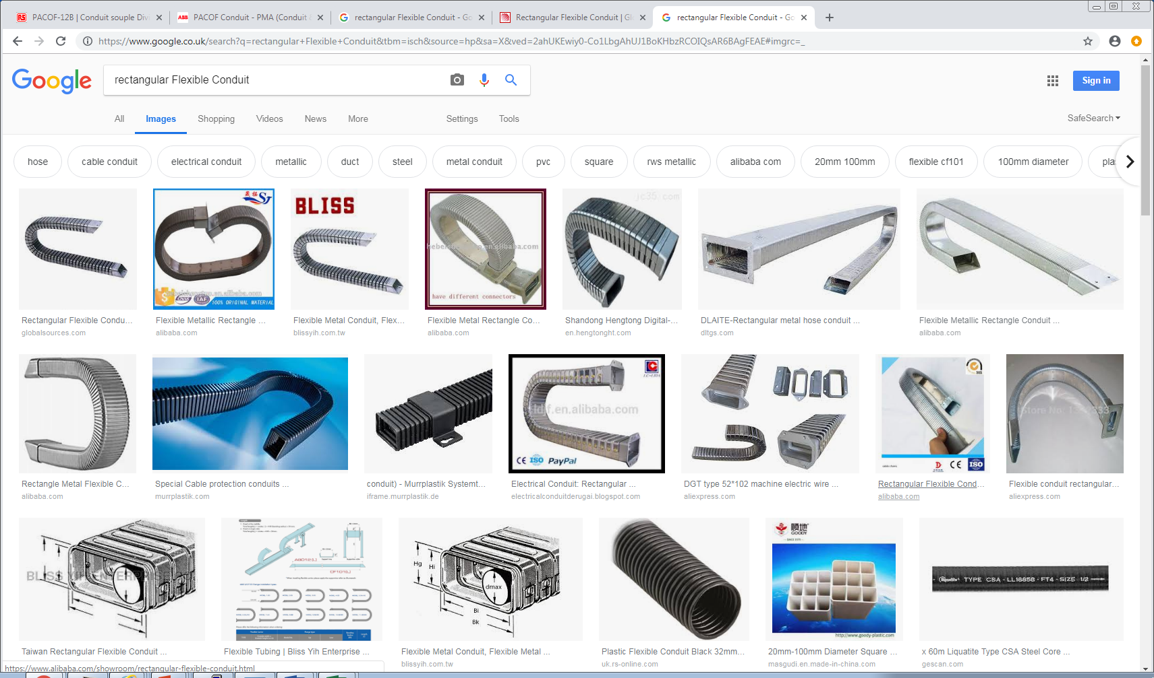

Slide 12
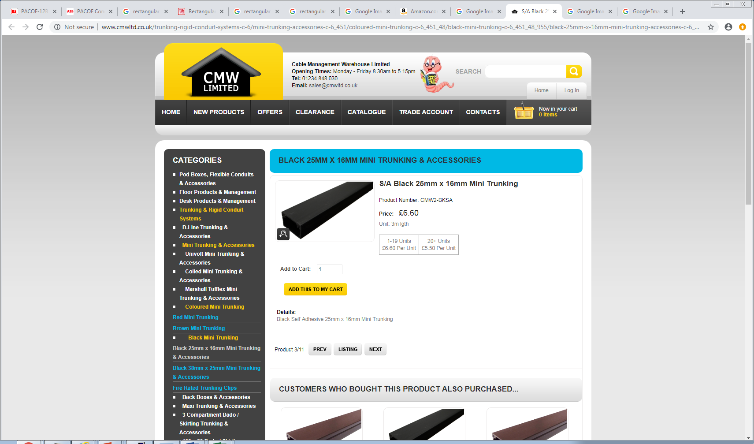
http://www.cmwltd.co.uk/trunking-rigid-conduit-systems-c-6/mini-trunking-accessories-c-6_451/coloured-mini-trunking-c-6_451_48/black-mini-trunking-c-6_451_48_955/black-25mm-x-16mm-mini-trunking-accessories-c-6_451_48_955_956/sa-black-25mm-x-16mm-mini-trunking-p-15275

Slide 13
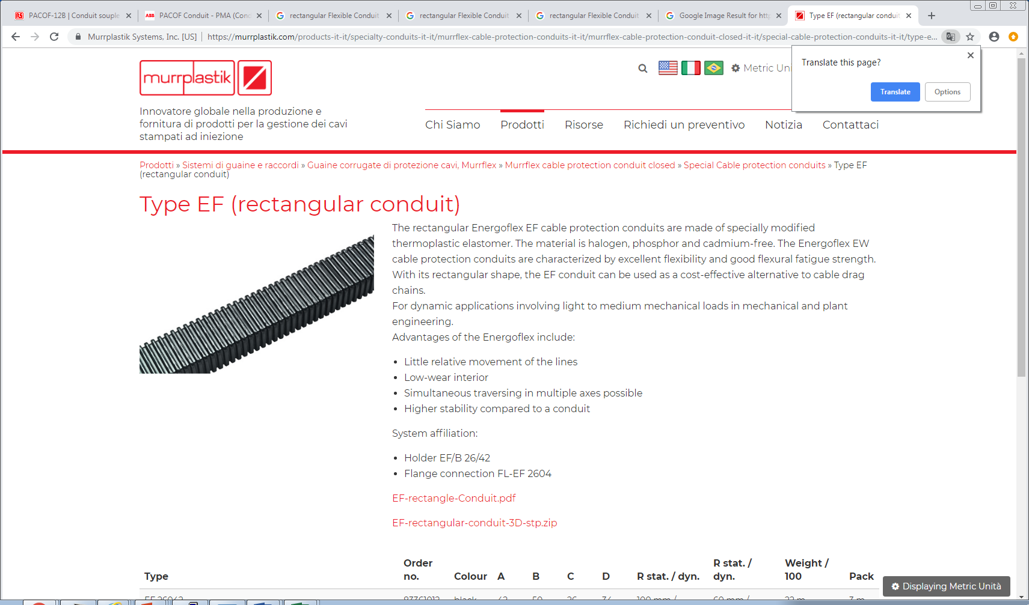
https://murrplastik.com/products-it-it/specialty-conduits-it-it/murrflex-cable-protection-conduits-it-it/murrflex-cable-protection-conduit-closed-it-it/special-cable-protection-conduits-it-it/type-ef-rectangular-conduit-it-it/

Slide 14
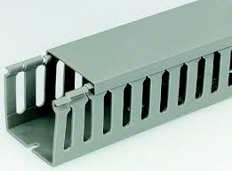
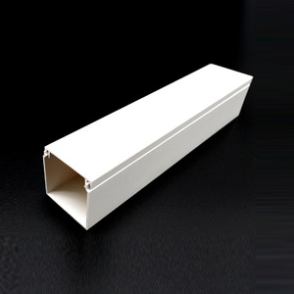
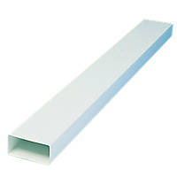
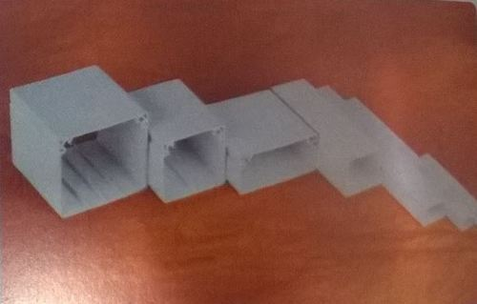

Slide 15
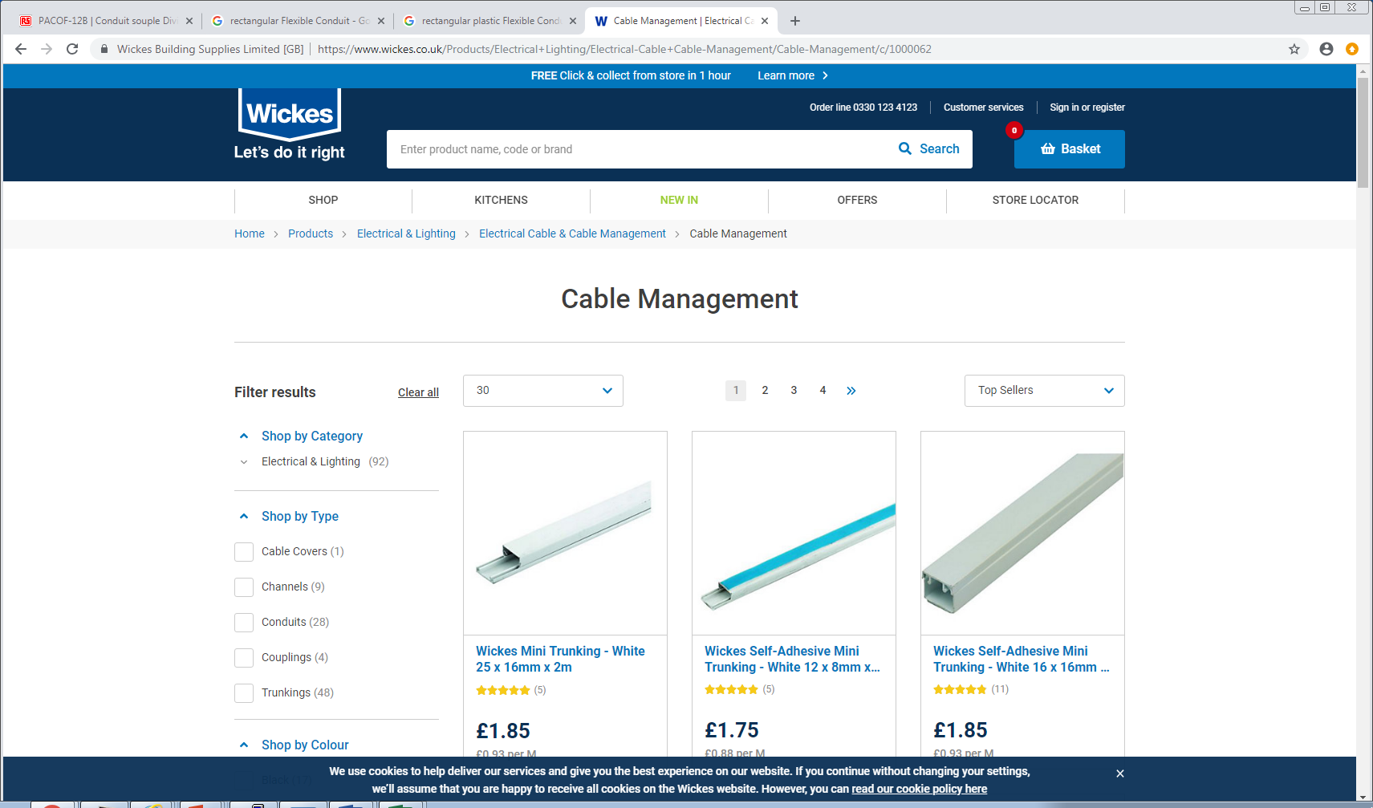

Slide 16
