Slide 1
Corrugated Offer Wiska.de
Ian from Andres
16 April 2019

Slide 2
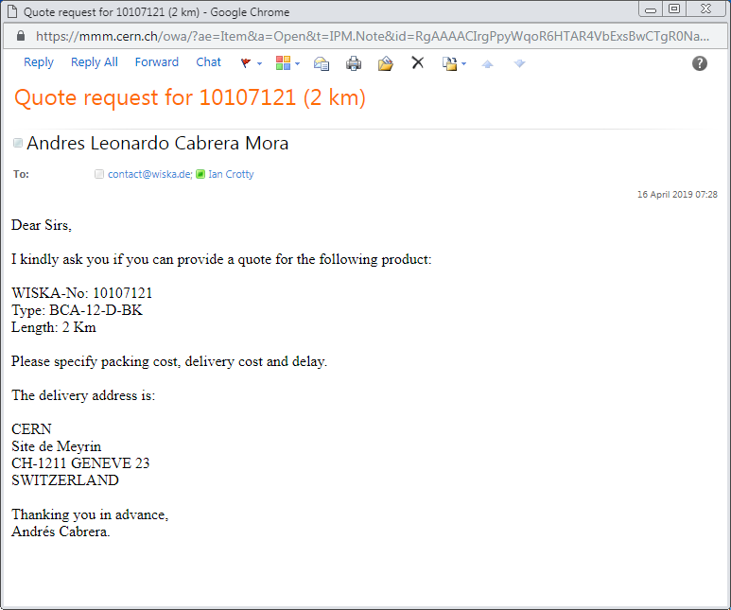
Email after addition search by Andres

