Slide 1
Swagelok Push-On fittings
Ian
14 Feb 2019

Slide 2
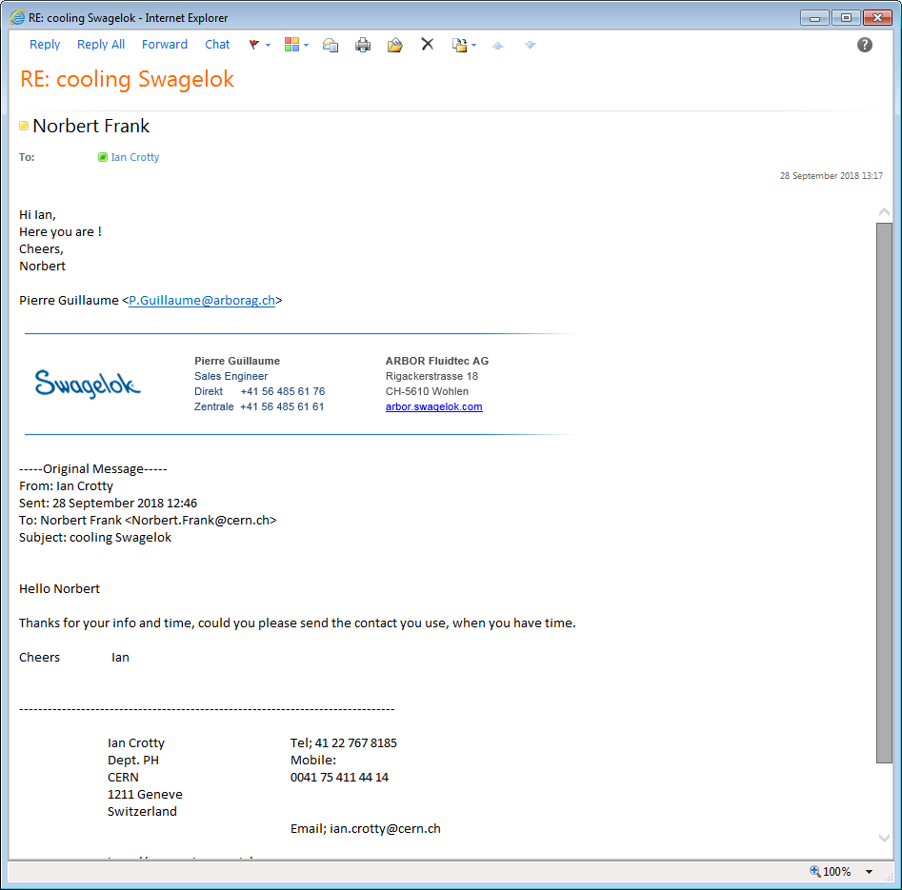
Swagelok Switzerland
Rigackerstrasse 18, 5610 Wohlen
Switzerland
+41 56 4856161
Email:info@arborag.ch
P.Guillaume@arborag.ch ( reference from norbert frank)
Web: https://arbor.swagelok.com
Full catalogue
https://www.swagelok.com/downloads/webcatalogs/en/MS-01-140.pdf

Slide 3
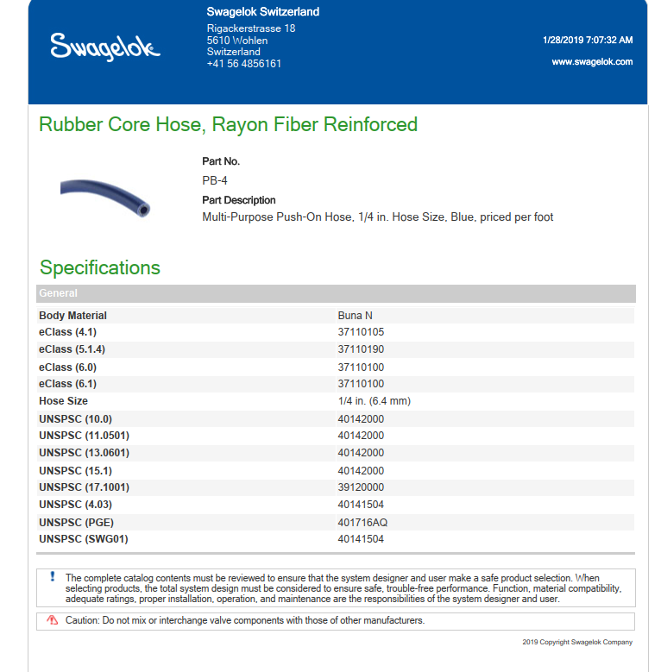
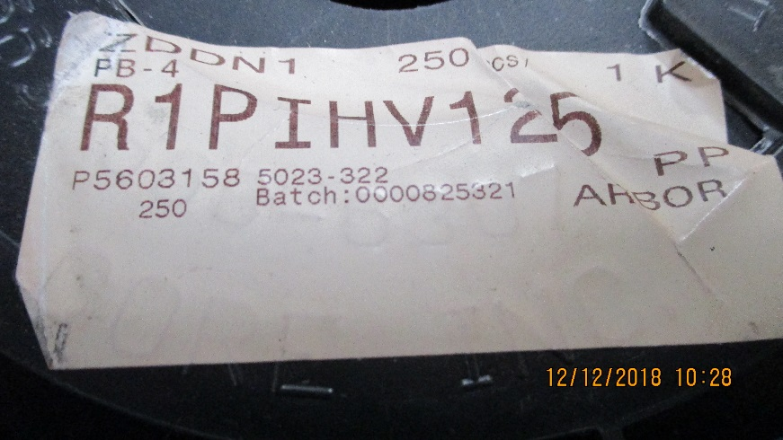
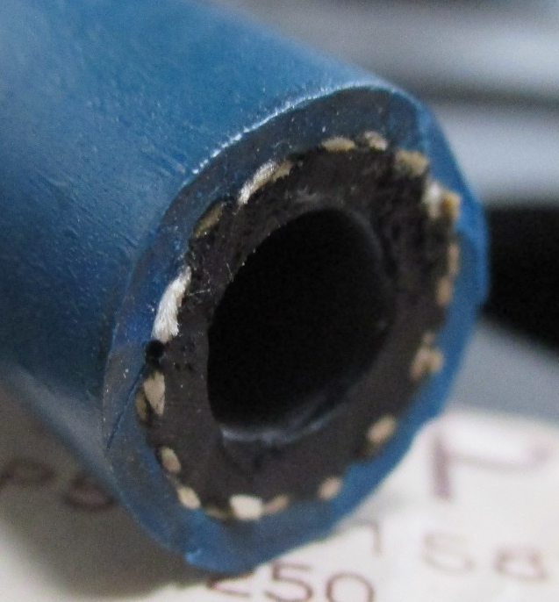
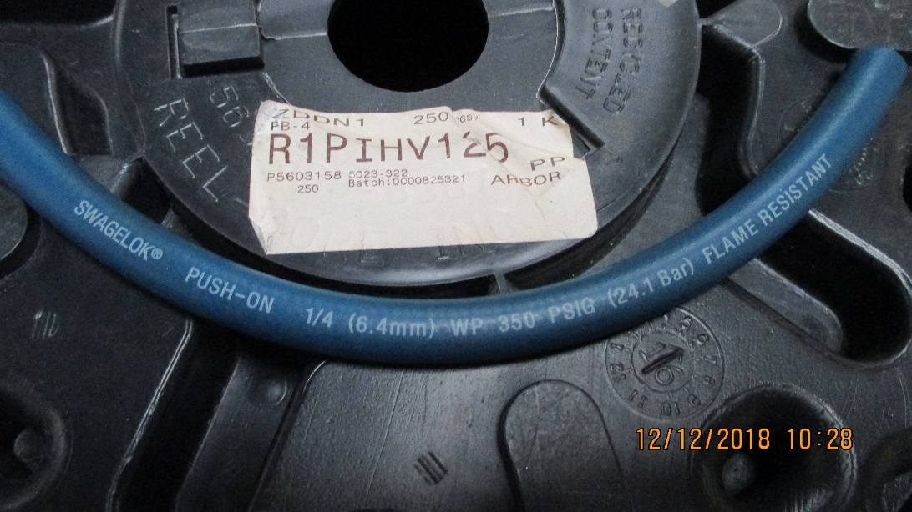
Push-On Hose
https://www.swagelok.com/tools%20pages/download_pdf.aspx?part=PB-4&configured=False
Photos of product used at CERN
Flame Resistant
Halogen Free ??

Slide 4
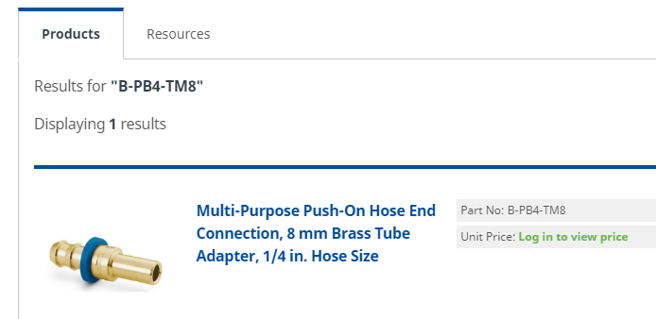
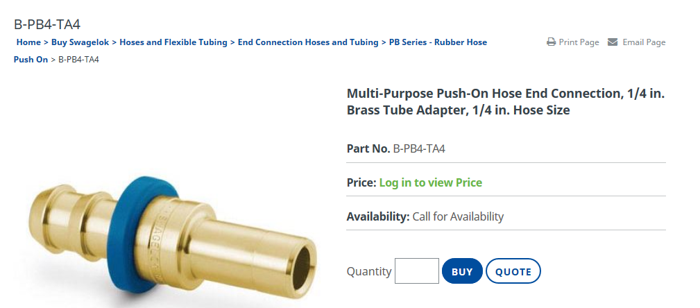
Daniel Robbez, Daniel@hydrosystem.ch, 0227191200
Swagelok Switzerland
Rigackerstrasse 18 5610 Wohlen Switzerland +41 56 4856161 info@arborag.ch https://arbor.swagelok.com
Also available with 8mm pipe;
B-PB4-TM8
From Norbert
Number represent 1/16 inch
ie PB4 equals ¼ inch

Slide 5
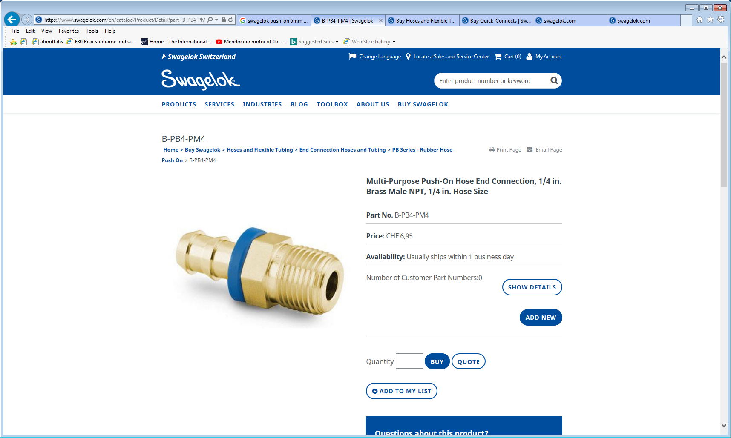
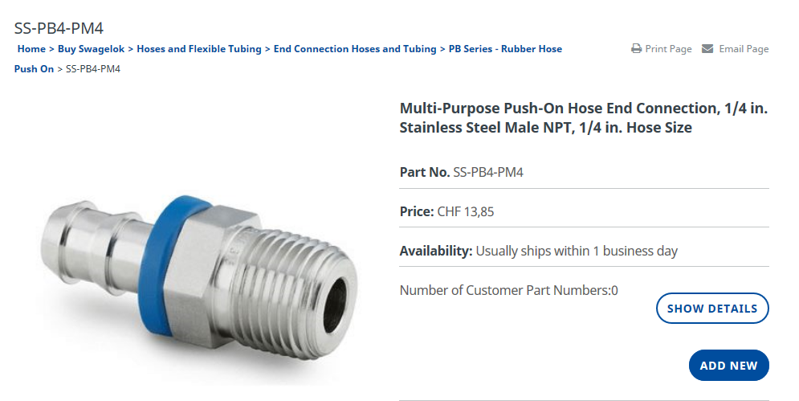
https://www.swagelok.com/en/catalog/Product/Detail?part=B-PB4-PM4
Tappered
SS-PB6-MT6
SS-PB4-PM4
B-PB4-PM4

Slide 6
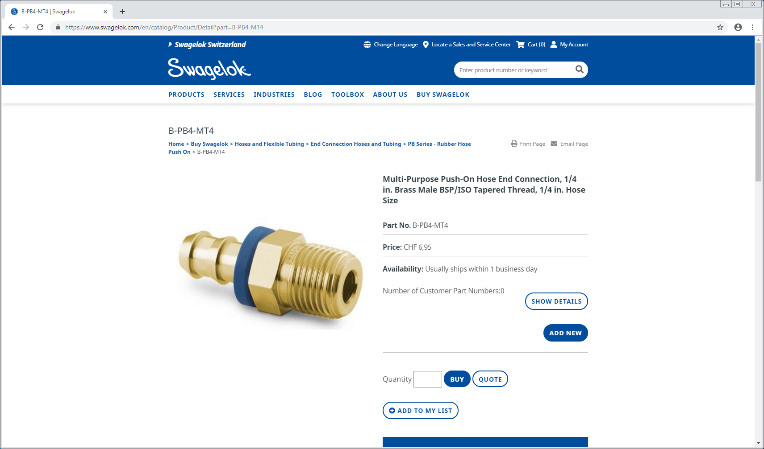

Slide 7
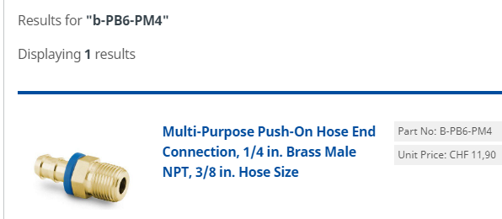

Slide 8
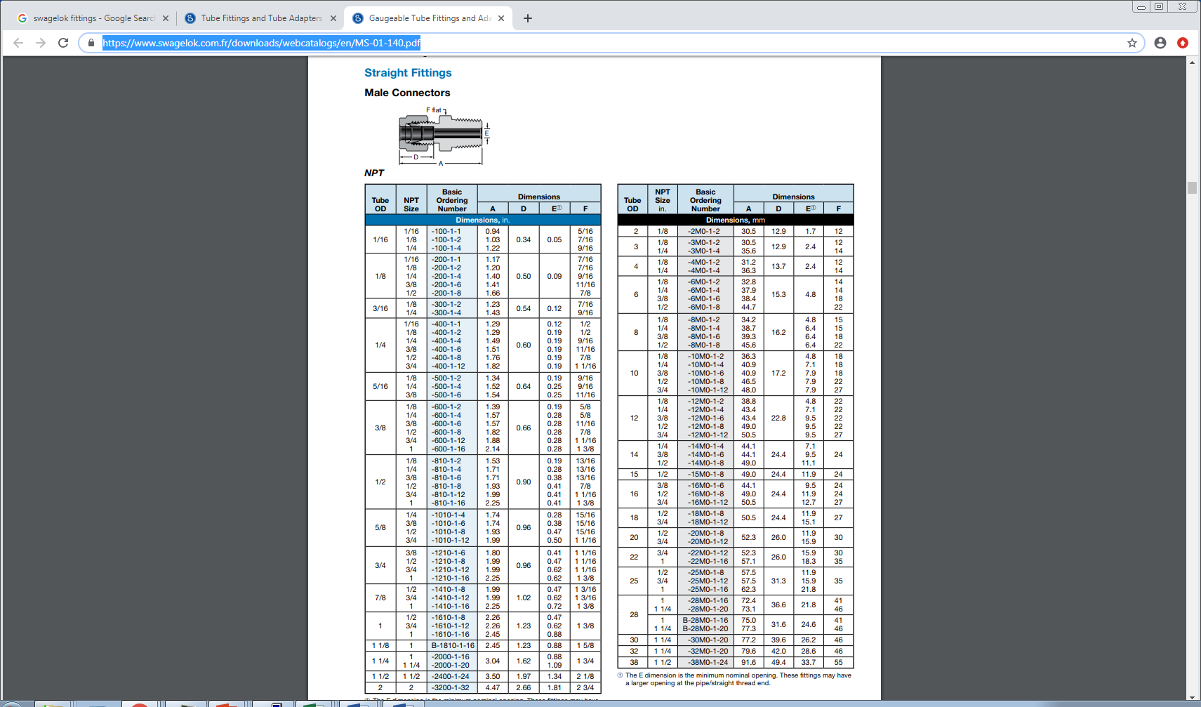
https://www.swagelok.com.fr/en/product/Fittings
https://www.swagelok.com.fr/downloads/webcatalogs/en/MS-01-140.pdf
Reference Brass
Page 14
C20-8MO-1-6
SS-8MO-1-6

Slide 10
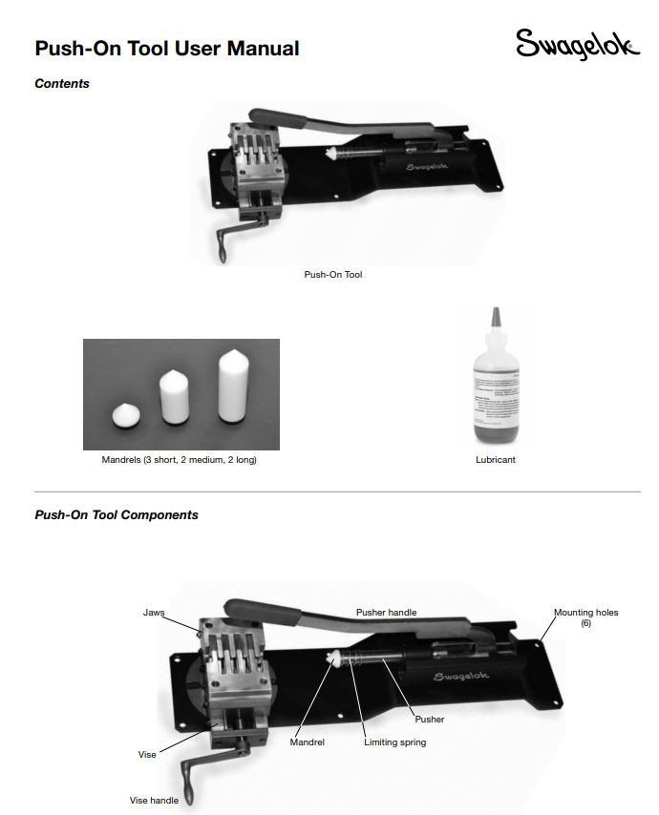
https://www.swagelok.com/downloads/webcatalogs/EN/MS-CRD-0190.PDF

Slide 11
Components for MiniManifold Mod. For RE4/1 cooling

Slide 12
Tables of components for Mini-Manifold modification to Swagelok “Push-On” flexible hose

Slide 13
Components for Chamber end

Slide 14
https://www.swagelok.com/en/catalog/Product/Detail?part=B-PB4-PM4

