Slide 1
Cooling components and unions for RE4/1 cooling.
Conversion to Swagelok done on the Mini-Manifold
Ian, 25 March 2019

Slide 2
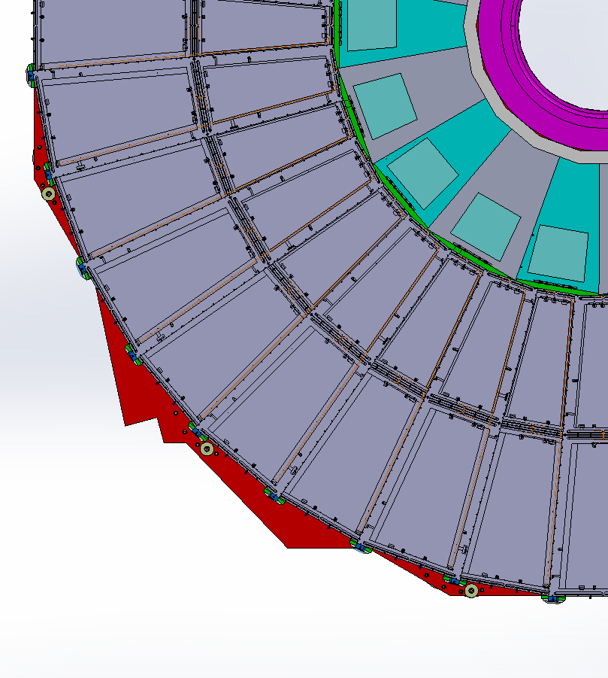
RE4/1 Cooling manifolds
RE4/1
Return
Manifold
Diagram of 1 channel per 2 chambers. Flexible hose from the “T” mounted on the mini manifold.
The two RE4/1s will also be linked by flexibles.
Supply

Slide 3
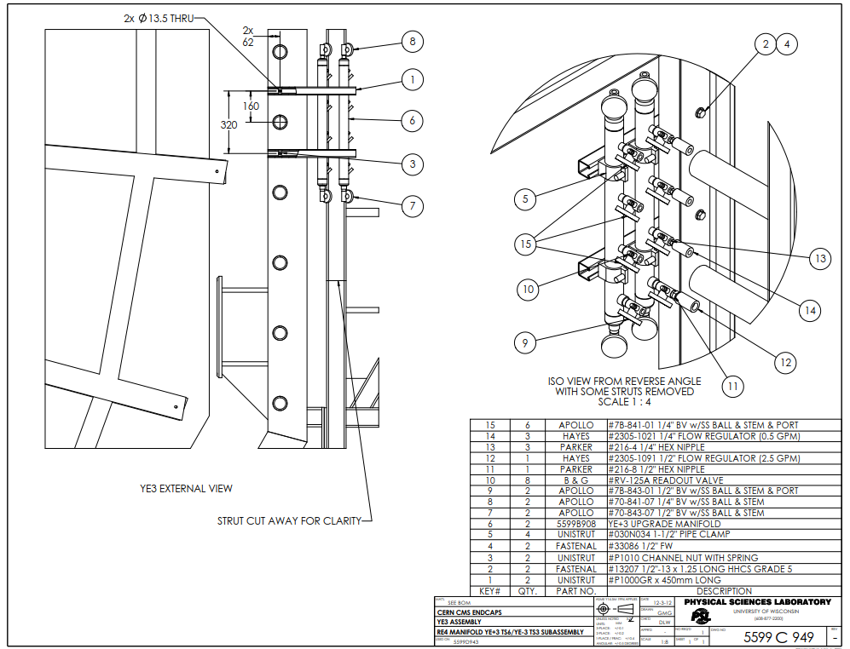
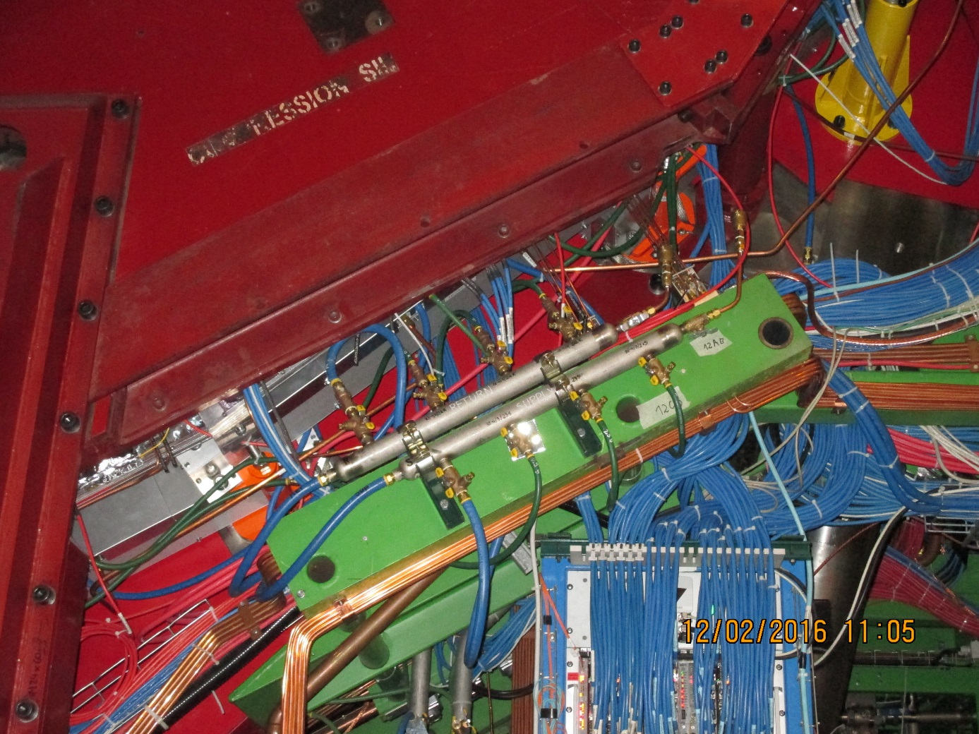
Mini manifold . To be modified to accept the necessary “T”s for the RE4/1 cooling.
The same flow regulators will be kept with individual cut off valves to each chamber, if costs permit.

Slide 4
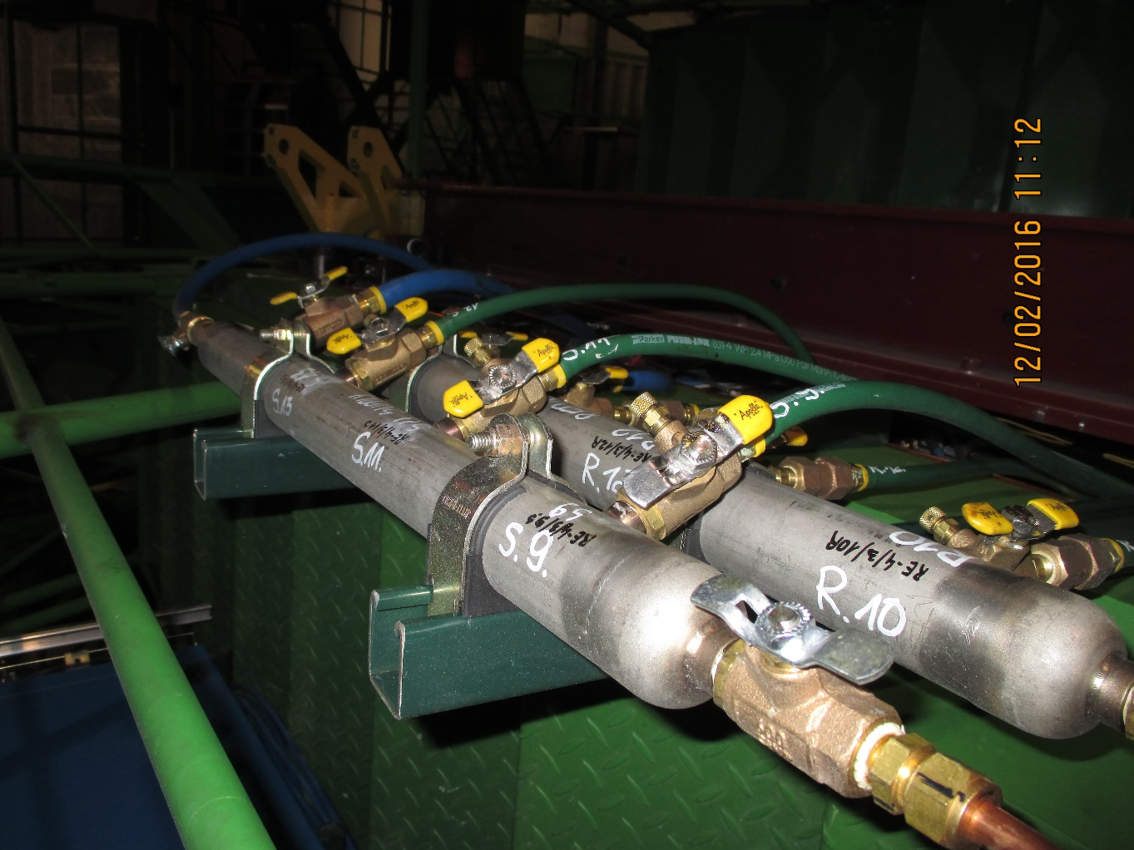
This list will be ordered, simplified , from the USA or from XX in P5 in inch size.

Slide 5
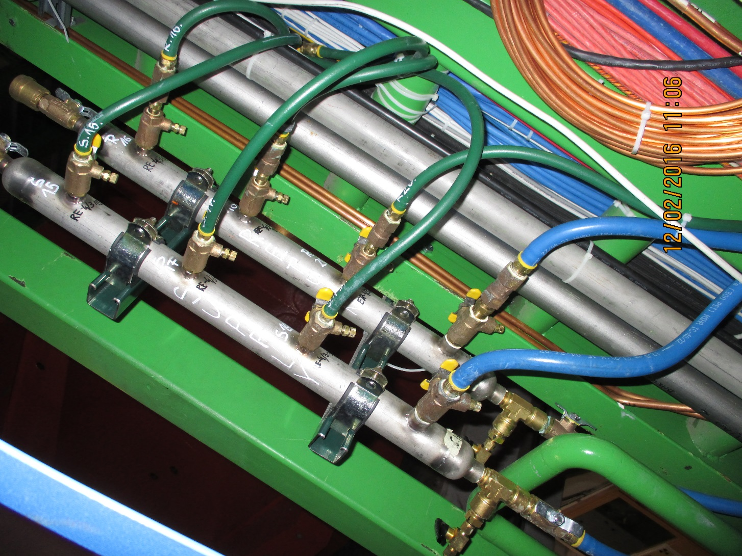

Slide 6
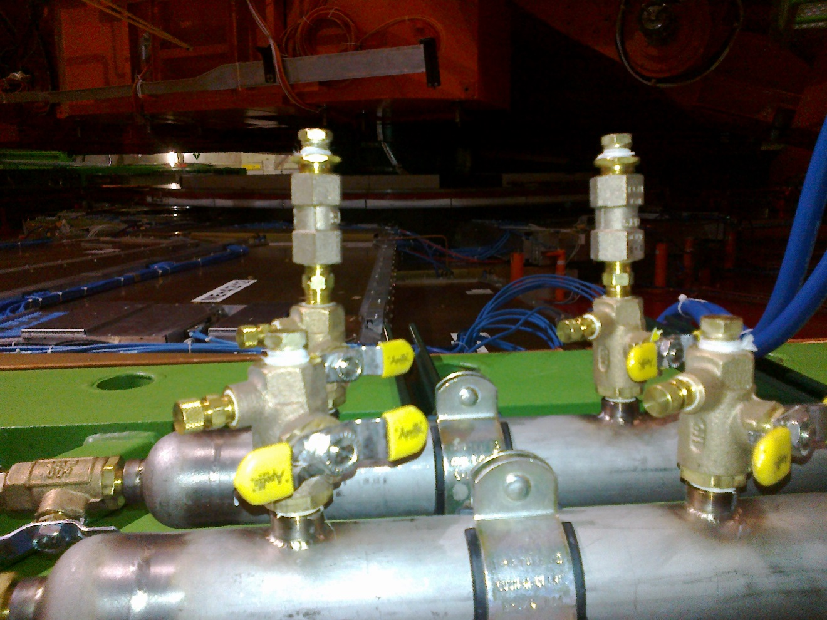

Slide 7
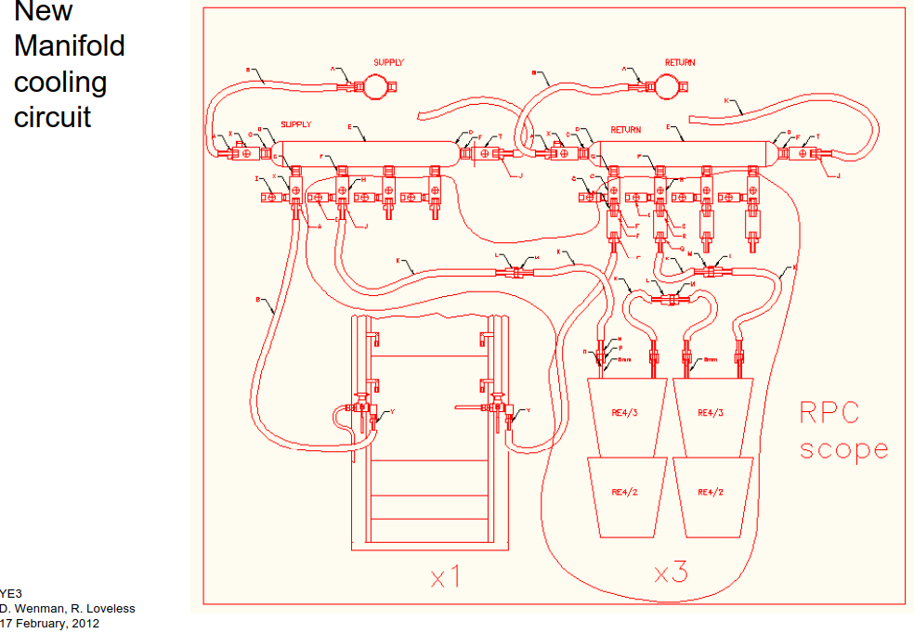

Slide 8
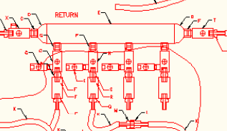
Return Manifold
H
S
R
Q
R
F

Slide 9
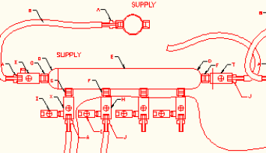
Supply Manifold
F
I
H
J
“MPT” should be “NPT”

Slide 10
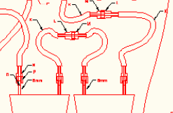
Chamber fittings
M
L
K
N
O
P
8mm

Slide 11
Modified Supply Manifold
NPT not MPT
A Bell & Gosset # RV -125A Readout valve
41.08.84.404.6
T Parker "T" Female 1/4 NPT 4-4-4 FT-SS
N Parker 216-4 1/4" hex nipple
J
H
H
J
A
A

Slide 12
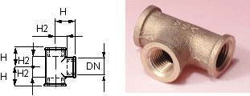
Modified Return Manifold
T Parker "T" Female 1/4 NPT 4-4-4 FT-SS
NPT not MPT
41.08.84.504.3
N Parker 216-4 1/4" hex nipple
“Hayes” should be “Hays”
41.20.12.008.1
Not ¼” NPT
R
H
H
R
Q
Q

Slide 13
Table originally sent to Dick in 2018
Components for the Mini Manifold modification for RE4/1 cooling
 | For one circuit | For one circuit |  | 9 circuits | 9 circuits | Total | Both Endcaps | 20% spares
 |  |  |  |  |  | One Endcap
 | Supply | Return |  | Supply | Return
Parker 216-4 1/4" hex nipple | 2 | 2 |  | 18 | 18 | 36 | 72 | 86
Parker "T" Female 1/4 NPT 4-4-4 FT-SS | 1 | 1 |  | 9 | 9 | 18 | 36 | 43
Apollo 7B-841-01 1/4" ball valve w/SS ball & stem & port | 1 | 1 |  | 9 | 9 | 18 | 36 | 43
Bell & Gosset # RV -125A Readout valve | 1 | 1 |  | 9 | 9 | 18 | 36 | 43
Hays Mesurflo #2305-1021 1/4" & 3/8"Flow Regulator (0.5gpm) |  | 1 |  |  | 9 | 9 | 18 | 22
Parker #30182-4-4B 1/4" NPT M to 1/4" hose barb | 1 |  |  | 9 |  | 9 | 18 | 22
Parker #30182-6-4B 3/8" NPT M to 1/4" hose barb |  | 1 |  |  | 9 | 9 | 18 | 22
Parker #831-4 1/4"Push-Lok hose green | 1 | 1 |  | 9 | 9 | 18 | 36 | 400m
Hays Mesurflo #2305-1011 1/4" & 3/8"Flow Regulator (0.25gpm) |  | 1 |  |  | 9 | 9 | 18 | 22
These 3 lines are converted to Swagelok
Line also removed

Slide 14
Additional slides

Slide 15
Refs. CSC Dick and co
http://project-cms-rpc-endcap.web.cern.ch/project-cms-rpc-endcap/rpc/Services/Cooling/RE4cooling/MiniManiFold/RE4MiniManifold.zip
Then folder RE4 cooling, file “coolingYE3_26apr12”

Slide 16
Power dissipated on chamber
30W per chamber
540W per station
1080W per Endcap
6 mini-manifolds for 18 chambers
3 chambers for 1 Mini-Mnifold
Each Mini Manifold has 3 channels
Each channel will me didvide into two.

Slide 17
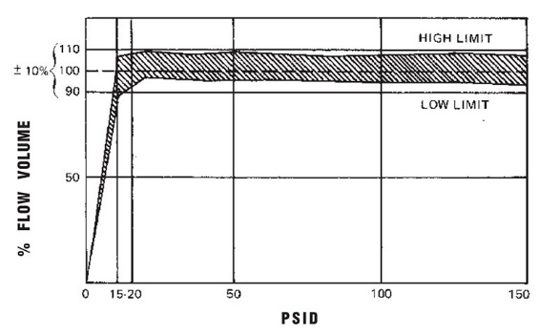
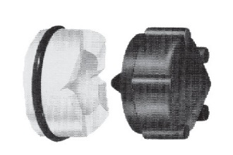
Apollo Valves
http://www.epmc.co.th/Valves/Apollo_pdfs/Apollo%20Ball%20Valve%20Numbering%20System.pdf
Full catalogue
https://www.cooneybrothers.com/ASSETS/DOCUMENTS/ITEMS/EN/Apollo_50GB-6A7A_Catalog.pdf
SS valves
https://www.parkersupply.com/images/siteAssets/pdf/Apollo_Ball_Valves_Catalog_-_APBVCA.pdf
Flow restrictors
Spelling “Hays” not Hayes !!
Hayes Mesurflo 2305-1021 ¼” flow regulator 0.5GPM ( gallons USA = XXX litres/ min)
http://flowcontrolvalves.haysfluidcontrols.com/viewitems/solenoid-valves/series-2305-mesurflo-automatic-flow-control
Full catalogue
http://famco.ca/wp-content/uploads/2013/07/Hays-Solenoid.pdf

Slide 18
Read Out from port on “Apollo” ball valve probe
B&G (Bell and Gosset) RV-125A Readout valve ( diaphragm to be pierced by)
http://bellgossett.com/flow-balancing/flow-measurement/readout-valve-rv-125a-and-readout-probe-rp-250b/
https://shop.galloup.com/buy/product/rv-125a-b-g/3053529
https://www.statesupply.com/bi1311
https://media.statesupply.com/filemanager/1/8/1854.pdf

Slide 19
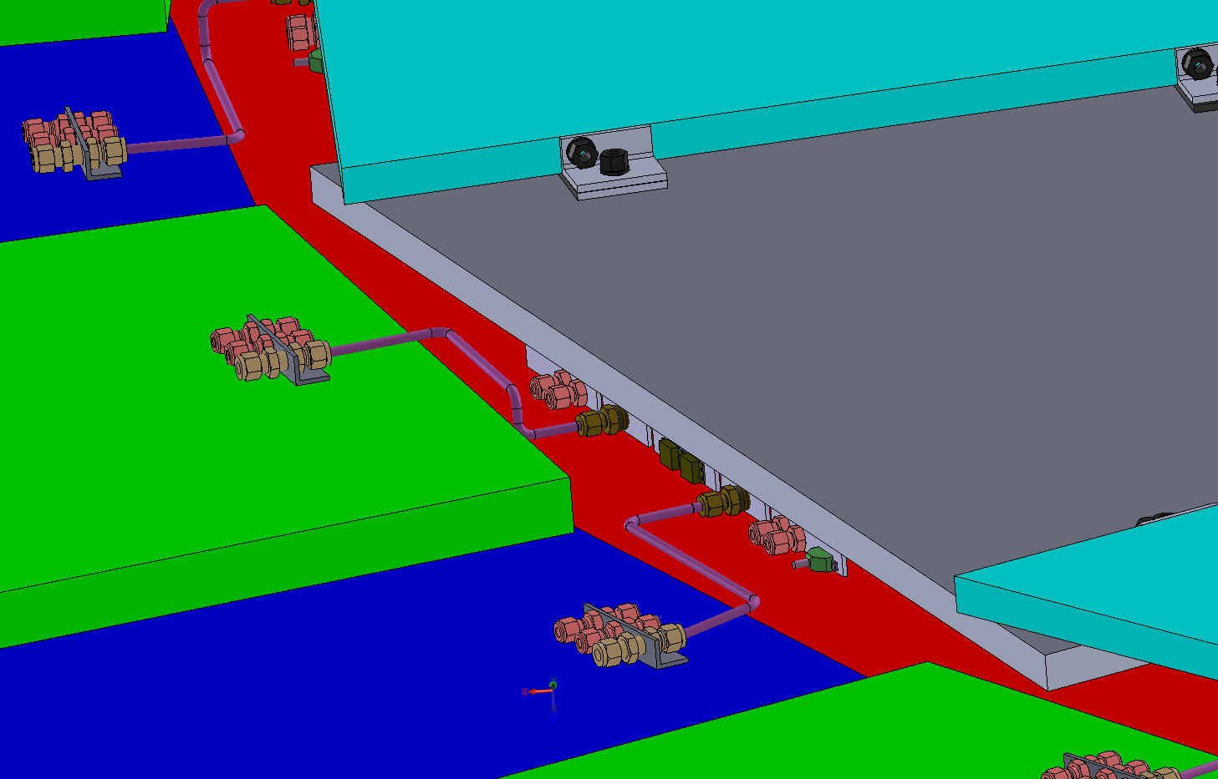
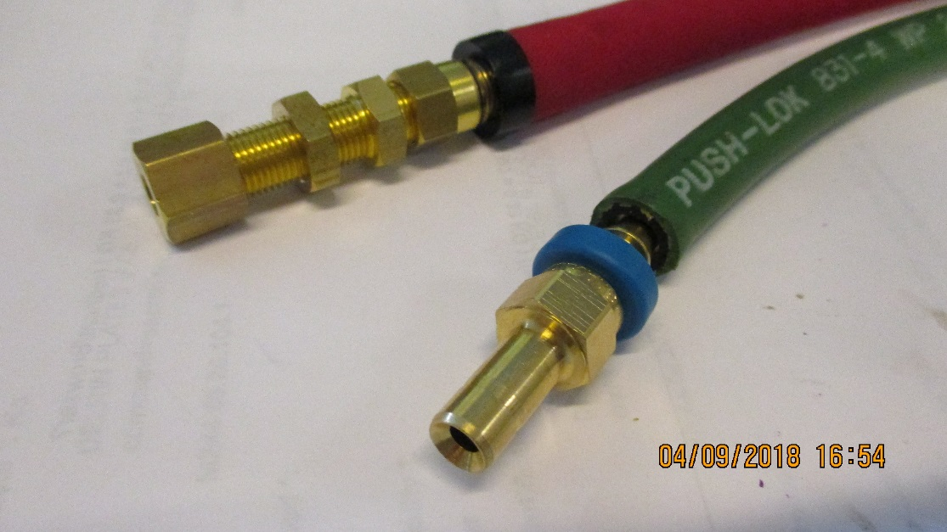
RE3/1 cooling link to RE3/2
x2 RE3/2 circuits feed x1 RE3/1 chamber
The rigid copper piping will be replaced by flexible hose links to reduce the strain on the unions.

Slide 20
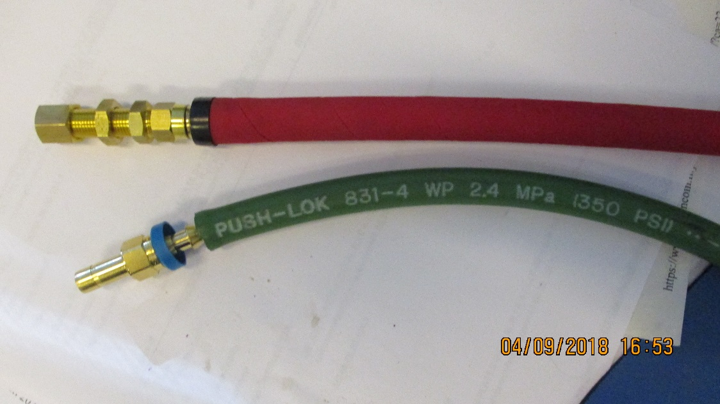
Cooling
RE3/1
Verify the assembly of the flexibles with simplified safer version, namely direct from RE3/2 PP to RE3/1 PP with three elements only, as opposed to 3 times as many unions with a “L” Cu pipe producing a lever arm on the chamber PP.
RE4/1
Modify the present Mini-manifolds to take additional “take offs” direct to the chambers with flexibles all the way to the RE4/1 PP.

Slide 21
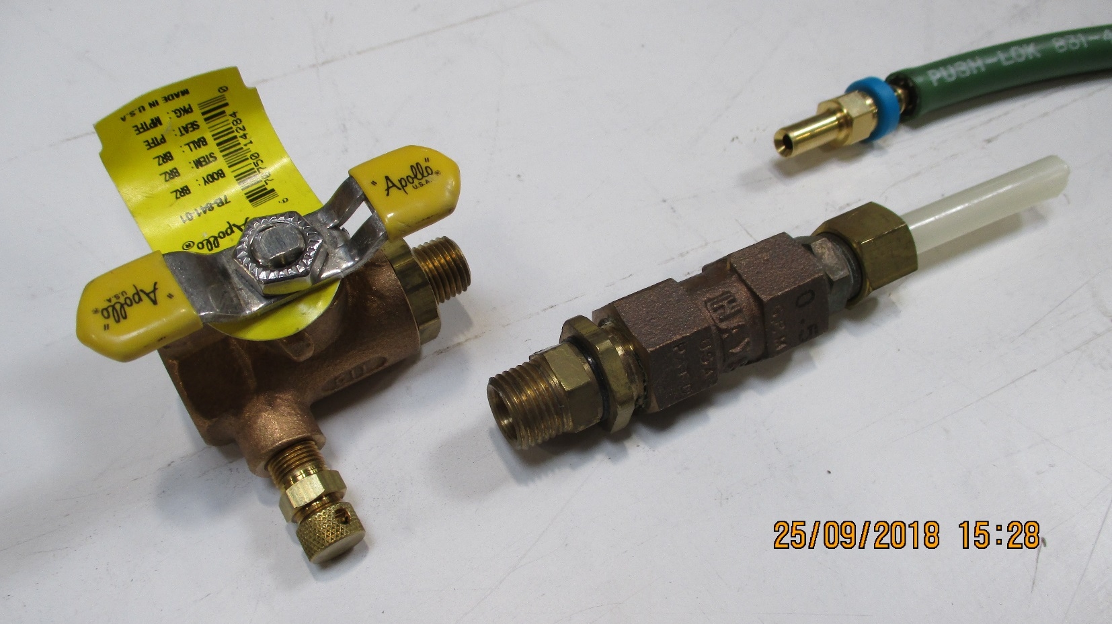
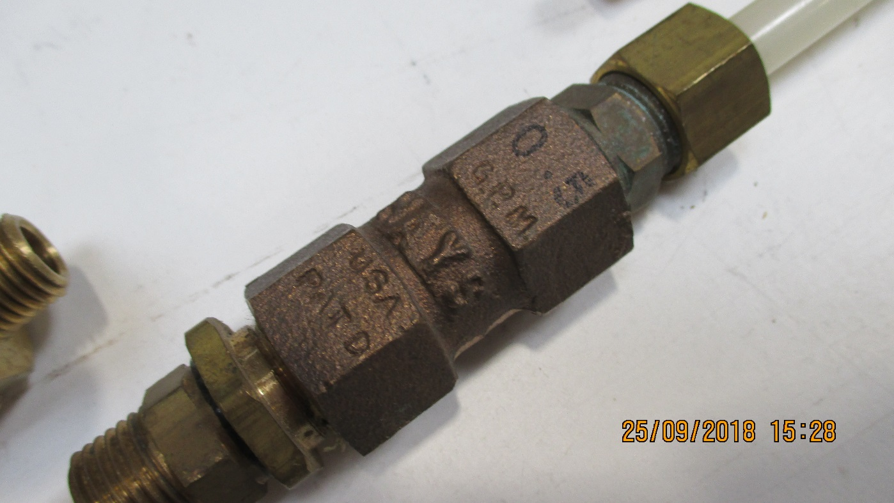
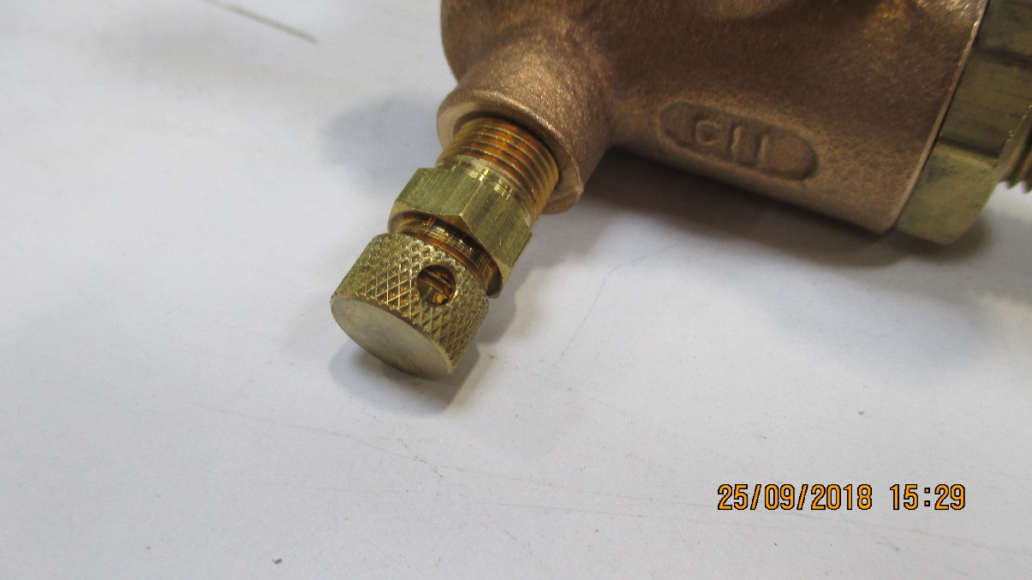
Components used in RE cooling and Mini-manifold

Slide 22
Contacts
French Supplier
USA Supplier
CERN
27/1-003 76295 163618 Norbert.Frank@cern.ch
35/3-015 72968 161148 vincent.pittin@cern.ch

Slide 23
