Slide 1
Hose leak tests in 904
Ian
14 Oct 2019

Slide 3
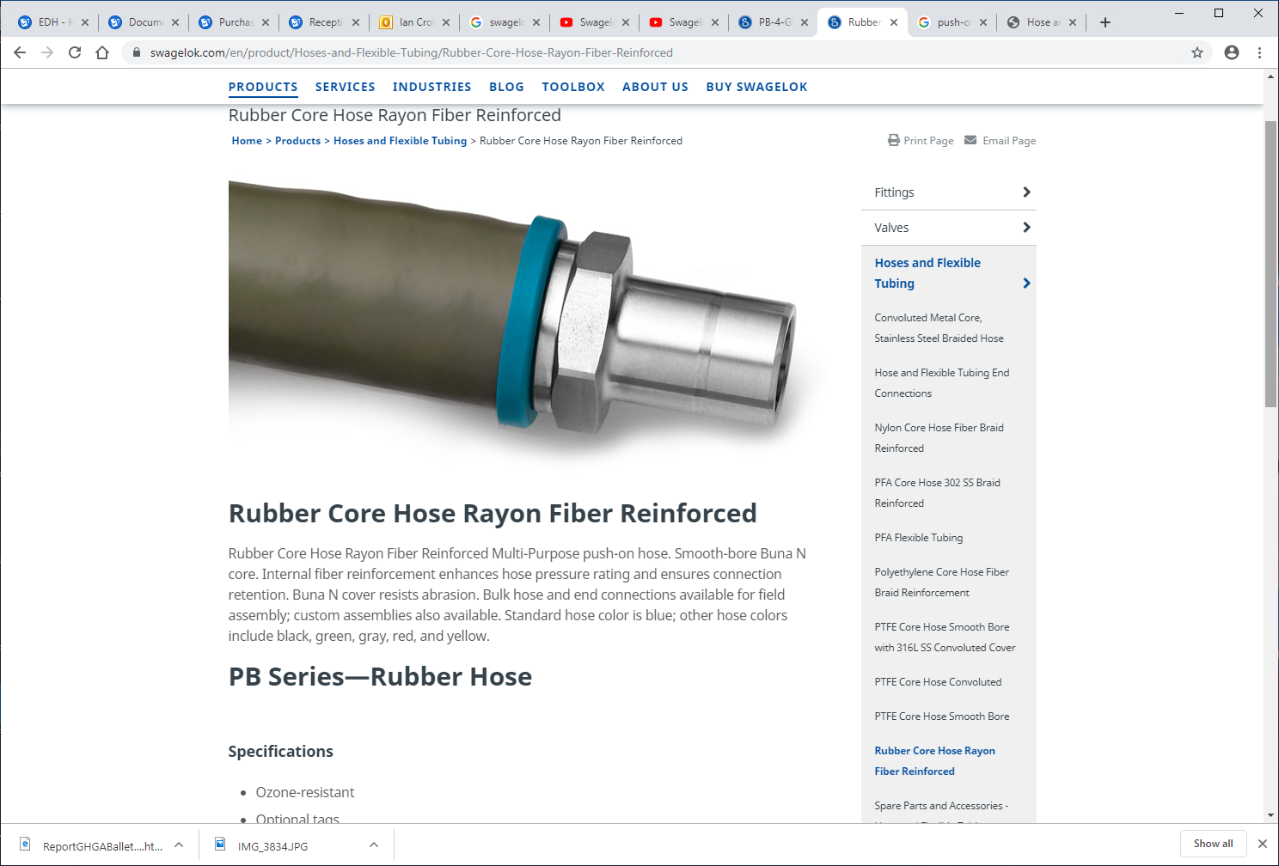
https://www.swagelok.com/en/product/Hoses-and-Flexible-Tubing/Rubber-Core-Hose-Rayon-Fiber-Reinforced

Slide 5
Video made by Piotr from ZEC in 10 Oct 2019 while pressure testing with Argon the RE+4/1 installed cooling hoses.
NOTA
The hose & union are not under pressure but have been !!!!
http://project-cms-rpc-endcap.web.cern.ch/project-cms-rpc-endcap/rpc/UpscopeHighEta/RPCDevelopements/RE31and41/Services/Cooling/PipingYoke/Modification/Installation/Photos/
Then select file ;
20191010101400.mp4
But if it does not work this file will;
redir.htm
follow the down load. It is 40Mb.

Slide 6
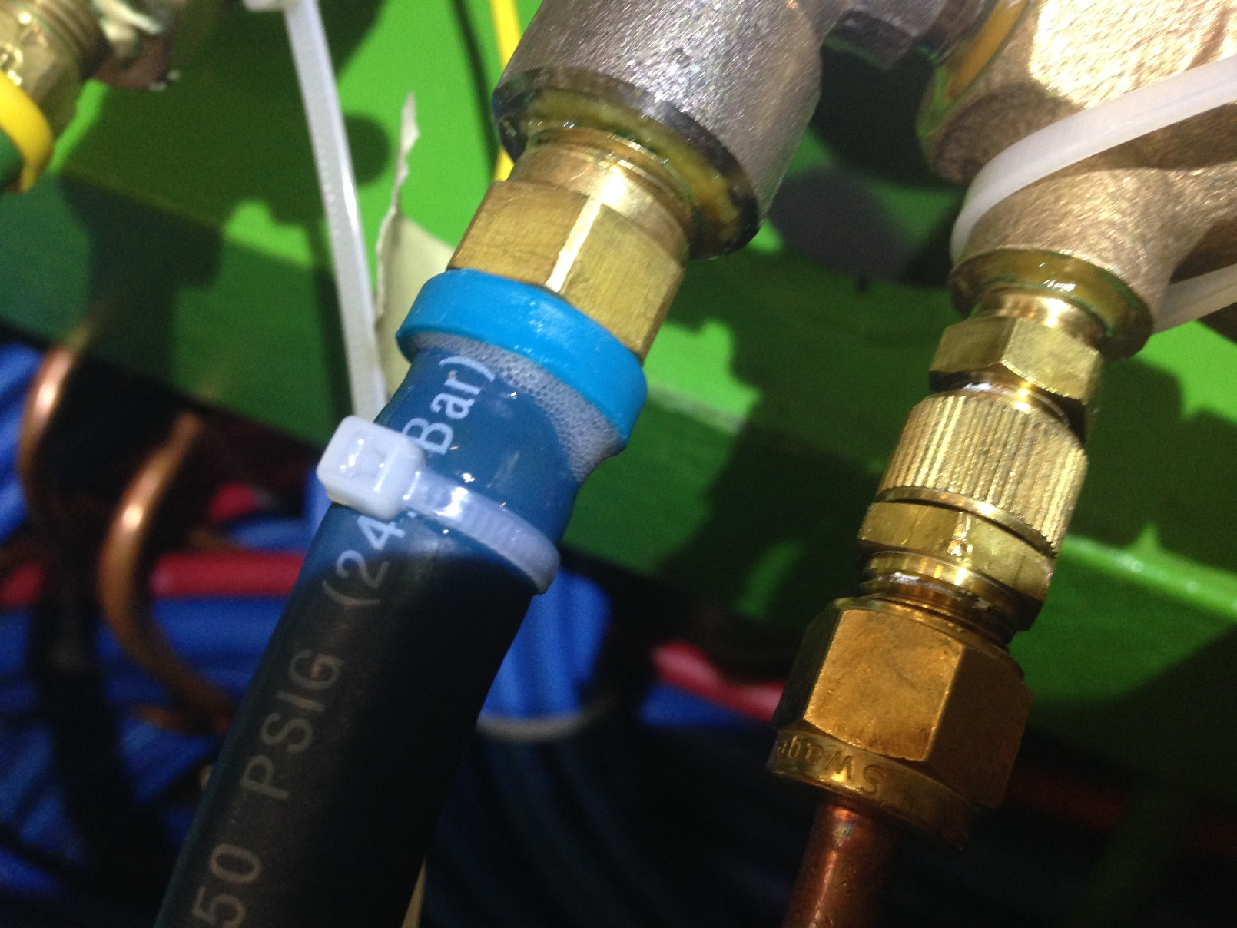
Photo taken on Friday by Anton with the line under 15 Bar Argon test pressure.
The cable tie has been applied AFTER the pressure was applied to try and stop the leak.
This is NOT the same condition indicated in the previous slide showing the video of the leak with NO pressure

Slide 7
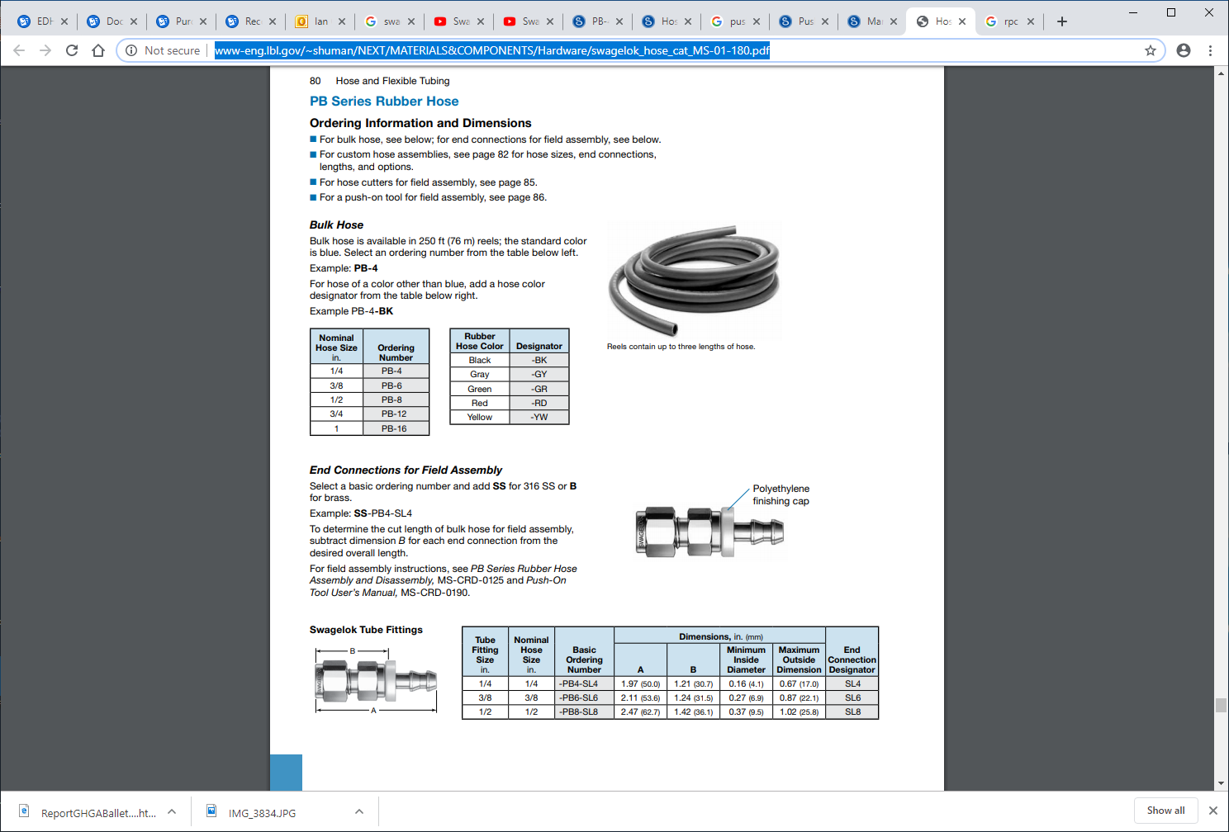
http://www-eng.lbl.gov/~shuman/NEXT/MATERIALS&COMPONENTS/Hardware/swagelok_hose_cat_MS-01-180.pdf

Slide 8
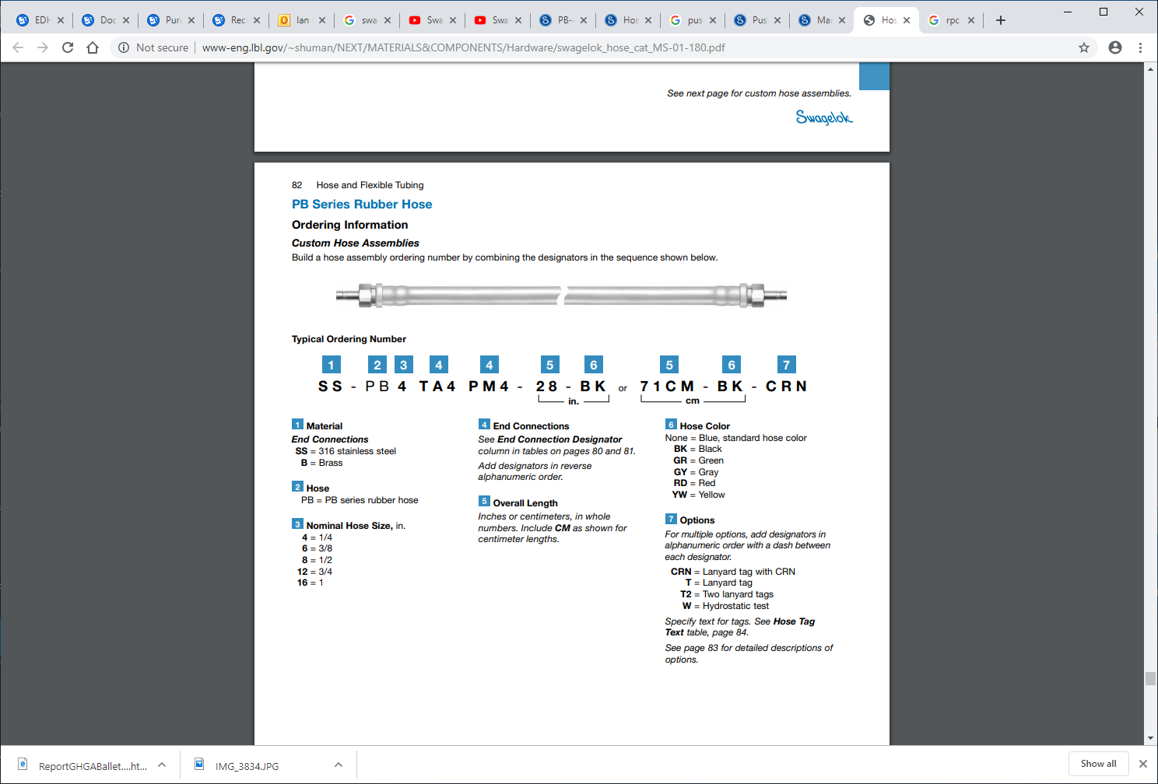

Slide 11
https://www.swagelok.com/downloads/webcatalogs/EN/MS-CRD-0190.PDF

Slide 12
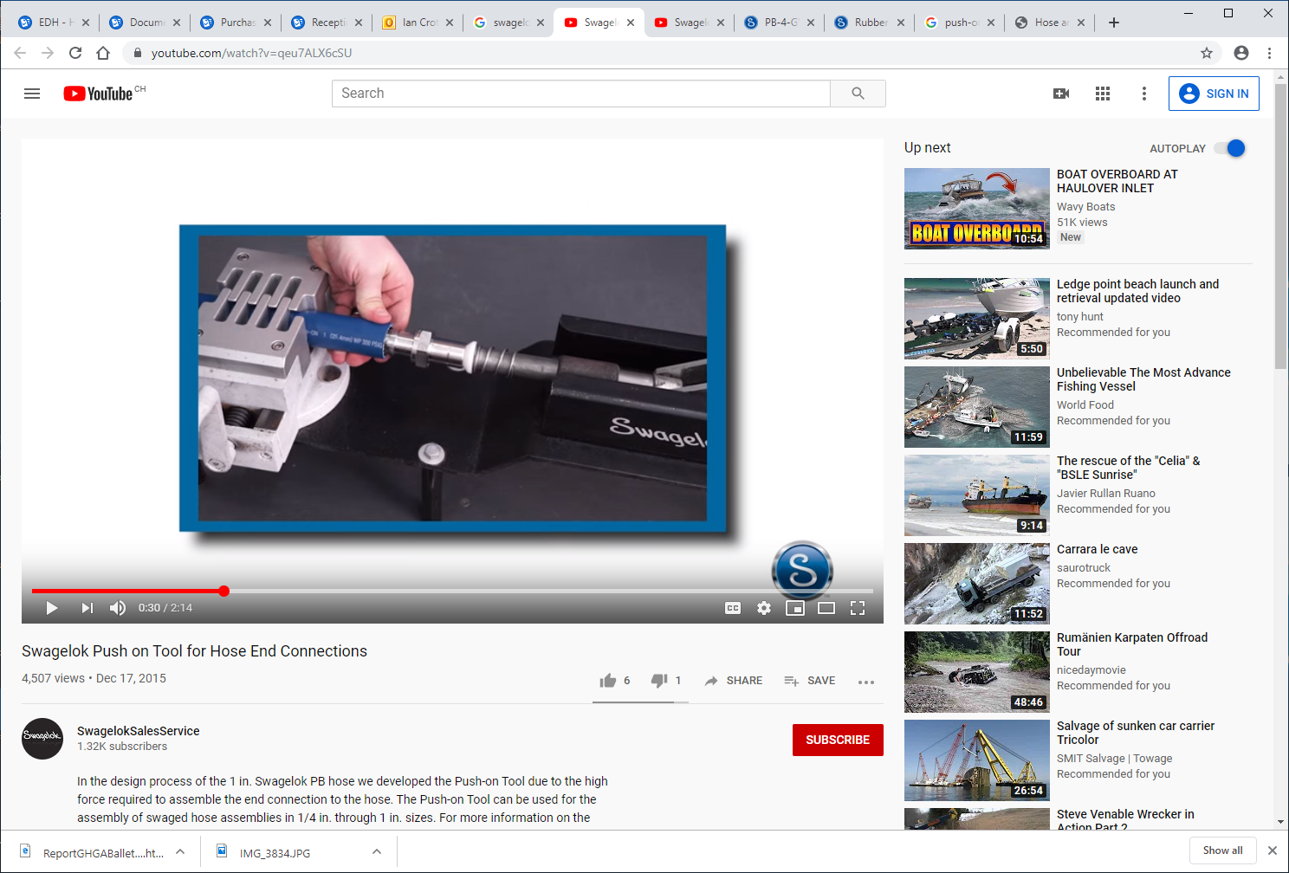
https://www.youtube.com/watch?v=qeu7ALX6cSU
https://www.youtube.com/watch?v=IAsKLmMpbtk

Slide 13
https://www.swagelok.com/downloads/webcatalogs/EN/MS-CRD-0125.PDF
This method is not good as the barbs WILL be damaged

Slide 14
https://www.youtube.com/watch?v=IAsKLmMpbtk

Slide 16
Other manufactures and their hoses , unions and assembly methods

Slide 17
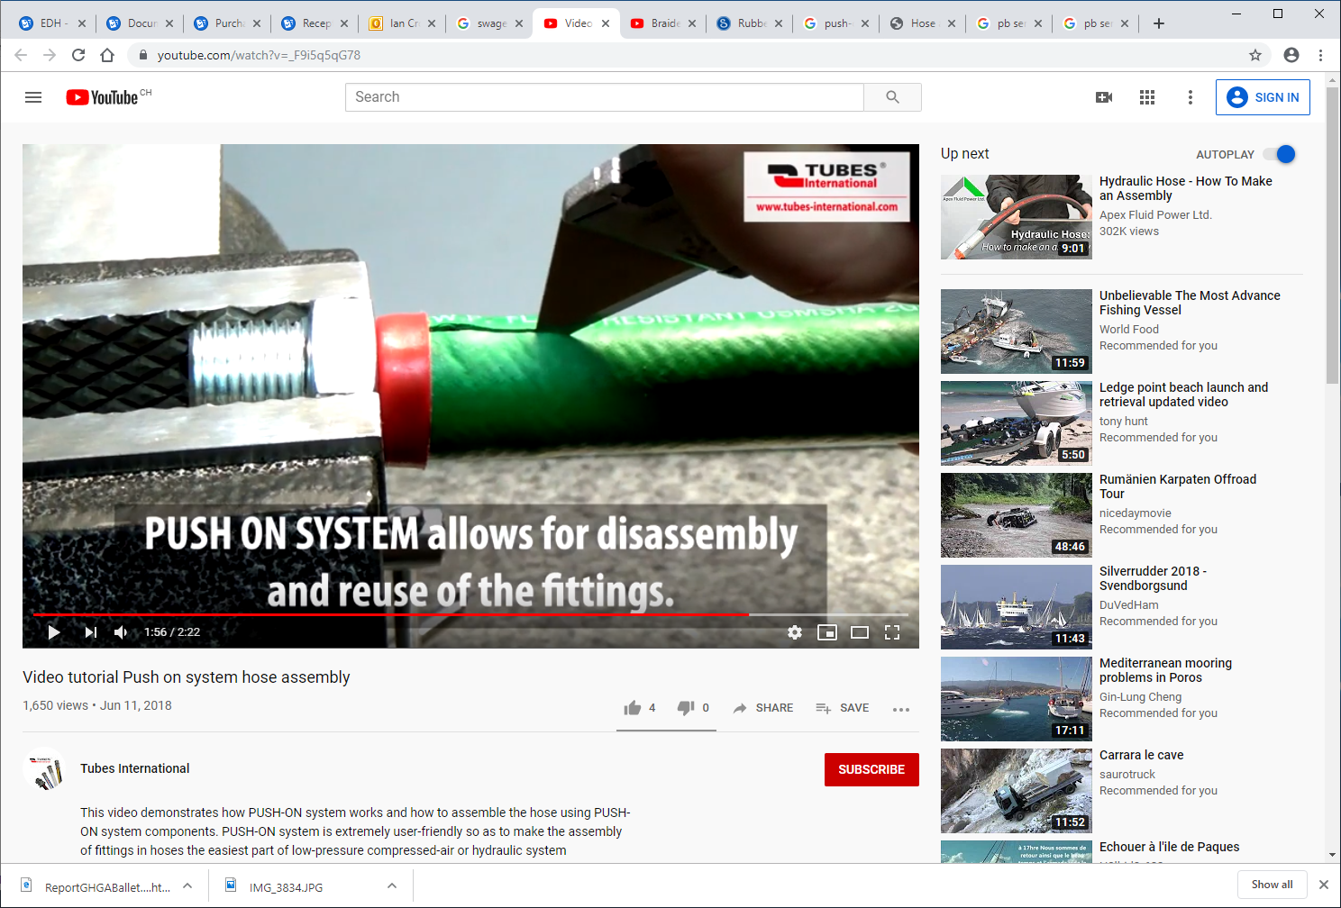
Tubes International
https://www.youtube.com/watch?v=_F9i5q5qG78

Slide 18
Parker

Slide 19
https://www.parker.com/static_content/LiteratureX/4281%20B1.pdf
https://www.parker.com/portal/site/PARKER/menuitem.223a4a3cce02eb6315731910237ad1ca/?vgnextoid=f92caf5c6f65e210VgnVCM10000048021dacRCRD&vgnextfmt=EN

Slide 20
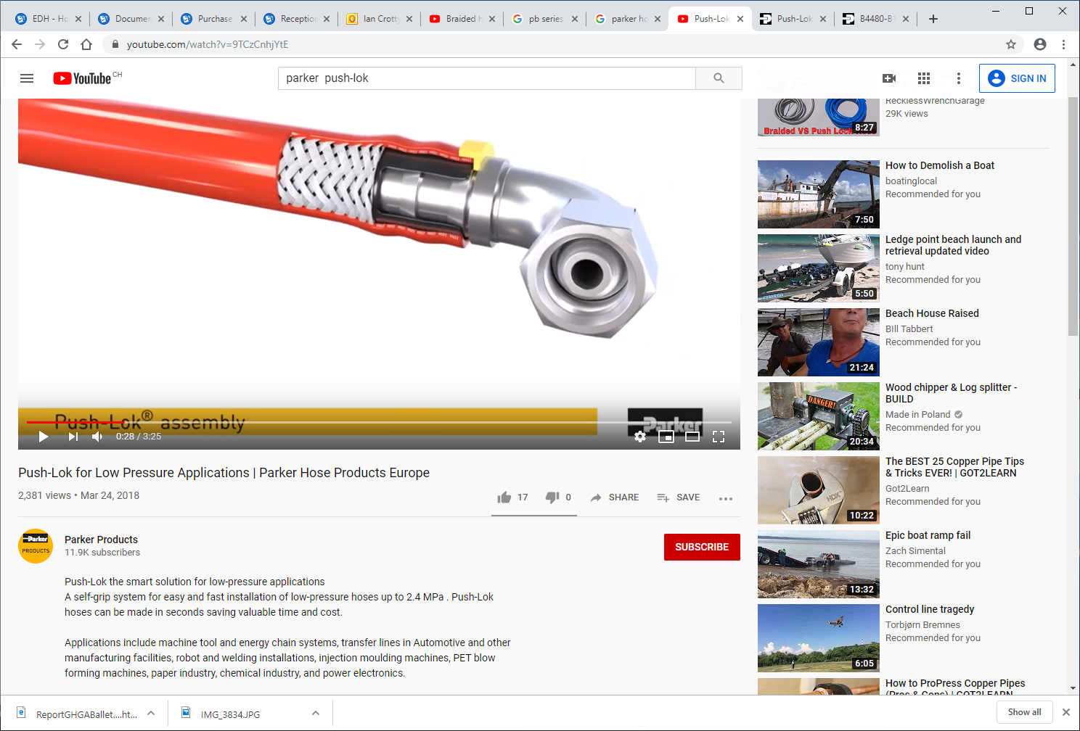
https://www.youtube.com/watch?v=rI_rVnmmy_E
https://www.youtube.com/watch?v=9TCzCnhjYtE

Slide 21
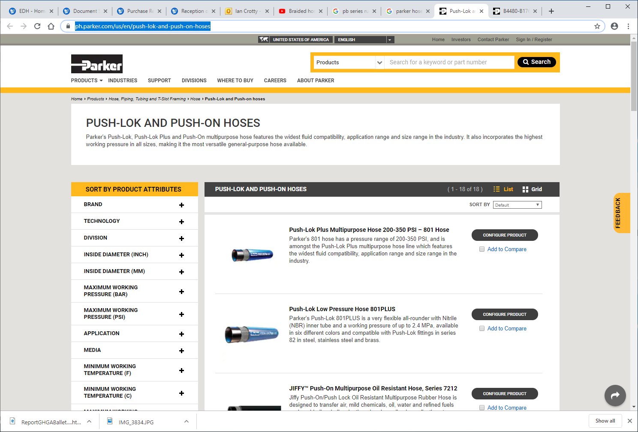
https://ph.parker.com/us/en/push-lok-and-push-on-hoses

Slide 22
https://www.parker.com/Literature/Hose%20Products%20Division%20Europe/Literature_2014/Sales%20and%20Marketing%20Bulletins/Push-Lok%20Hose_Fittings_BUL_4480-B176_UK_2016-11.pdf

Slide 23
http://www.hccl.ie/uploads/1/4/7/3/1473854/parker_push_lok_catalogue_-_industrial.pdf
Cataloge from UK supplier 2007
Very complete union selection

Slide 24
https://www.youtube.com/watch?v=f-hxFVYTh9Q

