Slide 1
Cooling Manifolds assemble Notes
Ivan, Jan, Andres and Ian
26 Aug 2019

Slide 2
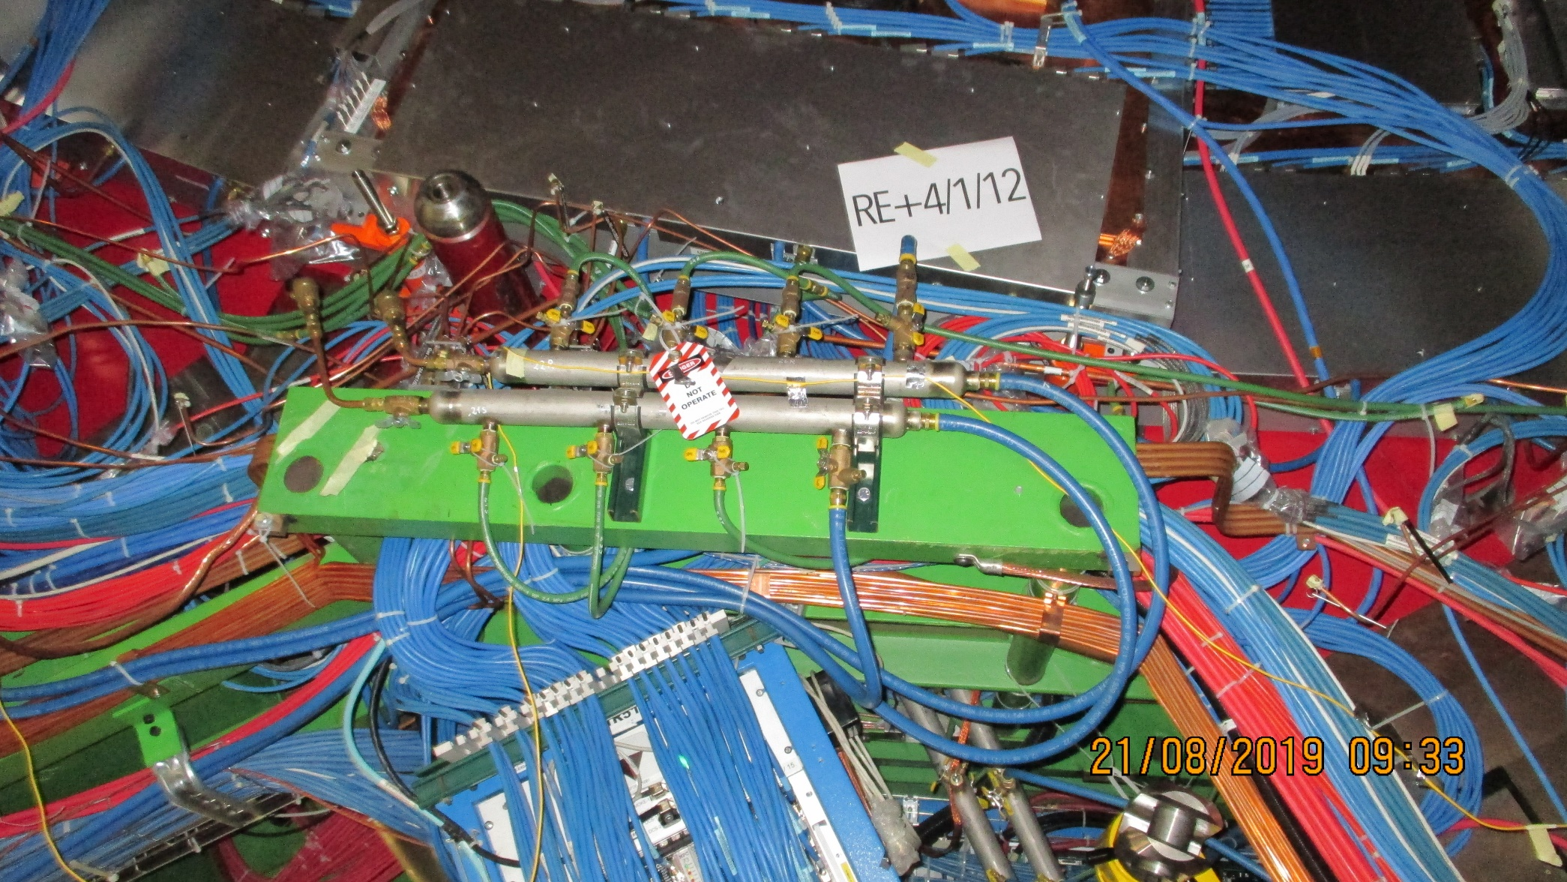
Mini Manifolds 3, 4 and 5 on the far side of RE+4/1

Slide 3
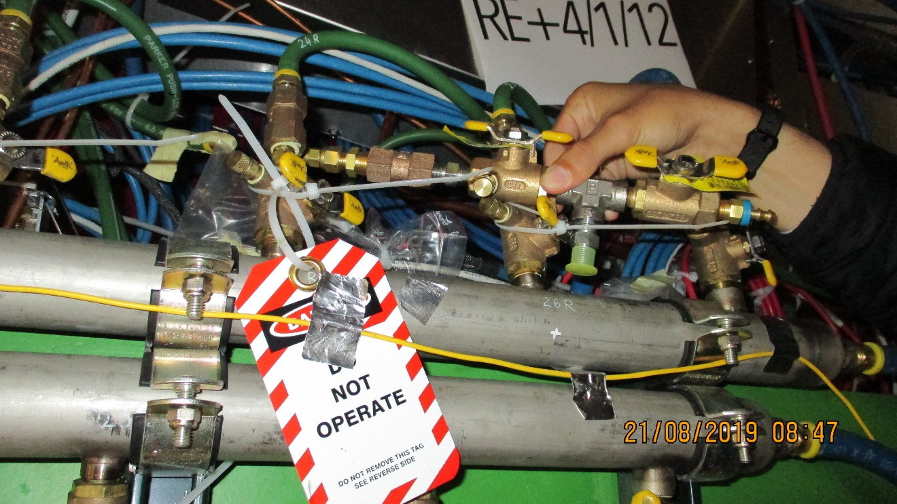
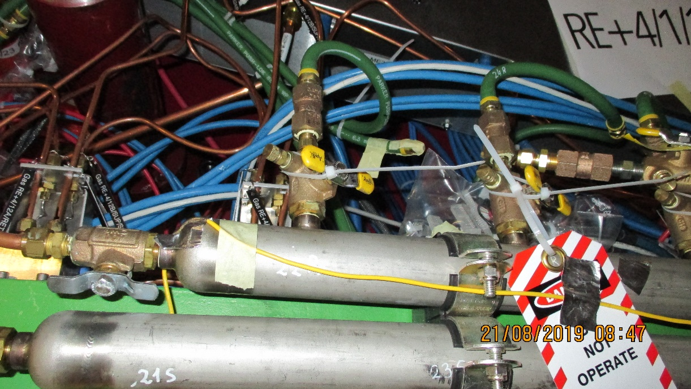
Mini Manifolds 5 Far side at the bottom

Slide 4
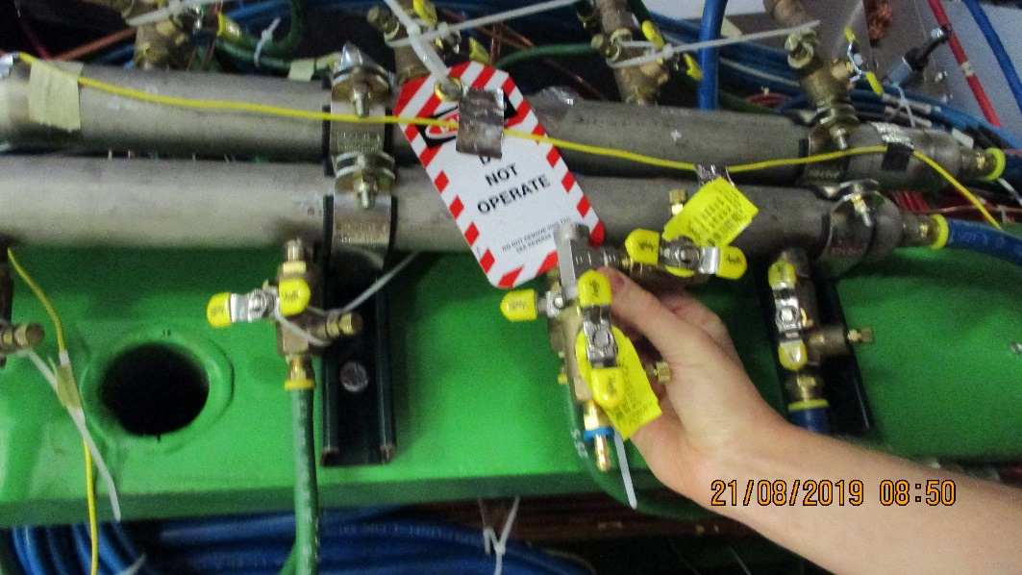
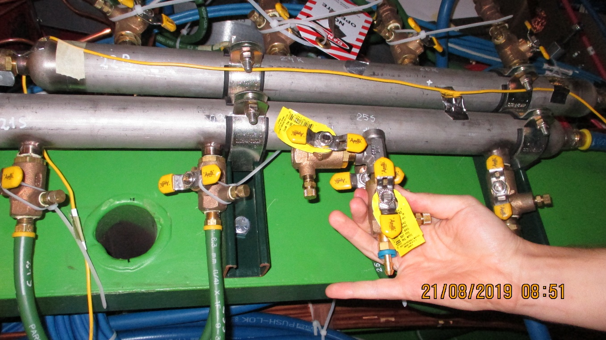
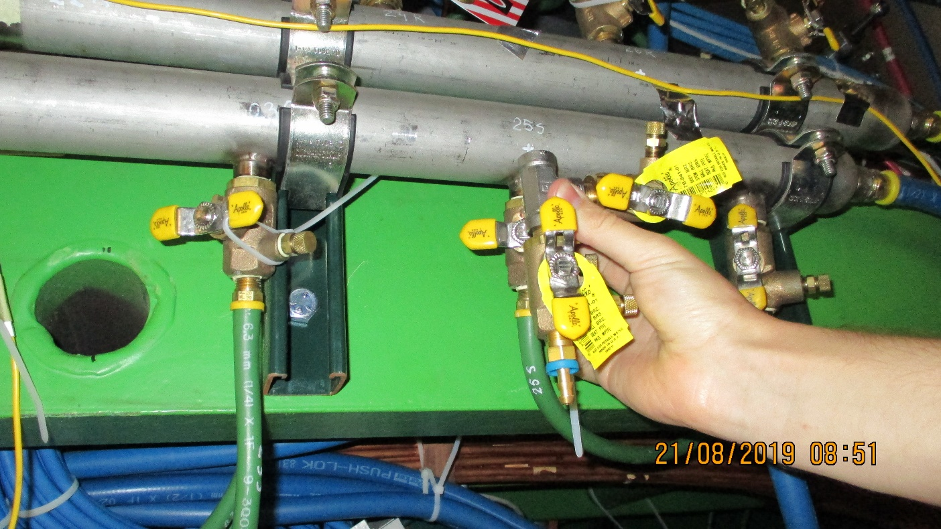
Alternative configuration
Mini Manifolds 5 Far side at the bottom

Slide 5
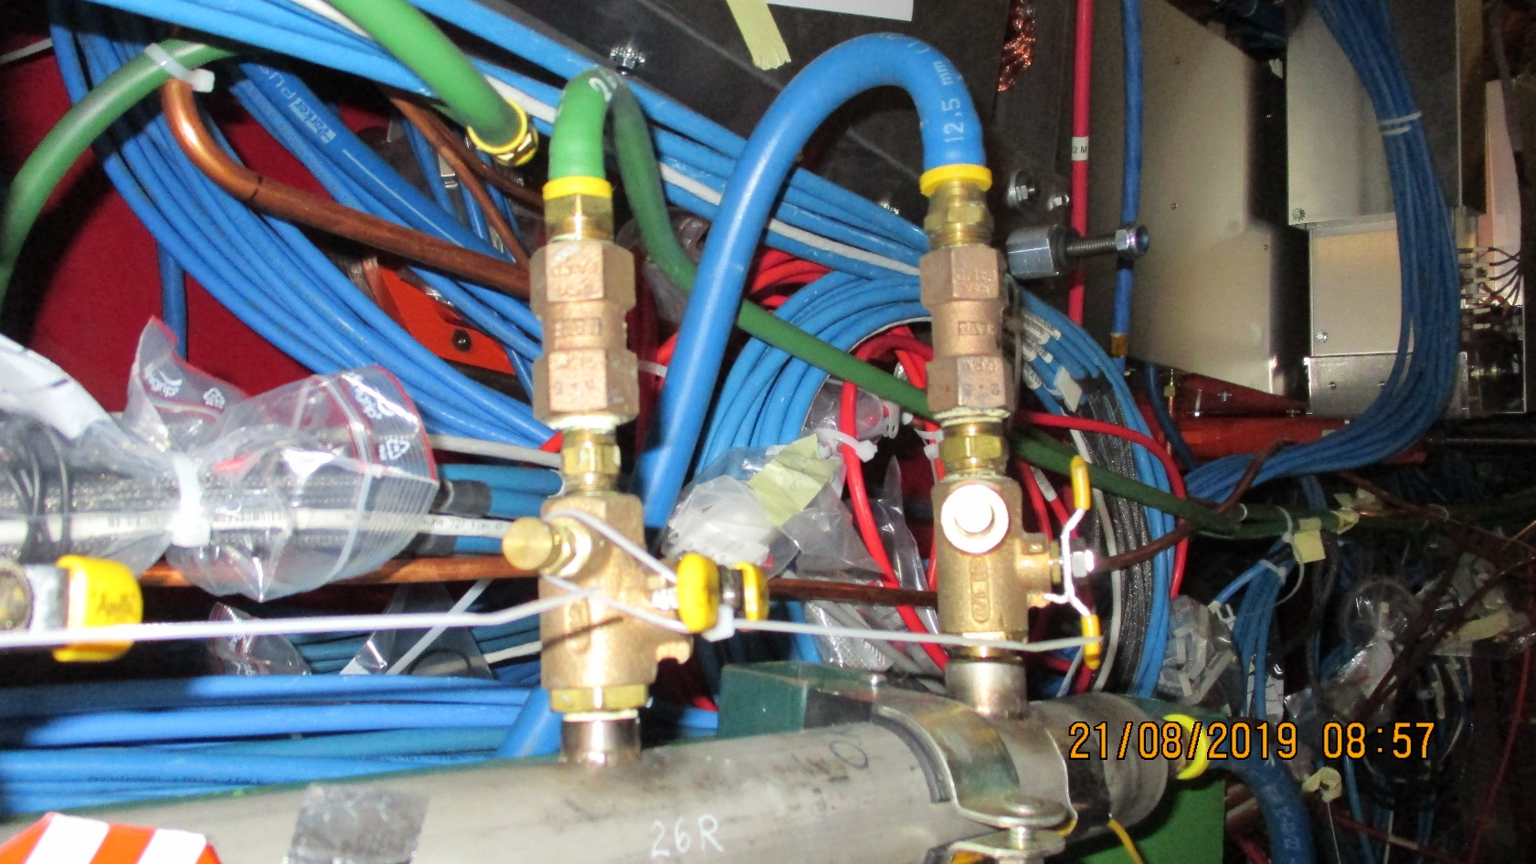
Configurations to avoid

Slide 6
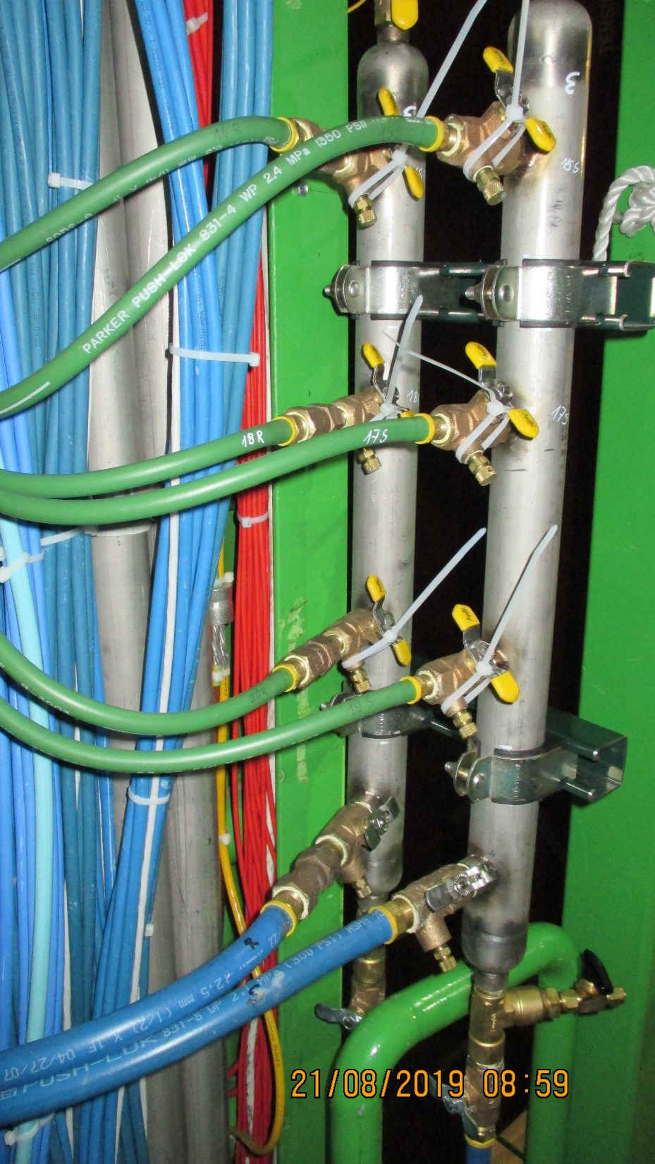
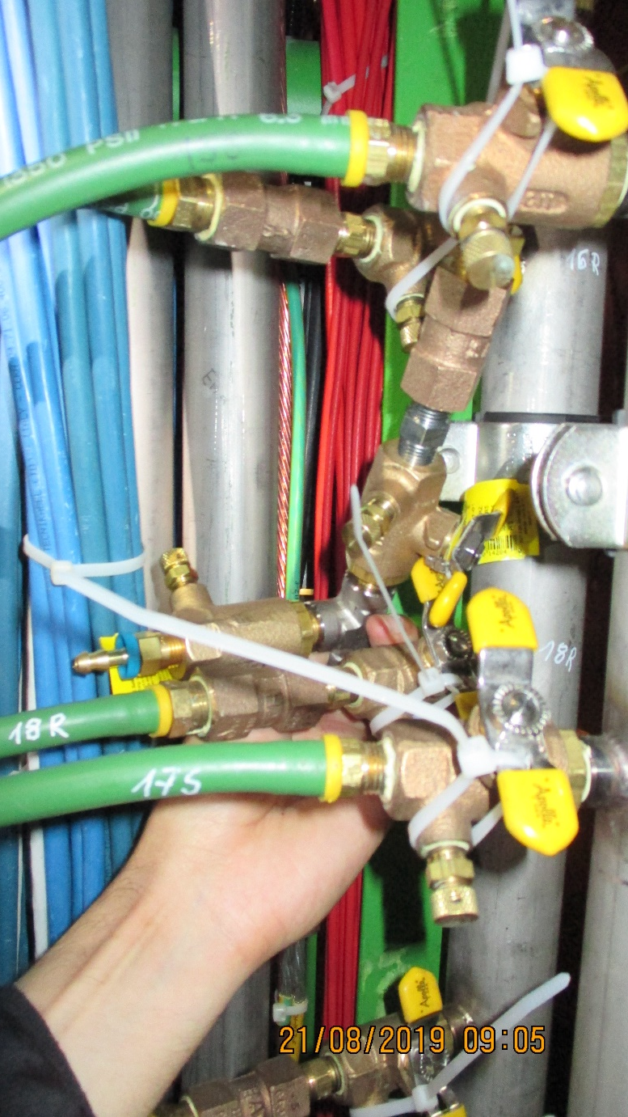
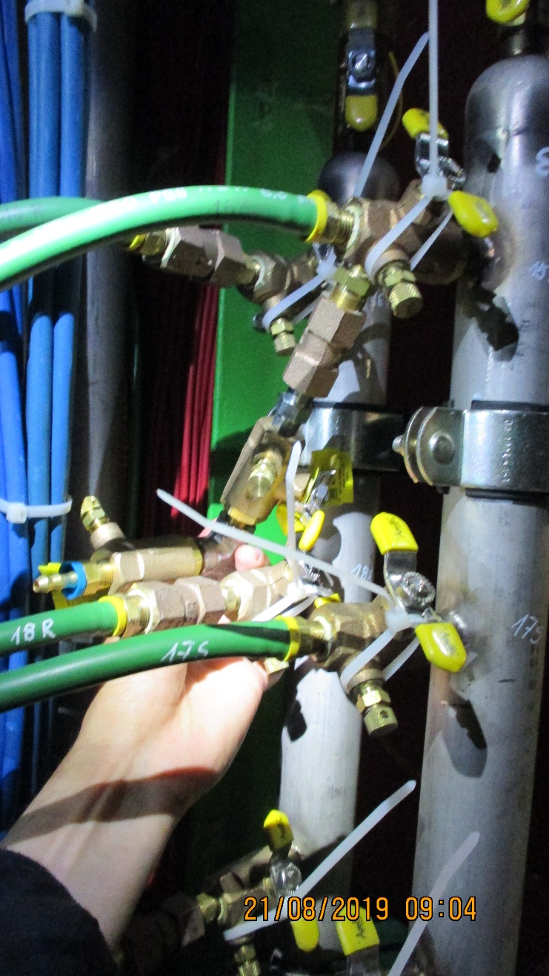
Mini Manifold 4 on the far side of RE+4/1 on X3 level

Slide 7
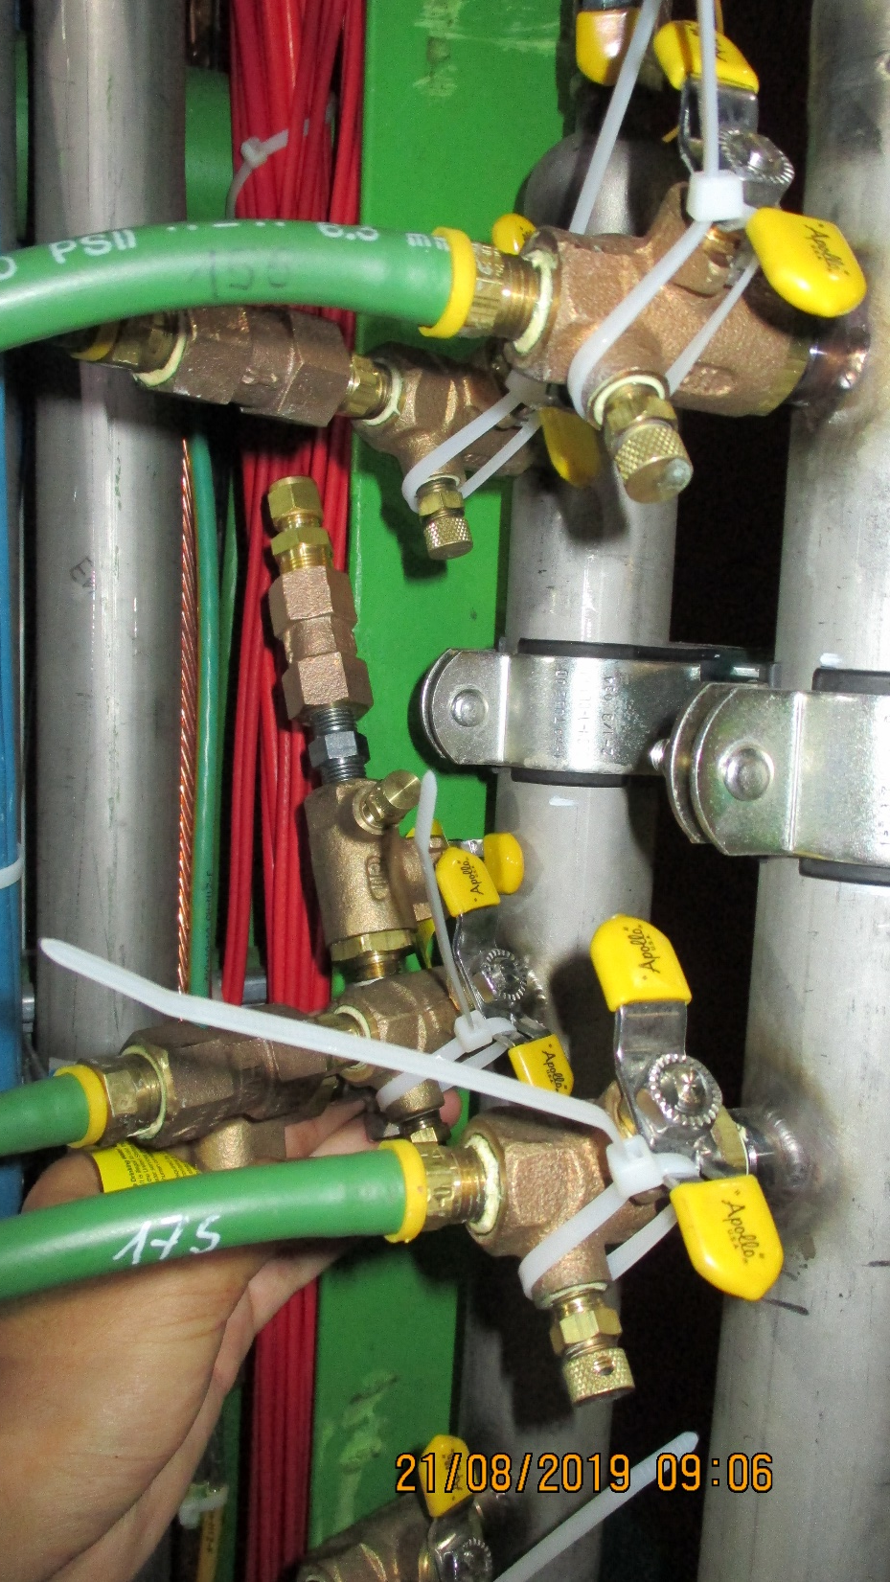

Slide 8
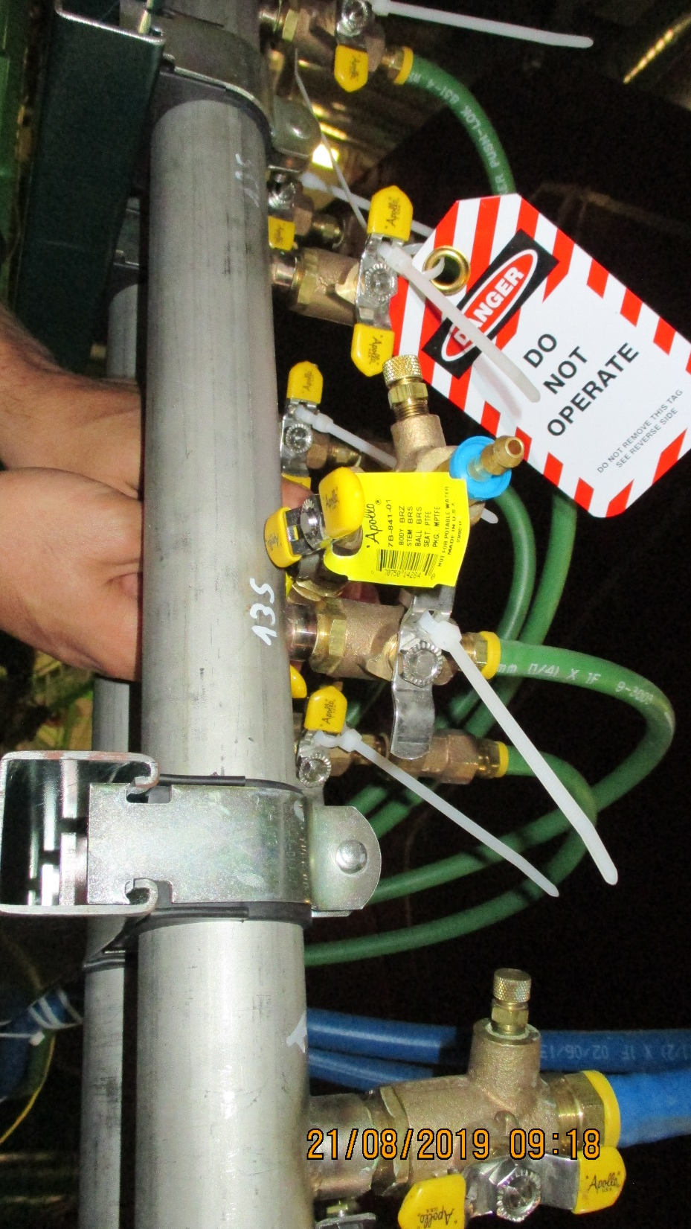
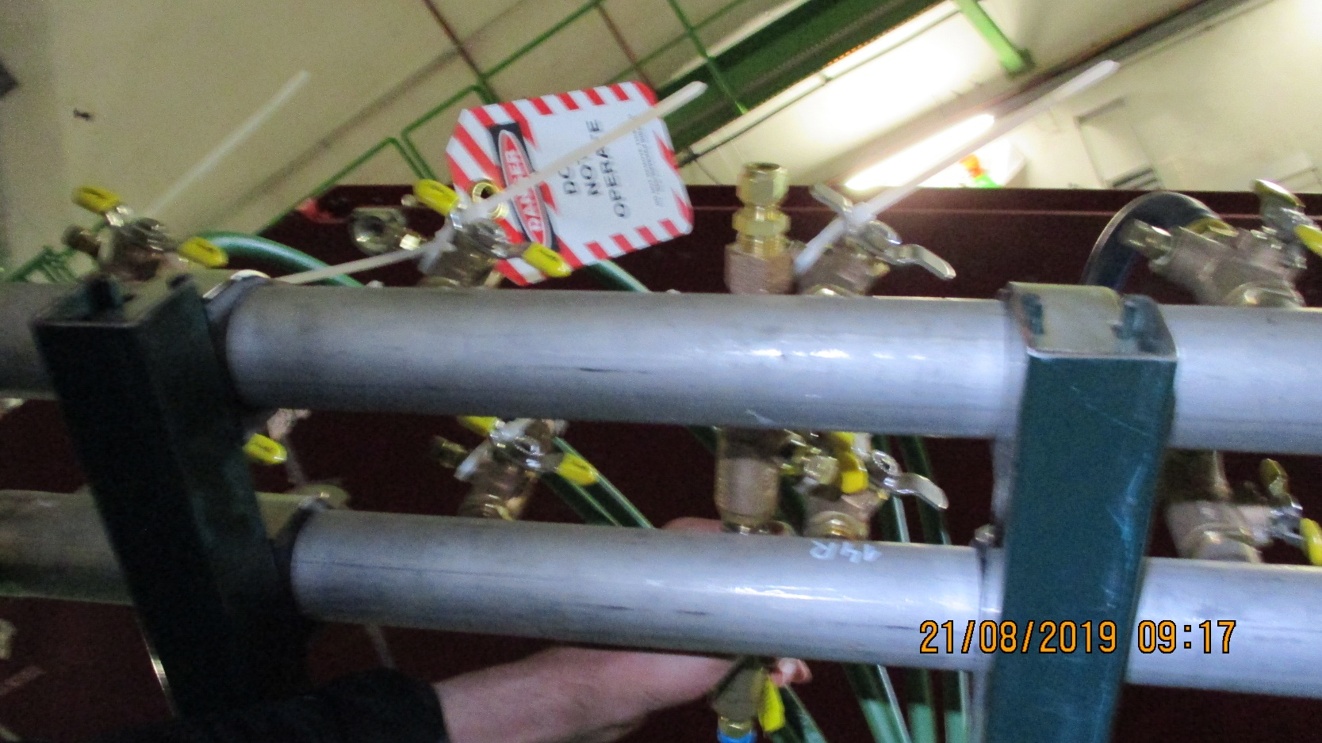
Mini Manifolds 3 on the far side of RE+4/1 on top walkway

Slide 9
