Slide 1
Cooling unions from Practice to Principle and back. Or How not to damage a cooling union
Ian
28 June 2021

Slide 2
The fluid union has similarities in conception to an electrical connector, namely the conduction of the medium and the mechanical retention (strain relief) of the supply conduit .
Both must be met.
In this case a leak tight joint AND a clamp sufficient to secure the pipe in the union against the pressure of the fluid (water).

Slide 3
VEBEO union from CERN gas group
Using Oring (4) and clamp (2)
The o-ring is directly on the pipe

Slide 4
So what is special about the O ring seal technology
The union becomes more leak tight the more the pressure difference increases.
Tightening the union does not improve the sealing only the pressure as the o-ring is squeezed into the gap, as shown above.

Slide 5
Double ferrule union Swagelok or Sagana, shown here

Slide 6
Integrate the Vebeo technology into the Sagana/Swagelok union
Rear ferrule
Front ferrule
O-ring,
Viton
1st Turn the back ferrule around to provide a “flat” pressure plate to the o-ring.
2nd Exchange the front ferrule for the o-ring.
3rd Tighten by finger.

Slide 7
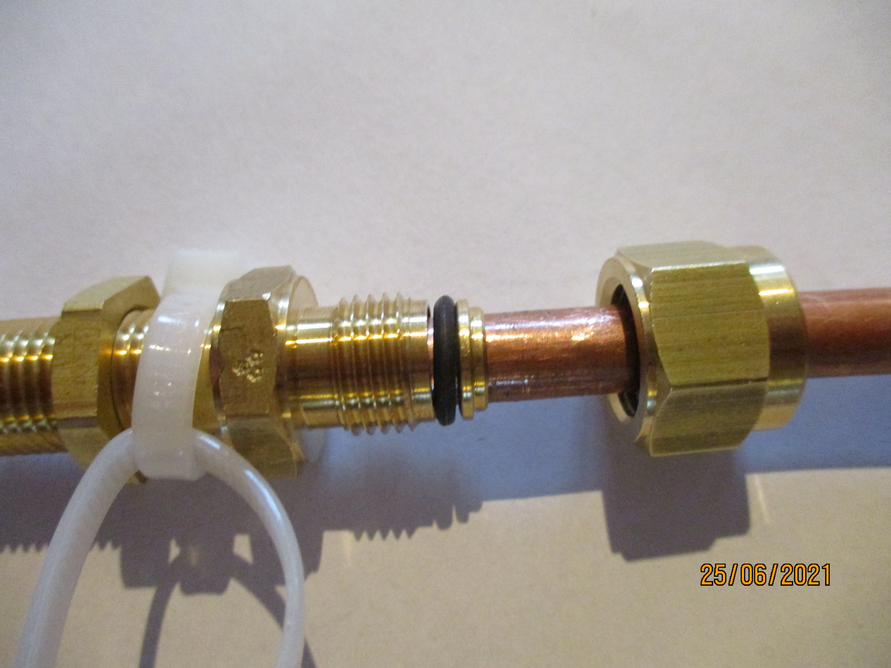
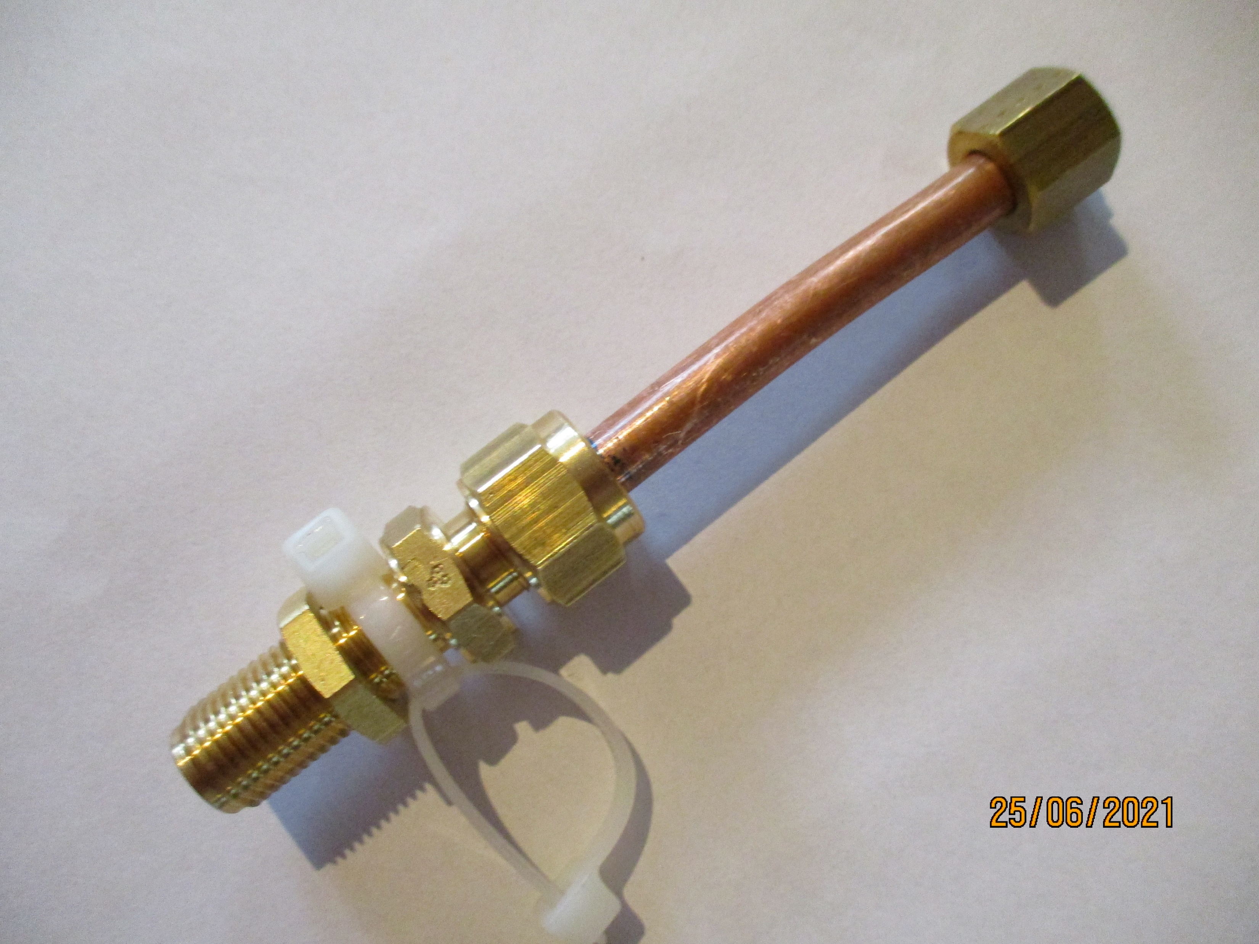
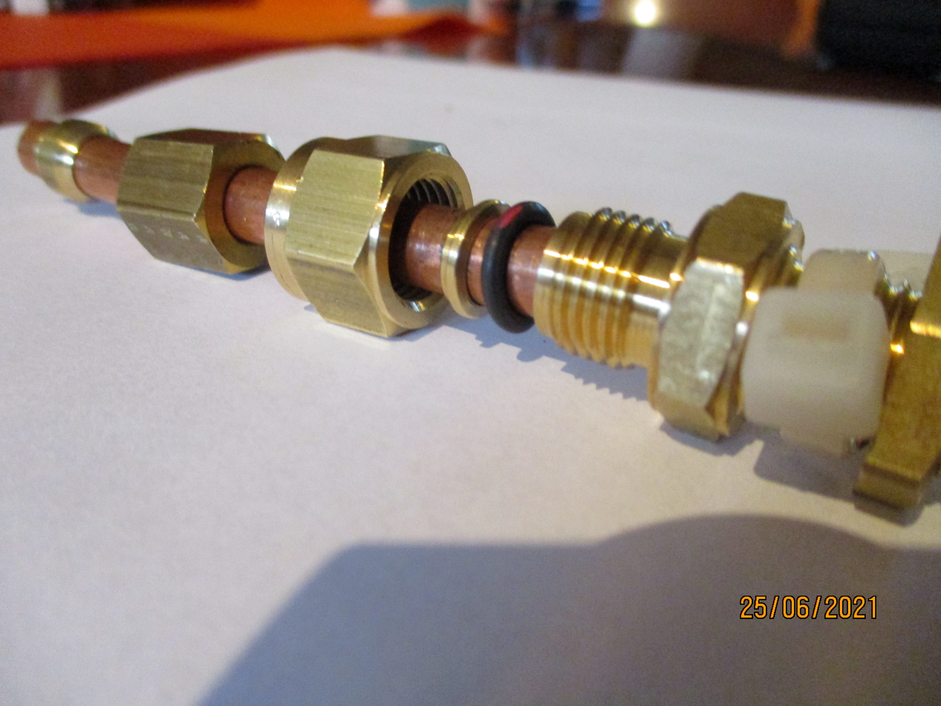
What was done .
A standard Sagana union, I did not have a Swagelok, was used for the trial
The pieces were exchanged as described above

Slide 8
The assembly was connected to an Argon bottle and the pressure increased incrementally until the pipe began to move out of the union between 8 – 10 Bar.
Possible solution for the pipe creeping out from the union
Clamp to resist the pressure force
Applied pressure
Copper pipe dia. 8mm
Bulkhead union on chamber

Slide 9
Conclusions
The union is operable for water cooling of FEBs.
The unions are not damaged as the nut is finger tight on the outside of the union body and the o-ring is an elastomer (Viton) that will not damage the inner sealing surface of the union.
The brass nut should be changed for stainless steal to avoid wearwhen frequently used.
The clamp to exert the reaction force necessary to oppose the water pressure, a small mechanical job.
The leak tightness was not checked but could readily be done up to 20 Bar.

Slide 10
Additional info.

Slide 11
https://www.parker.com/Literature/O-Ring%20Division%20Literature/ORD%205700.pdf

Slide 12
http://www.rotarex-gmbh.de/documents/ROTAREX_Klemmringe_2012.pdf
8mm pipe size
½” UNF body thread

Slide 13
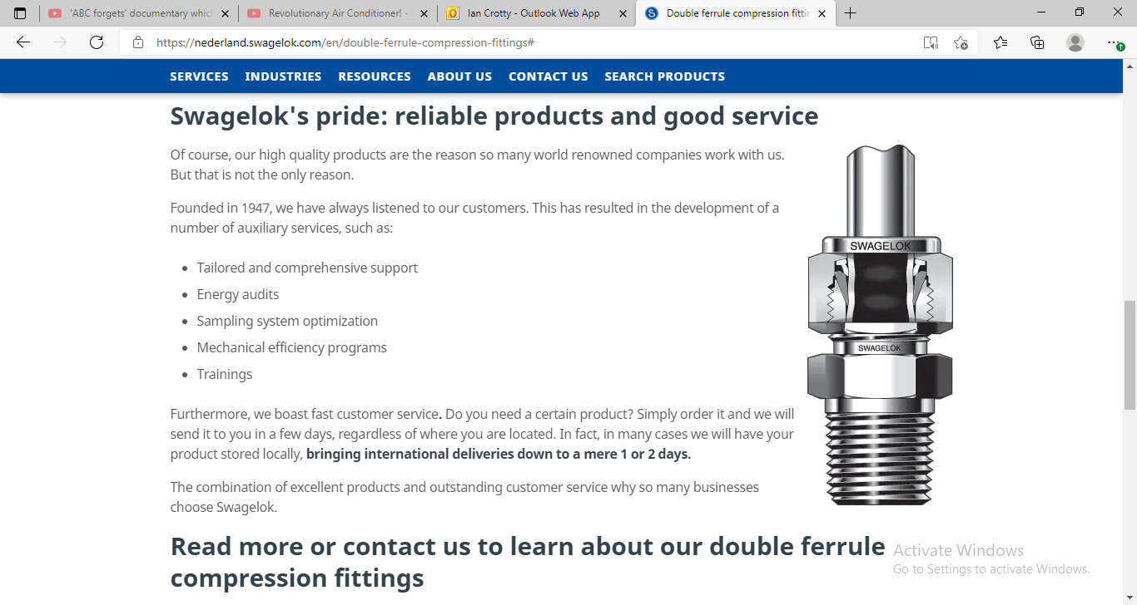
https://nederland.swagelok.com/en/double-ferrule-compression-fittings#

Slide 14
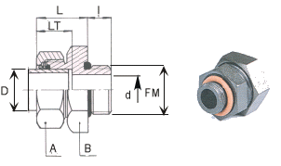
Vebeo

Slide 15
