Slide 1
Input for FEB cooling RE3/1
Ian
13 07 2108

Slide 2
Power and cooling spec
There will be x2 FEBs per chamber, cooled by one cooling loop.
Each FEB will consume 15W. Total 30W
Cooling is by water in copper pipes with brass unions, not Aluminium.
Flow rate is approx. 2litres/ minute
Pipe dia is 8x 6mm
Unions on Bulkhead are Sagana 8mm
Localised heat spots are not yet defined.
Design to fit Mech. Prototype drawings by Samvel

Slide 3
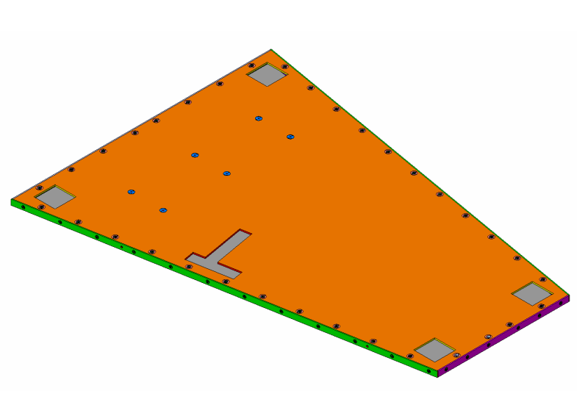
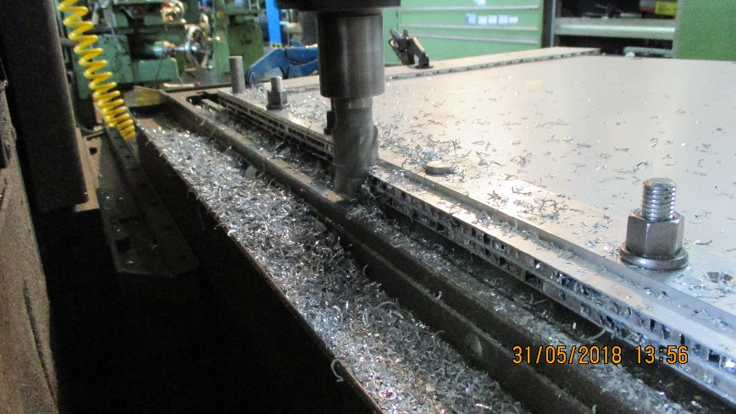
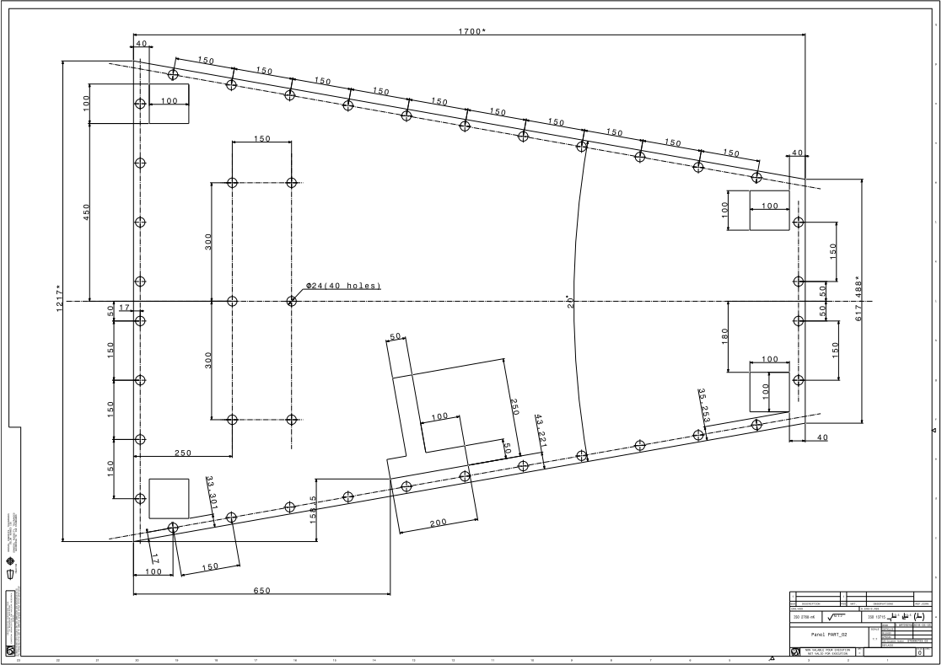
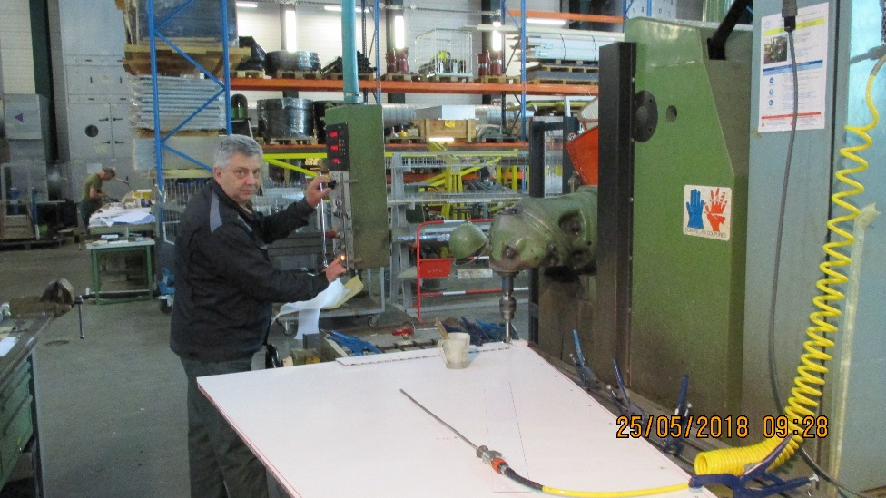
Samvel’s drawings of Mechanical Prototype

Slide 4
FEB Design from Lyon June 2018
By Christophe Combaret
Dimensions in mm
Patch Panel is from the top of the diagram

Slide 6
Constraint and degrees of Freedom
“Phi”
FEB
CCP
HCP Mechanics
GAP
PUSP
GAP
“Z”
HCP Mechanics
“R”

Slide 7
Connecter LV Power

Slide 8
Unions for Bulkhead 8mm

Slide 9
Connecter for underside of FEB to Pick up strip panel (PUSP)
https://www.erni.com/en/products-and-solutions/detail/244838/
https://www.erni.com/fileadmin/import/products/assets/DC0005778.PDF

Slide 10
Connecter on the Pick up strip to link to FEB

Slide 11
Conclusions
Details of the first prototype to be made by Georgia.
Input is based on what we know today.
Application is for the Mechanical Prototype HCP chamber.
Some missing details will have to be assumed based on a “good guess” basis.
Next step is application to the final FEB when is becomes available next early year

