Slide 1
Cooling for iRPC
Ian
15 Oct 2018

Slide 2
RE3/1 is linked to the present RE3/2 chambers by opening the circuit linking two RE3/2s at their inner radius.

Slide 3
Present power and flow
Power to one chamber is approx. 10W. There are 72 chamber in one station.
Power to one station is therefore 72 x 10 = 720W
There are 6 mini-manifolds each with 3 channels which therefore gives 4 chambers in one circuit.
0.5USA gallon/min in each circuit will give a max temp rise of 0.3degC
RE4/1 cooling taken off Mini-Manifolds located on the YE3
Power to the FEB is declared as 15W and measured as approx. 10W.
Power of one chamber is therefore 20W
Power to one station is 18 x 20 = 360 W

Slide 4
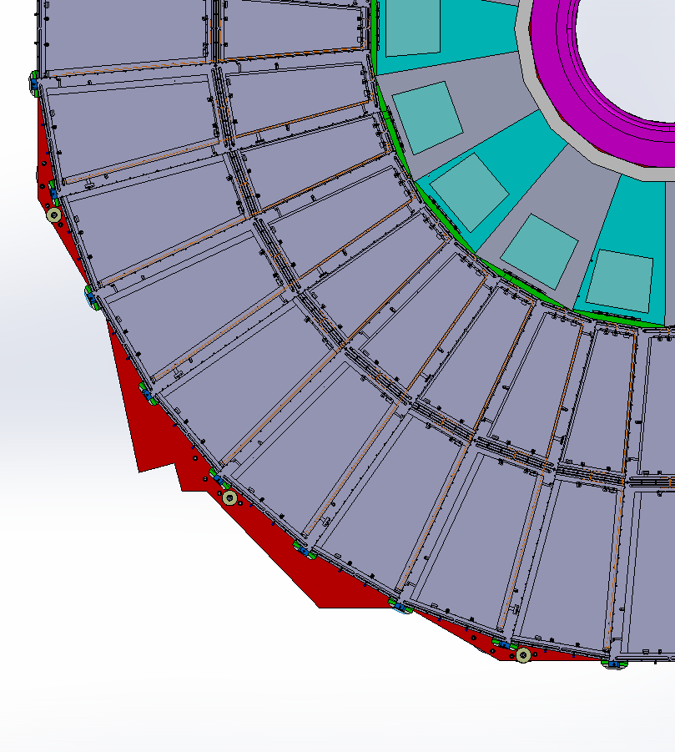
RE4/1 Cooling manifolds
RE4/1
Diagram of 1 channel per 2 chambers. Flexible hose from the “T” mounted on the mini manifold.
The two RE4/1s will also be linked by flexibles, not shown.
Return
Manifold
Supply

Slide 5
YE3 cooling parameters
 | Units | YE3 periphery manifold | CSC cooling circuit ME4/2 | CSC cooling circuit ME4/1 | RPC cooling circuit RE3 | Disk circuit | VME/CRBcircuit (minirack) | Rack cooling circuit (low flow) | Rack cooling circuit (high flow)
Tube/pipe OD | mm | 48.3 | 9.5 | 9.5 | 8.0 | 12.7 | 12.7 | 12.7 | 12.7
Tube/pipe wall | mm | 1.7 | 0.8 | 0.8 | 1.0 | 1.2 | 1.2 | 1.2 | 1.2
Tube/pipe ID | mm | 45.0 | 7.9 | 7.9 | 6.0 | 10.2 | 10.2 | 10.2 | 10.2
Tube/pipe Area | mm² | 1587 | 49 | 49 | 28 | 82 | 82 | 82 | 82
Flow rate | liter/min | 161 | 2.3 | 2.3 | 2 | 2 | 5 | 5 | 10
Flow velocity | m/sec | 1.7 | 0.8 | 0.8 | 1.2 | 0.4 | 1.0 | 1.0 | 2.0
Reynolds | unitless | 73640 | 5973 | 5973 | 6838 | 4014 | 10036 | 10036 | 20072
Heat removal/circuit | W | 15482 | 360 | 369 | 80 | 400 | 426 | 193 | 2516
Temperature rise | C | 1.4 | 2.2 | 2.3 | 0.6 | 2.9 | 1.2 | 0.6 | 3.6
Number of circuits | ea | 1 | 12 | 6 | 18 | 12 | 4 | 4 | 2
Total flow | liter/min | 161 | 27.6 | 13.8 | 36 | 24 | 20 | 20 | 20
Heat removed | W | 15482 | 4320 | 2214 | 1440 |  | 1704 | 772 | 5032
Heat removal capacity | W |  |  |  |  | 4800
Pressure drop (measured) | bar
Total flow | liter/min | 161
Total Heat removed | W | 15482
Total temperature rise | C | 1.4
From CSC colleagues, Dick Loveless, dated 2003 ?

Slide 8
Caculation of RE3/1 and RE4/1
 | Units | YE3 periphery manifold | CSC cooling circuit ME4/2 | CSC cooling circuit ME4/1 | RPC cooling circuit RE3 | Disk circuit | VME/CRBcircuit (minirack) | Rack cooling circuit (low flow) | Rack cooling circuit (high flow) | RE3/1 chambers | RE4/1 chambers | RE3/1, 3/2 & 3/3
Tube/pipe OD | mm | 48.3 | 9.5 | 9.5 | 8.0 | 12.7 | 12.7 | 12.7 | 12.7 | 8 | 8 | 8
Tube/pipe wall | mm | 1.7 | 0.8 | 0.8 | 1.0 | 1.2 | 1.2 | 1.2 | 1.2 | 1 | 1 | 1
Tube/pipe ID | mm | 45.0 | 7.9 | 7.9 | 6.0 | 10.2 | 10.2 | 10.2 | 10.2 | 6 | 6 | 6
Tube/pipe Area | mm² | 1587 | 49 | 49 | 28 | 82 | 82 | 82 | 82 | 28 | 28 | 28
Flow rate | liter/min | 161 | 2.3 | 2.3 | 2 | 2 | 5 | 5 | 10 | 2 | 2 | 2
Flow velocity | m/sec | 1.7 | 0.8 | 0.8 | 1.2 | 0.4 | 1.0 | 1.0 | 2.0 | 1.2 | 1.2 | 1.2
Reynolds | unitless | 73640 | 5973 | 5973 | 6838 | 4014 | 10036 | 10036 | 20072 | 6838 | 6838 | 6838
Heat removal/circuit | W | 14762 | 360 | 369 | 40 | 400 | 426 | 193 | 2516 | 20 | 40 | 60
Temperature rise | C | 1.3 | 2.2 | 2.3 | 0.3 | 2.9 | 1.2 | 0.6 | 3.6 | 0.1 | 0.3 | 0.4
Number of circuits | ea | 1 | 12 | 6 | 18 | 12 | 4 | 4 | 2 | 18 | 9 | 18
Total flow | liter/min | 161 | 27.6 | 13.8 | 36 | 24 | 20 | 20 | 20 | 36 | 18 | 36
Heat removed | W | 14762 | 4320 | 2214 | 720 |  | 1704 | 772 | 5032 | 360 | 360 | 1080
Heat removal capacity | W |  |  |  |  | 4800
Pressure drop (measured) | bar
Total flow | liter/min | 161
Total Heat removed | W | 14762 |  |  | Nota the original estimate 15 years ago for RE3 circuit was 80W/circuit ! Now 40W
Total temperature rise | C | 1.3

