Slide 1
Tools for RE4/1 mounting. Also RE4 SM
Ian
4 Nov 2020

Slide 2
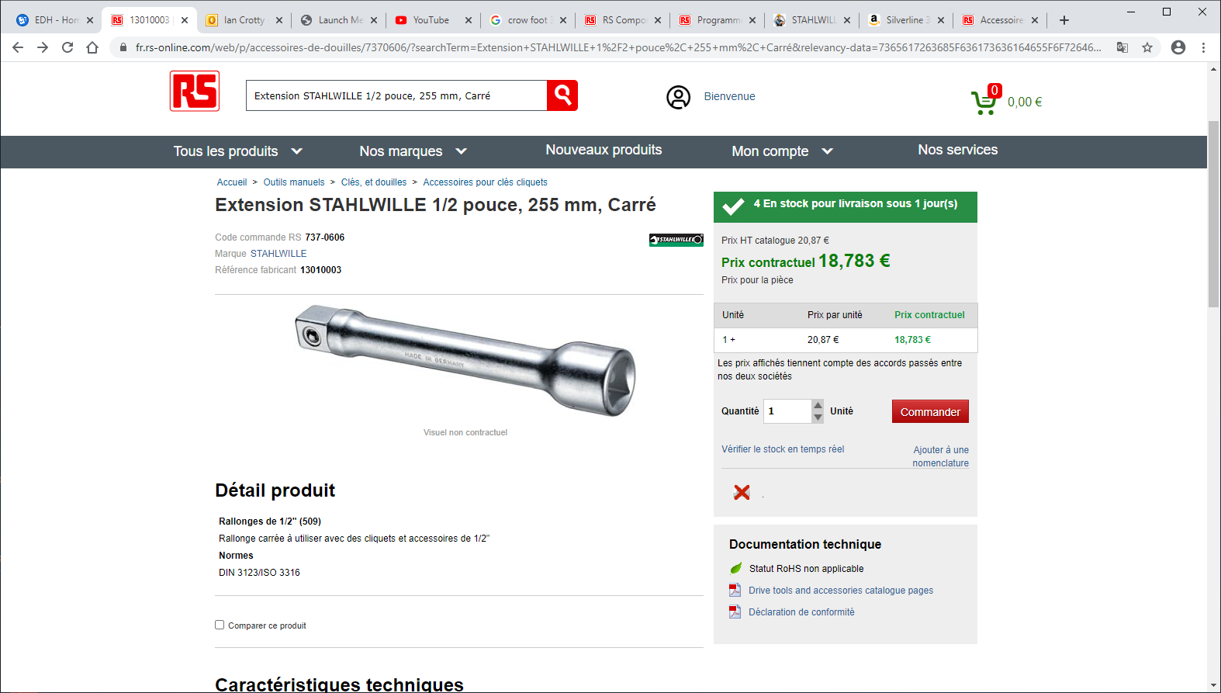

Slide 3
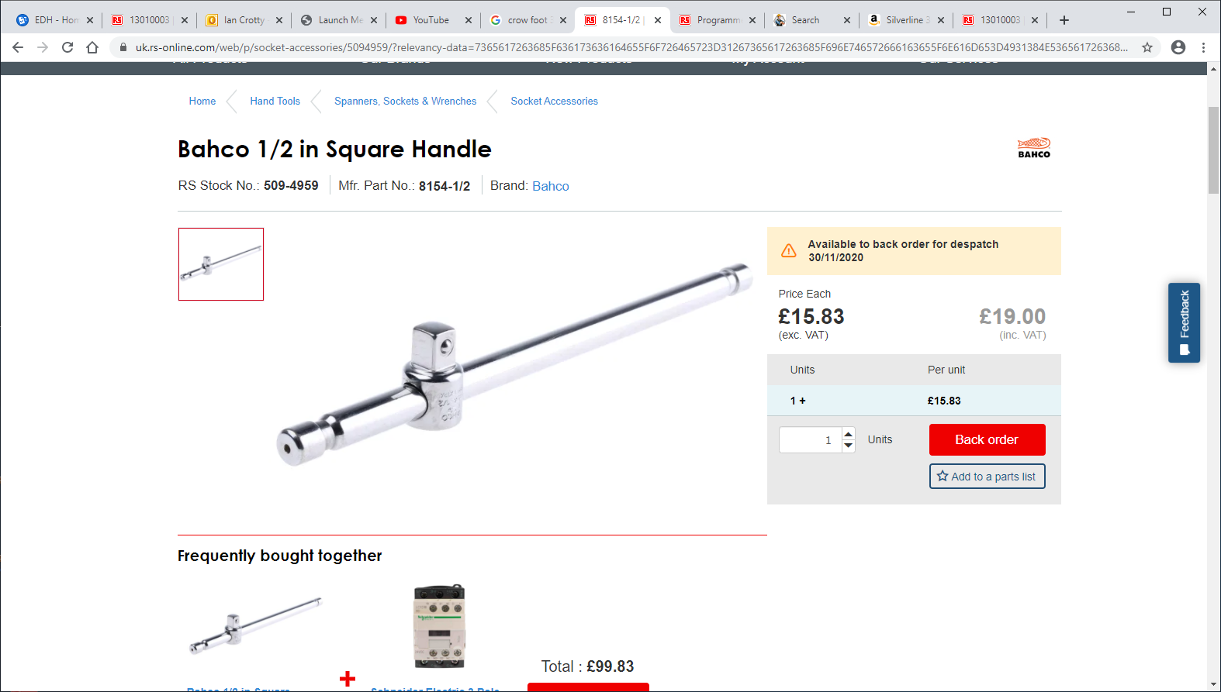

Slide 4
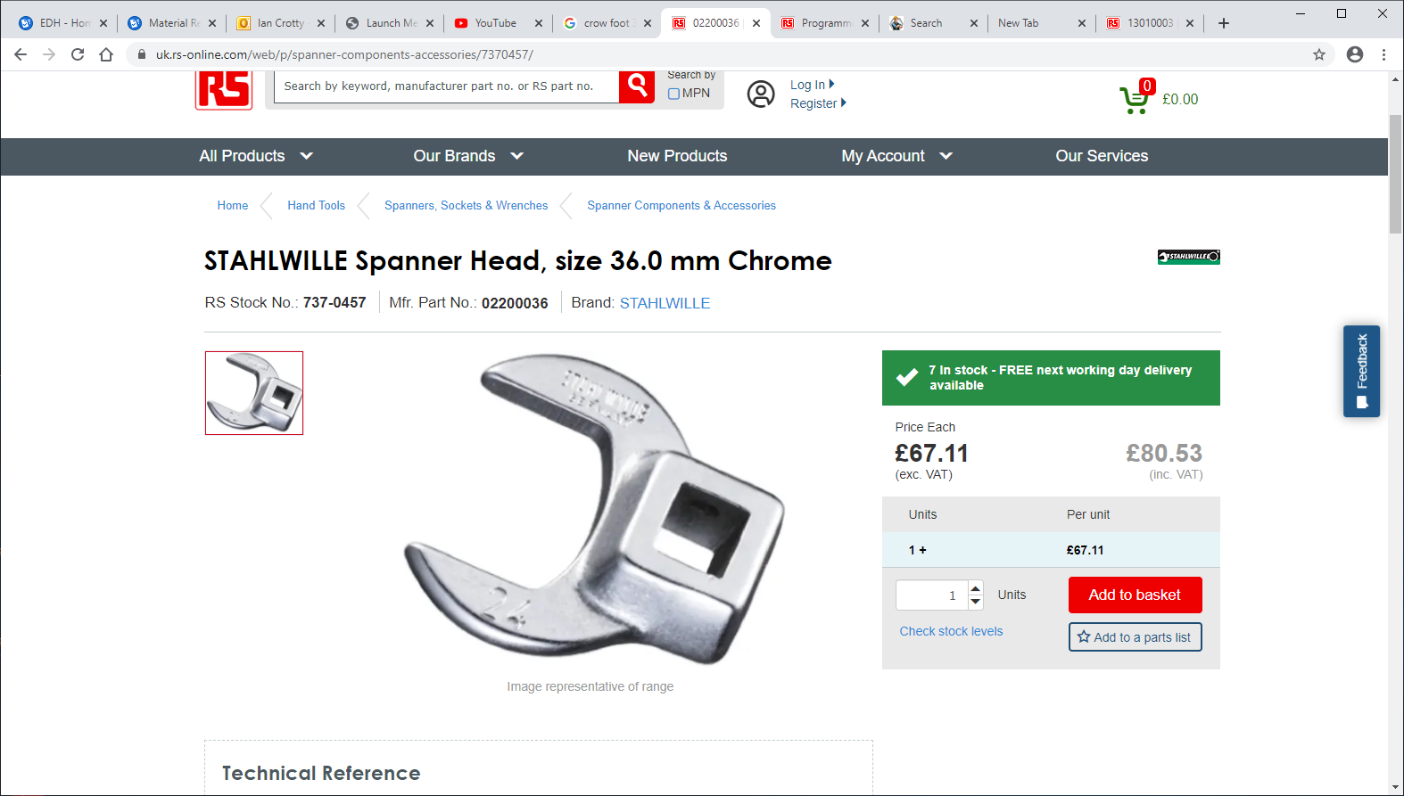

Slide 5
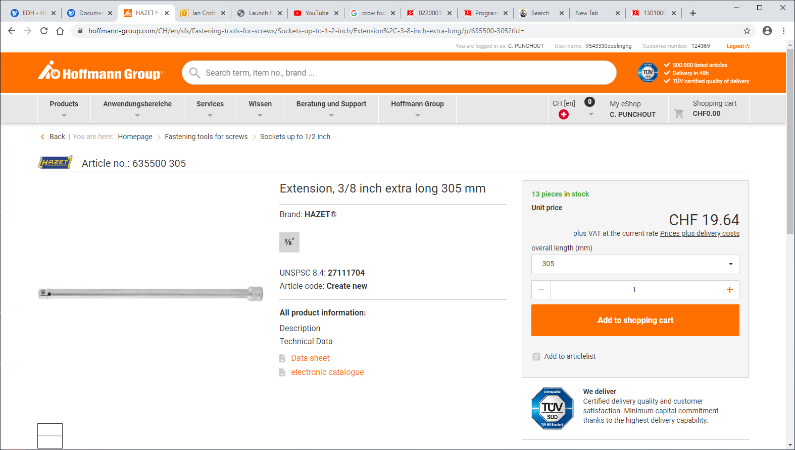

Slide 6
