Slide 1
Integration of RE3/1
Ian Crotty 07.06.2016

Slide 2
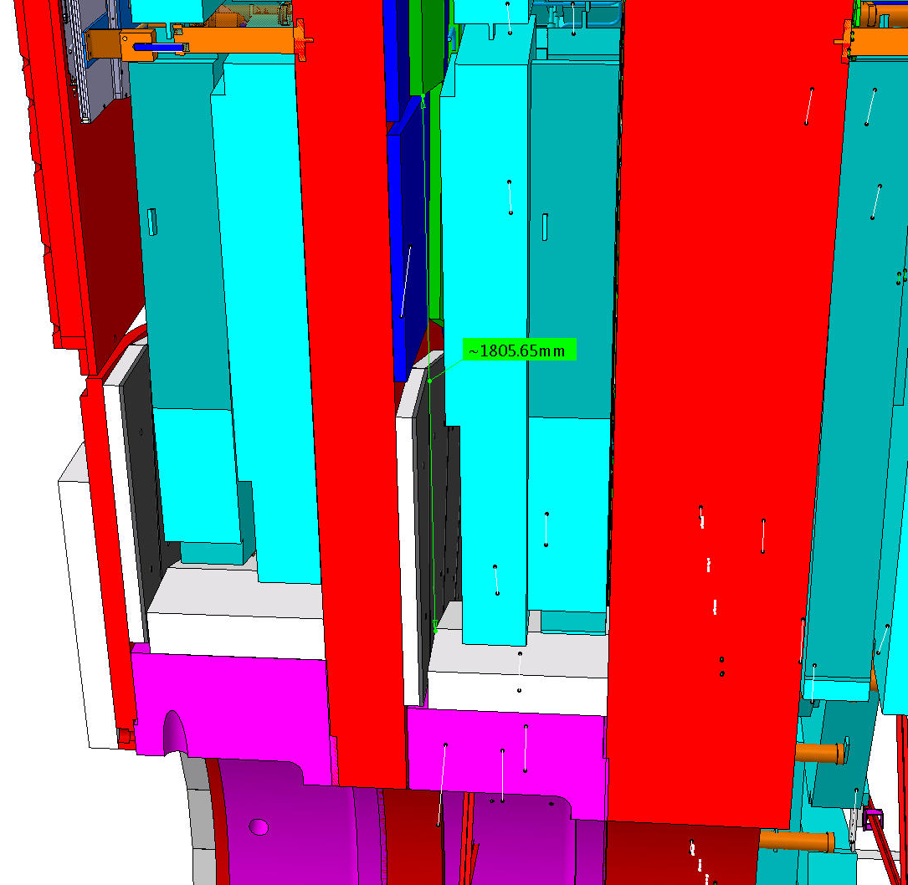
RE3/1
Basic parameters
R Outer = 3302
R Inner = 1526
Delta = 1776
This area has to be studied and an envelope produced and agreed with Integration

Slide 3
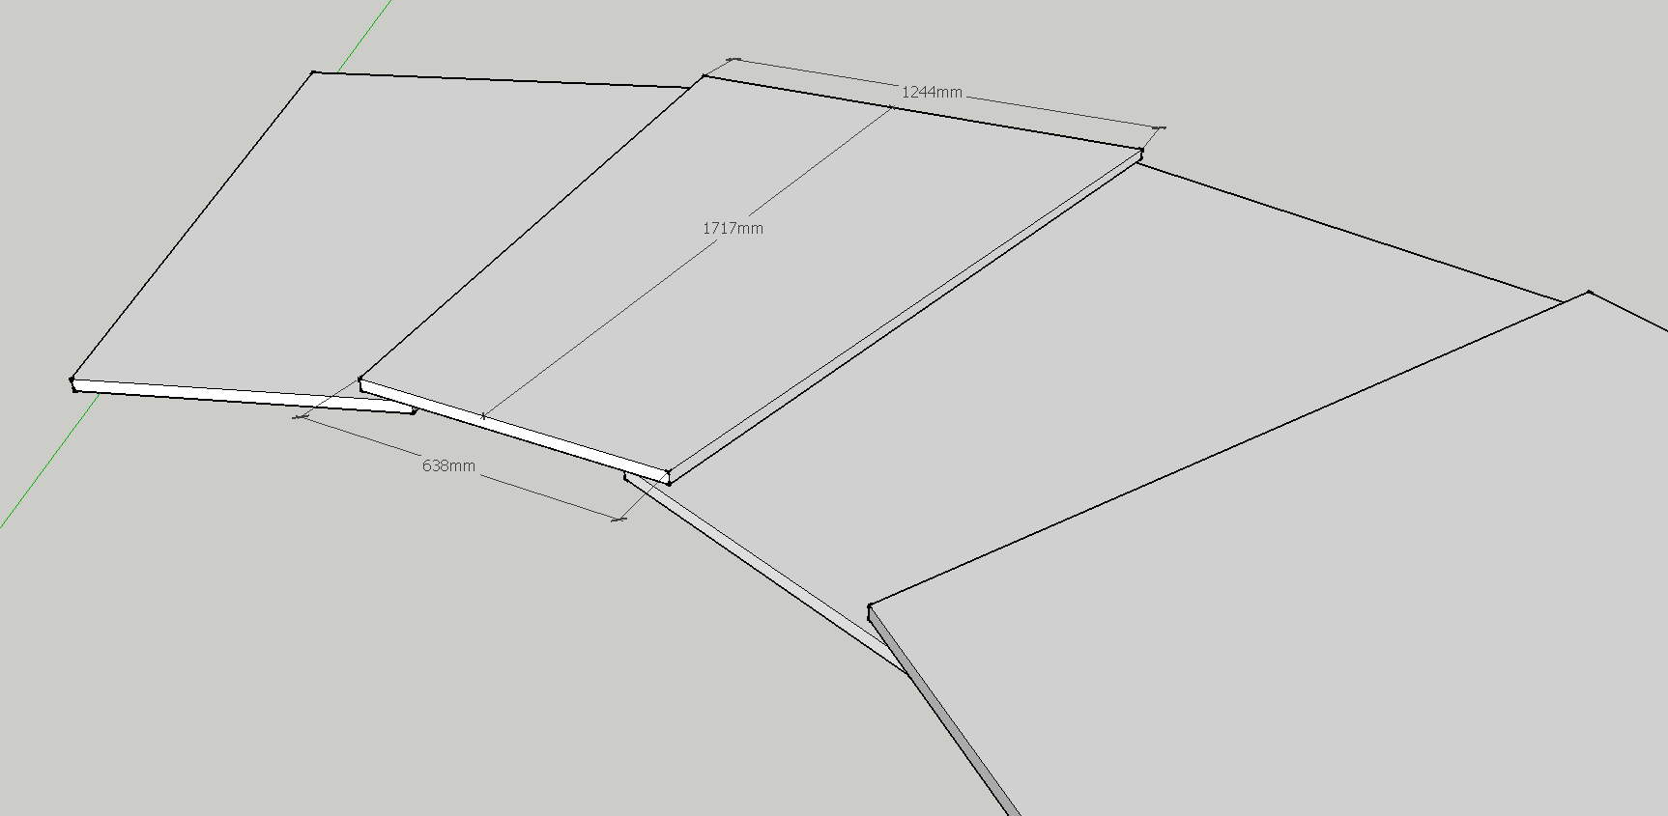
RE3/1 VERY preliminary envelope with overlap. Integration office is verifying this proposal
DRAFT

