Slide 1
Results of the check the Assembly RE3/1
Voevodina Elena
24-26 Nov. 2016

Slide 2
The main goal:
Checking and correction errors in the Assembly RE3/1

Slide 3
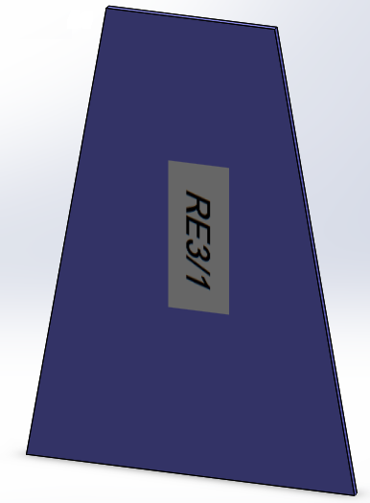
Trapezoid
Sketch of the trapezoid
3D model of the RE3/1
Thickness 25 mm

Slide 4
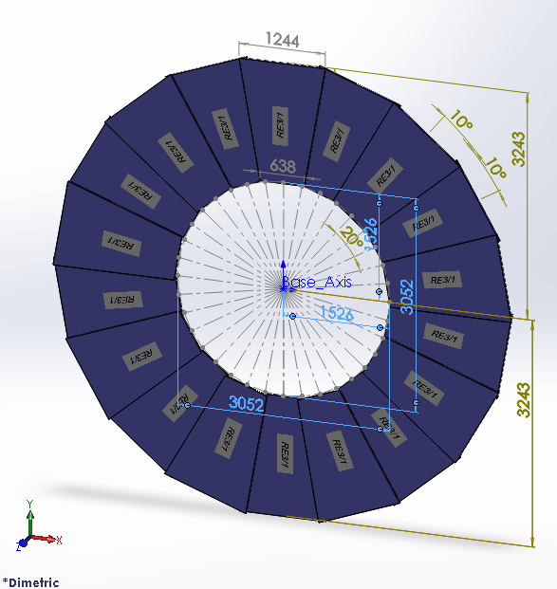
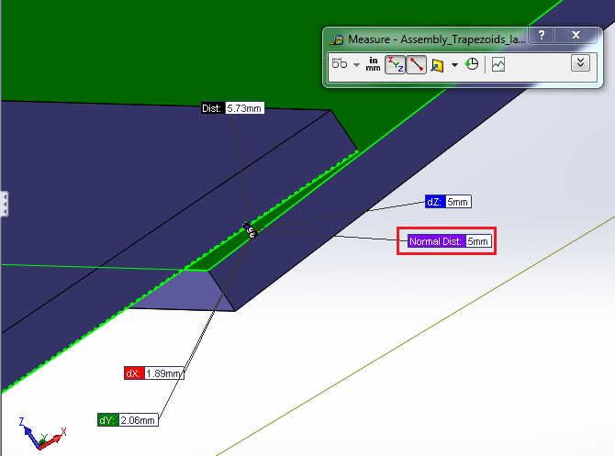
Assembly of the RE3/1
*3D model of the complete assembly of the RE3/1
Distance between two chambers of the RE3/1 = 5 mm
* Name of the file: Assembly_Trapezoids_labels_RE31.STEP

Slide 5
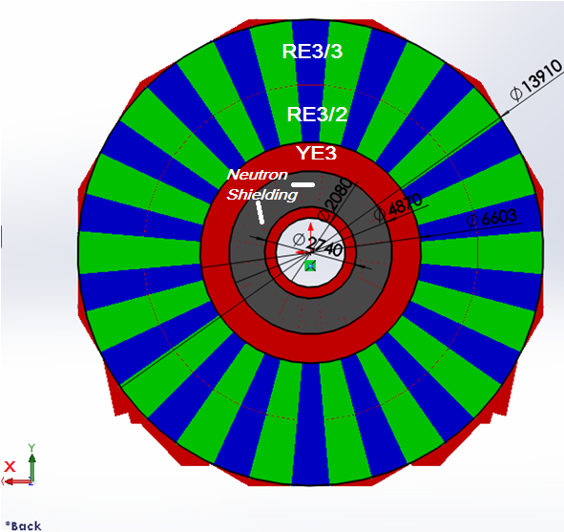
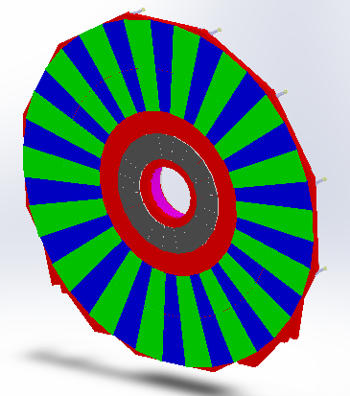
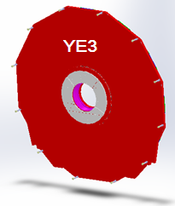
Assembly of the YE3 with RE3/2, RE3/3 and Neutron Shielding
Check of the main parameters of the assembly YE3
Thickness of the YE3 = 250 mm;
Thickness of the RE3/2 and RE3/3 = 38 mm;
Gap between RE3/2 and RE3/3 = 0.5 mm

Slide 6
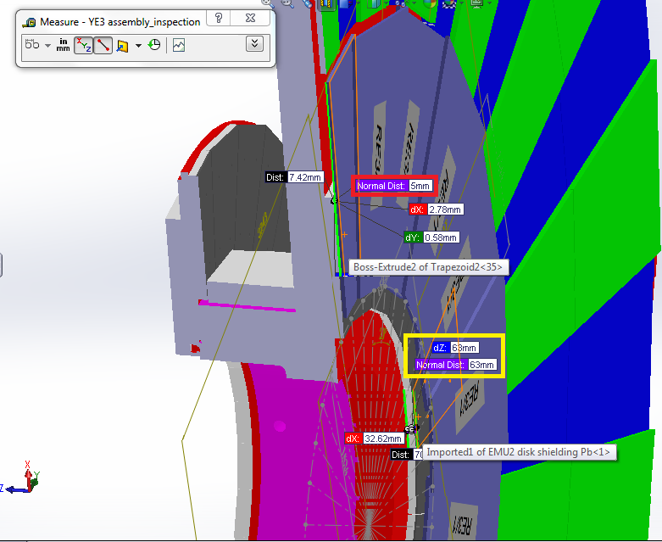
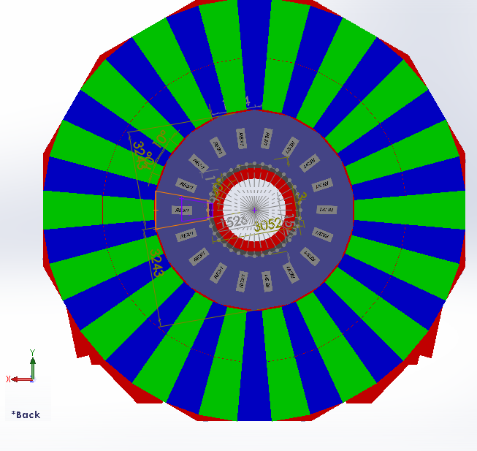
*Integration assemblies of the YE3 with RE3/1
Chamber №1 of the RE3/1 was centered of the “axis X”
Distance between the Assembly of the RE3/1 and Neutron Shielding = 5 mm
Thickness
of the
Neutron
Shielding
= 63 mm
* Name of the file: YE3 with RE31 assembly_inspection.STEP

Slide 7
*Mounting RE3/1
M12 Mounting Holes for 20deg Chambers
Ian Crotty
* Name of the file: HighEtaParaSpaceRPCIanFeb2014V2.pptx

Slide 8
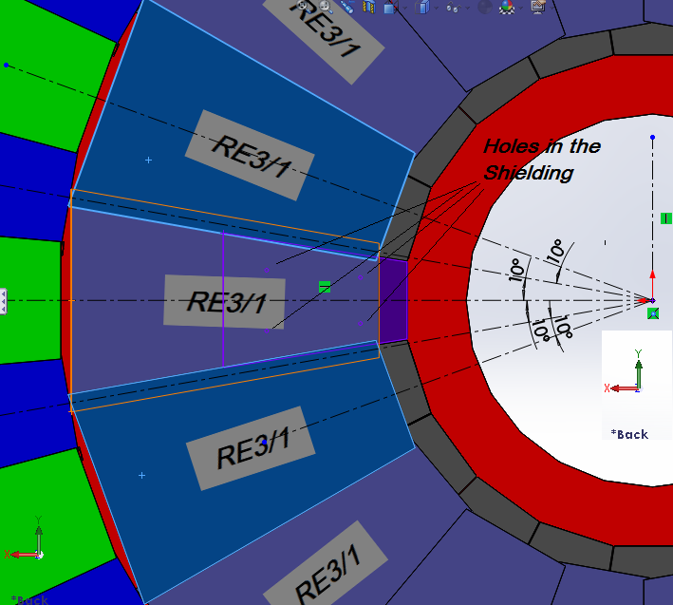
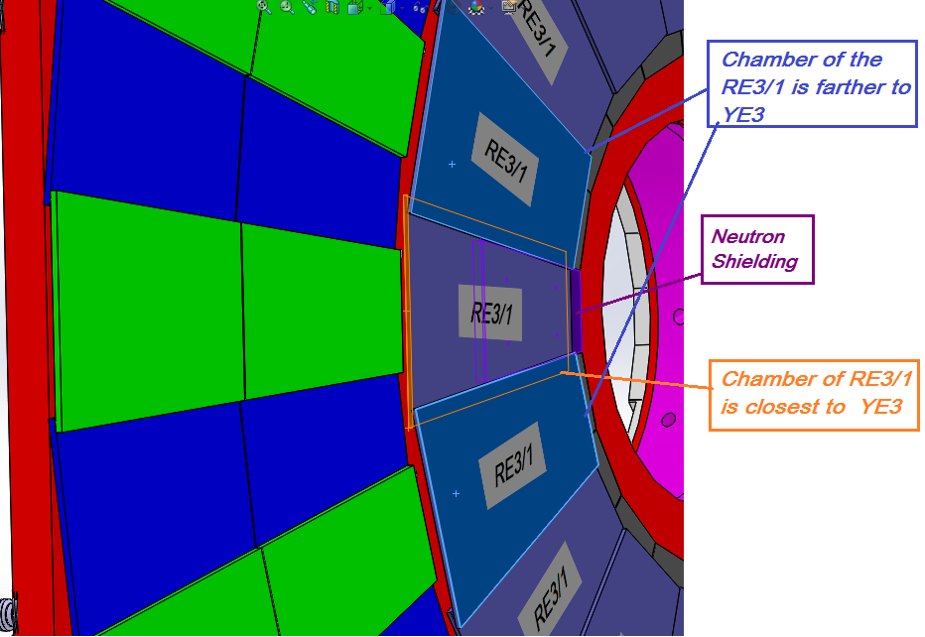
Probable location of the chamber №1 RE3/1
Open Question about M12 !
How does the M12 of the mounting holes locate on the YE3? (I need to known a coordinate [X ; Y] of the location M12 on the YE3)
I cannot only guess looking the image on the slide 7 I need to know exactly!
* In my assembly YE3 doesn’t have the M12 holes.

Slide 9
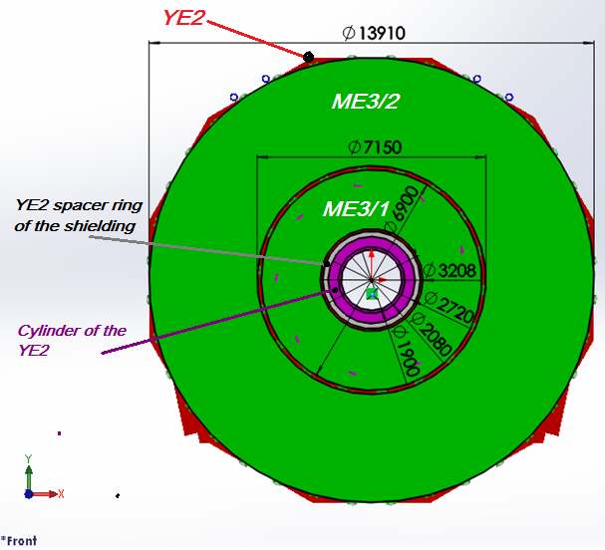
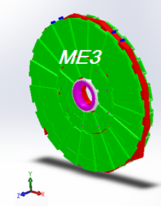
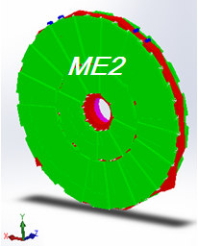
Assembly YE2 with ME3, ME2 and ring Neutron Shielding
Check of the main parameters
of the assembly YE2
Thickness of the YE2 = 600 mm;
Thickness of the ME = 244 mm;
Gap between the two chambers of the ME = 4mm

Slide 10
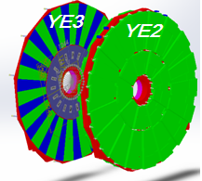
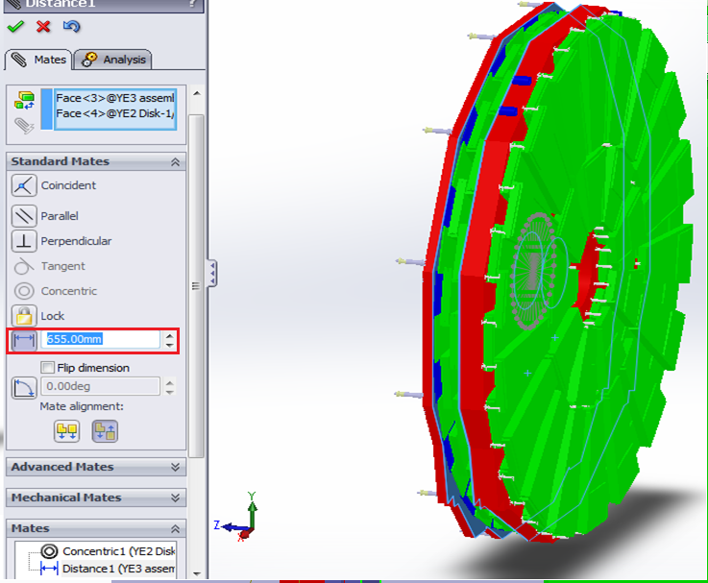
*Integration Assemblies YE3 and YE2
Distance between of the YE2 and YE2 = 9775 mm-9120 mm = 655 mm
* Name of the file: Integration of the YE2 and YE3 with RE31.STEP

Slide 11
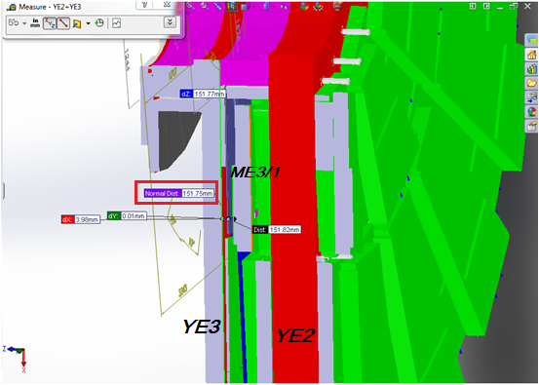
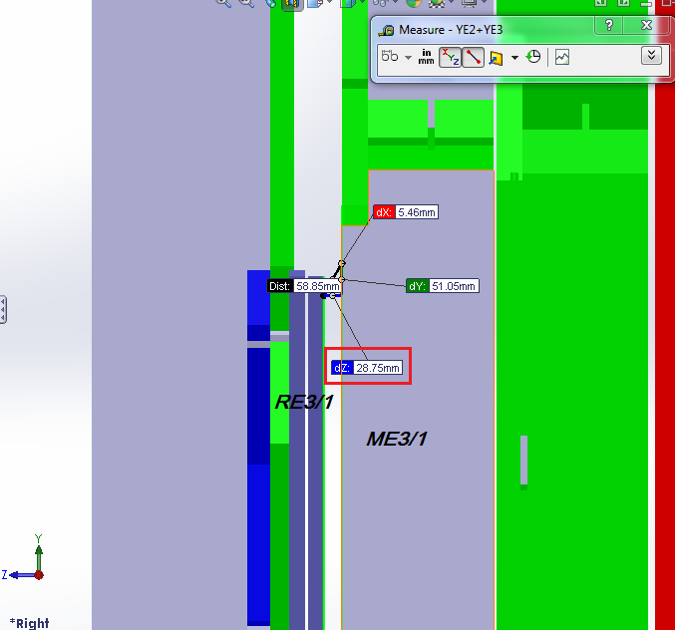
Defining of the distances
Distance between YE3 and ME3
Distance between
ME3 and RE3/1
151.75mm !
28.75mm !

Slide 12
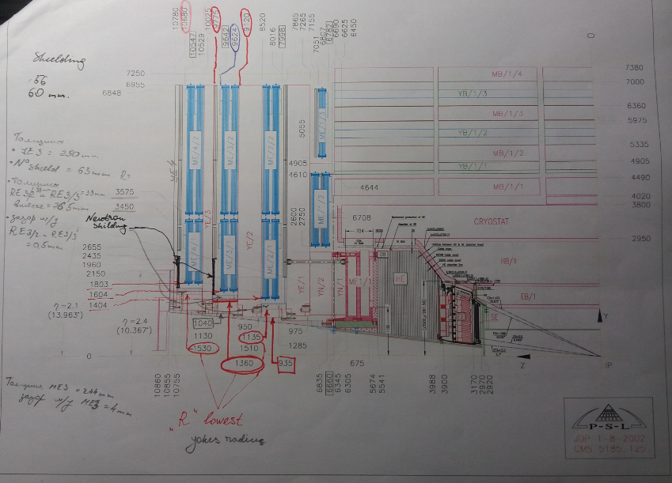
* The main document used in the work

