Slide 1
Chamber Integration Update
Ian Crotty, Elena Voevodina
11/07/2017

Slide 2
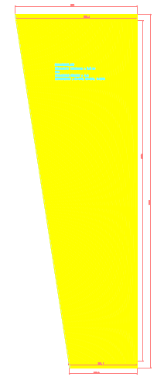
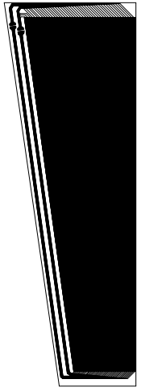
Pick-up strip panel
Return strip panel
570 mm
586 mm
565.3 mm
495 mm
Total: 88 strips
1584 mm
1645 mm
1570 mm
1700 mm
319.7 mm
274.5 mm
318.1 mm
341 mm

Slide 3
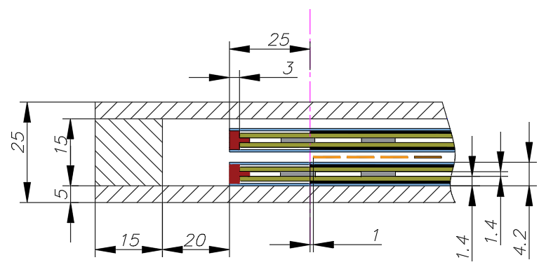
Mechanical details of RPC chambers
Start of Active area
Honey comb panel
Frame
Bar
HPL, 1.4 mm
Insulator layer, 300 µm
Graphite
Strips readout
Spacers, Ф 8 mm

Slide 4
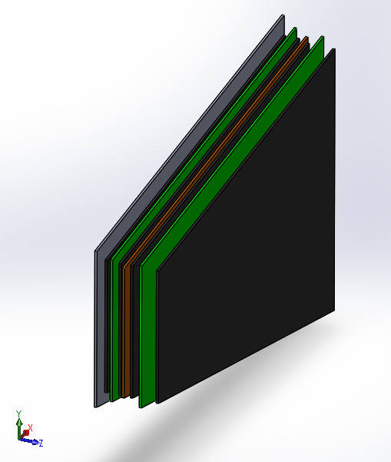
Topology of RPC chamber
Gap Top
Strip panel
Gap Bottom
Service panel
Effective areas
(graphite layers)

Slide 5
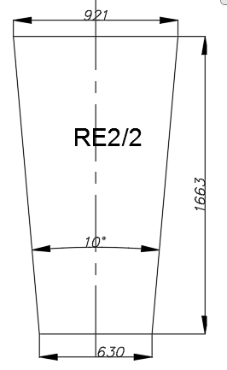
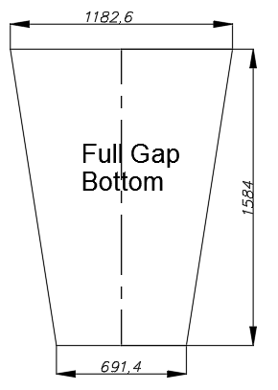
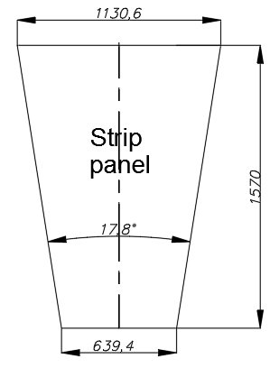
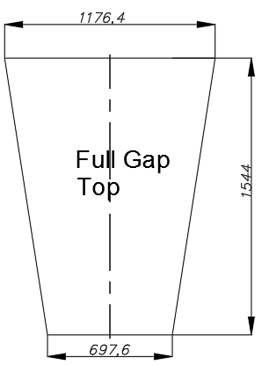
Probability using of RE2/2 ‘s gap top for prototype
1. Pick-up Strip panel

Slide 6
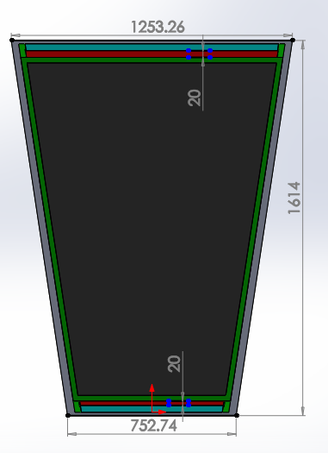
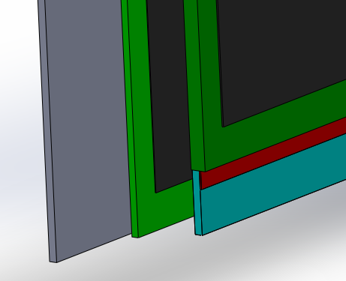
Schematic of the assembly RPC chamber with Pick-up Strip panel
Gap Top
Gap Bottom
Service panel
for soldering
20 mm
Band
Strips

Slide 7
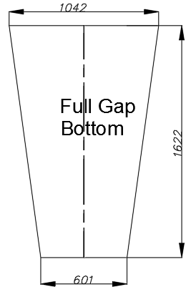
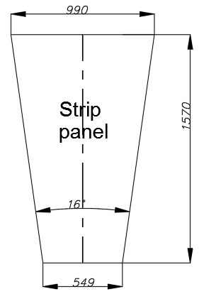
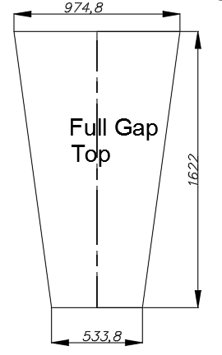
Probability using of RE2/2 ‘s gap top for prototype
1. Return Strip panel
Top gap will not cover
about 3 strips !
* We took into account dimensions of service passage

Slide 8
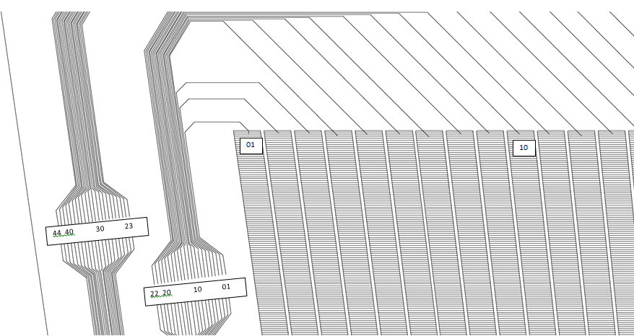
Connecters of Return Strip panel
11.2 mm
10 mm
26 mm
79 mm
Top gap will not cover
about 3 strips !

