Slide 1




Design & production of the prototype using new PCBs for testing in October
Naples
E. Voevodina, I. Crotty, S. Buontempo, N. Zaganidis
Upgrade meeting of RPC group, CERN, 31/07/2017

Slide 2
Three Options for prototype’s production:
New Gas Gaps for PCBs of 44/88 of coaxial and return;
Cut of RE4/2 bottom Gas Gaps using the available material in KODEL;
Using the available of Gas gaps of RE4/2 Top narrow from CERN.

Slide 3
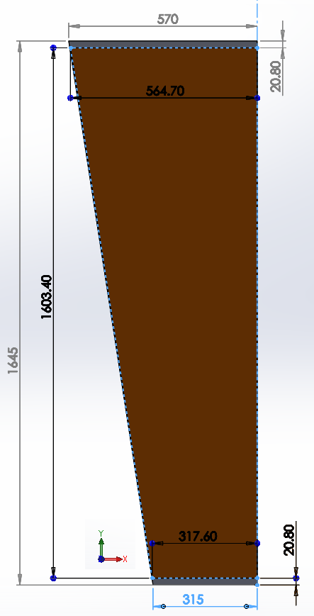
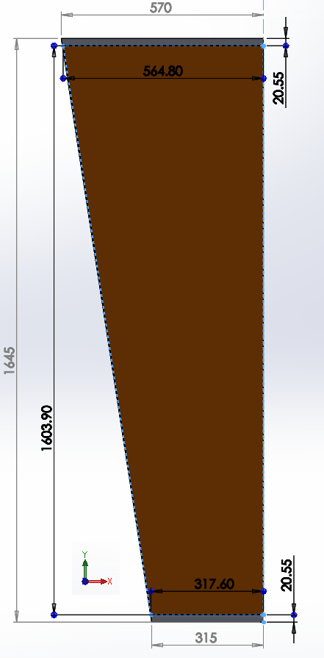
PCB with Coaxial cable
44 strips
88 strips
Production of one BOTTOM and one TOP gaps which will be completely identical

Slide 4

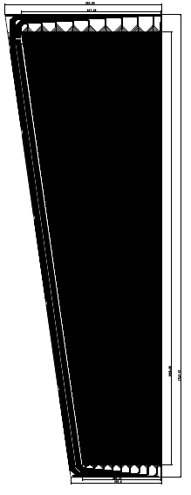
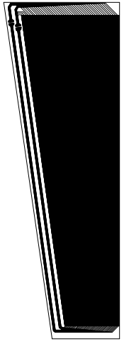
PCBs with Pick-Up and Return strips
580.03 mm
586.23 mm
Difference on 22.15 mm
44 strips
517.36 mm
495.21 mm
Production of one BOTTOM and one TOP gaps which will be completely identical
44 strips
88 strips
1713.42 mm
1700 mm
Difference on 34.77 mm
1603.85 mm
1569.08 mm
274.98 mm
289.64 mm
341.23 mm
336.2 mm

Slide 5
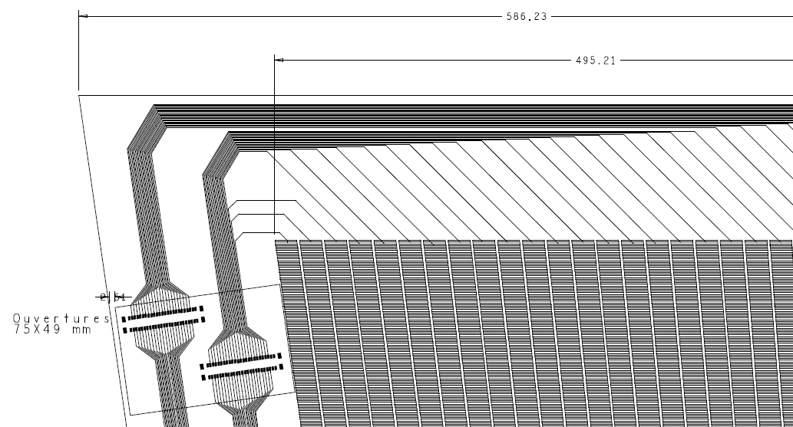
Features of PCBs with Pick Up and Return strips
44 strips
Pitch 11.2 mm
2.54 mm
80 mm

Slide 6
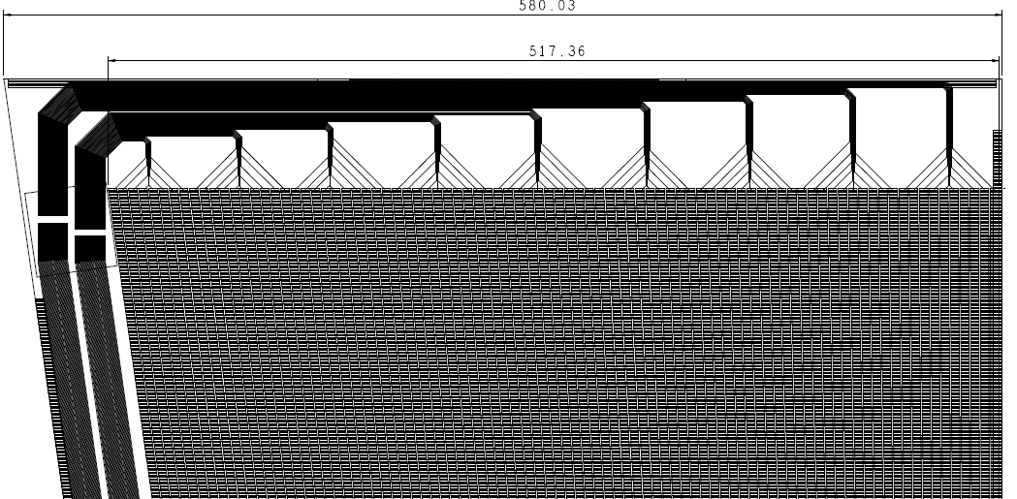
Features of PCBs with Pick Up and Return strips
88 strips
Pitch 5.6 mm
53 mm

Slide 7

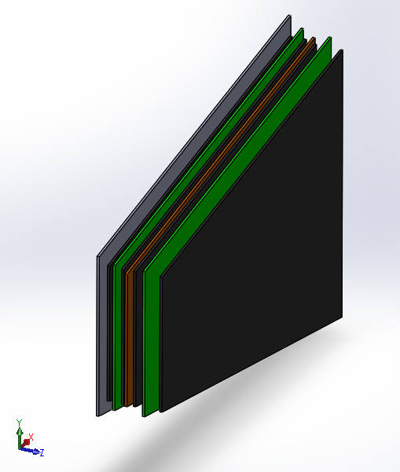
Topology of RPC chamber
Gap Top
Strip panel
Gap Bottom
Honey Comb panel
Effective areas
(graphite layers)

Slide 8
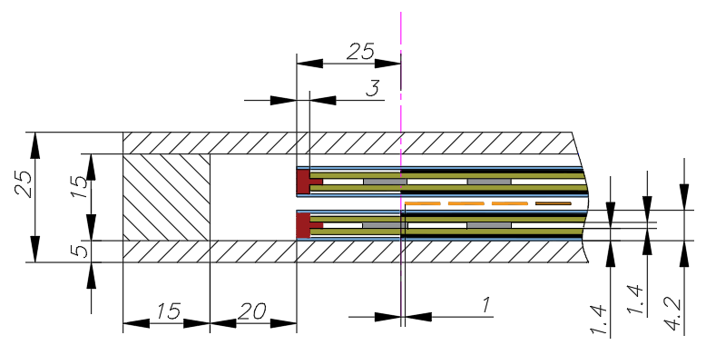
Mechanical details of RPC chambers
Border of Active area
Honey comb panel
Frame
Bar
HPL, 1.4 mm
Insulator layer, 300 µm
Graphite
Strips readout
Spacers, Ф 8 mm

Slide 9
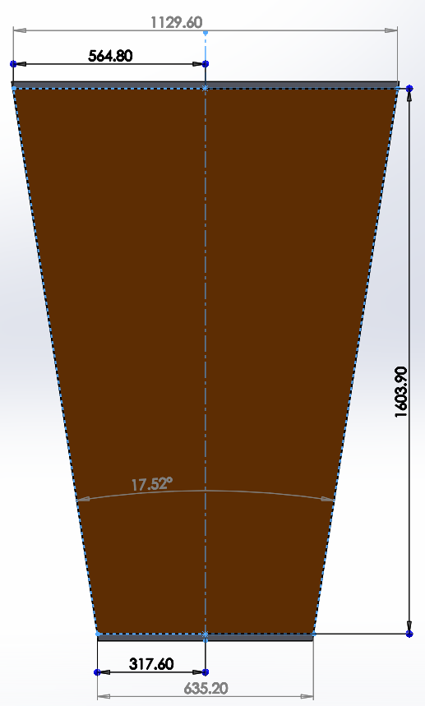
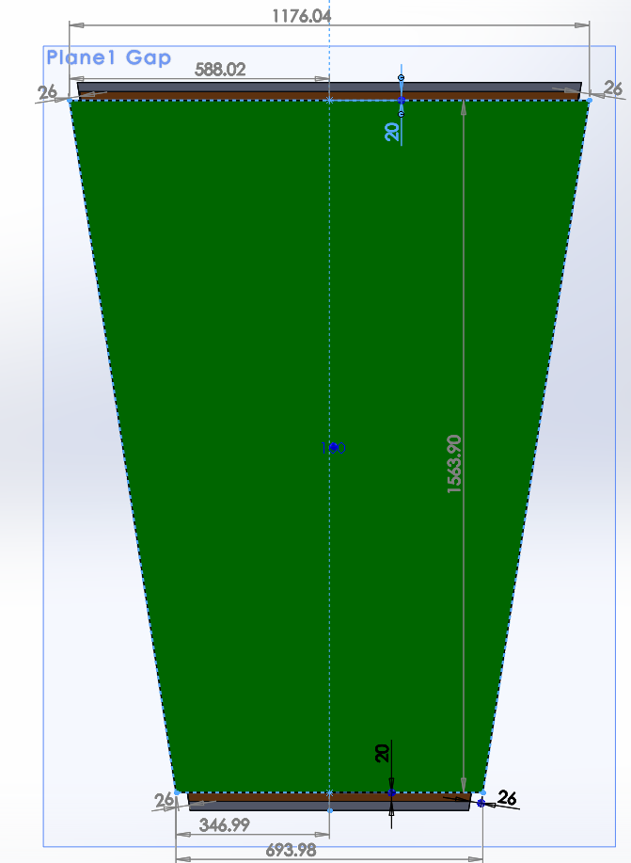
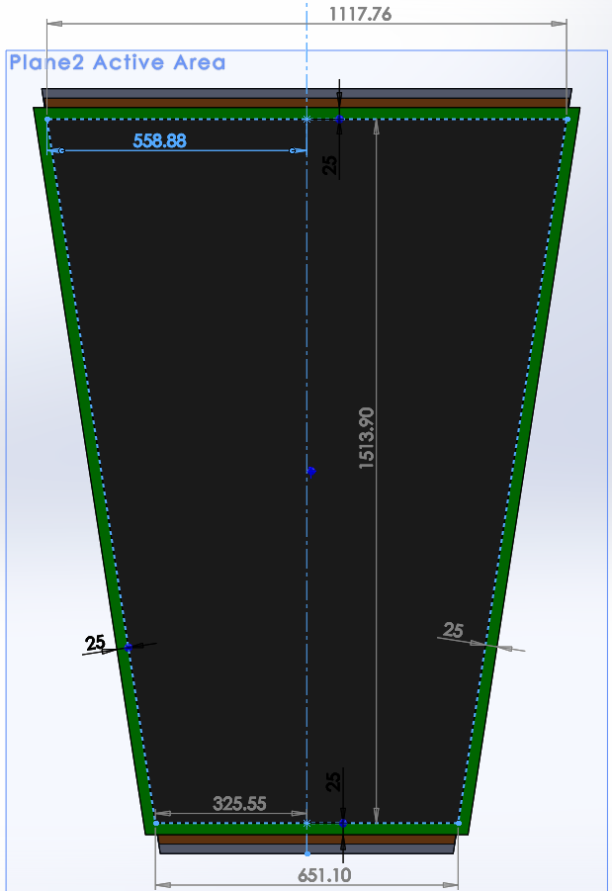

Prototype for PCB with 44/88 coaxial
Bottom & Top Gaps
Active area
44/88 Strips

Slide 10
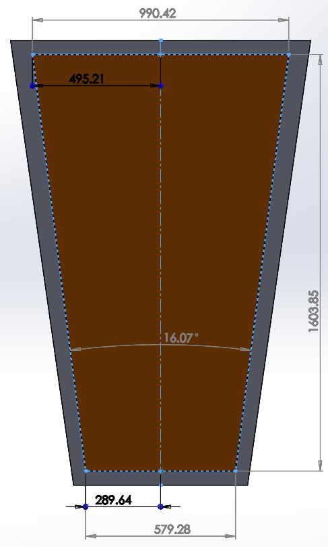
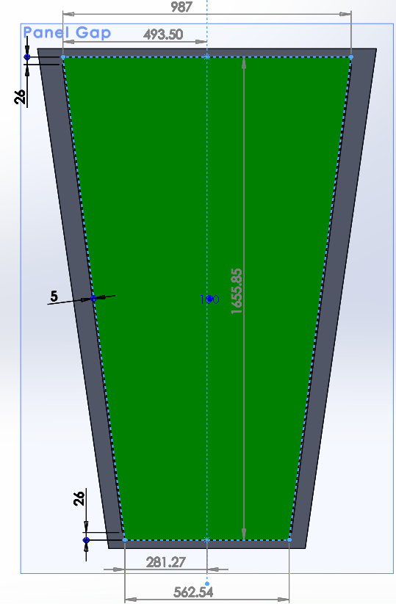
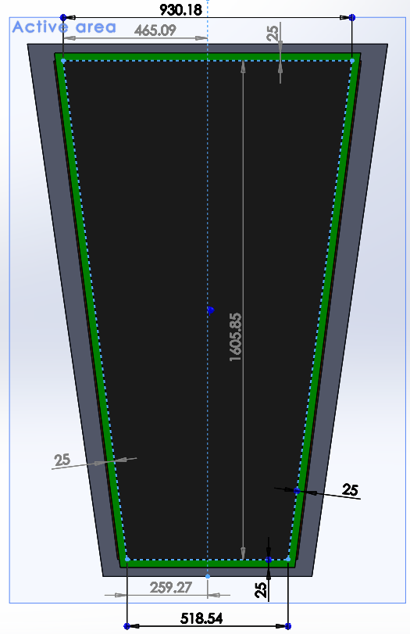
Prototype for PCB with 44/88 return
Bottom & Top Gaps
Active area
44/88 Strips

Slide 11
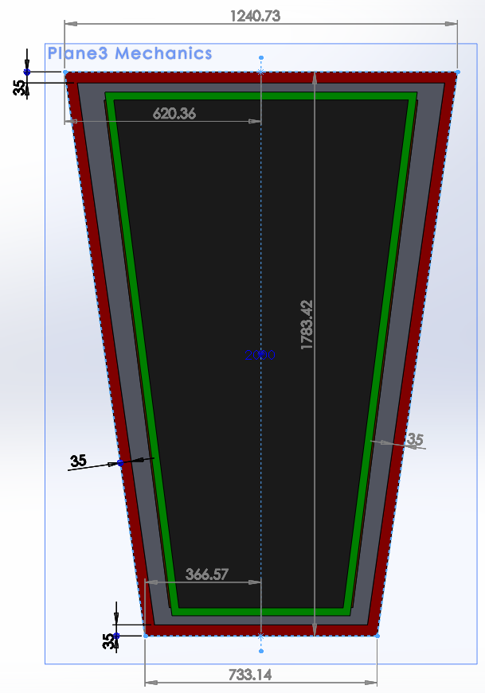
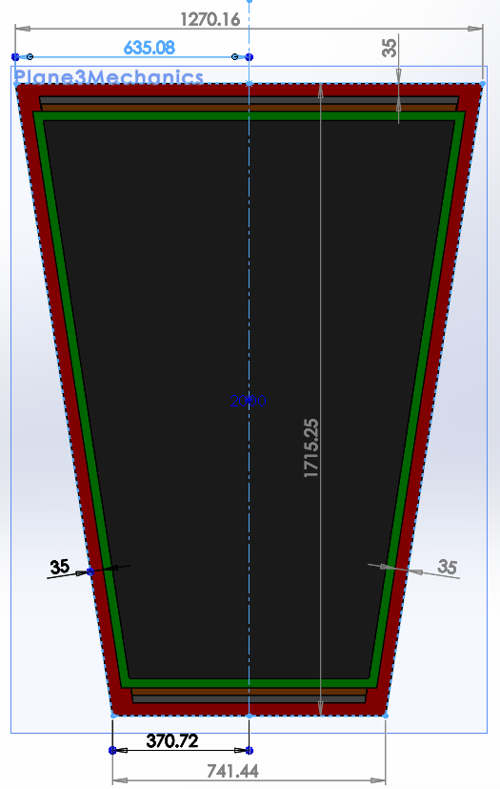
Dimensions for Mechanics
PCB with coaxial
PCB with return

Slide 12
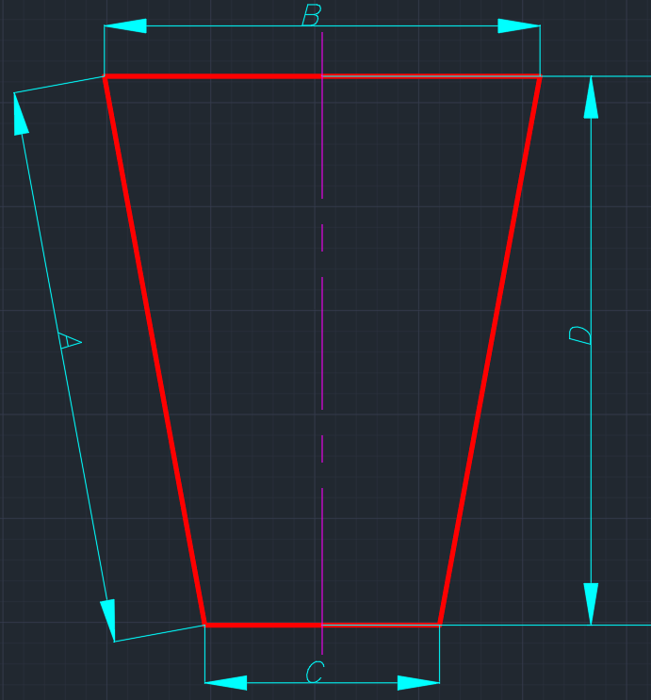
Table with main dimensions
Table 1: Strip area
Name | A, [mm] | B, [mm] | C, [mm] | D, [mm]
44/88 coaxial | 1622.84 | 1129.60 | 635.20 | 1603.9
44/88 return | 1616.97 | 990.42 | 579.28 | 1603.85
Table 2: Gap Details
44/88 coaxial | 1582.37 | 1176.04 | 693.98 | 1563.90
44/88 return | 1669.40 | 987 | 562.54 | 1655.85
Table 3: Active Area
44/88 coaxial | 1531.78 | 1117.76 | 651.10 | 1513.90
44/88 return | 1618.99 | 930.18 | 518.54 | 1605.85
Table 4: Mechanics
44/88 coaxial | 1735.50 | 1270.16 | 741.44 | 1715.25
44/88 return | 1801.39 | 1240.73 | 733.14 | 1783.42

Slide 13
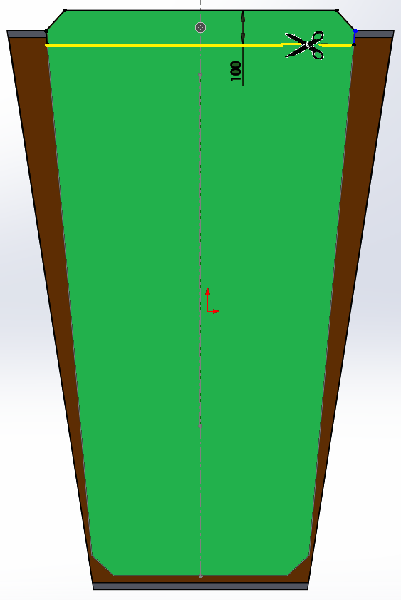
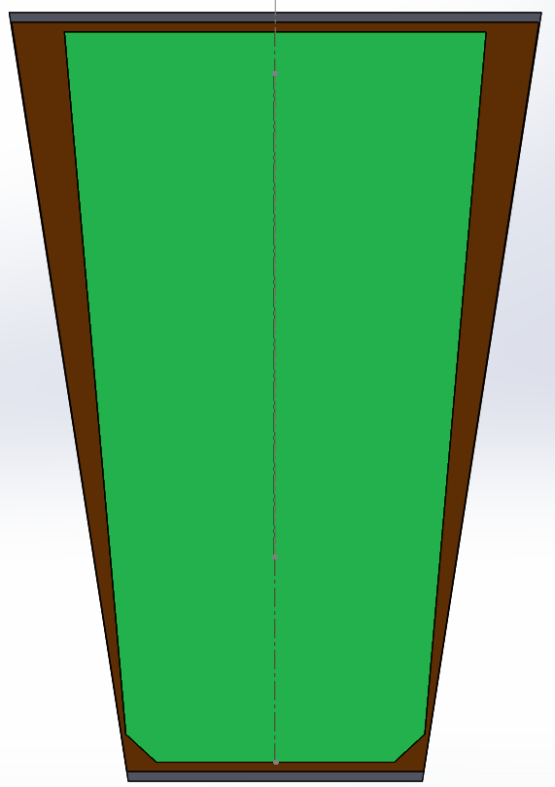
Shorter of RE4/2 (Bottom Gap) form KODEL
Adaptation of RE4/2 Bottom Gap for PCB with 44/88 coaxial cable
100 mm
20 mm for soldering
RE4/2
Bottom Gap
(Thickness of 6 mm)
Shorter
RE4/2
Bottom Gap
(Thickness of 6 mm)
1663 mm
1563 mm
1563.9 mm
20 mm for soldering

Slide 14
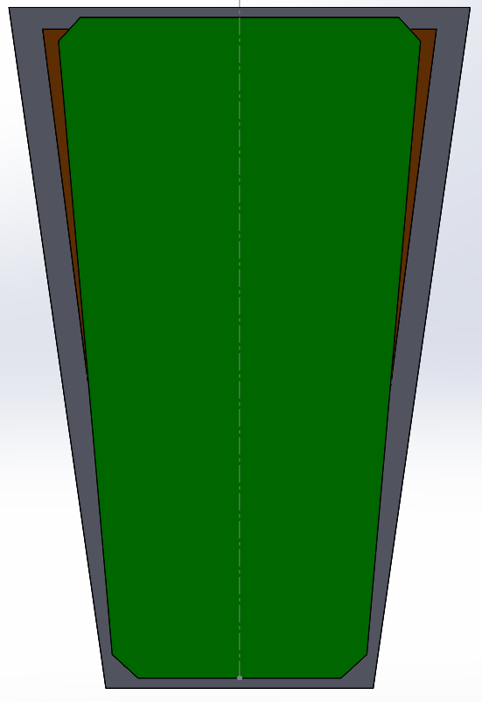
Shorter of RE4/2 (Bottom Gap) form KODEL
Adaptation of RE4/2 Bottom Gap for PCB with 44/88 return
PCB with
44/88 Pick Up & Return
RE4/2
Bottom Gap
(Thickness of 6 mm)
1663 mm
1713.42 mm
Strips’s Length 1603.85mm

Slide 15
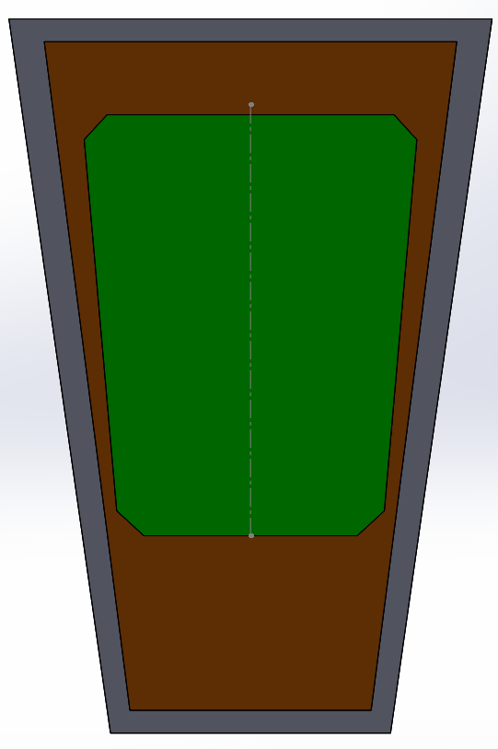
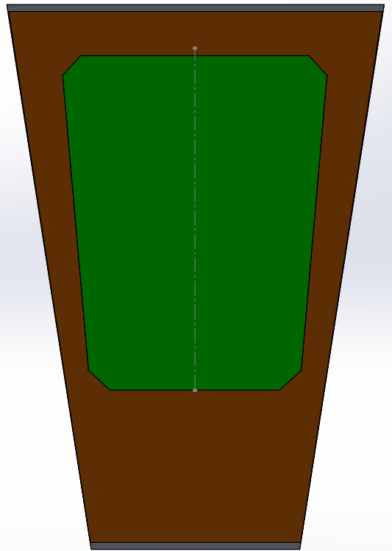
Using RE4/2 Top Narrow from CERN
PCB with 44/88 coaxial cable
PCB with 44/88 Pick Up & Return
RE4/2
TOP
Narrow
(Thickness of 6 mm)
RE4/2
TOP
Narrow
(Thickness of 6 mm)
1010 mm
1603.9 mm
1010 mm
1603.85 mm

Slide 16
Table with main dimensions
Table 1: Strip area
Name | A, [mm] | B, [mm] | C, [mm] | D, [mm]
44/88 coaxial | 1622.84 | 1129.60 | 635.20 | 1603.9
44/88 return | 1616.97 | 990.42 | 579.28 | 1603.85
Table 2: Gap Details
44/88 coaxial | 1582.37 | 1176.04 | 693.98 | 1563.90
44/88 return | 1669.40 | 987 | 562.54 | 1655.85
RE4/2 Bottom | 1669 | 921 | 630 | 1663
RE4/2 Top Narrow | 1014 | 809 | 632 | 1010
Table 3: Active Area
44/88 coaxial | 1531.78 | 1117.76 | 651.10 | 1513.90
44/88 return | 1618.99 | 930.18 | 518.54 | 1605.85
RE4/2 Bottom | 1619 | 866 | 584 | 1613
RE4/2 Top Narrow | 964 | 754 | 586 | 960
Table 4: Mechanics
44/88 coaxial | 1735.50 | 1270.16 | 741.44 | 1715.25
44/88 return | 1801.39 | 1240.73 | 733.14 | 1783.42
RE4/2 | 1693 | 979 | 684 | 1687

Slide 17
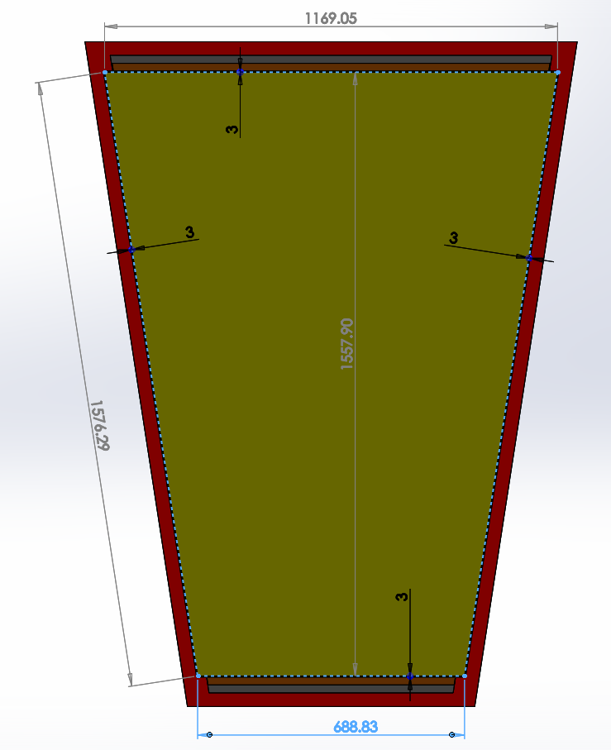
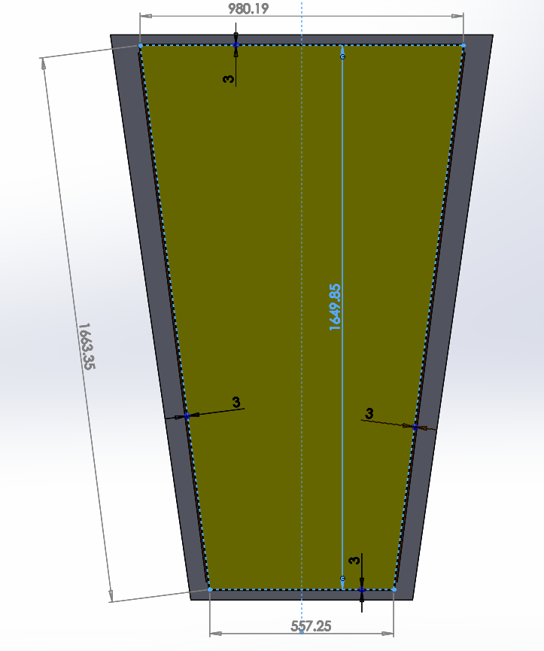
Dimensions of Bakelite
Bakelite
for coaxial
Bakelite
for return

Slide 18
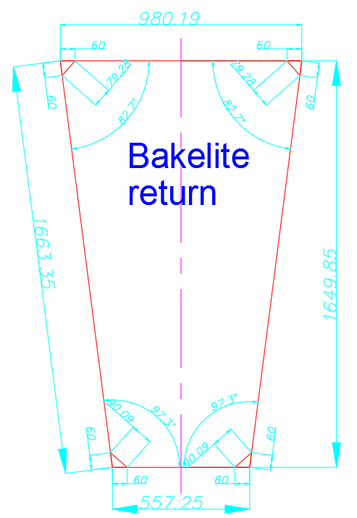
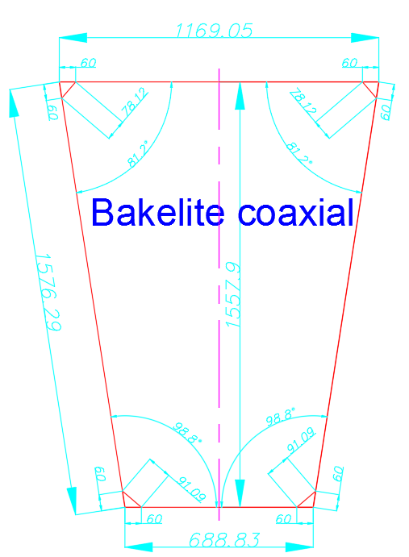
Drawing with Dimensions of Bakelite

Slide 19
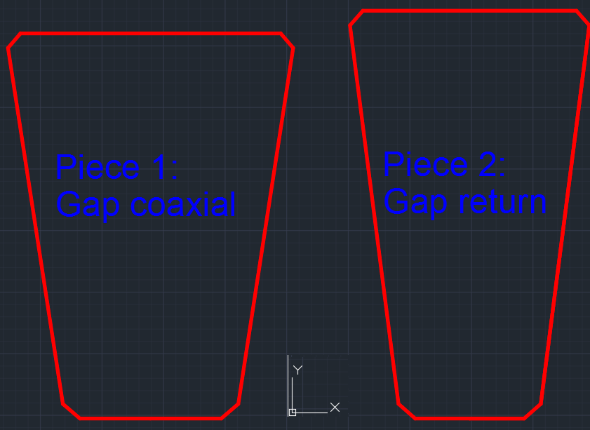
Pieces for cutting

Slide 20
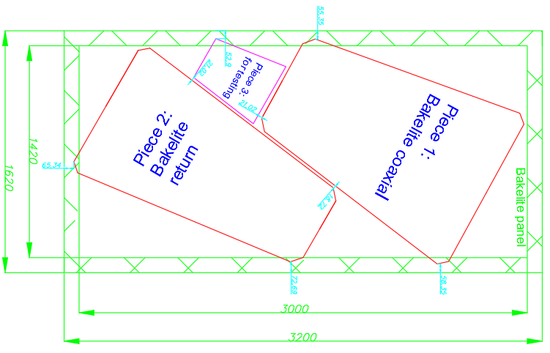
Cutting of HPL’s panels

Slide 21
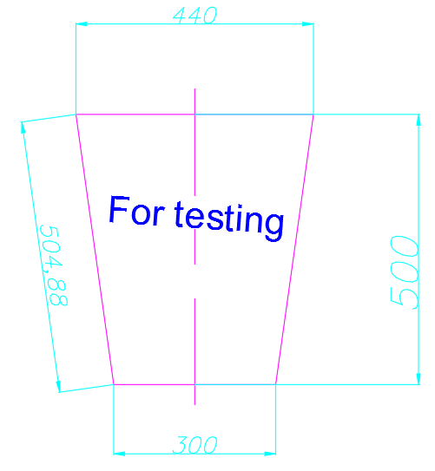
Piece 3: for testing

Slide 22
Final table with main dimensions
Table 1: Strip area
Name | A, [mm] | B, [mm] | C, [mm] | D, [mm]
44/88 coaxial | 1622.84 | 1129.60 | 635.20 | 1603.9
44/88 return | 1616.97 | 990.42 | 579.28 | 1603.85
Table 2: Gap Details
44/88 coaxial | 1582.37 | 1176.04 | 693.98 | 1563.90
44/88 return | 1669.40 | 987 | 562.54 | 1655.85
Table 3: Active Area
44/88 coaxial | 1531.78 | 1117.76 | 651.10 | 1513.90
44/88 return | 1618.99 | 930.18 | 518.54 | 1605.85
Table 4: Mechanics
44/88 coaxial | 1735.50 | 1270.16 | 741.44 | 1715.25
44/88 return | 1801.39 | 1240.73 | 733.14 | 1783.42
Table 5: Bakelite
44/88 coaxial | 1576.29 | 1169.05 | 688.83 | 1557.90
44/88 return | 1663.35 | 980.19 | 557.25 | 1649.85

Slide 23
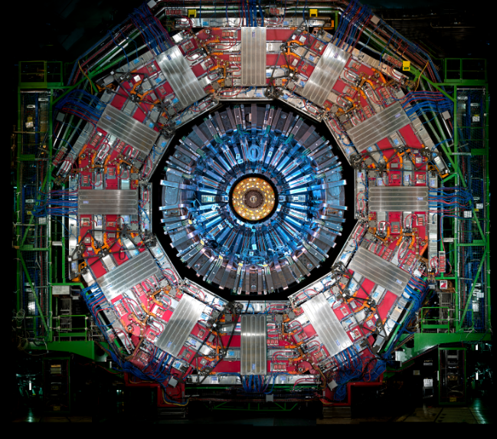
Thank you for your attention!

