Slide 1
Physics Package Thickness Gaps and the rest
Yasser Assran
Ian Crotty
20 April 2018

Slide 2
How thick will the new 1.4mm gas gap chambers be ?

Slide 3
How to Proceed
Two flat surfaces define the volume. The distance and their differences can be defined.
Honeycomb Panel (HCP) 32mm thick
Marble table “perfectly flat”

Slide 4
Is the HCP flat ?
Measure thickness with digital caliper
Aluminium Straight Edge
HCP 32mm thick
Marble table “perfectly flat”

Slide 5
Place the x2 gaps & Chamber lower HCP and faraday cage
Measure thickness with digital caliper
HCP 32mm thick
Physics package x2 gaps and Faraday cage
6mm aluminium HCP bottom panel
Marble table “perfectly flat”

Slide 6
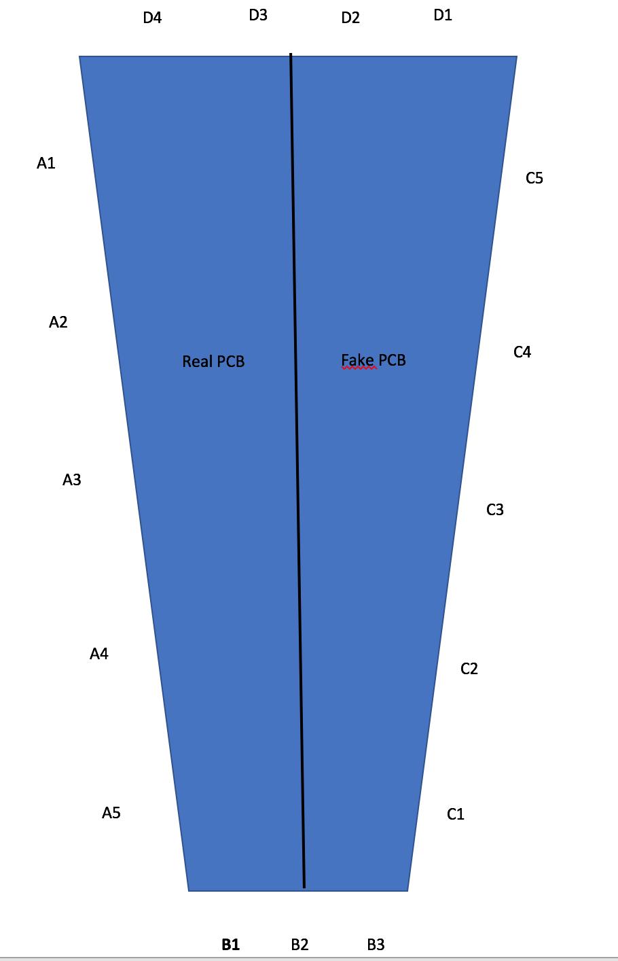
Measurement points, x17, around the Faraday edge

Slide 8
Histogram for Honeycomb

Slide 9
Histogram for Hone + Gaps + Al bar

Slide 10
Histogram for Honeycomb

Slide 12
Real Pickup PCb thickness is 0.8 mm.
Fack Pickup PCb thickness is 1.05 mm.
When we apply load to the whole chamber we found that the real PCB side is more thick than the other side and we got the inverse without applying load.

