Slide 1
J.K.Paik Alu HCP Strength
1999
https://ac.els-cdn.com/S0263823199000269/1-s2.0-S0263823199000269-main.pdf?_tid=83b16473-4702-4090-8158-56657f3472b1&acdnat=1525105670_93c4652f80f094247ae1d545312e07a3

Slide 2
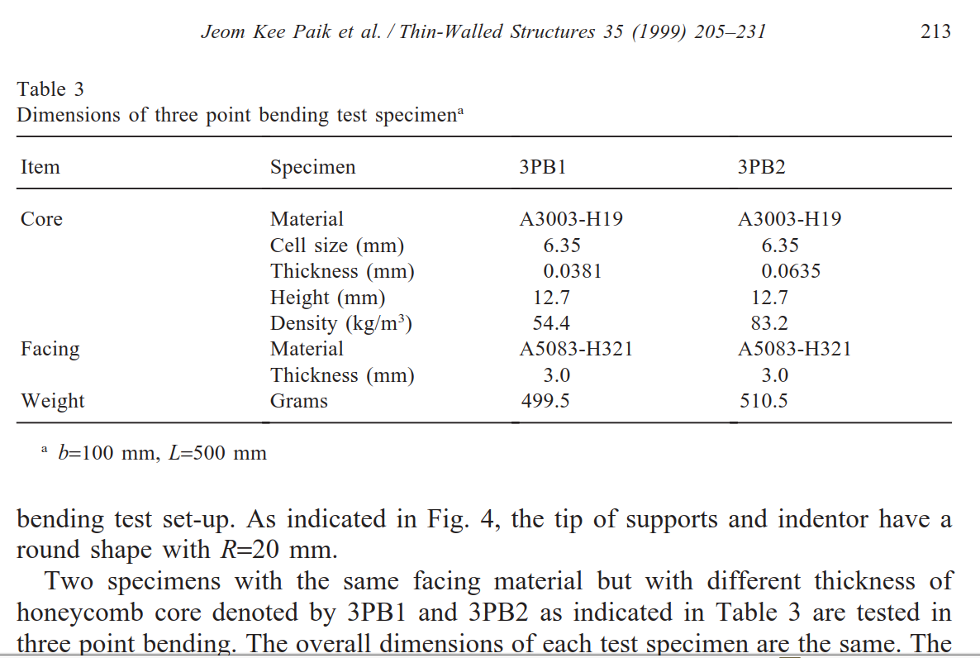
b = 100mm
L = 500mm
h_{c} = 12.7mm
h = 18.7mm

