Slide 1
HCP for R3/1 and RE4/1 Panel de panal
Ian
Jan 2018

Slide 2
Revisit the Honeycomb panel construction due to the very poor quality received from the Chinese supplier for RE4/2 and RE4/3.
Defects were the lower grad quality aluminium alloy skins . Insufficient bonding due to incomplete polymerisation of the film bonding the skins to the alu core (Cells). The resultant out-gassing caused massive delamination in zones from 20 - >60cm .
Consequences of this were the 1 year corrective work to collapse the bubbles formed by the aforementioned delamination.
Due to this lack of integrity the panel stiffness in compromised.
In addition it was not established if this outgassing is continuing causing pressure to bear on the gaps inside.

Slide 4
Approx. dimensions of RE3/1 (& RE4/1)
1.3m
Weights of panels solid and HCP
1.7m

Slide 5
Top HCP for RE4/3 showing cut outs and chamfered through holes on the edges for clamping the structural volume.

Slide 7
Characteristics of Original panels and solid Alu. Alloy
Stiffness is referred to as the Young’s Modulus (E) in units of MPa.
AW6082 Hardened and annealed E = 70 GPa
Tests from original HCP Chinese panels indicate a stiffness of ~30GPa

Slide 8
Alternative manufacture methods of Alu skinned HCP or foam cores
First scenario
Build up the panel, skins and core, as done on all RE’s. The fabrication facility has to have heated press and pre & post machining capability.
Second scenario
Procure full HCP panel , OEM panel from supplier.
Transfer to a facility that will cut to dimensions, create necessary cut-outs, insert and bond in-place dowels for threads, assembly holes and edge facings.

Slide 9
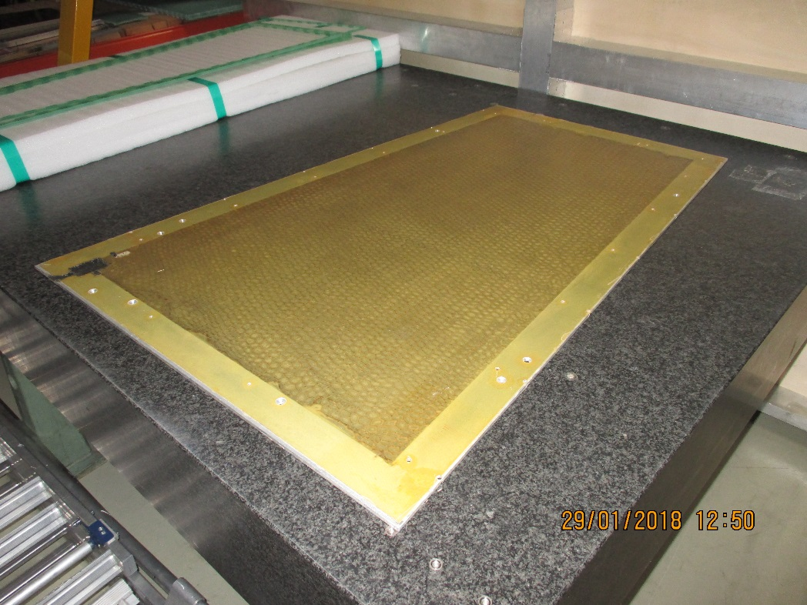
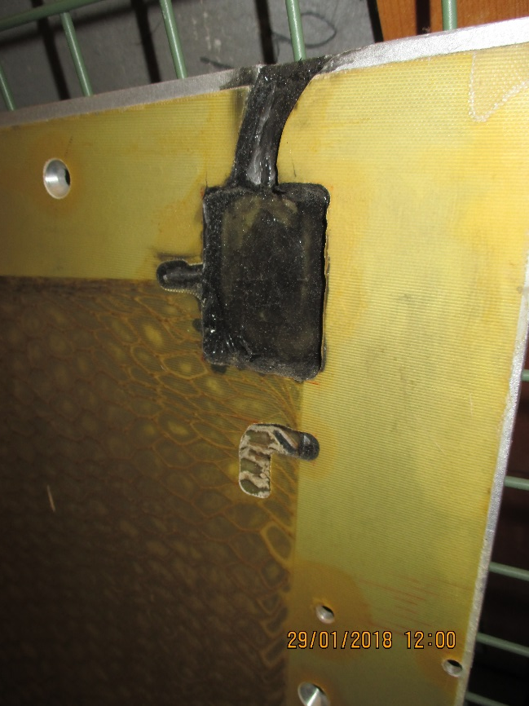
First Scenario
Individual lay-up of all the components.
Press and autoclave of consequent size.
An example of an HCP produced with limited materials and expertise at CERN

Slide 10
Alu bars inserted on all 4 edges
5 additional bars inserted for the cooling mounting
Foam injection for edge facings
Honeycomb cell cut to shape

Slide 11
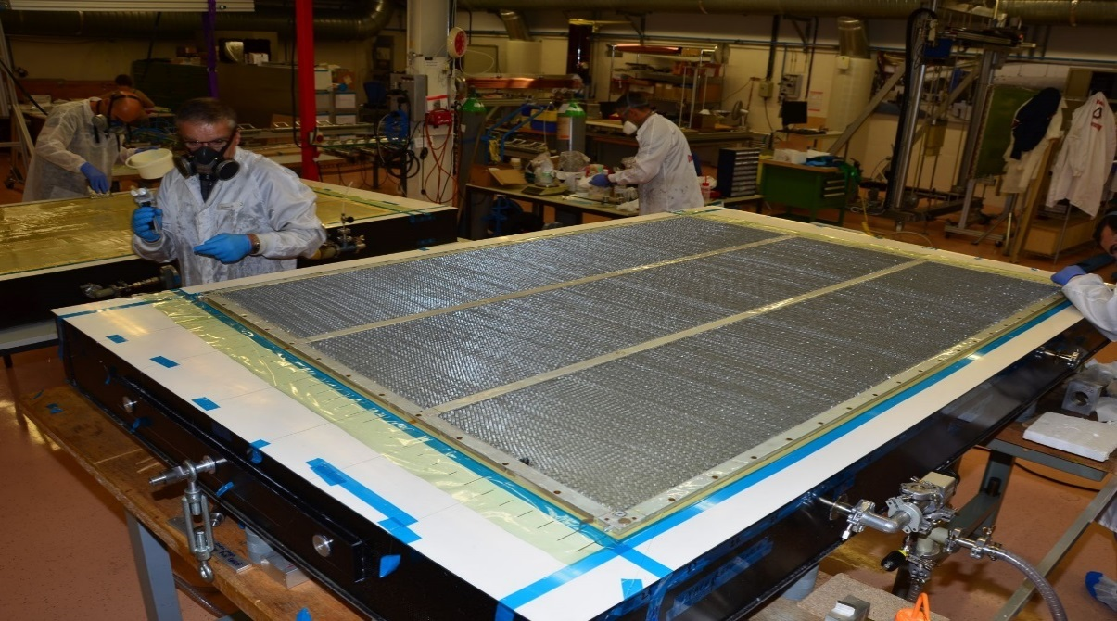
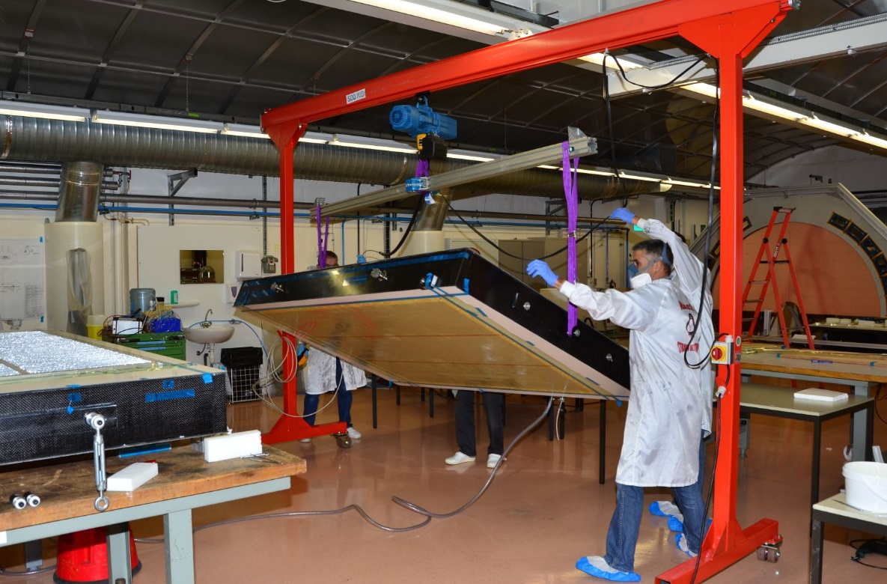
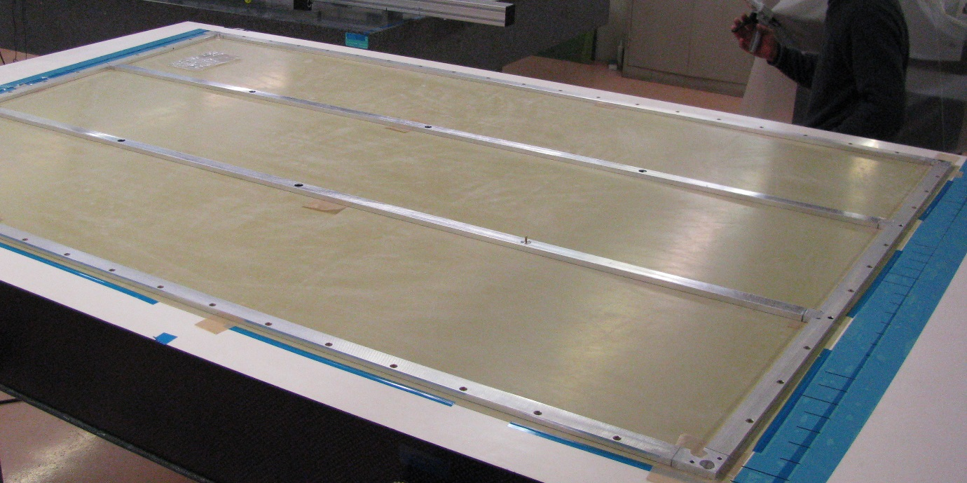
ATLAS MICROMEGAS
Module 0 Assembly procedure
drift panel assembly

Slide 12
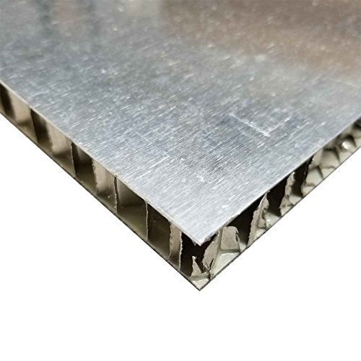
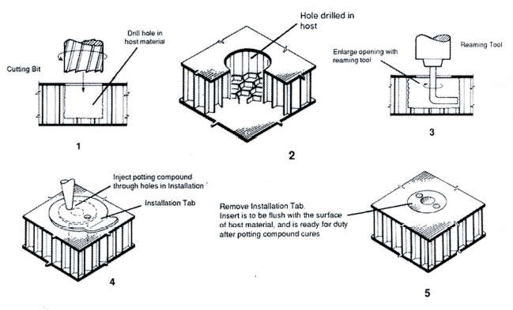
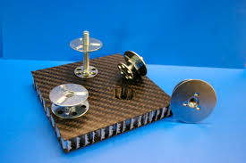
Second Scenario
Buy in OEM panel
Machining, inserts and edge facings

Slide 13
Close outs or Edge Facings
A large choice
See the book “Honeycomb Technology” by T. Bitzer, old but complete.

Slide 14
Close outs or Edge Facings

Slide 15
Panel edges or edge facing methods
Alucore edge prcocessing
https://www.youtube.com/watch?v=oIieqHavBBQ&spfreload=1
https://www.youtube.com/watch?v=Jnbcokk3N_A

Slide 16
Edge Facings Methods, automated large scale production
https://www.youtube.com/watch?v=W-udub9VPxM

Slide 17
Edge Facings, small hand tool approach
https://www.youtube.com/watch?v=oIieqHavBBQ&spfreload=1

Slide 18
Inserts , threaded holes etc
There are also many solution that have been refined since this publication.
See the book “Honeycomb Technology” by T. Bitzer, old but complete.

Slide 19
There are many insert solutions illustrated on Youtube;
https://www.youtube.com/watch?v=NCC2TcSR4bY
https://www.youtube.com/watch?v=nyVZyc2TTAg
https://www.youtube.com/watch?v=EFZBOP-Xb64&list=PLjztg1Gd4WZRbYbiKB-c1zrLAJChPo7vH
3M inserts ?
https://www.youtube.com/watch?v=M9qkvBZwMwE

Slide 20
Inserts continued
NPFasteners.com/deform-nut
https://www.youtube.com/watch?v=NCC2TcSR4bY
Shear test on M6 gives 584kg to rupture !

Slide 21
Inserts continued
https://www.clipnuts.com/products/potted-in-inserts.html
https://www.youtube.com/watch?v=M9qkvBZwMwE

Slide 22
Inserts continued
https://www.clipn
https://www.youtube.com/wa
Inserts continued
www.flatironpanelproducts.com
https://www.youtube.com/watch?v=M9qkvBZwMwE

Slide 23
http://www.wittenco.com/
http://www.youngengineers.com/newproducts.aspx

Slide 24
http://www.stanleyengineeredfastening.com/brands/spiralock/technology/see-it-work

Slide 25
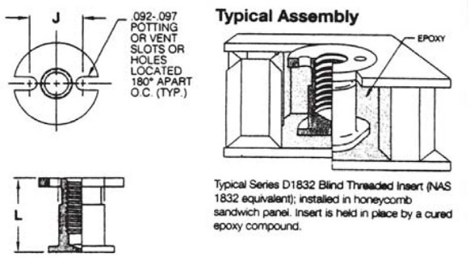
NAS1832 (equivalent D1832) moulded in inserts for HCP
https://industrio.fr/les-produits/inserts

Slide 26
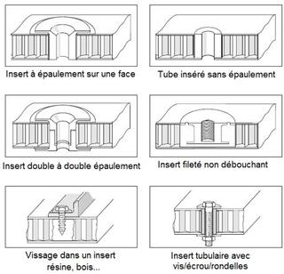
https://www.cr-system-components.de/english/products/standard-parts/

Slide 27
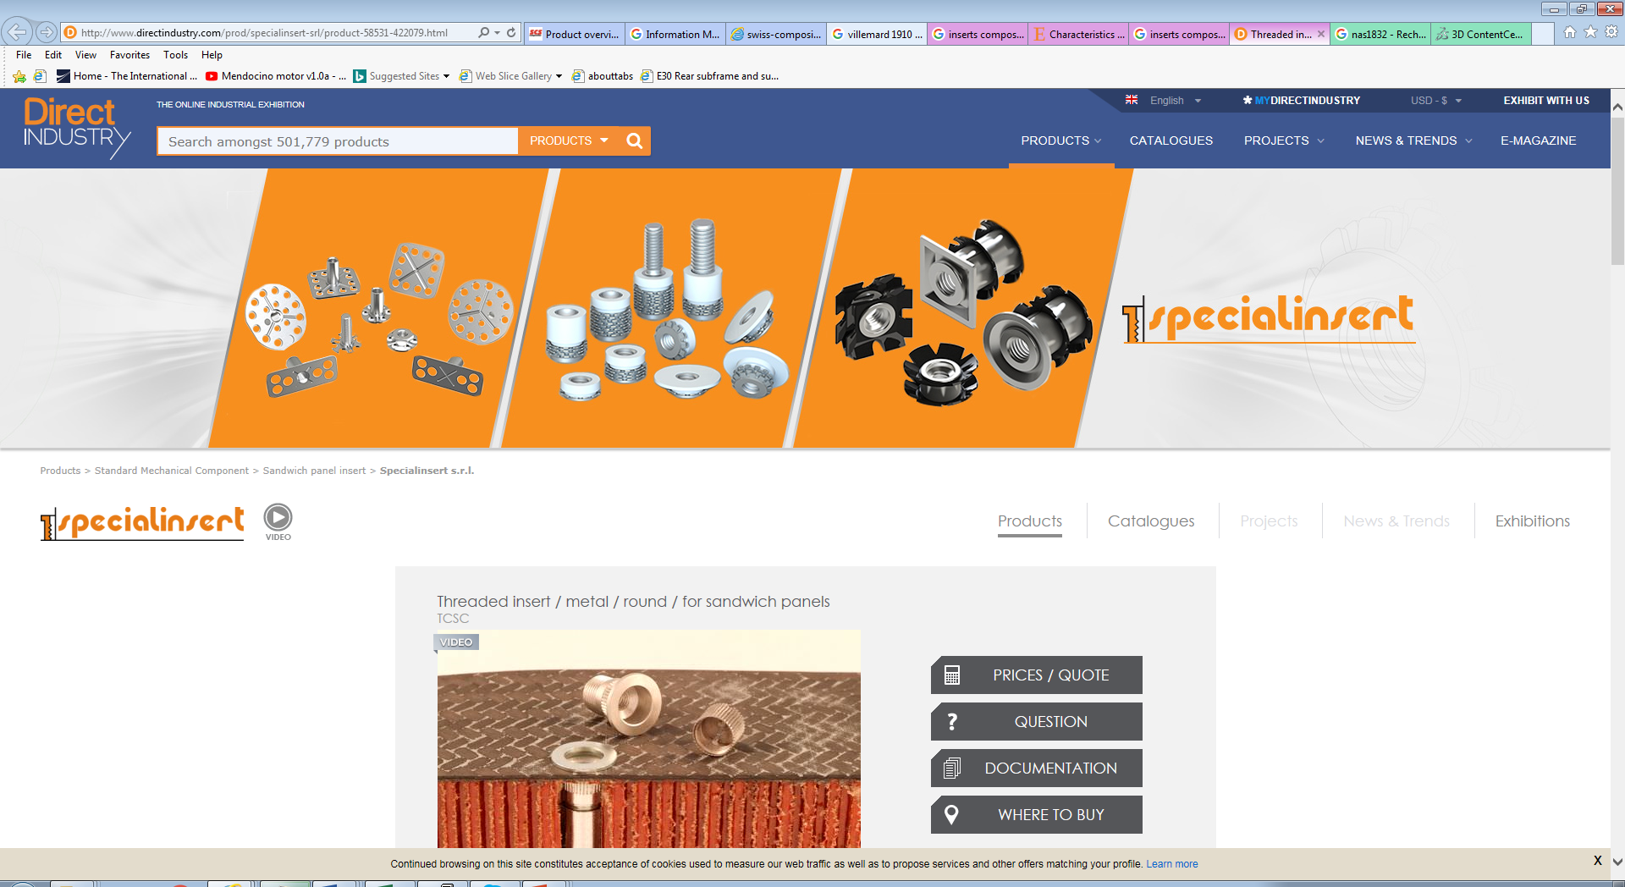
http://www.directindustry.com/prod/specialinsert-srl/product-58531-422079.html

Slide 28
http://pdf.directindustry.com/pdf/specialinsert-srl/inserts-composite-materials/58531-298077.html

Slide 29
https://catalog.monroeaerospace.com/item/all-categories/inserts-1/nas1833-3-375-1

Slide 30
https://depozit.isae.fr/theses/2005/2005_Bunyawanichakul_Phacharaporn.pdf
300 pages of good experimental work

Slide 31
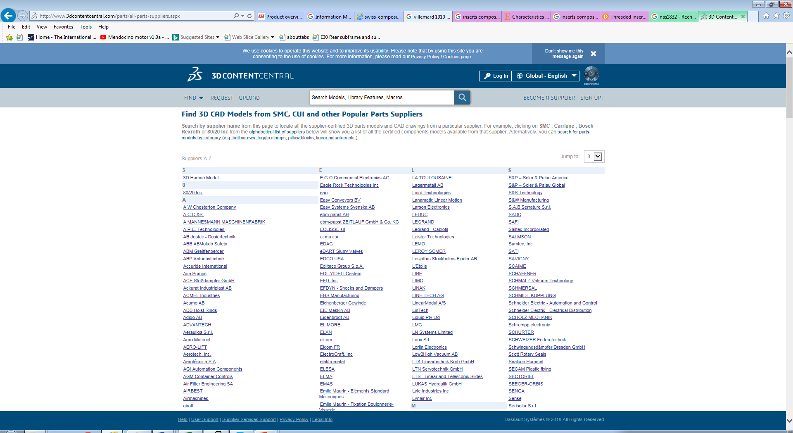
http://www.3dcontentcentral.com/parts/all-parts-suppliers.aspx
All suppliers with drawings !

Slide 32
Panel Sources in Mexico https://www.quiminet.com/productos/panel-de-honeycomb-103806321169/proveedores.htm
GRUPO LLERANDI. BLVD ESTEBAN DE ANTUÑANO S/N ENTRE 6 Y 10 PTE Puebla, Puebla México.
http://grupollerandi.com/servicios/materiales-compuestos
Provem. AVE. DE LA TRANSFORMACION 646, PARQUE INDUSTRIAL QUERETARO QUERETARO, QUERETARO México. Paper packing material
Novapak. Alberto N. Swain No. 234 Col. Ciudad Industrial, Coahuila, Torreón C.P. 27019. México. Packing.
BASF. Insurgentes Sur No. 975 Col. Ciudad de los Deportes, Distrito Federal C.P. 03710. México
Grupo Quinzco. Monterrey 25 Col. Fraccionamiento Valle CeylánEstado de México C.P. 54150. México. Tel; 52 55 4169-6844
Aislamientos y Más. José Benitez 2186 Col. Colonia Obispado, Monterrey, Nuevo León C.P. 64040. México. Tel; 52 81 4170-8342

Slide 33
Original panel characterisation, Can we produce something similar ?
Yes of course we can Honeycomb material is used in every country around the world in the building and transport industry. The days when the scope was limited to aerospace and military have gone.

Slide 34
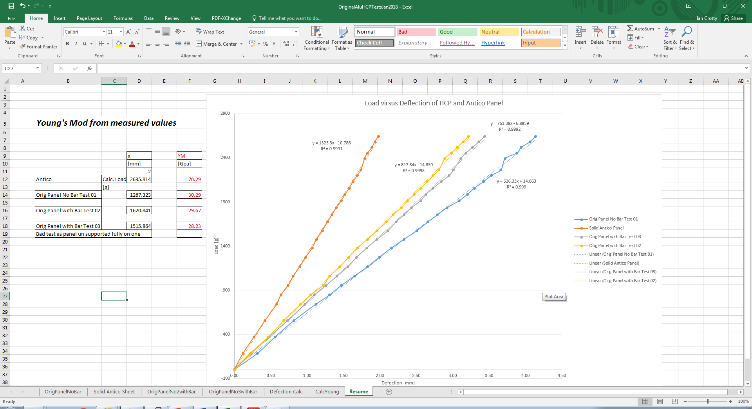
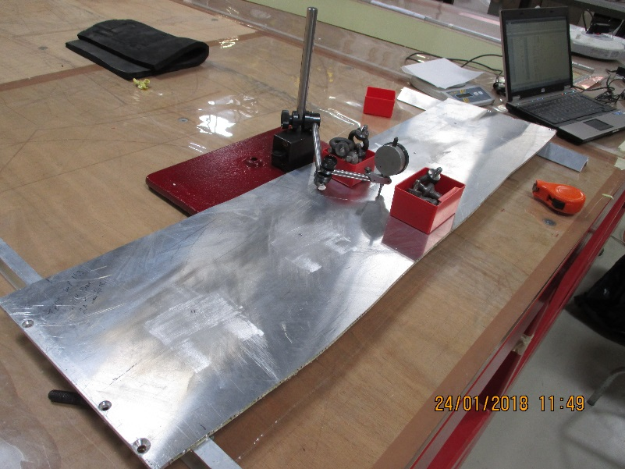
Original panel characterisation
Solid Alu panel is twice as stiff as an HCP but its weight is x4 times heavier.

Slide 35
Aluminium alloy (6mm) AW 6082 weighs 16.2kg/m2
Honey comb panel (6mm)weighs approx. 4kg/m2
RE*/3 panel weighs
RE*/2 anel weighs

Slide 36
Conclusion
It is possible to make HCP in house.
Making HCP without strict supervision is NOT a solution.
Adopting industrial practise of buying in and processing to obtain the required product IS a good solution.
Investigation of local industrial suppliers is required.
Post processing, inserts etc may be managed in house with non automated procedures.

Slide 37
Refs
Very large HCP made here at CERN
EDMS 1756235, PH/DT/CO, F. P. Gomez
Also thermal containment vessel. EDMS 1698508
EDMS 1507417
Mechanical Calculation ; https://www.youtube.com/watch?v=q-uLJN8upWE
Honeycomb Technology: Materials, Design, Manufacturing, Applications and Testing 1997th Edition
by T.N. Bitzer (Author)

Slide 38
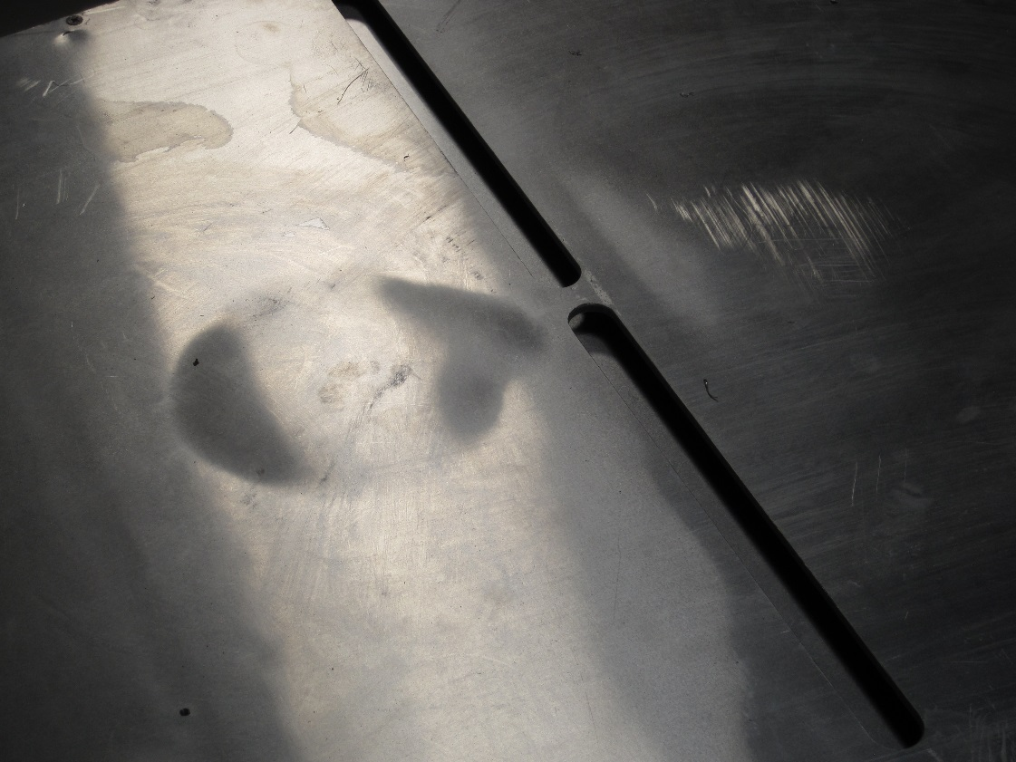
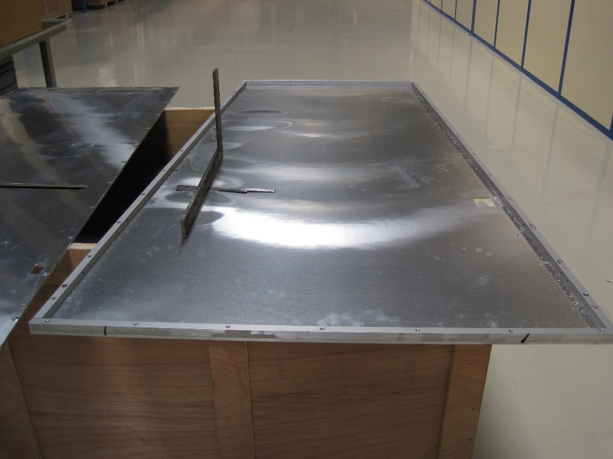
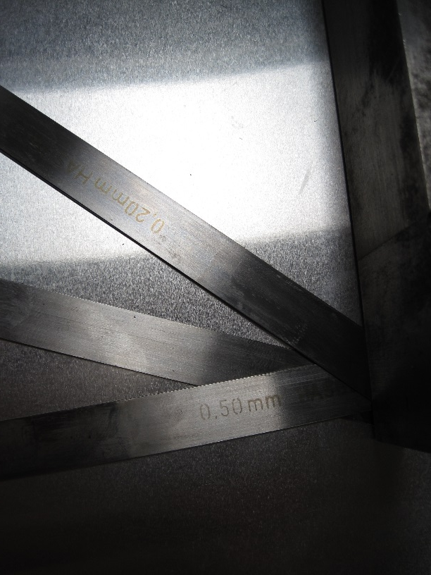
Retro fitting of HCP panels
Any changes cause problems. Bad preparation and processing causes bond failure. Pressure on the gaps is NOT good.
http://rpc-cms-re4-upscope.web.cern.ch/rpc-cms-re4-upscope/RPC/Chamber%20production/Components/Mechanics/RetroFitting/LucsDoc/CleaningRE4MechanicsV2.pdf

Slide 40
Aluminium HCP in UK
Aluminium HCP in Italy
http://www.honeycombpanels.eu/33/honeycomb-panel-compocel-al-(fr)
Swiss Composite
https://www.swiss-composite.ch/?gclid=EAIaIQobChMIzaG0O2E2QIVwpPtCh3hGwQAEAAYASAAEgKqx_D_BwE
https://www.swiss-composite.ch/pdf/Produkteuebersicht.pdf

Slide 41
En France
http://www.ipm-mondia.com/panneaux_usines.html
http://www.nidaplast.com/fr/produits/nidaskin
http://www.nidaplast.com/sites/default/files/downloads/COMP_FT_NIDASKIN-ALUMINIUM_FR_2017.pdf
http://www.afl-honeycomb.com/produit.html
Inserts
http://www.epciengineering.com/wp-content/uploads/2017/08/young-engineers-catalogue.pdf

Slide 44
Spoke with Julien Meunier on 070218.
Will call back 090218
On 00412192230730 or 34
Ready to talk , goog tech understanding.
Suggested KVT and keenest

Slide 45
https://3hti.com/wp-content/uploads/2015/03/mentorpaper_82958.pdf
??

Slide 46
http://www.honeycombpanels.eu/33/honeycomb-panel-compocel-al-(fr)

Slide 47
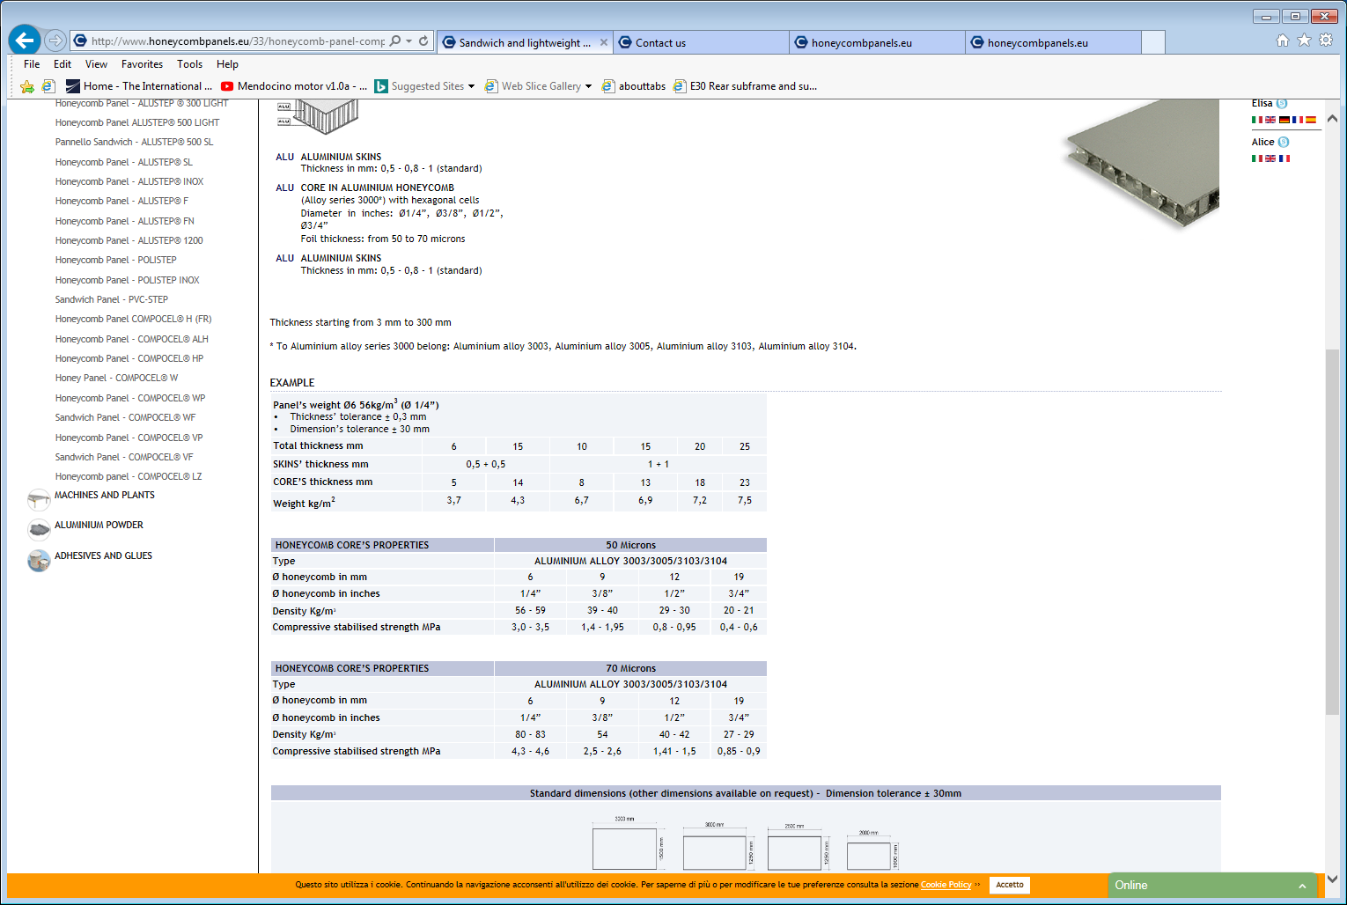

Slide 48
Additional types of HCP
Military faraday application made in mexico. Parker Hannifin de México S.A. de C.V. , Fluid Connectors Division, Antiguo Camino a San Lorenzo 338, Zona Industrial Toluca, Mexico
Tel; 722 275 42 00

Slide 49
Industrial Honeycomb production
https://www.youtube.com/watch?v=V7nwcqbn4QM

Slide 50
Dedicated Hand tools for cutting Composite panels
https://www.youtube.com/watch?v=GmWUftf_lm0
https://www.youtube.com/watch?v=m4AyjBfJ0k4

Slide 51
http://workshape.fr/
Recommended for advise etc by joao.carlos.batista.lopes@cern.ch 16 7340

Slide 52
Academic studies
Journals in CERN
Composite Structures
Failure behaviour of honeycomb sandwich corner joints and inserts, 2009
Sebastian Heimbs, Marc Pein
Characteristics of joining inserts for composite sandwich panels, Nov 2008
Byoung Jung Kim,

Slide 53
http://www.technolineconcept.fr/images/MTnidabeille.pdf
http://www.technolineconcept.fr/images/

Slide 54
Academic papers
https://depozit.isae.fr/theses/2005/2005_Bunyawanichakul_Phacharaporn.pdf

Slide 55
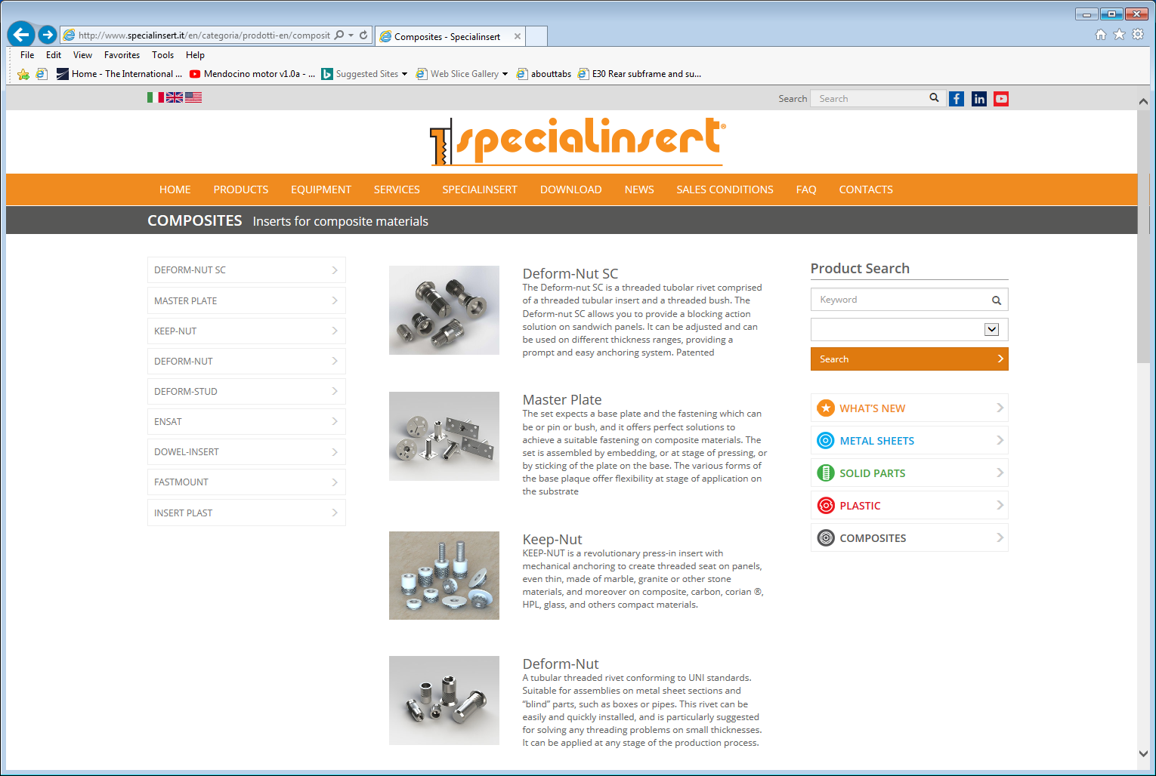
Inserts
http://www.specialinsert.it/en/categoria/prodotti-en/compositi-en/

Slide 56
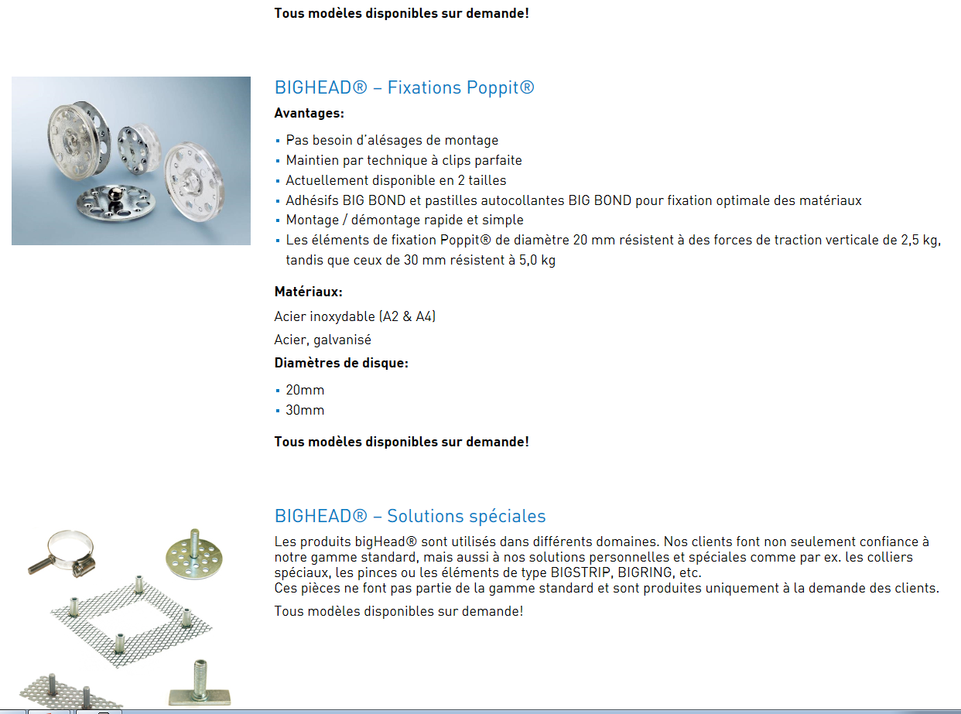
http://www.compositesbusch.ch/company/#Contact
3D printing Jerome Vuvan
Sintering@busch.ch
See on their site;
3d additive manufacturing
KVT fasteners
https://www.kvt-fastening.ch/fr/produits/marques/bighead/

Slide 57
Blog
http://www.talkcomposites.com/

Slide 58
Conference Mexico
http://fismat.ibero.mx/rpc2018/home/bulletin/XIV_Workshop_on_Resistive_Plate_Chambers_an_related_detectors_Bull3_v02.pdf

