Slide 1
Edge trim for HCP
Ian
June 2018

Slide 2
Hot melt
http://www.hotmeltparts.eu/?gclid=EAIaIQobChMIkom7vrbk2wIV3IKyCh2-qQGTEAAYAiAAEgKMSfD_BwE

Slide 3
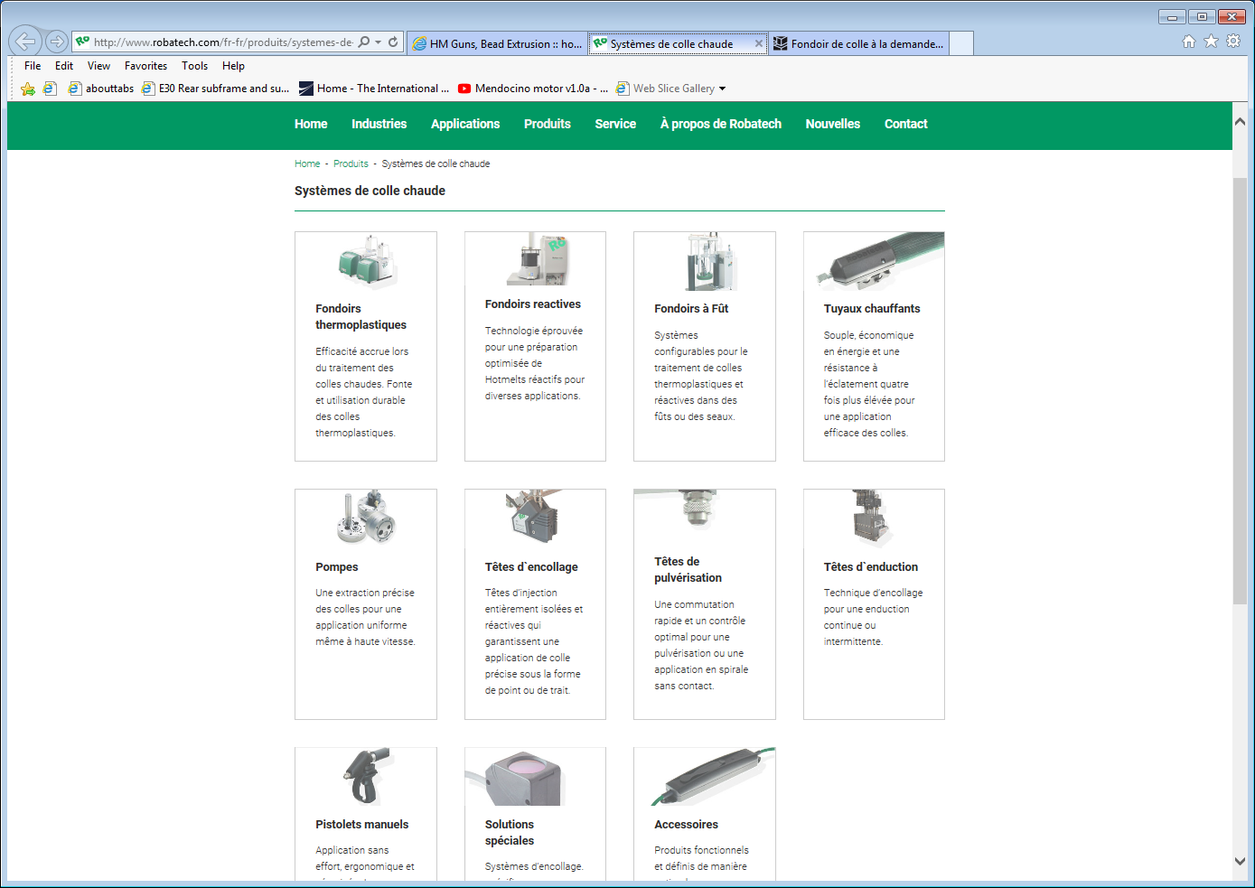
http://www.robatech.com/fr-fr/produits/systemes-de-colle-chaude?gclid=EAIaIQobChMIkom7vrbk2wIV3IKyCh2-qQGTEAAYASAAEgIZ8PD_BwE

Slide 4
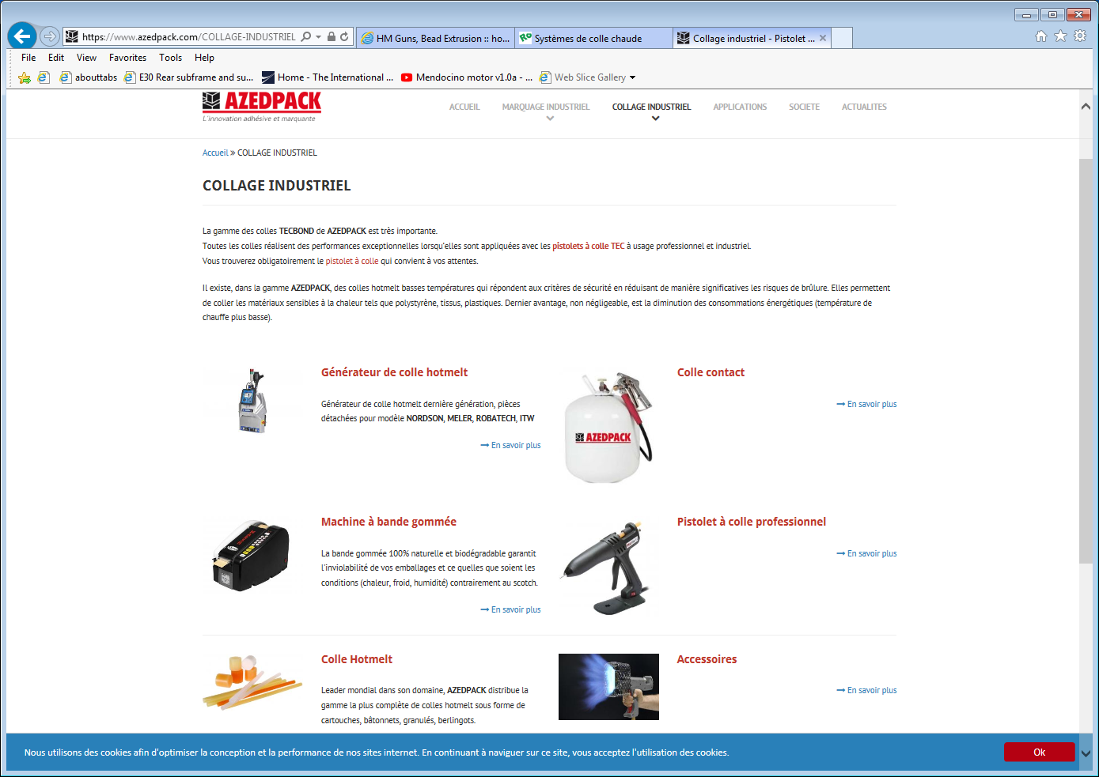
https://www.azedpack.com/COLLAGE-INDUSTRIEL

