Slide 1
Chamber engineering
Ian
5 Aug 2018

Slide 2
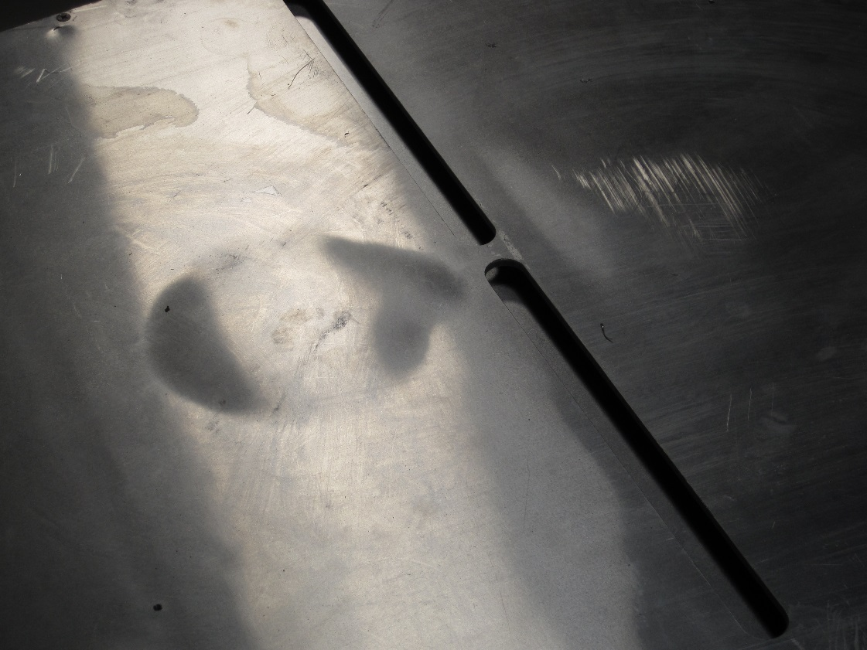
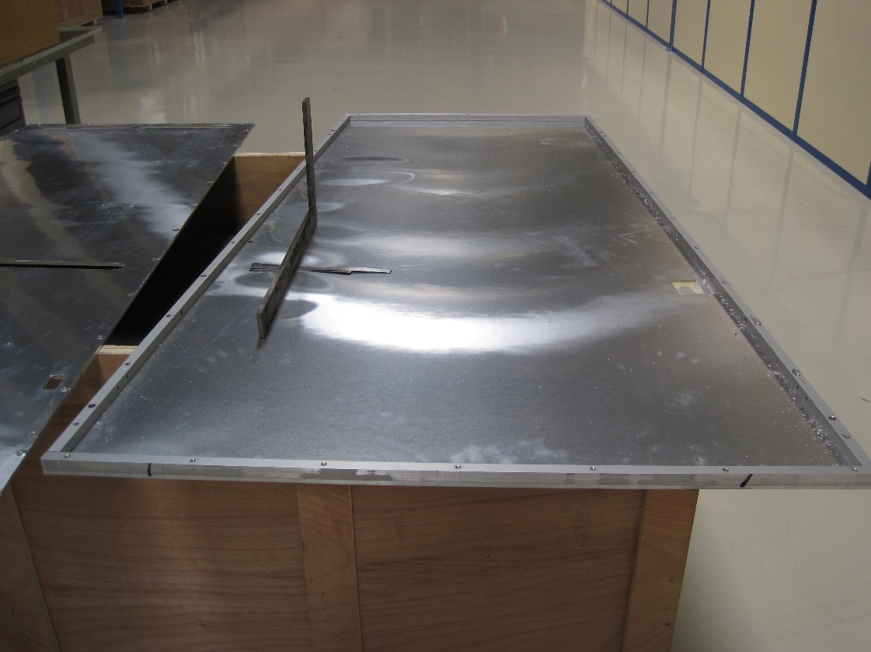
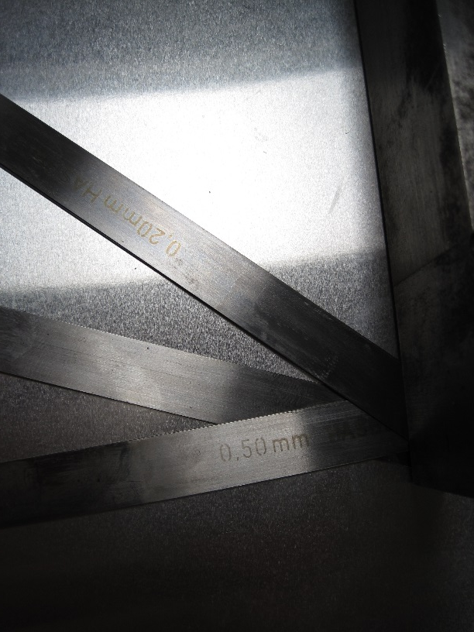
Retro fitting of HCP panels
Any changes cause problems. Bad preparation and processing causes bond failure. Pressure on the gaps is NOT good.
http://rpc-cms-re4-upscope.web.cern.ch/rpc-cms-re4-upscope/RPC/Chamber%20production/Components/Mechanics/RetroFitting/LucsDoc/CleaningRE4MechanicsV2.pdf

Slide 3
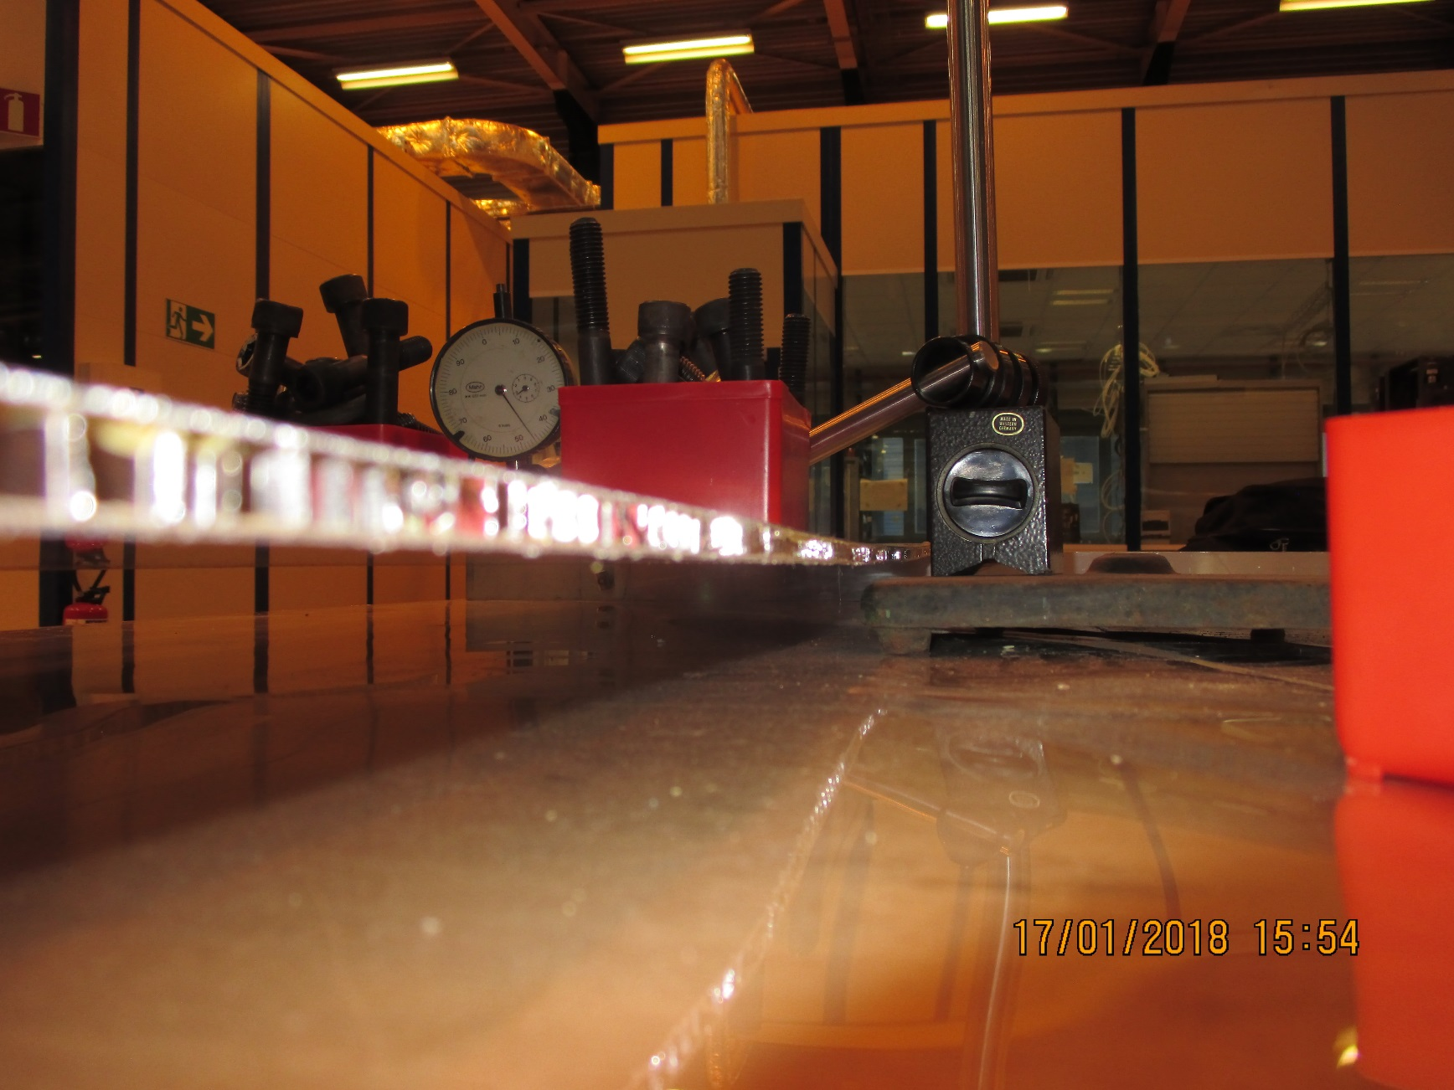
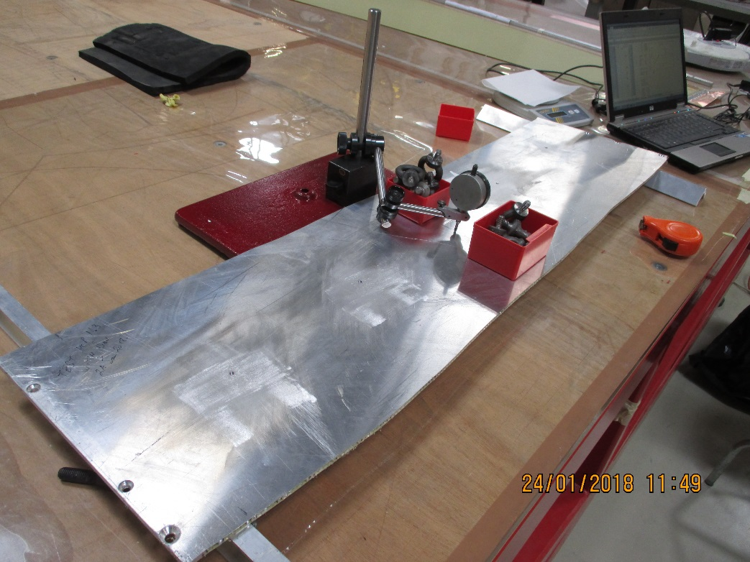
Establish the strength of a good HC panel by loading in bending

Slide 4
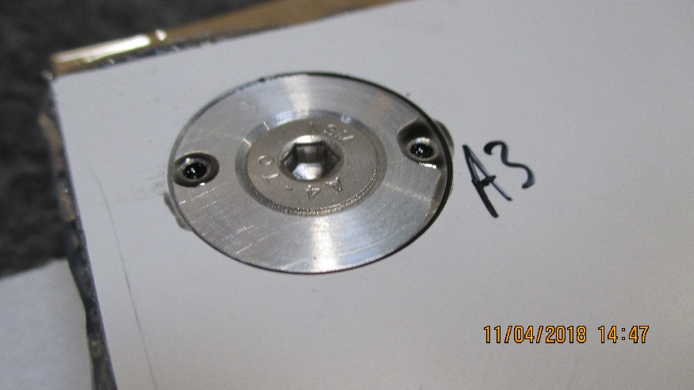
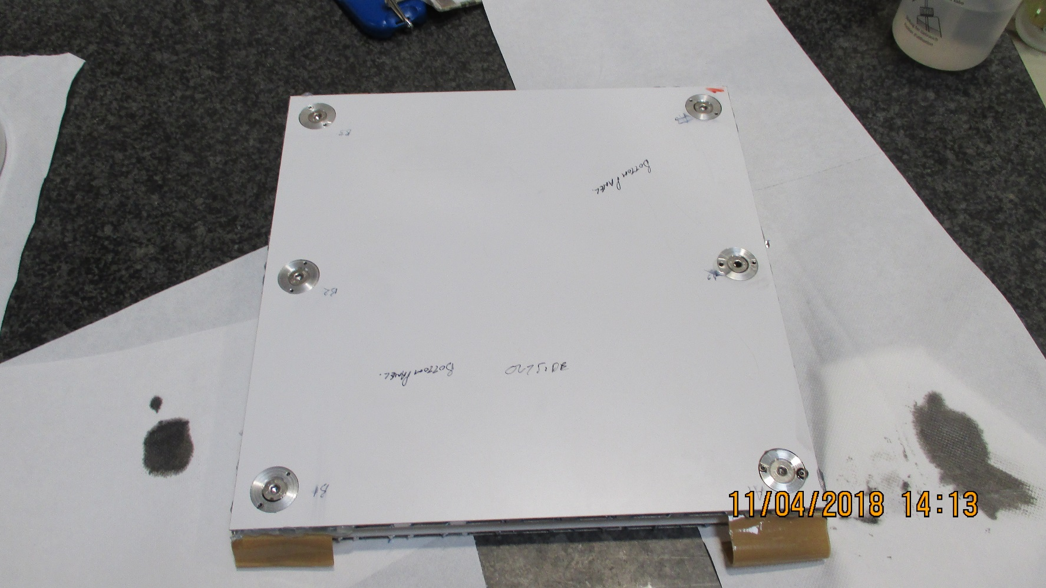
Small prototype, 30 x 30cm, to check for basic solutions fro inserts and bonding

Slide 5
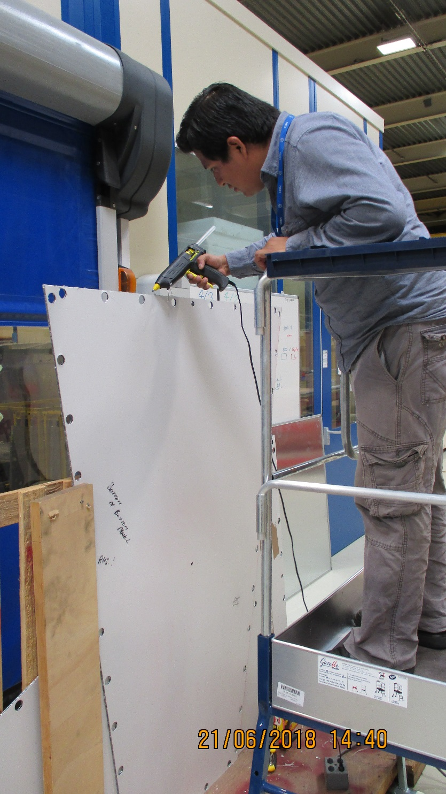
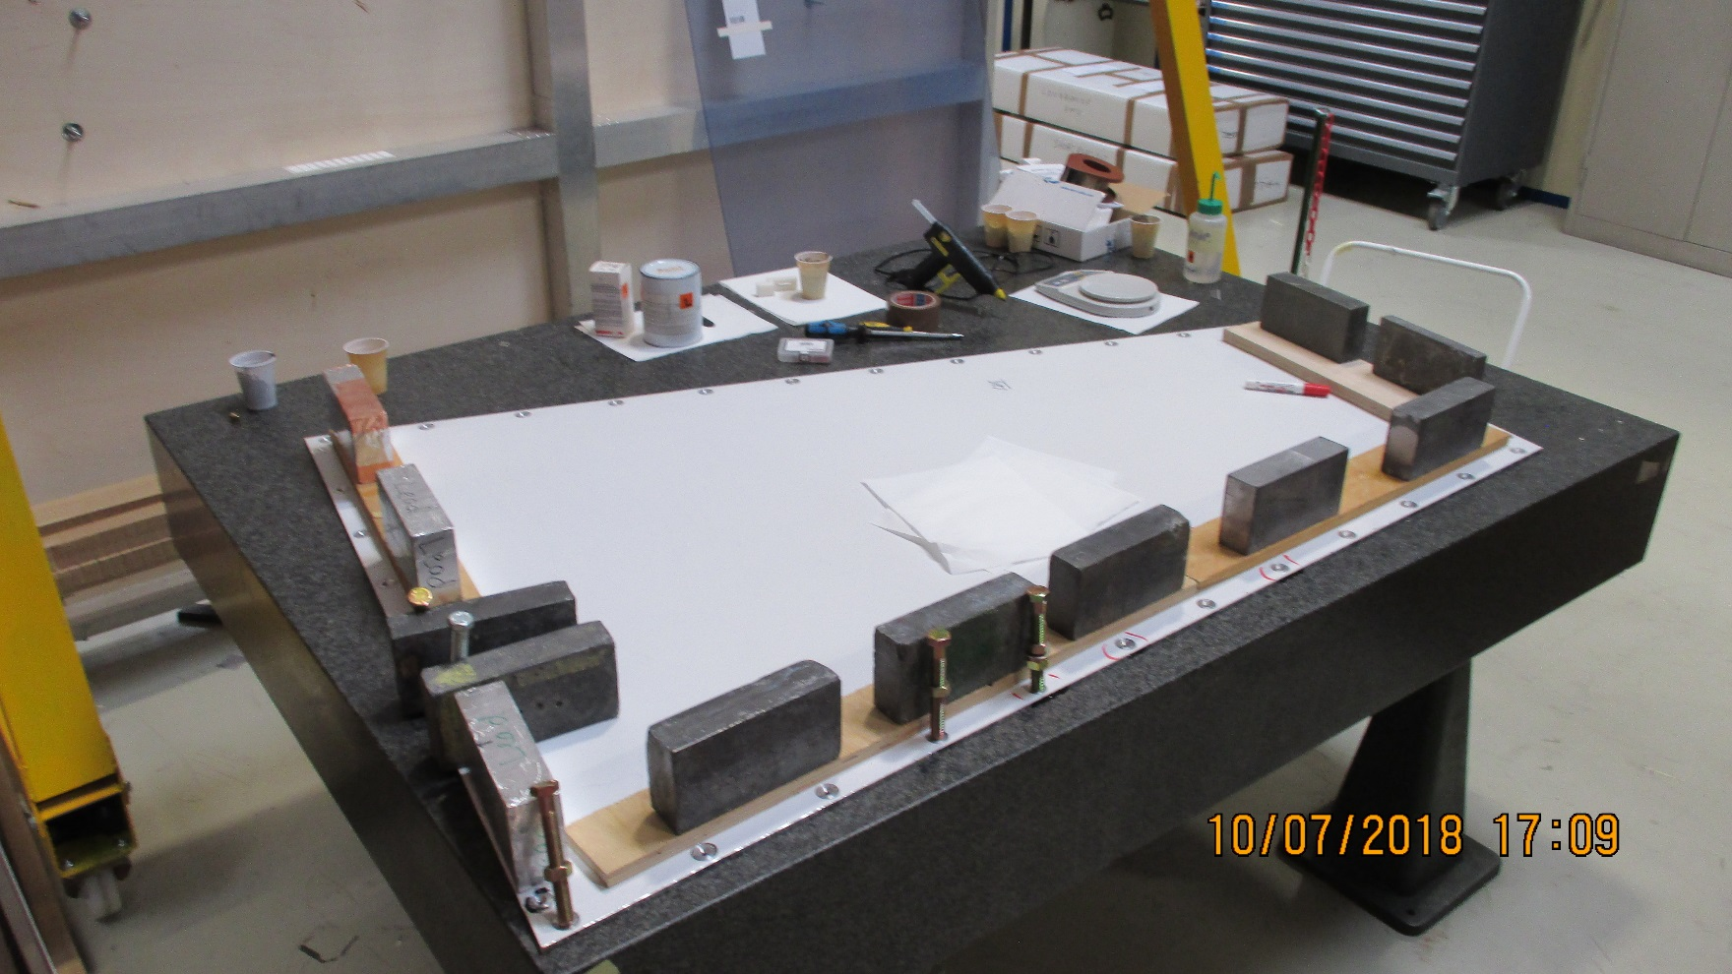
Mateo doing the insert bonding and Hot melt edge process presently in vogue
Both machining and assembly require large area tooling

Slide 6
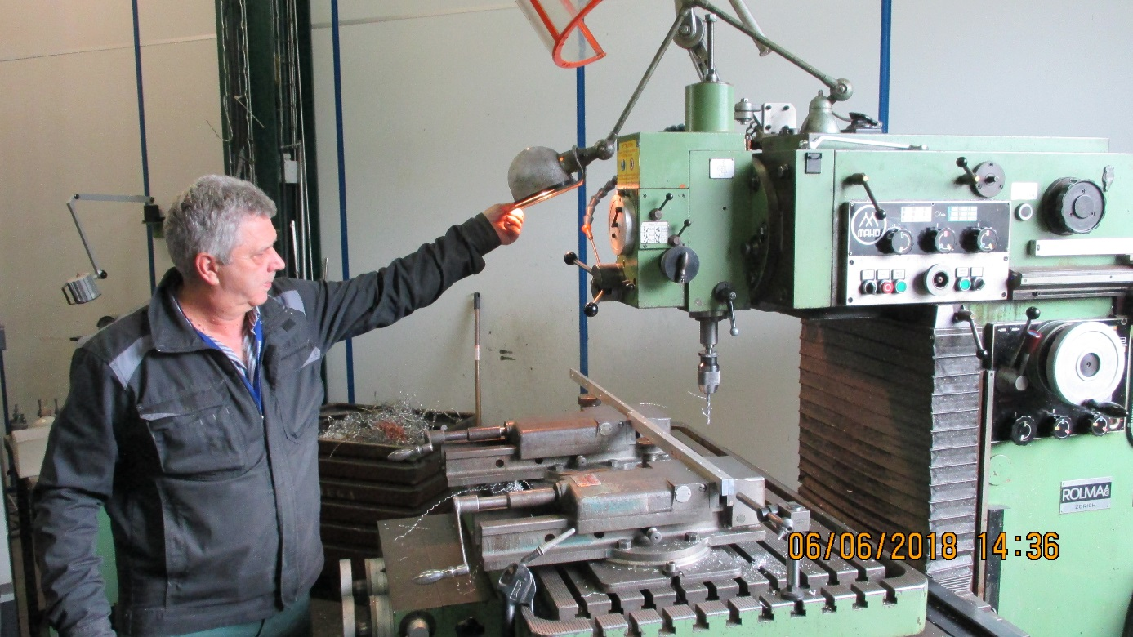
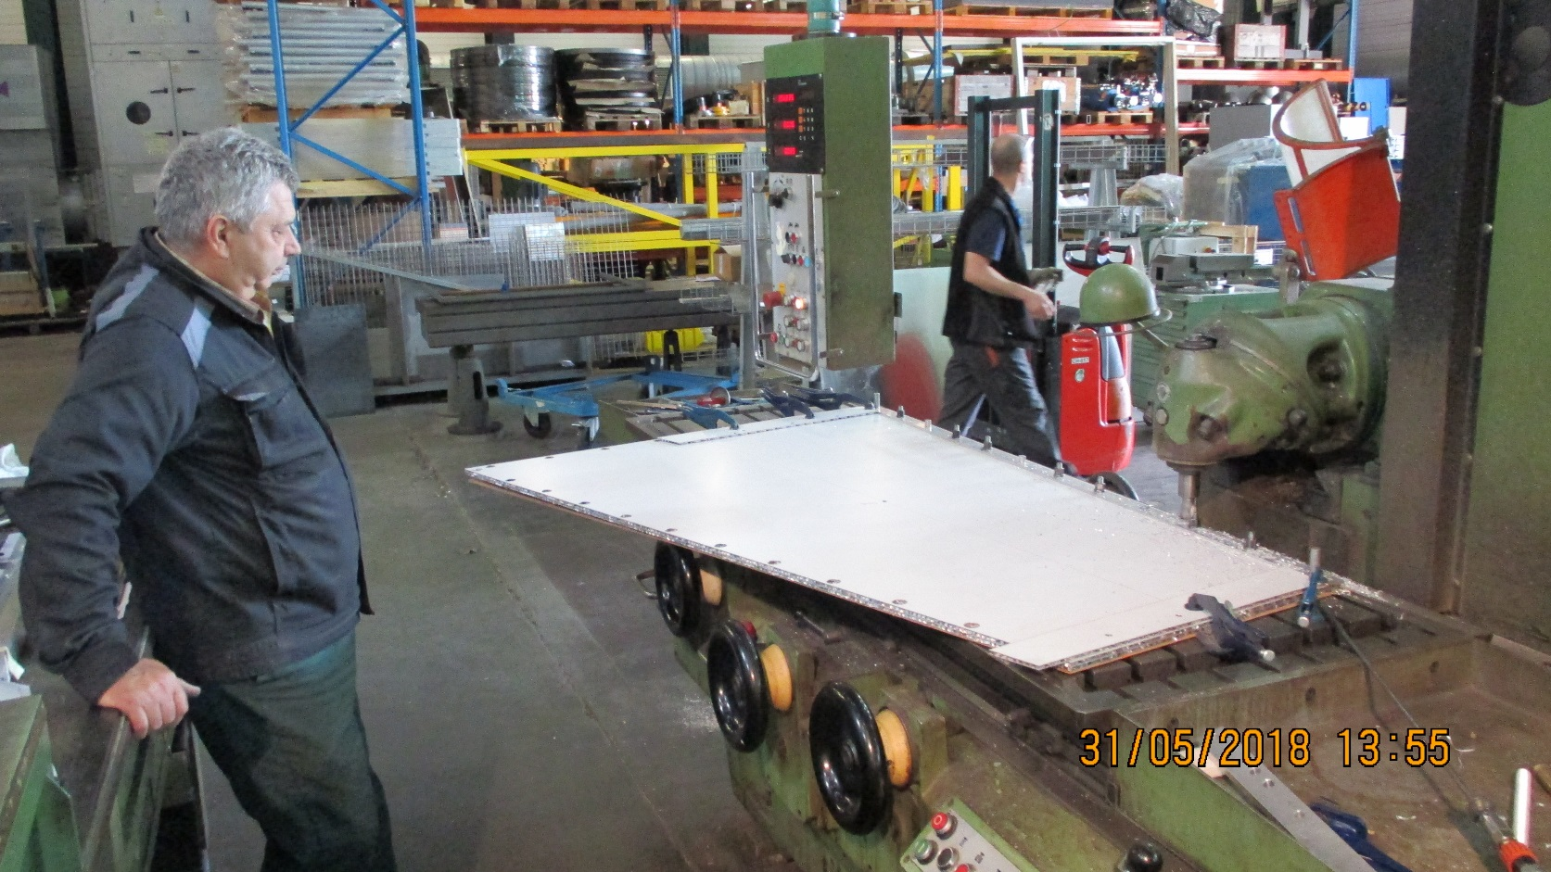
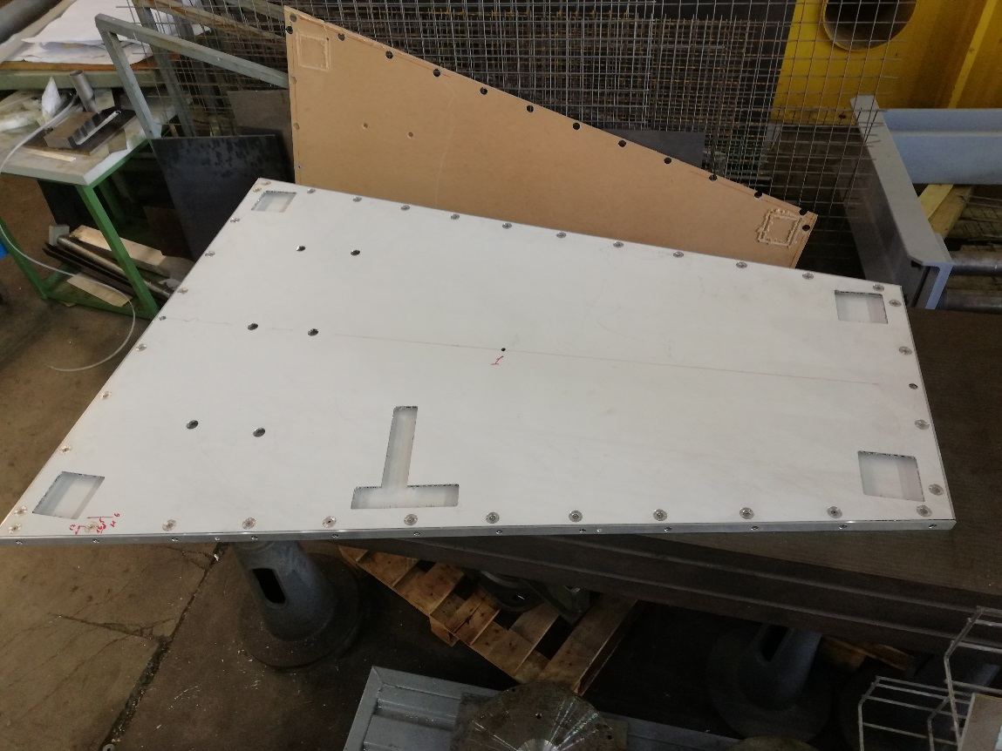
Many thanks to the Russian P5 team who machined the components for both the small ,30x30cm, and the 1.7m prototype.

Slide 7
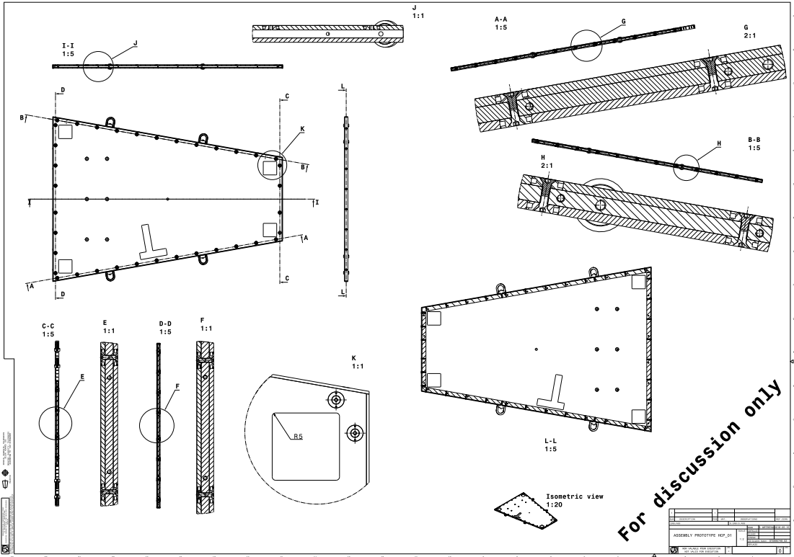
All drawings done by Samvel

Slide 8
Next steps
Finish the large proto. Do some strength tests but these will not be so relevant as the skins is soft and thick. This large proto illustrated and helped to understand production methods and some secrets !
Build full size chamber with ‘hard skins” for either BT or early final design
Find producer in Mexico

Slide 9
References;
http://project-cms-rpc-endcap.web.cern.ch/project-cms-rpc-endcap/rpc/UpscopeHighEta/RPCDevelopements/RE31and41/Production/Components/HoneycombPanels/HCPRE3141Jan2018V2.pptx

