Slide 1
Draft LS2 Draft Schedule
Goal: Collect all work objectives

Slide 2
Design Method
Assumptions
  5 working days/week
  Bank holidays / Lab closure not included
  Shift work possible when required
  Current levels of expertise maintained
  Using proven existing tooling

Slide 3
Key objectives
Infrastructure:
UXC55 2nd crane (beginning of shutdown – 4w) - EN-HE
  PM54 Lift (should start mid May 2017 till 21st July)
Refurbish magnet control system
Modify SCX5 Ctrl room by beginning of LS2 – CMS/GS
Build Multipurpose SX5 extension – CMS/GS
Add UPS for the DAQ computer farm – EN-EL
Move SCX5 UPS out of ctrl room to dedicated UPS building – EN-EL
Add 1.5 MW cooling capacity to the chilled water system –EN-CV
Refurbish SUX5 control infrastructure for chilled/mixed water production – EN-CV
Refurbish USC55 control infrastructure for all water distribution system – EN-CV
Consolidate instrument air infrastructure in SH5 – EN-CV
Refurbish underground ventilation control system– EN-CV
Test RP shielding in battle condition (before taking BP out)

Slide 4
Key objectives
Work on End Caps:
HE - Carry out phase1 upgrade of Front-End electronics, i.e. replacement of HPD->SiPMs
  Carry out sourcing program for HB (to define if we need to refurbish HB during LS3) & HE (2016-17 for HE & 2015-16 for HF): compulsory as cables will have been disconnected
Switch EC HF CT2 FWD Beam Pipes to Al2219 – (no CASTOR operation after LS2)Option to move to higher eta. The double bellow will be dealt with during LS3
Remove T1 & T2 for good
Install GE1/1 (including pipes + cables – remove “slice test” detector installed in 2016)
  2 teams, one on each side; SL and CP needed; UXC55 crane + jig needed for top sectors (30kg/Schamber)
  Installation rate: 2 Super chambers per day (36 total per end) – tbc by slice tests during YETS16-17
  Installation rate for services: 2 weeks per ECap
Reinforce polythene shielding (depends on thickness) – 1 shell taken as one single piece
Refurbish ME2/1, ME3/1, ME4/1? (duration? After new crane installed) – trigger latency boards
  Take away all MEx/1chambers to SX5 (2CPs)
  7 working days per gap (e.g. YE+1/2) to disconnect and remove the chambers
  15 working days per gap to re-install and commission the chambers
  60 working days per end for refurbishment
  Could the available area in the SX5 gas detector area be extended? 2m towards the PX56
  Input collected from A Lanaro and D Morse on 02.03.2016
Repair DT minicrates (4w per Barrel gap + 2w at EC-B interface)
  tbc: Install shielding on top sectors of YBs (crane)

Slide 5
Key objectives
Work on Barrels:
Fix RPC leaks in barrel region (tackle worse chambers first)
Repair 40% of YBs mini-crates using cherry pickers in all barrel gaps
Options / activities to be further defined:
High luminosity related tasks
Change HE Mega-Tiles

Slide 6

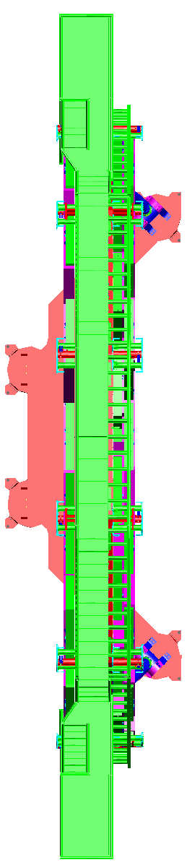
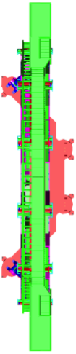
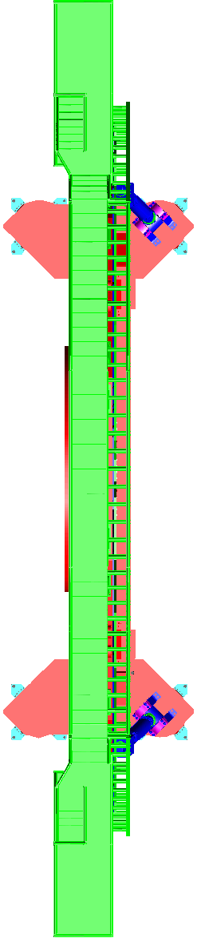
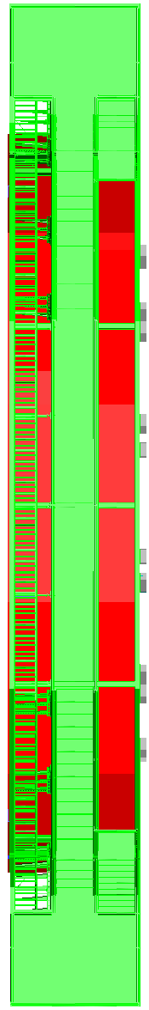
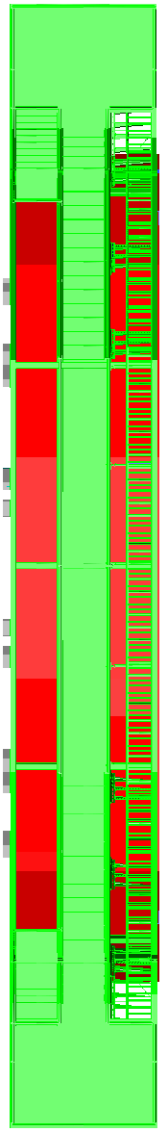
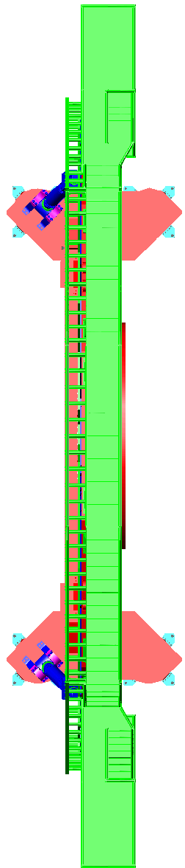
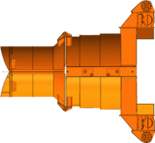

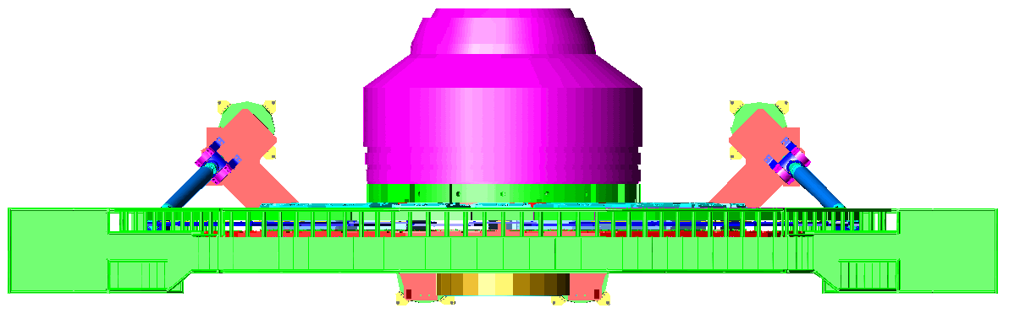

Week 1
ECAL
CMX
ZEC
CSC RE
DT+ RB
TK FPIX
Survey
HCAL
TE-VSC
EN Dept
GS Dept
RP
CMS beam pipe at Atm pressure
Start of Visits in UXC55
End of Heavy Ion Run
6. Inject Ne
Install 2nd UXC55 crane
W1/4
5. Prepare GIS
Full RP sweep
2. Open VAC shielding
3. EN-HE: Restart Crane 1
Open TX54
4. Open PX56 Plug
SL
CP
TX54

Slide 7
Week 2
ECAL
CMX
ZEC
CSC RE
DT+ RB
TK FPIX
Survey
HCAL
TE-VSC
EN Dept
GS Dept
RP
Install 2nd UXC55 crane
W2/4
SL
CP
TX54

Slide 8
Week 3
ECAL
CMX
ZEC
CSC RE
DT+ RB
TK FPIX
Survey
HCAL
TE-VSC
EN Dept
GS Dept
RP
Install 2nd UXC55 crane
W3/4
SL
CP
TX54

Slide 9
Week 4
ECAL
CMX
ZEC
CSC RE
DT+ RB
TK FPIX
Survey
HCAL
TE-VSC
EN Dept
GS Dept
RP
Install 2nd UXC55 crane
W4/4
1. Install collar switchboards
2. Lower 4 CPs + 2SL
SL
CP
TX54

Slide 10
Week 5
ECAL
CMX
ZEC
CSC RE
DT+ RB
TK FPIX
Survey
HCAL
TE-VSC
EN Dept
GS Dept
RP
2. Remove shims between collar and RS+Z
3. Open RS+Z
Remove shims between collar and RS-Z
B. Open RS-Z
SL
CP

Slide 11
Week 5
ECAL
CMX
ZEC
CSC RE
DT+ RB
TK FPIX
Survey
HCAL
TE-VSC
EN Dept
GS Dept
RP
1. Move HF+Z away from IP
2. Disconnect T1 services
3. Open HF+
SL
CP

Slide 12
Week 5
ECAL
CMX
ZEC
CSC RE
DT+ RB
TK FPIX
Survey
HCAL
TE-VSC
EN Dept
GS Dept
RP
1. Open T2 & BSC
2. Remove beam pipe support at 13.5m
3. Remove access gangway to HF+Z
4. Remove HF+Z towers reinforcement
5. EN-HE – Remove HF+ I beams
SL
CP

Slide 13
Week 5
ECAL
CMX
ZEC
CSC RE
DT+ RB
TK FPIX
Survey
HCAL
TE-VSC
EN Dept
GS Dept
RP
A. Move HF-Z away from IP
Lower HF+ on 2 risers
B. Open HF- + platform flooring
2. EN-HE – lift up 2 risers
C. Open T2 & BSC
3. Install HF access staircase
SL
CP

Slide 14
Week 6
ECAL
CMX
ZEC
CSC RE
DT+ RB
TK FPIX
Survey
HCAL
TE-VSC
EN Dept
GS Dept
RP
1. Install tooling for extension beam
2. Install extension beam on FIN
3. Perform load transfer @ 13.6m
A. Remove BP support @ 13.5m
B. Remove access gangway to HF-Z
EN-HE – Remove HF- I beams
Remove HF-Z towers reinforcement
SL
CP

Slide 15
W6
ECAL
CMX
ZEC
CSC RE
DT+ RB
TK FPIX
Survey
HCAL
TE-VSC
EN Dept
GS Dept
RP
RE
Extract T1+Z
Lower HF-Z on 2 risers
2. EN-HE – lift up T1+ to SX5
B. EN-HE – lift up 2 risers
SL
CP

Slide 16
W6
ECAL
CMX
ZEC
CSC RE
DT+ RB
TK FPIX
Survey
HCAL
TE-VSC
EN Dept
GS Dept
RP
RE
Install tooling for extension beam
Extract T1+Z
2. Install extension beam on FIN
3. Perform load transfer on Ext beam
0. EN-HE – Remove FIN Plug
4. EN-HE – Remove FIN Plug
Remove CT2-FWD bellow + FWD+Z module
SL
CP

Slide 17
W6
ECAL
CMX
ZEC
CSC RE
DT+ RB
TK FPIX
Survey
HCAL
TE-VSC
EN Dept
GS Dept
RP
RE
Extract T1-Z
Remove CT2-FWD bellow + FWD+Z module
2. EN-HE – lift up T1- to SX5
SL
CP

Slide 18
W6
ECAL
CMX
ZEC
CSC RE
DT+ RB
TK FPIX
Survey
HCAL
TE-VSC
EN Dept
GS Dept
RP
RE
1. Remove CT2-FWD bellow + FWD+Z module
SL
CP

Slide 19
W7
ECAL
CMX
ZEC
CSC RE
DT+ RB
TK FPIX
Survey
HCAL
TE-VSC
EN Dept
GS Dept
RP
RE
Remove CT2-FWD bellow + FWD-Z module
SL
CP

Slide 20
W7
ECAL
CMX
ZEC
CSC RE
DT+ RB
TK FPIX
Survey
HCAL
TE-VSC
EN Dept
GS Dept
RP
Lower HF to floor
2. Remove Collars
3. Install HF Pb doors
2. EN-HE – lift up 2 risers
SL
CP

Slide 21
W7
ECAL
CMX
ZEC
CSC RE
DT+ RB
TK FPIX
Survey
HCAL
TE-VSC
EN Dept
GS Dept
RP
Lower HF to floor
RE
2. EN-HE – lift up 2 risers
3. Remove Collars
4. Install HF Pb doors
Move HF+ in garage
RE
SL
CP

Slide 22
W7
ECAL
CMX
ZEC
CSC RE
DT+ RB
TK FPIX
Survey
HCAL
TE-VSC
EN Dept
GS Dept
RP
0. Remove BP support at 10.6m
Before opening EC
RE
1. Install YE traction system
RE
SL
CP

Slide 23
W8
ECAL
CMX
ZEC
CSC RE
DT+ RB
TK FPIX
Survey
HCAL
TE-VSC
EN Dept
GS Dept
RP
Open YE-1/2/3/4 – 1w
RE
RE
SL
CP

Slide 24
W9
ECAL
CMX
ZEC
CSC RE
DT+ RB
TK FPIX
Survey
HCAL
TE-VSC
EN Dept
GS Dept
RP
Open YE+1/2/3/4 – 1w
SL
CP

Slide 25
W10
ECAL
CMX
ZEC
CSC RE
DT+ RB
TK FPIX
Survey
HCAL
TE-VSC
EN Dept
GS Dept
RP
1. Install 20t Platform + supports
2. Install handrails for platform
3. Install BP support at 10.6m
4. Install PIX platform+ Bosch rails
5. Install PIX scissor table
A. Install 20t Platform + supports
6. Survey BP
B. Install handrails for platform
C. Install BP support at 10.6m
D. Install PIX platform+ Bosch rails
SL
CP
E. Install PIX scissor table
F. Survey BP

Slide 26
W11
ECAL
CMX
ZEC
CSC RE
DT+ RB
TK FPIX
Survey
HCAL
TE-VSC
EN Dept
GS Dept
RP
1. Release horizontal wire at 3.2m
6. Extract FPIX-Z
2. Modify BP support for PIX extraction
7. Lift up FPIX-Z to SHL5
3. Disconnect FPIX+Z
4. Extract FPIX+Z
Gino D1/2 WP:
5. Lift up FPIX+Z to SHL5
Eric 1h WP:
SL
CP

Slide 27
W12
ECAL
CMX
ZEC
CSC RE
DT+ RB
TK FPIX
Survey
HCAL
TE-VSC
EN Dept
GS Dept
RP
1. Disconnect BPIX-/+Z
2. Extract 2 half shells BPIX from –Z end
3. Install BP Bosch rails
4. Disconnect HF/CT2 pipe + slide outwards
SL
CP

Slide 28
W13
ECAL
CMX
ZEC
CSC RE
DT+ RB
TK FPIX
Survey
HCAL
TE-VSC
EN Dept
GS Dept
RP
1. Disconnect & Remove EndCap-Z pipe
2. Remove HF/CT2-Z pipe
3. Disconnect HF/CT2+Z pipe + Slide outwards
SL
CP

Slide 29
W14
ECAL
CMX
ZEC
CSC RE
DT+ RB
TK FPIX
Survey
HCAL
TE-VSC
EN Dept
GS Dept
RP
1. Disconnect & Remove EndCap+Z pipe
2. Remove HF/CT2+Z pipe
SL
CP

Slide 30
W15
ECAL
CMX
ZEC
CSC RE
DT+ RB
TK FPIX
Survey
HCAL
TE-VSC
EN Dept
GS Dept
RP
CSC
Remove Central BP
2d
Remove 20t platforms
Remove 20t platforms
SL
CP

Slide 31
W16
ECAL
CMX
ZEC
CSC RE
DT+ RB
TK FPIX
Survey
HCAL
TE-VSC
EN Dept
GS Dept
RP
Open YB-2
Remove GE1/1 slice test detector
Repair DT MiniCrates
YB-2-1 w1/4
CSC
Install RE HV umbilical cables NEAR
DT
Move YE-1
SL
CP

Slide 32
W17
ECAL
CMX
ZEC
CSC RE
DT+ RB
TK FPIX
Survey
HCAL
TE-VSC
EN Dept
GS Dept
RP
Install RE gas pipes in CC FAR
Open YB-2
Install RE HV umbilical cables FAR
Repair DT MiniCrates
YB-2-1 w2/4
GEM
CSC
GEM
Install GE+1/1 super-chambers
2/day W1/4
DT
Disconnect ME-2/1services
3d
Remove 18 ME-2/1 chambers
2d 2/4d
SL
CP

Slide 33
W18
Time to ME-x/1 refurbishment complete | 12w
ECAL
CMX
ZEC
CSC RE
DT+ RB
TK FPIX
Survey
HCAL
TE-VSC
EN Dept
GS Dept
RP
Install RE+3/1 HV cables FAR
CSC
Install GE+1/1 super-chambers
2/day W2/4
Repair DT MiniCrates
YB-2-1 w3/4
GEM
GEM
Remove 18 ME-2/1 chambers
2d 4/4d
Install RE+3/1 HV cables NEAR
DT
Move YE-2
1d
Disconnect ME-3/1services
2d 2/3d
SL
CP

Slide 34
W19
Time to ME-x/1 refurbishment complete | 11w
ECAL
CMX
ZEC
CSC RE
DT+ RB
TK FPIX
Survey
HCAL
TE-VSC
EN Dept
GS Dept
RP
Install RE+4/1 HV cables FAR
CSC
Install GE+1/1 super-chambers
2/day W3/4
Repair DT MiniCrates
YB-2-1 w4/4
GEM
GEM
Disconnect ME-3/1services
1d 3/3d
Install RE+4/1 HV cables NEAR
DT
Remove 18 ME-3/1 chambers
4d 4/4d
SL
CP

Slide 35
W20
Time to ME-x/1 refurbishment complete | 10w
ECAL
CMX
ZEC
CSC RE
DT+ RB
TK FPIX
Survey
HCAL
TE-VSC
EN Dept
GS Dept
RP
Move YB-1
1d
RPC
Install GE+1/1 super-chambers
2/day W4/4
Repair DT MiniCrates
YB-1-0 w1/4
GEM
GEM
Move YE-3/4 (YE4 anchored?)
1d
DT
Remove 36 RE4 chambers
4d d4/5
Install Cu gas pipes for RE-4/1
5d/10d
SL
CP

Slide 36
W21
Time to ME-x/1 refurbishment complete | 9w
ECAL
CMX
ZEC
CSC RE
DT+ RB
TK FPIX
Survey
HCAL
TE-VSC
EN Dept
GS Dept
RP
CSC
Install GE+1/1 services
W1/3
Repair DT MiniCrates
YB-1-0 w2/4
GEM
GEM
Remove 36 RE4 chambers
1d d5/5
Disconnect ME-4/1services
3d 3/3d
DT
Remove 18 ME-4/1 chambers
1d 1/4d
Install Cu gas pipes for RE-4/1
10d/10d
SL
CP

Slide 37
W22
Time to ME-x/1 refurbishment complete | 8w
ECAL
CMX
ZEC
CSC RE
DT+ RB
TK FPIX
Survey
HCAL
TE-VSC
EN Dept
GS Dept
RP
CSC
Install GE+1/1 services
W2/3
Repair DT MiniCrates
YB-1-0 w3/4
GEM
GEM
DT
Remove 18 ME-4/1 chambers
3d 4/4d
SL
CP

Slide 38
W23
Time to ME-x/1 refurbishment complete | 7w
ECAL
CMX
ZEC
CSC RE
DT+ RB
TK FPIX
Survey
HCAL
TE-VSC
EN Dept
GS Dept
RP
Move YB+2
Repair DT MiniCrates
YB-1-0 w4/4
GEM
GEM
DT
Move YE-3/4, 2
2d
SL
CP

Slide 39
W24
Time to ME-x/1 refurbishment complete | 6w
ECAL
CMX
ZEC
CSC RE
DT+ RB
TK FPIX
Survey
HCAL
TE-VSC
EN Dept
GS Dept
RP
Move YB-2-1
Repair DT MiniCrates
YB+2+1 w1/4
Install GE+1/1 services
W3/3
GEM
GEM
DT
SL
CP

Slide 40
W25
Time to ME-x/1 refurbishment complete | 5w
ECAL
CMX
ZEC
CSC RE
DT+ RB
TK FPIX
Survey
HCAL
TE-VSC
EN Dept
GS Dept
RP
Repair DT MiniCrates
YB+2+1 w2/4
Commission GE+1/1
W1/4
GEM
GEM
GEM
GEM
Install GE-1/1 super-chambers
2/day W1/4
DT
SL
CP

Slide 41
W26
Time to ME-x/1 refurbishment complete | 4w
ECAL
CMX
ZEC
CSC RE
DT+ RB
TK FPIX
Survey
HCAL
TE-VSC
EN Dept
GS Dept
RP
Repair DT MiniCrates
YB+2+1 w3/4
Commission GE+1/1
W2/4
GEM
GEM
GEM
GEM
Install GE-1/1 super-chambers
2/day W2/4
DT
SL
CP

Slide 42
W27
Time to ME-x/1 refurbishment complete | 3w
ECAL
CMX
ZEC
CSC RE
DT+ RB
TK FPIX
Survey
HCAL
TE-VSC
EN Dept
GS Dept
RP
Repair DT MiniCrates
YB+2+1 w4/4
Commission GE+1/1
W3/4
GEM
GEM
GEM
GEM
Install GE-1/1 super-chambers
2/day W3/4
DT
SL
CP

Slide 43
W28
Time to ME-x/1 refurbishment complete | 2w
ECAL
CMX
ZEC
CSC RE
DT+ RB
TK FPIX
Survey
HCAL
TE-VSC
EN Dept
GS Dept
RP
Move YB+1
Commission GE+1/1
W4/4
GEM
Repair DT MiniCrates
YB+1+0 w1/4
GEM
GEM
GEM
Install GE-1/1 super-chambers
2/day W4/4
DT
SL
CP

Slide 44
W29
Time to ME-x/1 refurbishment complete | 1w
ECAL
CMX
ZEC
CSC RE
DT+ RB
TK FPIX
Survey
HCAL
TE-VSC
EN Dept
GS Dept
RP
Repair DT MiniCrates
YB+1+0 w2/4
GEM
GEM
Install GE-1/1 services
W1/3
DT
SL
CP

Slide 45
W30
Time to ME-x/1 refurbishment complete | 0w
ECAL
CMX
ZEC
CSC RE
DT+ RB
TK FPIX
Survey
HCAL
TE-VSC
EN Dept
GS Dept
RP
Move YE+1
Repair DT MiniCrates
YB+1+0 w3/4
GEM
GEM
Install GE-1/1 services
W2/3
DT
SL
CP

Slide 46
W31
ECAL
CMX
ZEC
CSC RE
DT+ RB
TK FPIX
Survey
HCAL
TE-VSC
EN Dept
GS Dept
RP
CSC
Install GE-1/1 services
W3/3
CSC
Repair DT MiniCrates
YB+1+0 w4/4
GEM
GEM
Install 9 Back ME-2/1 chambers
2d
Connect 9 Back ME-2/1 chambers
2d
DT
Disconnect services and cables for ME+2/1
1d d1/3
Perform connectivity tests on Back ME-2/1 chambers
1d d1/2
SL
CP

Slide 47
W32
ECAL
CMX
ZEC
CSC RE
DT+ RB
TK FPIX
Survey
HCAL
TE-VSC
EN Dept
GS Dept
RP
Move YB+1, +2
CSC
Commission GE-1/1
W1/4
CSC
GEM
GEM
Disconnect services and cables for ME+2/1
1d d2/3
Perform connectivity tests on Back ME-2/1 chambers
1d d2/2
Install 9 Front ME-2/1 chambers
2d
Connect cables on 9 Front ME-2/1 chambers
2d d2/2
SL
CP

Slide 48
W33
ECAL
CMX
ZEC
CSC RE
DT+ RB
TK FPIX
Survey
HCAL
TE-VSC
EN Dept
GS Dept
RP
Repair DT MiniCrates
YB+1 w1/2
CSC
Commission GE-1/1
W2/4
CSC
GEM
DT
GEM
Disconnect services and cables for ME+2/1
1d d3/3
Perform connectivity tests on Front ME-2/1 chambers
2d d2/2
Connect services on 18 ME-2/1 chambers
2d d2/2
SL
CP

Slide 49
W34
ECAL
CMX
ZEC
CSC RE
DT+ RB
TK FPIX
Survey
HCAL
TE-VSC
EN Dept
GS Dept
RP
Repair DT MiniCrates
YB+1 w2/2
CSC
Commission GE-1/1
W3/4
CSC
GEM
DT
GEM
Remove 18 ME+2/1 Chambers
3d d3/4
Carry out leak tests on ME-2/1 chambers
3d
Move YE-2
1d
SL
CP

Slide 50
W35
Time to ME+x/1 refurbishment complete | 12w
ECAL
CMX
ZEC
CSC RE
DT+ RB
TK FPIX
Survey
HCAL
TE-VSC
EN Dept
GS Dept
RP
Carry out full commissioning tests on ME-2/1 chambers
3d Gas and cooling required
CSC
Commission GE-1/1
W4/4
CSC
GEM
GEM
Install 9 Back ME-3/1 chambers
2d
Connect 9 Back ME-3/1 chambers
2d
Remove 18 ME+2/1 Chambers
1d d4/4
Perform connectivity tests on Back ME-3/1 chambers
1d d1/2
SL
CP

Slide 51
W36
Time to ME+x/1 refurbishment complete | 11w
ECAL
CMX
ZEC
CSC RE
DT+ RB
TK FPIX
Survey
HCAL
TE-VSC
EN Dept
GS Dept
RP
Move YE+3
1d
CSC
CSC
Perform connectivity tests on Back ME-3/1 chambers
1d d2/2
Install 9 Front ME-3/1 chambers
2d
Connect cables on 9 Front ME-3/1 chambers
2d d2/2
SL
CP

Slide 52
W37
Time to ME+x/1 refurbishment complete | 10w
ECAL
CMX
ZEC
CSC RE
DT+ RB
TK FPIX
Survey
HCAL
TE-VSC
EN Dept
GS Dept
RP
CSC
CSC
Install RE-3/1 Cu gas pipes
Disconnect services and cables for ME+3/1
2d d2/3
Perform connectivity tests on Front ME-3/1 chambers
2d d2/2
Connect services on 18 ME-3/1 chambers
2d d2/2
SL
CP

Slide 53
W38
Time to ME+x/1 refurbishment complete | 9w
ECAL
CMX
ZEC
CSC RE
DT+ RB
TK FPIX
Survey
HCAL
TE-VSC
EN Dept
GS Dept
RP
CSC
CSC
Install RE-3/1 LV & signal cables
4d
Carry out leak tests on ME-3/1 chambers
3d
Disconnect services and cables for ME+3/1
1d d3/3
Move YE-3
1d
Remove 18 ME+3/1 chambers
4d
SL
CP

Slide 54
W39
Time to ME+x/1 refurbishment complete | 8w
ECAL
CMX
ZEC
CSC RE
DT+ RB
TK FPIX
Survey
HCAL
TE-VSC
EN Dept
GS Dept
RP
Move YE+3/4 (YE4 anchored?)
1d
CSC
Remove 36 RE+4 chambers
4d D4/5
Carry out full commissioning tests on ME-3/1 chambers
3d
RPC
Install 9 Back ME-4/1 chambers
2d
Install Cu gas pipes for RE+4/1
5/10d
Connect cables on 9 Back ME-4/1 chambers
2d
Perform connectivity tests on Back ME-4/1 chambers
1d d1/2
SL
CP

Slide 55
W40
Time to ME+x/1 refurbishment complete | 7w
ECAL
CMX
ZEC
CSC RE
DT+ RB
TK FPIX
Survey
HCAL
TE-VSC
EN Dept
GS Dept
RP
CSC
Remove 36 RE+4 chambers
1d d5/5
CSC
Perform connectivity tests on Back ME-4/1 chambers
1d d2/2
Install 9 Front ME-4/1 chambers
2d
Install Cu gas pipes for RE+4/1
10d/10d
Connect cables on 9 Front ME-4/1 chambers
2d d2/2
SL
CP

Slide 56
W41
Time to ME+x/1 refurbishment complete | 6w
ECAL
CMX
ZEC
CSC RE
DT+ RB
TK FPIX
Survey
HCAL
TE-VSC
EN Dept
GS Dept
RP
CSC
CSC
Disconnect services and cables for ME+4/1
2d d2/3
Perform connectivity tests on Front ME-4/1 chambers
2d d2/2
Connect services on 18 ME-4/1 chambers
2d d2/2
SL
CP

Slide 57
W42
Time to ME+x/1 refurbishment complete | 5w
ECAL
CMX
ZEC
CSC RE
DT+ RB
TK FPIX
Survey
HCAL
TE-VSC
EN Dept
GS Dept
RP
CSC
CSC
Disconnect services and cables for ME+4/1
1d d3/3
Carry out leak tests on ME-4/1 chambers
3d
Remove 18 ME+4/1 chambers
4d
Carry out full commissioning tests on ME-4/1 chambers
2d d2/3
SL
CP

Slide 58
W43
Time to ME+x/1 refurbishment complete | 4w
ECAL
CMX
ZEC
CSC RE
DT+ RB
TK FPIX
Survey
HCAL
TE-VSC
EN Dept
GS Dept
RP
Move YE+3,2
2d
RPC
Install 36 RE-4/2 4/3 chambers
SL
CP

Slide 59
W44
Time to ME+x/1 refurbishment complete | 3w
ECAL
CMX
ZEC
CSC RE
DT+ RB
TK FPIX
Survey
HCAL
TE-VSC
EN Dept
GS Dept
RP
CSC
RPC
Install 9 Back ME+2/1 chambers
2d
Connect 9 Back ME+2/1 chambers
2d
Commission 36 RE-4/2 4/3 chambers
Perform connectivity tests on Back ME+2/1 chambers
1d d1/2
Install RE+4/1 LV & signal cables
SL
CP

Slide 60
W45
Time to ME+x/1 refurbishment complete | 2w
ECAL
CMX
ZEC
CSC RE
DT+ RB
TK FPIX
Survey
HCAL
TE-VSC
EN Dept
GS Dept
RP
CSC
RPC
Perform connectivity tests on Back ME+2/1 chambers
1d d2/2
Install 9 Front ME+2/1 chambers
2d
Commission 36 RE-4 chambers
Connect cables on 9 Front ME+2/1 chambers
2d d2/2
SL
CP

Slide 61
W46
Time to ME+x/1 refurbishment complete | 1w
ECAL
CMX
ZEC
CSC RE
DT+ RB
TK FPIX
Survey
HCAL
TE-VSC
EN Dept
GS Dept
RP
CSC
RPC
Perform connectivity tests on Front ME+2/1 chambers
2d d2/2
Commission 36 RE-4 chambers
Connect services on 18 ME+2/1 chambers
2d d2/2
SL
CP

Slide 62
W47
Time to ME+x/1 refurbishment complete | 0w
ECAL
CMX
ZEC
CSC RE
DT+ RB
TK FPIX
Survey
HCAL
TE-VSC
EN Dept
GS Dept
RP
Repair DT MiniCrates
YB-1 w1/2
CSC
DT
Carry out leak tests on ME+2/1 chambers
3d
Move YE+2
1d
Install RE HV umbilical cables NEAR
SL
CP

Slide 63
W48
ECAL
CMX
ZEC
CSC RE
DT+ RB
TK FPIX
Survey
HCAL
TE-VSC
EN Dept
GS Dept
RP
Carry out full commissioning tests on ME+2/1 chambers
3d
Install RE gas pipes in CC FAR
CSC
Install RE HV umbilical cables FAR
Repair DT MiniCrates
YB-1 w2/2
DT
Install 9 Back ME+3/1 chambers
2d
Connect 9 Back ME+3/1 chambers
2d
Perform connectivity tests on Back ME+3/1 chambers
1d d1/2
SL
CP

Slide 64
W49
ECAL
CMX
ZEC
CSC RE
DT+ RB
TK FPIX
Survey
HCAL
TE-VSC
EN Dept
GS Dept
RP
CSC
Install RE-3/1 HV cables FAR
Perform connectivity tests on Back ME+3/1 chambers
1d d2/2
Install 9 Front ME+3/1 chambers
2d
Connect cables on 9 Front ME+3/1 chambers
2d d2/2
Install RE-3/1 HV cables NEAR
SL
CP

Slide 65
W50
ECAL
CMX
ZEC
CSC RE
DT+ RB
TK FPIX
Survey
HCAL
TE-VSC
EN Dept
GS Dept
RP
CSC
Install RE+3/1 Cu gas pipes
Install RE-4/1 HV cables FAR
Perform connectivity tests on Front ME+3/1 chambers
2d d2/2
Connect services on 18 ME+3/1 chambers
2d d2/2
Install RE-4/1 HV cables NEAR
SL
CP

Slide 66
W51
ECAL
CMX
ZEC
CSC RE
DT+ RB
TK FPIX
Survey
HCAL
TE-VSC
EN Dept
GS Dept
RP
CSC
Install RE+3/1 LV & signal cables
4d
Carry out leak tests on ME+3/1 chambers
3d
Move YE+3
1d
SL
CP

Slide 67
W52
ECAL
CMX
ZEC
CSC RE
DT+ RB
TK FPIX
Survey
HCAL
TE-VSC
EN Dept
GS Dept
RP
Carry out full commissioning tests on ME+3/1 chambers
3d
CSC
Install 9 Back ME+4/1 chambers
2d
Connect cables on 9 Back ME+4/1 chambers
2d
Perform connectivity tests on Back ME+4/1 chambers
1d d1/2
SL
CP

Slide 68
W53
ECAL
CMX
ZEC
CSC RE
DT+ RB
TK FPIX
Survey
HCAL
TE-VSC
EN Dept
GS Dept
RP
CSC
Perform connectivity tests on Back ME+4/1 chambers
1d d2/2
Install 9 Front ME+4/1 chambers
2d
Connect cables on 9 Front ME+4/1 chambers
2d d2/2
SL
CP

Slide 69
W54
ECAL
CMX
ZEC
CSC RE
DT+ RB
TK FPIX
Survey
HCAL
TE-VSC
EN Dept
GS Dept
RP
CSC
Perform connectivity tests on Front ME+4/1 chambers
2d d2/2
Connect services on 18 ME+4/1 chambers
2d d2/2
SL
CP

Slide 70
W55
ECAL
CMX
ZEC
CSC RE
DT+ RB
TK FPIX
Survey
HCAL
TE-VSC
EN Dept
GS Dept
RP
CSC
Carry out leak tests on ME+4/1 chambers
3d
Carry out full commissioning tests on ME+4/1 chambers
2d d2/3
SL
CP

Slide 71
W56
ECAL
CMX
ZEC
CSC RE
DT+ RB
TK FPIX
Survey
HCAL
TE-VSC
EN Dept
GS Dept
RP
RPC
Install 36 RE+4/2 4/3 chambers
SL
CP

Slide 72
W57
ECAL
CMX
ZEC
CSC RE
DT+ RB
TK FPIX
Survey
HCAL
TE-VSC
EN Dept
GS Dept
RP
RPC
Commission 36 RE+4/2 4/3 chambers
Install RE+4/1 LV & signal cables
SL
CP

Slide 73
Another example of potential configuration for CSC work
ECAL
CMX
ZEC
CSC RE
DT+ RB
TK FPIX
Survey
HCAL
TE-VSC
EN Dept
GS Dept
RP
YE4 as shield against FIN
SL
CP

Slide 74
Ready for Beam – 29Ws
ECAL
CMX
ZEC
CSC RE
DT+ RB
TK FPIX
Survey
HCAL
TE-VSC
EN Dept
GS Dept
RP
Configure CMS for BP re-installation
SL
CP

Slide 75
Ready for Beam – 28Ws
ECAL
CMX
ZEC
CSC RE
DT+ RB
TK FPIX
Survey
HCAL
TE-VSC
EN Dept
GS Dept
RP
Re-Install Beam Pipe W1/6
SL
CP

Slide 76
Ready for Beam – 27Ws
ECAL
CMX
ZEC
CSC RE
DT+ RB
TK FPIX
Survey
HCAL
TE-VSC
EN Dept
GS Dept
RP
Re-Install Beam Pipe W2/6
SL
CP

Slide 77
Ready for Beam – 26Ws
ECAL
CMX
ZEC
CSC RE
DT+ RB
TK FPIX
Survey
HCAL
TE-VSC
EN Dept
GS Dept
RP
Re-Install Beam Pipe W3/6
SL
CP

Slide 78
Ready for Beam – 25Ws
ECAL
CMX
ZEC
CSC RE
DT+ RB
TK FPIX
Survey
HCAL
TE-VSC
EN Dept
GS Dept
RP
Re-Install Beam Pipe W4/6
SL
CP

Slide 79
Ready for Beam – 24Ws
ECAL
CMX
ZEC
CSC RE
DT+ RB
TK FPIX
Survey
HCAL
TE-VSC
EN Dept
GS Dept
RP
Re-Install Beam Pipe W5/6
Install BP bake out jackets -Z
SL
CP

Slide 80
Ready for Beam – 23Ws
ECAL
CMX
ZEC
CSC RE
DT+ RB
TK FPIX
Survey
HCAL
TE-VSC
EN Dept
GS Dept
RP
Re-Install Beam Pipe W6/6
Remove 20t platform
SL
CP

Slide 81
Ready for Beam – 22Ws
ECAL
CMX
ZEC
CSC RE
DT+ RB
TK FPIX
Survey
HCAL
TE-VSC
EN Dept
GS Dept
RP
Install bake out jackets and racks
Remove 20t platform
Move –Z EndCap in BO position
Install BO scaffolding
Install YB0 gangway
SL
CP

Slide 82
Ready for Beam – 21Ws
ECAL
CMX
ZEC
CSC RE
DT+ RB
TK FPIX
Survey
HCAL
TE-VSC
EN Dept
GS Dept
RP
Install FWD BP
Prepare BO operations
Move +Z EndCap in BO position
Install BO scaffolding
Install YB0 gangway
SL
CP

Slide 83
Ready for Beam – 20Ws
ECAL
CMX
ZEC
CSC RE
DT+ RB
TK FPIX
Survey
HCAL
TE-VSC
EN Dept
GS Dept
RP
Install FWD BP
Prepare BO operations
Install Bake Out jackets + cables
SL
CP

Slide 84
Ready for Beam – 19Ws
ECAL
CMX
ZEC
CSC RE
DT+ RB
TK FPIX
Survey
HCAL
TE-VSC
EN Dept
GS Dept
RP
Bake Out CMS beam Pipe W1/3
SL
CP

Slide 85
Ready for Beam – 18Ws
ECAL
CMX
ZEC
CSC RE
DT+ RB
TK FPIX
Survey
HCAL
TE-VSC
EN Dept
GS Dept
RP
Bake Out CMS beam Pipe W2/3
SL
CP

Slide 86
Ready for Beam – 17Ws
ECAL
CMX
ZEC
CSC RE
DT+ RB
TK FPIX
Survey
HCAL
TE-VSC
EN Dept
GS Dept
RP
Bake Out CMS beam Pipe W3/3
SL
CP

Slide 87
Ready for Beam – 16Ws
ECAL
CMX
ZEC
CSC RE
DT+ RB
TK FPIX
Survey
HCAL
TE-VSC
EN Dept
GS Dept
RP
Open –Z EC
Remove YB0- access gangway
Remove –Z Surkov frame
SL
CP

Slide 88
Ready for Beam – 15Ws
ECAL
CMX
ZEC
CSC RE
DT+ RB
TK FPIX
Survey
HCAL
TE-VSC
EN Dept
GS Dept
RP
Open +Z EC
Remove YB0- access gangway
CP
Remove –Z Surkov frame
SL

Slide 89
Ready for Beam – 14Ws
ECAL
CMX
ZEC
CSC RE
DT+ RB
TK FPIX
Survey
HCAL
TE-VSC
EN Dept
GS Dept
RP
Install 20t platforms
SL
CP

Slide 90
Ready for Beam – 13Ws
ECAL
CMX
ZEC
CSC RE
DT+ RB
TK FPIX
Survey
HCAL
TE-VSC
EN Dept
GS Dept
RP
Re-Install PIX/BCM W1/6
SL
CP

Slide 91
Ready for Beam – 12Ws
ECAL
CMX
ZEC
CSC RE
DT+ RB
TK FPIX
Survey
HCAL
TE-VSC
EN Dept
GS Dept
RP
Re-Install PIX/BCM W2/6
SL
CP

Slide 92
Ready for Beam – 11Ws
ECAL
CMX
ZEC
CSC RE
DT+ RB
TK FPIX
Survey
HCAL
TE-VSC
EN Dept
GS Dept
RP
Re-Install PIX/BCM W3/6
SL
CP

Slide 93
Ready for Beam – 10Ws
ECAL
CMX
ZEC
CSC RE
DT+ RB
TK FPIX
Survey
HCAL
TE-VSC
EN Dept
GS Dept
RP
Re-Install PIX/BCM W4/6
SL
CP

Slide 94
Ready for Beam – 9Ws
ECAL
CMX
ZEC
CSC RE
DT+ RB
TK FPIX
Survey
HCAL
TE-VSC
EN Dept
GS Dept
RP
Re-Install PIX/BCM W5/6
SL
CP

Slide 95
Ready for Beam – 8Ws
ECAL
CMX
ZEC
CSC RE
DT+ RB
TK FPIX
Survey
HCAL
TE-VSC
EN Dept
GS Dept
RP
Re-Install PIX/BCM W6/6
SL
CP

Slide 96
Ready for Beam – 7Ws
ECAL
CMX
ZEC
CSC RE
DT+ RB
TK FPIX
Survey
HCAL
TE-VSC
EN Dept
GS Dept
RP
Remove 20t platforms
Prepare to close and lock YEs
SL
CP

Slide 97
Ready for Beam – 6Ws
ECAL
CMX
ZEC
CSC RE
DT+ RB
TK FPIX
Survey
HCAL
TE-VSC
EN Dept
GS Dept
RP
Close & Lock YE-Z
SL
CP

Slide 98
Ready for Beam – 5Ws
ECAL
CMX
ZEC
CSC RE
DT+ RB
TK FPIX
Survey
HCAL
TE-VSC
EN Dept
GS Dept
RP
Close & Lock YE+Z
SL
CP

Slide 99
Ready for Beam – 4Ws
ECAL
CMX
ZEC
CSC RE
DT+ RB
TK FPIX
Survey
HCAL
TE-VSC
EN Dept
GS Dept
RP
CRUZET Run
Position HF-
SL
CP

Slide 100
Ready for Beam – 3Ws
ECAL
CMX
ZEC
CSC RE
DT+ RB
TK FPIX
Survey
HCAL
TE-VSC
EN Dept
GS Dept
RP
CRUZET Run
Position HF+
SL
CP

Slide 101
Ready for Beam – 2Ws
ECAL
CMX
ZEC
CSC RE
DT+ RB
TK FPIX
Survey
HCAL
TE-VSC
EN Dept
GS Dept
RP
Close Rotating Shielding
BP pump down W1/2
SL
CP

Slide 102
Ready for Beam – 1W
ECAL
CMX
ZEC
CSC RE
DT+ RB
TK FPIX
Survey
HCAL
TE-VSC
EN Dept
GS Dept
RP
Magnet Re-commissioning
BP pump down W2/2
SL
CP

Slide 103
Ready for Beam
ECAL
CMX
ZEC
CSC RE
DT+ RB
TK FPIX
Survey
HCAL
TE-VSC
EN Dept
GS Dept
RP
Ready for re-commissioning with Beam
SL
CP

Slide 104
Very first look at scheduling constraints
Time windows without basic services, e.g. power or cooling, to be included
Opening of CMS + removal of PIX and beam pipe: up to W15
CSC project: Start W16 (April 2019)
Complete: W56 (March 2020)
Closing of CMS + installation of PIX and beam pipe:
Start 29w from ready for beam

Slide 105
Back-up

Slide 106
