Slide 1
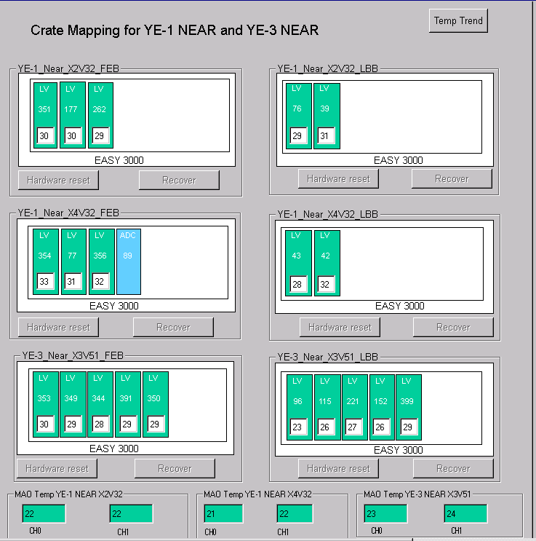
LV Power System Optimisation for RE3/1 & RE4/1
For each end && side we would need 2 A3016 LV
boards to power the RE3/1 and RE4/1 chambers.
We should redesign the entire RPC LV system such that:
  We redistribute the LV power cables of 2 RE4 A3009 boards into the neighbouring 3 RE3 A3009 boards
then
  We will free slots for 2 A3016 boards for powering RE3/1 and RE4/1
Assuming we double connections into one board after the power
redistribution, it will still continue to work in optimal power
regime ~60% of max power.
In this scenario – no additional crates, branches and
rack space is required!
RE3
RE4

