Slide 1
UCO+RMO Joint meeting
Isabel Pedraza on behalf of the RPC

Slide 2
Description of assumptions when estimates are conservative/optimistic
Electrodes cost estimation was done using recent production.
New FE cost based on estimated price got in fall 2016.
Gas, HV system, cables, chamber assembly cost: extrapolation from the costs of the RE4 (2012 upgrade)
In average the cost estimation is realistic.

Slide 3
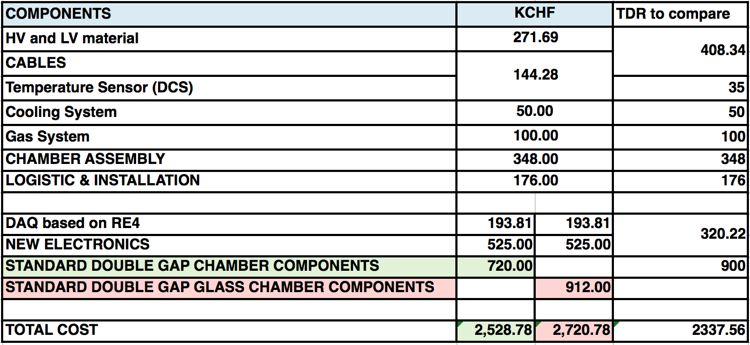
Document in detail cost changes ( any increase will be scrutinized )
The increment is coming from the new electronics (needed to improve the detector performance and longevity)
Estimation of the cost for a new DAQ gives a similar value, down by 7%

Slide 4
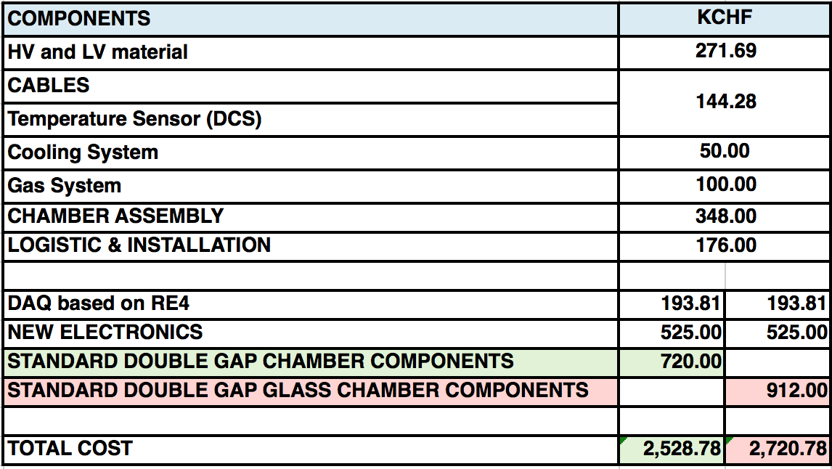
Identify potential cost savings from technical choices (*)
The current value for the glass, would give us a saving choosing bakelite.

Slide 5
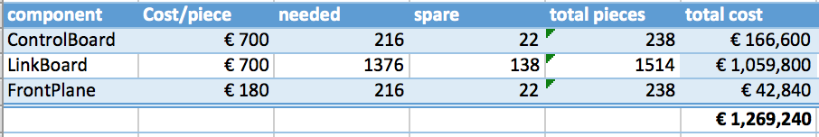
Board Link Upgrade Current System
extrapolation from the costs of the RE4 boards (2012 upgrade)

