Slide 1
My integration meetings
14 Sept 2021
Ian

Slide 4
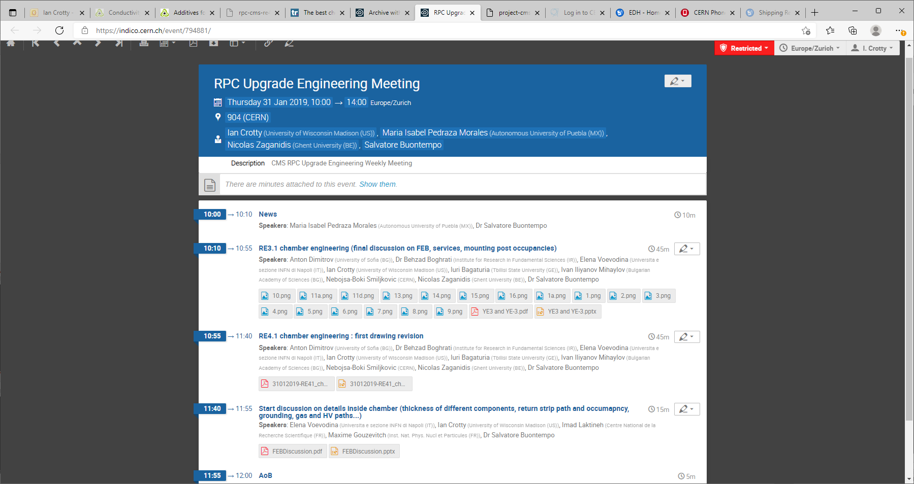

Slide 5
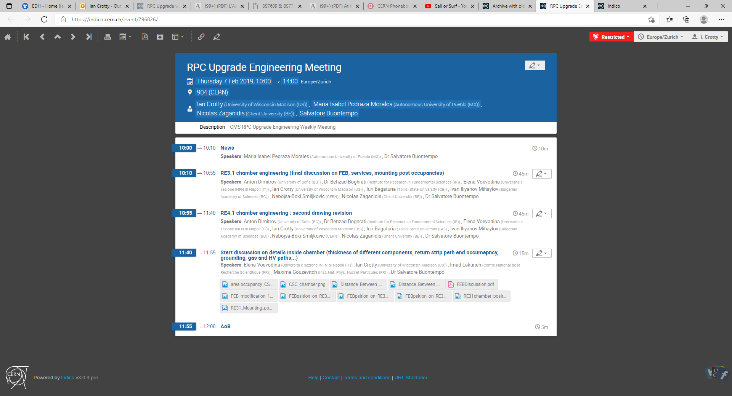

Slide 6
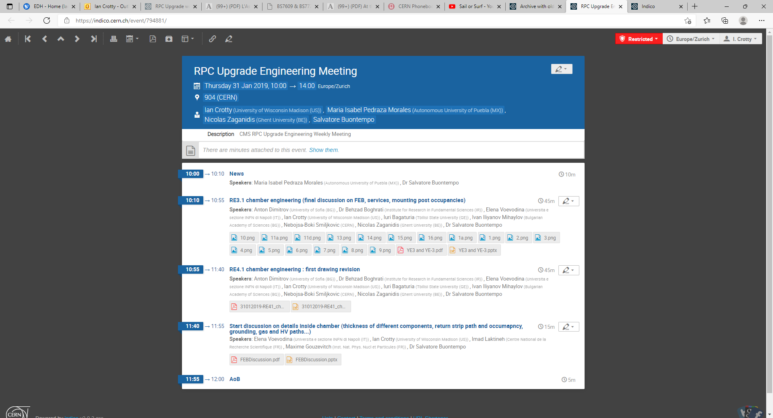

Slide 8
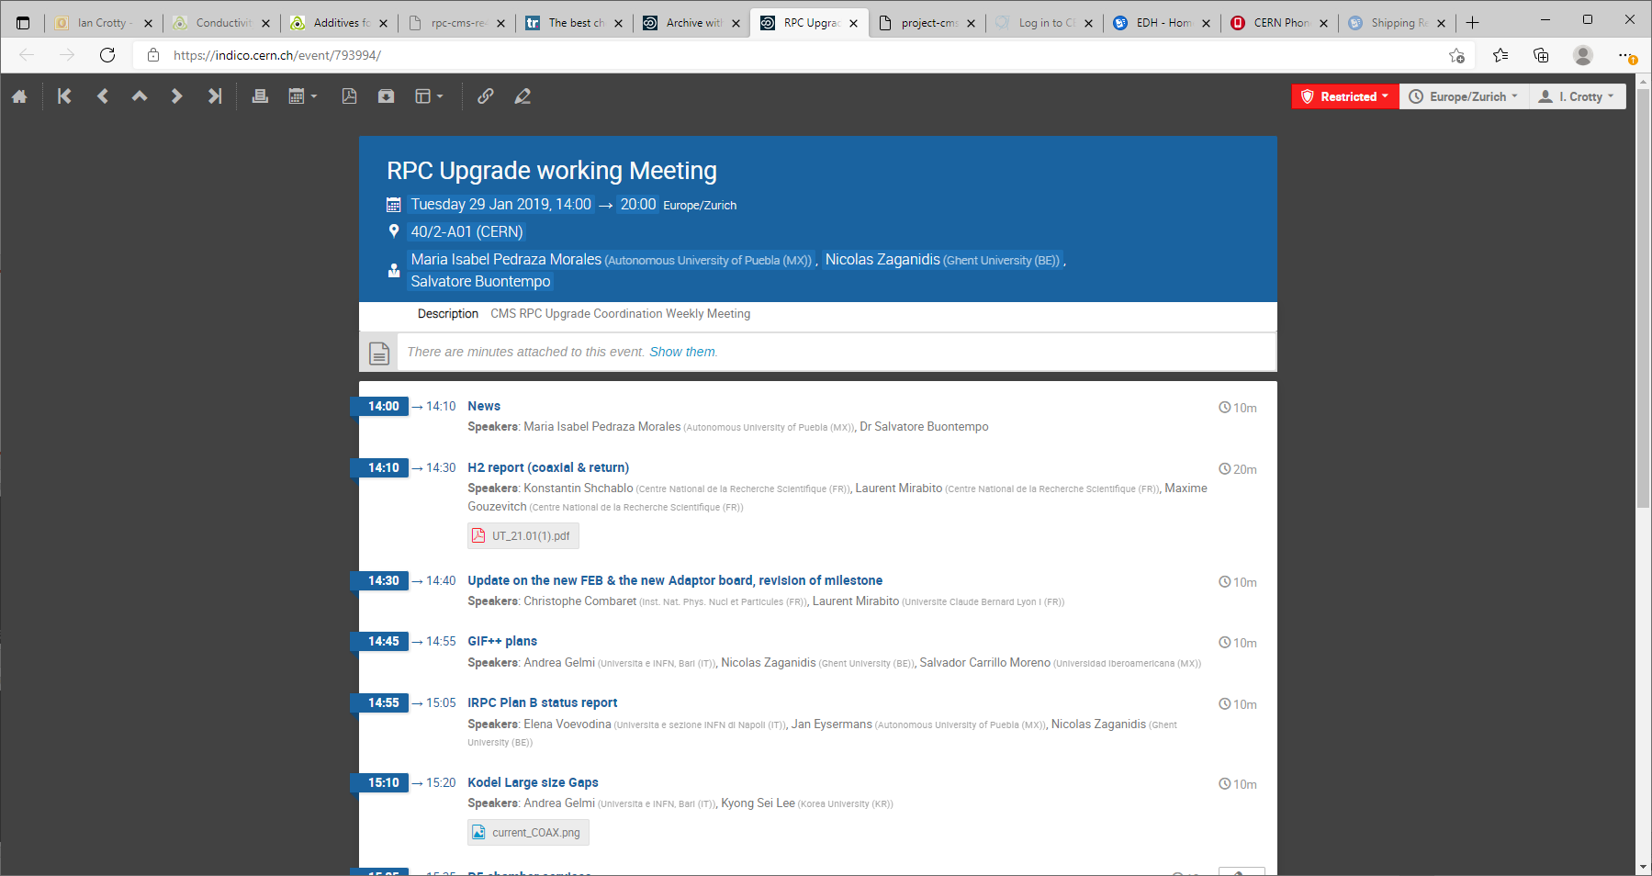

Slide 9
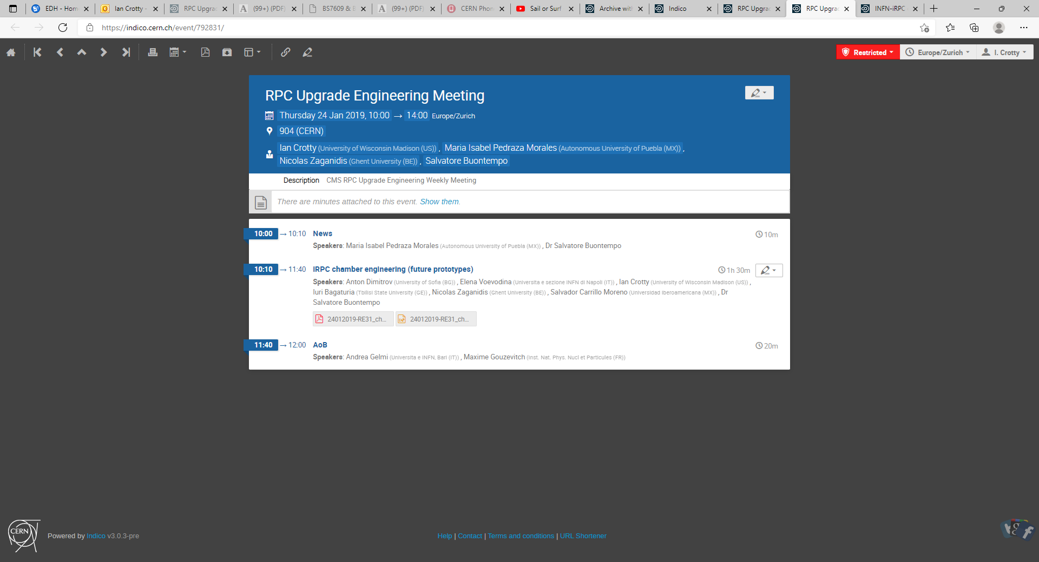

Slide 10
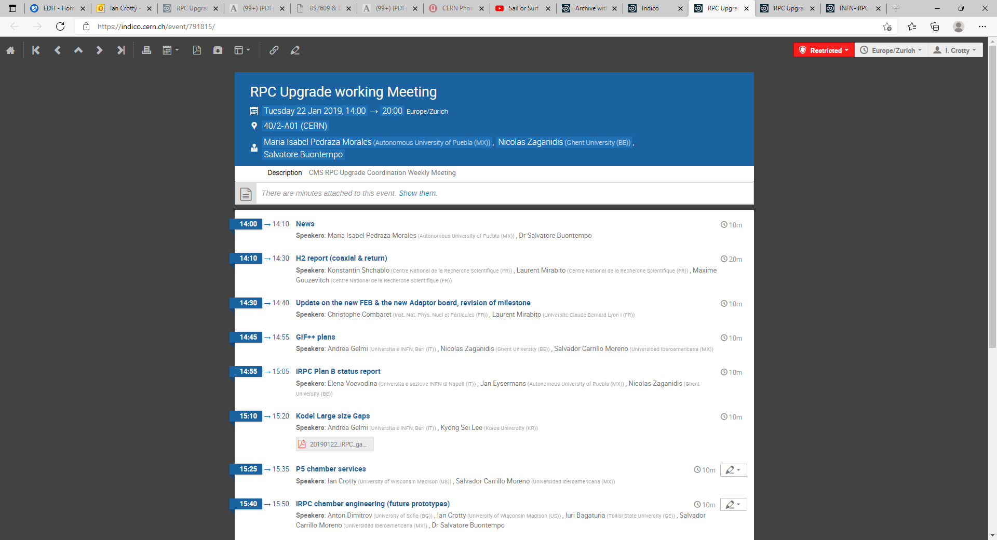

Slide 11
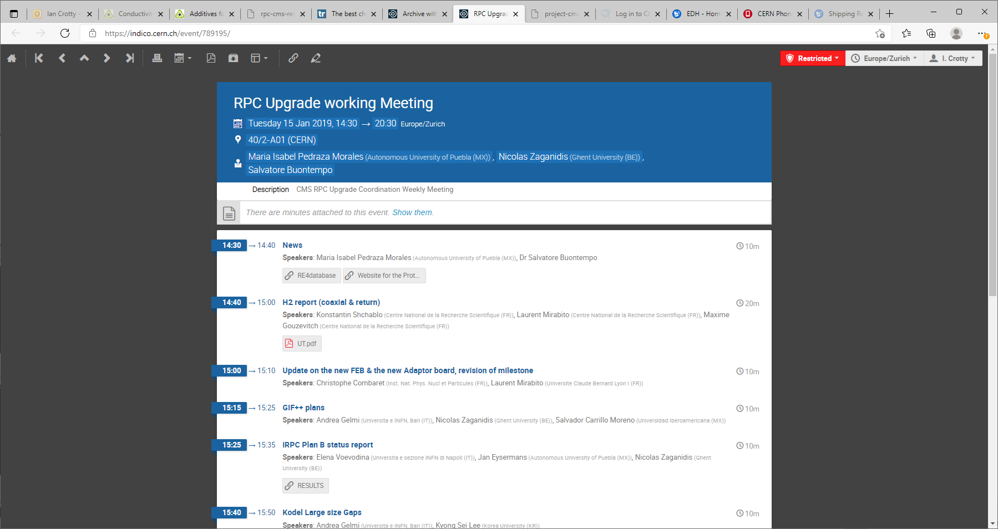

Slide 13
The last meeting on Upgrade and Engineering and Services 10 Jan 2019. It became engineering with S. Buontempo running it .
So he is running the Upgrade Engineering. and the Upgrade working meeting
“We will keep you informed by email” S. Buontempo
My end Jane 2019.
Previously ,2018, told by the project manager to treat only specific subjects, I assumed that was to keep the meetings short. In reality as Lena ( Russian Phd student) was no longer able to work on the drawings they were waiting till the two excellent technicians from Belgium and the experienced Ivan were taken on board so they could do the work. And so as I had dealt with specific immediate subjects it could be argued I was not covering all aspects. I only wanted to do the integration as done in the other stations 1, 2 & 3 and so the chamber design on the out side at least.
As I had no support except summer students, Andres was there for the fibres and I had to show him all the details of the integration and we learnt fibres together, for the services then I had no option to make sure that went ahead.
At no poiny was there any discussion with me.

Slide 14
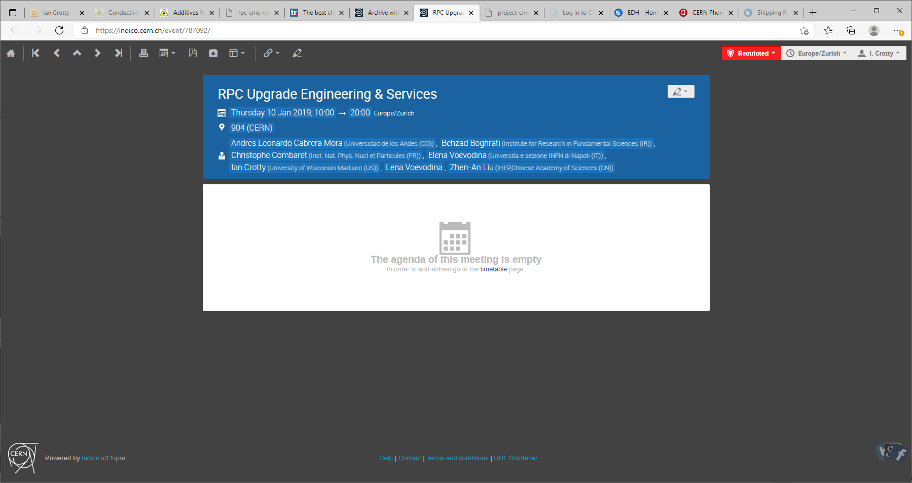

Slide 16
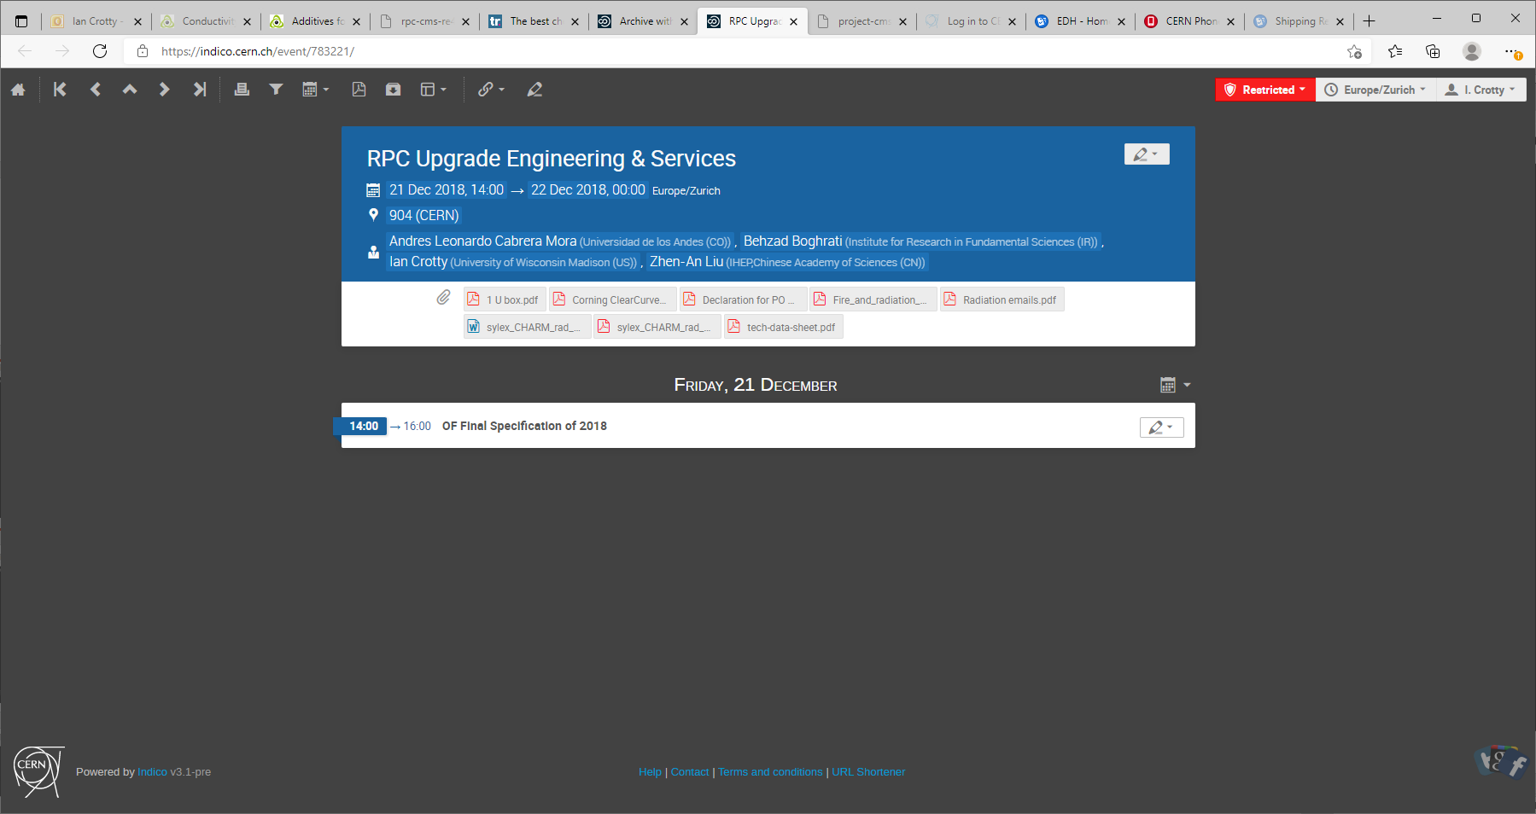

Slide 17
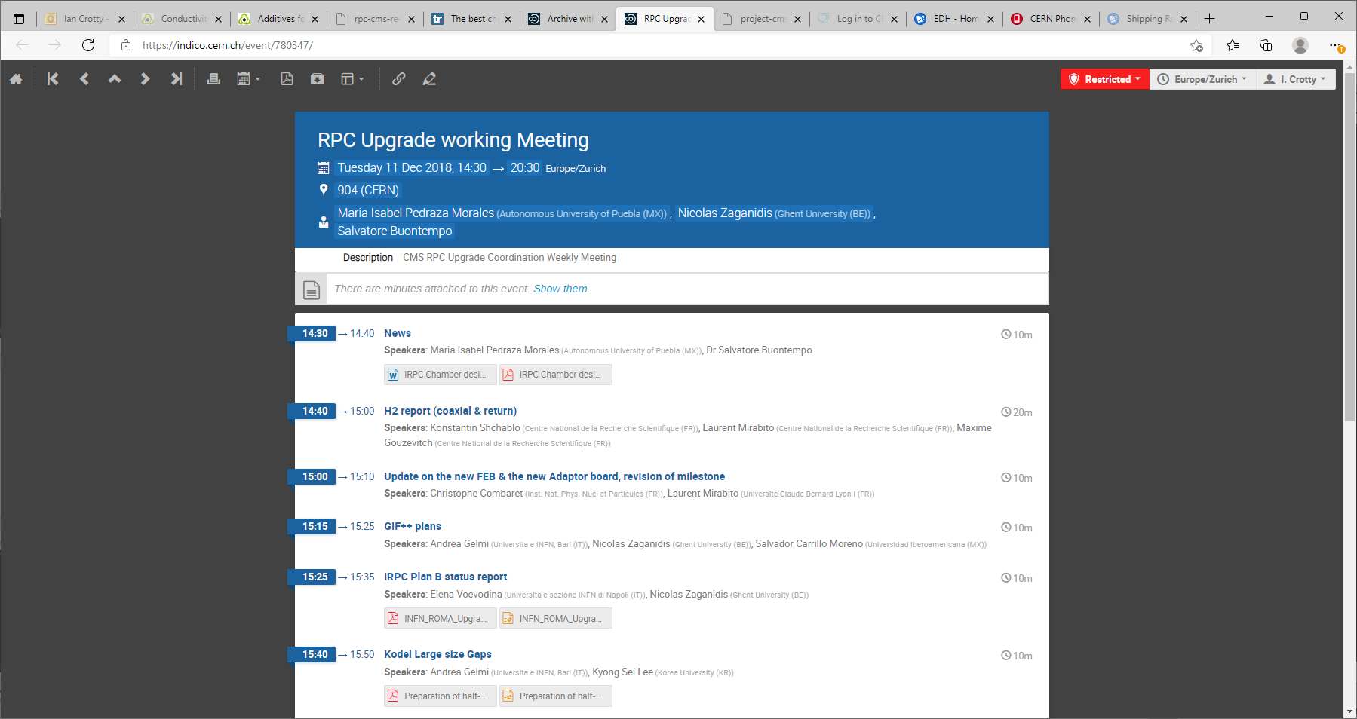

Slide 18
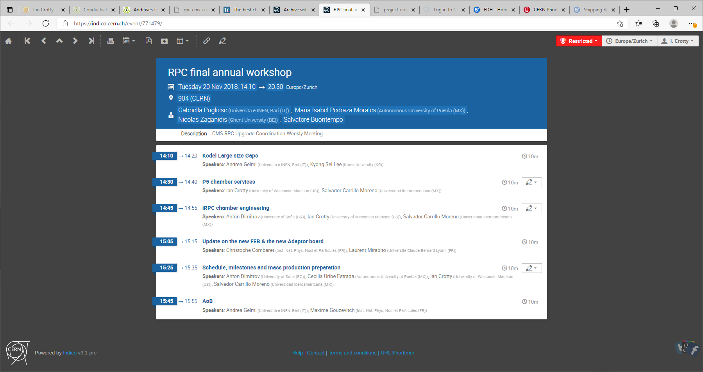

Slide 19
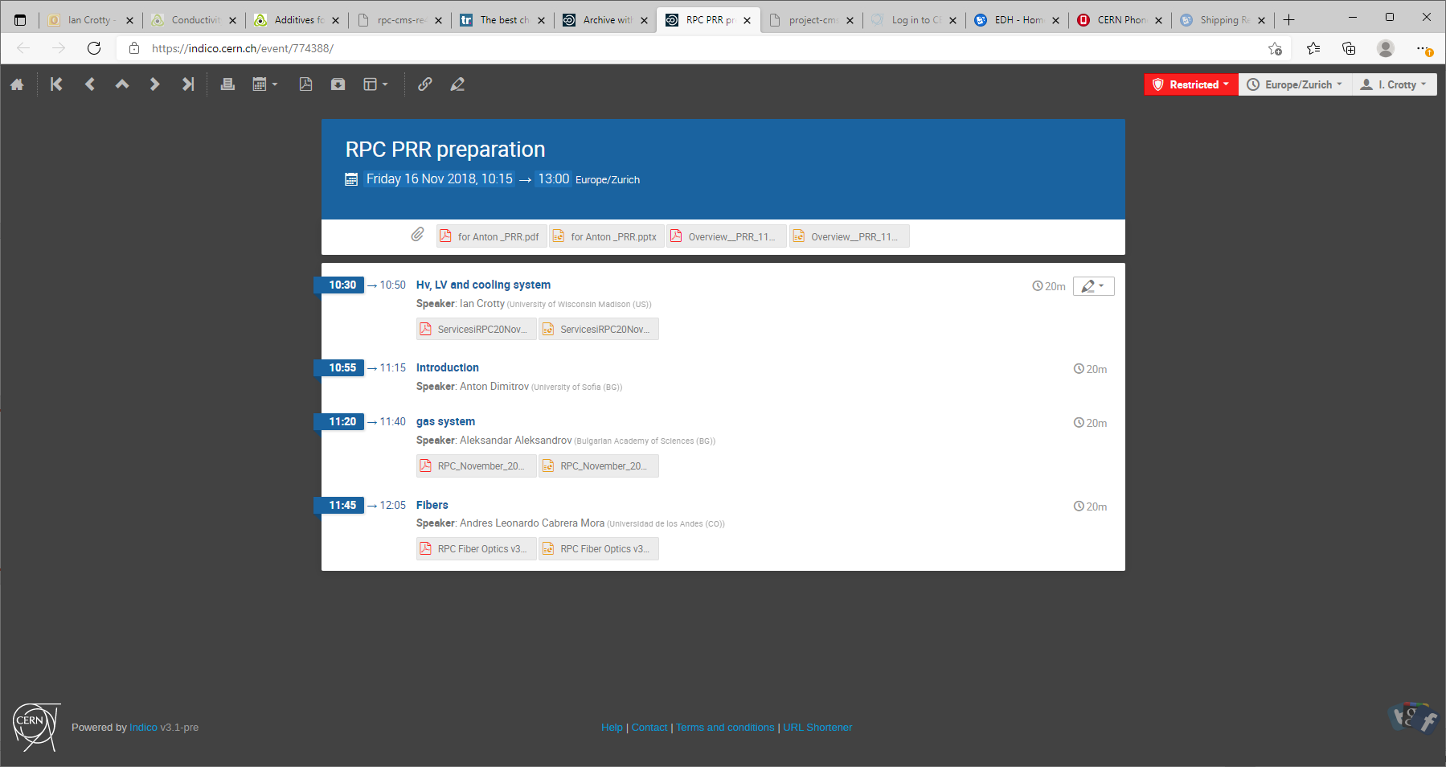

Slide 20
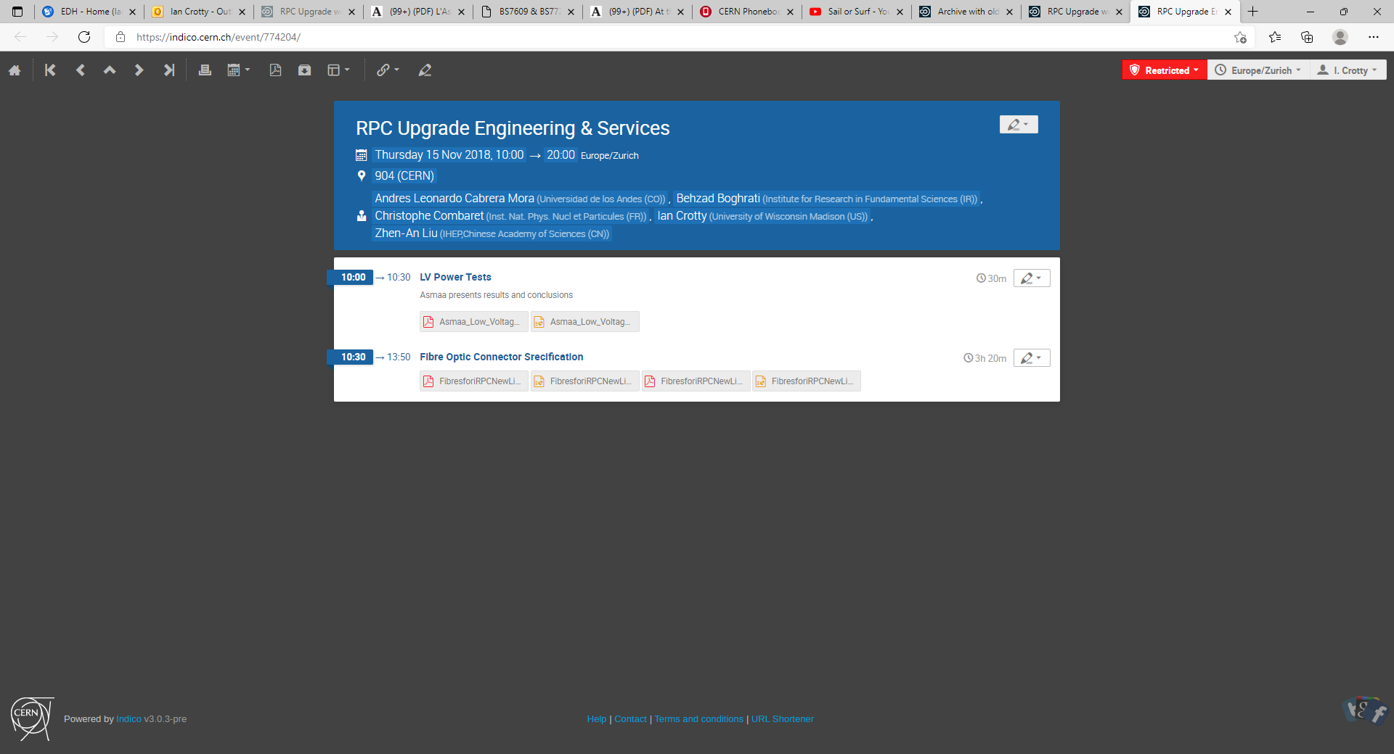

Slide 22
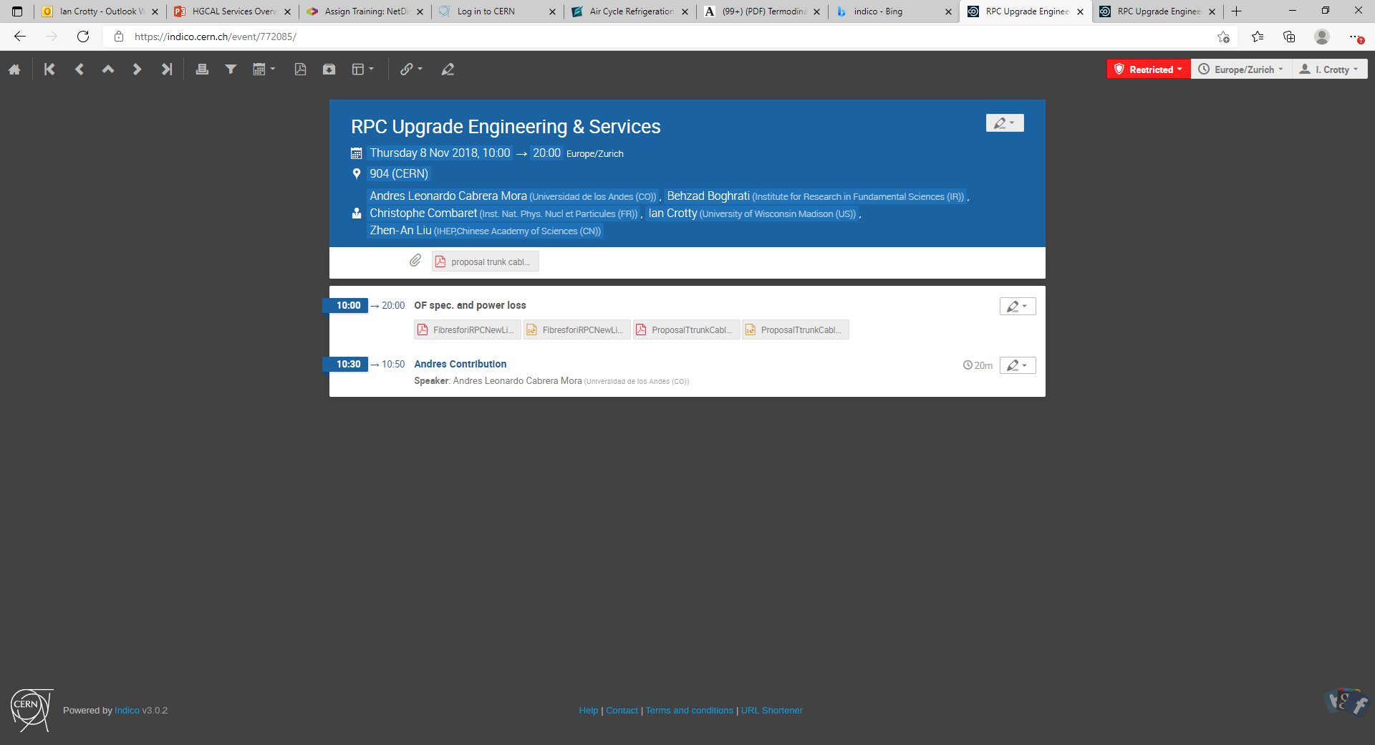

Slide 23
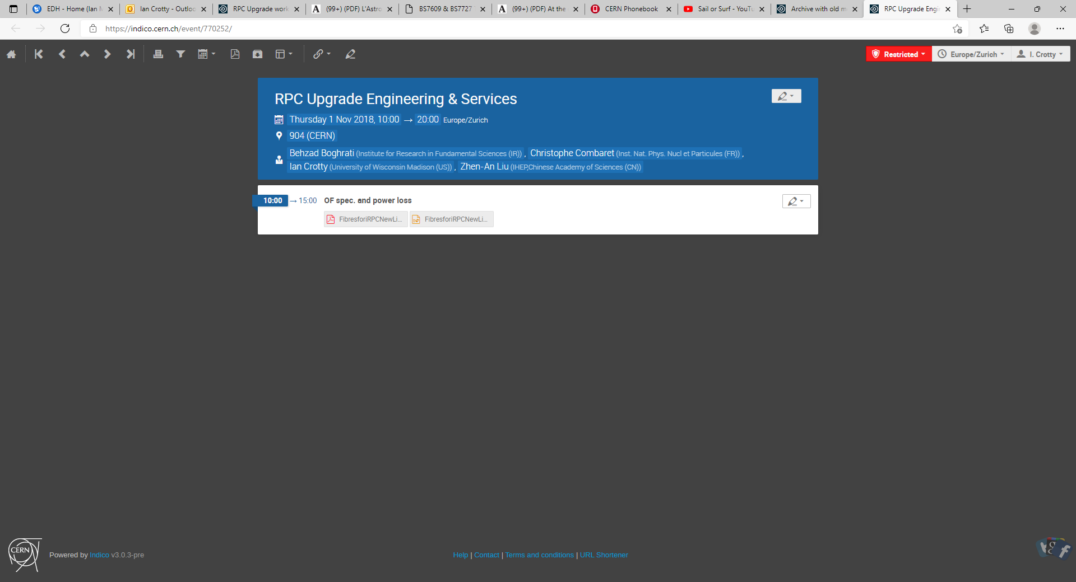

Slide 24
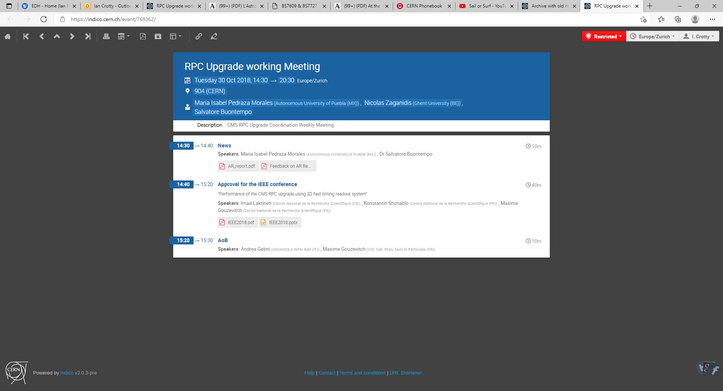

Slide 25
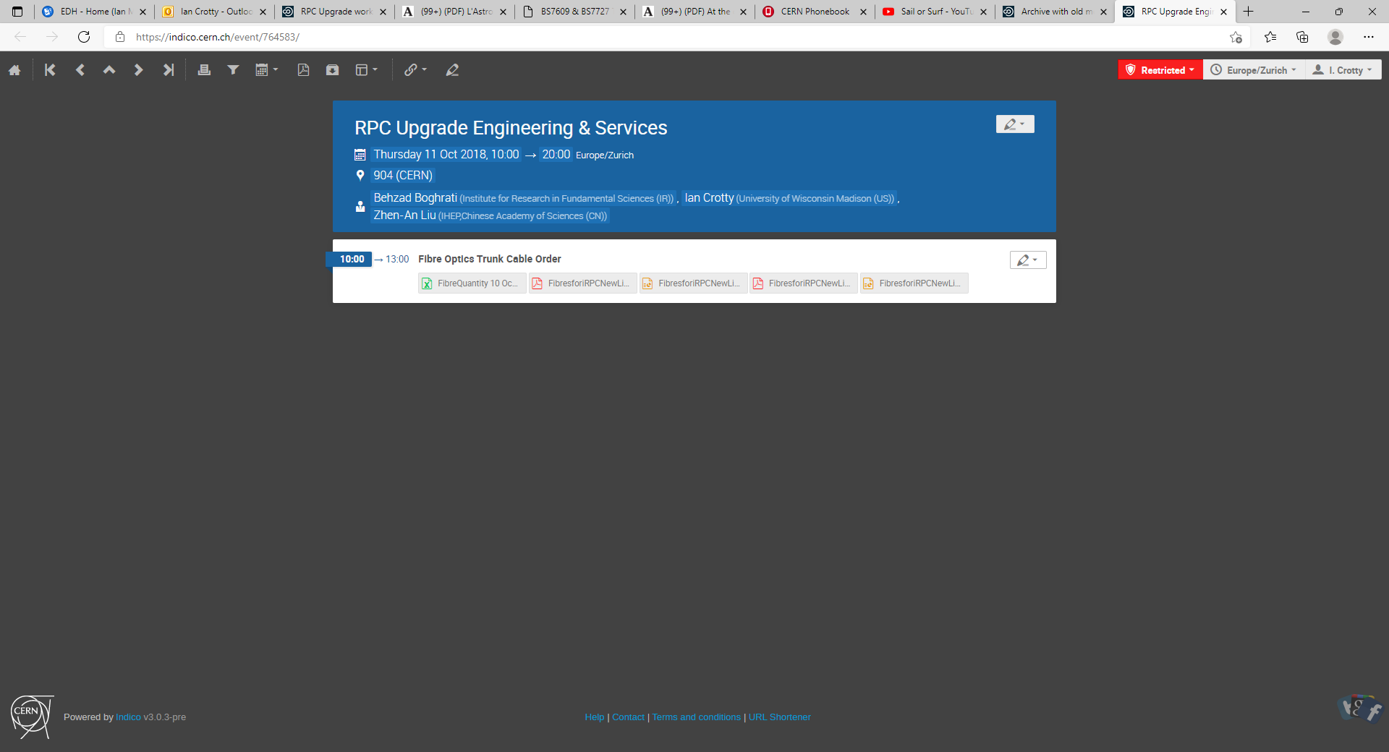

Slide 26
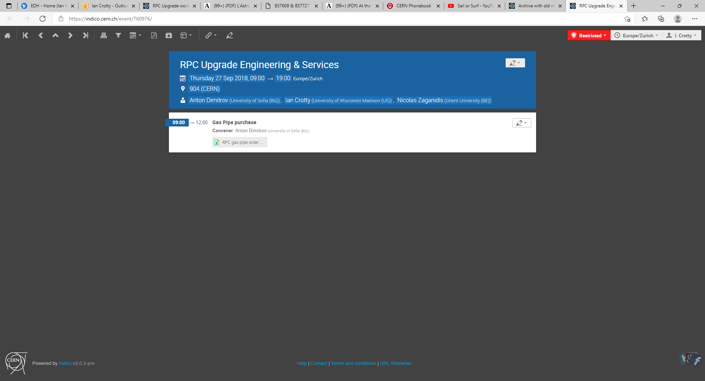

Slide 27
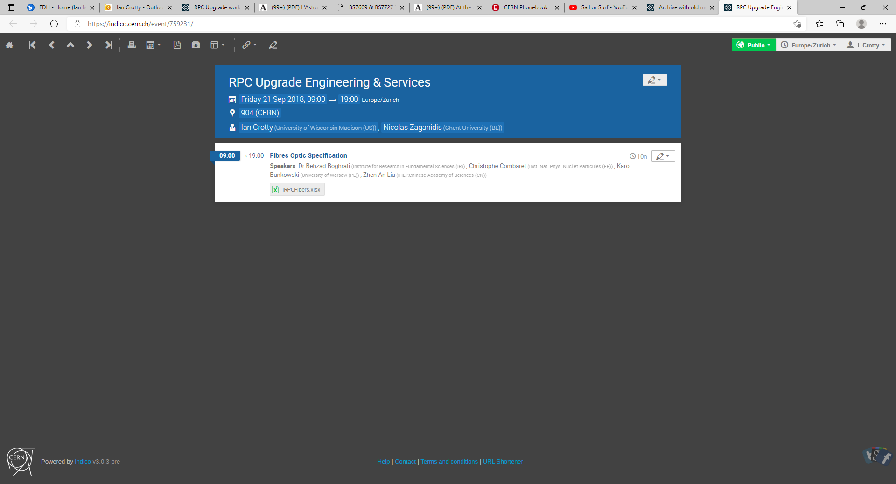

Slide 28
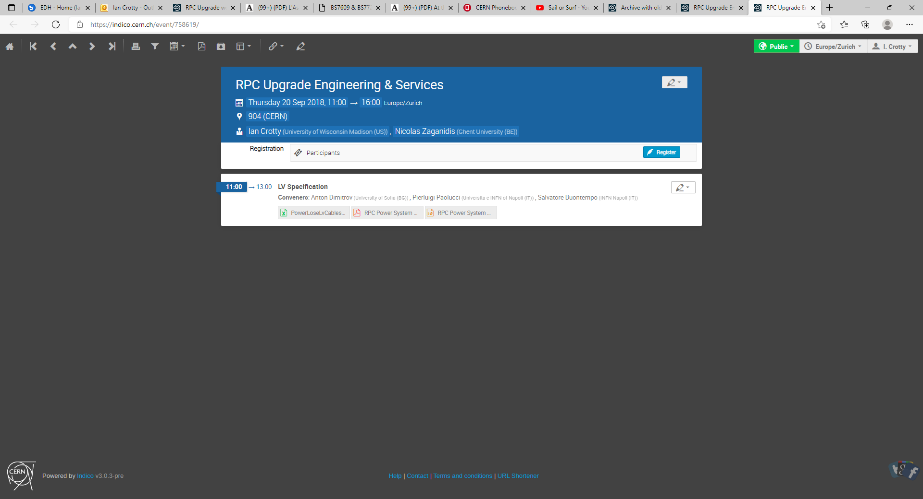

Slide 29
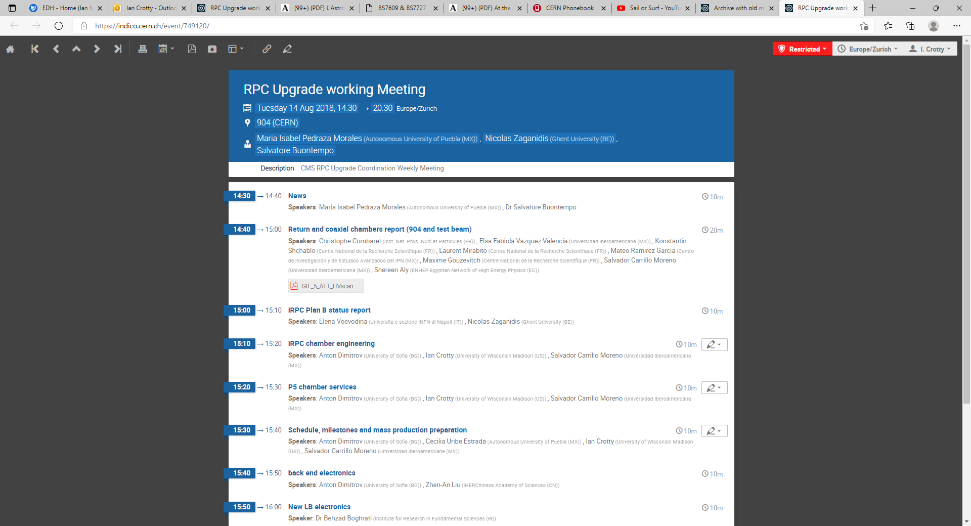

Slide 30
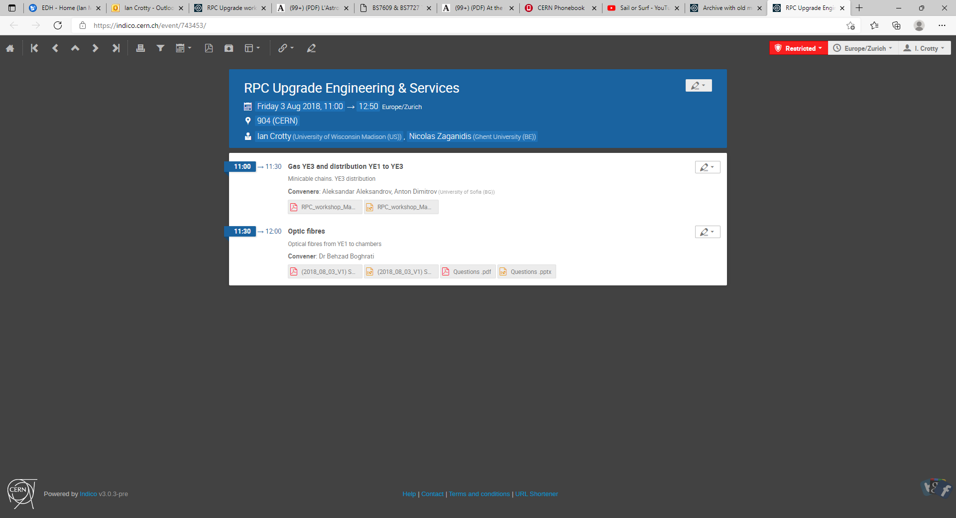

Slide 31
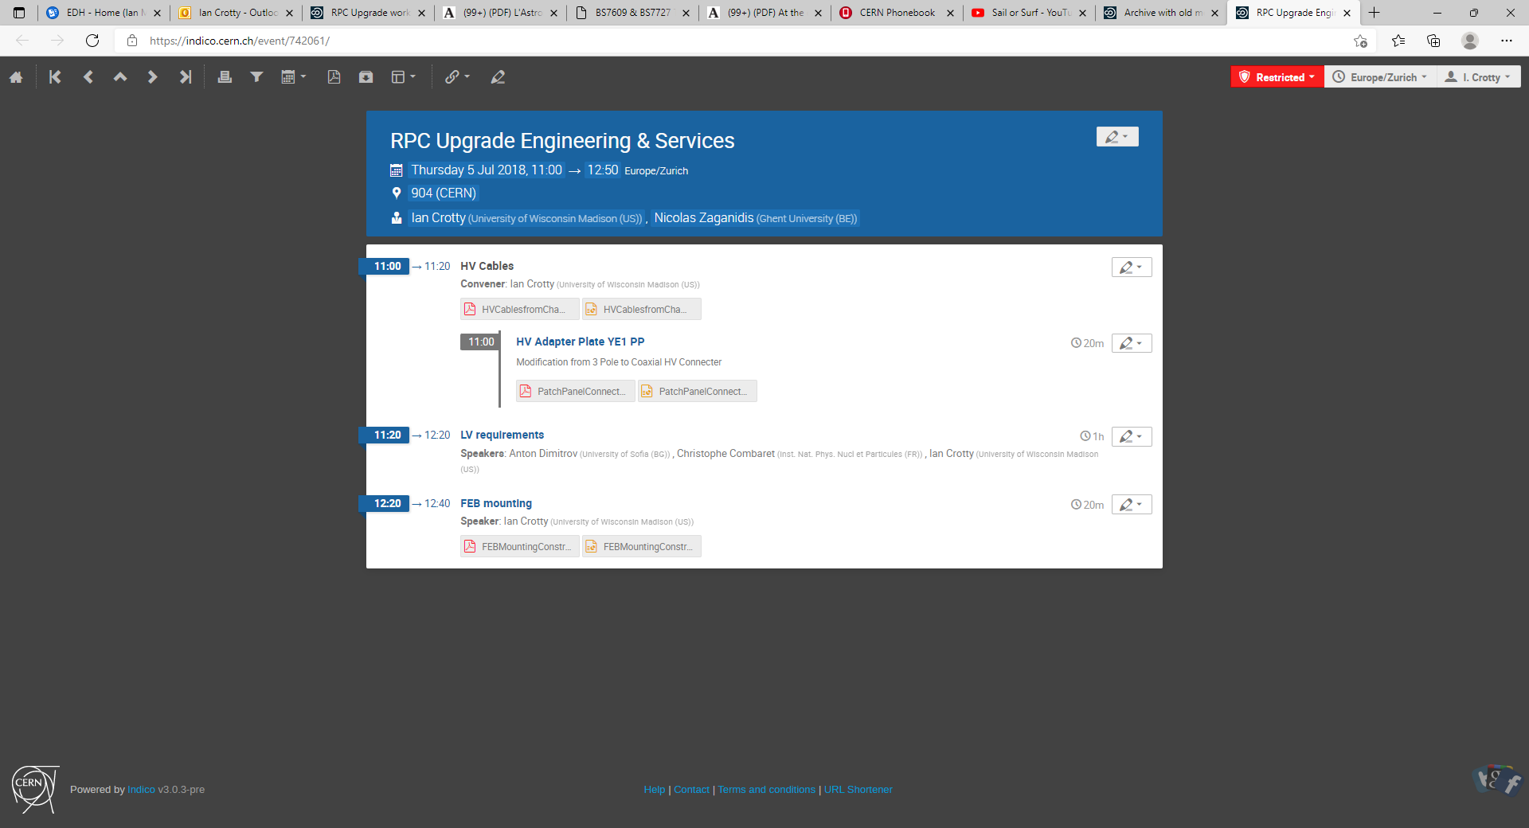

Slide 32
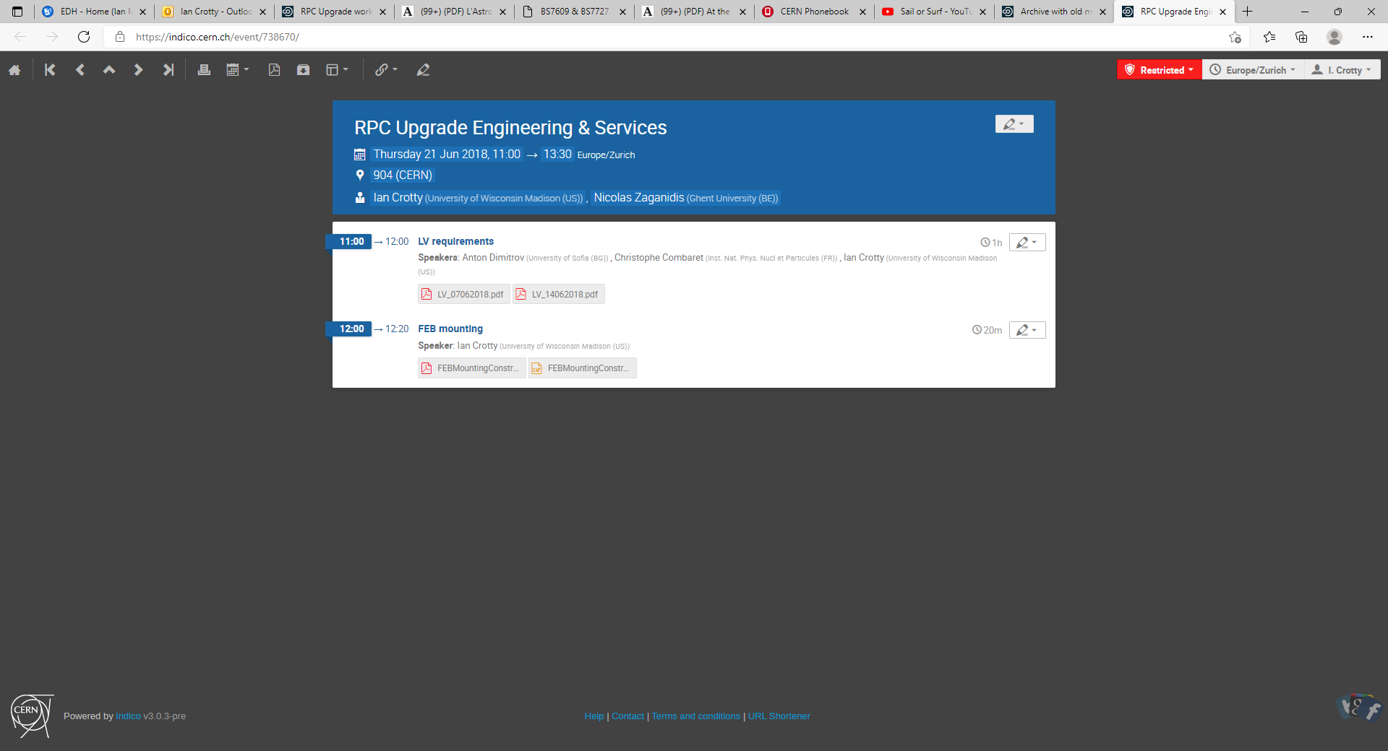

Slide 33
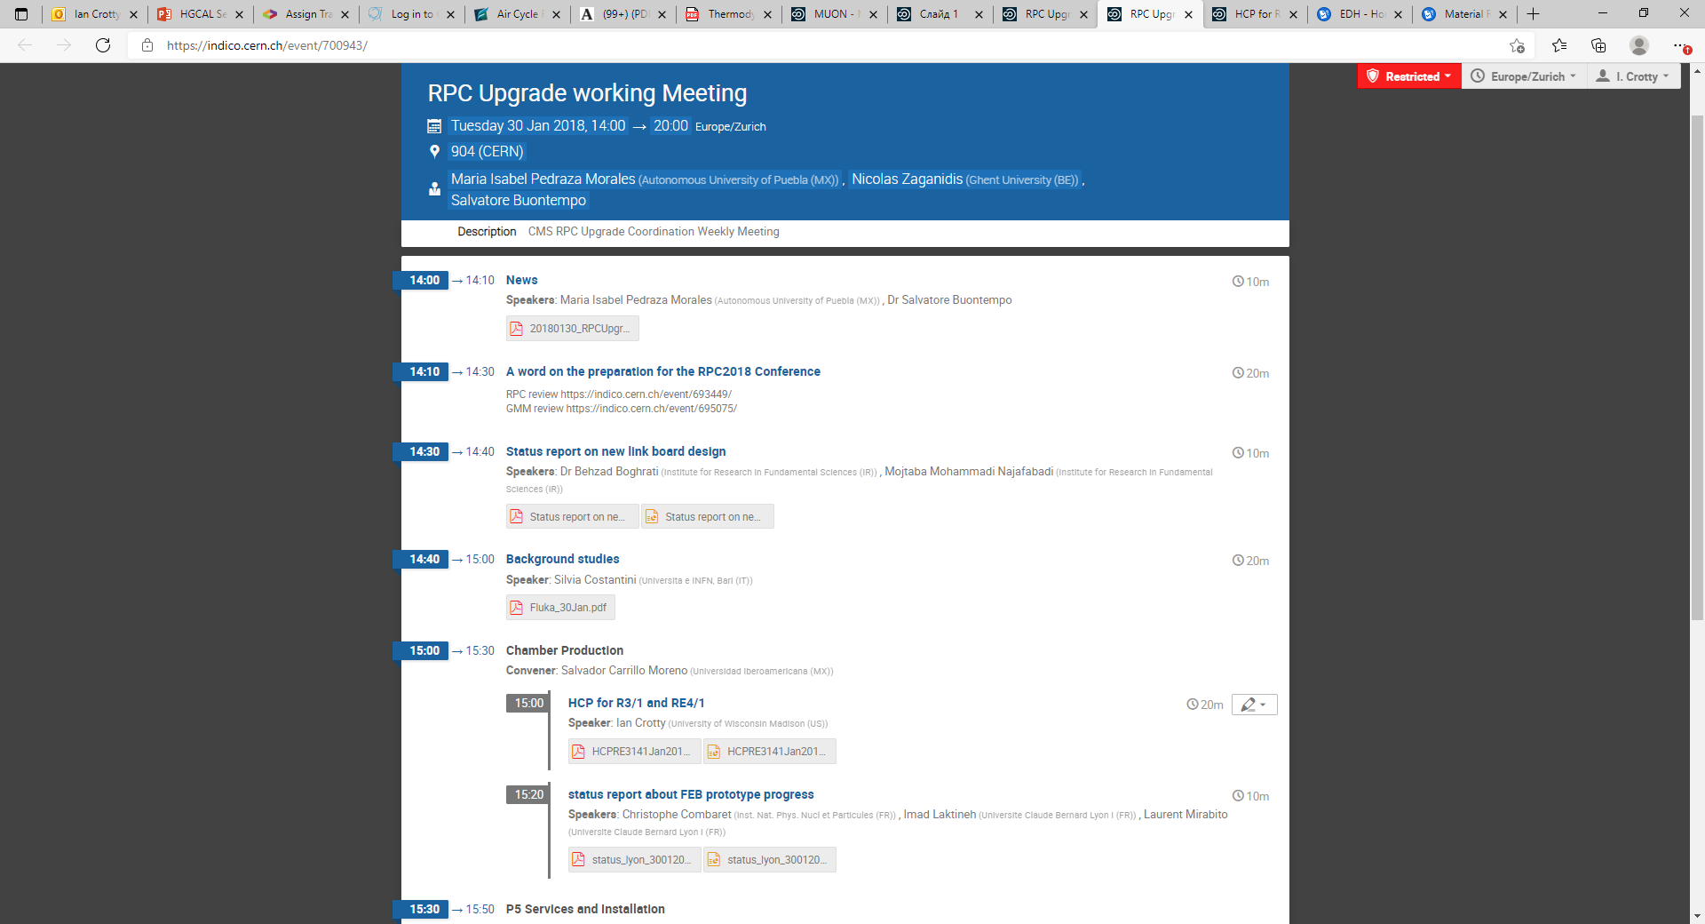

Slide 35
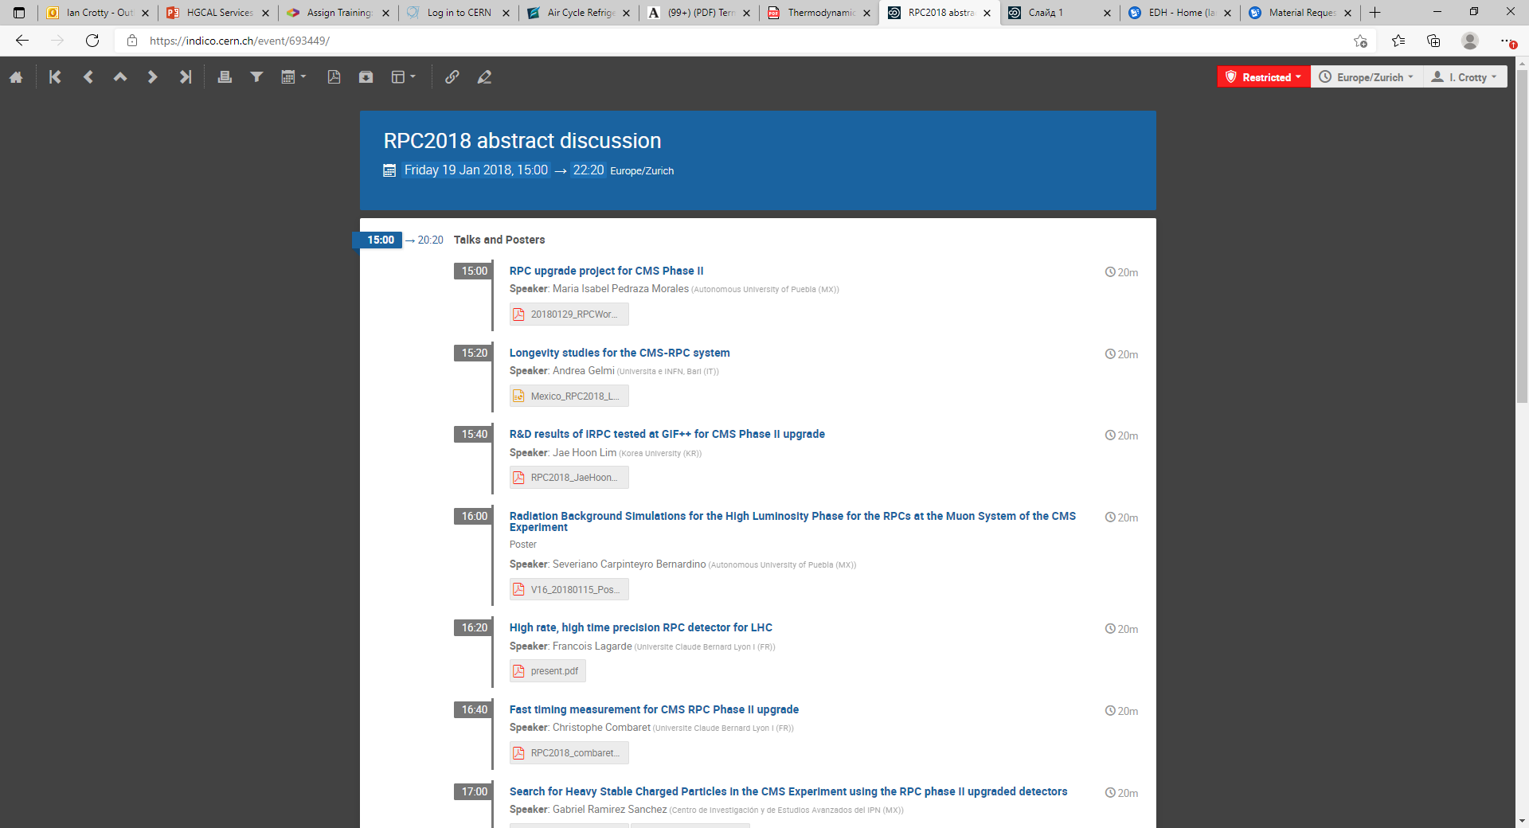

Slide 37
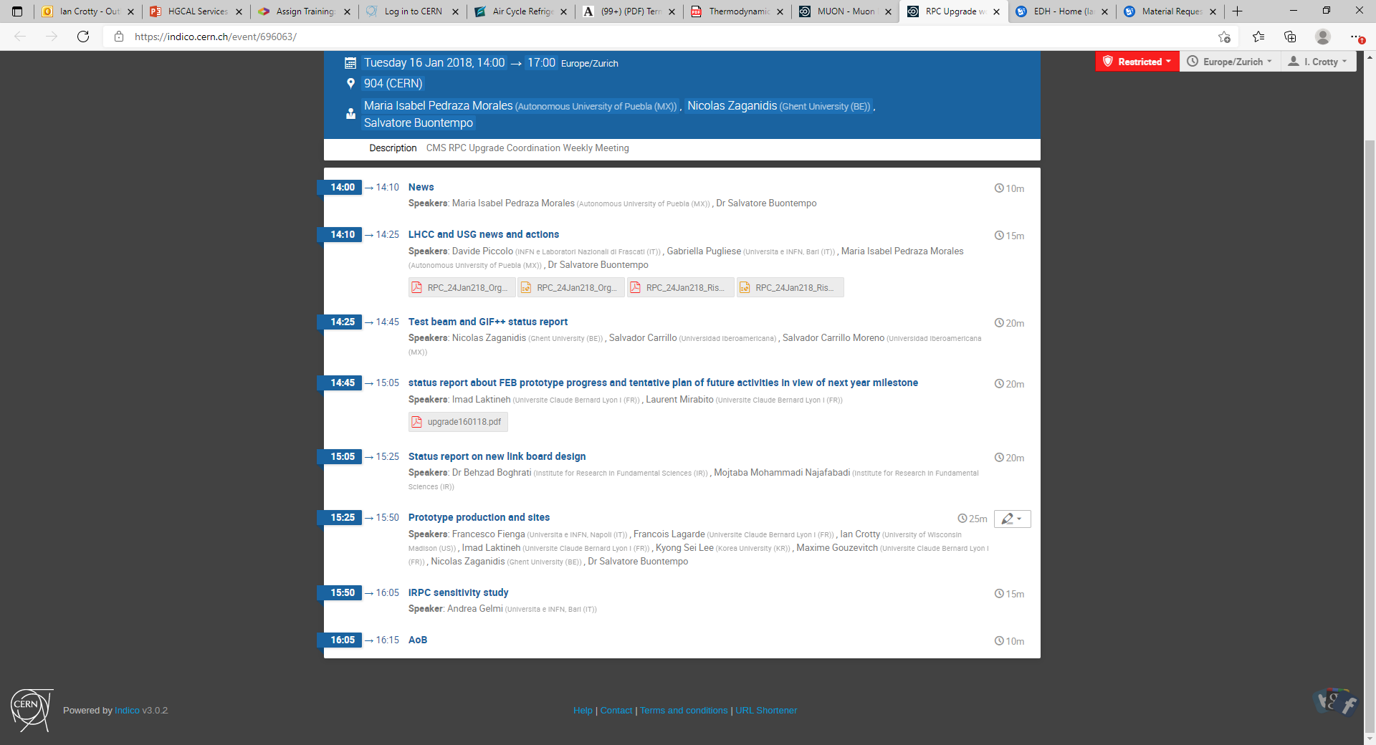

Slide 38
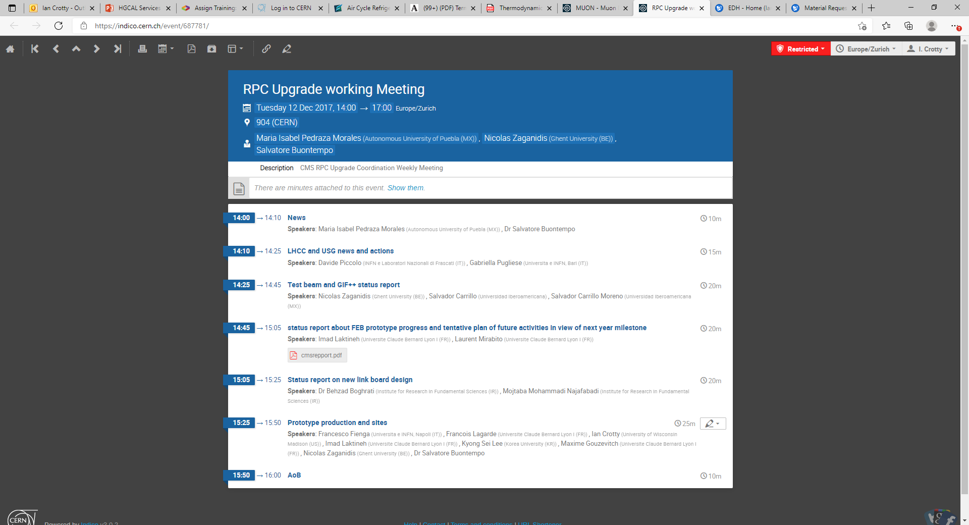

Slide 39
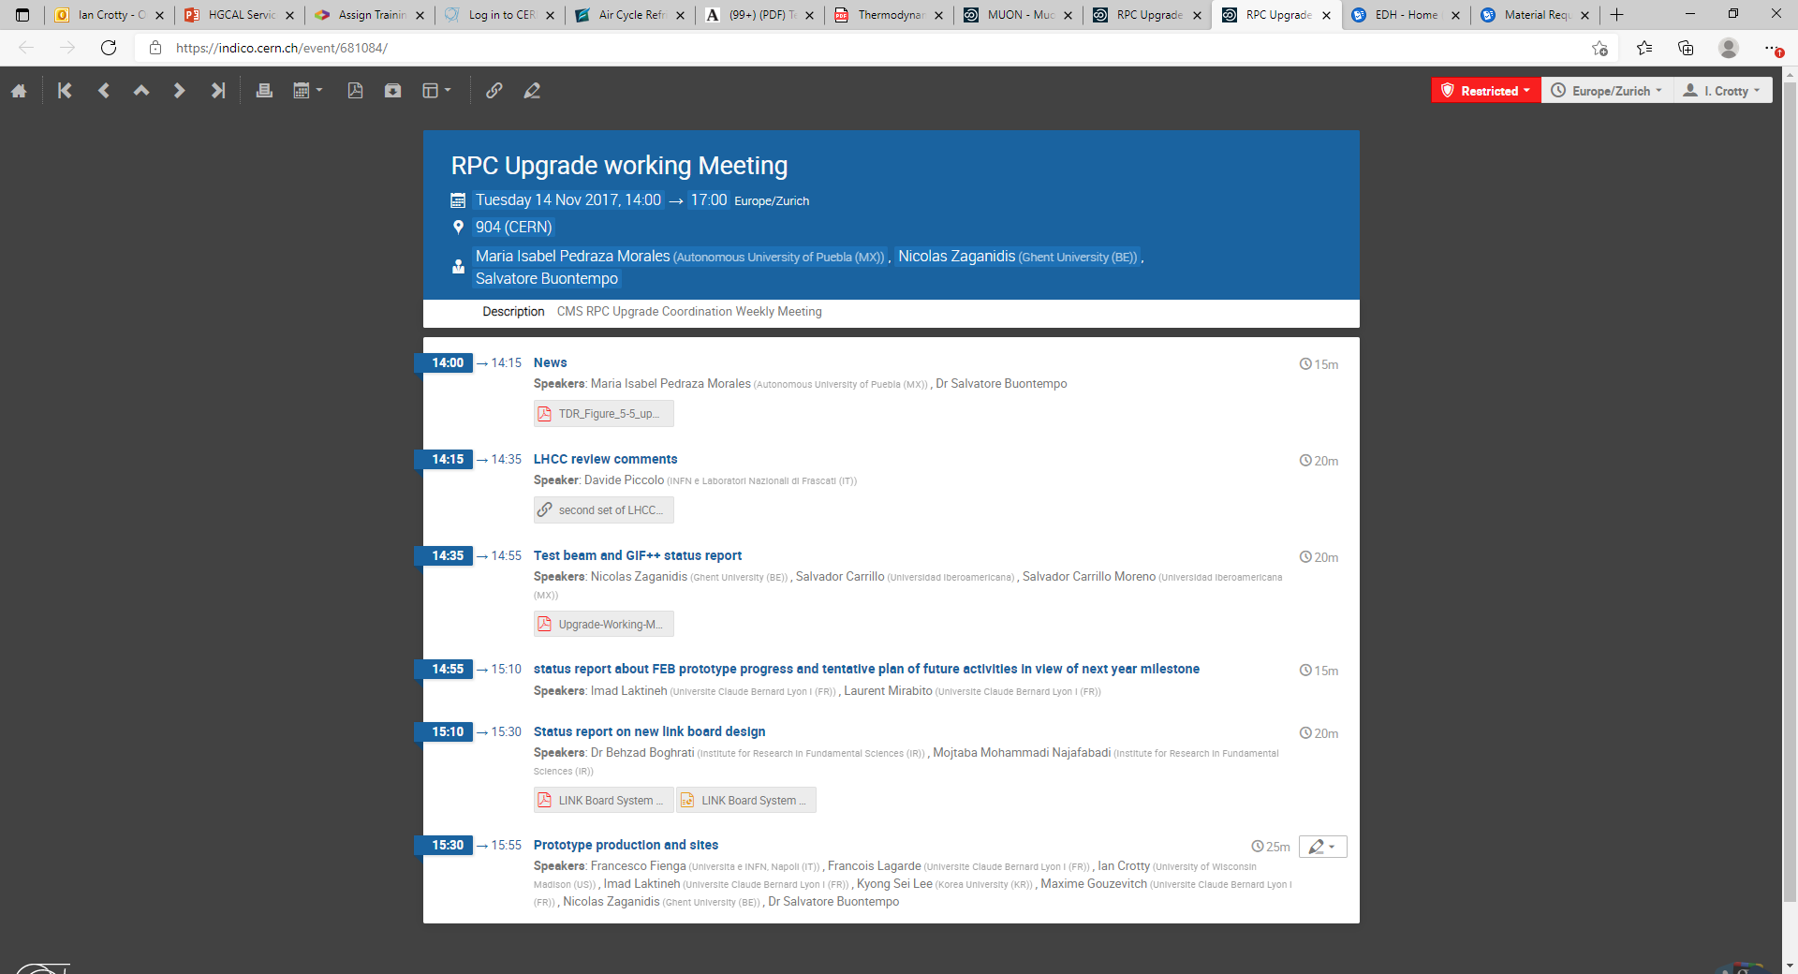

Slide 40
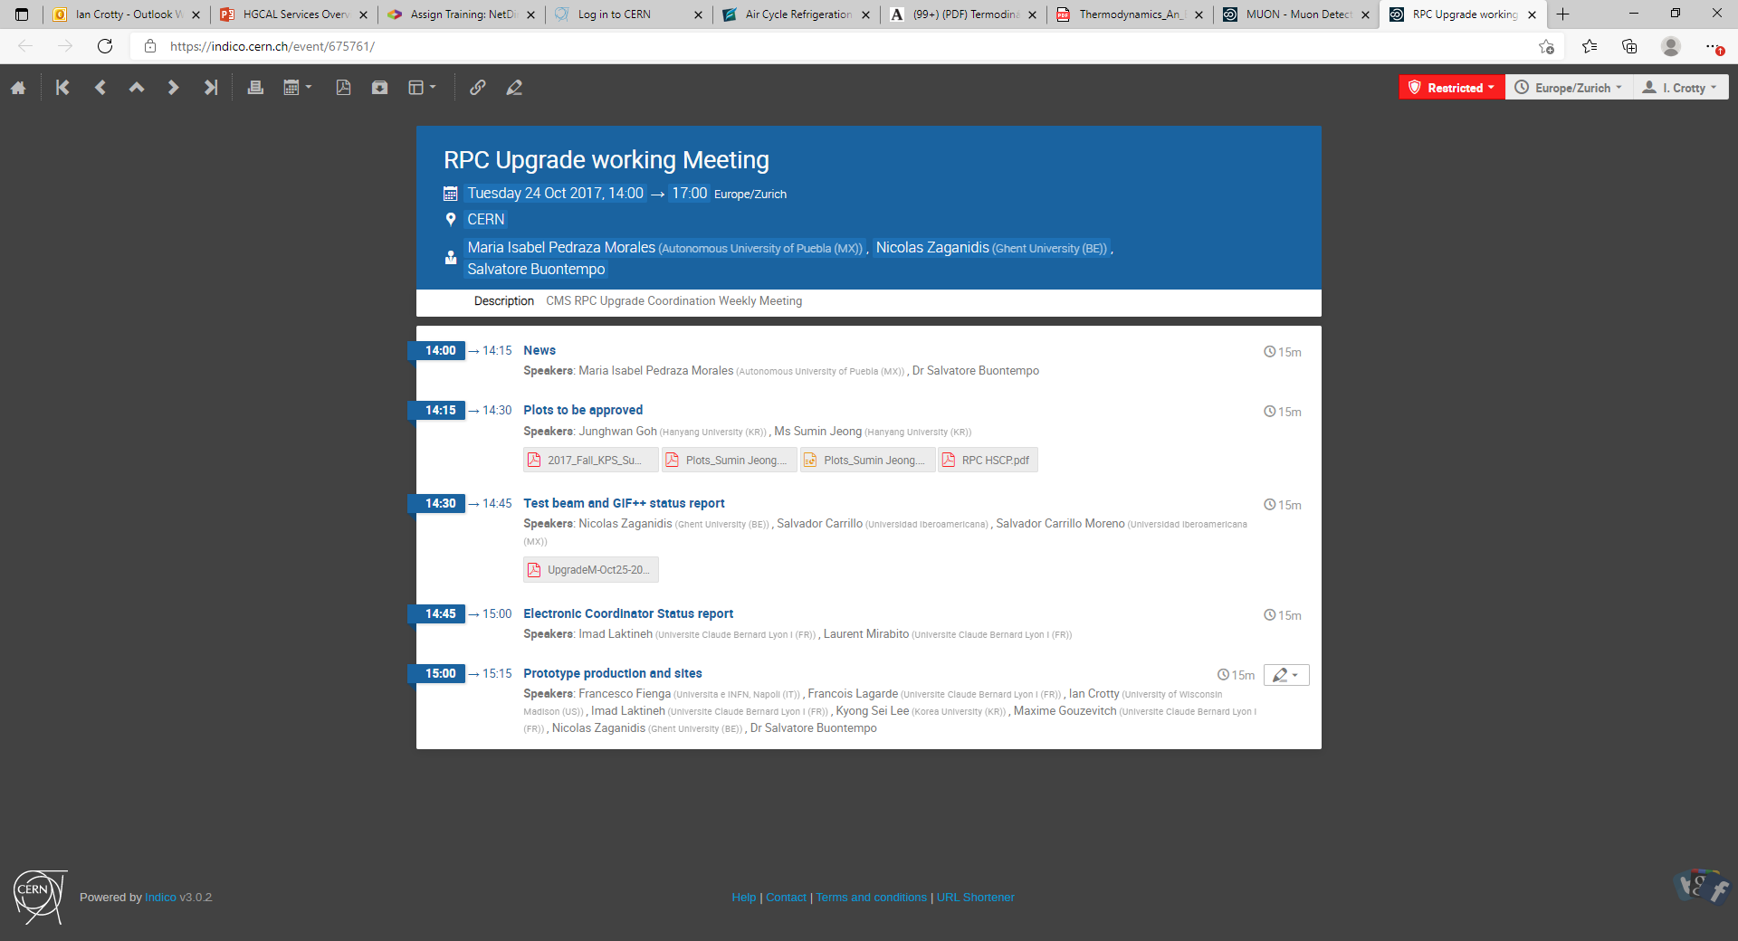

Slide 41
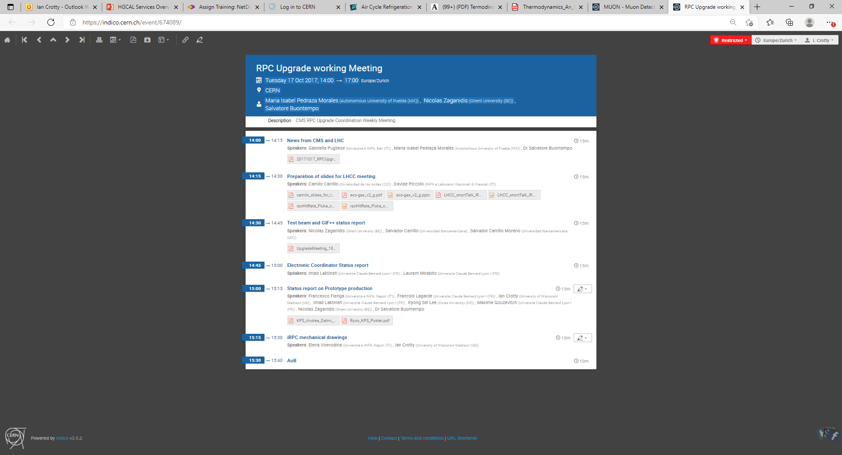

Slide 42
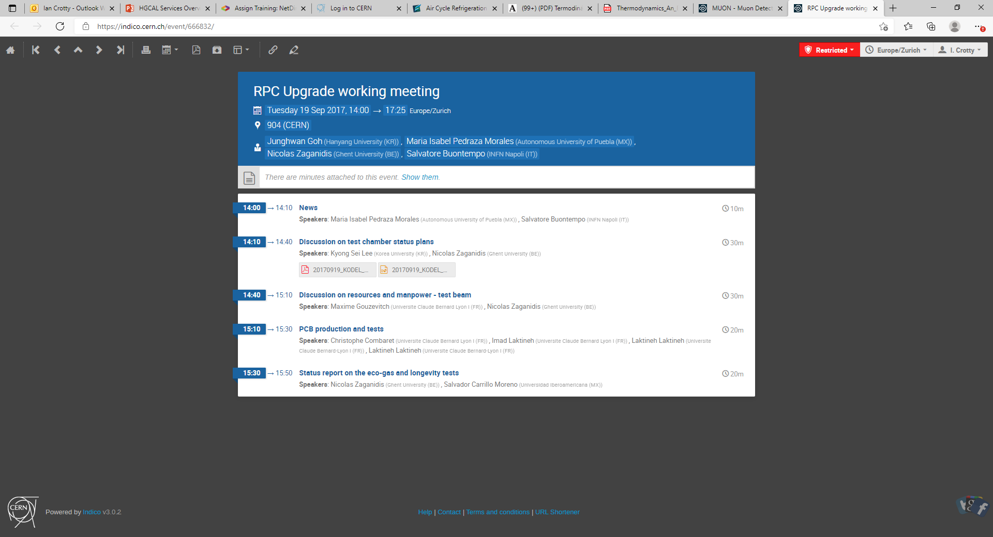

Slide 43
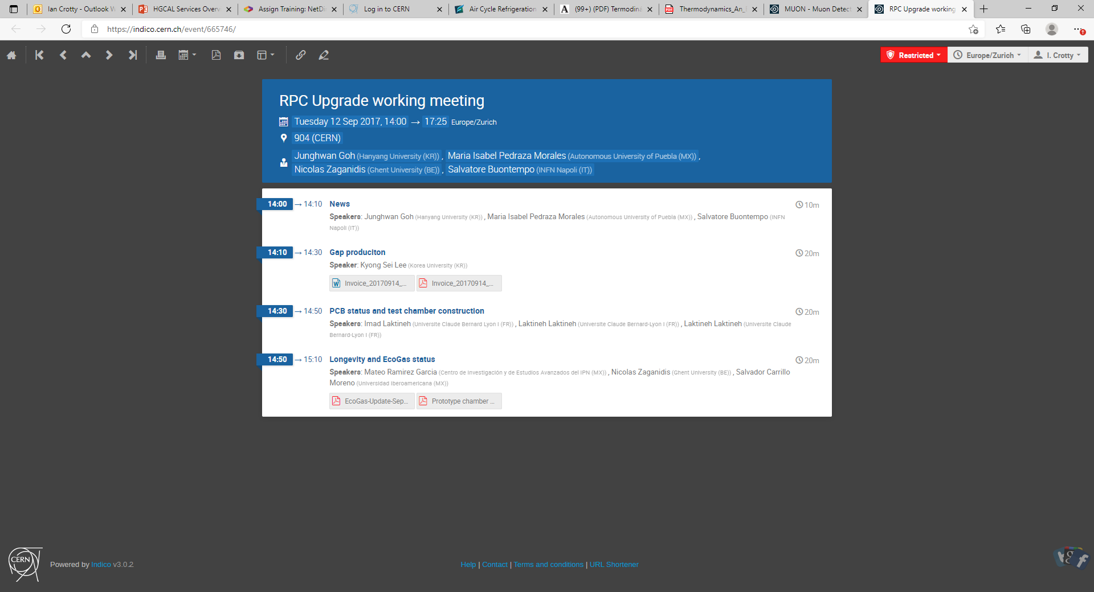

Slide 44
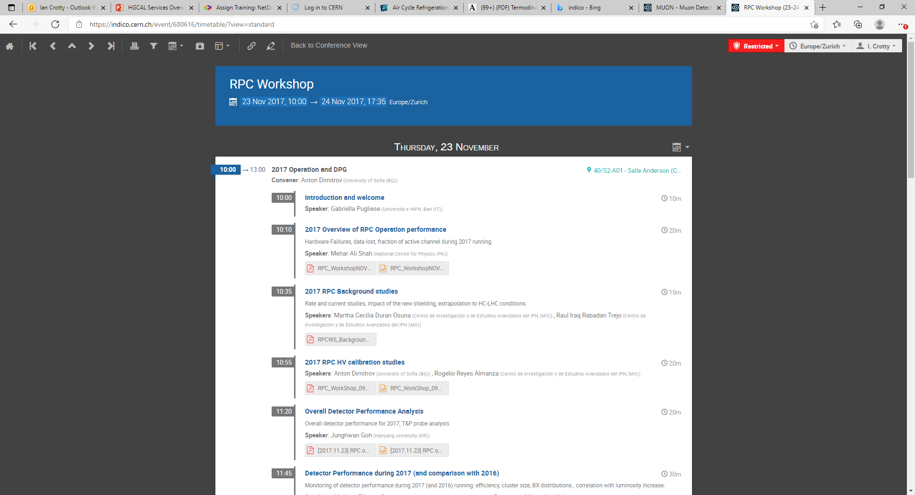

Slide 45
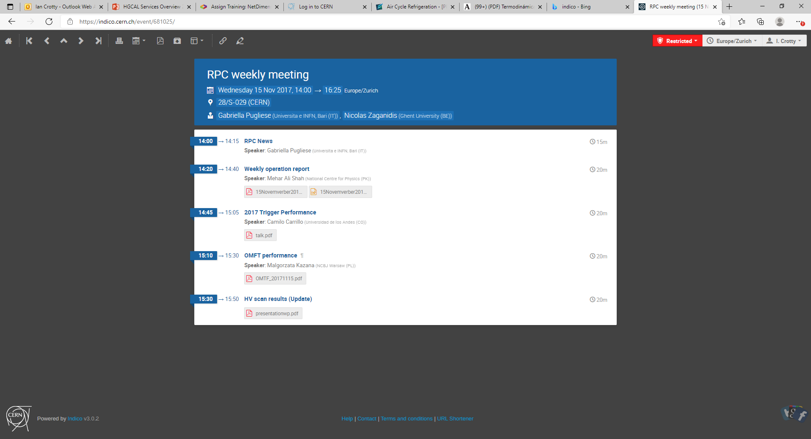

Slide 46
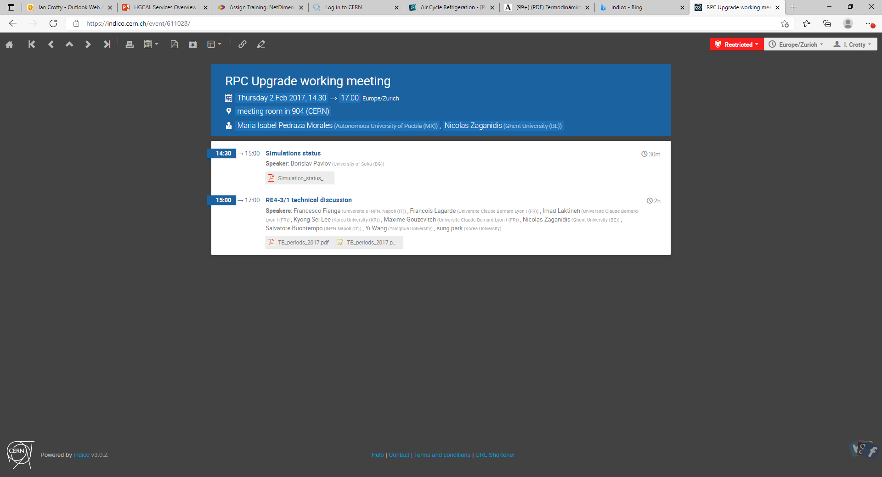

Slide 47
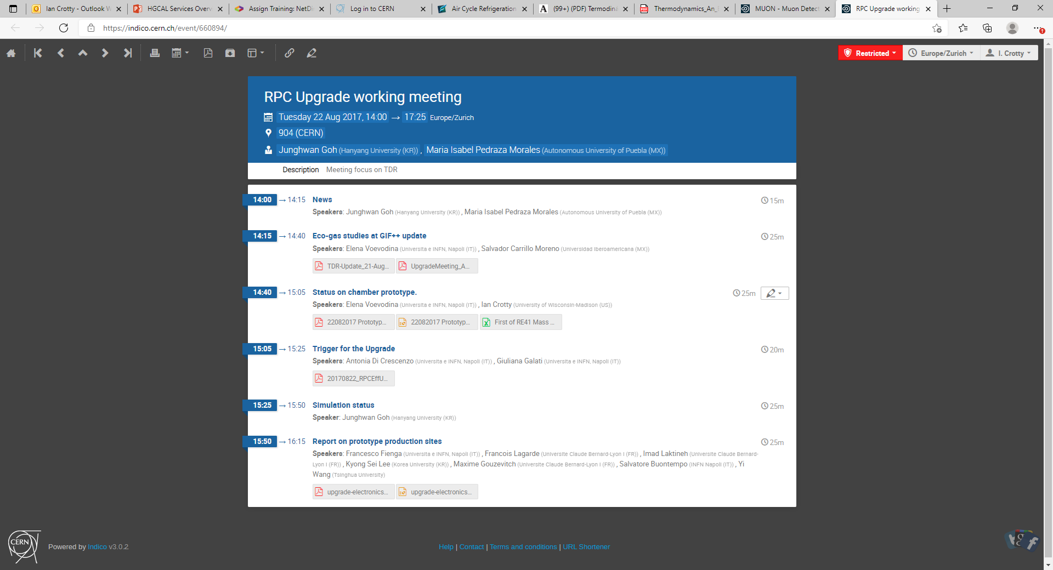

Slide 48
