Slide 1
Distance Measurement between CMS Yokes
Ian Crotty
29 Nov 2016

Slide 2
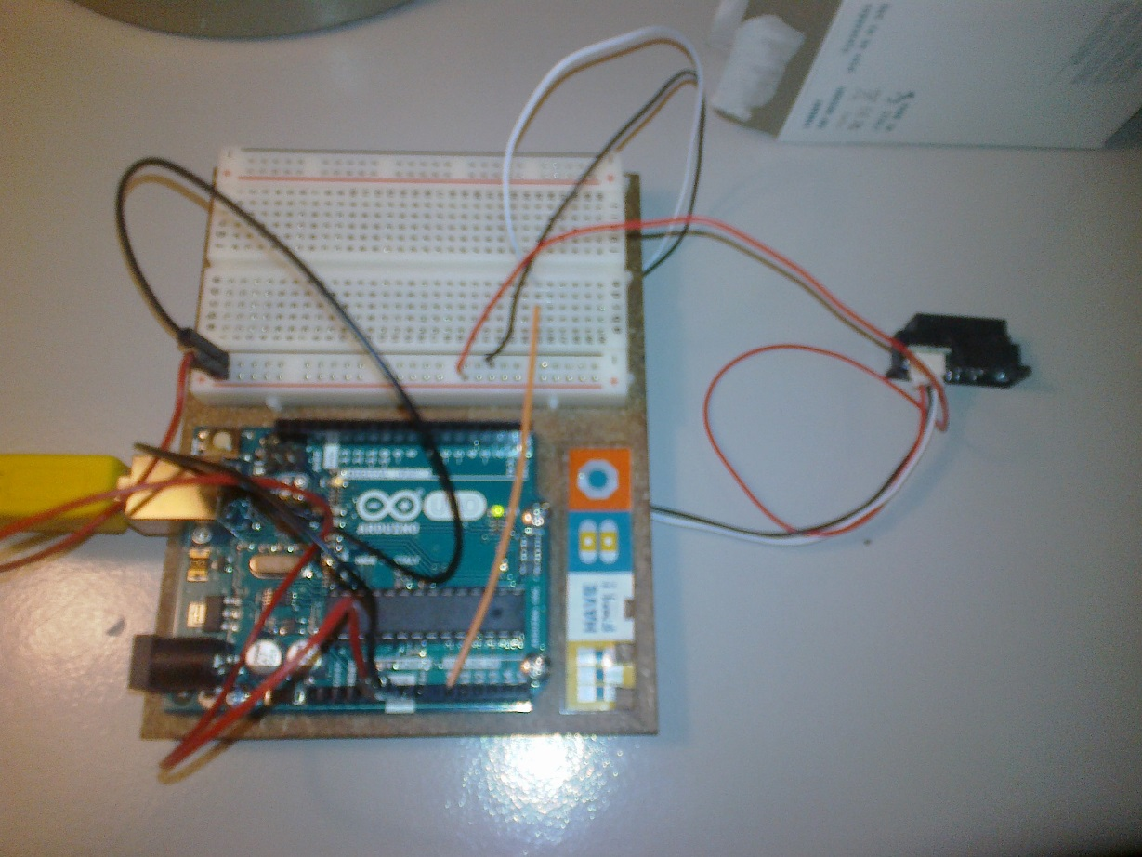
Use remote sensing IR
Measured distance
IR Sensor
Arduino Uno
10 bit ADC

Slide 3
Signal from IR sensor
Ambiguous values @ small distances < 2cm

Slide 4
First results on the Bench (desk)

Slide 5
Conclusion
Seems to give good results in the 30-150mm as announced.
Lower values will have to be sorted due to the response of the IR sensor.
Calibration to be worked on.
Code needs developing for multiple sensors.
Hardware to be made CMS cavern robust.

