Slide 1
RE3/1 and RE4/1 Integration
Ian Crotty
06 September 2016

Slide 2
Steps for both RE3/1 & RE4/1
Envelope agreed with Integration Office
Detailed schematic of nominal chamber exterior ( PP and Electronic covers)
Detail design of the different chamber technologies.
Model (wood or Alu case) of RE3/1 & RE4/1 for installation in P5. Dates.
Mounting design for RE4/1, complicated concept
Mounting for RE3/1 with present locations or new.

Slide 3
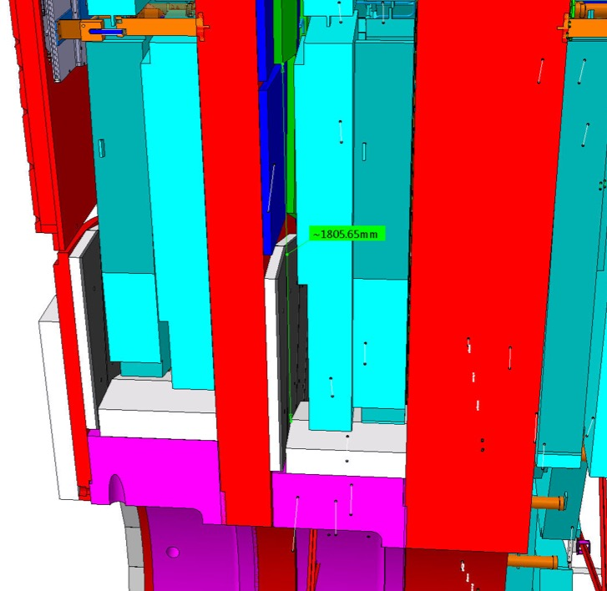
Envelope
RE4/1
RE3/1
Establish 3D model outer limits, namely touching
neighbouring elements , CSCs etc.
Cut back in order to provide agreed
clearances wrt neighbours.
Evolve basic chamber
Measure the distances with CMS closed
with B= 1 & 0. Basically confirm the 14mm between yokes. There are numerous interesting solutions to look for this important detail.

Slide 4
Proposed outer limits to go to IO this week
Lena Voevodina

Slide 5
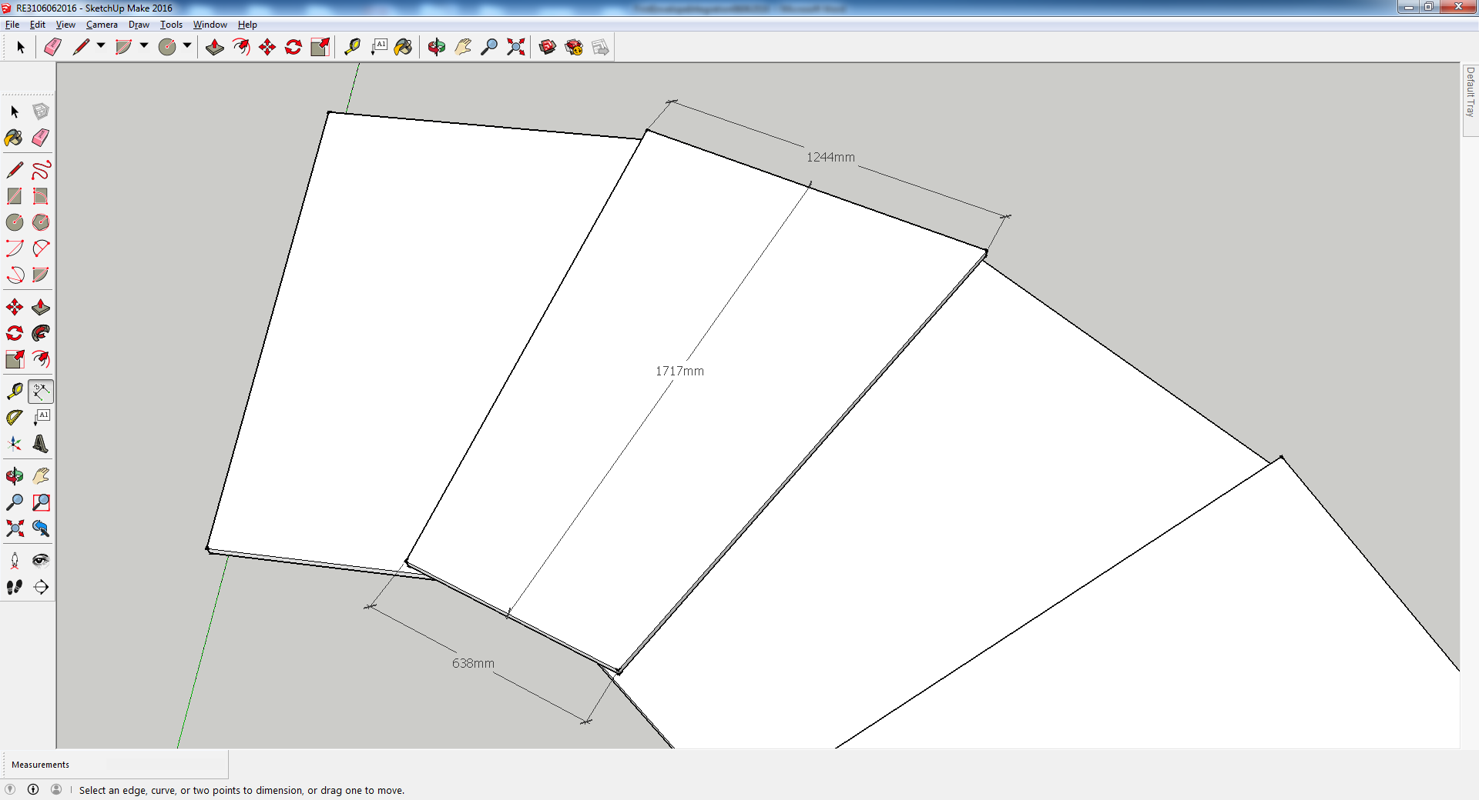
Installation model for P5
Make at P5 WS a wooden or light weight (10kg) case for verifying P5 envelope, study mounting and installation scenarios.
Modify detailed schematic using input
from above, there will be detailed changes.
If this can be done it is either during
Xmas break or 1 week April 2017

Slide 6
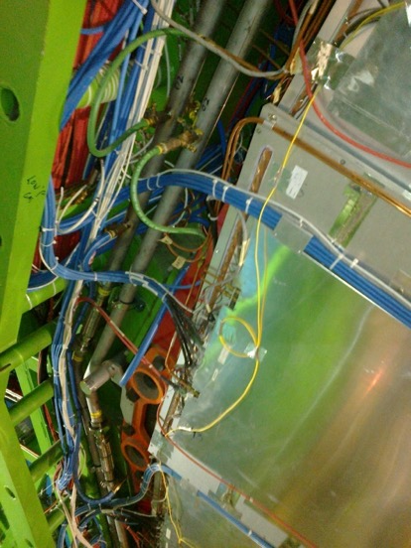
Detailed schematic
Integrate the basic chamber to the surroundings
  Mounting schematic for both RE3 & 4
  Cooling and gas up to external periphery ( Obtain input form CMS cooling & gas
  Cable paths to rack space.
  This is a big job
  Followed by detailed prototype

Slide 7
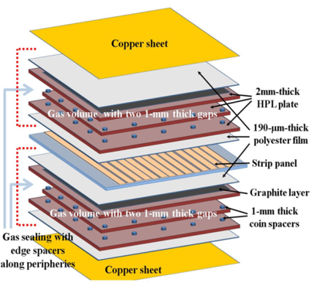
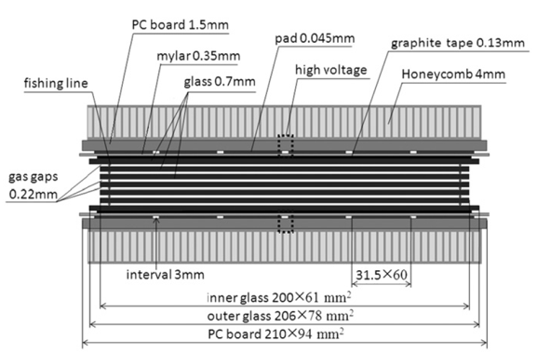
Chamber design for the different technology
Obtain basic layout info from China, Lyon and Korea
With collaboration of external institutes come up with a design . This is an iterative process.
Propose basic internal design, for the different designs if time permits, to verify validity of these basic assumptions on layout HV and Gas

Slide 8
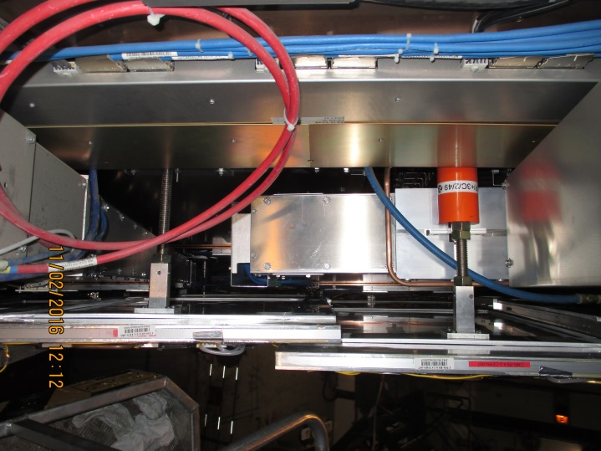
Mounting design for RE4/1
The inner radius is simple as the inner CSC mounts are there and available.
The outer radius is more sophisticated as
the mounting post is behind the RE4 SM.
There are basically 2 options
either assemble a platform on which
the chambers can be mounted.
OR
mount directly to the mounting posts.

Slide 9
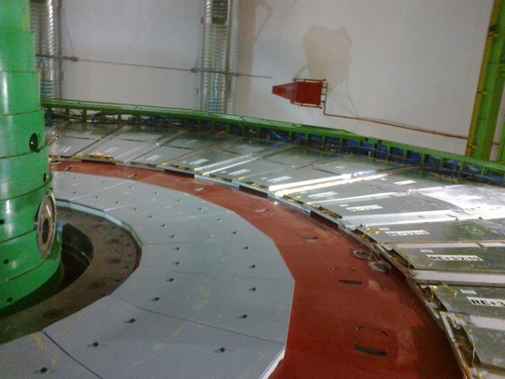
Mounting design for RE3/1
The present mounting points (M12 threaded holes) are for the low Eta coverage..
These points (x4) could be used for
a chamber going to high eta.
The question will be to mount
“over” the shielding.
The access to the FE should be
with no chamber removal.
CSC alignment system use has to be understood.
High Eta
Low Eta

Slide 10
Time line
We need the basic envelope asap. October 2016
Installation model to verify interferences etc inside CMS. Dec 2016
Design of services off the chamber to the Perpherey. Basic calculations and schematics. March 2017.
Detailed prototype first design June 2017
Build mechanical prototype. June 2017
Mounting design and prototype in 904 Aug 2017

Slide 11
Conclusion
There is a lot of work to be completed.
Integration of the two stations is quite different.
The sooner we can converge on a technology the easier will be the design work.
Collaboration with IO started well, has slowed over the summer.
Man power, time line to be developed

