Slide 1



CMS iRPC - RE3/1 Detector Design & Integration
Elena Voevodina
on behalf of RPC group
PhD Student - Department of Physics,
University of Napoli & INFN Napoli
CERN, 24/01/2019

Slide 2
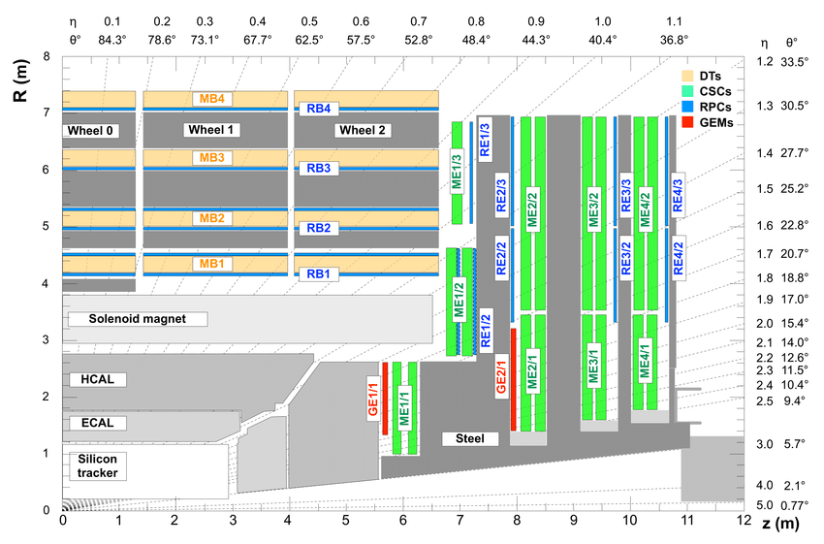
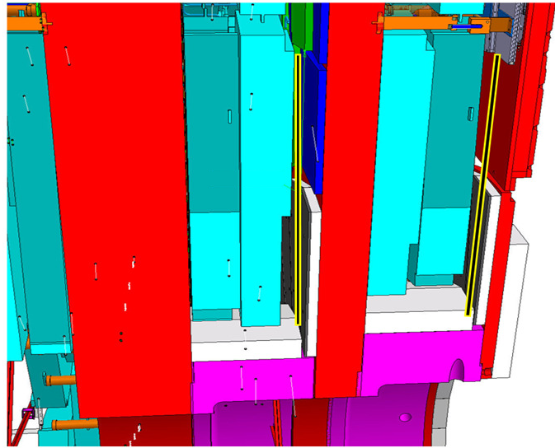

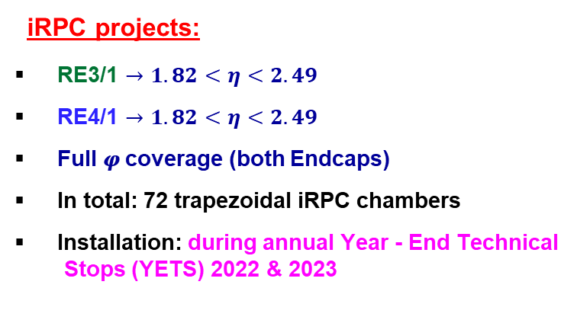
CMS - Improved Resistive Plate Chamber
RPC Endcap Ring $3 (4)$ Station $1$
Barrel Region
Endcap Region
The new iRPC - RE3/1 and RE4/1 stations will increase the overall robustness of the CMS Muon System.
RE3/1
RE4/1
iRPC projects:
RE3/1 $→1.82<η<2.49$
RE4/1 $→1.82<η<2.49$
Full 𝝋 coverage (both Endcaps)
In total: 72 trapezoidal iRPC chambers
Installation: during annual Year - End Technical
Stops (YETS) 2022 & 2023
24/01/2019
2

Slide 3
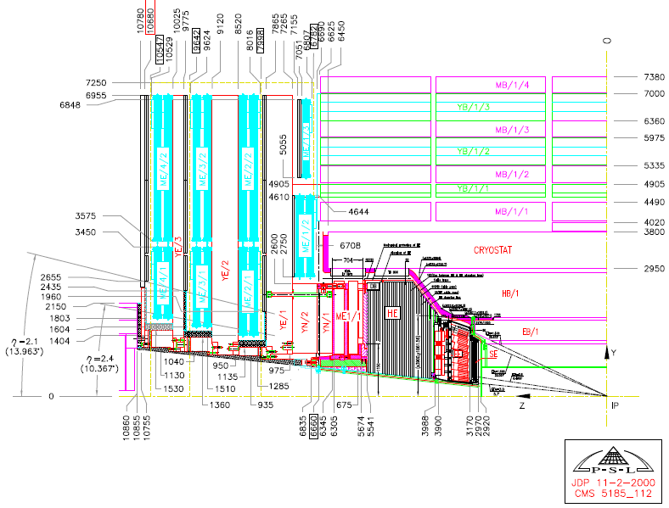
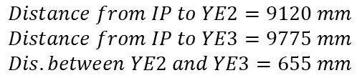


Position of the RE3/1 station
At a distance of around 9775 mm from the interaction point RE3/1 chambers will be located
RE3/1 chamber will be installed in the available space between YE3 and CSC ME3/1 chambers
$$Distance from IP to YE2=9120 mm$$
$$Distance from IP to YE3=9775 mm$$
$$Dis. between YE2 and YE3=655 mm$$
Y-axis
$$η$$
Radius
$$φ$$
RE3/1 chambers
Z-axis
X-axis
Y-axis
Interaction
Point (IP)
Beam line
Z-axis
3
24/01/2019

Slide 4
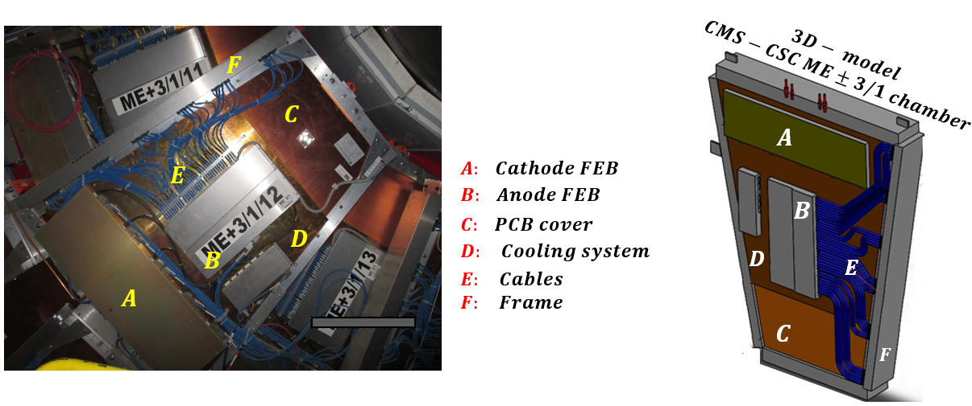
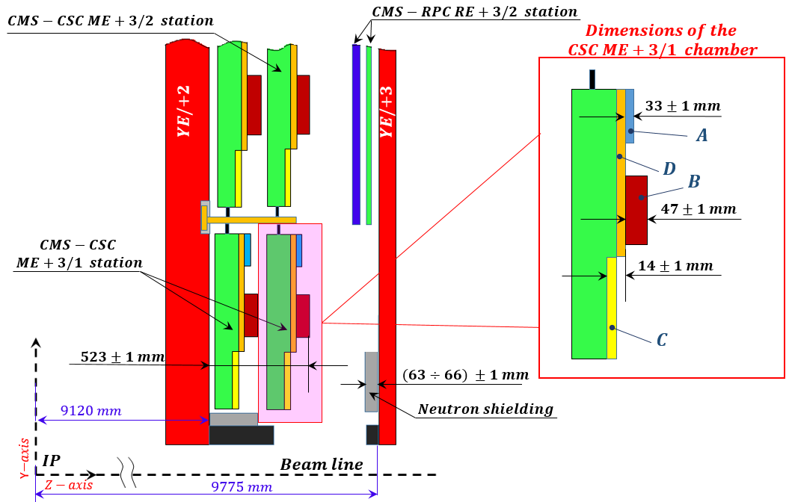
Available space for RE3/1 chambers
The available space for the iRPC RE3/1 chambers is essentially determined by the thickness of the CSC Anode Front- End Board (element labelled to as B) on the YE±2 iron disks and the thickness of the neutron shielding on the YE±3 iron disks.
Important, to take into account the different topology of CSC ME3/1 chamber surface.
Available space
4
24/01/2019

Slide 5
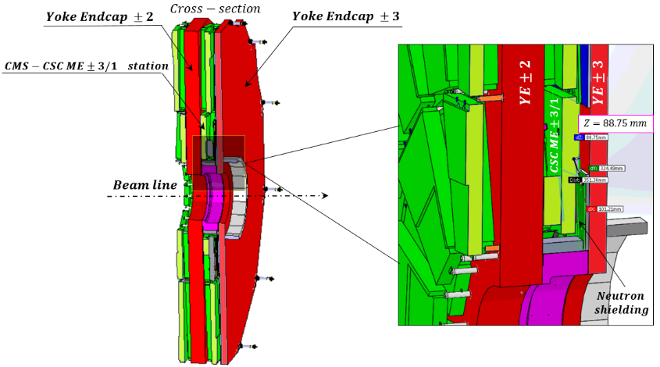
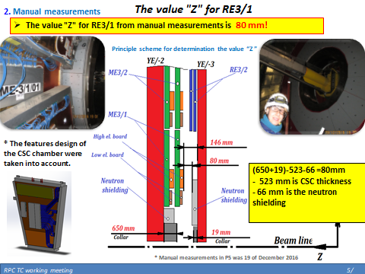
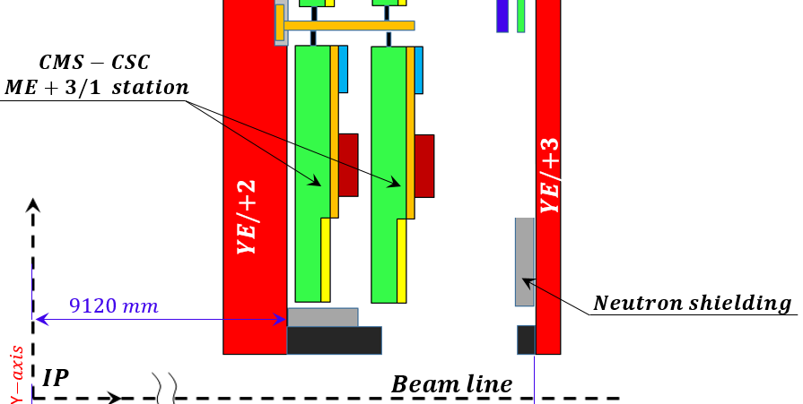
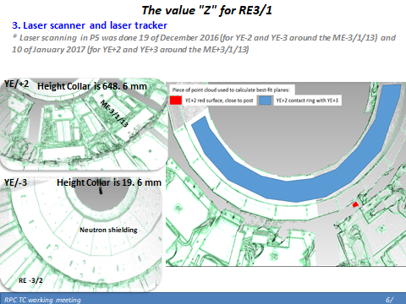
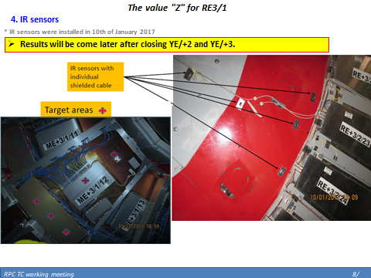
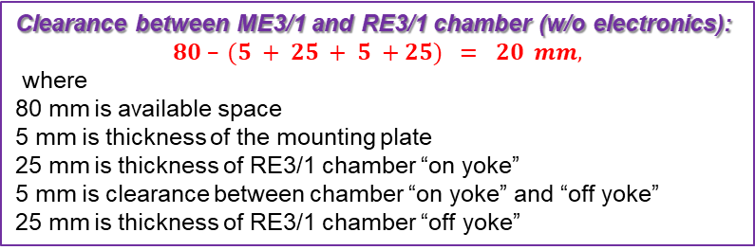
Available space for RE3/1 chambers
Four methods to determine the value "Z" for RE3/1
Main drawing of the CMS;
Manual measurements;
Laser scanner and laser tracker;
IR - sensors.
Result:
around 80 – 83 mm
around 80 – 83 mm
Clearance between ME3/1 and RE3/1 chamber (w/o electronics):
$$80 – (5 + 25 + 5 +25) = 20 mm,$$
where
80 mm is available space
5 mm is thickness of the mounting plate
25 mm is thickness of RE3/1 chamber “on yoke”
5 mm is clearance between chamber “on yoke” and “off yoke”
25 mm is thickness of RE3/1 chamber “off yoke”
24/01/2019
5

Slide 6
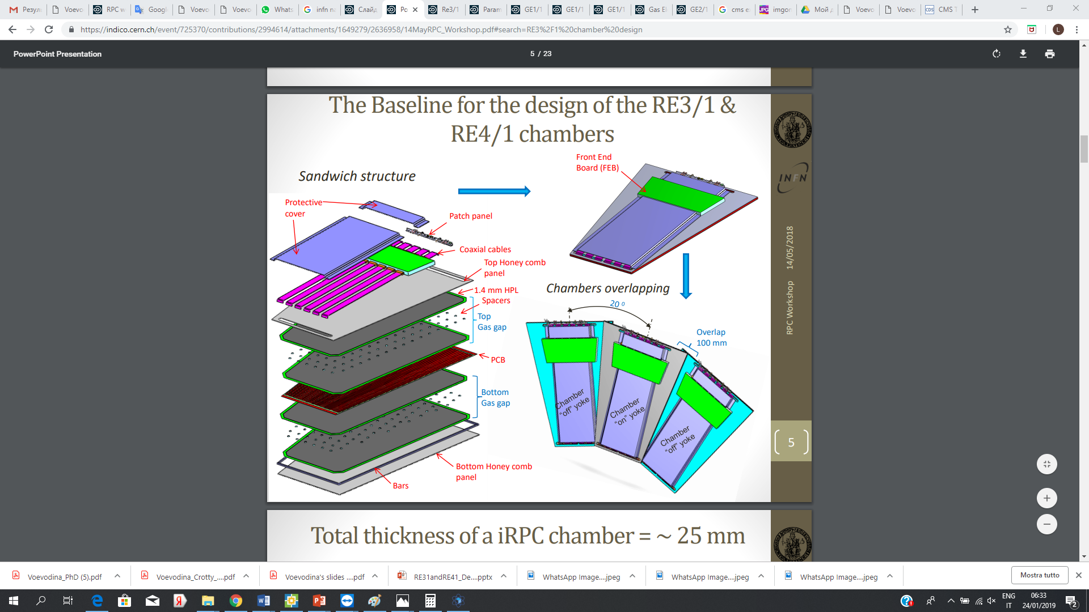
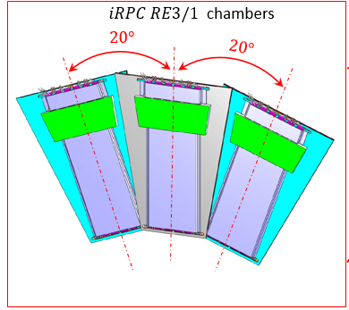
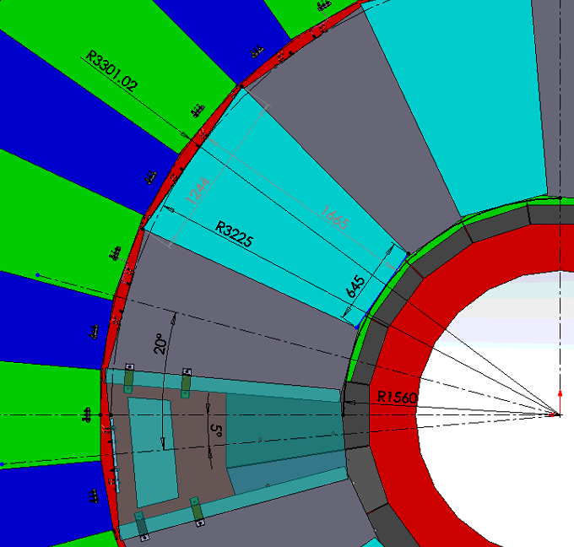
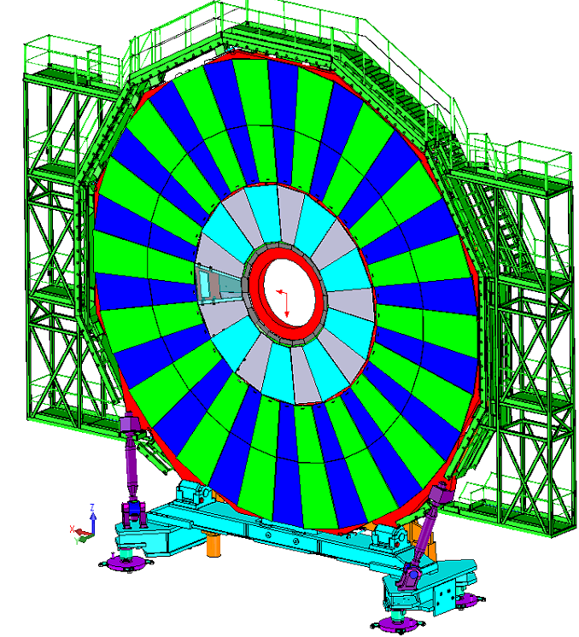
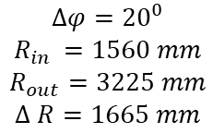
Orientation RE3/1 chambers on the Ring
RE3/1
“off yoke”
RE3/1
“on yoke”
RE3/2
“on yoke”
Y-axis
YE3
YE3
X-axis
RE3/1
RE3/2
$$Δφ={20}^{0}$$
$$R_{in }=1560 mm$$
$$R_{out}=3225 mm$$
$$Δ R=1665 mm$$
RE3/3
24/01/2019
6

Slide 7
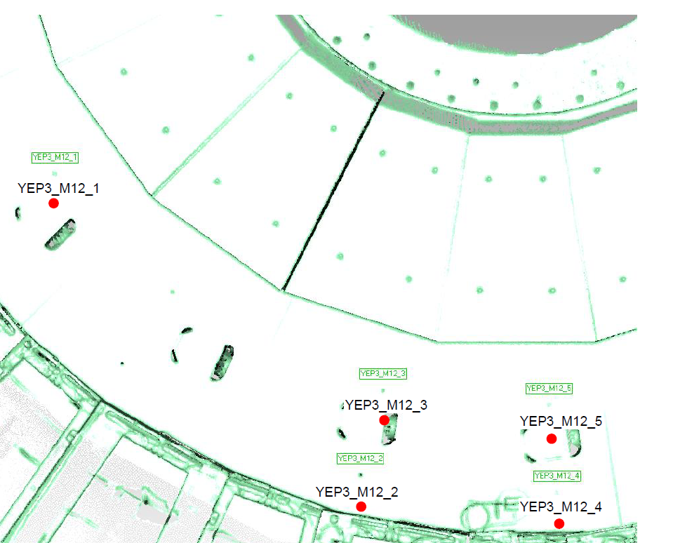
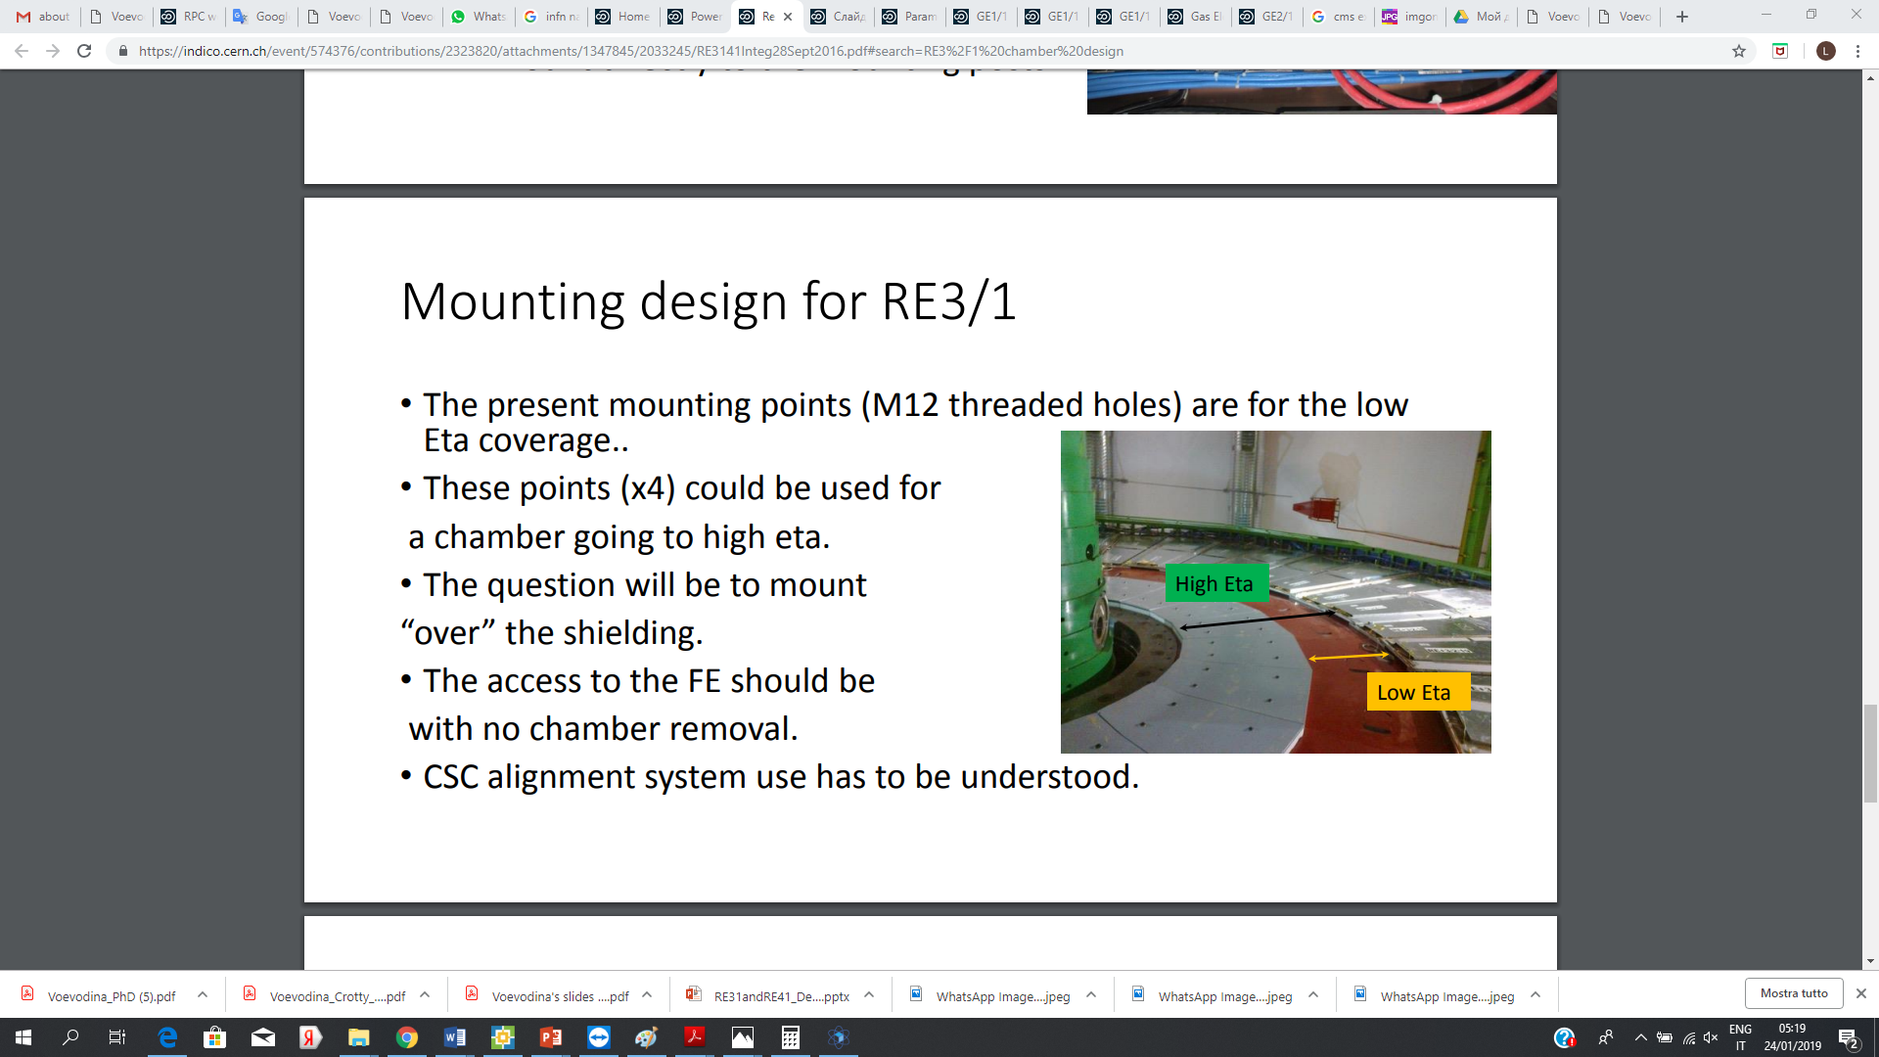
Mounting post for RE31 chambers
RE3/1 chambers will be installed directly on the endcap YE3, using the foreseen mounting posts (M12) threaded into the yoke steel.
RE3/1 chambers will cover the circular neutron shielding attached to the inner part of YE3
Neutron shielding
Mounting post of the neutron shielding can be problem to mount the RE3/1 chamber on the shielding surface due to the cylindrical heads of mounting screws protrude outwards.
RE3/2 station
The screws and washers securing the neutron shielding should be modified.
24/01/2019
7

Slide 8
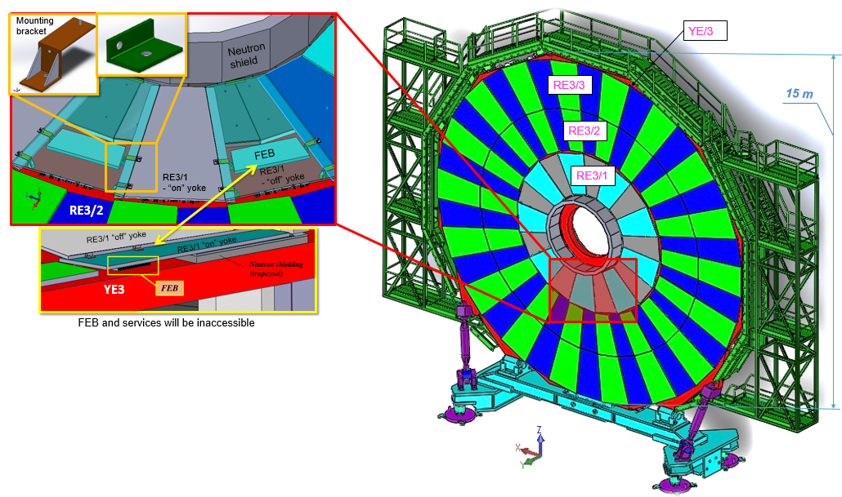
Mounting post for RE31 chambers
Cylindrical neutron shielding on YE2 (opposite YE3)
Mounting on the Yoke Endcap 3 iron disk using the simplified kinematic mounts such as mounting “L” and "Z" brackets.
Due to the space limitation between YE2 and YE3, the electronics and cooling system will be the hidden.
8

Slide 9
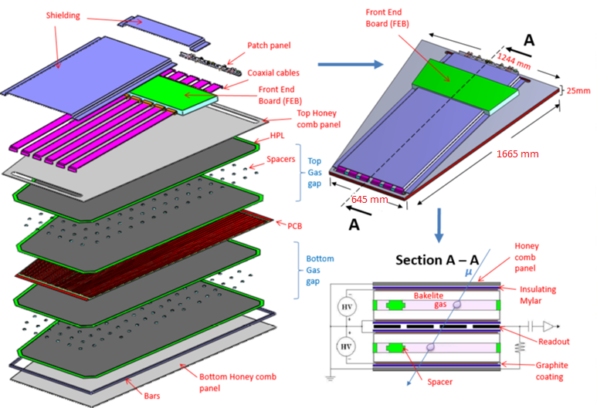
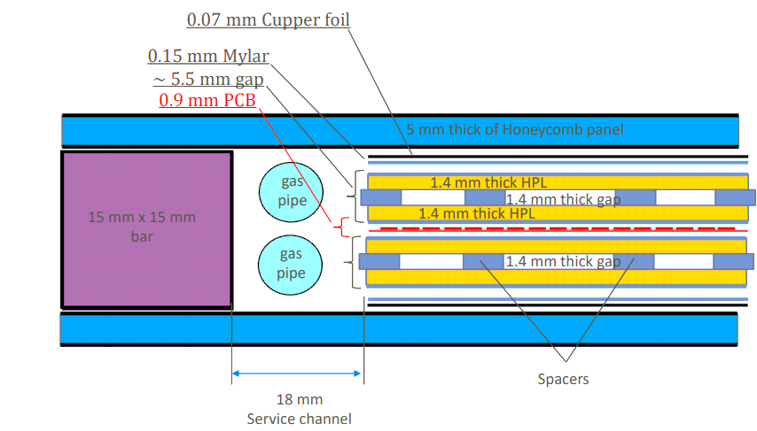
The Baseline for the RE3/1 Chamber Design
Cross section A-A
Service channel

Slide 10
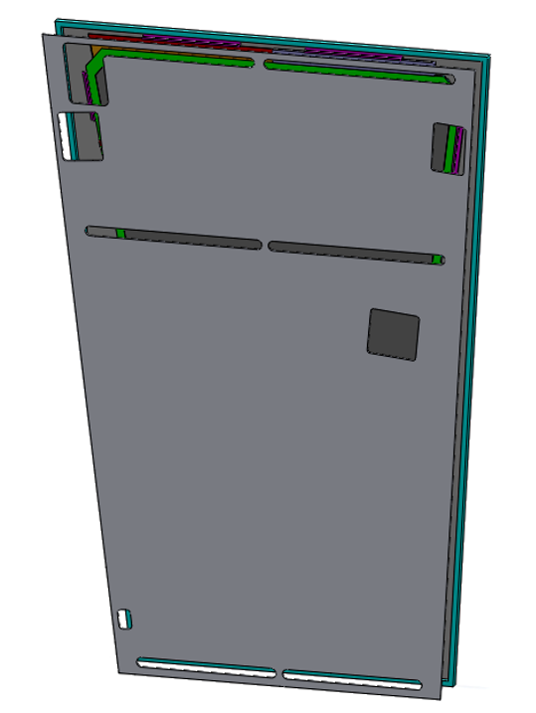
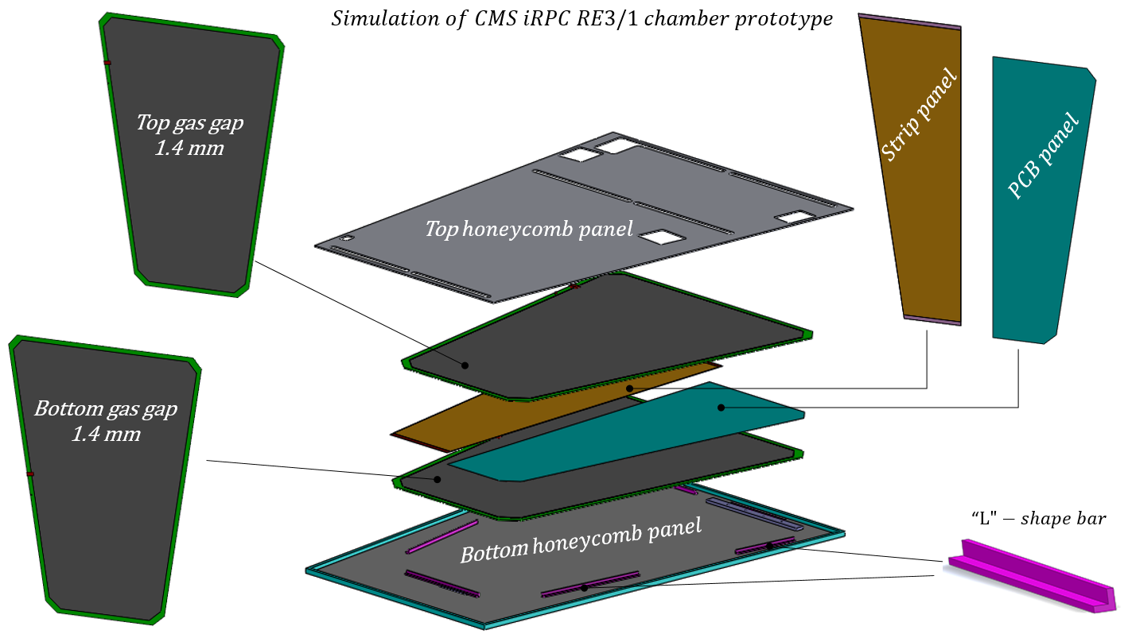
iRPC- RE3/1 Detector Prototype Simulation

Slide 11
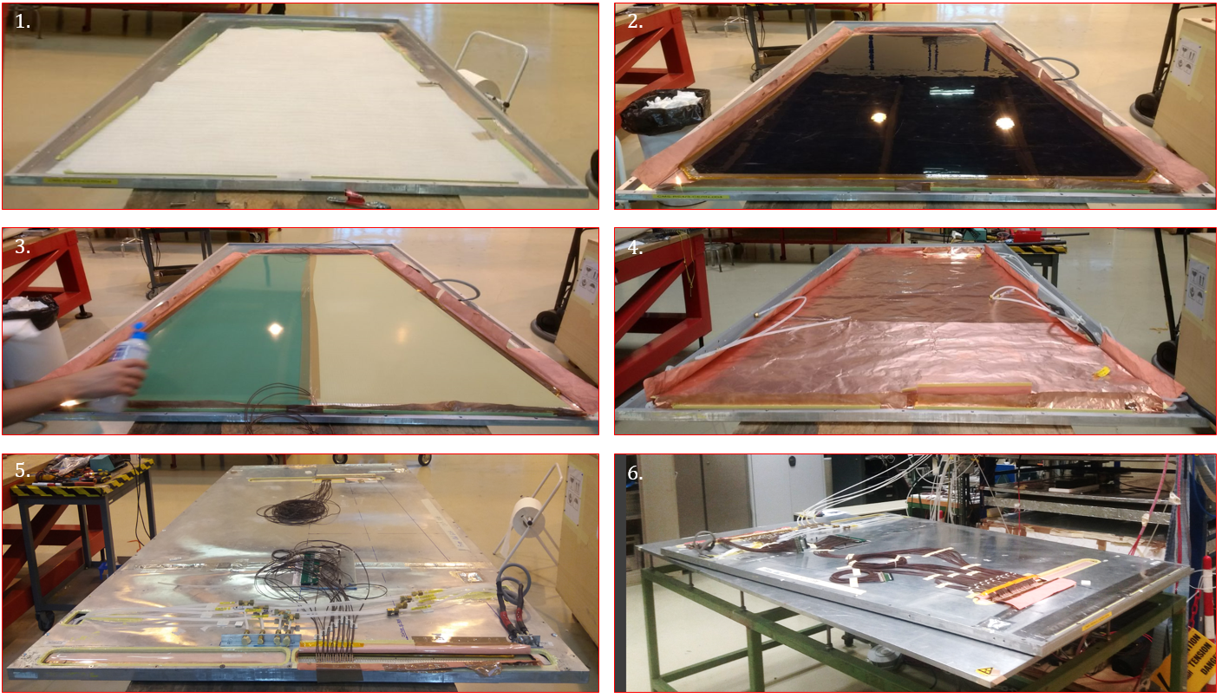
iRPC- RE3/1 Detector Prototype Assembly
Gas Gap
Fake Strip panel
Strip panel
Faraday cage

