Slide 1
RE3/1 & RE4/1 Parameter Space
Services
Ian Crotty
12 Feb 2014

Slide 2
CMS Parameter drawing

Slide 3
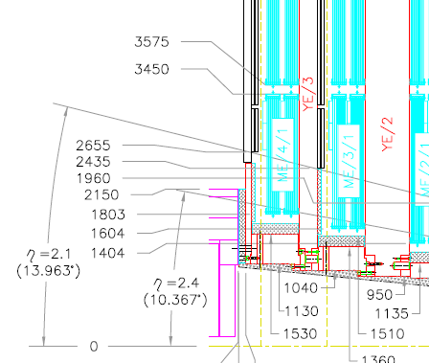
RE4/1 & RE3/1
As planned high Eta up to 2.1.
Extending to Extra High Eta
= 2.4 or 2.5

Slide 4
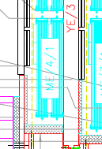
Boundries on Extra High Eta
Alignment lines
RE4/1
ETA=2.1
RE3/1
Neutron Shielding on Vertical faces of yoke
Cylindrical Neutron Shielding

Slide 5
Dimensions as per our Parameter Book
Geometrical Layout and Mechanical details of CMS
End Cap RPCs
(Version:November, 2002)
B
Ri
D
Station | Ri | Ro | A | B | C | D | Thickness | Z Position rpc Z of cu-strips
Ro
RE2/1 | 1960 | 3241 | 1301 | 1251 | 799 | 1281 | 36 | 7865-7902 7883 –7920*
RE2/2 | 3299 | 4986 | 1693 | 979 | 684 | 1687 | 36 | 7865-7902
RE2/3 | 5001 | 6955 | 1961 | 1323 | 981 | 1954 | 36 | 7865-7902
RE3/1\ Eta=2.4 | 2435 | 3241 | 819 | 1251 1251 | 966 | 806 1623 | 36 | 9775-9738 9757-9720*
RE3/2 | 3299 | 4986 | 1693 | 979 | 684 | 1687 | 36 | 9775-9738
RE3/3 | 5001 | 6955 | 1961 | 1323 | 981 | 1954 | 36 | 9775-9738
RE4/1 Eta=2.4 | 2655 | 3241 | 595 | 1251 1251 | 1044 | 586 1436 | 36 | 10676-10639 10654-10621*
RE4/2 | 3299 | 4986 | 1693 | 979 | 684 | 1687 | 36 | 10676-10639
RE4/3 | 5001 | 6955 | 1961 | 1323 | 981 | 1954 | 36 | 10676-10639
20 deg Sectors
20 deg Sectors

Slide 6
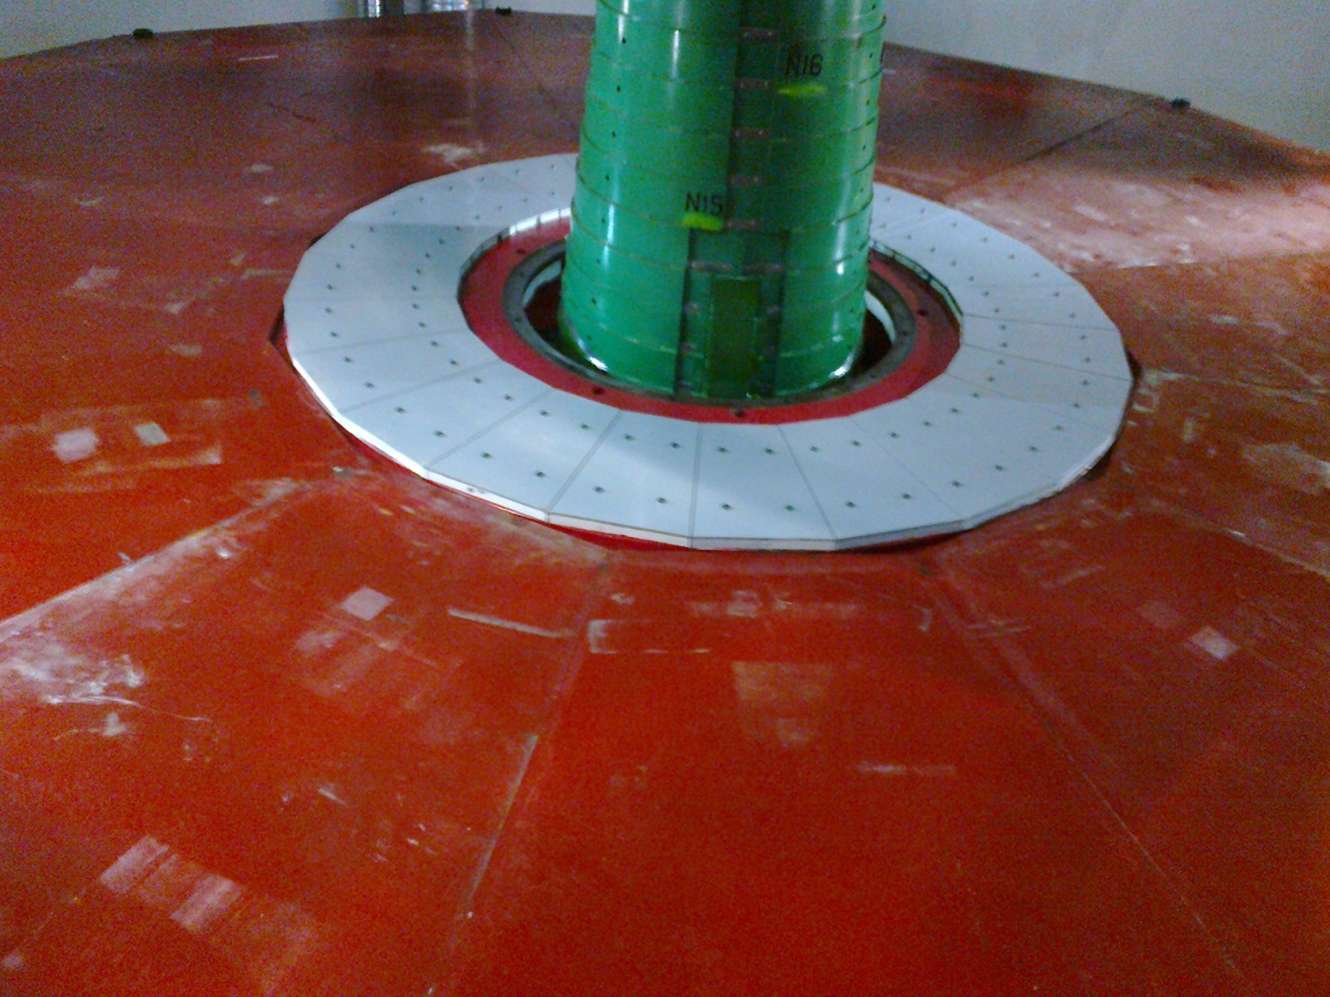
The easy solution
A flat wall YE4 to mount to
However there are no services, Gas, Rack space, Mini Cable Chains etc available on YE4. Taking services there from YE3 would require disconnects or new Mini cable chains. The former is not CMS policy.

Slide 7
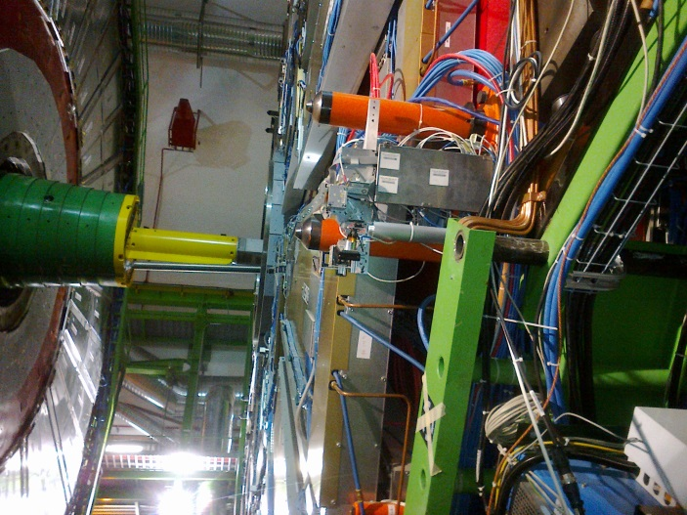
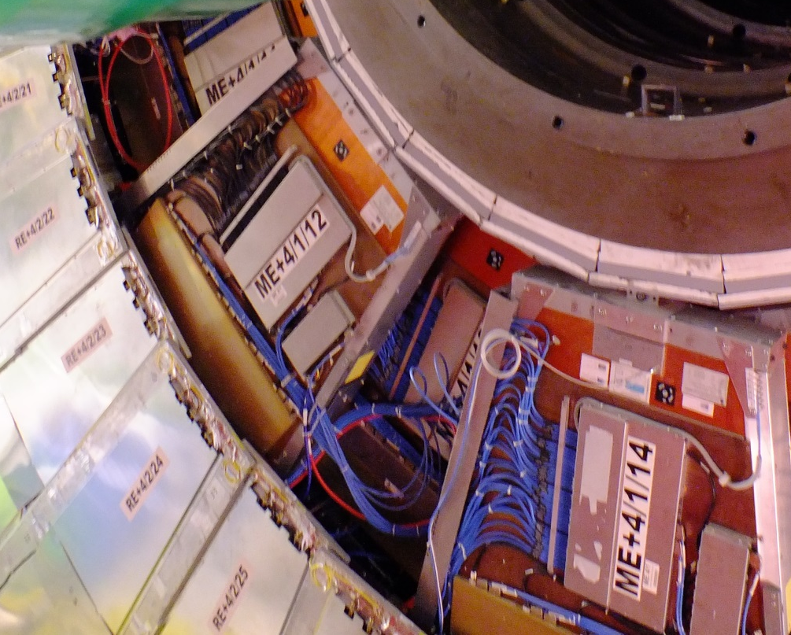
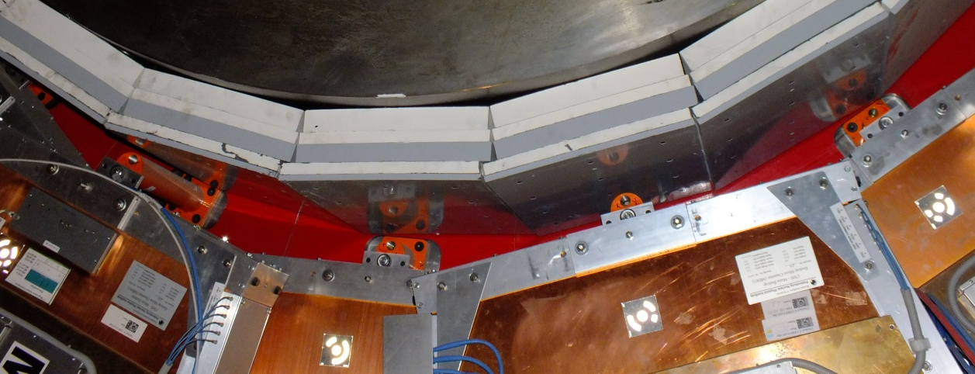
Mounting RE4/1
Outer radius mounting posts are hidden behind RE4SM
Alignment system has gone giving space ~60mm in Z
Inner radius mounts M24 every 20deg
Require a technically smart solution to fix the outer radius

Slide 8
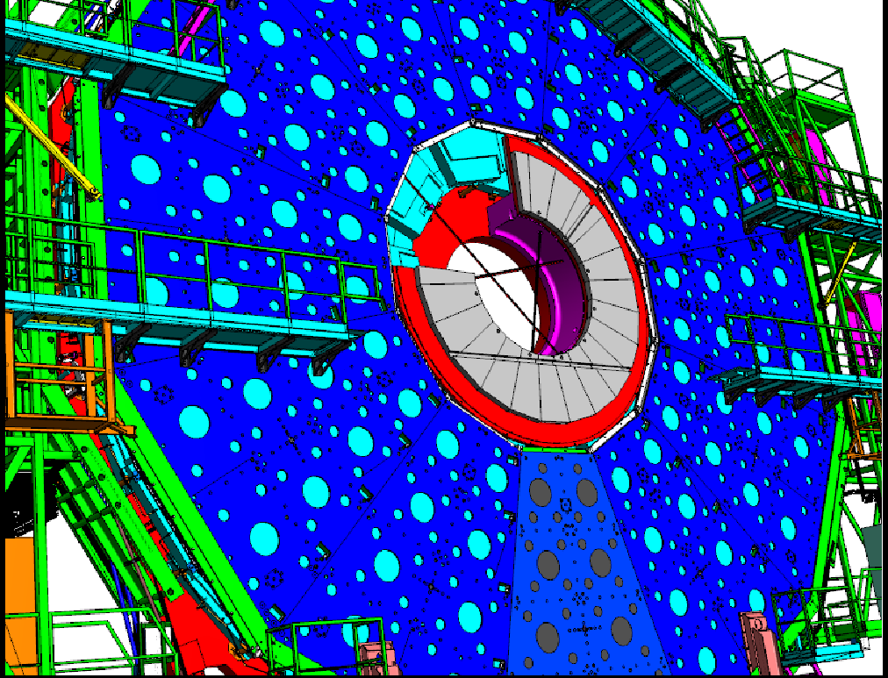

Slide 9
Mounting Posts

Slide 10
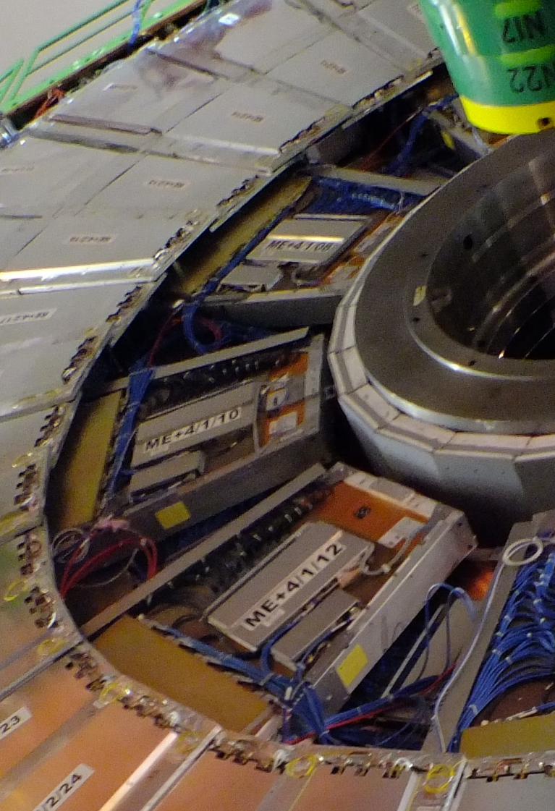
Access to Periphery
Lead cables and pipes over the top of the RPCs,
OR
Under them where the space was for the alignment system .

Slide 11
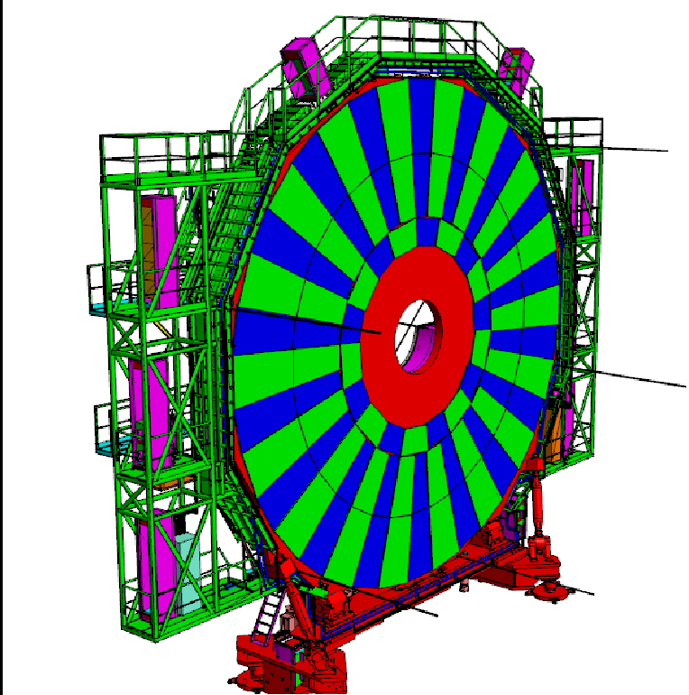
RE3/1

Slide 12
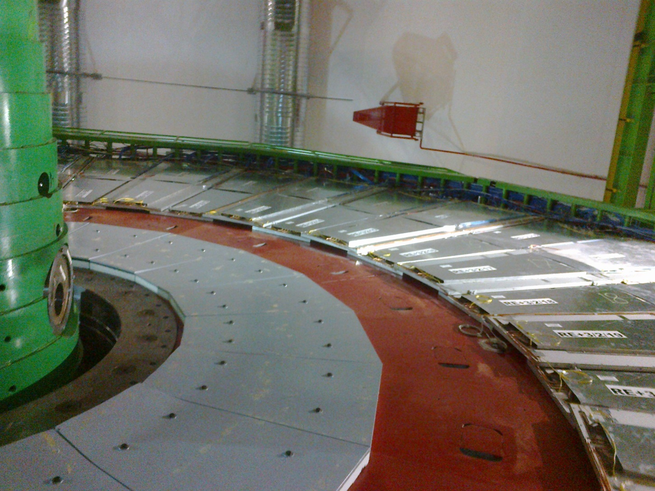
RE3/1 High Eta & Extra High Eta
RE3/1 Eta = 2.4
RE3/1 Eta=2.1

Slide 13
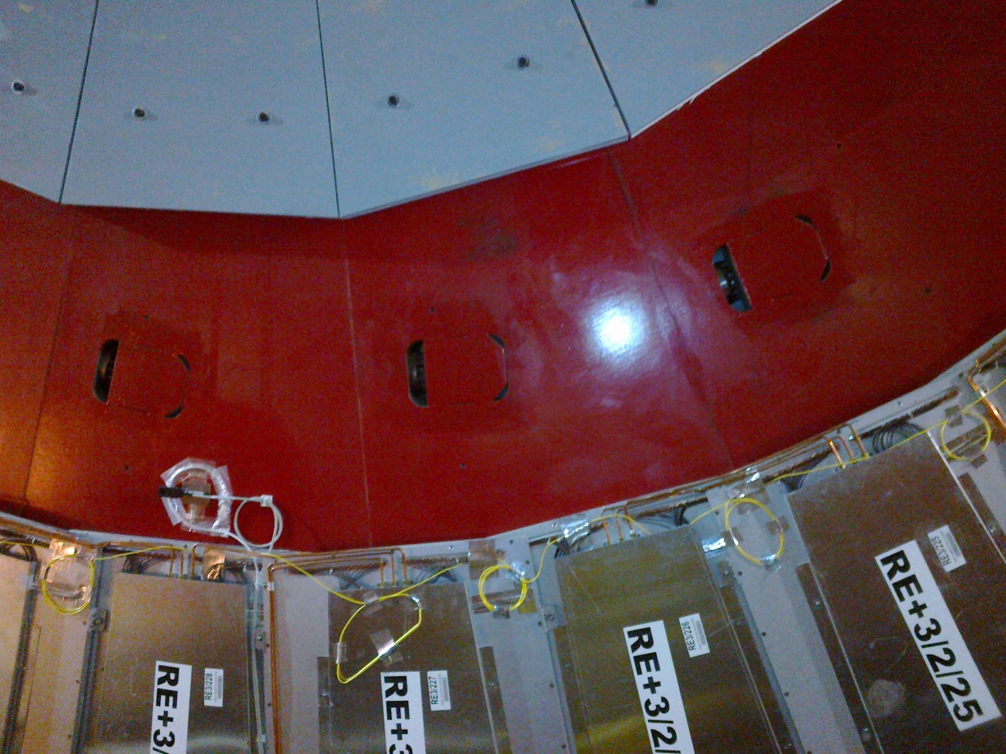
Mounting RE3/1
M12 Mounting Holes for 20deg Chambers

Slide 14
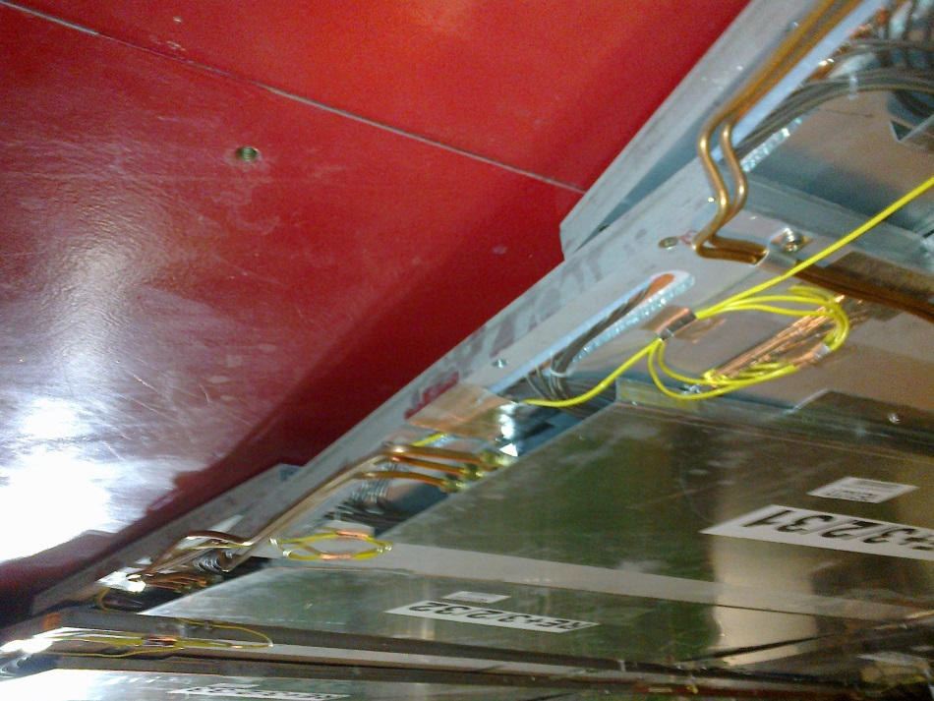
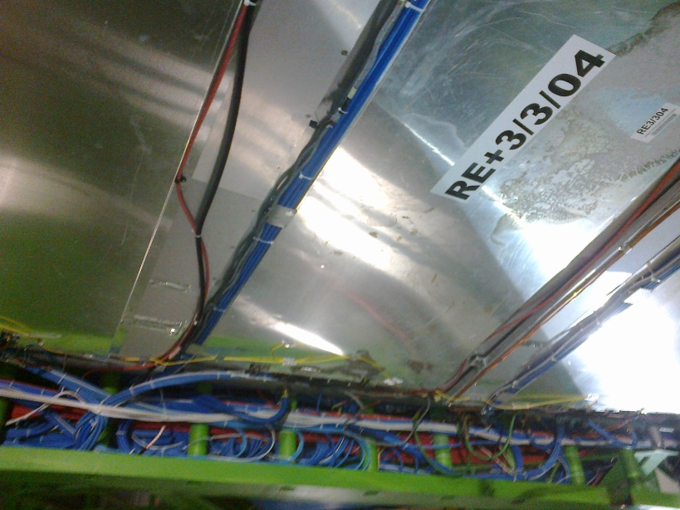
Access to Periphery
Over the top of the RPCs
Under the RE3/2 & RE3/3

Slide 15
Services
Gas rack(s)
Cooling, capacity of YE3 Manifold
Rack (LV , LBC
Cables (HV, LV Signal dcs
Access to Periphery (Green Structure)
Space in Main & Mini Cable Chains

Slide 16
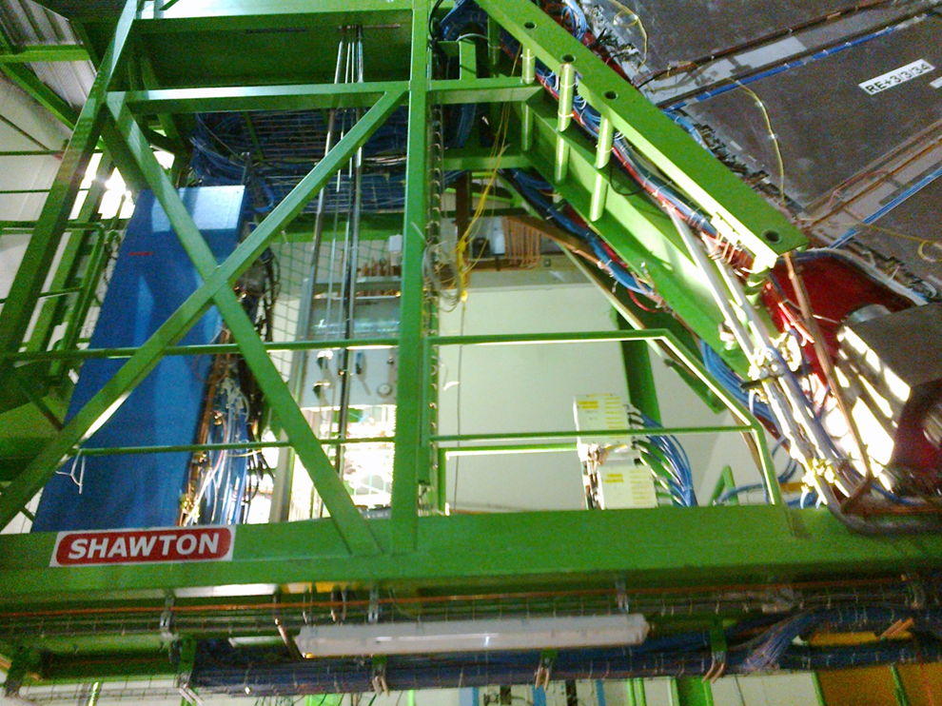
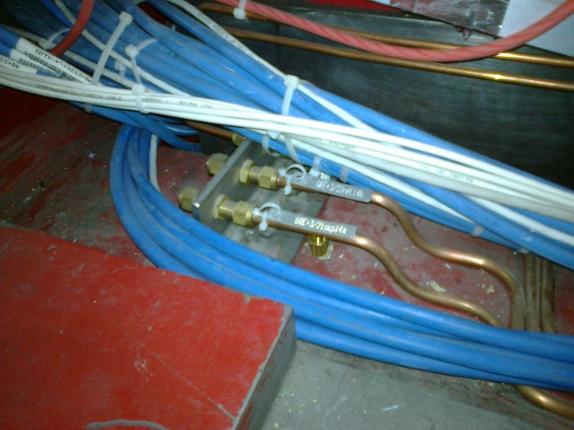
Gas rack space available on Near of YE3 suitable for both RE3/1 & 4/1 ?

Slide 17
Conclusion
The mounting of RE4/1 is tricky
The rack space for both RE4/1 & RE3/1 on the same yoke (YE3) will be difficult
Exact volumes for High ets & Extra High eta to be established with Integration 904
Iteration of chamber design and boundary conditions in P5
This doc and others are visible at;
http://project-cms-rpc-endcap.web.cern.ch/project-cms-rpc-endcap/rpc/UpscopeHighEta/Parameters/HighEtaParaSpaceRPCsIanFeb2014.pptx

Slide 18
Supplementary slides
RE2/1

Slide 19
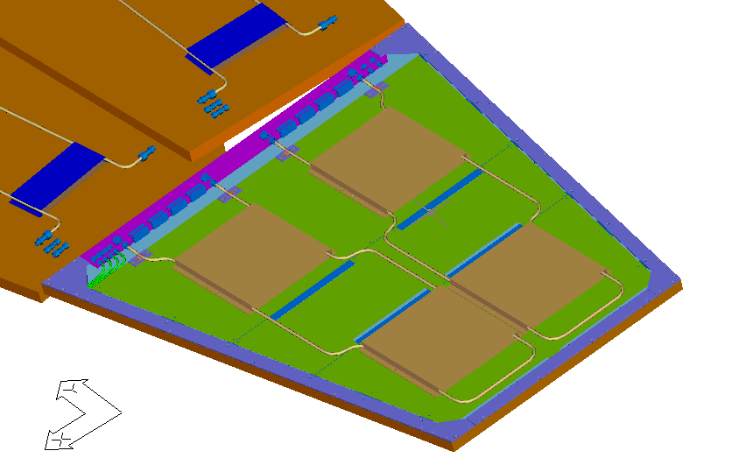
RE2/1 and its Cooling

Slide 20
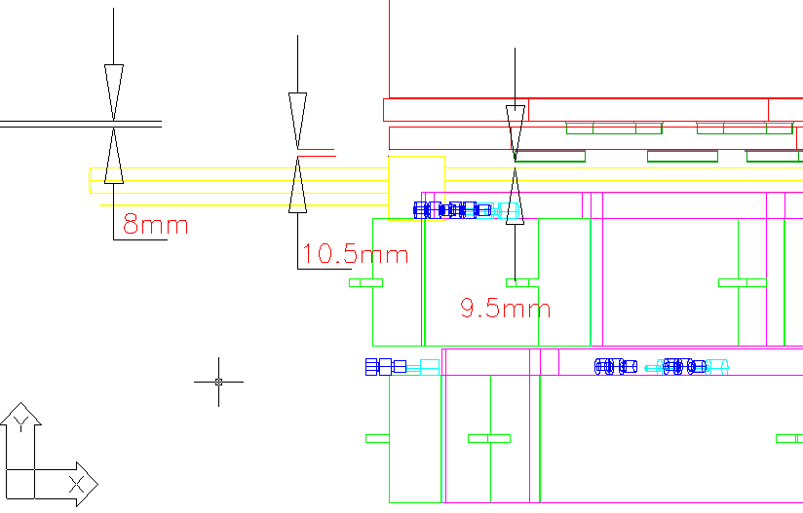
X Section of CSC-RPC interface

Slide 21
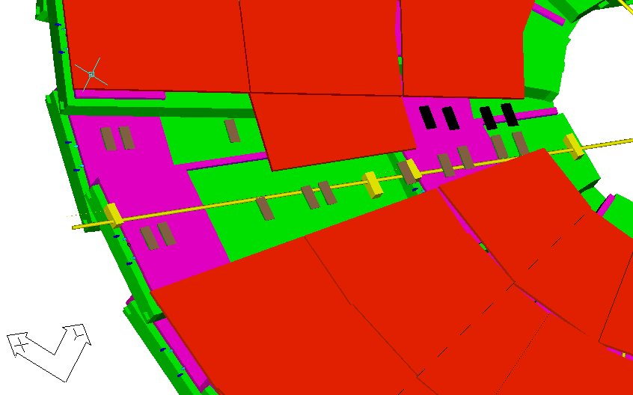
Alignment path

Slide 22
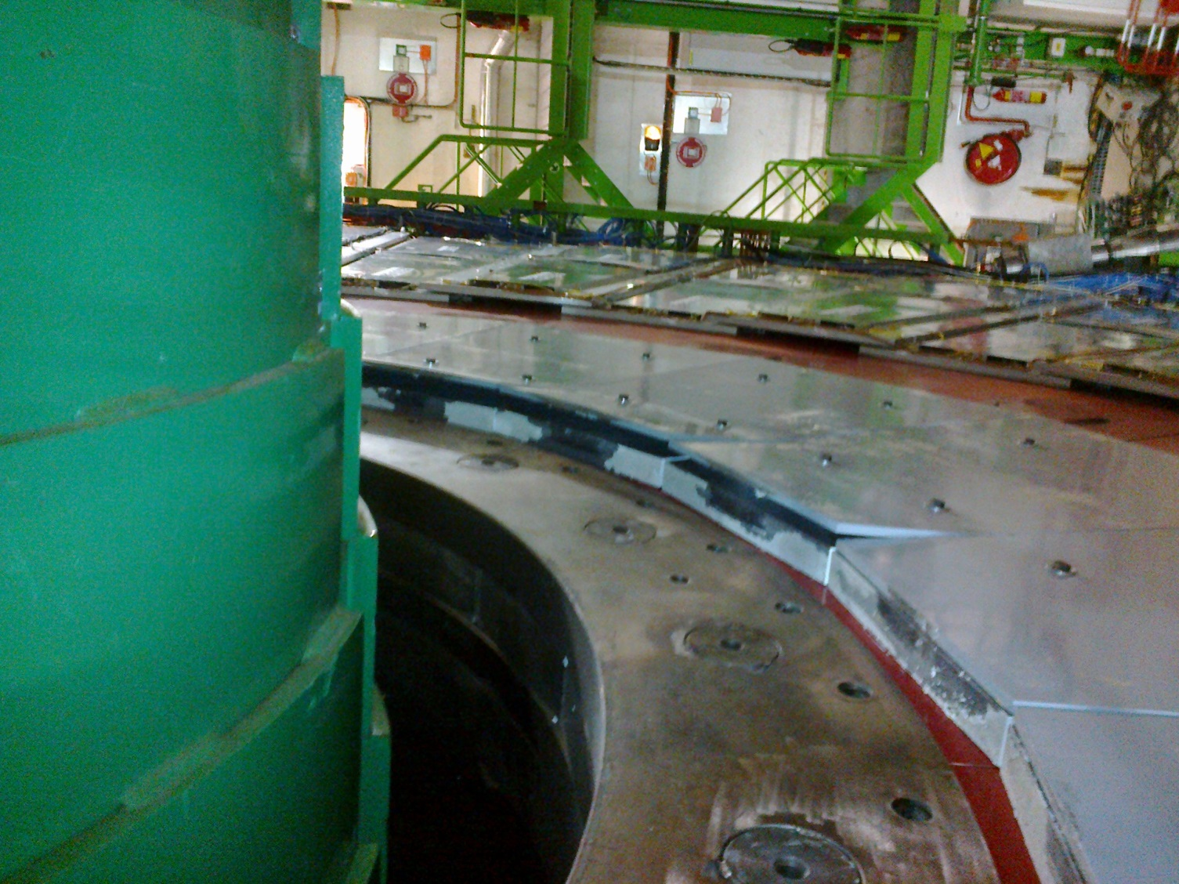
Damage to shielding during separation of YE3 & YE2. The new Extra high eta (2.4) should not suffer the same damage !

