Slide 1
GEM Mock-up in 904
Saleh Muhammad
Ian Crotty

Slide 2
Outlines
Super Chamber Patch Panel
GEM Mock-up structure idea
Objectives
Requirements List we are working

Slide 3
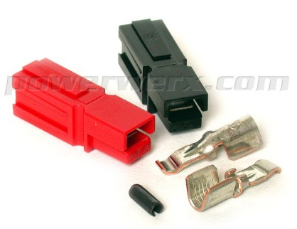
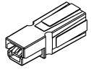

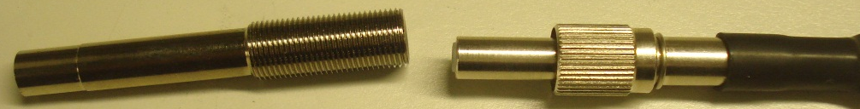
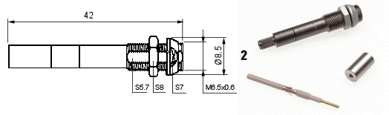
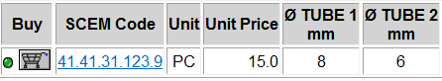
Patch Panel Design
High Voltage (Ian and Saleh)
Low Voltage (Ian and Saleh)
Gas (Ian and Saleh)
Coolant (Antonio, Plamen and Georgi)
Optical readout connector (Yifan Yang)
Alignment (Zoltan)
G
O.F
LV
O.F
O.F
O.F
O.F
G
C
O.H.P
H
A
C
LV
LV. APP 45
H
HV. Jupiter Connector
G

Slide 4


GEM Mock-up Structural Idea
• 40°
• 4 super chambers
• 8 chambers total
1,2,35,36

Slide 5
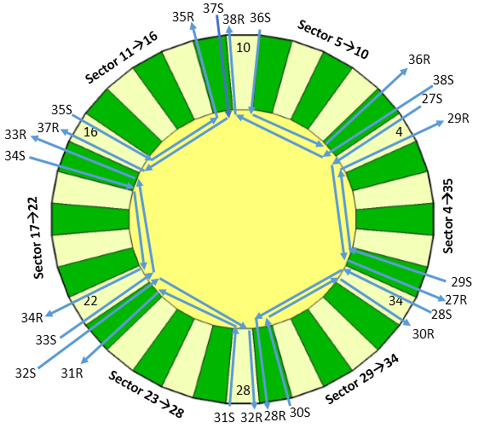
Objectives
Finalization of the Patch Panel
Gas circulation studies in sector.
Coolant prototype
Cables and pipes routing
For gas impedance measurement a real GEM with all stuff inside is requested to BRIAN, he has two GE1/1-3. He is agreed to provide it for this test.

