Slide 1
GE1/1 – LV Powering
Andrey Marinov
On behalf of CMS GEM collaboration

Slide 2
Introduction
VFAT3 ASIC
GEB
Opto-hybrid
GBT
TTC
TTC
Opto links
DCS
uTCA
uTCA
DCS
DAQ
DAQ
Muon TF
Backend electronics
Paul & Gilles

Slide 3
Segmentation?
Powering the GE1/1 Super-chamber with one LV channel is not the best solution.
Dealing with high currents 13A 3.3V
The cable will be very big, minimum cross-section for 10m length is ~9.5mm2
In case of failure we can loose the full detector.
Is it possible to divide The GE1/1 Super-chamber to several LV zones?

Slide 4
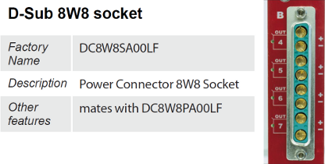
Power Supply A2517
8 independently controllable Low Voltage channels
Individual Floating Channel
Individual remote sense lines
Full Digital PID Control Loop
8 pin D-Sub connectors
1÷5 V output voltage with 10 mV set resolution
15 A current full scale with 10 mA set resolution
50 W Max channel output power
1 mV Voltage Monitor resolution
1 mA Current Monitor resolution

Slide 5
Cable
> 9.5 mm2 Cross-section
The LV cable has to be compatible with the power consumption requirements
13A, 3.3V length about 10m - from YE1 X2V33 rack to the GE1/1 installation zone.
> 4mm diameter
13A, 3.3V 10m length
The LV cable will be routed on top of the CSC detectors ME1/3, ME1/2 and has to meet the electromagnetic compatibility. Proper shielding is a must.
Custom made cable will be required. DRAKA company can be asked for quotes. Similar cable was made for the CMS Tracker.

Slide 6
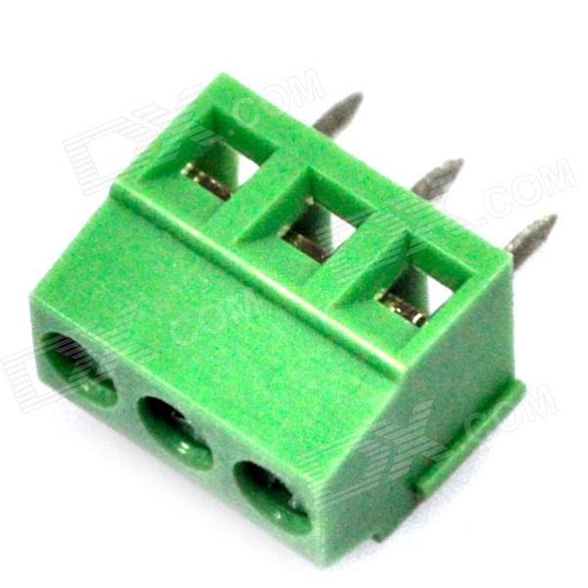
On detector Connectors - PP to GEBs
4 mm wires
GE1/1 PP connector
Cable terminals for the GEB board

Slide 7
Open Questions
Power Supply – A2517 is a brand new model from CAEN needs to be confirmed if it can be used in UXC
Magnet Tolerant
13A @ 3.3V per channel
CMS DCS compatible
Segmentation may be is a good option if possible?
Cable – I can contact DRAKA and see what they can propose as cable and confirm the time and price estimates
Connectors

