Slide 1
Installation and removal of Mock-up GE1/1
Installed 22 April 2014
Removed 3 July 2014
Ian Crotty 4 July 2014

Slide 2
Installation
The area of installation is narrow. One arm is already good. Two people in front of the problem is already a tight fit.
This position close to the “x” axis is the easiest. They were installed in positions 33,34 & 35. The more vertical planes will give significantly greater challenges.
All these different orientations must be studied in situ.
Installation of the RE1/1s was done with an extension arm (in “R”) to assist in guiding the chamber into position.
Cherry picker access does all positions with work outside the cherry picker when on top of the HE nose .

Slide 3
Insertion
Space outside of the HE nose is required, at least the length of the chamber.
Installation of the RE1/1s was done with an extension arm (in “R”) to assist in guiding the chamber into position

Slide 4
Alignment & securing to the yoke
The M12 mounting bolts can changed to an allen or Torx head.
Cutting back the threads to the core dia will ease alignment.
A short stud can be placed in the yoke so the chamber can be hung on to take the weight (25kg ?). One M12 is put in the adjacent hole and the stud removed.
25 kg is the legal max for one person.

Slide 5
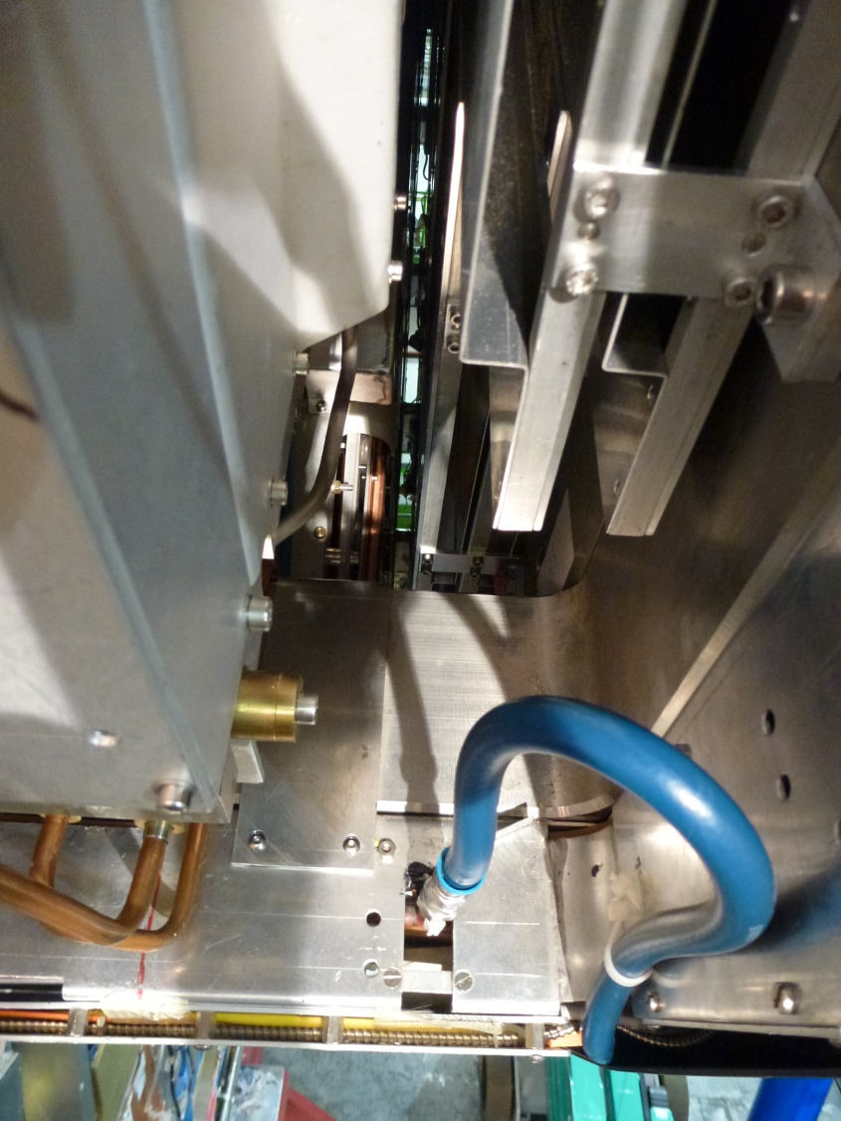
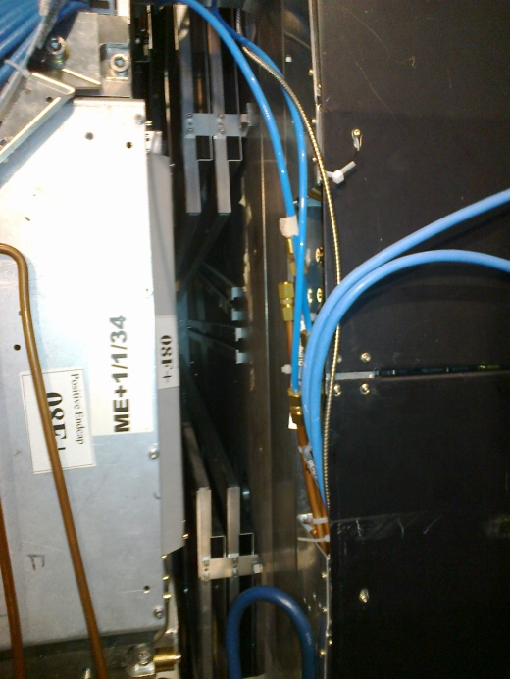
Space in Z
There is plenty of space in Z (~20mm) that could well be used to increase patch panel size and service space on the plane of the chamber. We should not restrict the design unnecessarily.
In the future we will see if more space is required.
The gas system installed for the RE1/1s will be used but will have to be cut back to reduce hindrance for installation.
We should not forget the volumes available for the RE Link Boards

Slide 6
Space in R
Space is for service connexions and access.
Under the HE brackets there is sufficient space for “flexible” services, but not for pipes and connectors that are difficult to locate in position.
At present there are cooling “flexibles” that in the way and have already lost some of their elasticity.

Slide 7
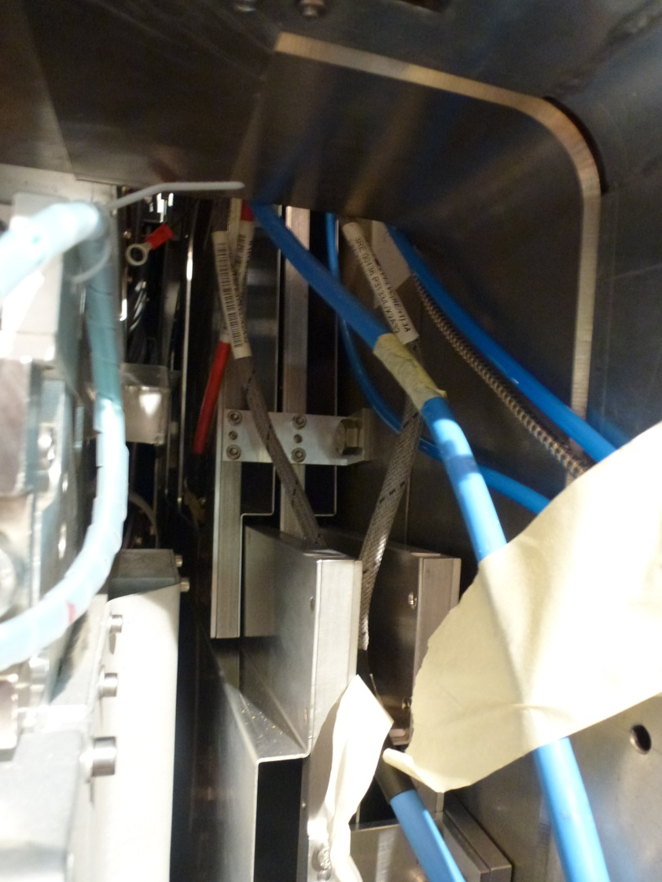
Service interference
Services, LV, HV Fibres, cooling and gas already installed must be moved out of the way for each case.
Already care must be taken with Fibres of all sub detectors
Future services that will be installed before the GEs will further complicate the areas.

Slide 8
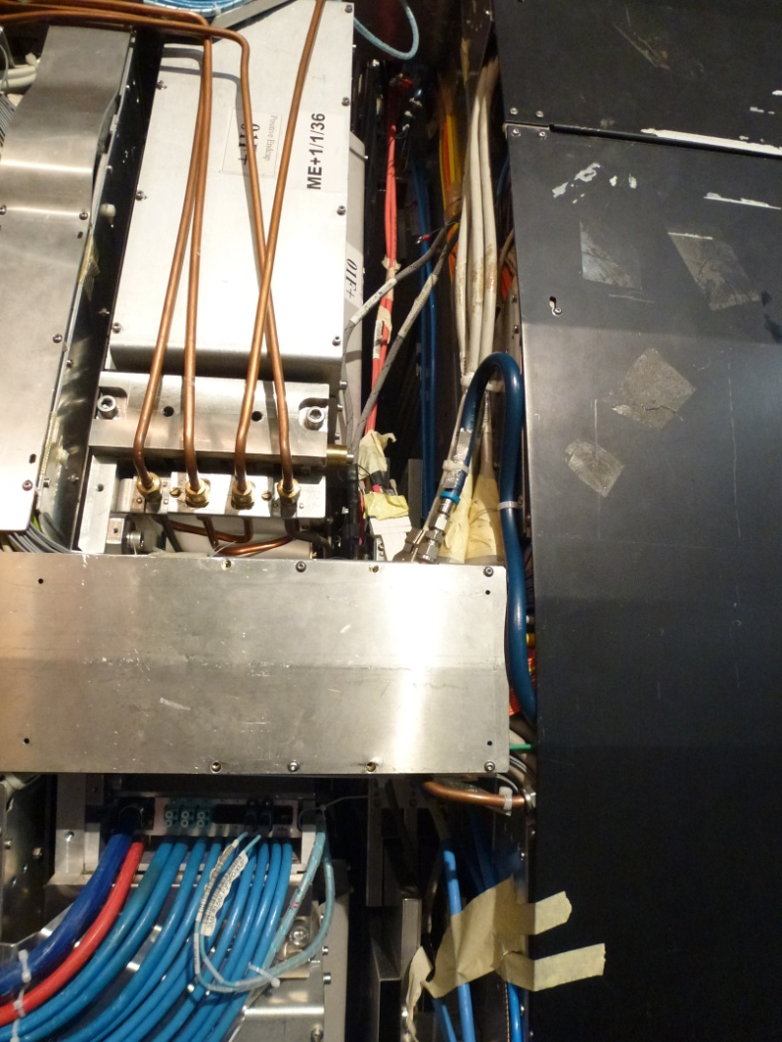
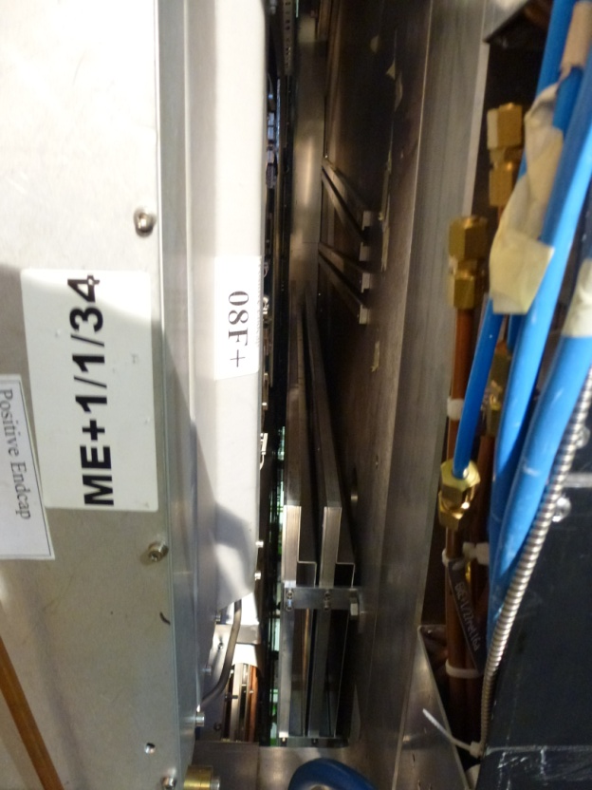
Le voisinage
ME1/1, RBX, ECAL etc have services running close by, care must be taken in all activities.
Power should go off to the ME1/1s for installation and all power and cooling to the nose when installing future services.

Slide 9
Thanks Antonio for most photos
This presentation can be found here;
http://project-cms-rpc-endcap.web.cern.ch/project-cms-rpc-endcap/rpc/UpscopeHighEta/GEM/DummyMount22April2014/InstalltionRemovalMockGE11.pptx

