Slide 1
LS2 Electrical Services Upgrade: RE
S. Lusin

Slide 2
RE Power Cabling: YE+3 Run2 & Run3 Configurations
Run 2
Run 3
Adding 1 A3486 + 1 EASY 3000 crate per side during LS2
Existing CAEN power supplies on YE3

Slide 3
RE Power Cabling: YE-3 Run2 & Run3 Configurations
Existing RE power cable
feeds both sides of YE3
Two new power distribution boxes will be added per endcap
Will need to install new on-detector power cable on far side
… by “going over the top” of YE3 steel
& route through mini cable-chain

Slide 4
LV Distribution Boxes
Two varieties of power distribution box
Connectors are keyed for 230 VAC three-phase
“Pass-through” …
… & “End”

Slide 5
RE DCS Cabling: Run2 Configuration, Plus Side
Will need to add 4 additional branch drivers in RE CAEN mainframe in S4F
CAEN branch driver can address maximum of six EASY crates
Existing branch drivers already address the maximum
Each branch driver will need its own 50-conductor DCS cable between S4F and patch panels at base of YE1 towers
Four on YE1 …
… and two on YE3

Slide 6
RE DCS Cabling: Run3 Configuration, YE+3
Patch-panel slots exist for new DCS connections
YE1 daisy-chain remains as is …
… but does not continue to YE3 via mini-cable chain
User-side cable comes out the back
Propose to split existing daisy-chain as follows …
That segment will be fed from new branch driver

Slide 7
RE DCS Cabling: Run2 Configuration, Minus Side
Recommend that RE team simply make a link between YE1 patch panel & existing cable in YE3 min cable-chain
& reuse existing connection to 1st rack on YE3

Slide 8
RE DCS Cabling: Run3 Configuration, YE-3
Availability of cables is question to be resolved
On minus-side, patch panel slot for DCS cables are available as well
Spares have been installed during initial CMS construction, but do not always run to right locations
On YE3, DCS daisy-chain is then extended to 2nd rack
If no suitable spares available, will add new cables through main cable chains

Slide 9
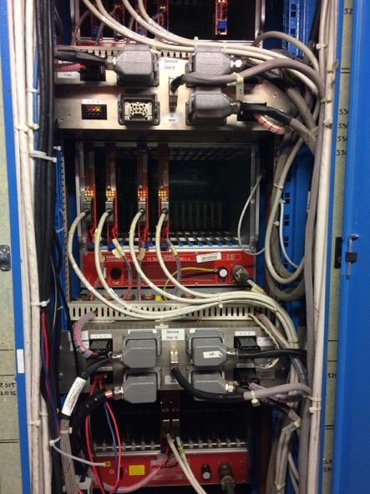
Service Power Distribution in S4
Will add 4 new branch drivers to existing 4 branch drivers in RE CAEN mainframe in S4F
DCS cables will run directly to UXC from S4F …
… but service power needs to be routed through DSS relay boxes to large 7x6 mm^2 cables to UXC
Located space for 3 connections via existing hardware, but will need to add 1 new cable for YE+1 near

Slide 10
Service Power Distribution in UXC
Plus End
Minus End
On YE3, all that needs to be done is to extend daisy-chain to second A3486
Service power from USC is used only to power A3486 communication boards. Service power for downstream units is derived from A3486s
Service power daisy-chain will be broken in same way as for DCS chain. Service power cable in mini cable-chain will be reused

Slide 11
Power Patch Panels: RE Power, Service Power & DCS
Front
YE+1 Far
YE+1 Near
Front
Power:
5551021 (Aln)
DCS:
5553009
Svc:
5552002
One power cable through
each far-side mini cable-chain to be installed
Power:
5551024
DCS:
5553018
Svc:
555xxxx
Rear
Rear
Reuse far side alignment cables for DCS & Service Power
Front
YE-1 Far
YE-1 Near
Front
Power:
5551130
DCS:
5553078
Svc:
5552020
Power:
5551112 (Aln)
DCS:
5553054
Svc:
5552014
Rear
Rear

Slide 12
S4F Zone LS2 Upgrade Tasks
Will need 1 new USC-UXC service power cable installed
Either repurpose link alignment cables or add 2 new circuit breakers to armoire EXD10/55 +
2 new USC-UXC power cables

