Slide 1
Hoses and Barbs Swagelok & Parker
Ian
27 Sept 2022

Slide 2
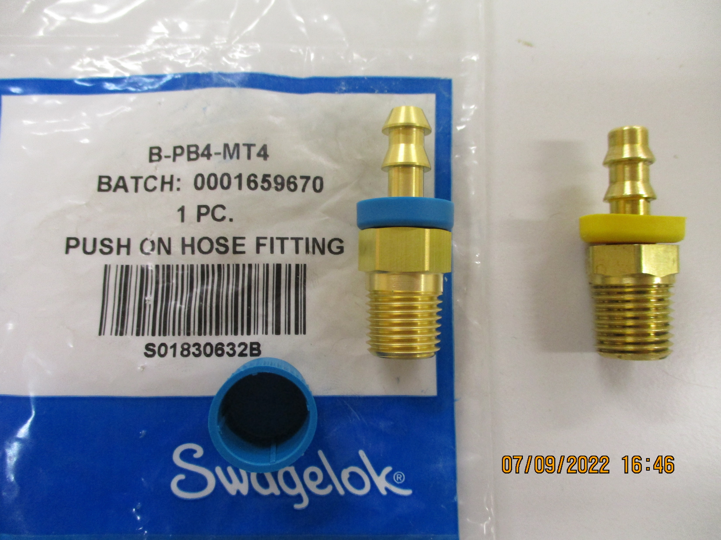
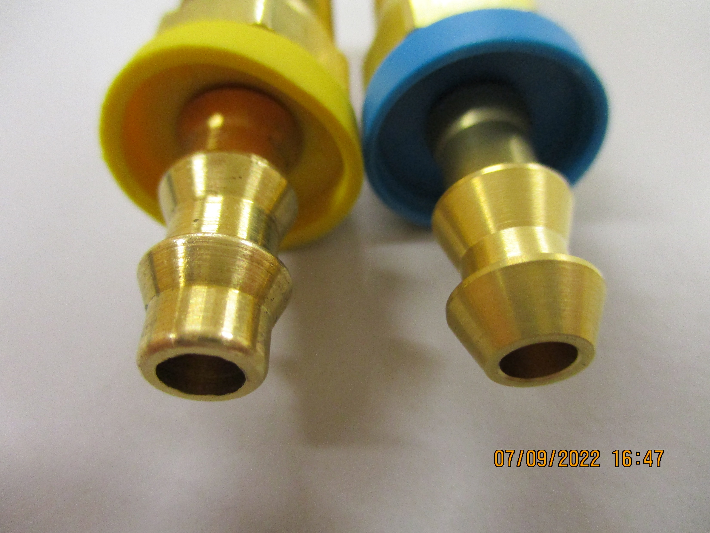
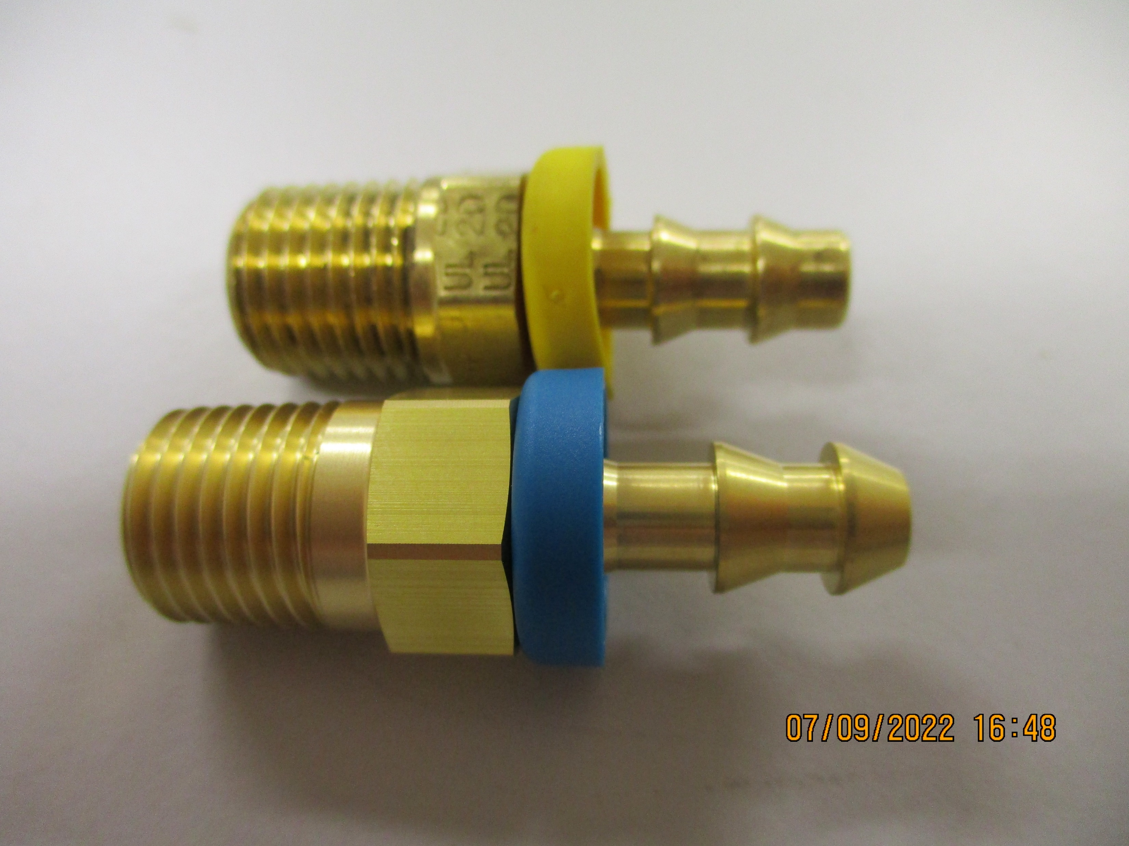
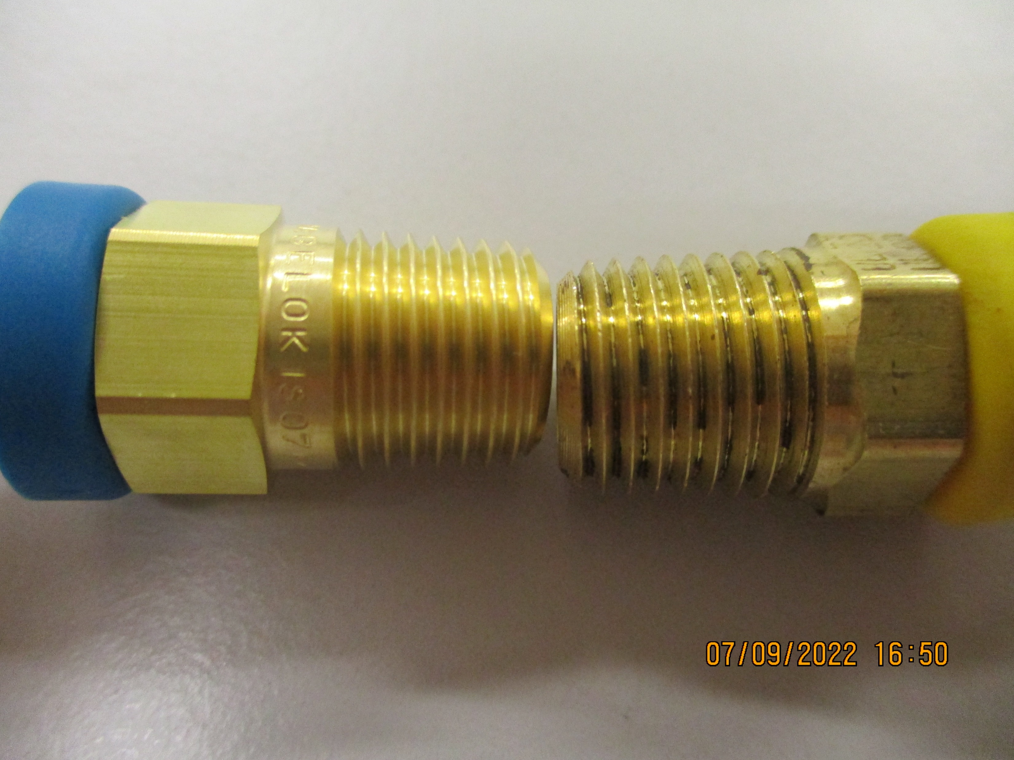
Barb fittings/unions
Swagelok
Parker
Swagelok
Parker
BSP
NPT

Slide 3
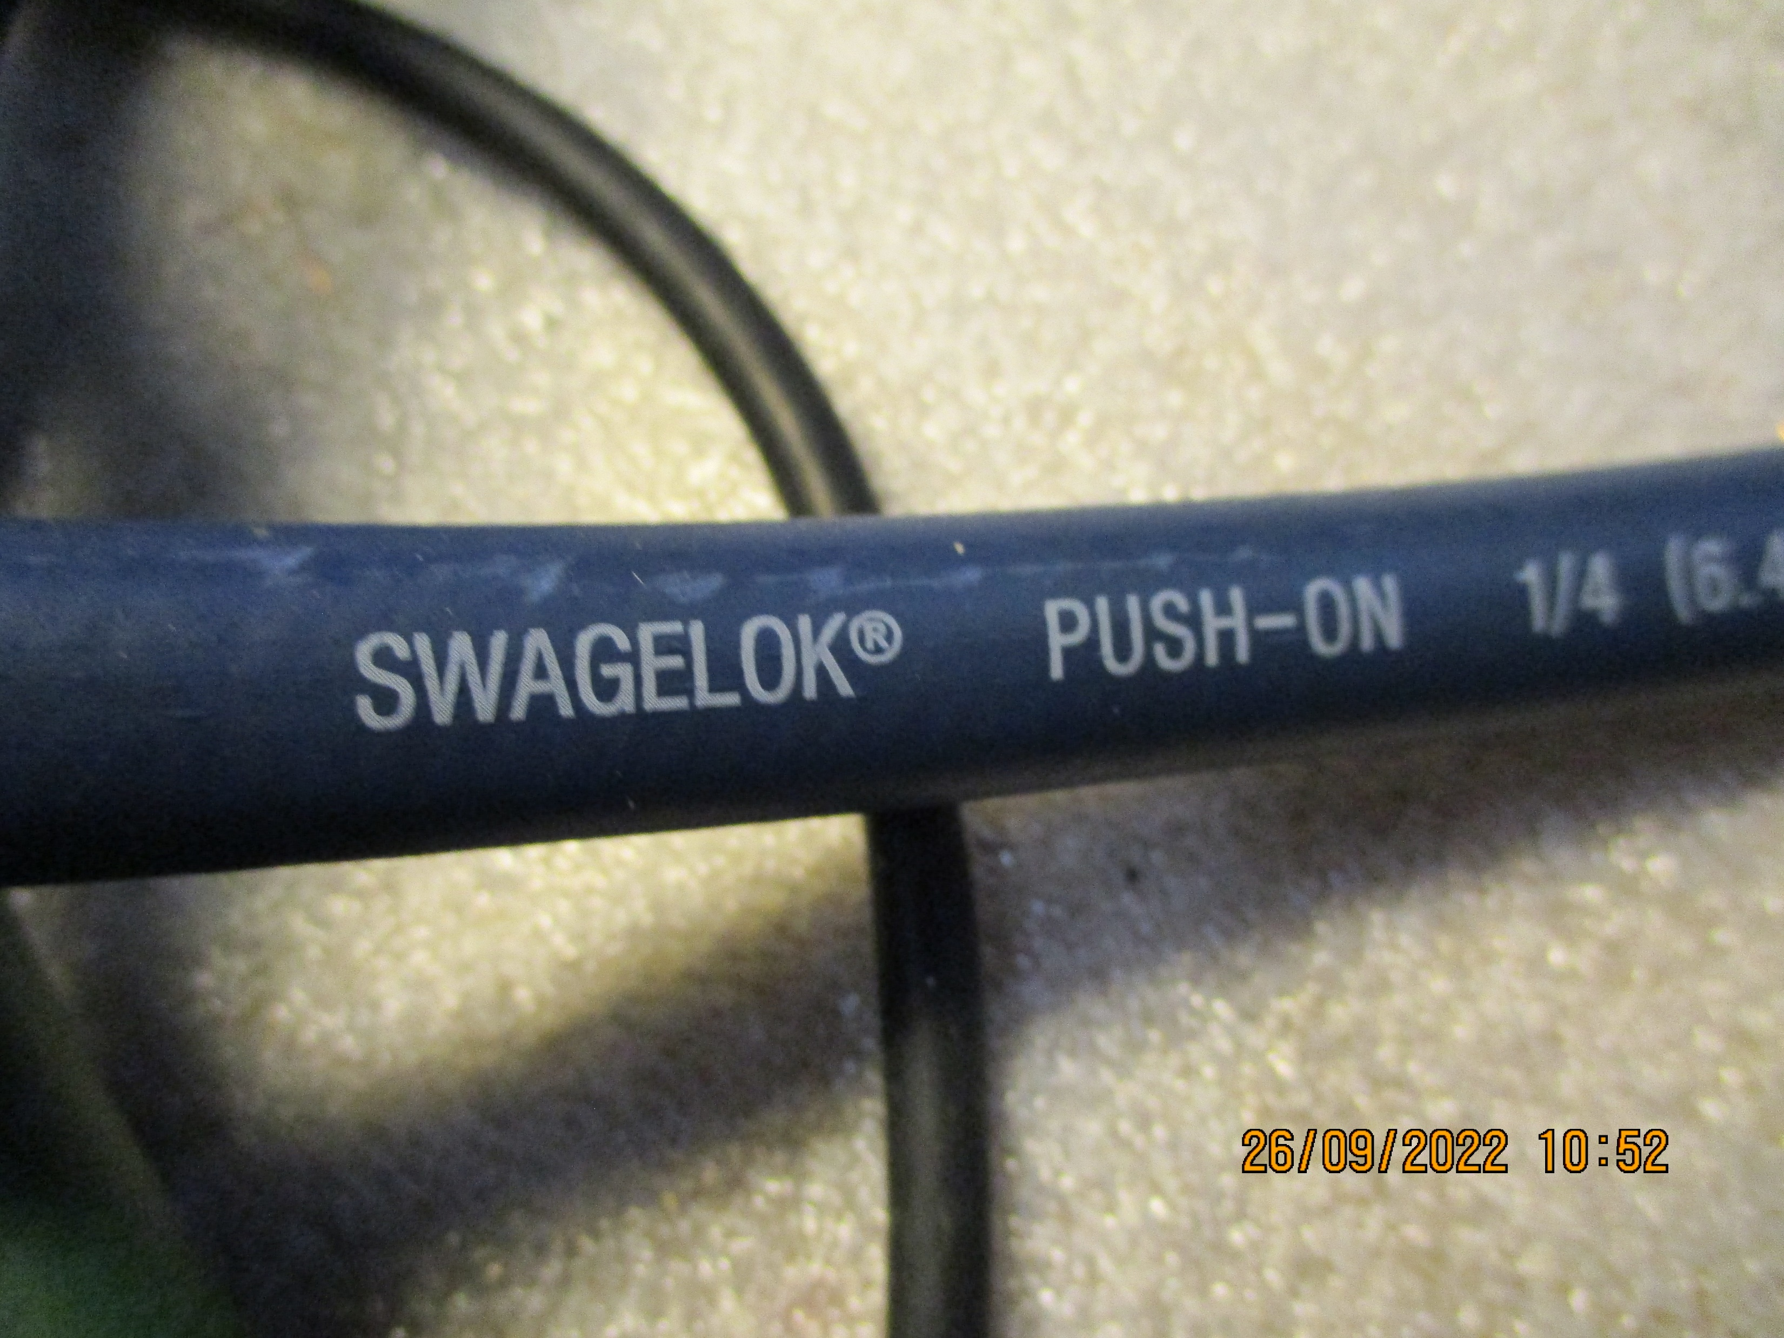
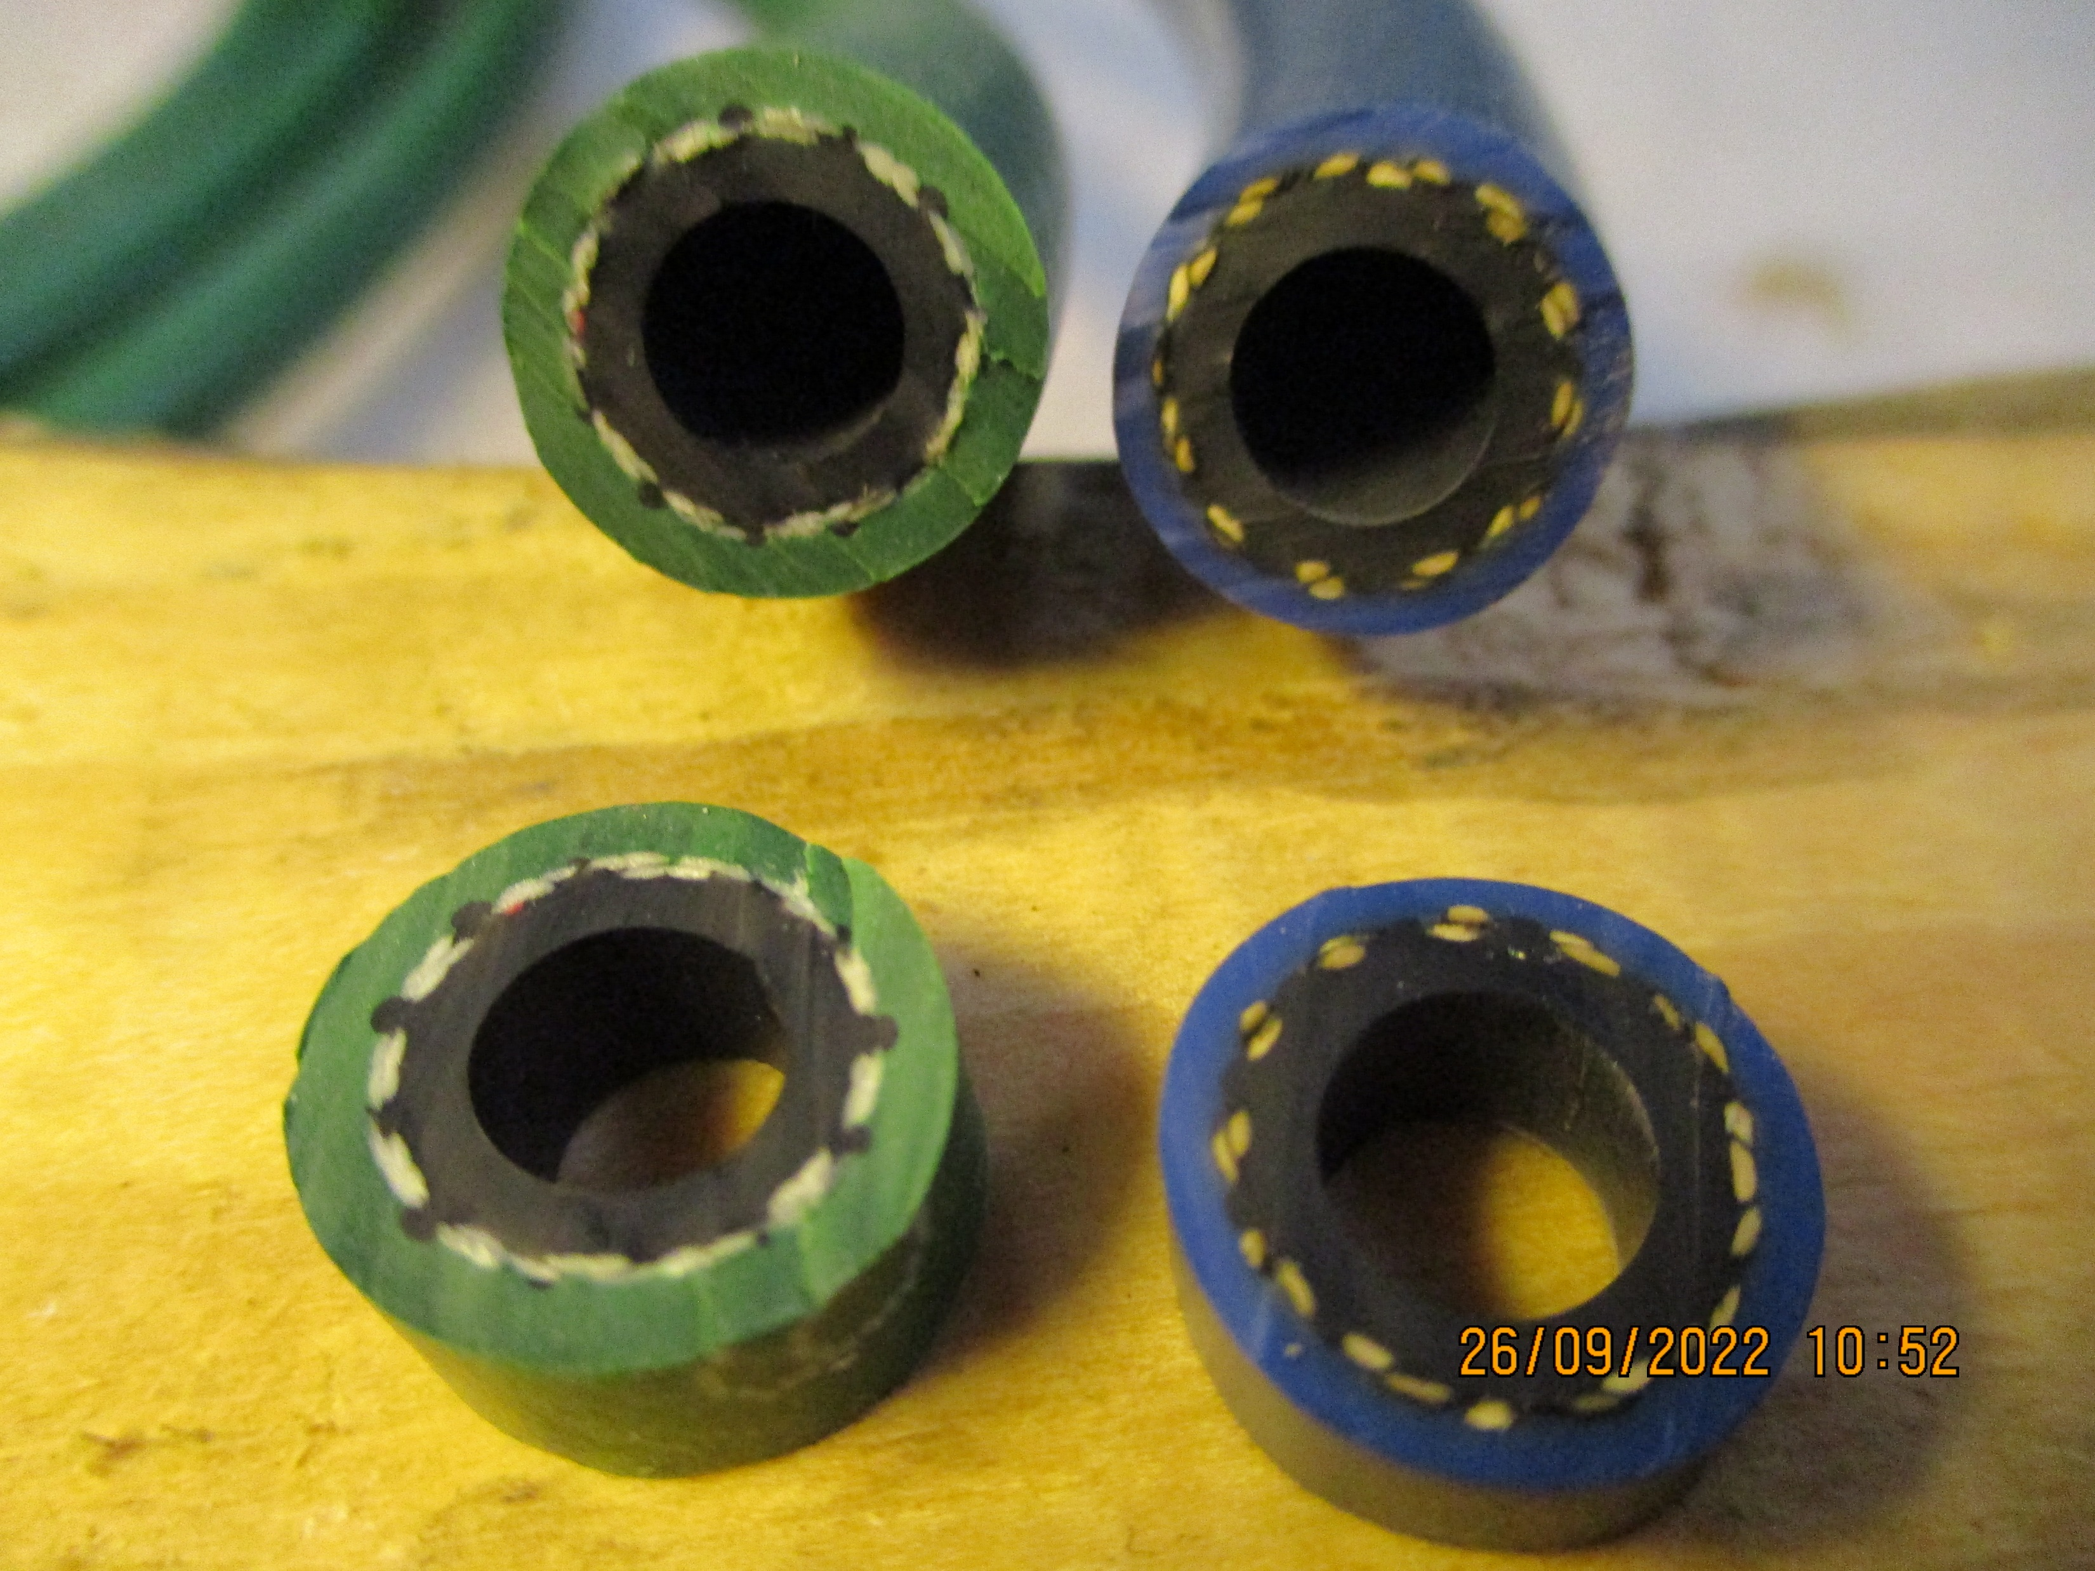
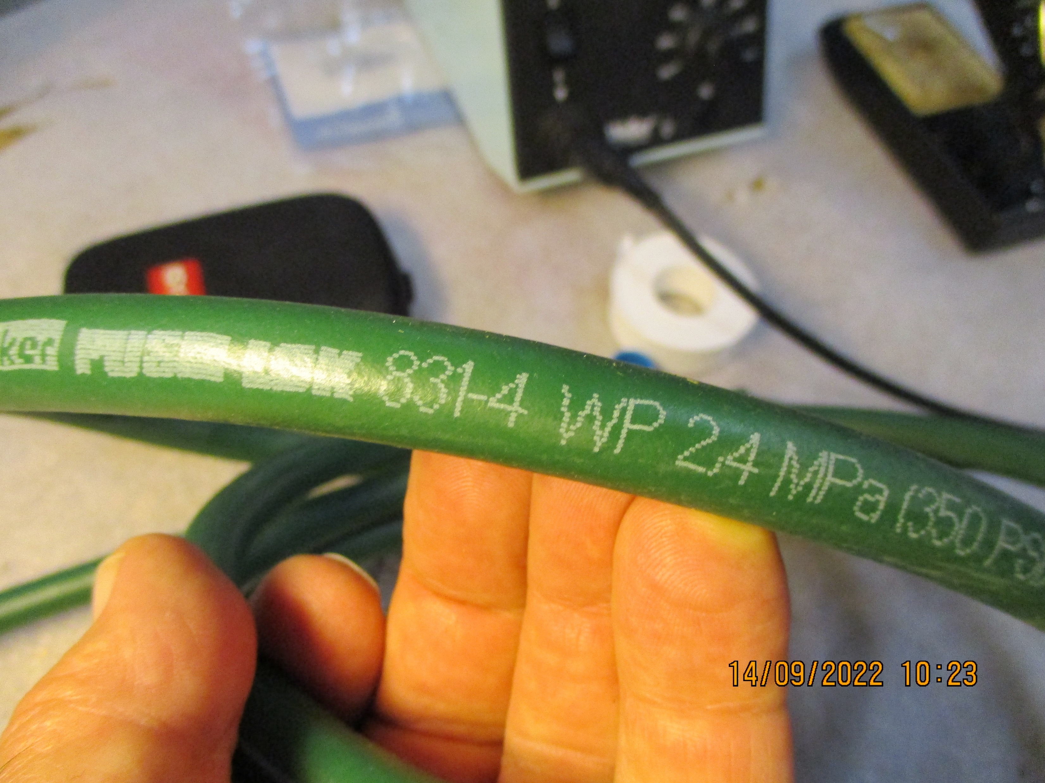
Push on hoses
Swagelok
Parker

Slide 4
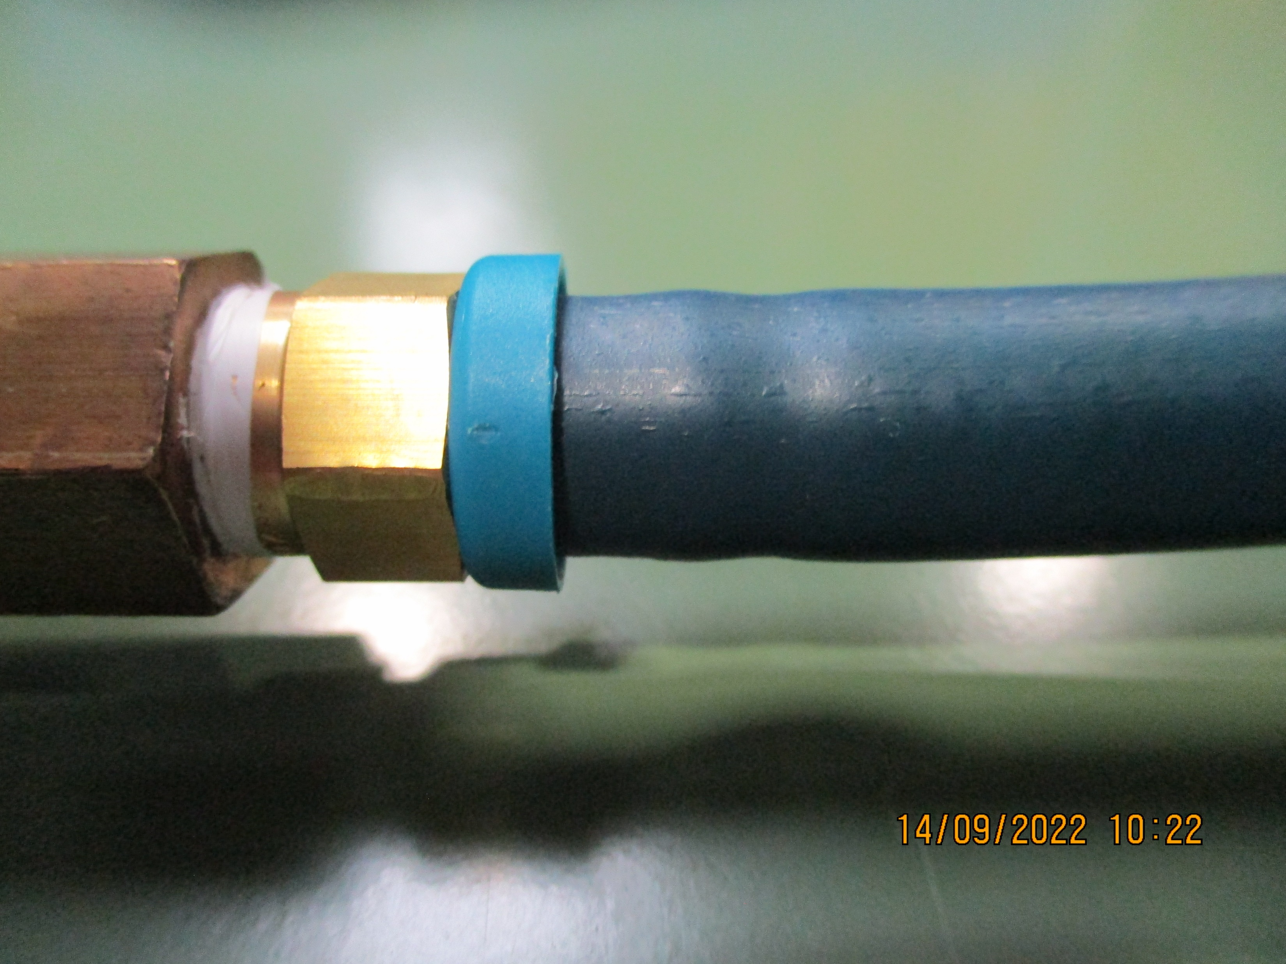
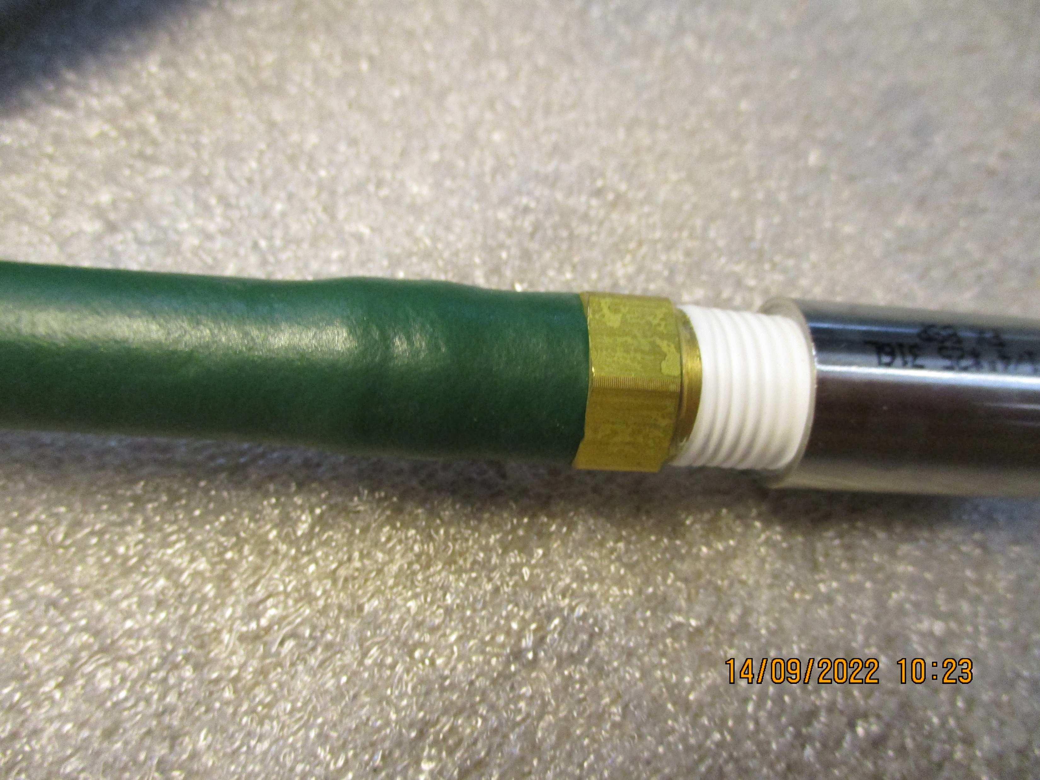
The hoses were pushed on to but up against the fitting to see for any movement with pressure and time
The hose expands to accommodate the barb fitting.
The expansion due to pressure was measured, see results

Slide 5
The barb fittings are within 0.1mm at the barb diameter
Barb diameter
Parker |  |  | Swagelok
Barb | Shank |  | Barb | Shank
[mm] | [mm] |  | [mm] | [mm]
8.74 | 6.67 |  | 8.67 | 6.24
Parker hose |  |  | Swagelok hose
outer dia. | Inner dia. |  | outer dia. | Inner dia.
[mm] | [mm] |  | [mm] | [mm]
13.18 | 6.59 |  | 13.07 | 6.95
Shank diameter
The hose internal diameters are within 0.3mm

Slide 6
The plot shows the expansion due to pressure.
The pressure converts to hoop stress and the diameter is the effective strain so the relative slopes indicates the effective difference of the Youngs Modulus of the two materials .
They are similar.

Slide 7
Conclusions
The hoses and the fittings are very similar in dimensions, few tenths of aa millimeter
The expansion of the hose under pressure is approx. 0.5mm oat 4 -5 times operating pressure
There is no axial displacement of the hose on the barb fitting due to the axial force andover the short test interval of 3-4 days.
The hose material between the two manufactures has similar characteristics

