Slide 1
New Signal cable for phase 3 RE1 and RE2
Ian
3 Sept 2021

Slide 2
 | Signal & DCS cables Phase II
 |  |  |  | Ian, 3 Sept 2021
 | Nos cable/chamber | RE1/2 | RE1/3 | RE2/2 | RE2/3
Signal | 6 | 36 | 36 | 36 | 36
 | Cable per ch type | 216 | 216 | 216 | 216
DCS | 1
 | Cable per ch type | 36 | 36 | 36 | 36
Signal | Total cables per Endcap |  |  |  | 864
DCS | Total cables per Endcap |  |  |  | 144
Signal | Both Endcaps |  |  |  | 1728
DCS | Both Endcaps |  |  |  | 288
Signal | No spares except for Tests Lab installation = 20 of 10m |  |  |  |  | 1748
DCS | No spares except for Tests Lab installation = 20/6 of 10m |  |  |  |  | 292

Slide 3
Email from D. Piccolo, Monday, August 22, 2005 3:59 PM
Our requirements were also more stringent than yours(LHCB): skew of 1 ns for 25 mt long cable.
The first batch of production will be delivered by end of october 2005
Mobile davide; 0039 3394611584.
rpc cable harness and BERG connectors
Dear Laurent,
We have already placed and received this material under Material
Request 1936935. The price was .78 CHF/ meter.
i don't know exactly where the price breaks.
I know that tecknicabel could arrive to 15 or maybe 20 km per month
(starting from end october) with a small increse of price they are still
ie how much do we have to order to get 2.4CHF/m from Teckni or
1.7 euro/m from Novacavi?
Best regards, Austin.
Sounds like we are ready to go.
> 90 km in spools of 1km continuous length.
> price 2.4 CHF/m, including delivery.
> Samples from each production batch of 15 km.
> Did they agree to deliver in 6 batches of 15 km as they become
> available?

Slide 4
Email, 19 April 2005 18:46
https://edms.cern.ch/document/522768/1/TAB3
https://edms.cern.ch/document/522770/1/TAB3
https://edms.cern.ch/document/522767/1/TAB3
these cables ARE NOT the TRIGGER RPC cables as you wrote.
They are the barrel dcs and t-sens signal cables (that
means no power and heat) as described in the 'used in' tab
https://edms.cern.ch/document/522768/1/TAB4
https://edms.cern.ch/document/522770/1/TAB4
https://edms.cern.ch/document/522767/1/TAB4
The cable which you are speking about is (NOVACAVI trigger cable)
https://edms.cern.ch/document/520458/1/TAB3
https://edms.cern.ch/document/520458/1/TAB4

Slide 6
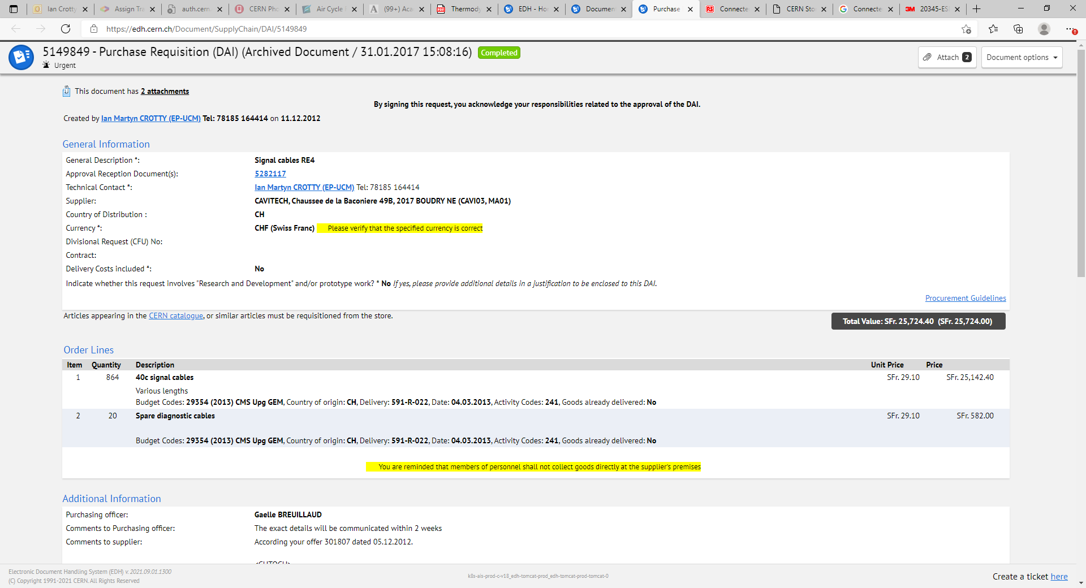
5149849 - Purchase Requisition (DAI)
And the DCS ? Next slide
Nota, quantity is half as only one station not 2 !!

Slide 7
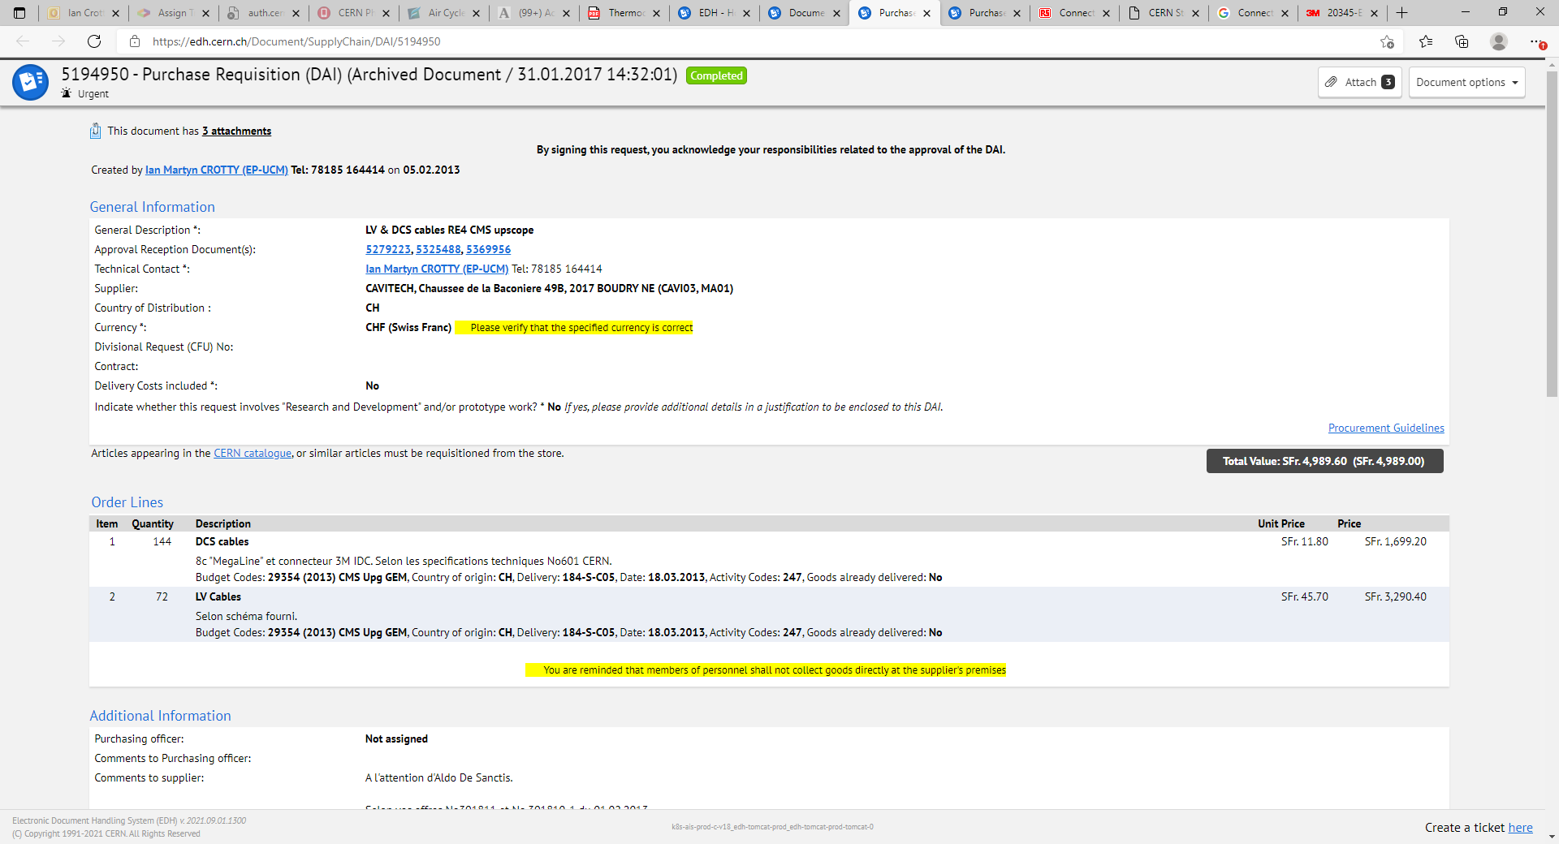
5194950 - Purchase Requisition (DAI)
DCS and LV BUT only one end cap ! ?

Slide 8
Price estimate at 2011/12 date
Signal 51448chf did not include cable
Si. Cable cost xxxchf
DCS 3400chf did not include cable
Mega cable cost xxx chf

Slide 9
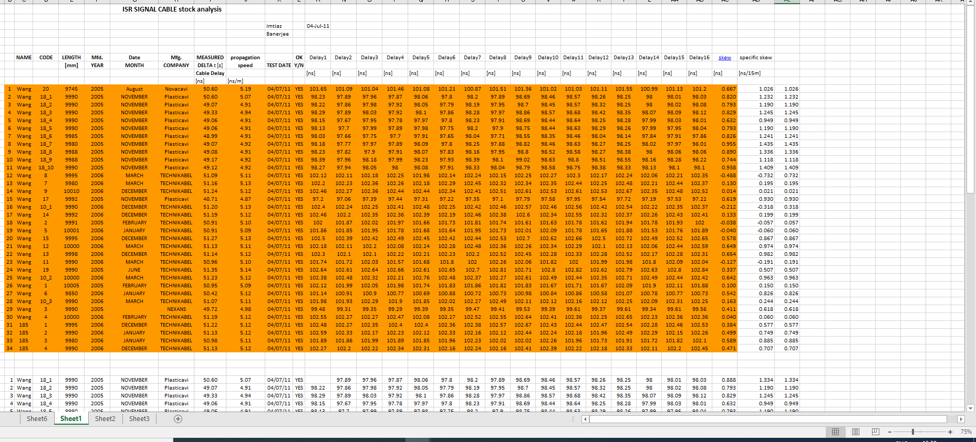
Skew Tests in the ISR
Info from Workspace, c, cmsrpcforward

Slide 10
Skew cable test done on
Tecnikabel
Novacavi
Pasticavi
Nexans
Which cable did we use finally ?

Slide 11
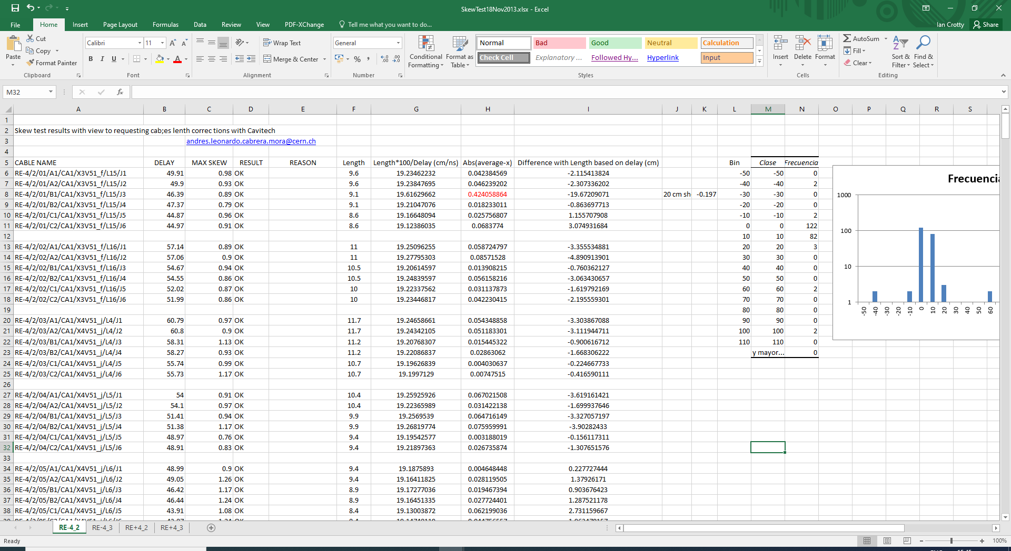

Slide 12
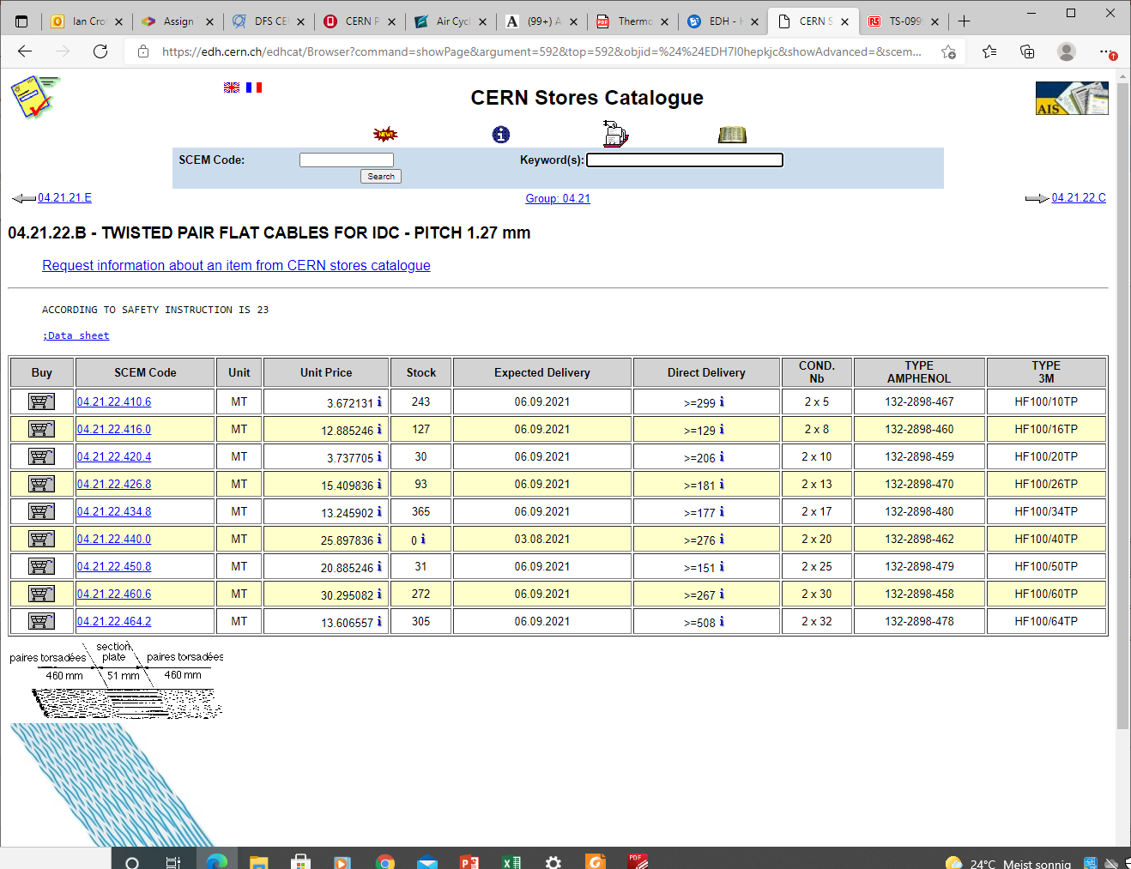

Slide 13
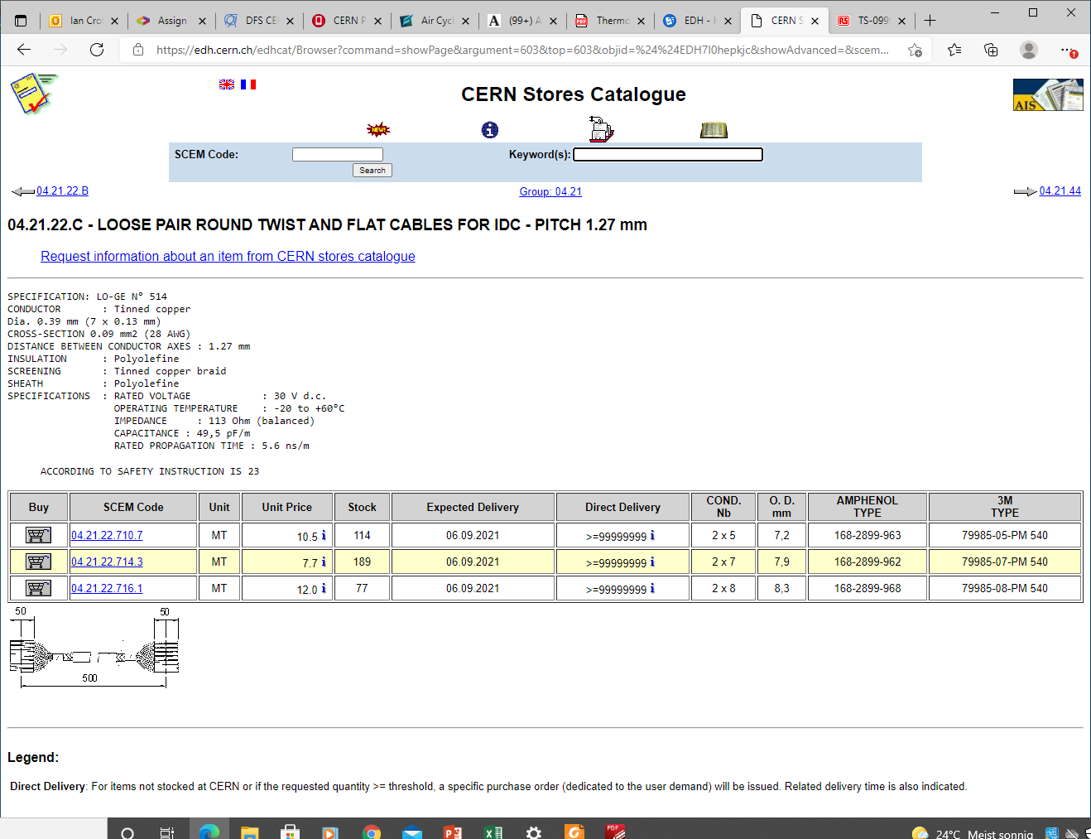

Slide 14
79985-20-PM 540

Slide 15
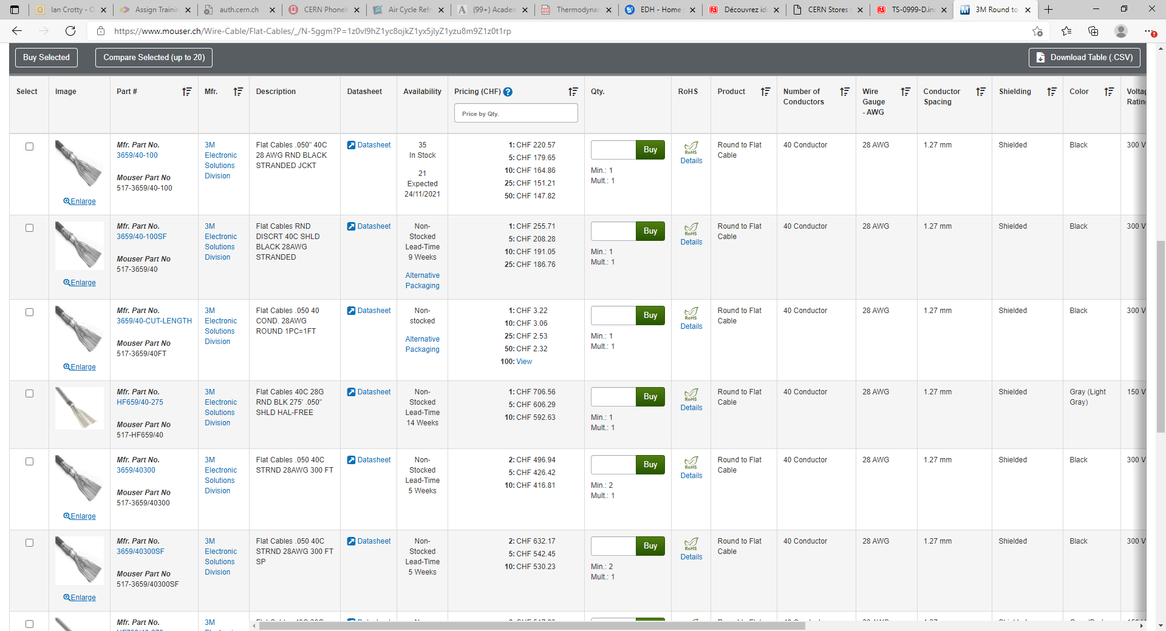
https://www.mouser.ch/Wire-Cable/Flat-Cables/_/N-5ggm?P=1z0vl9hZ1yc8ojkZ1yx5jlyZ1yzu8m9Z1z0t1rp

Slide 16
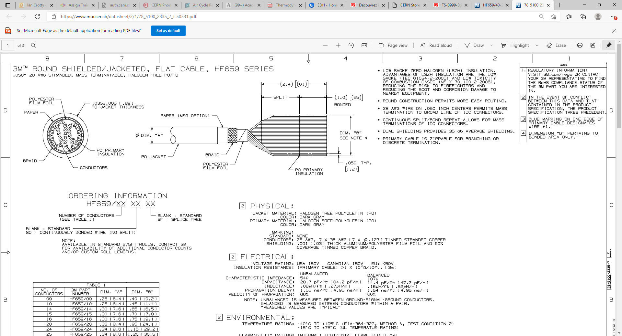
78_5100_2335_7_f-50531.pdf (mouser.ch)
HF659/40-275 3M Electronic Solutions Division | Mouser Switzerland

Slide 17
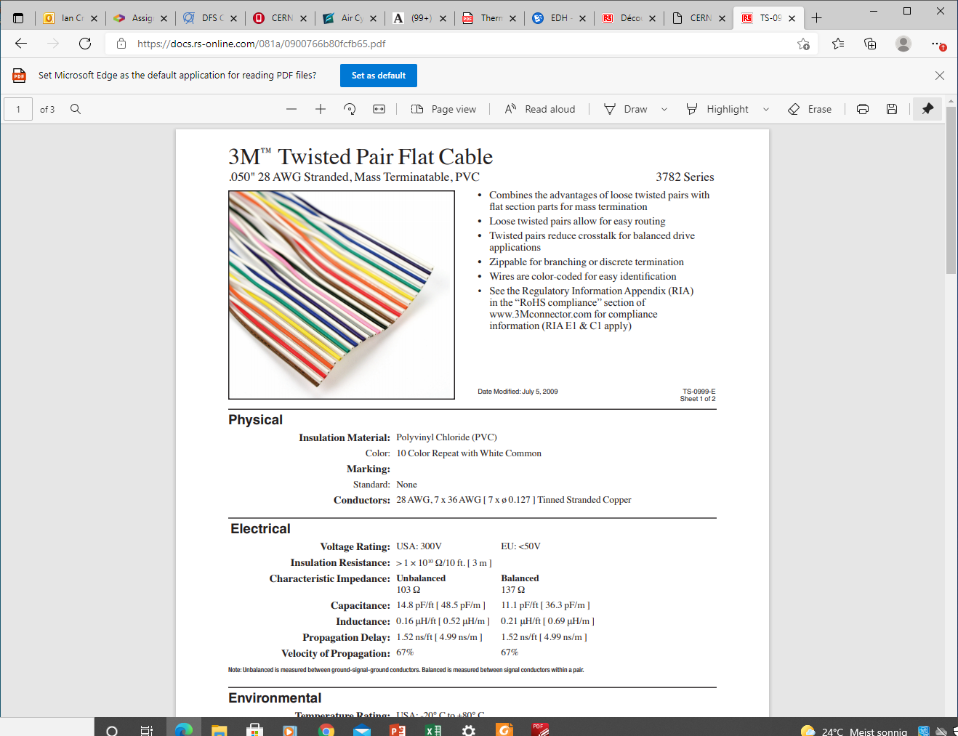
https://docs.rs-online.com/081a/0900766b80fcfb65.pdf

Slide 18
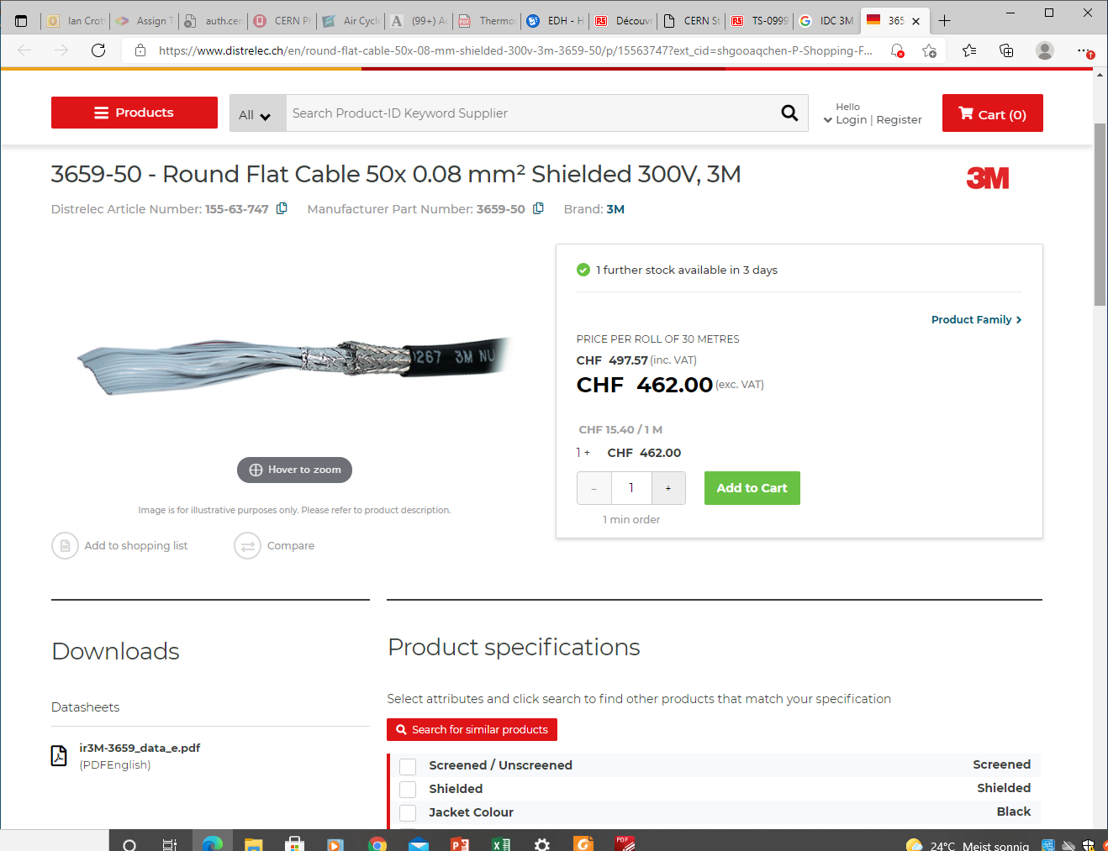
https://www.distrelec.ch/en/round-flat-cable-50x-08-mm-shielded-300v-3m-3659-50/p/15563747?ext_cid=shgooaqchen-P-Shopping-Fallback&pi=15563747&gclid=EAIaIQobChMI2tLFutXi8gIVCOh3Ch2KxAIkEAQYASABEgLNU_D_BwE

Slide 19
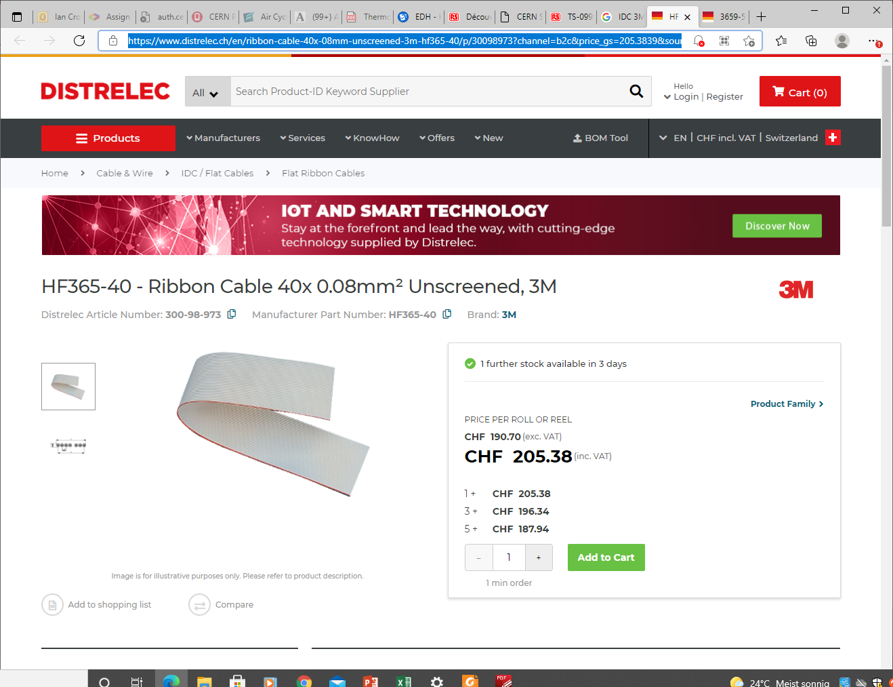
HF365-40 | 3M Ribbon Cable 40x 0.08mm² Unscreened | Distrelec Switzerland

Slide 24
Connectors 40c IDC flat cable (3M)

Slide 26
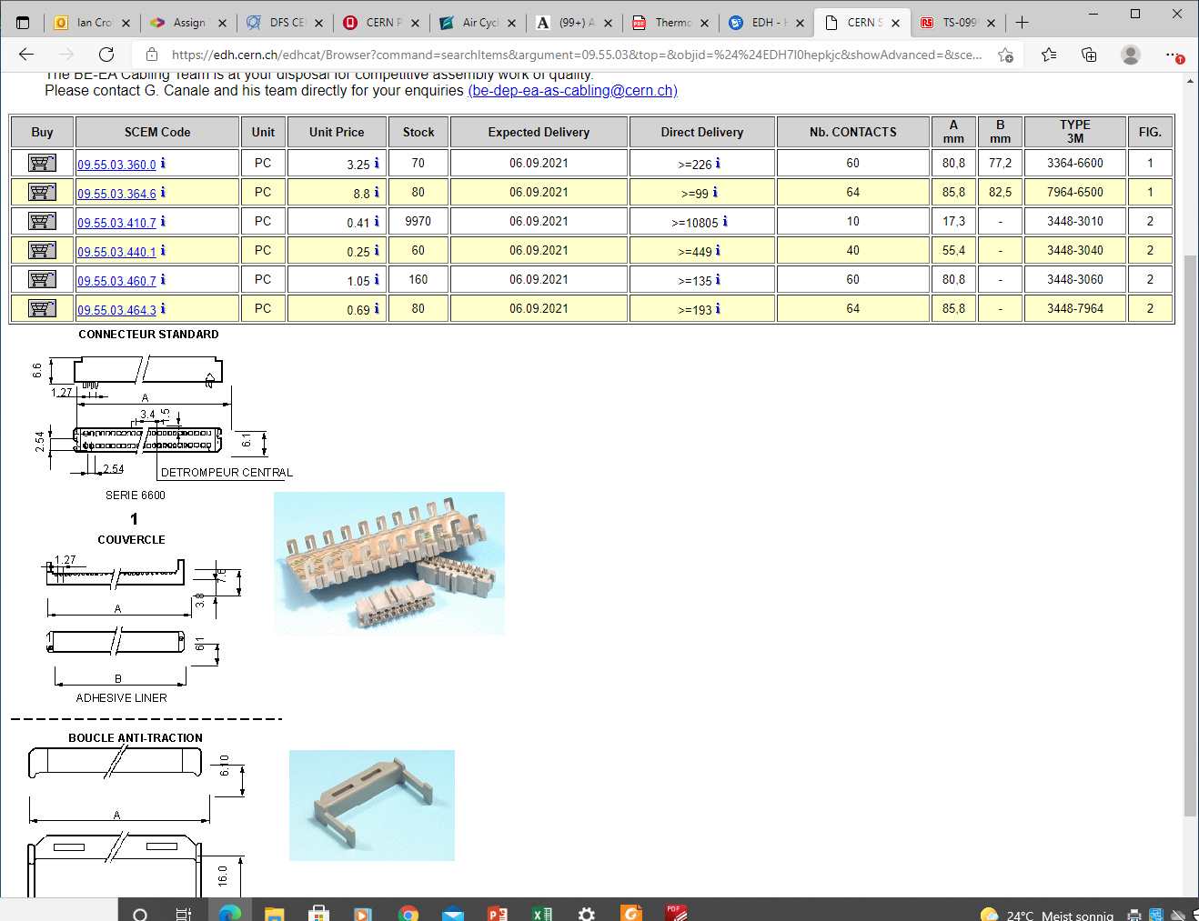

Slide 27
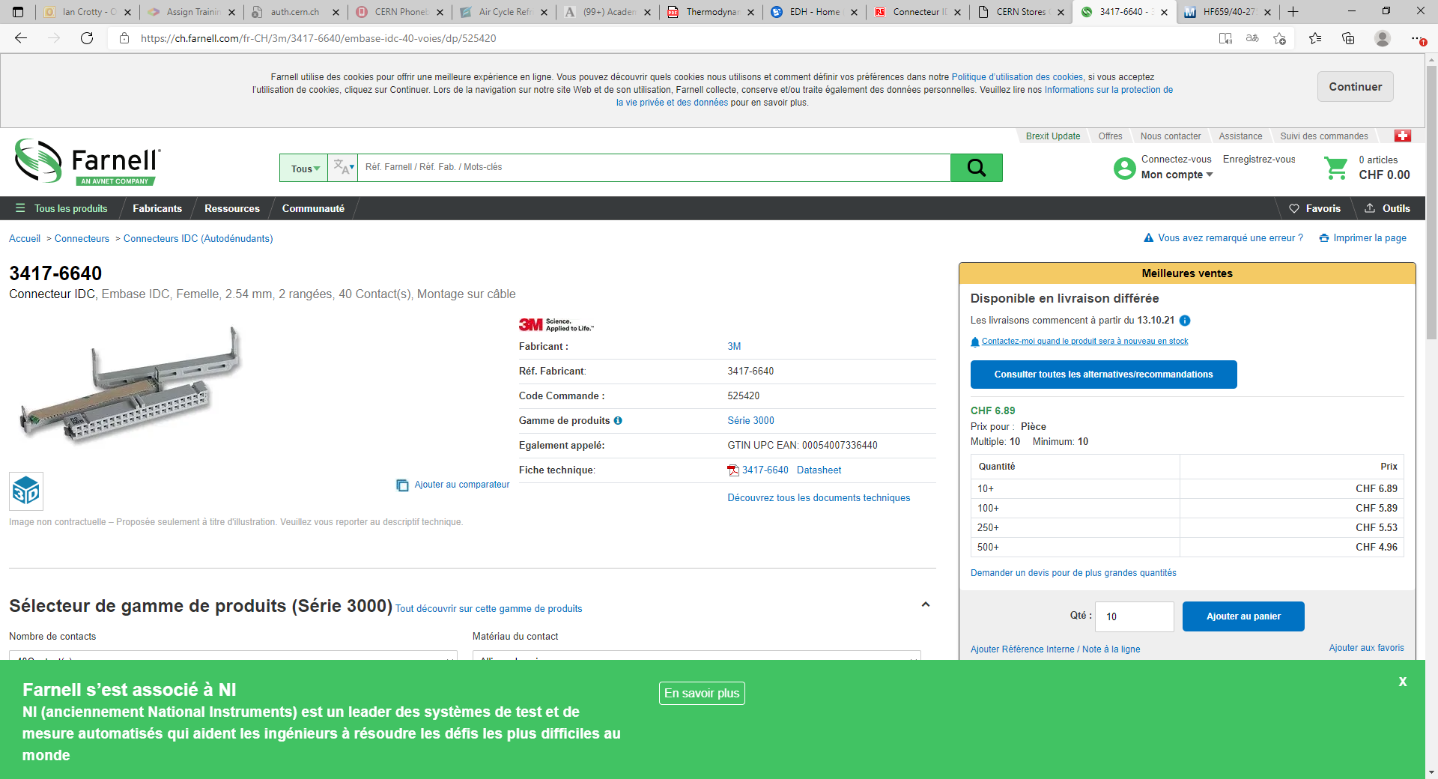
https://ch.farnell.com/fr-CH/3m/3417-6640/embase-idc-40-voies/dp/525420
3417-6640

Slide 28
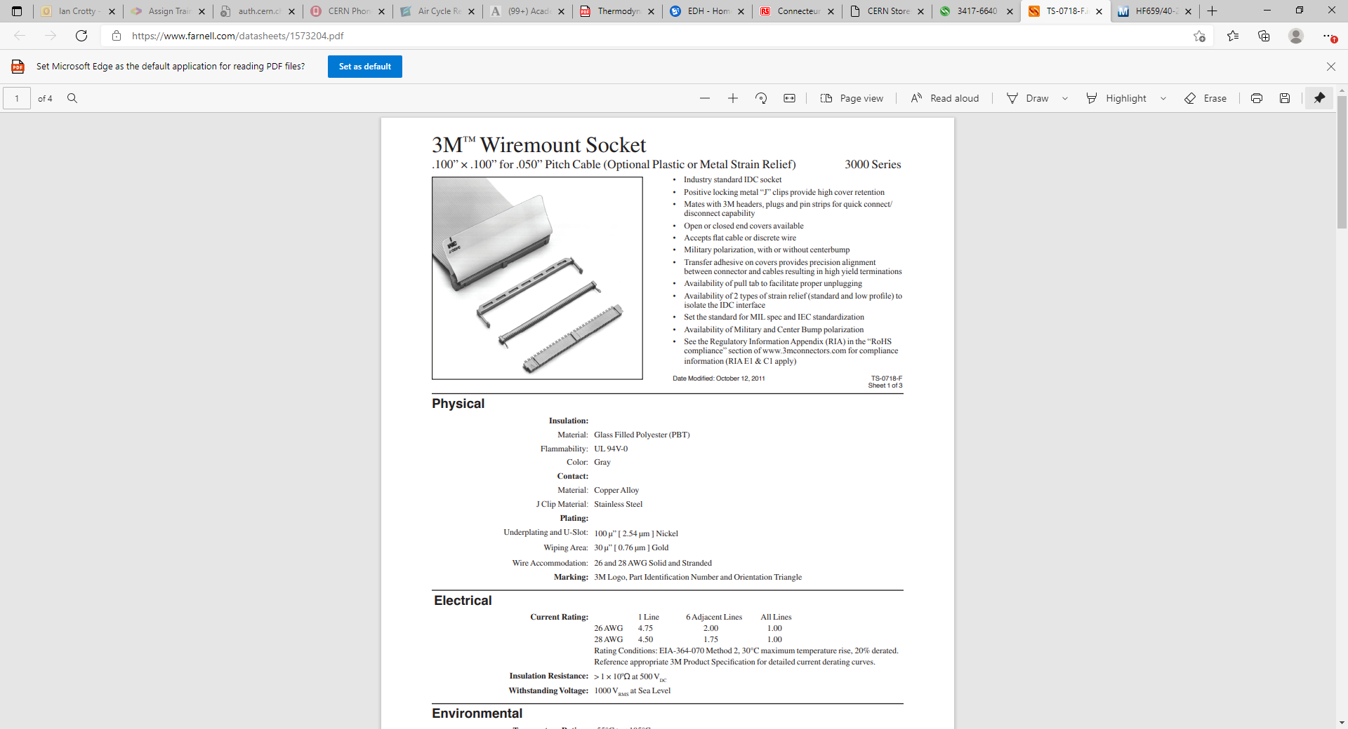
https://www.farnell.com/datasheets/1573204.pdf

Slide 29
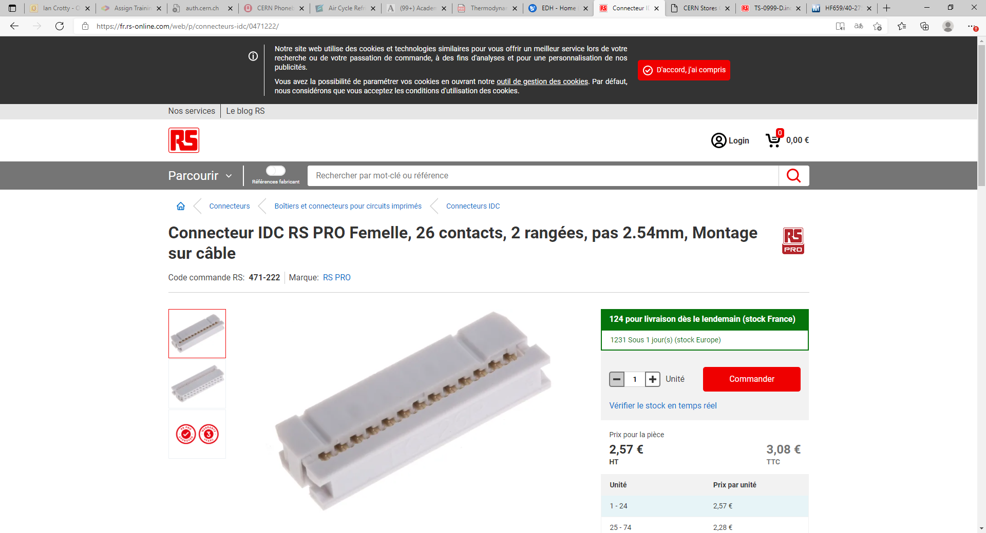
https://fr.rs-online.com/web/p/connecteurs-idc/0471222/

Slide 30
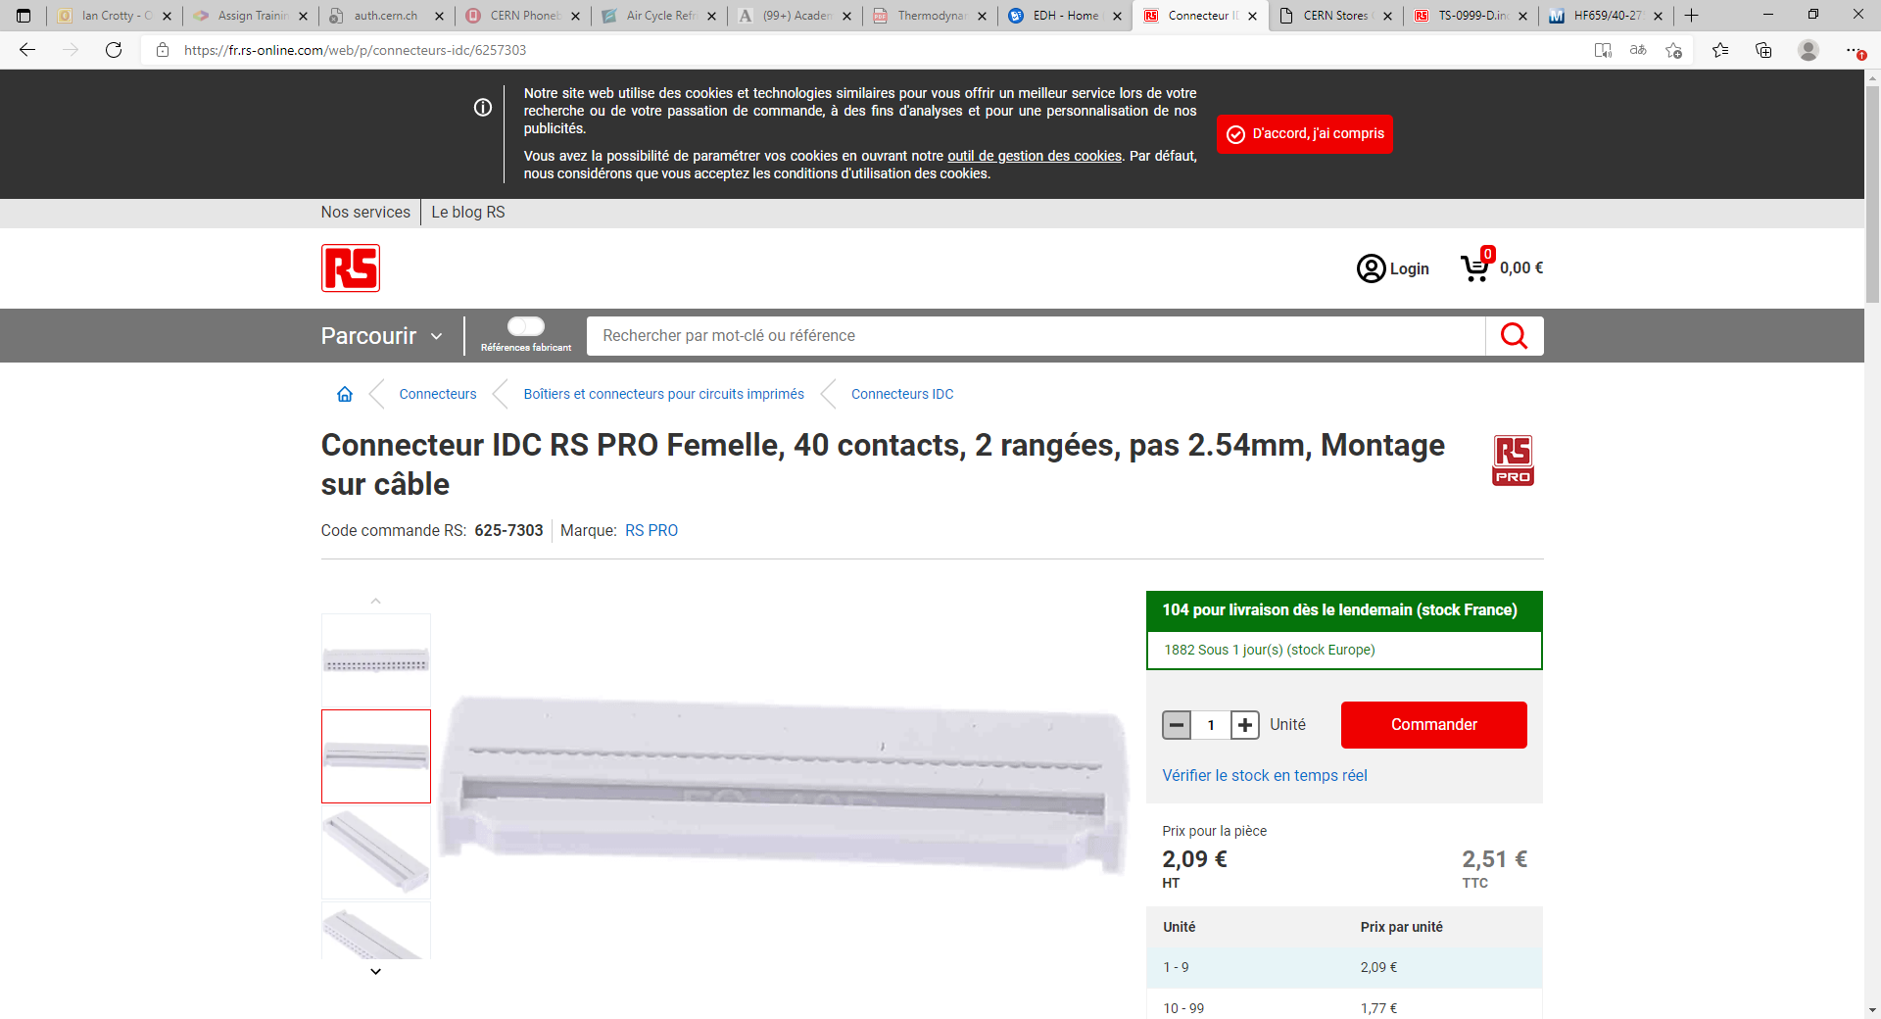
https://fr.rs-online.com/web/p/connecteurs-idc/6257303

Slide 31
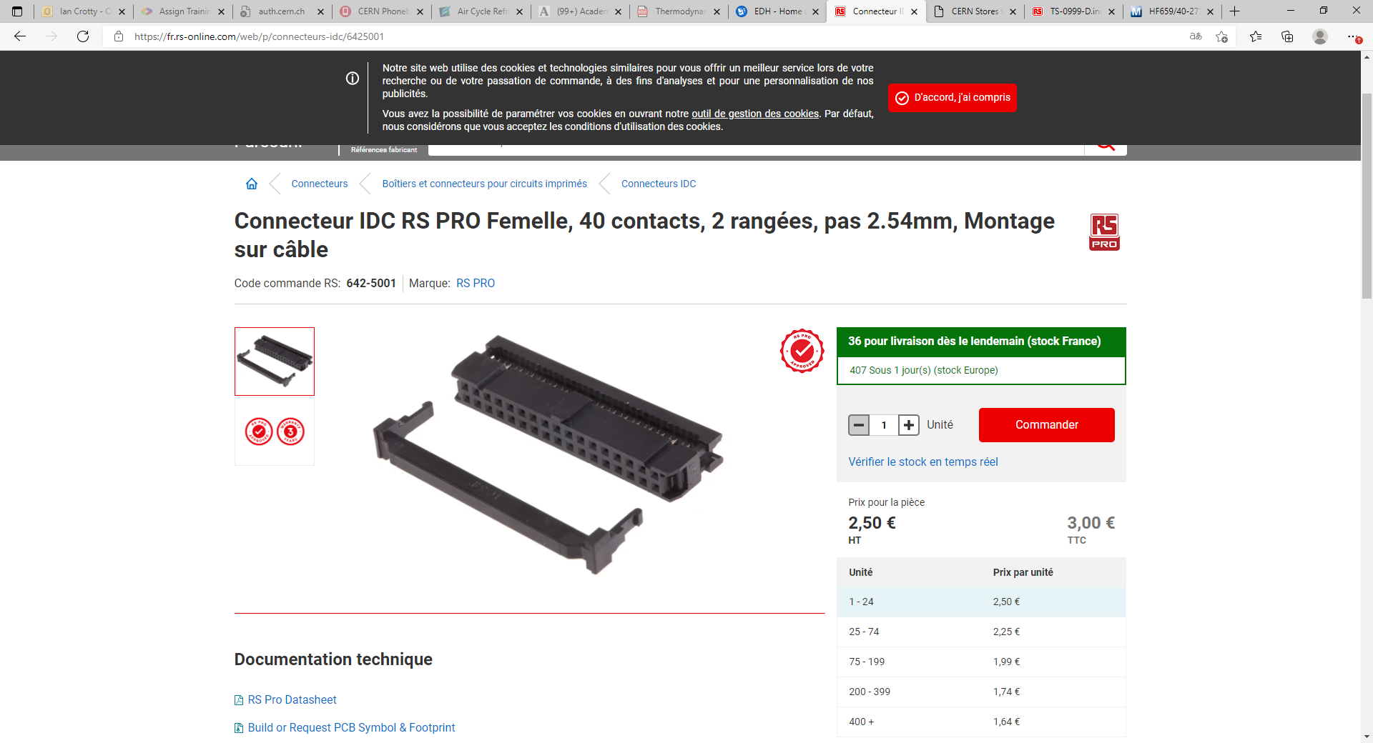
https://fr.rs-online.com/web/p/connecteurs-idc/6425001

