Slide 1
Legris fittings Suppliers France and switzerland
Ian
7 May 2024

Slide 2
Catalogue
All of legris/ parker fittings
file:///G:/Websites/p/project-cms-rpc-endcap/RPC/Services/Cooling/Components/Suppliers/Legris/catalogue/03_maquette_tubes_Print_EN.indd.pdf
From rs
https://docs.rs-online.com/d51f/A700000009518927.pdf
Compression fittings
file:///G:/Websites/p/project-cms-rpc-endcap/RPC/Services/Cooling/Components/Suppliers/Legris/catalogue/parkerlegrisCompFittings.pdf

Slide 3
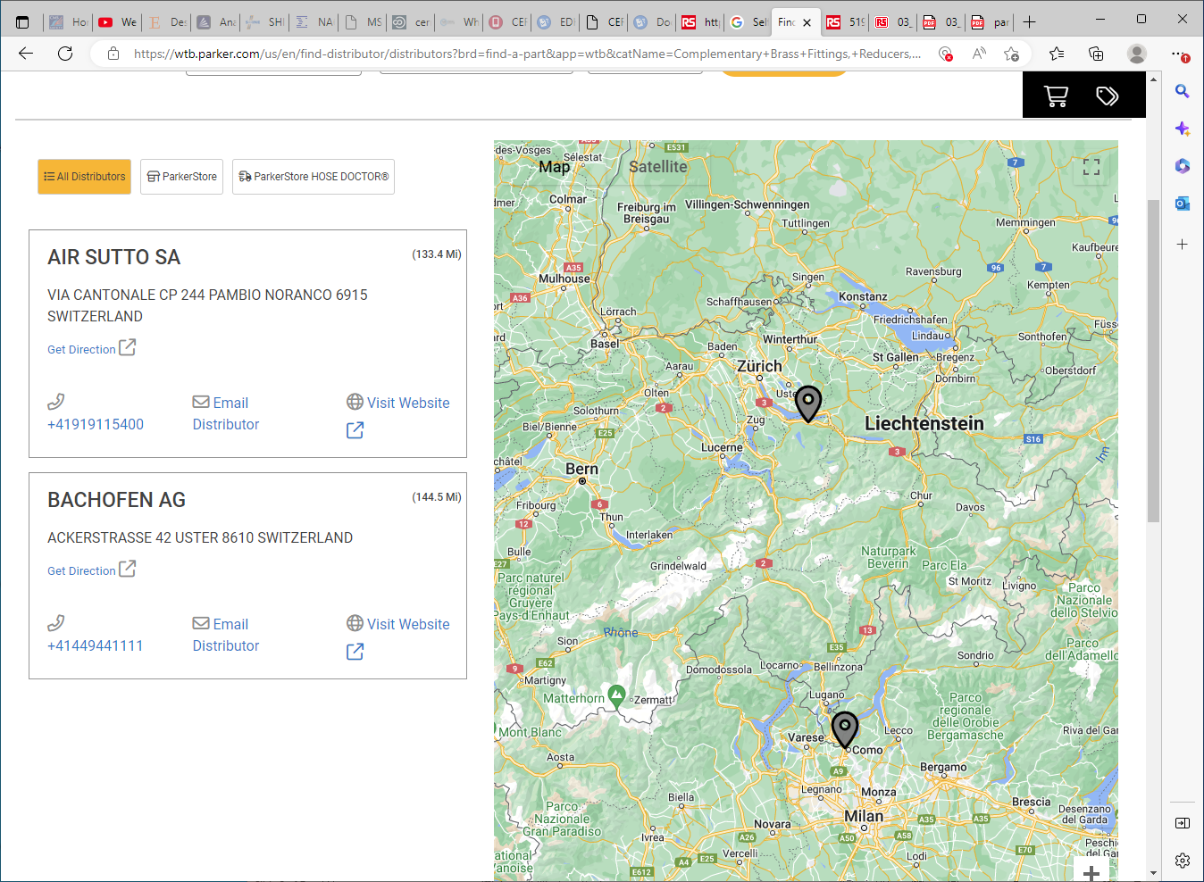
info@airsutto.ch
+41919115400
info@bachofen.ch
+41449441111

